Slide 1
Workshop
Abel Sanchez

Slide 2
Emphasis
Make the work fun
Goal is to motivate girls to continue after workshop
Demystify - Show them is not scary
Show them that is important to everyday life
Show them that it can apply to any field of study you choose

Slide 3
Emergent properties I
All teams were very visual. All teams started drawing on the boards along the sides of the classroom.
Note: this would not have worked in a computer lab
The entire team presented as a group (although leaders were clear)
Instead of the teams coming to the front of the class, the teaching staff went to each work area (there were whiteboards on all walls of the classroom)

Slide 4
Emergent properties II
The diagrams, illustrations, and architectures were very effective, in the way PowerPoint can never be
The diagrams had personality, some of them recurring themes and characters, clarity, they told a story
The presentations were fun!
They often acted out the parts of the different roles/actors/users. The entire classroom was engaged.

Slide 5
Show video
Fun …
They love to
Draw – most solutions were graphical
Sing
Work in groups
Show do not tell
Especially important due to language gaps

Slide 6
No computers in the morning!
The top half of the day was dedicated to computational thinking (algorithmic thinking) without computers in the classroom.
Demonstrations were done physically. For example, bubble sort with a group of girls.
The competitions were also done without computers. For example, the binary sorting of cards, and the towers of Hanoi.
If needed we provided pencil and paper

Slide 7
Approach (In the classroom)
Present the idea
(the story)
Demonstrate the idea
(the demo)
Students demonstrate understanding
(replicate what instructor did - hold competitions)
Students apply idea to real life
(a problem of their choosing)
Same approach as MIT research group
(let them figure it out)
Reward best team with prize

Slide 8
Computers in the afternoon (ran it like 100)
Structured code exercises
Introduce: layout, styles, and logic
Presentation, animation, simulation, and full applications (using bootstrap)

Slide 9
Materials
High quality whiteboard markers, lots of them
Prizes – wrist bands
Card decks, per team: 1 giant deck, 4 small decks; Pairs of fruit cards
Paper, pencils, markers
Index cards, number cards
Scotch tape, two-sided tape
Post-its
Color string
Graph paper, Construction paper
Thirteen candies, one pepper
Towers of Hanoi

Slide 10
Schedule
9-12 unplugged
Mid-morning snacks
12-1 lunch
Mid-afternoon snacks
1-3 code
3-4 project
4-5 wrap-up meeting, prepare for next day

Slide 11
Draw a scientist/engineer

Slide 12
MONDAY

Slide 13
Create Teams – 10 mins
First activity of day – don’t explain
Number 1-to-5
1s together
2s together
Etc
Opportunity to talk about patterns later on

Slide 14
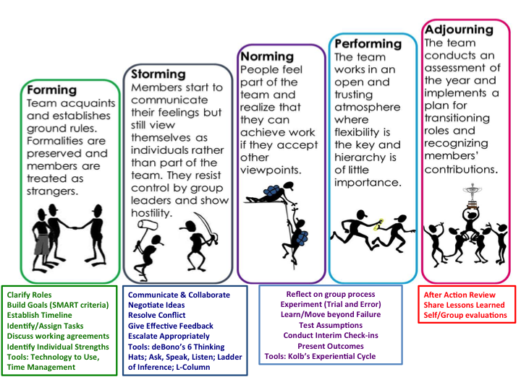

Slide 15
Instructor: Introduce yourself – 15 mins
Make it fun!
Most will not know what MIT is - should we show a short video?
Who are you?
Where are you from?
What do you do?
What do you do for fun
Let them see you as a scientist
Let them see you as a person
Pictures are great
Optional: let them ask you questions about what you do

Slide 16
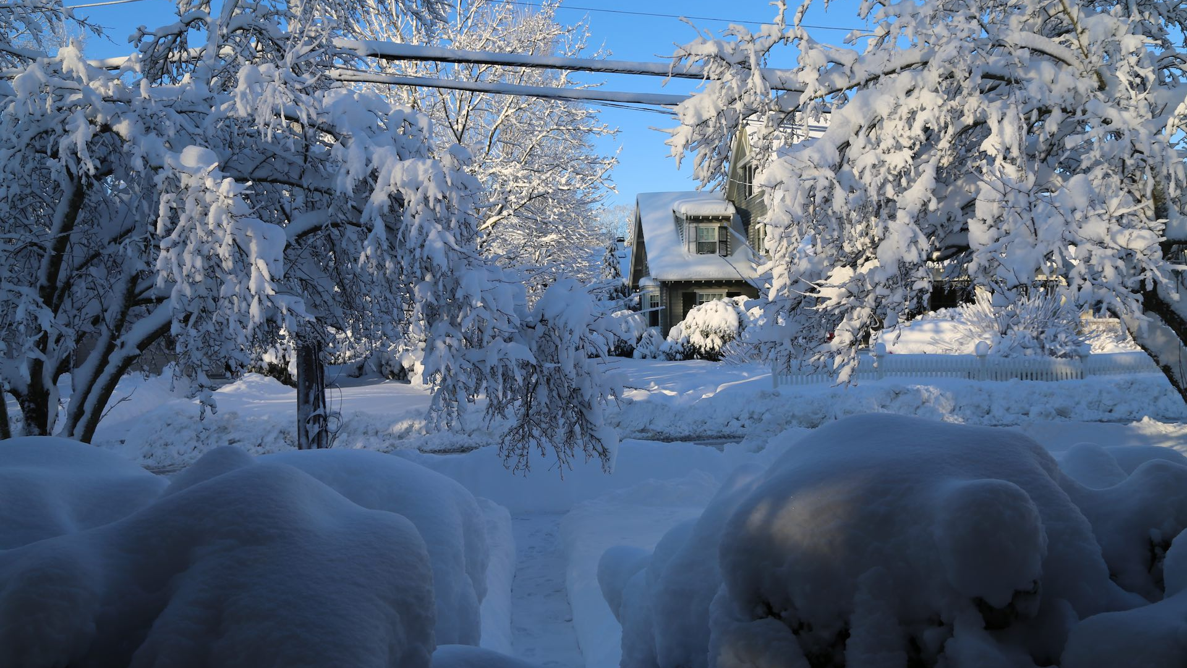

Slide 17
Ice breaker – 30 mins Students: Introduce Yourself
Name
Why are you taking the class
DO NOT ASK where are you from?
City is okay
Hobbies
Instruments
Sports
Most common hobby was dance in 2017
opportunity for discussion on patterns

Slide 18
Workshop Introduction - 30 mins
Introduce the idea of patterns, PATRONES
Note I am not saying algorithms, or design patterns
Ask class, “what is a pattern?”, let them tell you
Give them additional examples
Restaurant as a computer
Emphasis: every field is a set of patterns.
Practicing professionals: apply field patterns
Optional activity: identify a pattern, identify pattern components

Slide 19
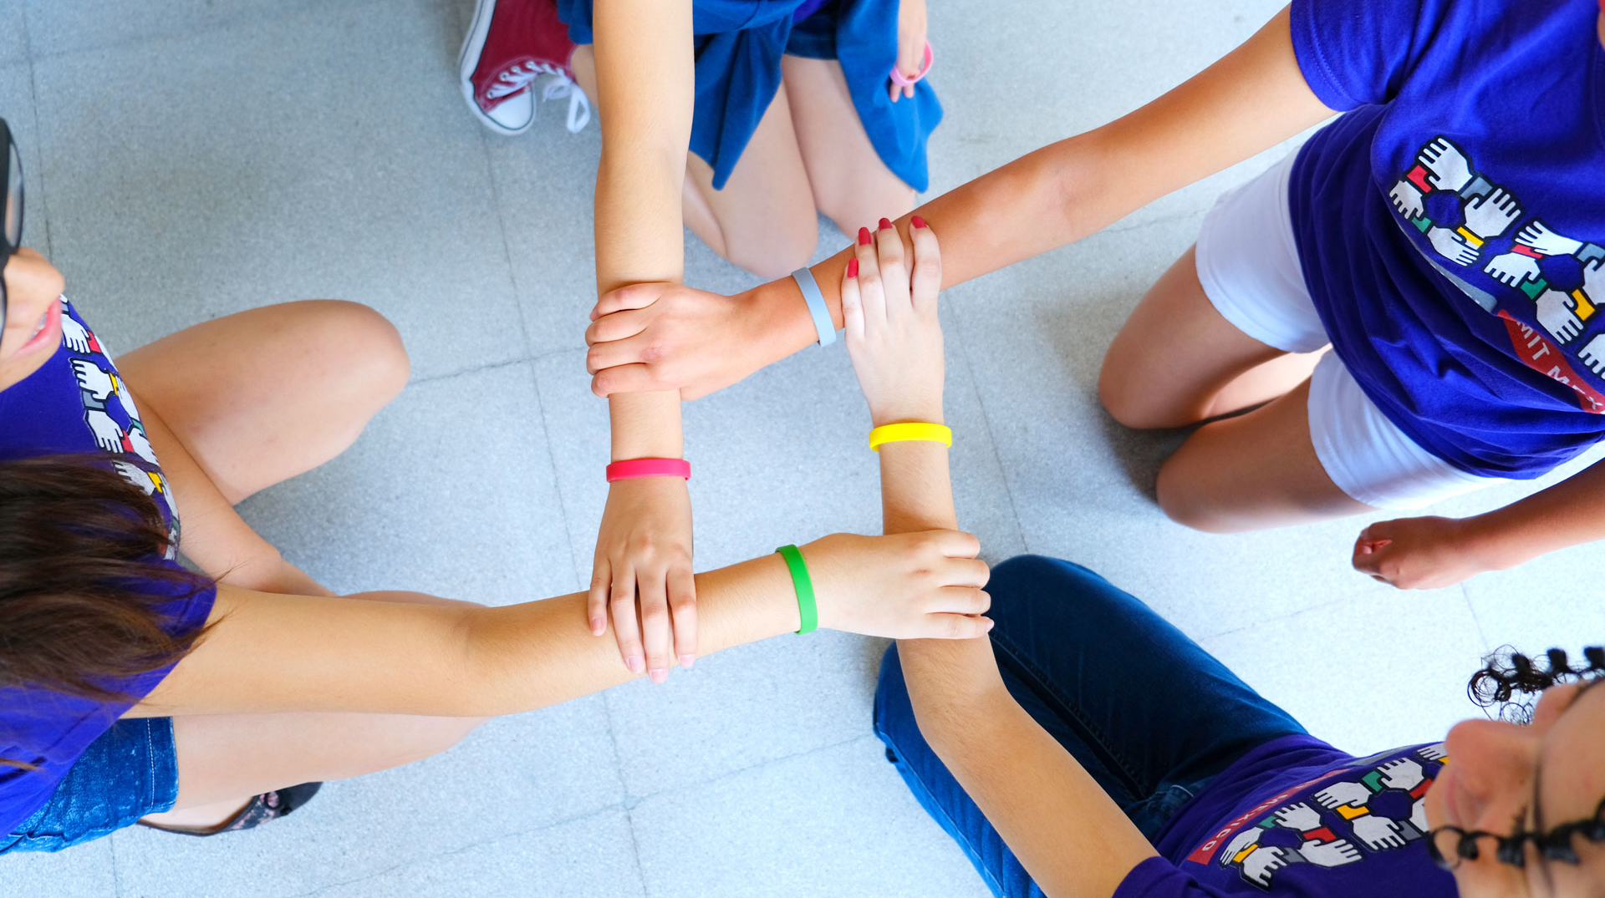
Wristbands

Slide 20
Gale-Shapley Algorithm
Show video, only for instructors
Comments:
If the exercise is going well, don’t worry about time

Slide 21
Gale-Shapley - Teaching Staff Notes
Provide students with cards
Provide students with card configuration
Ask them to maximize happiness
Scoring system
1st choice: 4 pts
2nd choice: 3 pts
3rd choice: 2 pts
4th choice: 1 pts

Slide 22
Exercise explanation (10 mins)
Explain
Cards initial arrangement
Required minimum score is 11
First team to high score gets wristbands – or equivalent

Slide 23
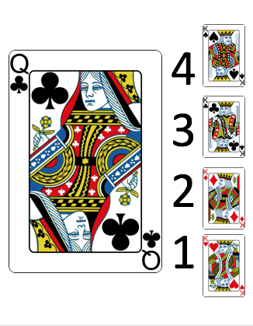
Sample Setup Image – Show one by one

Slide 24
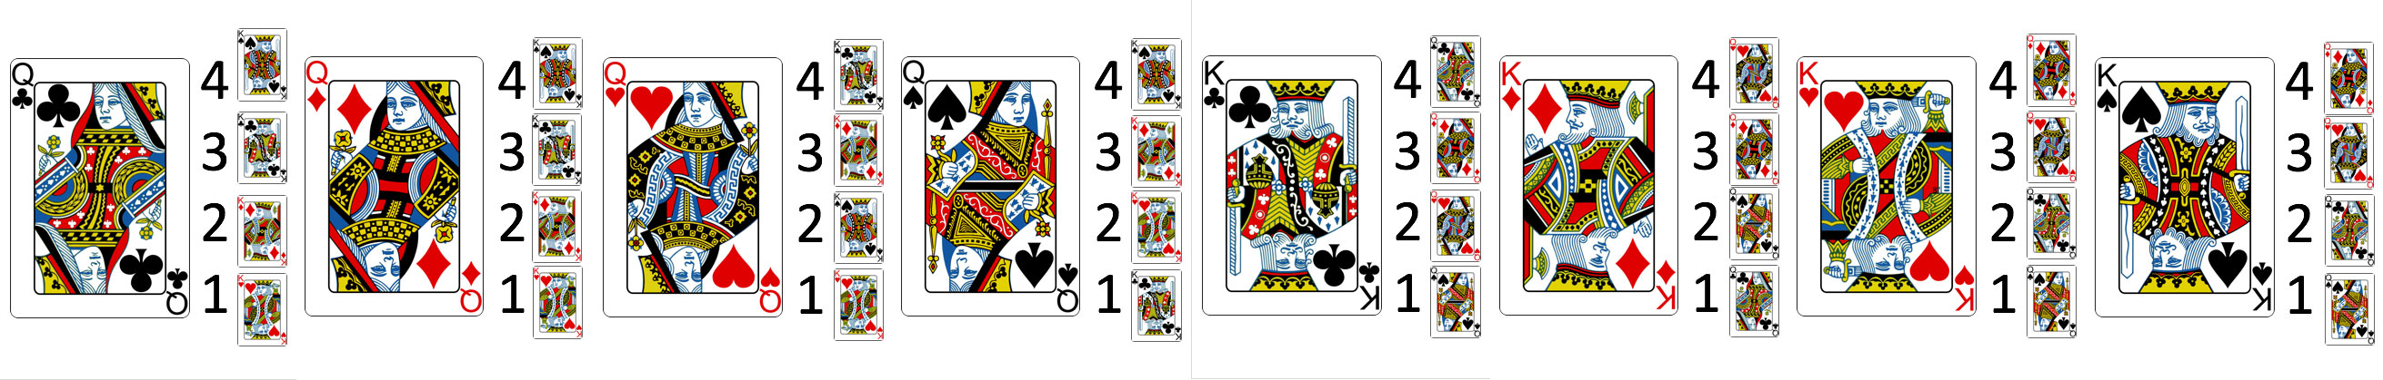
The complete list

Slide 25
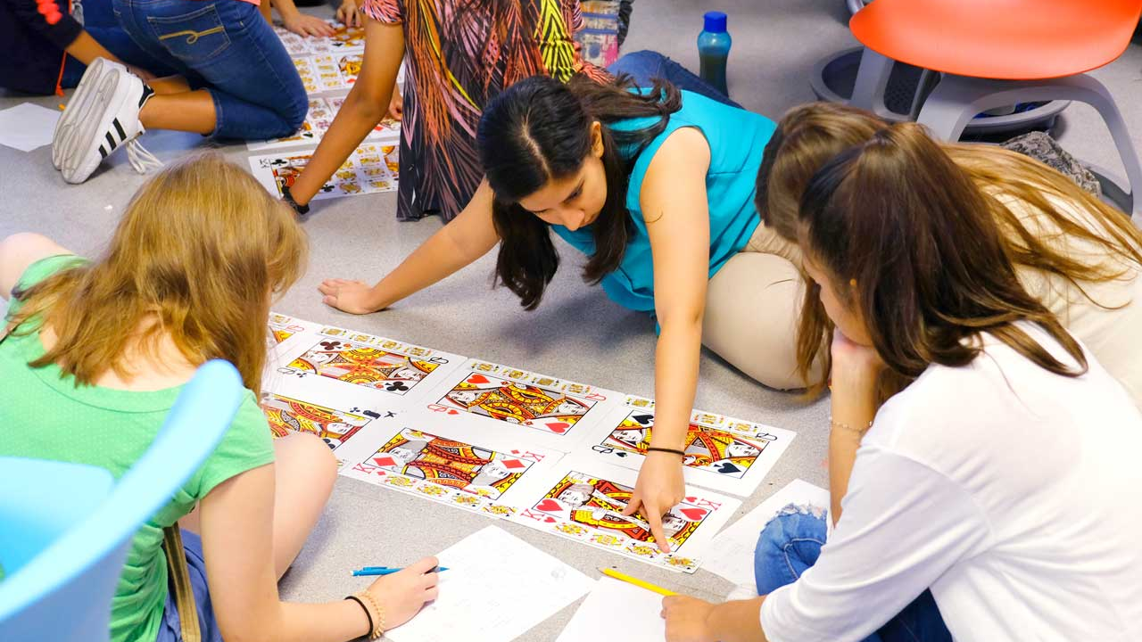
Student work – 30 mins

Slide 26
With Algorithm – Round 1
Queens select their top 4 choices
Queens select their top choice (first paring)
King consider offers
King selects top offer (rejects others)
Rejected queens top choice is removed

Slide 27
With Algorithm – Round 2
Queens select their next top choice
King consider offers
King selects top offer (rejects others)
Rejected queens top choice is removed

Slide 28
Apply to something of their choosing
Explain problem
Support application
Every team presents

Slide 29
TUESDAY

Slide 30
Create Teams – 10 mins
First activity of day
Create teams yourself
Other strategies for forming groups
http://www.supportrealteachers.org/techniques-for-forming-groups.html

Slide 31
Magician - small activity
Solution
Sixteenth card at start
Eight of hearts
Must choose from 16th to 32nd cannot choose sixteenth or thirty two
Throw closed
Down up
Throw away downs
Important: spread deck right-to-left

Slide 32
Students: how does work?
Let them try …

Slide 33
Give them the answer
Ask them to demonstrate …

Slide 34
Competition
Teams select representative
Teams compete against each other

Slide 35
Teach Binary counting
THERE ARE ONLY 10 TYPES
OF PEOPLE IN THE WORLD:
THOSE WHO UNDERSTAND BINARY
AND THOSE WHO DON'T

Slide 36
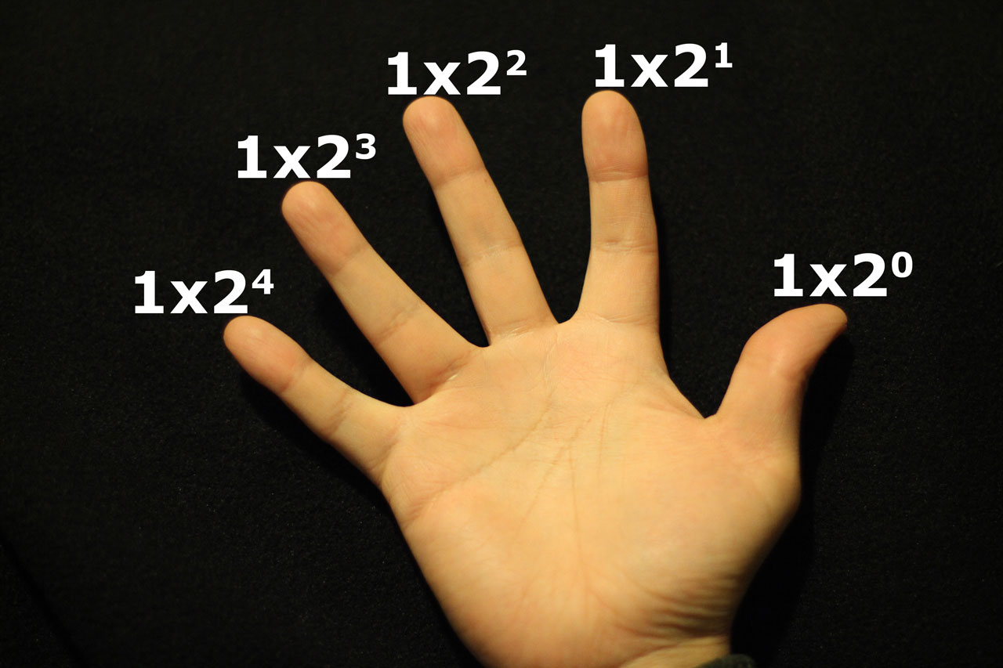

Slide 37
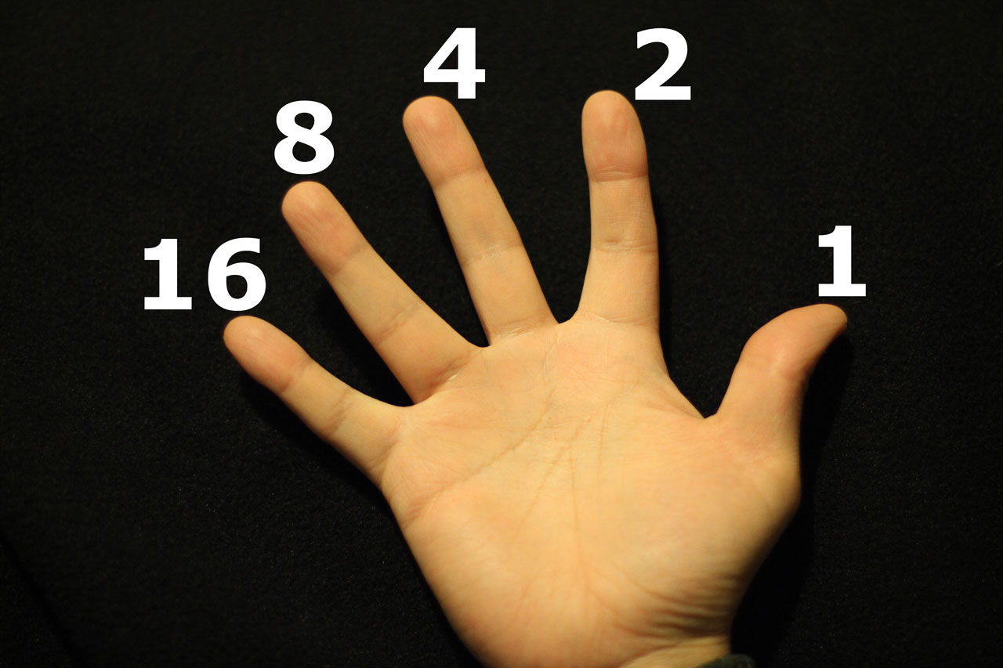

Slide 38
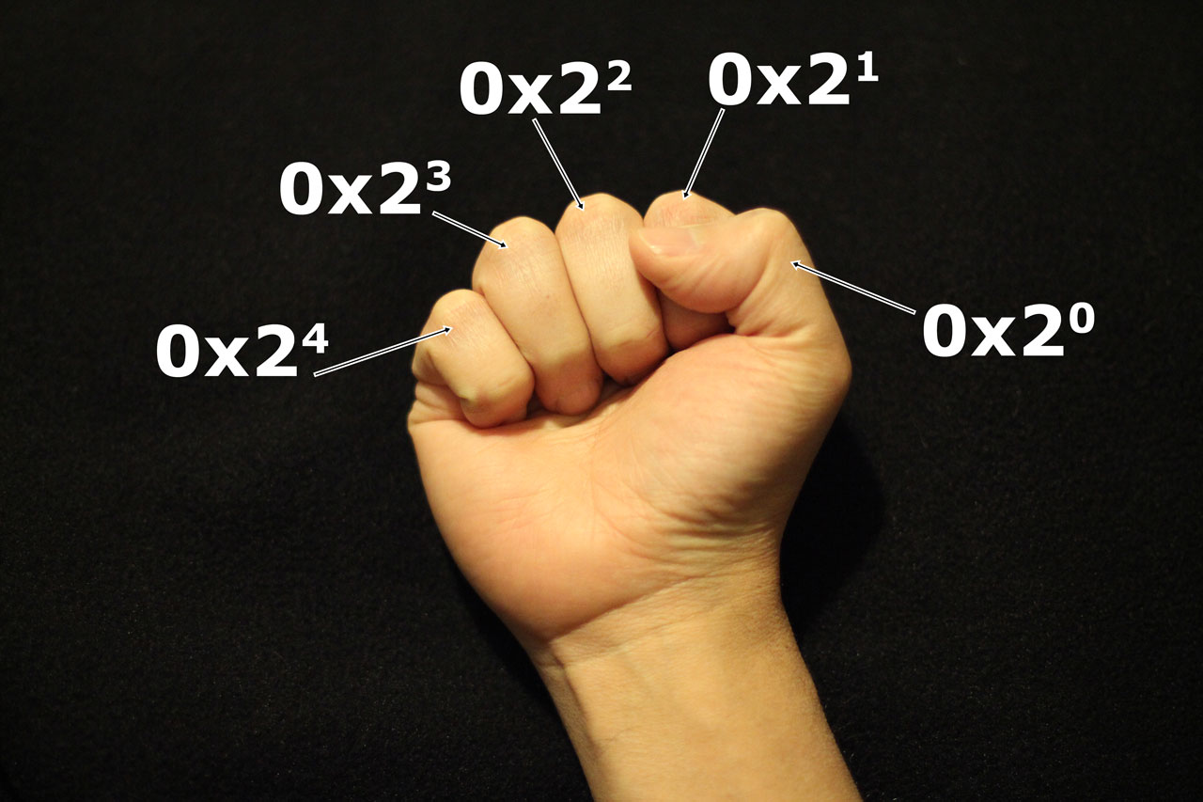

Slide 39
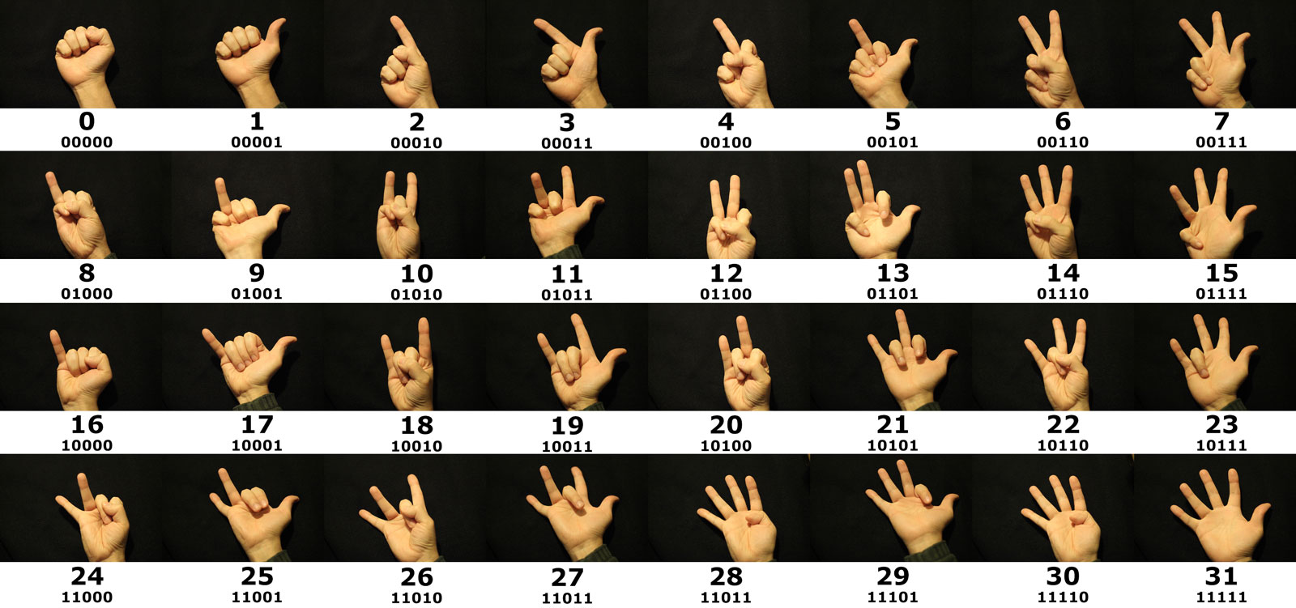

Slide 40
Binary counting activity
Practice binary counting
Optional: consider increasing to both hands

Slide 41
Class competition – Individual, not teams
Fun …

Slide 42
Binary clock activity
Explain problem
Have every team create a binary clock
Every team presents solution

Slide 43
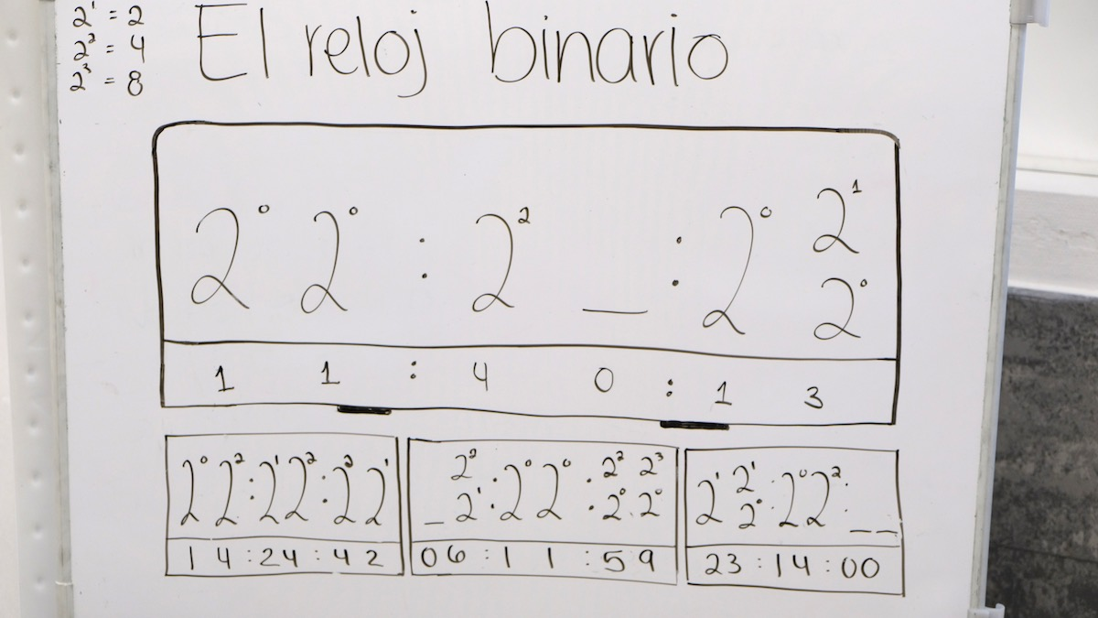
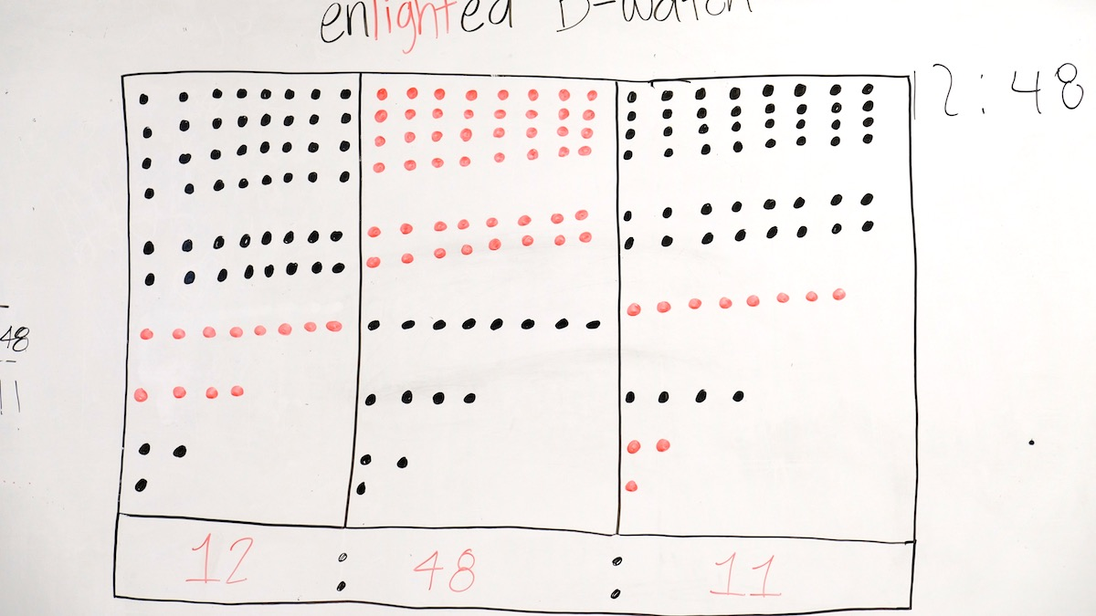
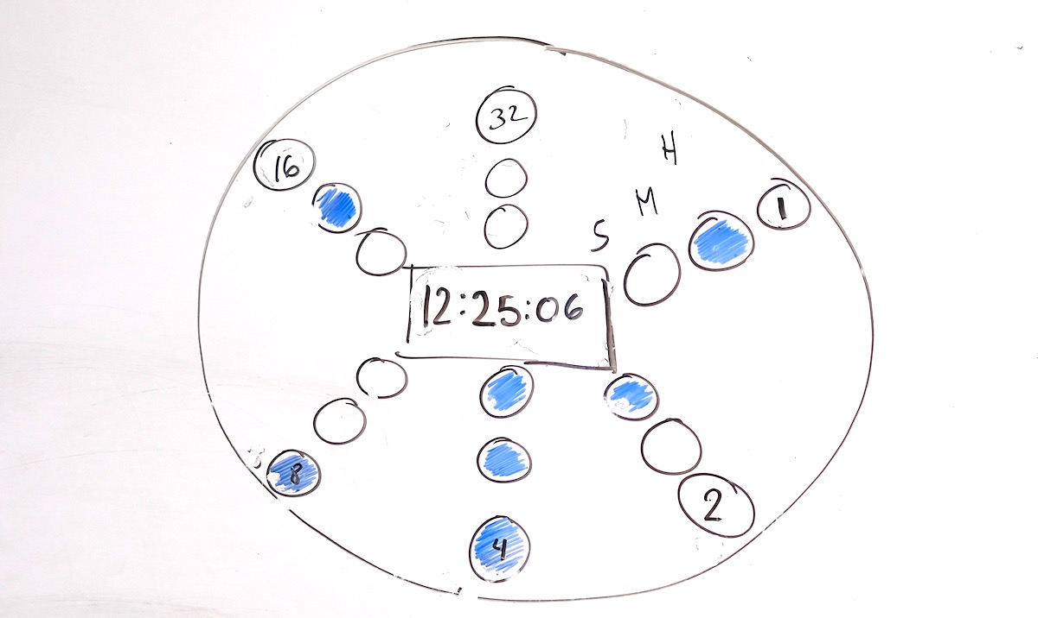
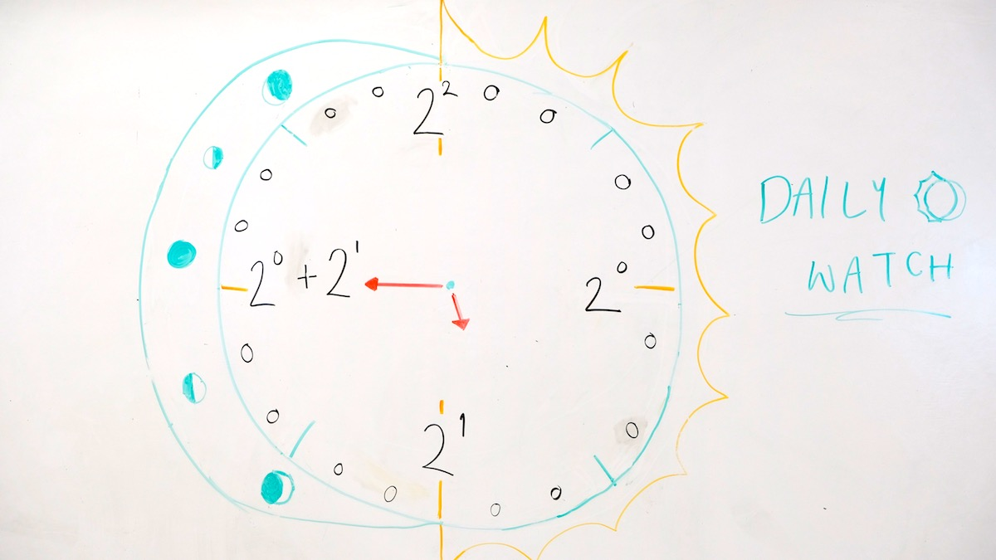
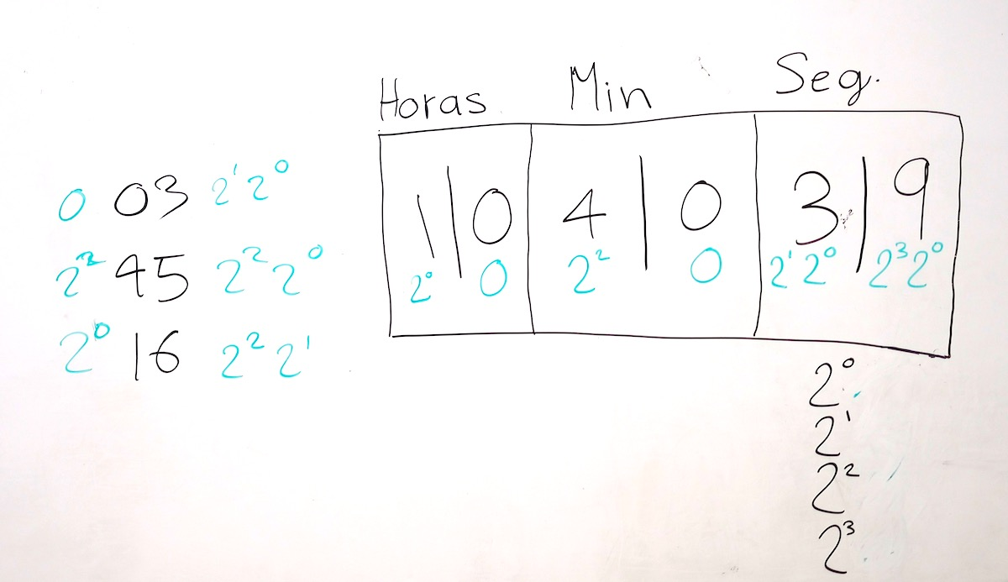
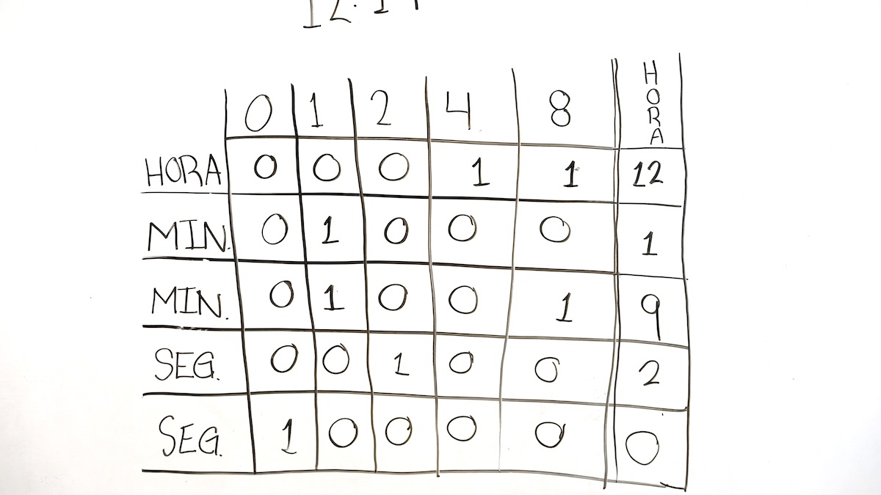
Samples

Slide 44
WEDNESDAY

Slide 45
Activity - minimum guesses to find a number between 1 and X
Given the numbers 1 to 1000, what is the minimum numbers guesses needed to find a specific number if you are given the hint "higher" or "lower" for each guess you make. Number of guesses to 10, 100, 1000, 10000
Solution
Log₂ 10 ≈ 3.3
Log₂ 100 ≈ 6.6
Log₂ 1000 ≈ 10
Log₂ 10000 ≈ 13.3
Log₂ 100000 ≈ 16.6
Log₂ 100000 ≈ 19.9

Slide 46
Activity: Encoding information
5x5

Slide 47
Add extra row and column
Your Row
6x6
Your Column

Slide 48
Make row/column sum even
Your Row
6x6
Your Column

Slide 49
Step out of the room, ask class to make change
Changed row/column no longer event
Your Row
Your Column

Slide 50
Activity – ask teams to demonstrate

Slide 51
Optional: ISBN verification
ISBN number verification
1101980133
= (1*10)+(1*9)+(0*8)+(1*7)+(9*6)+(8*5)+(0*4)+(1*3)+(3*2)
= 10+9+0+7+54+40+0+3+6
= 129
= 129/11
= 11 remainder 8
= 11-8
= 3

Slide 52
Cypher Activity – ask class to discover cypher (hash) function
Hash
Function
hello
52

Slide 53
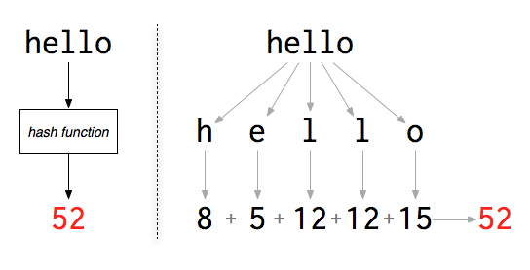
Hash
http://www.filosophy.org/post/8/what_is_a_password_anyway/

Slide 54
Cyphers activity
fachada bella, 6-1-3-8-1-4-1 2-5-12-12-1
mama bella, 13-1-13-1 2-5-12-12-1
medalla, 13-5-4-1-12-12-1
medicina bella, 13-5-4-9-3-9-14-1 2-5-12-12-1
angel, 1-14-7-5-12
camello, 3-1-13-5-12-12-15
cadena bella, 3-1-4-5-14-1 2-5-12-12-1
chile, 3-8-9-12-5
fabula, 6-1-2-21-12-1
hacienda bella, 8-1-3-9-5-14-4-1 2-5-12-12-1
anemia, 1-14-5-13-9-1
bella, 2-5-12-12-1

Slide 55
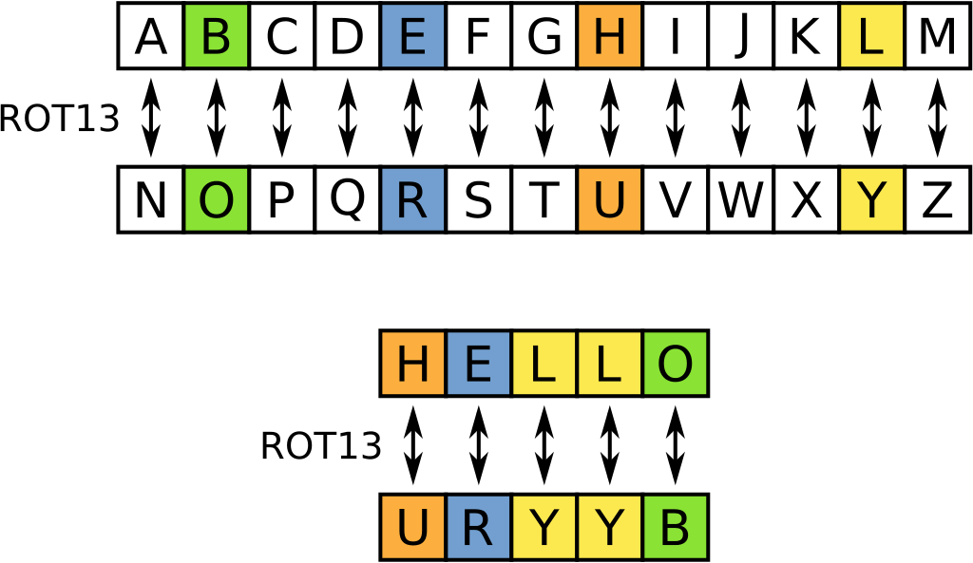

Slide 56
Cyphers Activity – ROT13
fachada bella, snpunqn oryyn
mama bella, znzn oryyn
Medalla, zrqnyyn
medicina bella, zrqnyyn
angel, natry
camello, pnzryyb
cadena bella, pnqran oryyn
chile, puvyr
fabula, snohyn
hacienda bella, unpvraqn oryyn
anemia, narzvn
bella, oryyn

Slide 57
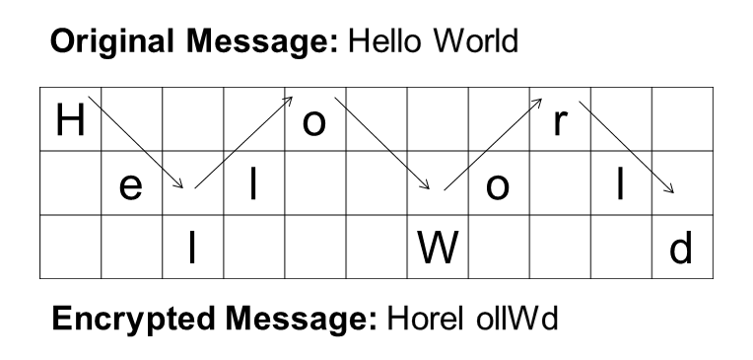
Rail fence cypher

Slide 58
Cyphers Activity – Rail Fence
fachadabella, faeahdblacal
mamabella, mbaaaelml
medalla, mlealda
medicinabella, mcbaeiiaeldnl
angel, alneg
camello, claelmo
cadenabella, cnlaeaeldba
chile, cehli
fabula, flauab
haciendabella, hebaainaelcdl
anemia, ainmae
bella, baell

Slide 59
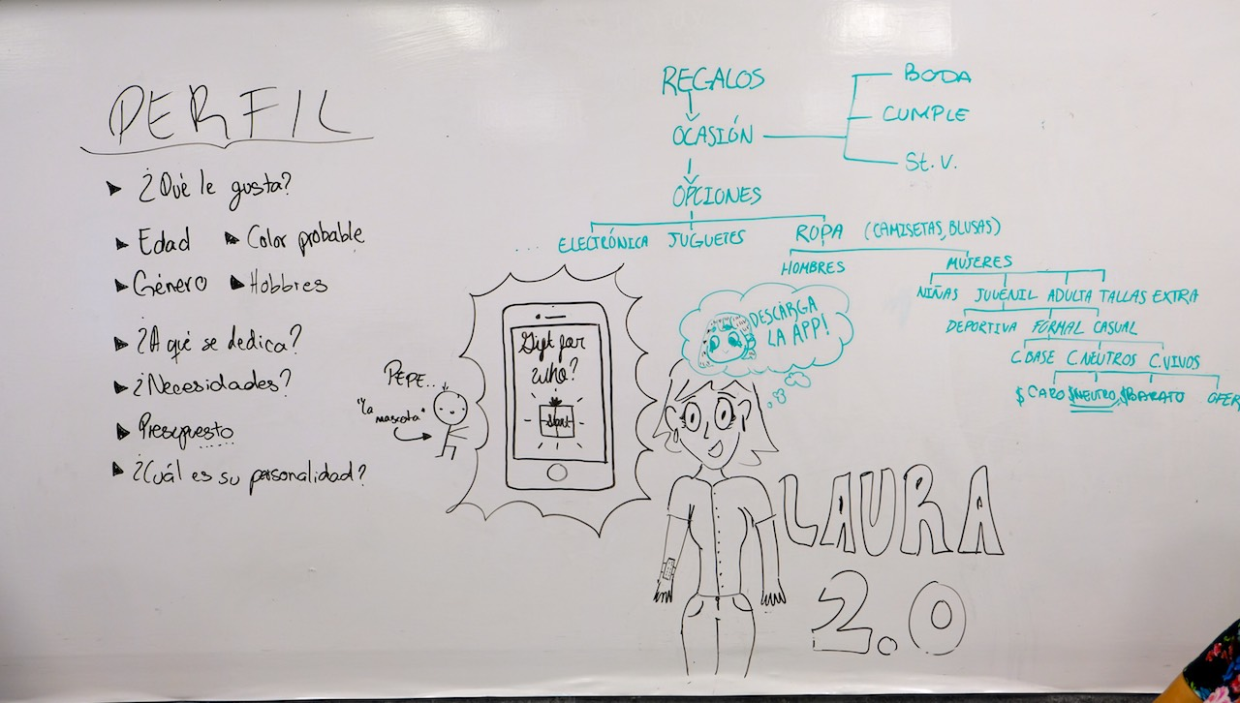
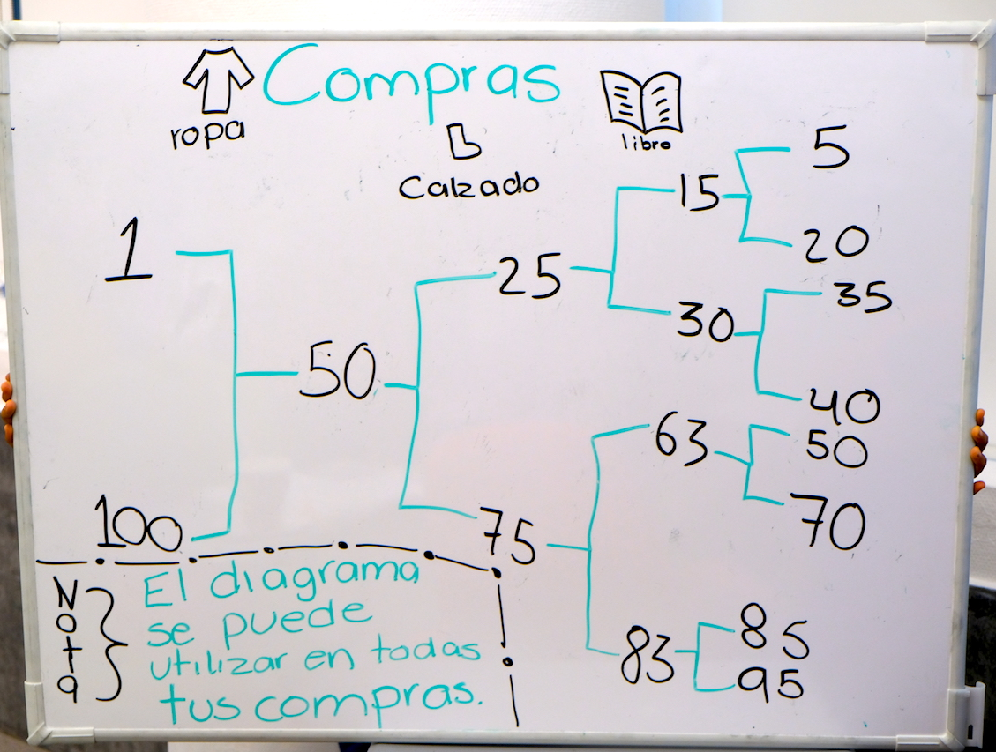
Activity: Binary Decision Trees

Slide 60
THURSDAY

Slide 61
Search (20 mins) – numbers not in order
Select cards with numbers 1-to-15
Shuffle cards
Select 15 students from class
Have them come up to the board
Give a each student a shuffled card
Ask each group to make a guess
They are trying to find a number we selected

Slide 62
Search – linear (20 mins)
Numbers are in order
Do not tell class numbers in order

Slide 63
Sorting – no algorithm (20 mins)
Select all students 25
Shuffle numbers
Select numbers at random
Give a each student a shuffled number
Ask them to sort

Slide 64
Activity – create sorting scheme
Not an easy thing to do …

Slide 65
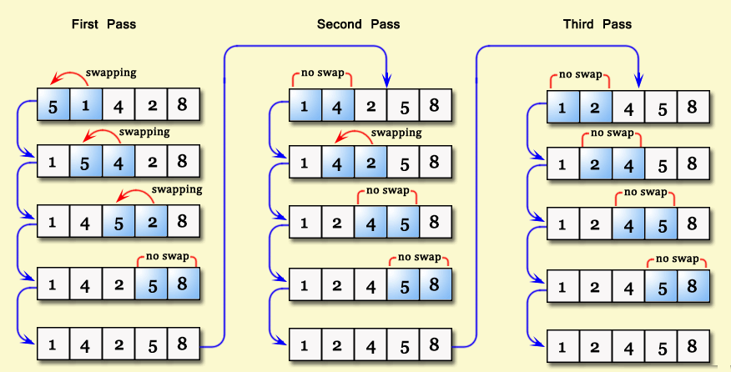
Bubble Sort

Slide 66
Sorting – bubble sort (20 mins)
Select all students 25
Shuffle numbers
Select numbers at random
Give a each student a shuffled number
Ask them to sort

Slide 67
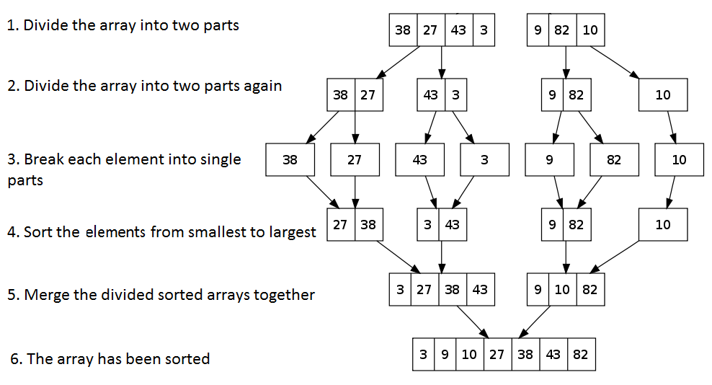
Merge Sort

Slide 68
Sorting – merge sort (20 mins)
Select all students 26
Shuffle numbers
Select numbers at random
Give a each student a shuffled number
Ask them to sort

Slide 69
Demonstrate
https://www.cs.usfca.edu/~galles/visualization/ComparisonSort.html
https://www.toptal.com/developers/sorting-algorithms
https://www.toptal.com/developers/sorting-algorithms

Slide 70
Activity - Sorting
Cat 1
Cat 2
Cat 3
Cat 4
[Text]
[Text]
Cat 5
[Text]
[Text]
[Text]
[Text]
[Text]
[Text]
[Text]
Sentence formed by concatenating words in category
First team to form sentence wins

Slide 71
Activity – complexity, coin flips
Number of times coins need to be flipped to get 5 "heads/tails" in a row

Slide 72
Activity – Traveling Salesman
Explain problem
Place dots
Check all possible routes
Each additional dot grows exponentially
Formula N!/2
03 cities ------> 3 routes
04 cities ------> 12 routes
05 cities ------> 60 routes
06 cities ------> 360 routes
10 cities ------> 1.8 million

Slide 73
Towers of Hanoi
Tournament
Team selects representative
Two teams at a time
Team that completes Towers wins
Team that beats all other teams wins
https://www.youtube.com/watch?v=aGlt2G-DC8c

Slide 74
FRIDAY

Slide 75
Activity - Knapsack
Suppose you have a bunch of valuable items that you want to carry to the market, but your backpack only holds 20 lbs. You can't take all the items because their weights sum to 50 lbs. What items do you take to the market if you want to maximize the value of items you can sell?

Slide 76
Activity – Prepare for presentations

Slide 77
Activity – Presentations

