Slide 1
Thursday
Abel Sanchez

Slide 2
Data Collection
Collaborative Wall
Today’s question: What was your favorite part of yesterday? [¿Cual fue la parte del dia de ayer que más te gusto?]
Take photo at end of day
Document via photos & video
Document via photos & video with your phone. Specifically, try to capture times when learning is being demonstrated: the students giving explanations of their solutions, describing applications of algorithms, or presenting their projects. Upload to Dropbox, link to follow.

Slide 3
Create Teams – 10 mins
First activity of day
Create teams yourself
Other strategies for forming groups
http://www.supportrealteachers.org/techniques-for-forming-groups.html

Slide 4
Information Hiding
First person chooses a random number (keeps it secret)
First person adds allowance to random number (creates new note)
First person passes note to next person
Next person adds allowance to number (creates new note)
Next person passes note to next person
Repeat until finished
Upon completion remove random number and devide by number in group to get allowance average

Slide 5
Sorting – no algorithm (20 mins)
Select all students 25
Shuffle numbers
Select numbers at random
Give a each student a shuffled number
Ask them to sort

Slide 6
Activity – create a sorting scheme
Not an easy thing to do …

Slide 7
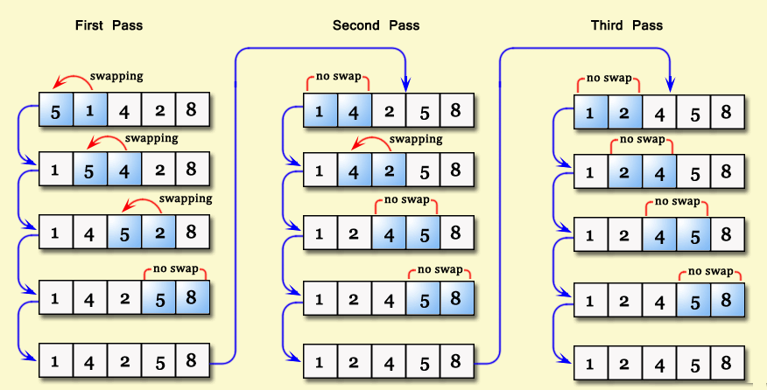
Bubble Sort

Slide 8
Sorting – bubble sort (20 mins)
Select all students 25
Shuffle numbers
Select numbers at random
Give a each student a shuffled number
Ask them to sort

Slide 9
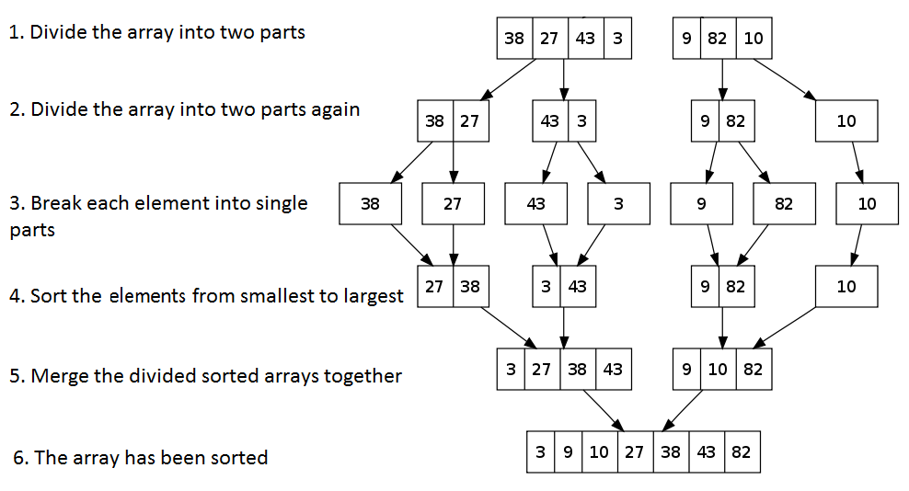
Merge Sort

Slide 10
Sorting – merge sort (20 mins)
Select all students 26
Shuffle numbers
Select numbers at random
Give a each student a shuffled number
Ask them to sort

Slide 11
Demonstrate
https://www.cs.usfca.edu/~galles/visualization/ComparisonSort.html
https://www.toptal.com/developers/sorting-algorithms
https://www.toptal.com/developers/sorting-algorithms

Slide 12
Activity - Sorting
Cat 1
Cat 2
Cat 3
Cat 4
[Text]
[Text]
Cat 5
[Text]
[Text]
[Text]
[Text]
[Text]
[Text]
[Text]
Sentence formed by concatenating words in category
First team to form sentence wins

Slide 13
Activity – complexity, coin flips
Number of times coins need to be flipped to get 5 "heads/tails" in a row

Slide 14
Activity – Traveling Salesman
Explain problem
Place dots
Check all possible routes
Each additional dot grows exponentially
Formula N!/2
03 cities ------> 3 routes
04 cities ------> 12 routes
05 cities ------> 60 routes
06 cities ------> 360 routes
10 cities ------> 1.8 million

Slide 15
Activity – Traveling Salesman
Identify real world traveling salesman problems
Note:
Maybe we should call it Traveling Saleswoman

Slide 16
Towers of Hanoi
Tournament
Team selects representative
Two teams at a time
Team that completes Towers wins
Team that beats all other teams wins
https://www.youtube.com/watch?v=aGlt2G-DC8c

Slide 17
AFTERNOON

Slide 18
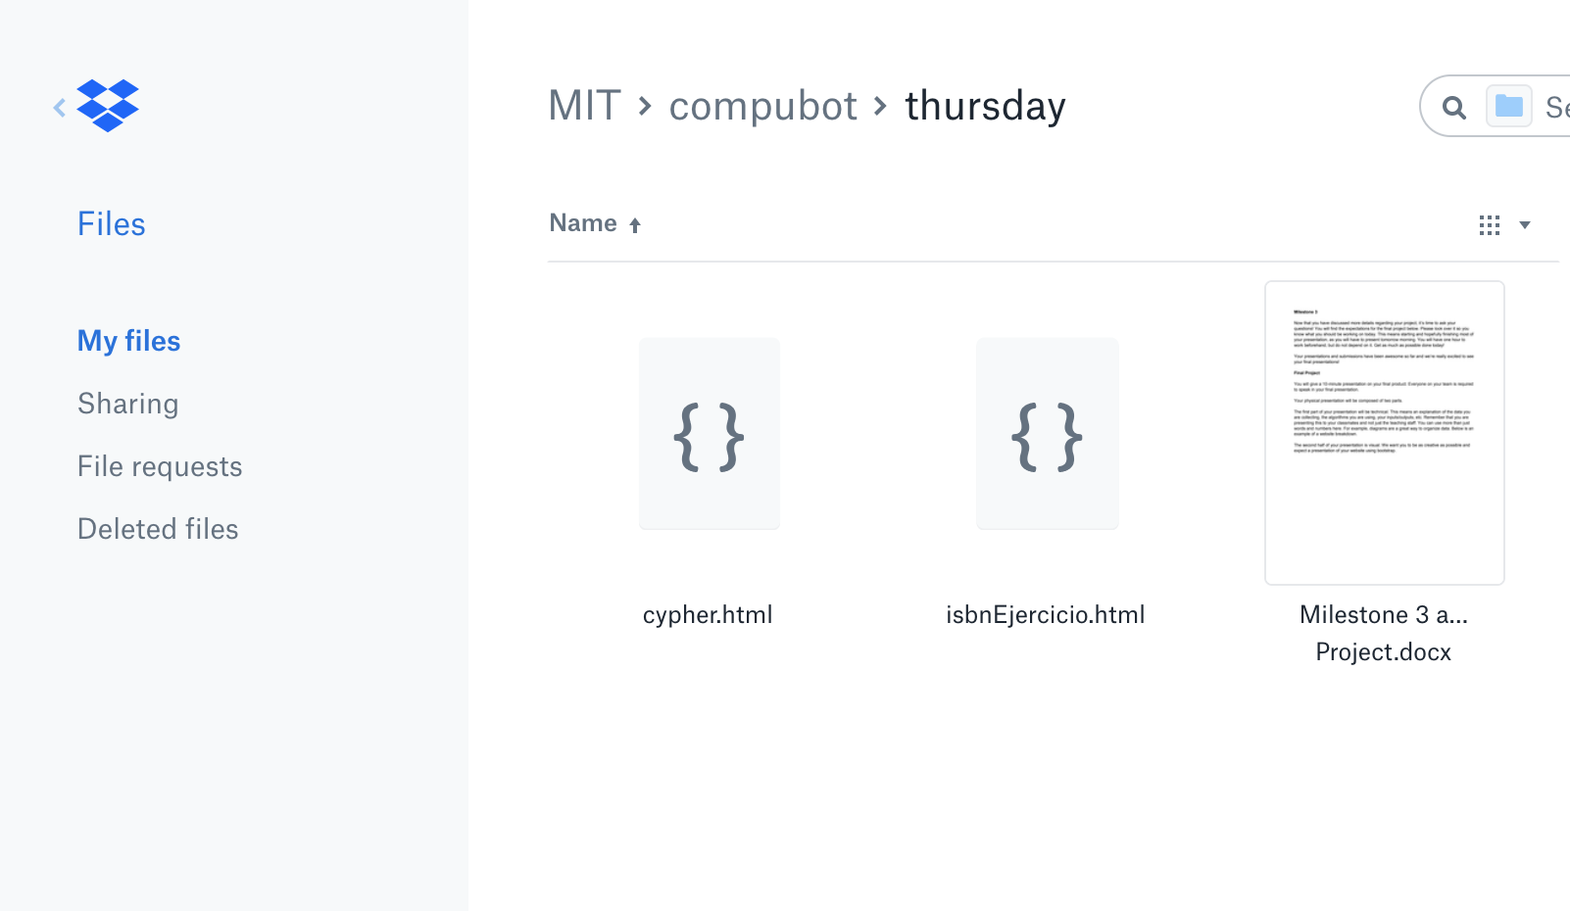
Project Time – http://bit.ly/patronx
Milestones
Document

Slide 19
END OF THE DAY TASKS

Slide 20
Instructor – Submit Reflection
Upload to
TBD

Slide 21
TA – Submit Reflection
Upload to
TBD

Slide 22
Students – Submit Reflection
Upload to
TBD

