Slide 1
Modeling Choices in Omics
Implications for Health Disparities in Human Genetics
Kynon J. Benjamin, PhD · Minoli Perera, PharmD, PhD
Northwestern University Feinberg School of Medicine

Slide 2
Financial Disclosure
We do not have any relationships to report within the last 24 months with ACCME defined ineligible companies.

Slide 3
Unlabeled/Investigational Uses
We will not be discussing unlabeled/investigational uses of medical devices or pharmaceuticals during this presentation.

Slide 4
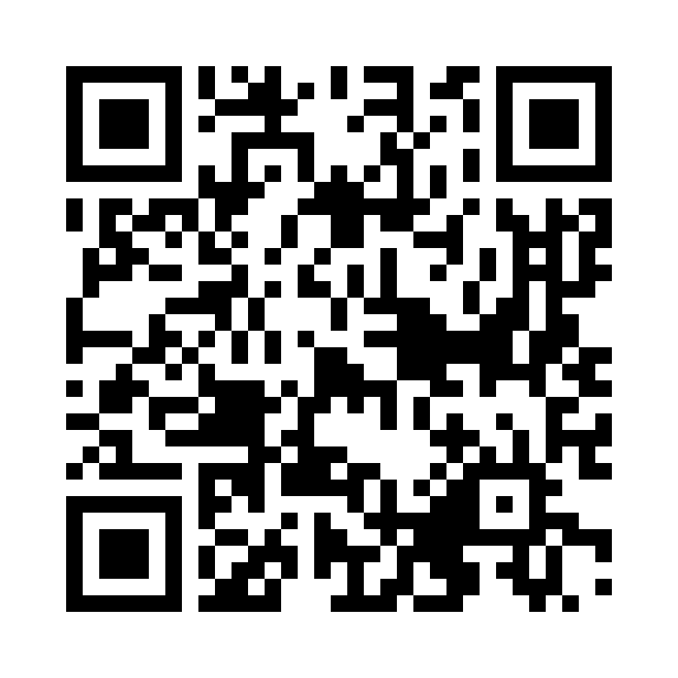
Join the platform
ASHG 2026 · Modeling Choices in Omics
heart-gen.github.io/
modeling-choices-omics-ashg2026
No account, no install.
Opening poll:
How does your team usually evaluate ancestry-related heterogeneity?
Notes:
Opening poll options:
A. Pooled analysis only
B. Pooled plus subgroup checks
C. Ancestry-aware models by default
D. It varies by project

Slide 5
Two-hour agenda
Agenda
Segment | Time
Opening and live poll | 15 min
Framing and prediction practice | 15 min
Interactive exercises I | 30 min
Interactive exercises II | 30 min
Synthesis | 15 min
Wrap-up and Q&A | 15 min
Notes:
Opening and live poll (15 min): Welcome participants and assess current analytic practices. The poll surface depends on the build — see below.
Framing and prediction practice (15 min): The organiser deck (genomics today, race vs ancestry, meta-analysis masking, local ancestry and Tractor, multi-ancestry PRS), then the "How the modules work" slide. The opening poll has no reveal, so this slide is where commit-then-reveal is practised.
Interactive exercises I (30 min): Scenarios 1–3: pooled/stratified, meta-analysis, and local ancestry (10 min each).
Interactive exercises II (30 min): Scenarios 4–6: complexity, regularization, and scalable inference (10 min each).
Synthesis (15 min): Compare recurring patterns and participant predictions.
Wrap-up and Q&A (15 min): Build a take-home decision framework and answer questions.
6 modules at 10 minutes each, in the order they appear in the platform.

Slide 6
How the modules work
Every module runs the same way
1
2
3
4
Commit
Room split
Explore
Debrief
Answer before any chart appears
See how the room divided
Move every control
What makes another answer right?
Notes:
Commit: Answer the module's question before any chart or control is visible.
Room split: The facilitator projects how the room divided, then reveals the answer the precomputed numbers give.
Explore: The controls unlock. Move every one and watch the result change; the presets are the entry points.
Debrief: What would have to be true of a real cohort for one of the other answers to be right?
6 modules · 10 minutes each · the correct answer is computed from the module's own numbers, never typed in.

Slide 7
Pooled vs Stratified Analysis
Module 1 · Commit first
Raise the European-ancestry share of the pooled sample from 35% to 95%. What happens to the pooled effect estimate?
A. It grows toward the strong European-ancestry effect
B. It shrinks toward the weak African-ancestry effect
C. It stays put; only the interval changes
D. It stops being significant
Notes:
Before switching models, predict whether a single pooled estimate will describe every ancestry group in the sample, or only the largest one.

Slide 8
Pooled vs Stratified Analysis: the answer
Module 1 · Reveal
Answer
It grows toward the strong European-ancestry effect
Notes:
The pooled estimate is the most precise number on the screen and it is significant at every mix. As the European-ancestry share rises it moves onto the strong European effect, because a pooled regression is an information-weighted average and the European group carries most of the information. The African-ancestry estimate is 0.02 with an interval that includes zero at every mix, and nothing in the pooled output says so.

Slide 9
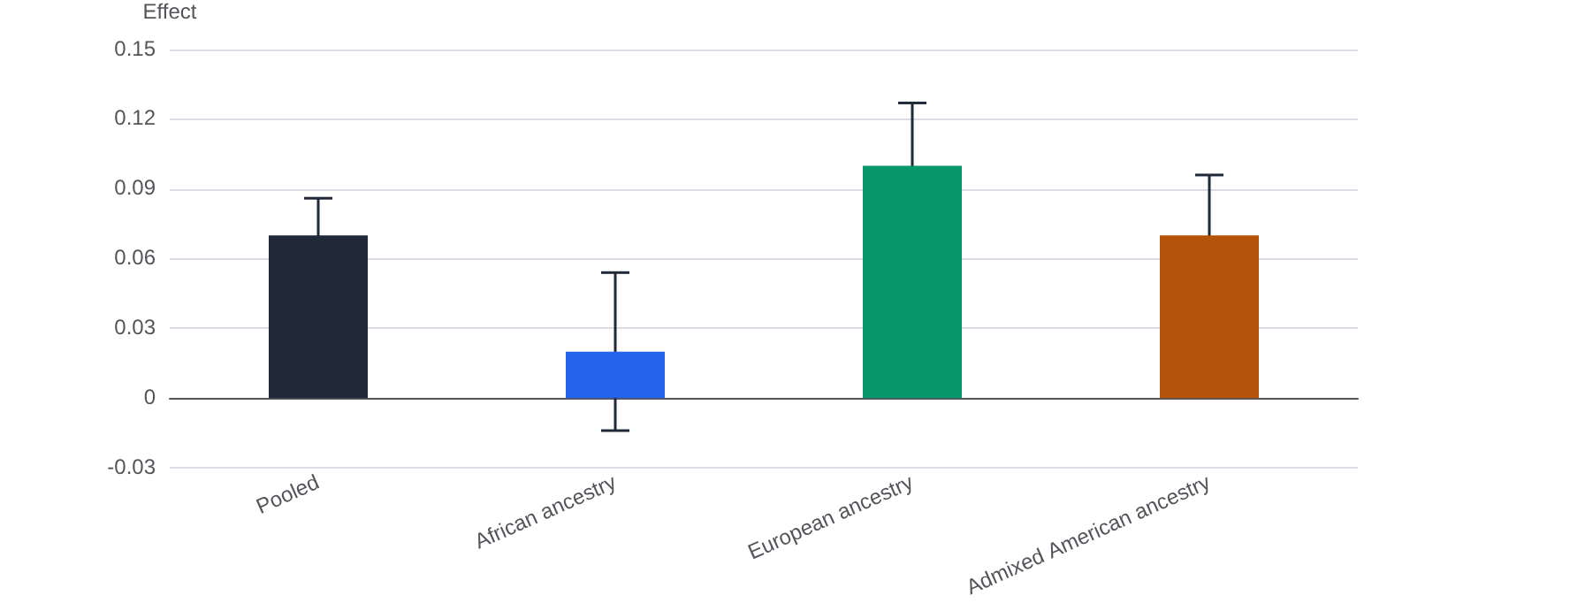
Module 1: Effect estimates at 35% European ancestry
Module 1 · Reveal
Notes:
Move the ancestry-mix slider and watch the pooled estimate migrate toward whichever group dominates the sample. The stratified estimates do not move. The top of the slider is the GWAS catalog today (the 'Genomics today' slide): the pooled estimate equals the European effect and is highly significant, while the African-ancestry estimate has never been distinguishable from zero. Point out that the direction is the real LCT biology: rs4988235 is the European persistence allele, and persistence in African populations is carried by other variants that this SNP does not tag. If the room asks why this is not the PCSK9 example from the framing slides: a loss-of-function allele absent in European ancestry cannot be diluted by pooling, because the European sample carries no information about it. This module shows the more common and less visible case, where the pooled number is real, significant, and wrong for a third of the room.

Slide 10
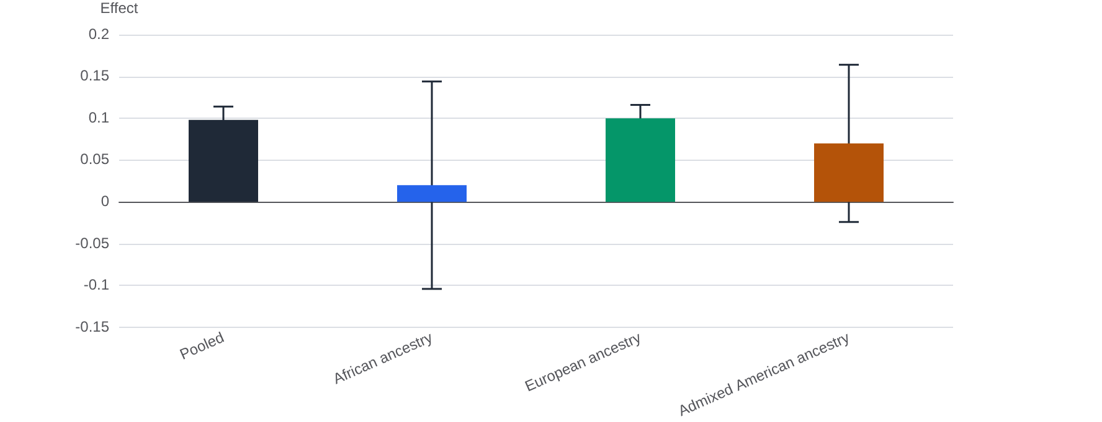
Module 1: Effect estimates at 95% European ancestry
Module 1 · Reveal

Slide 11
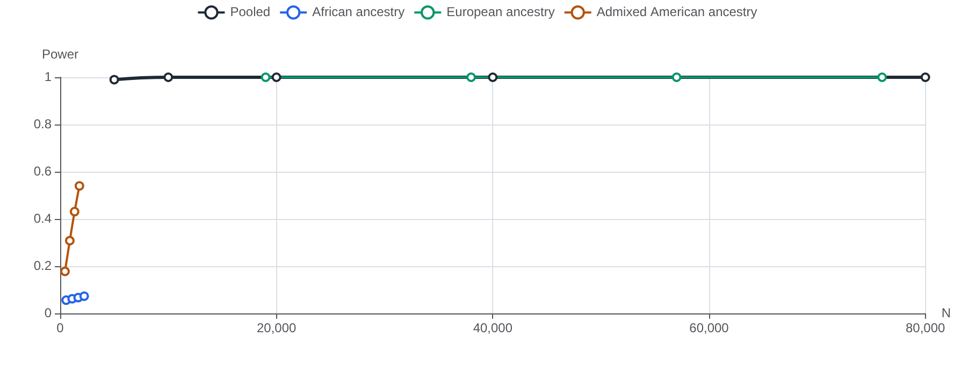
Module 1: Power curve at 95% European ancestry
Module 1 · Reveal
Notes:
A pooled result can look efficient and decisive while describing only the dominant group. Applied to the underrepresented group, it overstates an effect that may barely exist there; this is the same number a pooled polygenic score is built from (module 5).

Slide 12
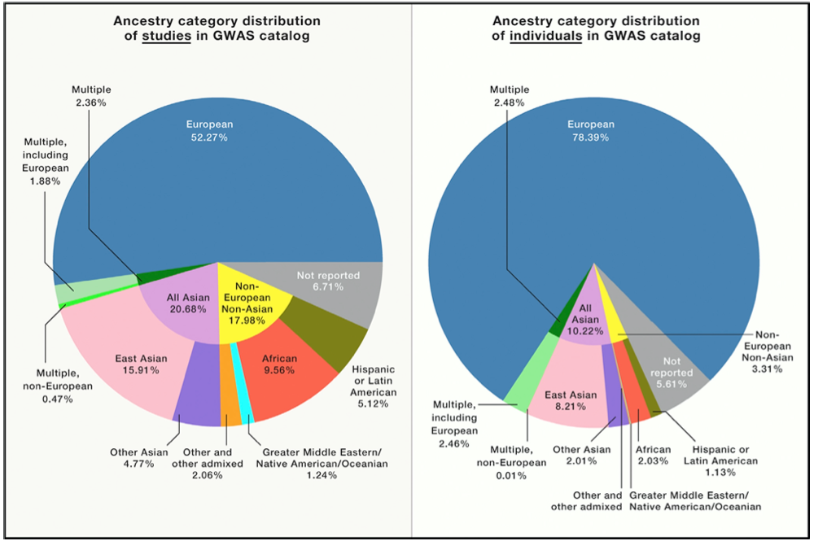
Genomics today
More studies are STILL in predominantly European-descent populations.
Sirugo et al, Cell, 2019

Slide 13
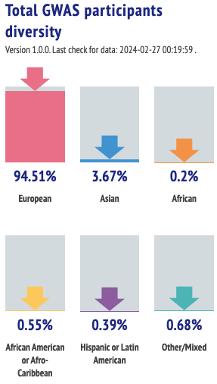
Genomics today
More studies are STILL in predominantly European-descent populations.
Sirugo et al, Cell, 2019

Slide 14
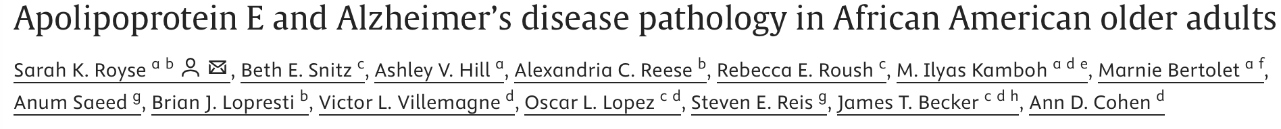
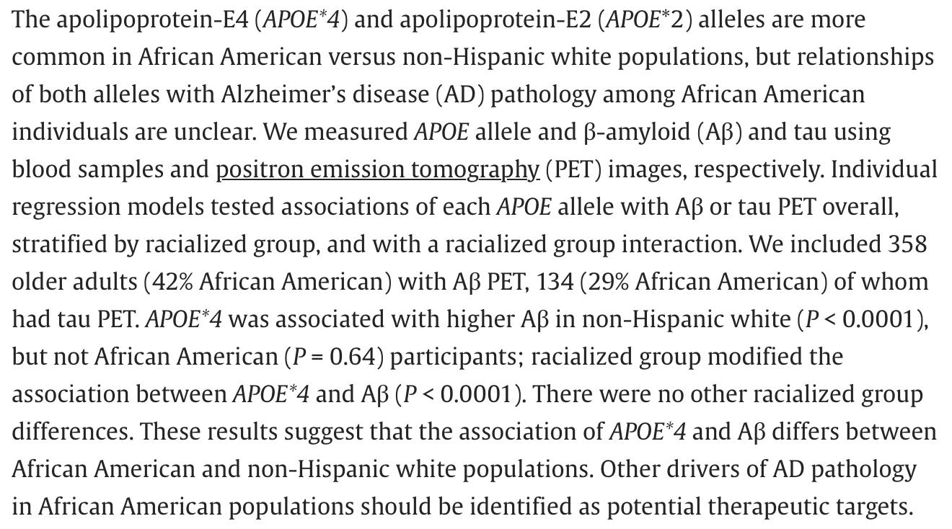
Sirugo et al. The Missing Diversity in Human Genetic Studies. Cell 2019
Fruchart, International Journal of Diabetes Mellitus, 2010.

Slide 15
Within-Ancestry Testing vs Meta-Analysis
Module 2 · Commit first
Four ancestry groups are meta-analysed. Push heterogeneity to 100%, where the East Asian effect is about 3 times the others'. What happens to the fixed-effect summary?
A. It stays narrow and significant
B. Its interval widens like the random-effects one
C. It stops being significant
D. It flips sign
Notes:
Does a significant meta-analysis mean the same biology is operating in every ancestry group?

Slide 16
Within-Ancestry Testing vs Meta-Analysis: the answer
Module 2 · Reveal
Answer
It stays narrow and significant
Notes:
The fixed-effect summary stays narrow and significant at every level of heterogeneity because its weights never change: they are set by precision alone, so the two largest groups carry about three quarters of the weight and the East Asian group, where the effect is about 3 times larger, carries about a seventh. The random-effects model lets tau² re-balance the weights toward equality and its interval widens to say so. Only within-ancestry testing reports the East Asian effect itself.

Slide 17
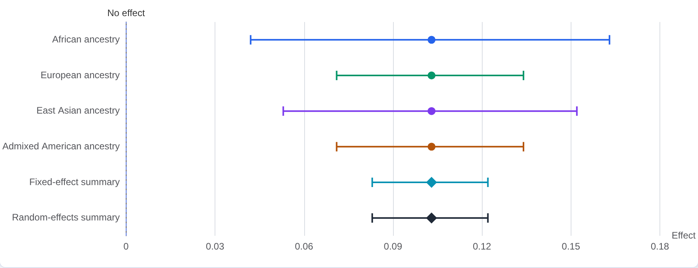
Module 2: Forest plot at 0% heterogeneity
Module 2 · Reveal
Notes:
Switch the synthesis select through its three settings before touching the slider: within-ancestry reports four estimates and four p-values; each meta-analysis reports one diamond, one p-value, and prints the weight each group carried on its row. Then set heterogeneity to 0: the two summaries coincide and I² is near zero. Move to 100. The fixed-effect weights do not move, the summary stays narrow and significant, and the rows show why: the East Asian group with the 3-fold effect carries about 15% of the weight. This is the meta-analysis half of the Sirugo quote on the framing slides (diverse populations 'only as part of large meta-analyses'), and it is also what Tractor-style local-ancestry analysis does after stratifying (module 3).

Slide 18
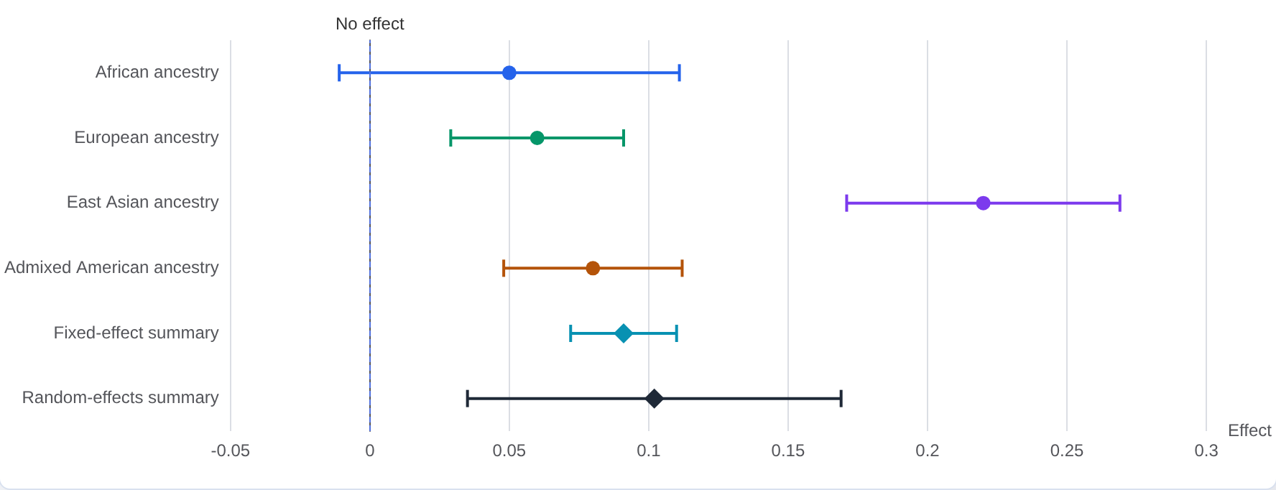
Module 2: Forest plot at 100% heterogeneity
Module 2 · Reveal
Notes:
A meta-analysis summary describes the groups that carry its weight. When the distinctive biology sits in a small group, the combined p-value can be impressive while saying nothing about that group; equity-aware synthesis reports the weights, the heterogeneity, and the within-ancestry estimates, not only the strongest combined p-value.

Slide 19
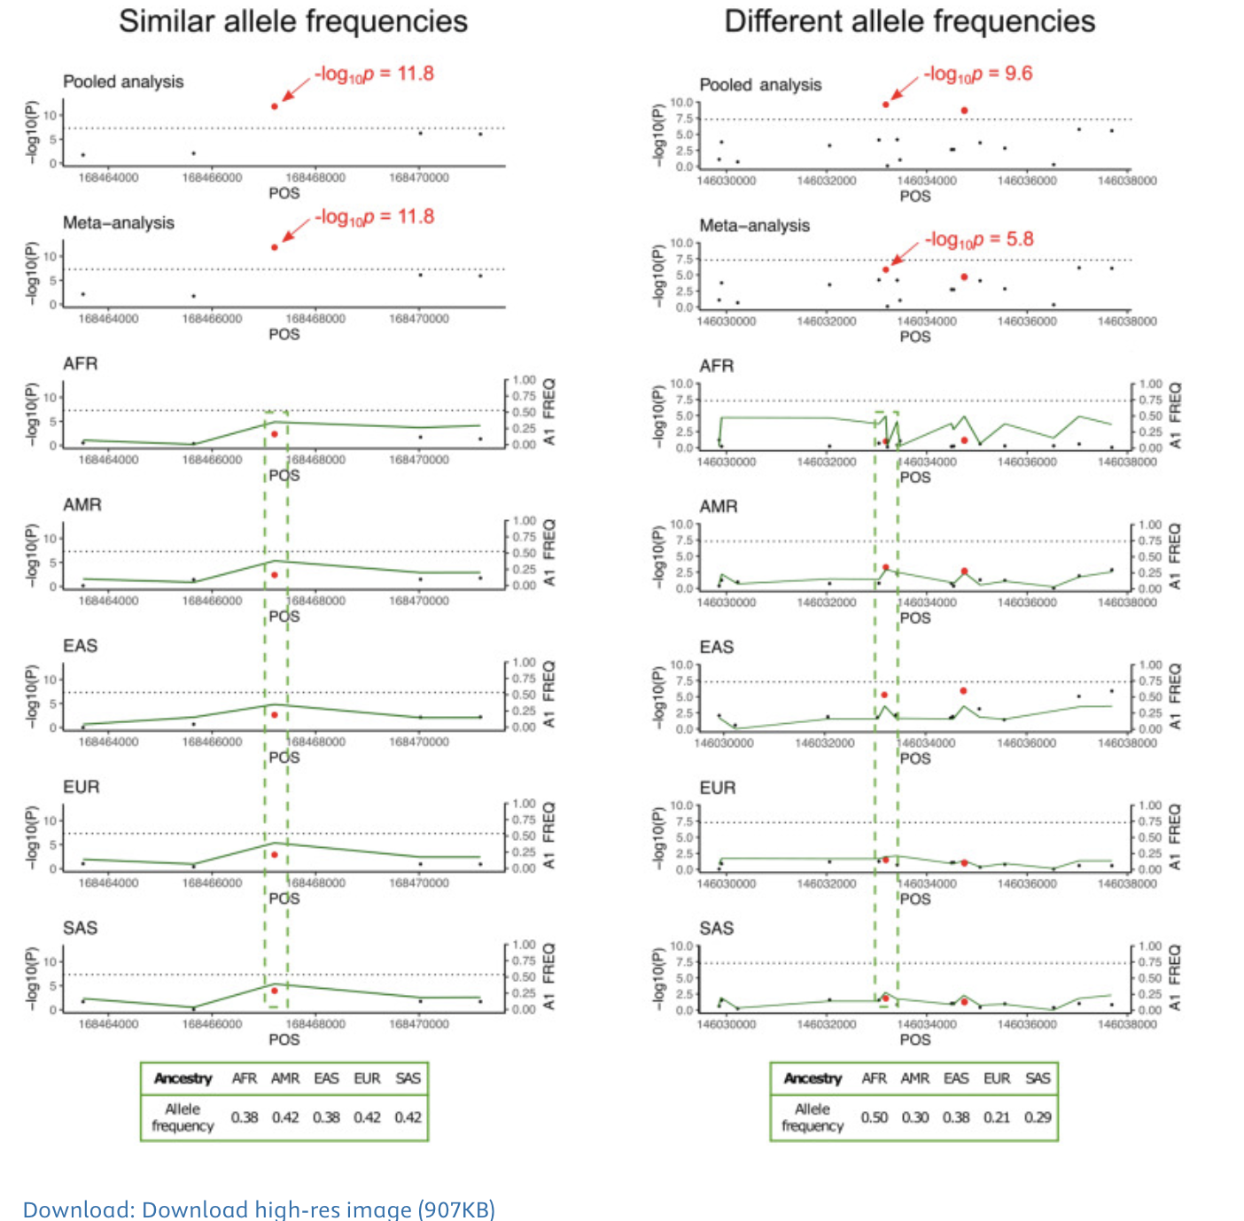
Dias et al, AJHG, 112(10), 2 October 2025, Pages 2493-2508

Slide 20
Opposite effects by ancestry: which model detects them?
“Even when diverse populations are studied, specific gene effects in these populations may not be evident, as often diverse populations are studied only as part of large meta-analyses that estimate associations from combined data. The result of this analytical strategy is to identify variants that have mostly similar effects across populations, but it can reduce the ability to detect population-specific genetic risk factors.”
Cell. 2019 Mar 21;177(1):26–31.

Slide 21
Global vs Local Ancestry Modeling
Module 3 · Commit first
The tag SNP has opposite effects on African- and European-ancestry haplotypes (+0.12 and -0.08) in a 15,000-person admixed study. Which is the simplest analysis that detects it at p < 0.05?
A. Global ancestry PCs
B. Adding local ancestry as a covariate
C. Local ancestry interaction
D. None at this sample size
Notes:
Does modelling local ancestry at this locus buy power, cost power, or neither?

Slide 22
Global vs Local Ancestry Modeling: the answer
Module 3 · Reveal
Answer
Local ancestry interaction
Notes:
With opposing effects the standard scan reports nothing at this locus: the pooled estimate averages the two directions to near zero. Adding local ancestry as a covariate does not rescue it, because the problem is effect modification rather than confounding. Only the interaction model, which fits one slope per background and combines them, separates the backgrounds. Set both effects the same and the verdict reverses: the plain scan wins even though the allele frequency differs (0.11 vs 0.34), because local ancestry has nothing to add and the interaction model pays for its extra parameters in degrees of freedom.

Slide 23
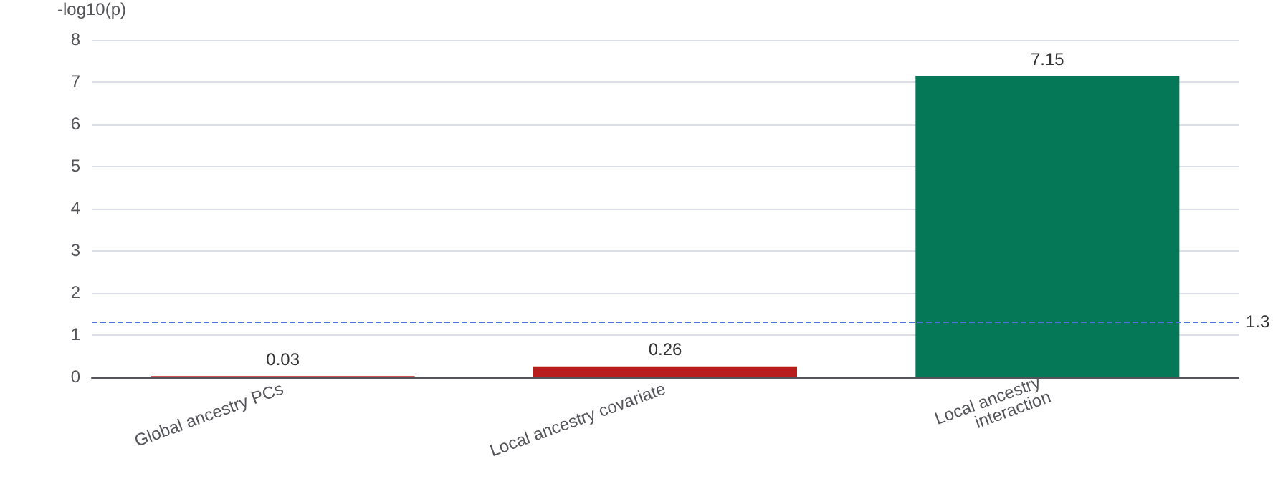
Module 3: Does each model detect the locus?
Module 3 · Reveal
Notes:
Collect the prediction before anyone touches a control, then project the room's split. The middle option is the intuitive one and it is wrong: local ancestry as a covariate does almost nothing here, because the backgrounds disagree rather than confound. The interaction model is the Tractor idea from the framing slides: stratify the genotype by local ancestry, estimate one effect per background, then combine, which is module 1's stratified analysis and module 2's meta-analysis done at a single locus. Then send them to the presets. 'Same effect, different frequency' is the one that surprises people who have just learned to reach for the interaction model: the frequencies differ three-fold, the effects agree, and the plain scan wins. Say the take-home out loud: local ancestry improves power only when the effect differs between populations; when it is similar, global ancestry is better even with different allele frequencies; there is no one right way. Watch the 'best here' line on the detection panel change hands as they move the sliders. Module 4 is the cost side of this trade-off at small sample sizes.

Slide 24
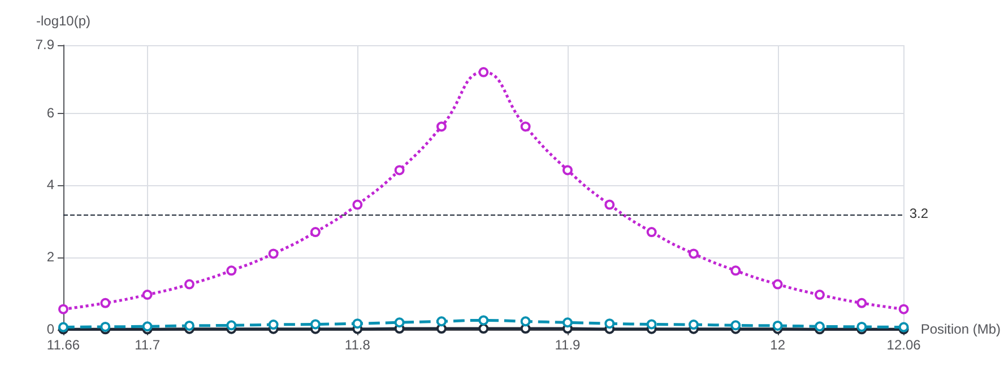
Module 3: Regional signal under each model
Module 3 · Reveal
Notes:
Local-ancestry modelling is stratify-then-combine (Tractor), the same choice as modules 1 and 2 made at one locus. It buys power only when the effect genuinely differs between ancestry backgrounds; when the effect is similar, global ancestry adjustment is the better analysis even if the allele frequency is not. There is no one right way, and a null from the wrong model is not the same as no biology.

Slide 25
Local Ancestry Inference
Global Ancestry Inference – PCA
Local Ancestry Inference – RFMix
Zhang et al., Clinical Pharmacology & Therapeutics, 2019
Notes:
In the AA population, ancestry analysis reveals significant admixture, as seen in the principal component analysis plot. This plot includes 1000 genome ancestral populations (CEU - European, YRI - African, CHB - East Asian) and NIGMS AA populations. It highlights the mixed ancestry of AA individuals, positioned along the axis between the CEU and YRI groups.
The black dots show two individuals with the similar global ancestry. The local ancestry of these two individuals (inferred via RFMix v1.5.4) at each chromosome is also shown. While these individuals have similar global ancestry, their local ancestry differs markedly at specific locations and showing mosaic pattern of 2 different ancestries in a genomic region. This difference in local ancestry adds an additional variable in genetic association analysis. So, looking at these plots we can see that local ancestry can be used as an additional predictor in gene expression prediction model, specifically designed for admixed populations like African American population.

Slide 26
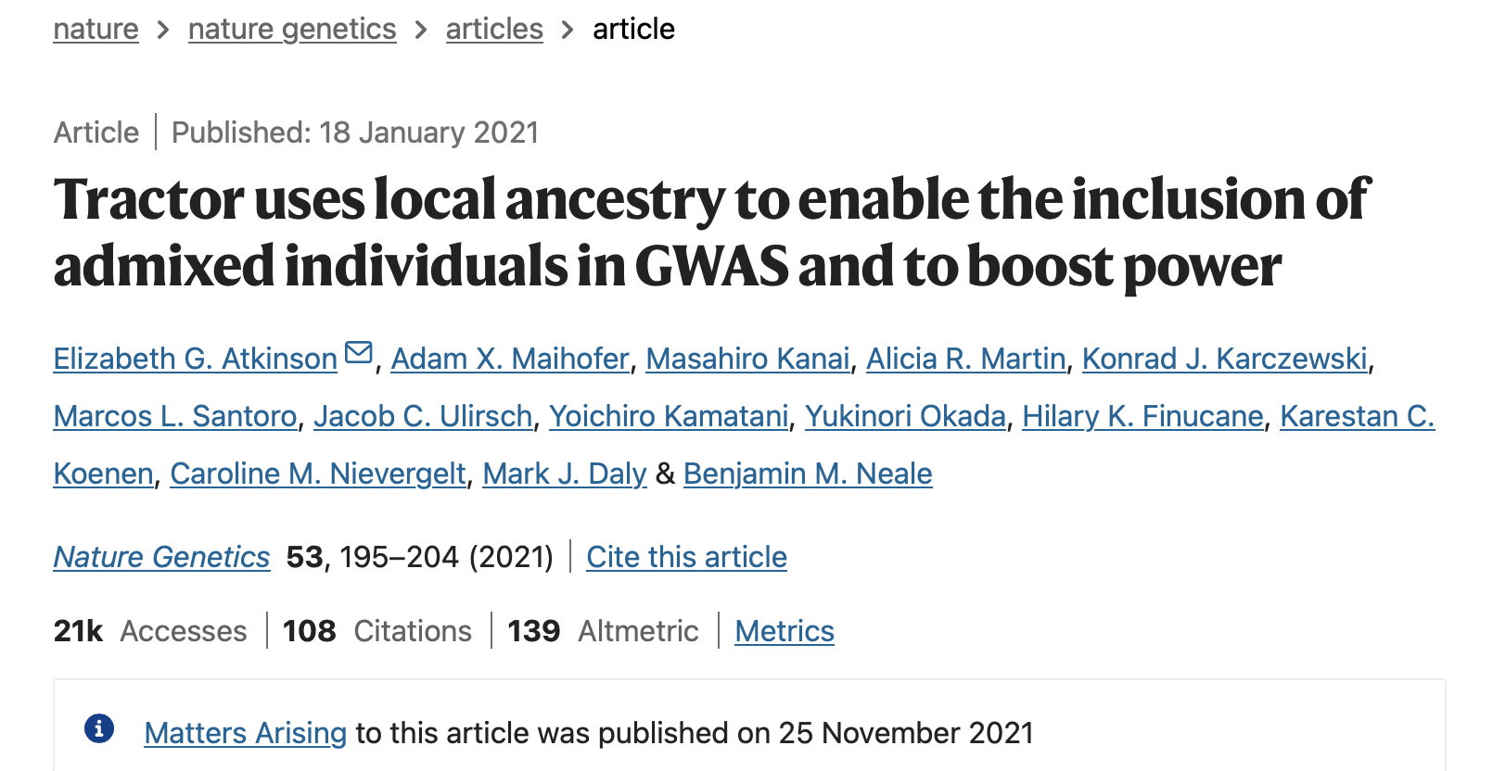

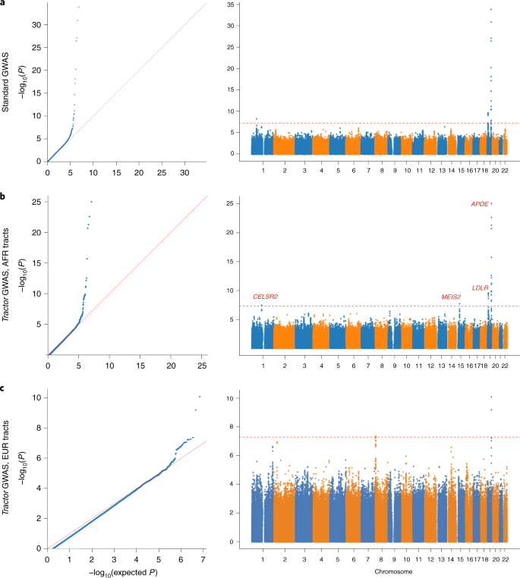
Allows for the interrogation of each ancestry segment separately.
These separate ancestry-specific GWAS can then be meta-analyzed.
Increased the power to detect novel signals that differ in allele frequencies between populations.

Slide 27
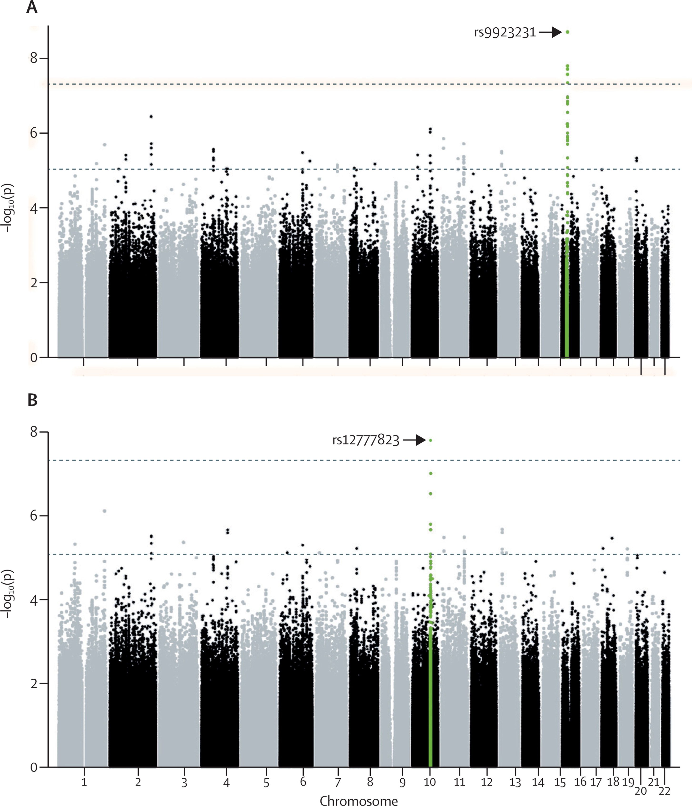
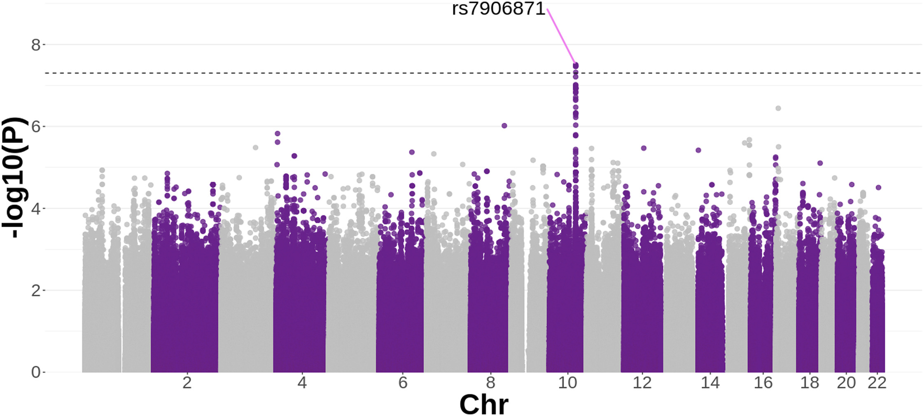
Traditional GWAS
TRACTOR GWAS
rs12777823 achieved p-values of 2.2E−6 in the African tract and 8.3E−6 in the meta-analysis. The VKORC1 variant, rs9923231, achieved p-values of 2E−3 in the African tract and 4E−3 in the meta-analysis.
Lancet. 2013 Aug31;382(9894):790-6
Am J Hum Genet. 2025 Nov 6;112(11):2708-2719

Slide 28
Local Ancestry and Model Complexity
Module 4 · Commit first
At this locus the effect is the same on every ancestry background and the allele frequencies are similar. In an admixed study of 500 people adjusted for age, sex and ten global PCs, which of global ancestry PCs alone, adding a local-ancestry covariate, and the local-ancestry interaction model detect it at p < 0.05?
A. All three
B. Global PCs and the local-ancestry covariate, but not the interaction model
C. Global ancestry PCs only
D. None of them
Notes:
The effect is the same on every ancestry background. Does modelling local ancestry help, hurt, or neither?

Slide 29
Local Ancestry and Model Complexity: the answer
Module 4 · Reveal
Answer
Global PCs and the local-ancestry covariate, but not the interaction model
Notes:
Every model estimates the same effect; only the uncertainty differs, and it differs by what each added term explains. Global PCs and the local-ancestry covariate are within a hair of each other, because the allele frequencies barely differ by background, so local ancestry explains about 0.5% of the genotype variance: nothing to correct, almost nothing to pay. The interaction model fits one slope per background and tests them jointly on three degrees of freedom, so it first detects the locus near n=900 where the single-slope models cross near n=450. The covariate switches show the other two cases: three clinical covariates take the global-PC p-value from 0.031 to 0.016 at n=500, because they explain a fifth of LDL variance; sixty technical indicators move it to 0.041, and at n=250 from 0.131 to 0.187, because they explain almost nothing and cost sixty terms.

Slide 30
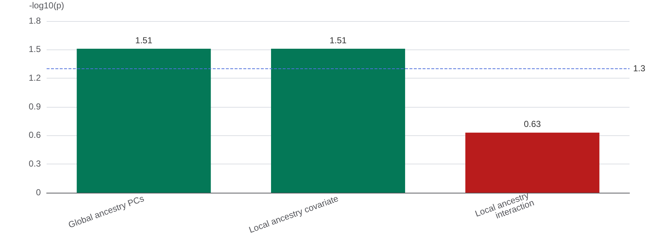
Module 4: Does each model detect the locus?
Module 4 · Reveal
Notes:
Introduce from module 3: the same three models and the same admixed composition, but a locus where the backgrounds agree and the allele frequencies are similar (APOE rs7412: 0.11 / 0.08 / 0.06). Park the slider at 500: global PCs and the covariate model are significant with near-identical intervals, the interaction model is not, and every point estimate is the same. That is the module in one screen. The near-identical first two arms are deliberate and worth saying: a local-ancestry covariate is cheap and, here, useless; the interaction model is neither. Then the two switches: clinical covariates make every model more significant (they explain LDL), sixty technical indicators make every model less significant, most at n=250. Slide to 1,200 and all three models agree, which is why the same choice is free in a biobank and decisive in a small study. Then put the two modules together: there is no one right way, and the answer depends on whether the effect differs between backgrounds and on what each covariate actually explains, which you cannot know before you look.

Slide 31
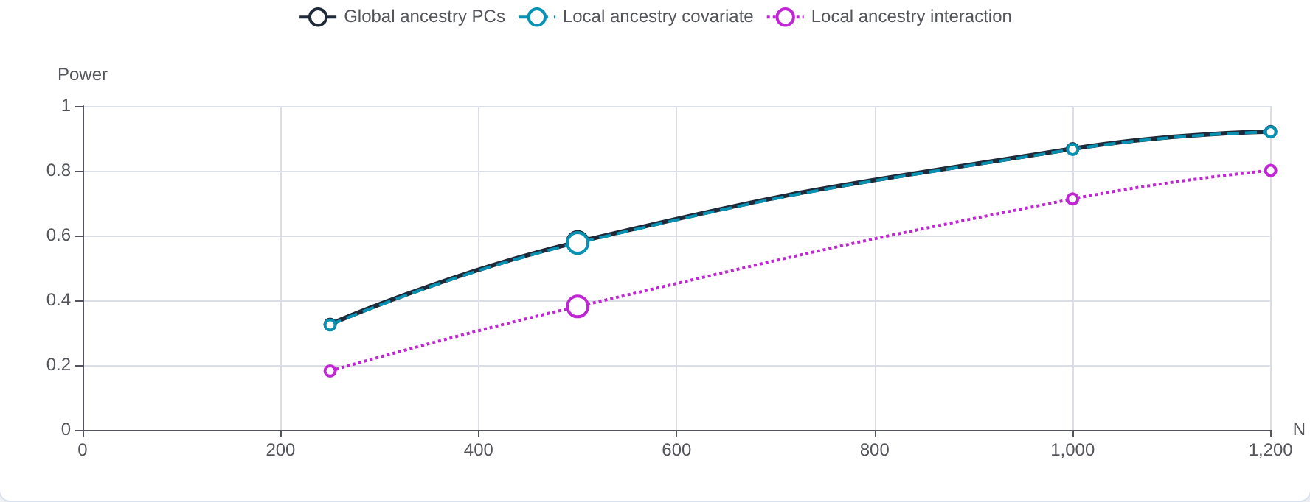
Module 4: Power by model and sample size
Module 4 · Reveal
Notes:
A term earns its place by what it explains. Clinical covariates explain the outcome and buy power; technical indicators explain little and cost k/n; local ancestry explains genotype variance, which is a cost unless the backgrounds differ; and an interaction model pays in degrees of freedom. Local ancestry can fail, not because the model is wrong but because complexity was added that the locus did not need, and every one of these prices falls hardest where the sample is smallest, which is exactly the admixed and underrepresented cohorts the method was built for. Module 3 shows when the extra parameters pay for themselves; this module shows what they cost when they do not.

Slide 32
Polygenic Scores Across Ancestries
Module 5 · Commit first
Three polygenic scores are trained on a cohort that is 59% European, 23% African and 18% Admixed American ancestry. At the starting shrinkage, which score is best calibrated in the smallest ancestry group?
A. The pooled-cohort PRS
B. The ancestry-aware PRS
C. The pooled PRS under strong shrinkage
D. They are equally calibrated
Notes:
A polygenic score trained on the pooled multi-ancestry cohort reports the higher global R². An ancestry-aware score is better calibrated in the smallest group. Which one is worse?

Slide 33
Polygenic Scores Across Ancestries: the answer
Module 5 · Reveal
Answer
The ancestry-aware PRS
Notes:
The pooled-cohort PRS is trained on everyone at once, so its weights converge to the largest group's. The ancestry-aware PRS estimates each ancestry group's weights from that group's data and pays for the extra parameters in global R². What it buys is calibration: in the smallest group it is far better calibrated than the pooled score at the same shrinkage. Raise the shrinkage and the pooled score's calibration collapses first, while the ancestry-aware score still holds when the pooled one has shrunk to nothing.

Slide 34
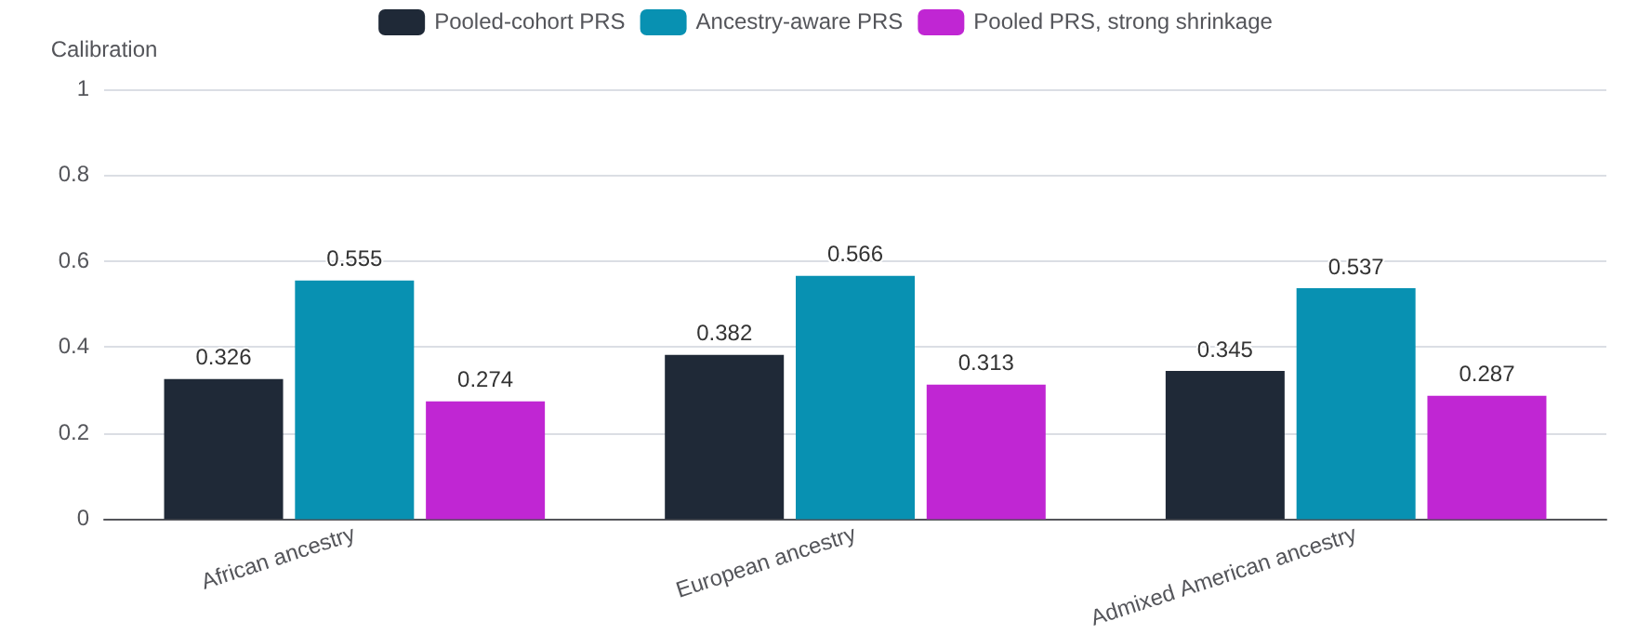
Module 5: Calibration at the starting shrinkage
Module 5 · Reveal
Notes:
This is the African-ancestry exception on the multi-ancestry PRS slide. Read the two panels against each other at the starting shrinkage: the ancestry-aware PRS looks slightly worse on global R² and is markedly better for the smallest group. Then push the shrinkage to the maximum: the pooled score's weights go to zero while the ancestry-aware score is still predicting (switch the score select to see each one's weight path; the ancestry-aware path is drawn for the Admixed American ancestry group). A score chosen on the headline metric alone is the one that fails the smallest group first. The weight blocks are a three-block stand-in for a genome-wide weight vector, not named loci; say so if asked.

Slide 35
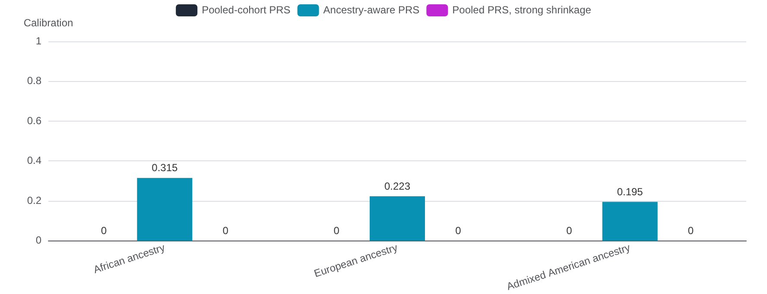
Module 5: Calibration at the strongest shrinkage
Module 5 · Reveal
Notes:
This is the multi-ancestry polygenic score result from the framing slides: the score trained on the pooled cohort wins on the headline metric for most groups and fails the group that made up a few percent of the training data. A single accuracy metric rewards fitting the largest group while under-serving smaller or heterogeneous ones, and it is built from pooled effect estimates like module 1's.

Slide 36
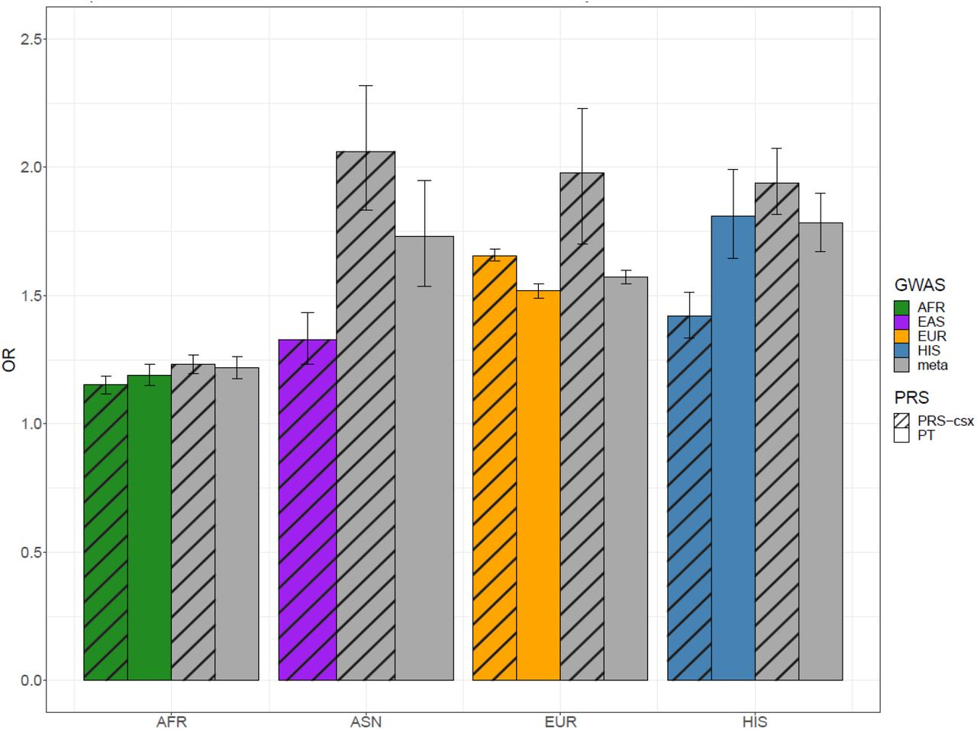
Polygenic Risk Scores: Cohorts used to inform PRS
PRS models have historically been non-transferable between populations
Several studies used a multi-ancestry GWAS to inform their PRS models to address this issue
One PRS on CHD built from a cohort of 1.1 million people found that the multi-ancestry PRS models outperformed the ancestry-specific PRS models by a large margin for all groups except for AAs
The multi-ancestry cohort used by this study was still heavily biased
  Only 31K AFR patients (~3% of cohort) and not all were AAs
Highlights the need for more studies comparing PRS models built on different cohorts for AAs.
Ancestry Group
Smith et al, MedRxiv (2024)
Notes:
Phenotype dependent: when phenotype occurs in larger frequency in one population PRS generally performs better when informed by ancestry specific GWAS, when phenotype occurs more equally among populations then multiethnic may perform better due to power gains of larger sample size, multiethnic can get rid of ancestry specific variants that could be causal – improvement in multi vs pop specific
Hispanics, while admixed generally have a large percentage of their ancestry coming from European ancestry (Avg in US: 65%) which may explain high accuracy with multiethnic model
Prior studies have shown overlap for various traits and diseases at the variant level and genome level for East asians and europeans; Also this study combined South Asians and East Asians which can lead to inaccurate results when taken together – South Asians have much higher rate of CHD than EUR or East Asians
LD blocks are smaller in Africans – may need more genetic variants to capture same level of variation as other populations
Figure legend, cannot see legend – talk abt legend (grey is multi ancestry)
We calculated OR per 1-SD increase in PRS using multivariable logistic regression across all validation cohorts.
PRS with the highest observed odds ratio (OR) for CHD per 1 standard deviation (SD) increase were deemed to have the optimal training parameter values across ancestry populations and subsequently advanced for validation.

Slide 37
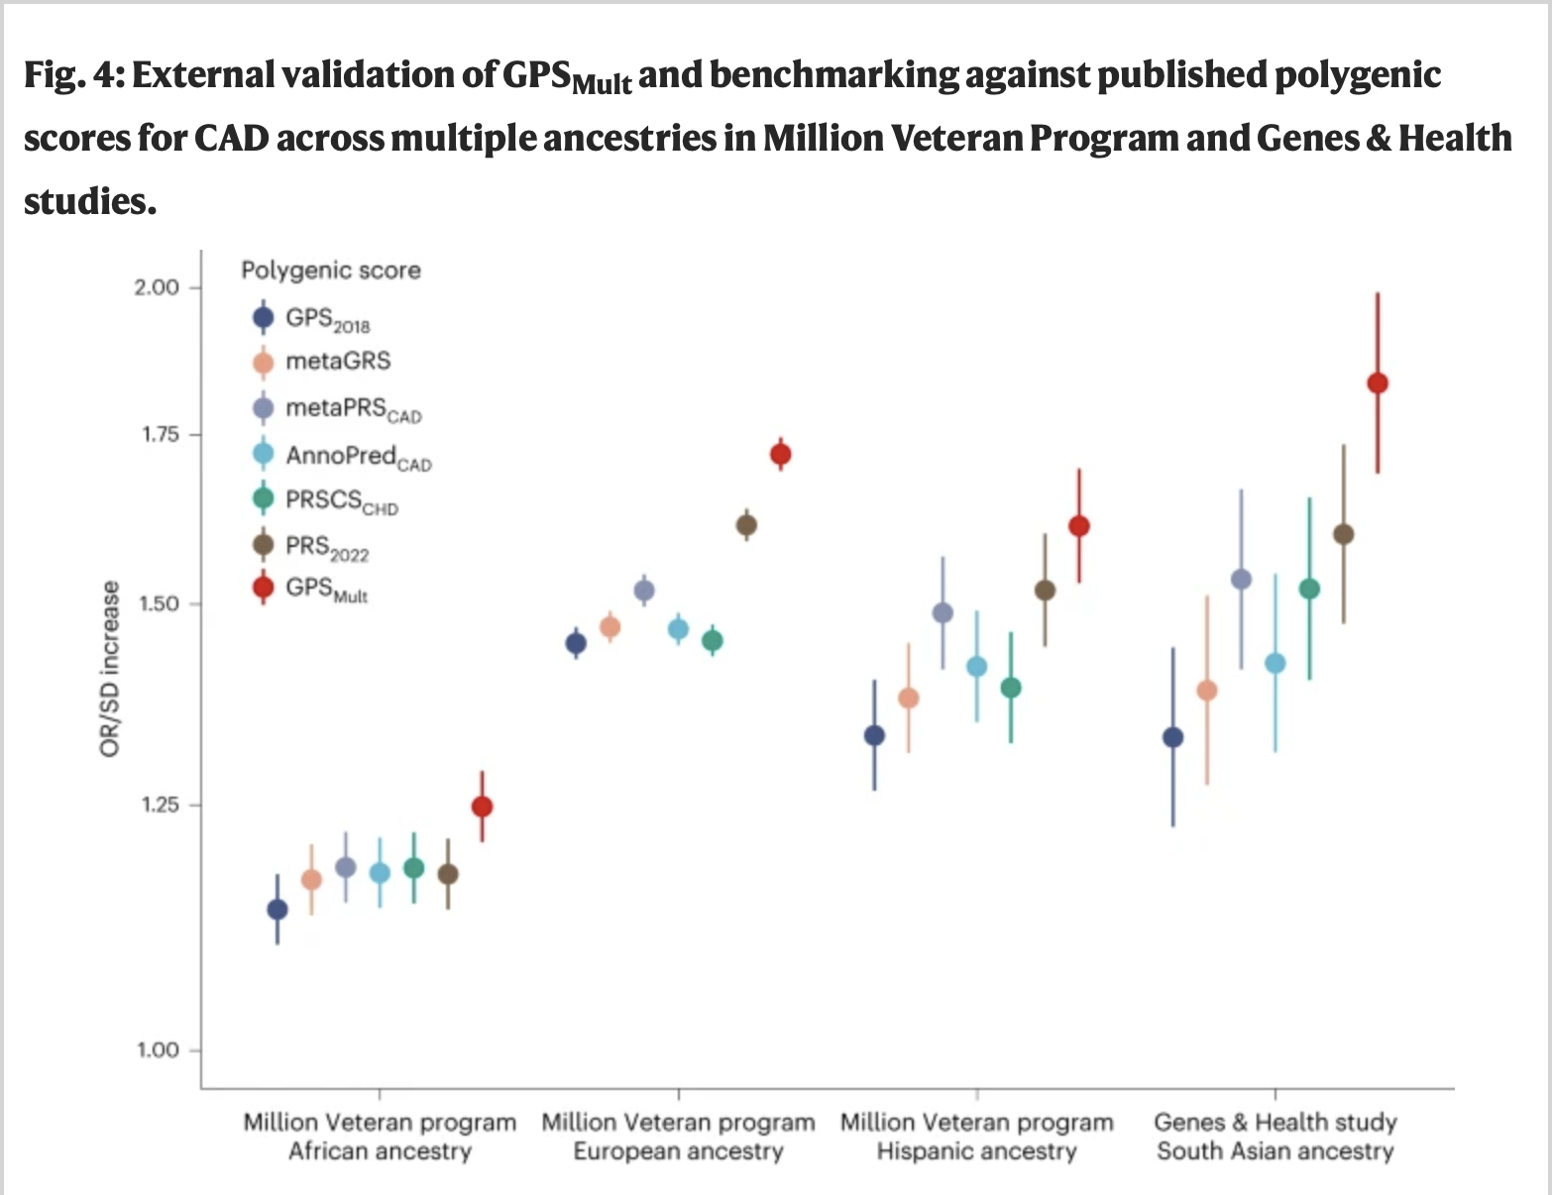
PRS was created with trait-specific GWAS across ancestries.
Score performed well across the entire cohort.
  GPS_{Mult} was also associated with incident CAD events (hazard ratio per standard deviation 1.73, 95% confidence interval 1.70–1.76, P < 0.001)
Nature Medicine volume 29, pages 1793–1803 (2023)

Slide 38
Scalable Inference and Who Can Afford It
Module 6 · Commit first
Three genome-wide scans are queued on a Bridges-2 RM node (128 cores) for 8 million variants in 250,000 people: a standard GWAS scan, a local ancestry-aware scan (4x the work), and a permutation scan (ancestry interaction with 1,000 permutations, 4,000x). Which finish within one week?
A. All three scans
B. The standard GWAS scan and the local ancestry-aware scan, but not the permutation scan
C. The standard GWAS scan only
D. None of them
Notes:
If a local ancestry-aware genome-wide scan takes four times the compute of a standard GWAS, who decides whether it gets run?

Slide 39
Scalable Inference and Who Can Afford It: the answer
Module 6 · Reveal
Answer
The standard GWAS scan and the local ancestry-aware scan, but not the permutation scan
Notes:
Switching platforms does not change any scientific conclusion. It changes which analyses are practical at all, and the ones it gates are precisely the ancestry-aware models from the earlier modules.

Slide 40
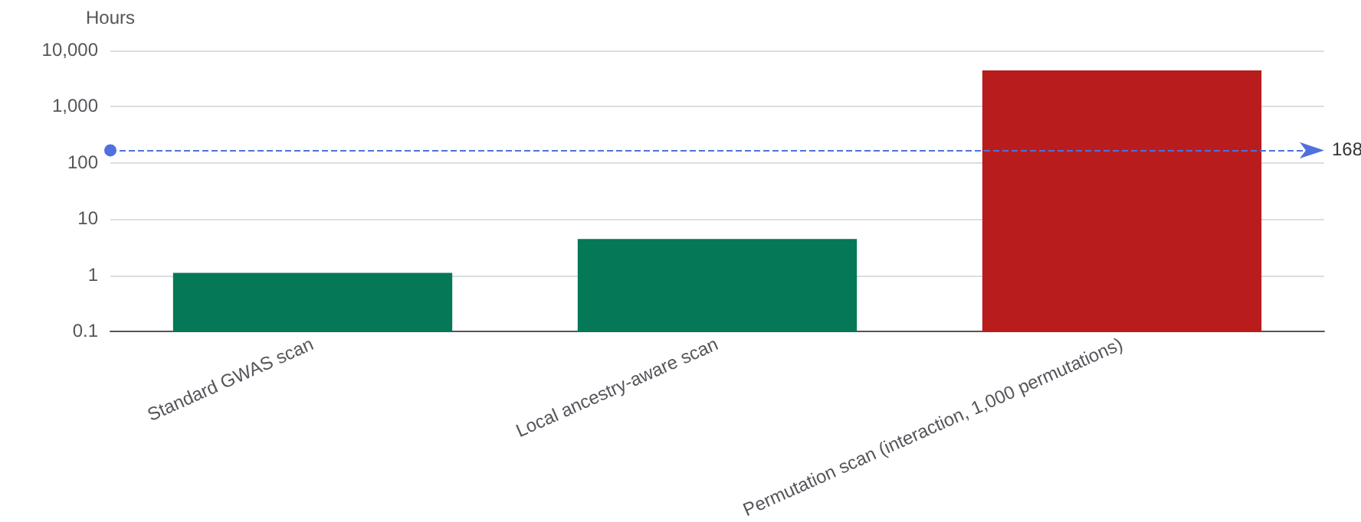
Module 6: One-week feasibility on one RM node
Module 6 · Reveal
Notes:
Connect this back to module 3: the local ancestry interaction model that detected the MTHFR locus — the Tractor-style scan from the framing slides — is the one sitting in the infeasible column on a Bridges-2 node. Switch the platform to the laptop, which is what most of the room has, and slide the variant count up: the local ancestry-aware scan drops out of the week too. Then switch to the GPU node and read the allocation panel: it is faster *and* cheaper in service units, because a GPU-hour is 2 SU and a node-hour of 128 cores is 128. Bridges-2 is free to US researchers with an ACCESS allocation; the cloud panel is what the same run costs on a credit card. 'Who can afford it' is therefore mostly 'who has an allocation and the expertise to use it', which is the argument for accelerated frameworks and for training, made concrete.

Slide 41
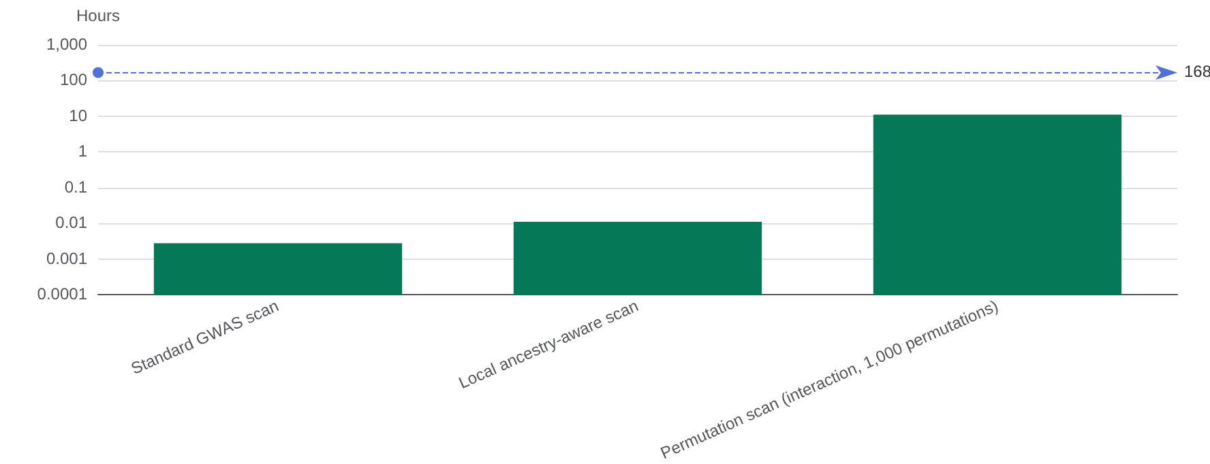
Module 6: One-week feasibility on one GPU node
Module 6 · Reveal
Notes:
When the equity-improving analysis is also the expensive one, compute access silently determines whose biology gets discovered.

Slide 42
Same code on CPU or GPU
Module 6 · Resources
PyTorch one code path, CPU or GPU
JAX compiled for CPU, GPU or TPU
CuPy · cuDF NumPy and pandas on the GPU
Numba Python loops on threads or CUDA
Dask a laptop's cores to a cluster
Notes:
The point for module 6: the permutation scan is infeasible on one node because of hardware, not because the method is exotic. A genome-wide scan repeats the same regression at millions of variants, which is exactly the work these libraries spread across cores and GPUs without changing the statistics.
PyTorch: tensors and models move between CPU and GPU with .to(device); multi-threaded on CPU. JAX: NumPy-style code compiled through XLA; vmap turns a one-variant test into an all-variants test. CuPy is a NumPy-compatible GPU array library; RAPIDS cuDF is the pandas equivalent, and cudf.pandas runs existing pandas code on the GPU. Numba: @njit(parallel=True) across CPU threads, @cuda.jit for NVIDIA GPUs. Dask: the same array and dataframe code from one machine to a cluster, including SLURM through dask-jobqueue.
https://pytorch.org · https://docs.jax.dev · https://cupy.dev · https://rapids.ai · https://numba.pydata.org · https://www.dask.org · https://jobqueue.dask.org

Slide 43
Genetics tools that already scale
Module 6 · Resources
PLINK 2 association and QC, multi-threaded
REGENIE whole-genome regression, multi-threaded
Hail Spark clusters; gnomAD, All of Us
tensorQTL QTL mapping on GPU (PyTorch)
Parabricks GPU alignment and variant calling
NSF ACCESS research HPC at no cost (Bridges-2)
Notes:
PLINK 2: association testing, QC and scoring on biobank-scale genotypes; multi-threaded (Chang et al., GigaScience 2015). REGENIE: whole-genome regression for quantitative and binary traits; --threads defaults to all cores but one (Mbatchou et al., Nature Genetics 53:1097-1103, 2021). Hail: genomic dataframes on Apache Spark, from a laptop to a cluster; its README names it the analysis engine for gnomAD, and the All of Us Researcher Workbench documents Hail on Dataproc clusters. tensorQTL: cis- and trans-QTL mapping built on PyTorch; the README reports ~200-300x faster than CPU-based implementations, and it also runs on CPU (Taylor-Weiner, Aguet et al., Genome Biology 2019). NVIDIA Parabricks: GPU versions of BWA-MEM alignment, DeepVariant and other callers; free public container, paid enterprise support optional. NSF ACCESS: allocations for research and education, including Bridges-2 at PSC, the platform module 6 prices; cloud providers also run research credit programs.

Slide 44
What the data said: modules 1–3
Synthesis · What the room predicted, what the data said
Module | The answer
1 · Pooled vs Stratified Analysis | It grows toward the strong European-ancestry effect
2 · Within-Ancestry Testing vs Meta-Analysis | It stays narrow and significant
3 · Global vs Local Ancestry Modeling | Local ancestry interaction
Notes:
Module 1: Raise the European-ancestry share of the pooled sample from 35% to 95%. What happens to the pooled effect estimate?
Module 2: Four ancestry groups are meta-analysed. Push heterogeneity to 100%, where the East Asian effect is about 3 times the others'. What happens to the fixed-effect summary?
Module 3: The tag SNP has opposite effects on African- and European-ancestry haplotypes (+0.12 and -0.08) in a 15,000-person admixed study. Which is the simplest analysis that detects it at p < 0.05?

Slide 45
What the data said: modules 4–6
Synthesis · What the room predicted, what the data said
Module | The answer
4 · Local Ancestry and Model Complexity | Global PCs and the local-ancestry covariate, but not the interaction model
5 · Polygenic Scores Across Ancestries | The ancestry-aware PRS
6 · Scalable Inference and Who Can Afford It | The standard GWAS scan and the local ancestry-aware scan, but not the permutation scan
Notes:
Module 4: At this locus the effect is the same on every ancestry background and the allele frequencies are similar. In an admixed study of 500 people adjusted for age, sex and ten global PCs, which of global ancestry PCs alone, adding a local-ancestry covariate, and the local-ancestry interaction model detect it at p < 0.05?
Module 5: Three polygenic scores are trained on a cohort that is 59% European, 23% African and 18% Admixed American ancestry. At the starting shrinkage, which score is best calibrated in the smallest ancestry group?
Module 6: Three genome-wide scans are queued on a Bridges-2 RM node (128 cores) for 8 million variants in 250,000 people: a standard GWAS scan, a local ancestry-aware scan (4x the work), and a permutation scan (ancestry interaction with 1,000 permutations, 4,000x). Which finish within one week?

Slide 46



Thank you!
Workshop organizers
Kynon J. Benjamin, PhD
Assistant Professor
HEART-GeN Lab
Minoli Perera, PharmD, PhD
Associate Professor
Perera Lab
Northwestern University Feinberg School of Medicine
Funding: NIH NIMHD R00MD016964 (KJMB)

