Slide 1
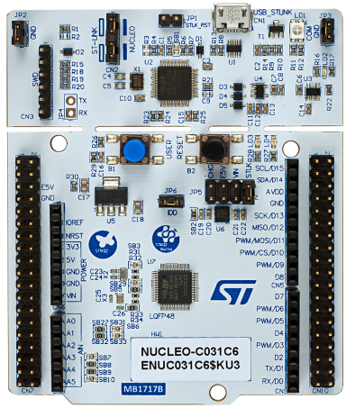
NUCLEO-F103RB
Ver.2024년

Slide 2
Features
• Common features – STM32 microcontroller in LQFP64 or LQFP48 package – 1 user LED shared with ARDUINO® – 1 user and 1 reset push-buttons – 32.768 kHz crystal oscillator – Board connectors: ◦ ARDUINO® Uno V3 expansion connector ◦ ST morpho extension pin headers for full access to all STM32 I/Os – Flexible power-supply options: ST-LINK USB VBUS or external sources – On-board ST-LINK debugger/programmer with USB re-enumeration capability: mass storage, Virtual COM port, and debug port – Comprehensive free software libraries and examples available with the STM32Cube MCU Package – Support of a wide choice of Integrated Development Environments (IDEs) including IAR Embedded Workbench®, MDK-ARM, and STM32CubeIDE
• Board-specific features – External SMPS to generate Vcore logic supply – 24 MHz or 48 MHz HSE – Board connectors: ◦ External SMPS experimentation dedicated connector ◦ Micro-B or Mini-B USB connector for the ST-LINK ◦ MIPI® debug connector

Slide 3
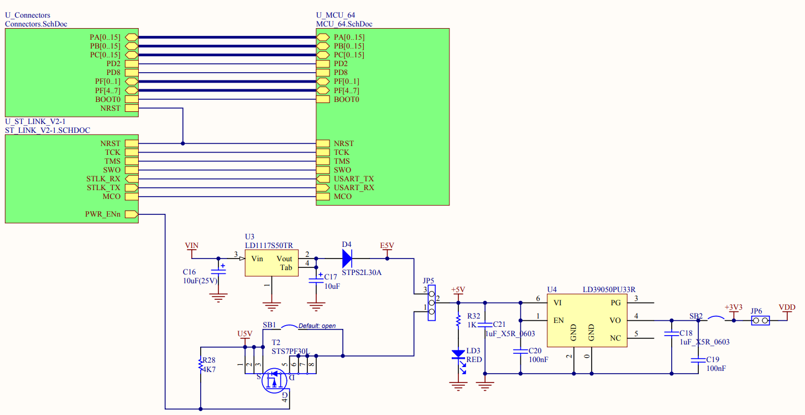
Schematic . Power

Slide 4
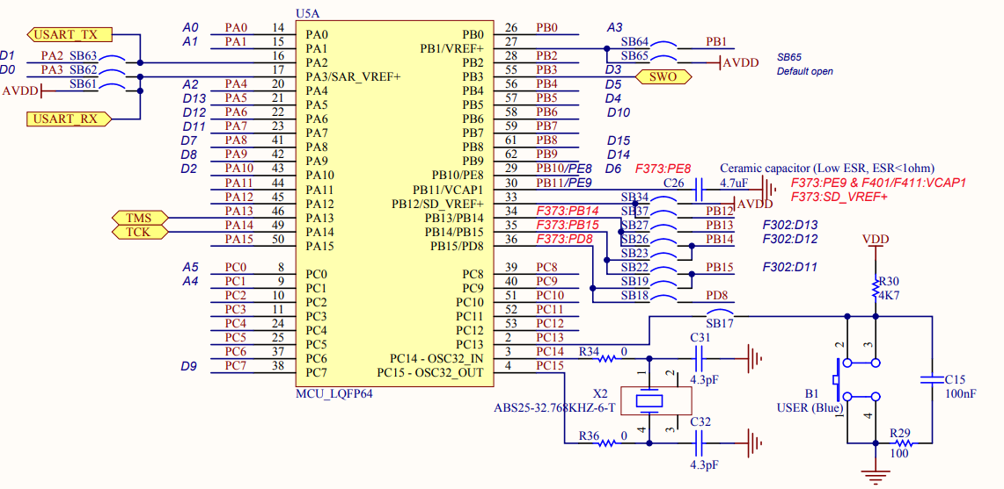
Schematic. MCU Part - 1

Slide 5
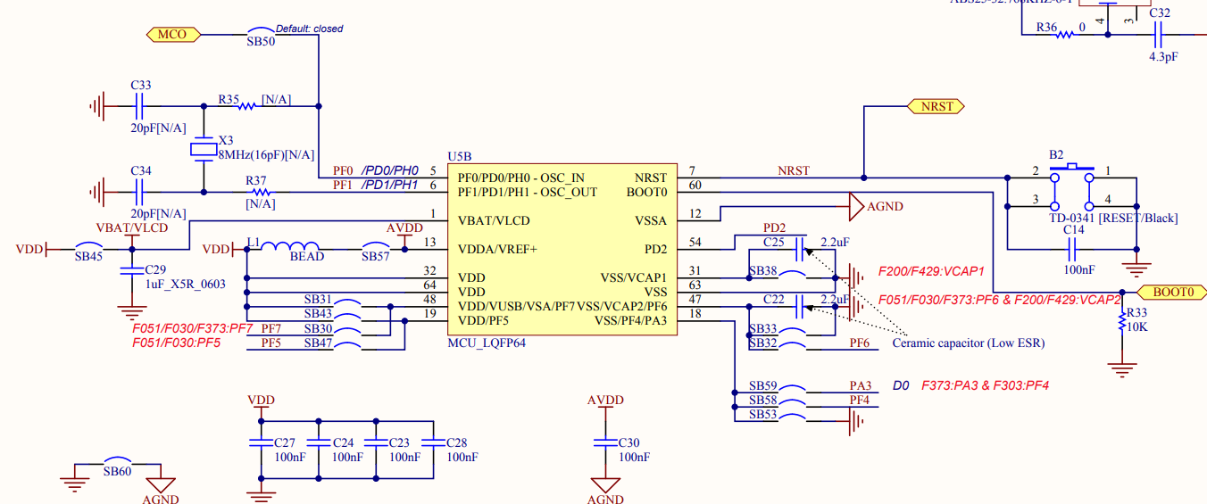
Schematic. MCU Part -2

Slide 6
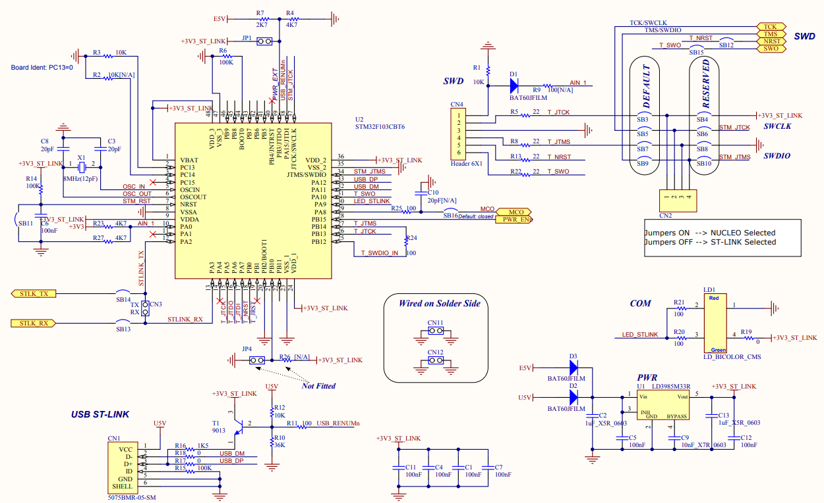
Schematic.STLINK/V2-1

Slide 7
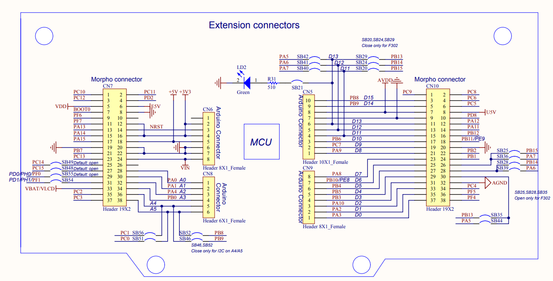
Schematic. Extension connectors

Slide 8
Project 생성
GPIO 제어

Slide 9
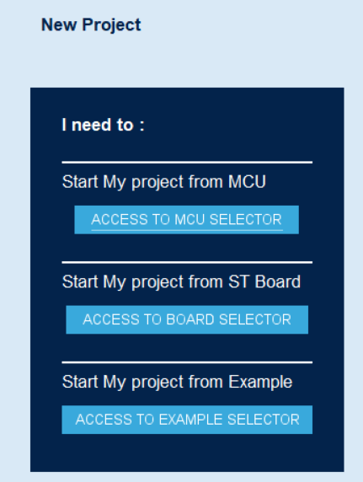
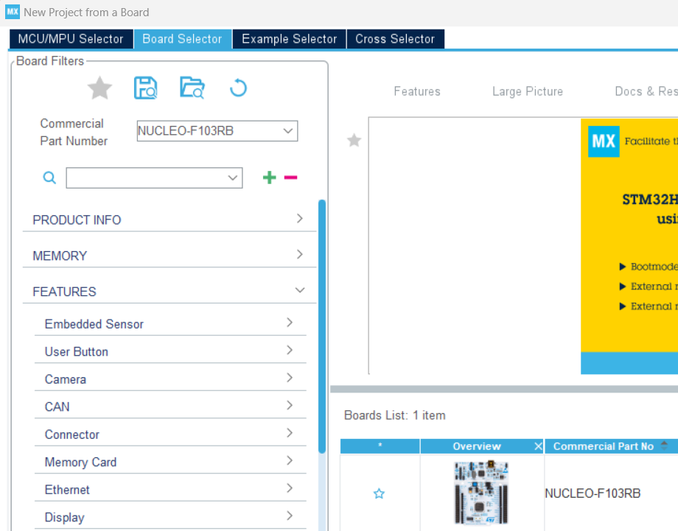
CubeMx 설정 - 1
NUCLEO-F103RB

Slide 10
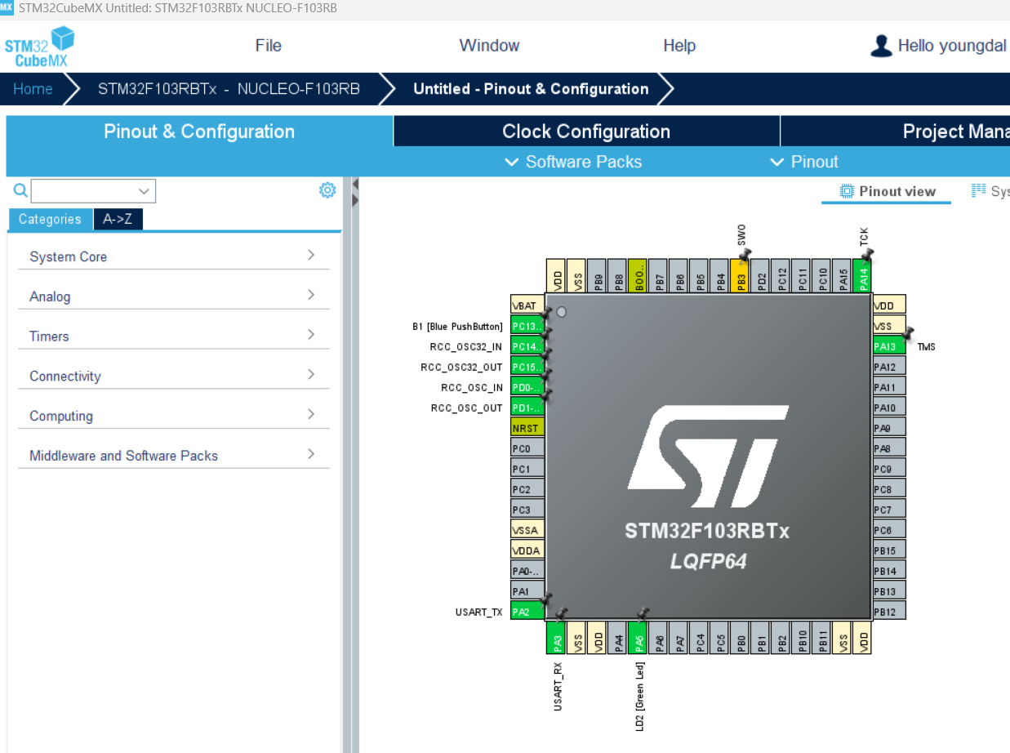
CubeMx 설정 - 2

Slide 11
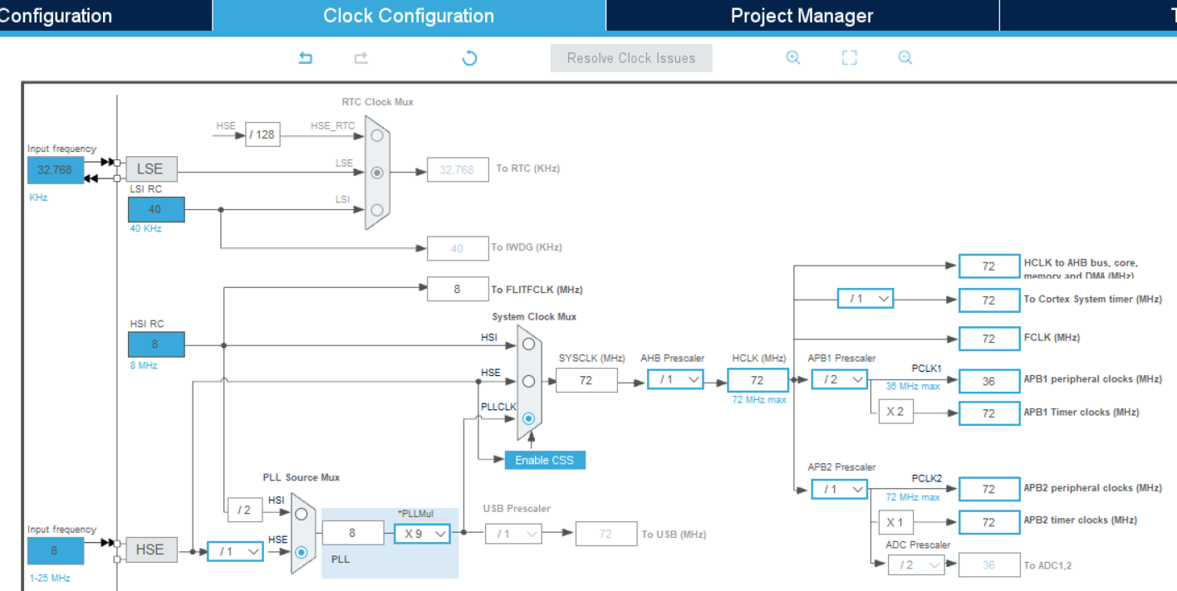
CubeMx 설정 – 3. Clock Configuration

Slide 12
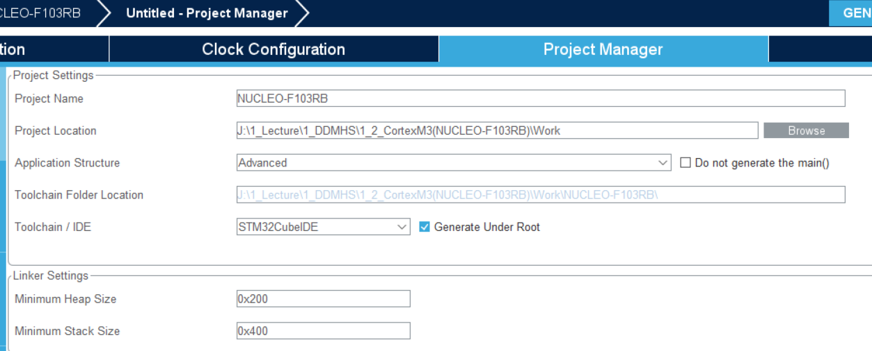
CubeMx 설정 – 4.Project Manager

Slide 13
CubeIDE . Button을 누르면 LED가 켜지는 Code
/* Infinite loop */
/* USER CODE BEGIN WHILE */
while (1)
{
if(!(HAL_GPIO_ReadPin(GPIOC, GPIO_PIN_13))){
HAL_GPIO_WritePin(GPIOA, GPIO_PIN_5, GPIO_PIN_SET);
}
else HAL_GPIO_WritePin(GPIOA, GPIO_PIN_5, GPIO_PIN_RESET);
/* USER CODE END WHILE */
/* USER CODE BEGIN 3 */
}
/* USER CODE END 3 */
}

Slide 14
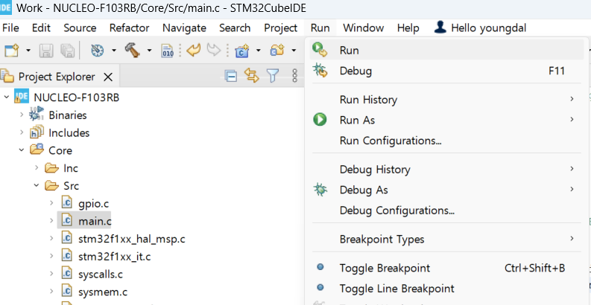
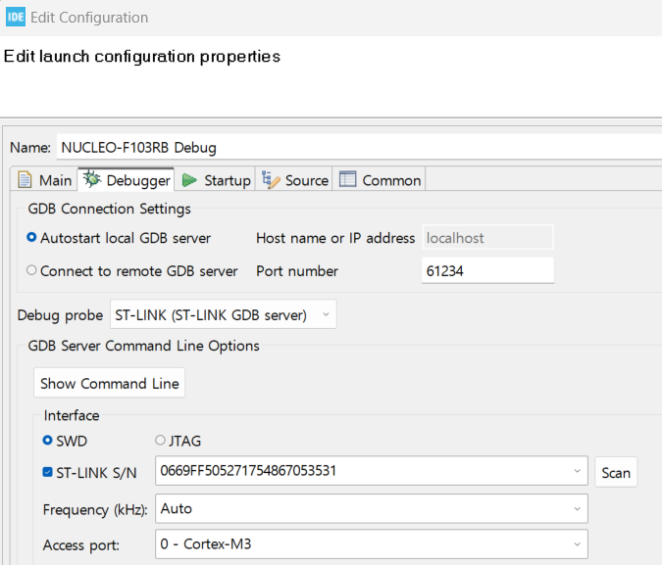
CubeIDE . ST-Link 설정
설정한 후, Run 클릭하면
Build 및 Download 까지 진행

Slide 15
printf

Slide 16
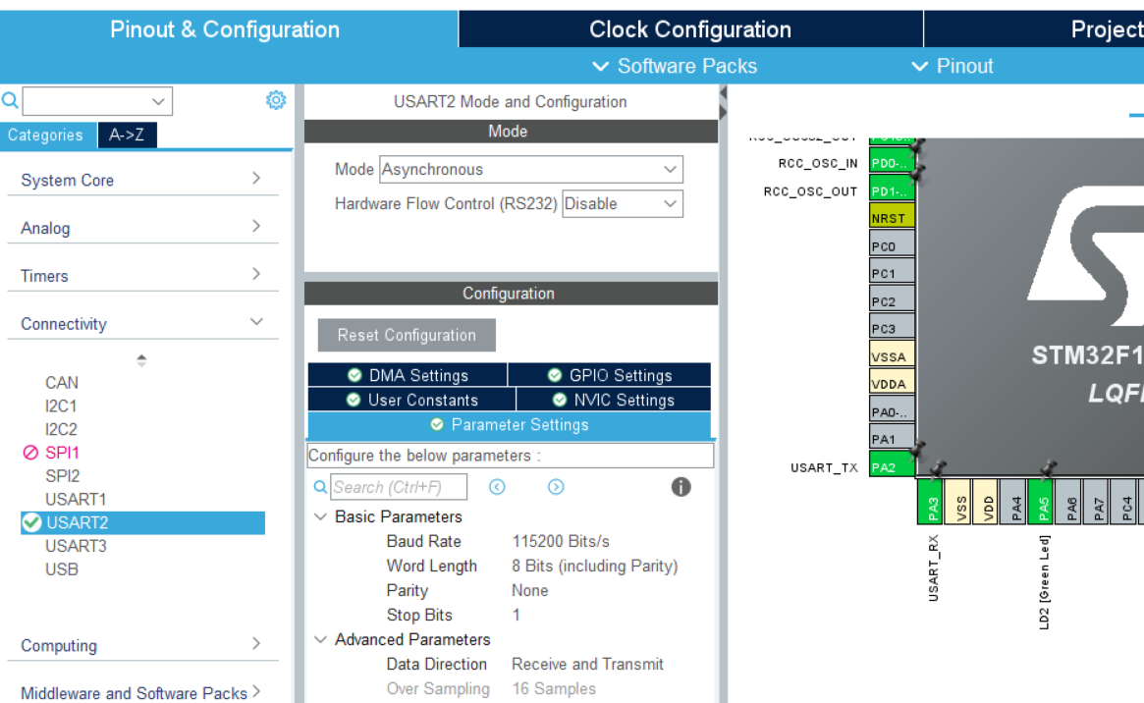
CubeMx. USART2가 이미 설정되어 있음

Slide 17
CubeIDE. code 추가
#include <stdio.h> // 추가
// main 함수 바로 위에 아래 함수들 추가
int _write(int file, unsigned char* p, int len)
{
HAL_UART_Transmit(&huart2, p, len, 10);
return len;
}
#ifdef __GNUC__
#define PUTCHAR_PROTOTYPE int __io_putchar(int ch)
#else
#define PUTCHAR_PROTOTYPE int fputc(int ch, FILE *f) //for printf
#endif
PUTCHAR_PROTOTYPE
{
HAL_UART_Transmit(&huart2, (uint8_t *)&ch, 1, 0xFFFF);
return ch;
}
// main 함수 안에 한 줄 추가
MX_GPIO_Init();
MX_USART2_UART_Init();
/* USER CODE BEGIN 2 */
setvbuf(stdout, NULL, _IONBF, 0);

Slide 18
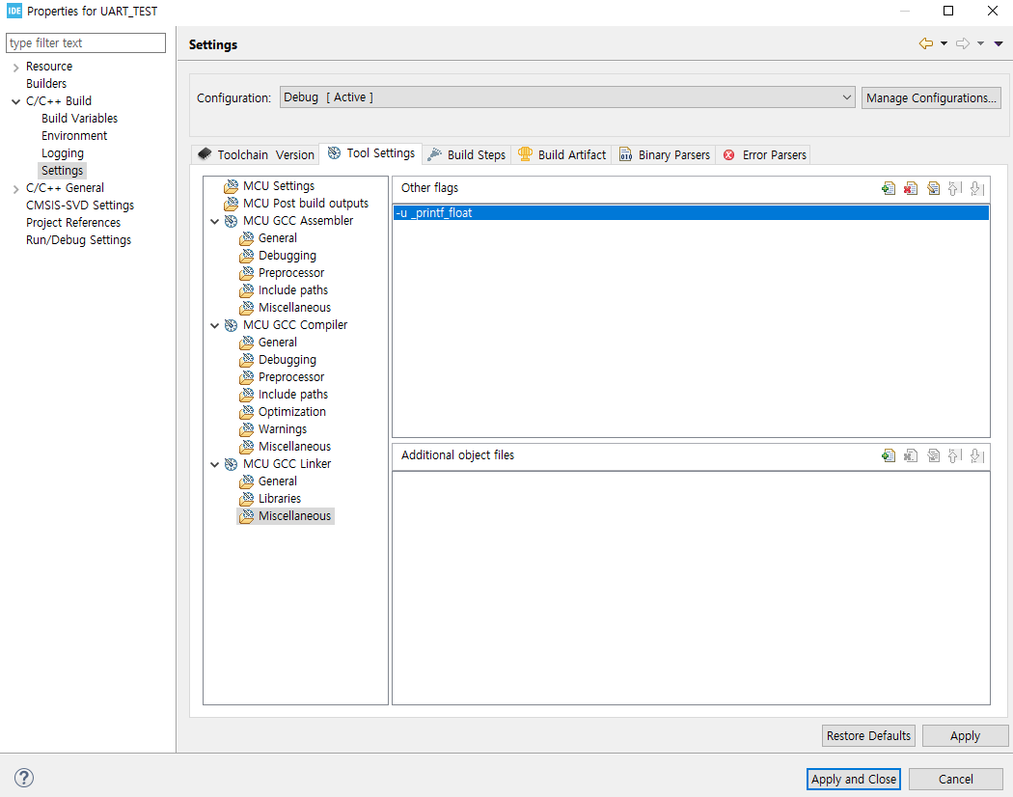
CubeIDE. code 추가 → float 출력
Float 출력 설정 : Project > Properties > C/C++ Build > Setting > MCU GCC linker > Miscellaneous
-u _printf_float

Slide 19
Keep adding.

