Slide 1
C# MDI
(Multiple Document Interface)
https://github.com/heartcom/Csharp

Slide 2
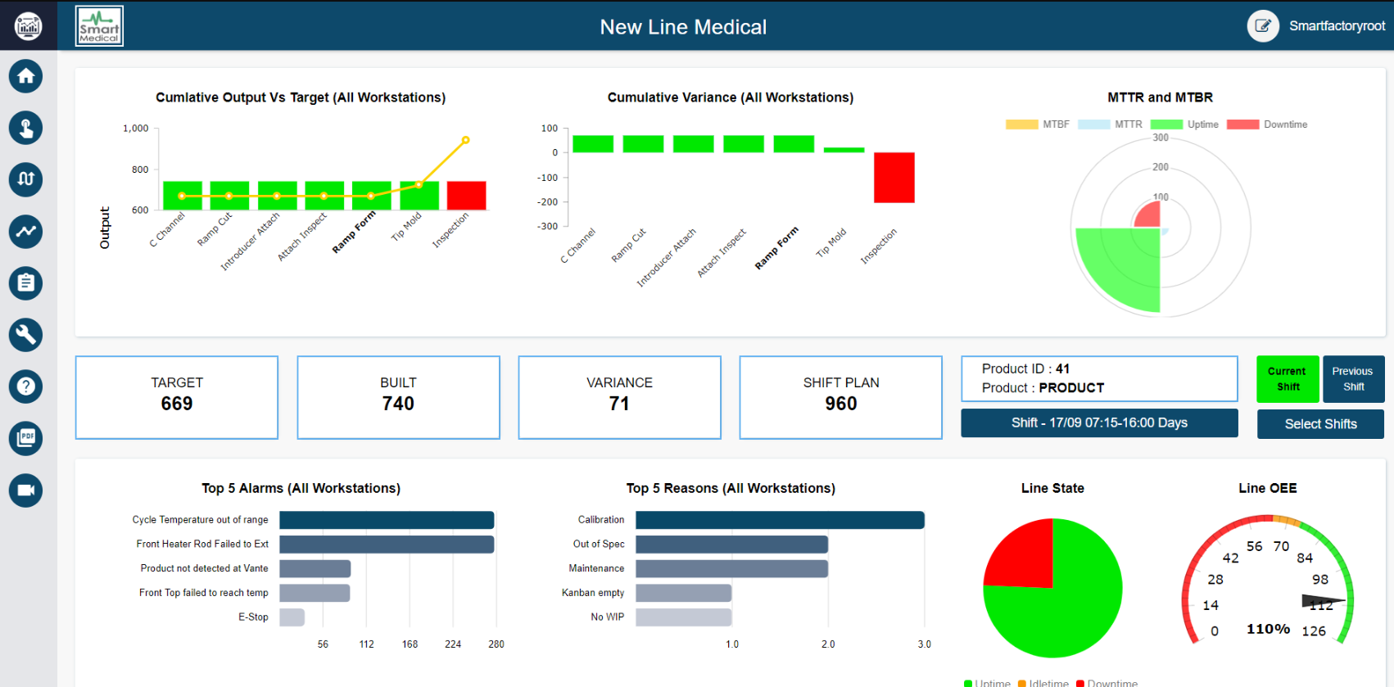
MDI Program . example → https://smartfactory.ie/wp-content/uploads/2018/10/Dashboard.png

Slide 3
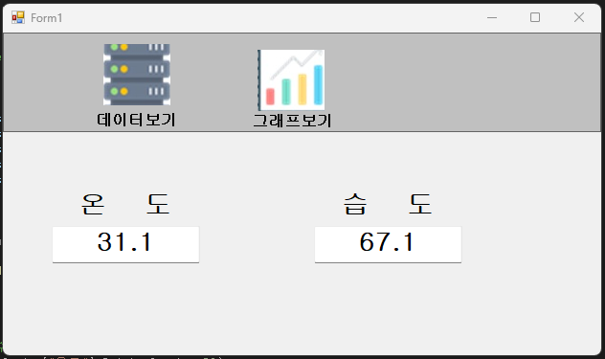
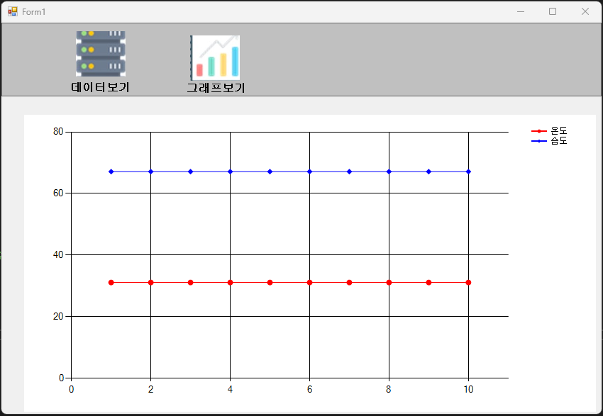
MDI Program . 개요

Slide 4
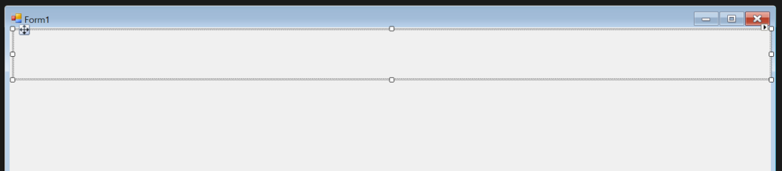
MDI Program . Design → 메뉴 바를 만들기 위해 ‘Panel’ 컨트롤 배치
Form 위쪽에 ‘Panel’ 올리기
속성 BoarderStyle : FixedSingle
Dock : Top
Dock를 Top으로 하면 윈도우 크기와 상관없이 Top 부분에 Panel이 꽉 차게 보임

Slide 5
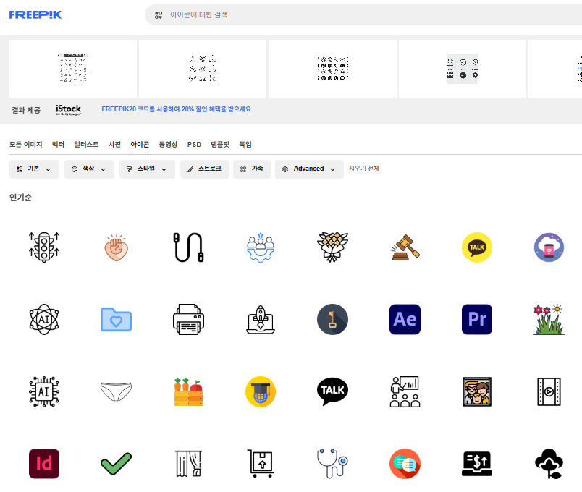
MDI Program . Design → 메뉴바에 사용할 ICON Download
법적으로 사용해도 문제가 없는 무료 icon download
2개 정도 다운로드
아이콘 | Freepik

Slide 6
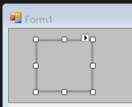
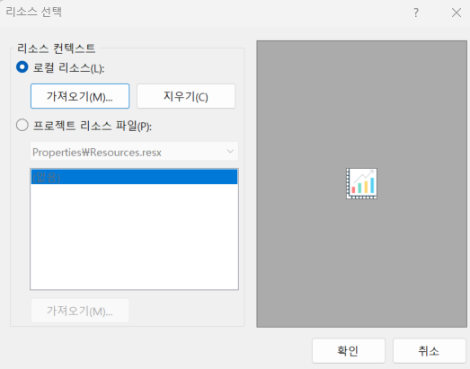
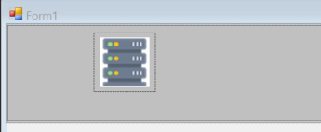
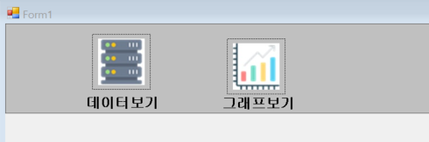
MDI Program . Design → 메뉴바에 ICON 2개 배치하기
Panel 위에 아이콘 배치하기 1) PictureBox 올리기
2) PictureBox 속성에서 Image 클릭
삽입할 아이콘
이미지 선택
Name
pictureBox1, pictureBox2

Slide 7
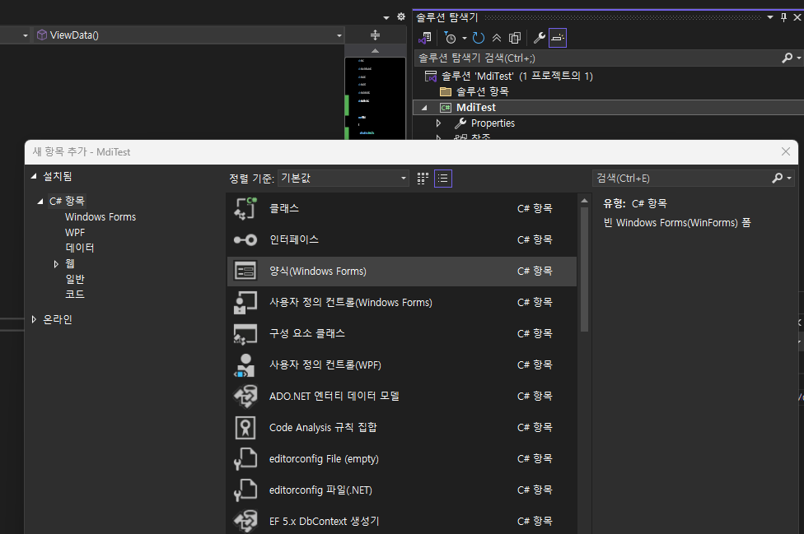
MDI Program . ChildForm 2개 만들기
솔루션 탐색기 → 마우스 우클릭 →
추가 → 새파일 → 양식(Windows Forms)
속성에서 name → ViewData, ViewGraph

Slide 8
MDI Program . Coding → Form1.cs
namespace MdiTest
{
public partial class Form1 : Form
{
public Form1()
{
InitializeComponent();
// PictureBox 클릭 이벤트 연결
pictureBox1.Click += (s, e) => LoadChildForm(new ViewData());
pictureBox2.Click += (s, e) => LoadChildForm(new ViewGraph());
}
private void LoadChildForm(Form childForm)
{
// 기존 컨트롤 제거
mainPanel.Controls.Clear();
// ChildForm 설정
childForm.TopLevel = false;
childForm.FormBorderStyle = FormBorderStyle.None;
childForm.Dock = DockStyle.Fill;
// Panel에 추가
mainPanel.Controls.Add(childForm);
childForm.Show();
}
}
}

Slide 9
MDI Program . Coding → ViewData.cs
namespace MdiTest
{
public partial class ViewData : Form
{
public ViewData()
{
InitializeComponent();
Label lbl = new Label
{
Text = "ChildForm1 내용입니다",
Dock = DockStyle.Fill,
TextAlign = ContentAlignment.MiddleCenter
};
this.Controls.Add(lbl);
}
}
}

Slide 10
MDI Program . Coding → ViewGraph.cs
namespace MdiTest
{
public partial class ViewGraph : Form
{
public ViewGraph()
{
InitializeComponent();
Label lbl = new Label
{
Text = "ChildForm2 내용입니다",
Dock = DockStyle.Fill,
TextAlign = ContentAlignment.MiddleCenter
};
this.Controls.Add(lbl);
}
}
}

Slide 11
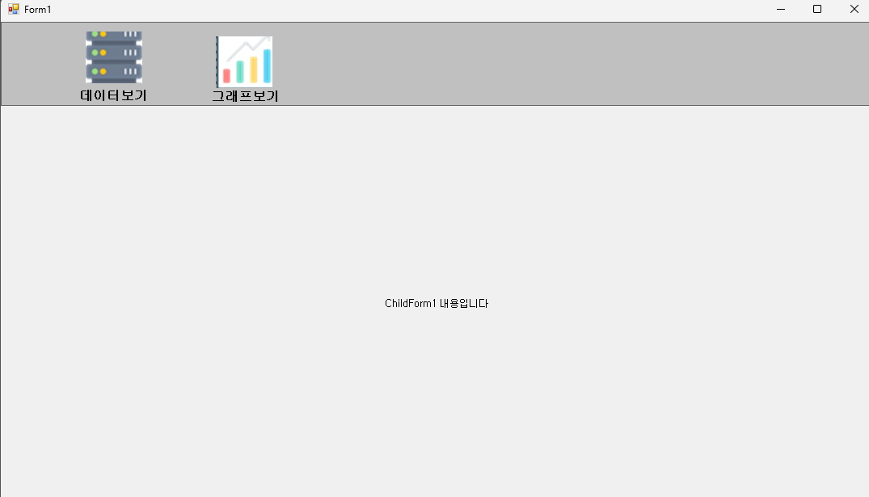
MDI Program . 실행

Slide 12
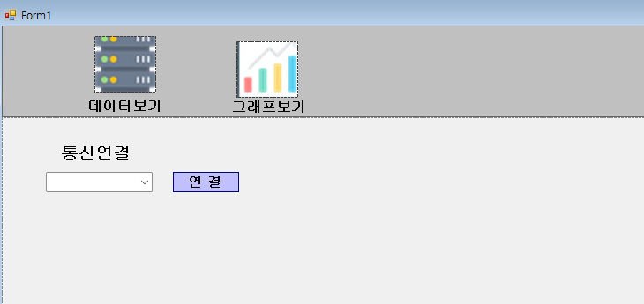
MDI Program . GUI → Form1
Serial 통신을 위한 콤보박스, 버튼 추가
comboBox1, btnConnect

Slide 13
MDI Program . Form1 code → LoadSerialPorts() 추가
public partial class Form1 : Form
{
private ViewData viewDataForm;
private ViewGraph viewGraphForm;
private SerialPort serialPort;
public Form1()
{
InitializeComponent();
// PictureBox 클릭 이벤트 연결
pictureBox1.Click += (s, e) => LoadChildForm(new ViewData());
pictureBox2.Click += (s, e) => LoadChildForm(new ViewGraph());
LoadSerialPorts();
}
private void LoadSerialPorts()
{
string[] ports = SerialPort.GetPortNames();
Array.Sort(ports);
comboBox1.Items.Clear();
comboBox1.Items.AddRange(ports);
if (comboBox1.Items.Count > 0)
{
comboBox1.SelectedIndex = 0;
}
else
{
comboBox1.Text = "None";
}
}

Slide 14
MDI Program . Form1 code
comboBox1 더블 클릭
private void comboBox1_SelectedIndexChanged(object sender, EventArgs e)
{
String selectedPort = comboBox1.SelectedItem.ToString();
}

Slide 15
MDI Program . Form1 code → btnConnect 더블 클릭
private SerialPort serialPort; // class 번역 변수 선언
private void btnConnect_Click(object sender, EventArgs e)
{
if (comboBox1.SelectedItem != null)
{
string selectedPort = comboBox1.SelectedItem.ToString();
if (string.IsNullOrEmpty(selectedPort) || selectedPort == "None")
{
MessageBox.Show("Please select a valid Port.");
return;
}
try
{
serialPort = new SerialPort(selectedPort)
{
BaudRate = 115200,
DataBits = 8,
Parity = Parity.None,
StopBits = StopBits.One,
};
serialPort.DataReceived += SerialPort_DataReceived; //Event Handler
serialPort.Open();
MessageBox.Show("Serial Port Connected");
btnConnect.Enabled = false;
}
catch (Exception ex)
{
MessageBox.Show($"Fail to Connect : {ex.Message}");
}
}
else
{
MessageBox.Show("Please select a valid Port.");
}
}
수신 데이터 처리를 위한 Event Handler 함수인 SerialPort_DataReceived() 만들어야 함

Slide 16
MDI Program . Form1 code → SerialPort_DataReceived()
private void SerialPort_DataReceived(object sender, SerialDataReceivedEventArgs e)
{
try
{
string line = serialPort.ReadLine().Trim(); // 예: "23.5,45.2"
string[] parts = line.Split(',');
if (parts.Length == 2 &&
float.TryParse(parts[0], out float temp) &&
float.TryParse(parts[1], out float humi))
{
this.Invoke((MethodInvoker)delegate
{
viewDataForm?.UpdateValues(temp, humi); //ViewData.cs 로 온도, 습도 데이터 전달
viewGraphForm?.AddDataPoint(temp, humi); // ViewGraph.cs로 온도, 습도 데이터 전달
});
}
}
catch (Exception ex)
{
// 에러 무시하거나 로깅
}
}

Slide 17
MDI Program . Form1 code → LoadSerialPorts() 함수 추가
public Form1()
{
InitializeComponent();
// PictureBox 클릭 이벤트 연결
pictureBox1.Click += (s, e) => LoadChildForm(new ViewData());
pictureBox2.Click += (s, e) => LoadChildForm(new ViewGraph());
LoadSerialPorts();
}
private void LoadSerialPorts()
{
string[] ports = SerialPort.GetPortNames();
Array.Sort(ports);
comboBox1.Items.Clear();
comboBox1.Items.AddRange(ports);
if (comboBox1.Items.Count > 0)
{
comboBox1.SelectedIndex = 0;
}
else
{
comboBox1.Text = "None";
}
}

Slide 18
MDI Program . Form1 code → LoadChildForm() 메서드 수정
private void LoadChildForm(Form childForm)
{
// 기존 컨트롤 제거
mainPanel.Controls.Clear();
// ChildForm 설정
childForm.TopLevel = false;
childForm.FormBorderStyle = FormBorderStyle.None;
childForm.Dock = DockStyle.Fill;
// Panel에 추가
mainPanel.Controls.Add(childForm);
childForm.Show();
// 타입에 따라 인스턴스를 저장
if (childForm is ViewData vd)
viewDataForm = vd;
else if (childForm is ViewGraph vg)
viewGraphForm = vg;
}

Slide 19
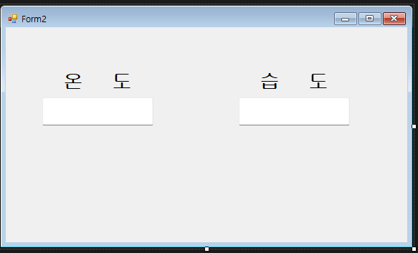
MDI Program . ViewData → GUI
txtTemp txtHumi

Slide 20
MDI Program . ViewData → Code
namespace MdiTest
{
public partial class ViewData : Form
{
public ViewData()
{
InitializeComponent();
}
public void UpdateValues(float temp, float humi)
{
txtTemp.Text = temp.ToString("F1");
txtHumi.Text = humi.ToString("F1");
}
}
}

Slide 21
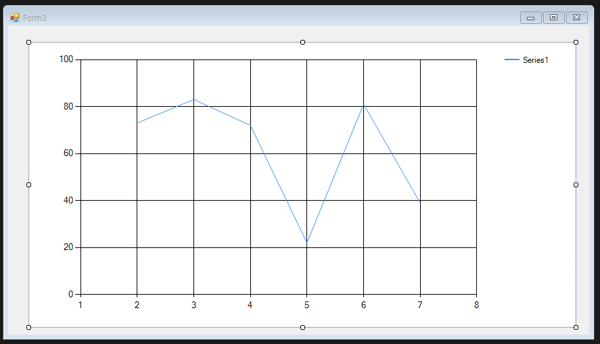
MDI Program . ViewGraph → GUI
Chart 속성 → Series → Series 컬렉션 편집기 → ChartType → Line

Slide 22
MDI Program . ViewGraph → Code 1/2
namespace MdiTest
{
public partial class ViewGraph : Form
{
public ViewGraph()
{
InitializeComponent();
chart1.Series.Clear();
Series tempSeries = new Series("온도");
tempSeries.ChartType = SeriesChartType.Line;
tempSeries.Color = Color.Red;
tempSeries.MarkerStyle = MarkerStyle.Circle; // 도형: 원
tempSeries.MarkerSize = 8; // 크기
tempSeries.MarkerColor = Color.Red; // 마커 색상
//tempSeries.ChartArea = "MainArea";
chart1.Series.Add(tempSeries);
Series humidSeries = new Series("습도");
humidSeries.ChartType = SeriesChartType.Line;
humidSeries.Color = Color.Blue;
humidSeries.MarkerStyle = MarkerStyle.Diamond; // 도형: 다이아몬드
humidSeries.MarkerSize = 8; // 크기
humidSeries.MarkerColor = Color.Blue; // 마커 색상
//humidSeries.ChartArea = "MainArea";
chart1.Series.Add(humidSeries);
}

Slide 23
MDI Program . ViewGraph → Code 2/2
private int timeIndex = 0;
public void AddDataPoint(float temp, float humi)
{
// Chart에 데이터 추가
chart1.Series["온도"].Points.AddY(temp);
chart1.Series["습도"].Points.AddY(humi);
// 포인트 수 제한 (최근 50개)
if (chart1.Series["온도"].Points.Count > 50)
{
chart1.Series["온도"].Points.RemoveAt(0);
chart1.Series["습도"].Points.RemoveAt(0);
}
}
}
}

Slide 24
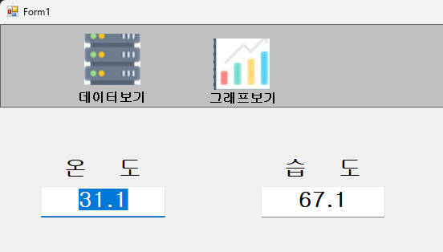
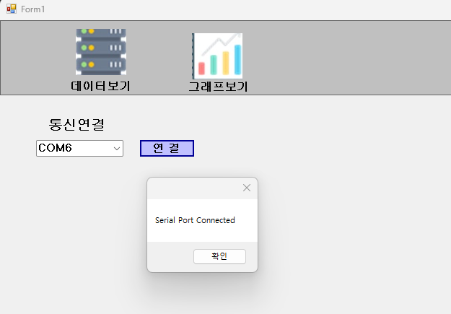
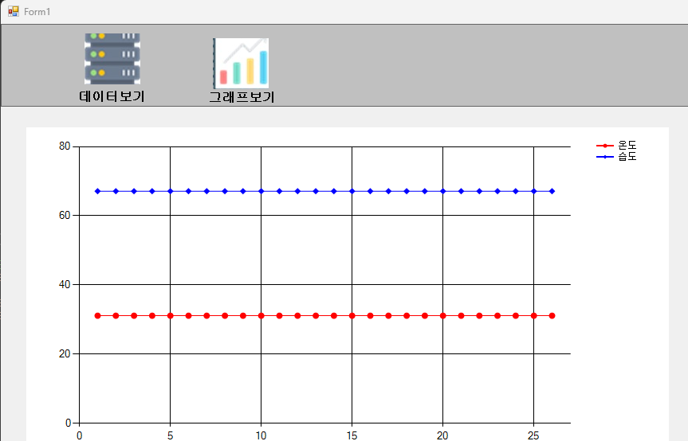
MDI Program . 실행

Slide 25
END.

