Slide 1
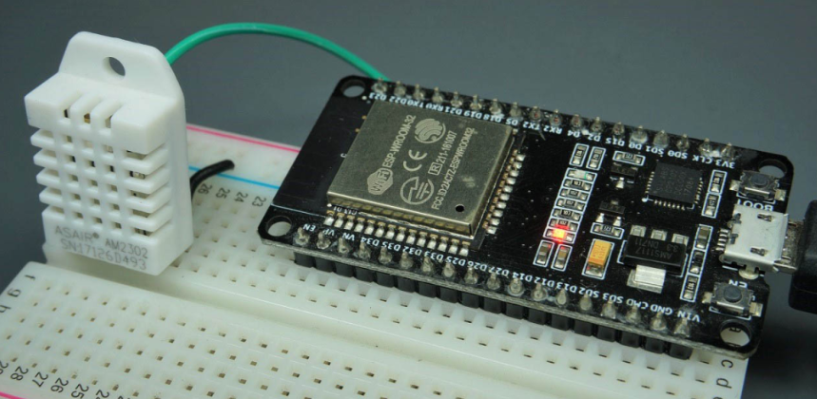
ESP32 with DHT11/DHT22 Temperature
and Humidity Sensor using Arduino IDE
https://randomnerdtutorials.com/esp32-dht11-dht22-temperature-humidity-sensor-arduino-ide/
ESP32와 DHT11 온/습도 센서
인터페이스 코드 설계
https://github.com/heartcom/ESP32

Slide 2
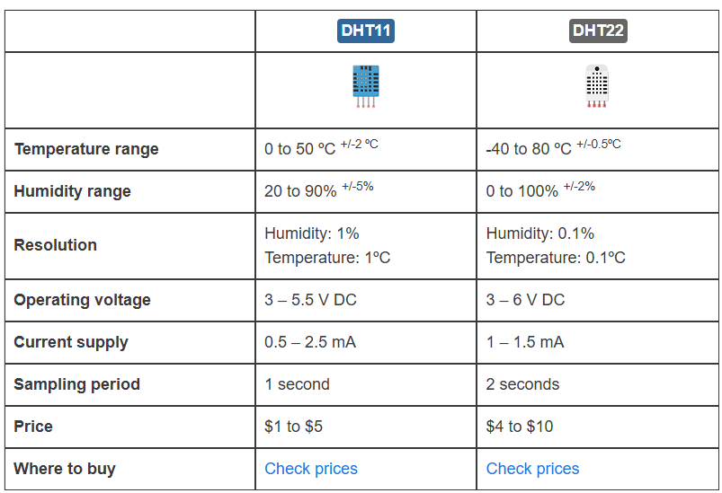
DHT11 Vs. DHT22

Slide 3
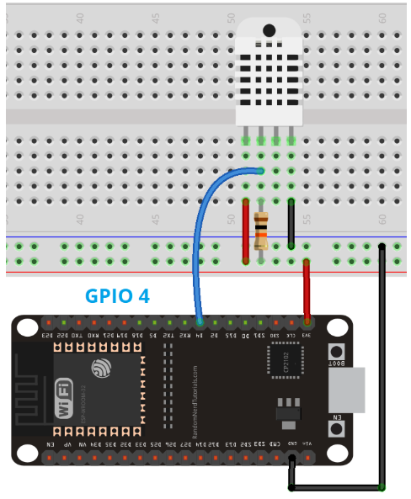
Schematic

Slide 4
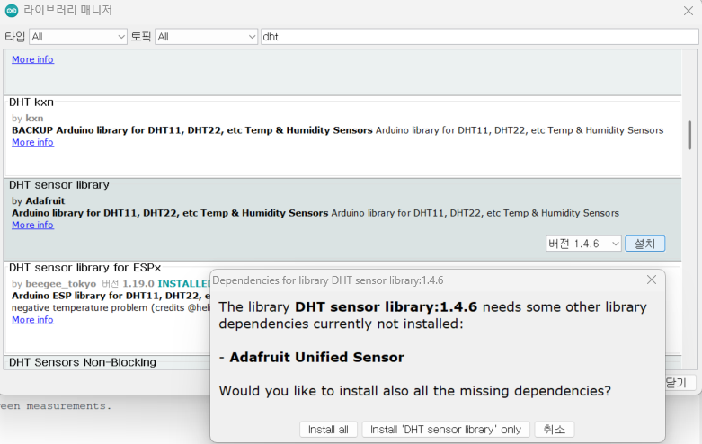
Installing Libraries → Adafruit library 사용

Slide 5
Code 1/2
ESP32 with DHT11/DHT22 Temperature and Humidity Sensor using Arduino IDE | Random Nerd Tutorials
#include "DHT.h"
#define DHTPIN 4 // Digital pin connected to the DHT sensor
// Feather HUZZAH ESP8266 note: use pins 3, 4, 5, 12, 13 or 14 –
// Pin 15 can work but DHT must be disconnected during program upload.
// Uncomment whatever type you're using!
#define DHTTYPE DHT11 // DHT 11
//#define DHTTYPE DHT22 // DHT 22 (AM2302), AM2321
//#define DHTTYPE DHT21 // DHT 21 (AM2301)
// Connect pin 1 (on the left) of the sensor to +5V
// NOTE: If using a board with 3.3V logic like an Arduino Due connect pin 1
// to 3.3V instead of 5V!
// Connect pin 2 of the sensor to whatever your DHTPIN is
// Connect pin 4 (on the right) of the sensor to GROUND
// Connect a 10K resistor from pin 2 (data) to pin 1 (power) of the sensor
// Initialize DHT sensor.
// Note that older versions of this library took an optional third parameter to
// tweak the timings for faster processors. This parameter is no longer needed
// as the current DHT reading algorithm adjusts itself to work on faster procs.
DHT dht(DHTPIN, DHTTYPE);
void setup() {
Serial.begin(9600);
Serial.println(F("DHTxx test!"));
dht.begin();
}

Slide 6
Code 2/2
ESP32 with DHT11/DHT22 Temperature and Humidity Sensor using Arduino IDE | Random Nerd Tutorials
void loop() {
// Wait a few seconds between measurements.
delay(2000); // Reading temperature or humidity takes about 250 milliseconds!
// Sensor readings may also be up to 2 seconds 'old' (its a very slow sensor)
float h = dht.readHumidity(); // Read temperature as Celsius (the default)
float t = dht.readTemperature(); // Read temperature as Fahrenheit (isFahrenheit = true)
float f = dht.readTemperature(true); // Check if any reads failed and exit early (to try again).
if (isnan(h) || isnan(t) || isnan(f)) {
Serial.println(F("Failed to read from DHT sensor!"));
return;
}
// Compute heat index in Fahrenheit (the default)
float hif = dht.computeHeatIndex(f, h); // Compute heat index in Celsius (isFahreheit = false)
float hic = dht.computeHeatIndex(t, h, false);
Serial.print(F("Humidity: ")); Serial.print(h);
Serial.print(F("% Temperature: ")); Serial.print(t); Serial.print(F("°C "));
Serial.print(f); Serial.print(F("°F Heat index: ")); Serial.print(hic); Serial.print(F("°C "));
Serial.print(hif); Serial.println(F("°F"));
}

Slide 7
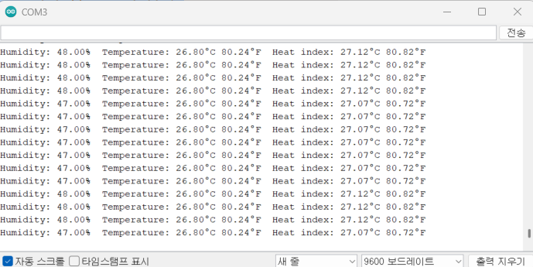
출력
ESP32 with DHT11/DHT22 Temperature and Humidity Sensor using Arduino IDE | Random Nerd Tutorials

Slide 8

예제 코드의 문제점
DHT11의 저급한 성능 때문에 무조건 2초를 기다려야 한다.
이것 때문에 다른 일을 전혀 하지 못하게 된다.
이 문제를 해결하기 위하여 별도의 Timer를 사용하여 센서 값을 읽어 올 수 있다.
하지만, OS가 있다면 thread를 돌릴 수 있다.

Slide 9
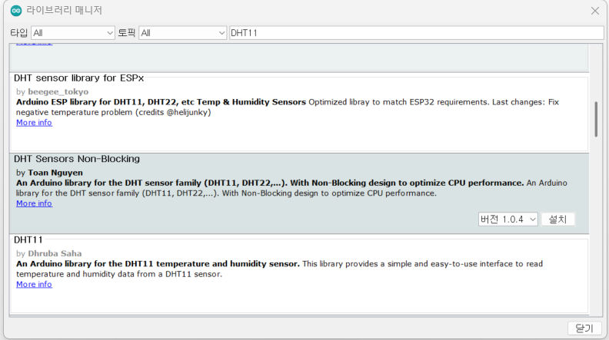
Install Library for ESPx → DHT SENSOR library for ESPx

Slide 10
Code 1/6
#include "DHTesp.h" // Click here to get the library: http://librarymanager/All#DHTesp
#include <Ticker.h>
#ifndef ESP32
#pragma message(THIS EXAMPLE IS FOR ESP32 ONLY!)
#error Select ESP32 board.
#endif
/**************************************************************/
/* Example how to read DHT sensors from an ESP32 using multi- */
/* tasking. */
/* This example depends on the Ticker library to wake up */
/* the task every 20 seconds */
/**************************************************************/
DHTesp dht;
void tempTask(void *pvParameters); //pvParameters → pointer to void 포인터가 가리키는 대상이 정해지지 않은 포인터
bool getTemperature();
void triggerGetTemp();

Slide 11
Code 2/6
/** Task handle for the light value read task */
TaskHandle_t tempTaskHandle = NULL;
/** Ticker for temperature reading */
Ticker tempTicker;
/** Comfort profile */
ComfortState cf;
/** Flag if task should run */
bool tasksEnabled = false;
/** Pin number for DHT11 data pin */
int dhtPin = 17;

Slide 12
Code 3/6
/*** initTemp, Setup DHT library, Setup task and timer for repeated measurement
* @return bool → true if task and timer are started, false if task or timer couldn't be started */
bool initTemp() {
byte resultValue = 0;
dht.setup(dhtPin, DHTesp::DHT11);
Serial.println("DHT initiated");
// Start task to get temperature
xTaskCreatePinnedToCore(
tempTask, /* Function to implement the task */
"tempTask ", /* Name of the task */
4000, /* Stack size in words */
NULL, /* Task input parameter */
5, /* Priority of the task */
&tempTaskHandle, /* Task handle. */
1); /* Core where the task should run */
if (tempTaskHandle == NULL) {
Serial.println("Failed to start task for temperature update");
return false;
} else {
// Start update of environment data every 20 seconds → 20초마다 triggerGetTemp() 함수 실행
tempTicker.attach(20, triggerGetTemp);
}
return true;
}

Slide 13
Code 4/6
/*** triggerGetTemp , Sets flag dhtUpdated to true for handling in loop() , called by Ticker getTempTimer */
void triggerGetTemp() {
if (tempTaskHandle != NULL) {
xTaskResumeFromISR(tempTaskHandle);
}
}
/*** Task to reads temperature from DHT11 sensor * @param pvParameters * pointer to task parameters */
void tempTask(void *pvParameters) {
Serial.println("tempTask loop started");
while (1) // tempTask loop
{
if (tasksEnabled) {
// Get temperature values
getTemperature();
}
// Got sleep again
vTaskSuspend(NULL);
}
}

Slide 14
Code 5/6
bool getTemperature() {
// Reading temperature for humidity takes about 250 milliseconds!
// Sensor readings may also be up to 2 seconds 'old' (it's a very slow sensor)
TempAndHumidity newValues = dht.getTempAndHumidity();
// Check if any reads failed and exit early (to try again).
if (dht.getStatus() != 0) {
Serial.println("DHT11 error status: " + String(dht.getStatusString()));
return false;
}
float heatIndex = dht.computeHeatIndex(newValues.temperature, newValues.humidity);
float dewPoint = dht.computeDewPoint(newValues.temperature, newValues.humidity);
float cr = dht.getComfortRatio(cf, newValues.temperature, newValues.humidity);
String comfortStatus;
switch(cf) {
case Comfort_OK:
comfortStatus = "Comfort_OK";
break;
case Comfort_TooHot:
comfortStatus = "Comfort_TooHot";
break;
~~~~~~~~~ 이하 생략

Slide 15
Code 6/6
void setup()
{
Serial.begin(115200);
Serial.println();
Serial.println("DHT ESP32 example with tasks");
initTemp();
// Signal end of setup() to tasks
tasksEnabled = true;
}
void loop() {
if (!tasksEnabled) {
// Wait 2 seconds to let system settle down, 전원 인가 후 단 한번만 2초 대기.
delay(2000);
// Enable task that will read values from the DHT sensor
tasksEnabled = true;
if (tempTaskHandle != NULL) {
vTaskResume(tempTaskHandle);
}
}
yield();
}

Slide 16
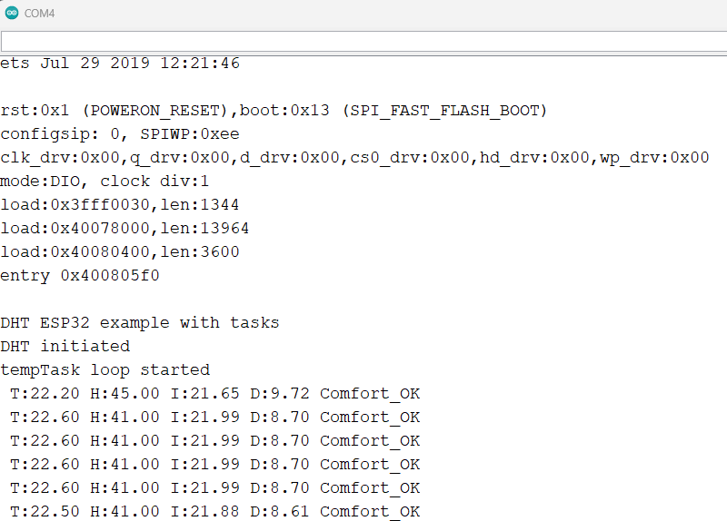
시험 결과

Slide 17
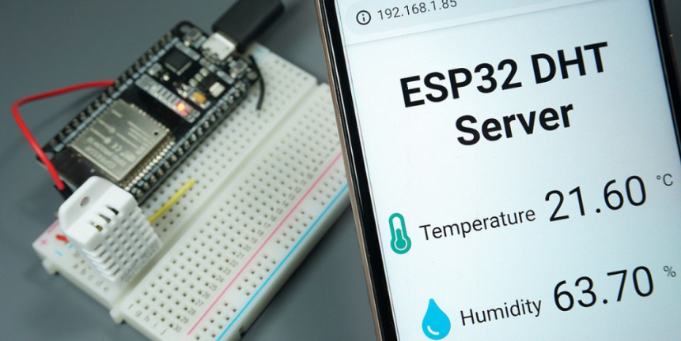
ESP32 DHT11/DHT22 Web Server
Temperature and Humidity using Arduino IDE
https://randomnerdtutorials.com/esp32-dht11-dht22-temperature-humidity-web-server-arduino-ide/
Asynchronous ESP32 web serve를 만들고, DHT11 온도, 습도를 모니터링
Arduino IDE사용
온, 습도 값은 자동 refresh

Slide 18
Install Library
https://github.com/adafruit/Adafruit_Sensor
https://github.com/adafruit/DHT-sensor-library

Slide 19
Code 1/5
/********* Rui Santos Complete project details at https://randomnerdtutorials.com *********/
#include "WiFi.h"
#include "ESPAsyncWebServer.h"
#include <Adafruit_Sensor.h>
#include <DHT.h>
// Replace with your network credentials
const char* ssid = "REPLACE_WITH_YOUR_SSID";
const char* password = "REPLACE_WITH_YOUR_PASSWORD";
#define DHTPIN 27 // Digital pin connected to the DHT sensor
#define DHTTYPE DHT11 // DHT 11
//#define DHTTYPE DHT22 // DHT 22 (AM2302)
//#define DHTTYPE DHT21 // DHT 21 (AM2301)
DHT dht(DHTPIN, DHTTYPE);
// Create AsyncWebServer object on port 80
AsyncWebServer server(80);

Slide 20
Code 2/5
String readDHTTemperature() {
// Sensor readings may also be up to 2 seconds 'old' (its a very slow sensor)
// Read temperature as Celsius (the default)
float t = dht.readTemperature(); // Read temperature as Fahrenheit (isFahrenheit = true)
if (isnan(t)) {
Serial.println("Failed to read from DHT sensor!");
return "--";
} else {
Serial.println(t); return String(t);
}
}
String readDHTHumidity() {
// Sensor readings may also be up to 2 seconds 'old' (its a very slow sensor)
float h = dht.readHumidity();
if (isnan(h)) {
Serial.println("Failed to read from DHT sensor!");
return "--";
} else {
Serial.println(h);
return String(h);
}
}

Slide 21
Code 3/5
const char index_html[] PROGMEM = R"rawliteral(
<!DOCTYPE HTML><html>
<head>
<meta name="viewport" content="width=device-width, initial-scale=1">
<link rel="stylesheet" href="https://use.fontawesome.com/releases/v5.7.2/css/all.css" integrity="sha384-fnmOCqbTlWIlj8LyTjo7mOUStjsKC4pOpQbqyi7RrhN7udi9RwhKkMHpvLbHG9Sr" crossorigin="anonymous">
<style>
html { font-family: Arial; display: inline-block; margin: 0px auto; text-align: center; }
h2 { font-size: 3.0rem; }
p { font-size: 3.0rem; } .units { font-size: 1.2rem; } .dht-labels{ font-size: 1.5rem; vertical-align:middle; padding-bottom: 15px; }
</style>
</head>
<body>
<h2>ESP32 DHT Server</h2>
<p> <i class="fas fa-thermometer-half" style="color:#059e8a;"></i> <span class="dht-labels">Temperature</span>
<span id="temperature">%TEMPERATURE%</span> <sup class="units">&deg;C</sup> </p>
<p> <i class="fas fa-tint" style="color:#00add6;"></i> <span class="dht-labels">Humidity</span>
<span id="humidity">%HUMIDITY%</span> <sup class="units">&percnt;</sup> </p>
</body>
<script>
setInterval(function ( ) {
var xhttp = new XMLHttpRequest();
xhttp.onreadystatechange = function() {
if (this.readyState == 4 && this.status == 200) {
document.getElementById("temperature").innerHTML = this.responseText;
}
};
xhttp.open("GET", "/temperature", true);
xhttp.send();
}, 10000 ) ;

Slide 22
Code 4/5
setInterval(function ( ) {
var xhttp = new XMLHttpRequest();
xhttp.onreadystatechange = function() {
if (this.readyState == 4 && this.status == 200) {
document.getElementById("humidity").innerHTML = this.responseText;
}
};
xhttp.open("GET", "/humidity", true); xhttp.send();
}, 10000 ) ;
</script>
</html>)rawliteral";
// Replaces placeholder with DHT values
String processor(const String& var){
//Serial.println(var);
if(var == "TEMPERATURE"){
return readDHTTemperature();
}
else if(var == "HUMIDITY"){
return readDHTHumidity();
}
return String();
}

Slide 23
Code 5/5
void setup(){
Serial.begin(115200);
dht.begin();
WiFi.begin(ssid, password);
while (WiFi.status() != WL_CONNECTED) {
delay(1000);
Serial.println("Connecting to WiFi..");
} // Print ESP32 Local IP Address
Serial.println(WiFi.localIP()); // Route for root / web page
server.on("/", HTTP_GET, [](AsyncWebServerRequest *request){
request->send_P(200, "text/html", index_html, processor);
});
server.on("/temperature", HTTP_GET, [](AsyncWebServerRequest *request){
request->send_P(200, "text/plain", readDHTTemperature().c_str());
});
server.on("/humidity", HTTP_GET, [](AsyncWebServerRequest *request){
request->send_P(200, "text/plain", readDHTHumidity().c_str());
});
server.begin();
}
void loop(){ }

Slide 24
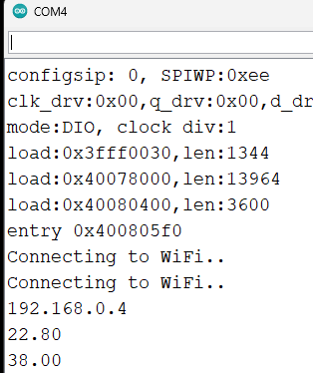
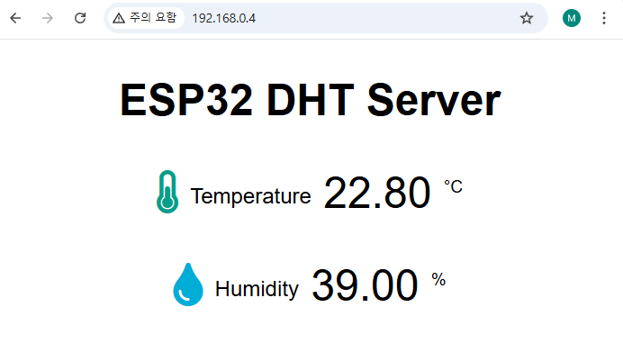
결과
Arduino
Web

Slide 25
앞의 예제에서 html code를 index.html로 분리해보자.
폴더구조
project folder
data
index.html
index.html

Slide 26
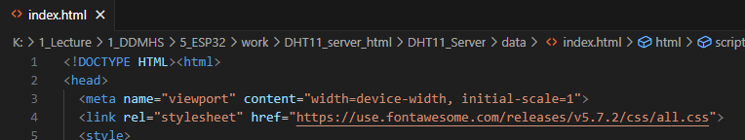
file 분리 → 기존 Arduino 파일에서 html 부분을 잘라내어 index.html 파일 생성
index.html → 기존 코드에서 수정할 부분
1. CSS Link
<link rel="stylesheet" href="https://use.fontawesome.com/releases/v5.7.2/css/all.css">

Slide 27
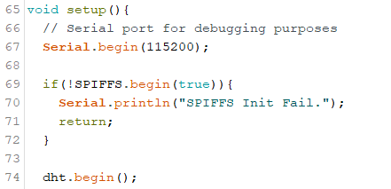
Arduino file 수정
index.html → 기존 코드에서 수정할 부분
1. header file 추가
#include "FS.h"
#include "SPIFFS.h"
FS.h : file system interface 를 제공하는 파일 시스템 라이브러리
SPIFFS.h : ESP32 플래시 메모리에 파일을 저장할 수 있도록 설계된 라이브러리
2. setup() 함수에서 SPIFFS 시작
if(!SPIFFS.begin(true)){
Serial.println("SPIFFS Init Fail.");
return;
}

Slide 28
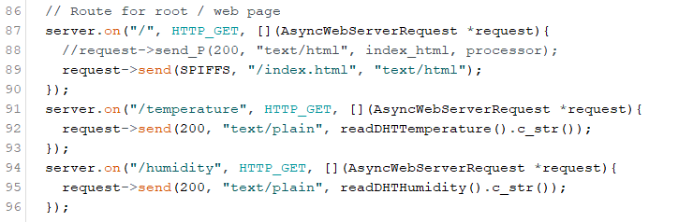
Arduino file 수정
3. setup() 함수에서 web page 경로 수정
// Route for root / web page
server.on("/", HTTP_GET, [](AsyncWebServerRequest *request){
//request->send_P(200, "text/html", index_html, processor);
request->send(SPIFFS, "/index.html", "text/html");
});
server.on("/temperature", HTTP_GET, [](AsyncWebServerRequest *request){
request->send(200, "text/plain", readDHTTemperature().c_str());
});
server.on("/humidity", HTTP_GET, [](AsyncWebServerRequest *request){
request->send(200, "text/plain", readDHTHumidity().c_str());
});

Slide 29
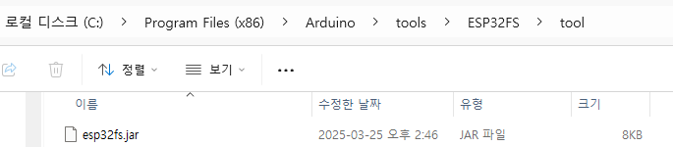
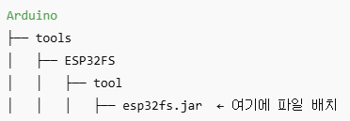
ESP32 Sketch Data Upload Tool 설치
ESP32FS Plug-in download
다운로드 받은 파일에서 esp32fs.jar 파일을 Arduino IDE tools 폴더에 복사
Windows: C:\Users\<사용자이름>\Documents\Arduino\tools Arduino를 program files 에 설치한 경우 → C:\Program Files (x86)\Arduino\tools\ESP32FS\tool
Releases · me-no-dev/arduino-esp32fs-plugin

Slide 30
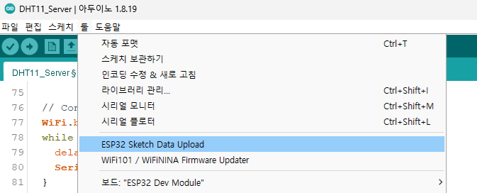
ESP32 Sketch Data Upload Tool 설치
3. Arduino 종료 후, 재 실행
4. 툴 → ESP32 Sketch Data Upload 메뉴 생겼는지 확인.

Slide 31
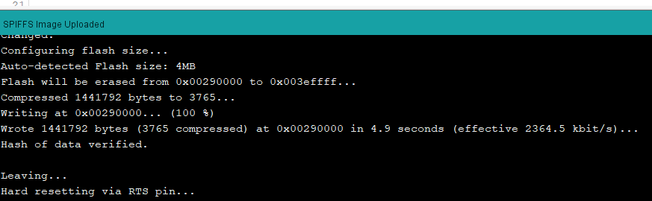
ESP32 Sketch Data Upload Tool 설치
5. ESP32 Sketch Data Upload 클릭 ESP32 플래시 파일 시스템에 파일 업로드 시작( .html, .css, .js, .json 등 web resource file 을 SPIFFS에 저장)
6. Uploader 버튼 클릭

Slide 32
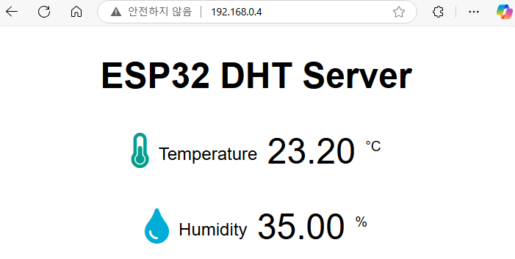
동작

