Slide 1
PyQt with Designer
Ver.20250405

Slide 2
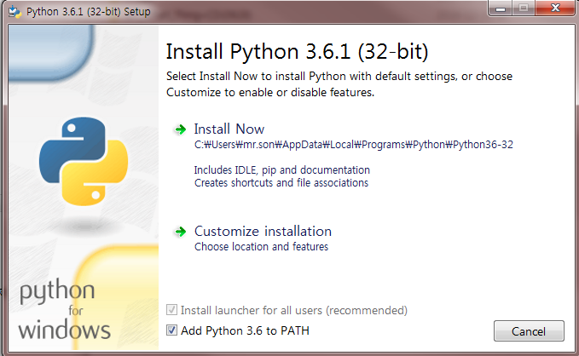
개발 환경 구축 : Python 설치

Slide 3
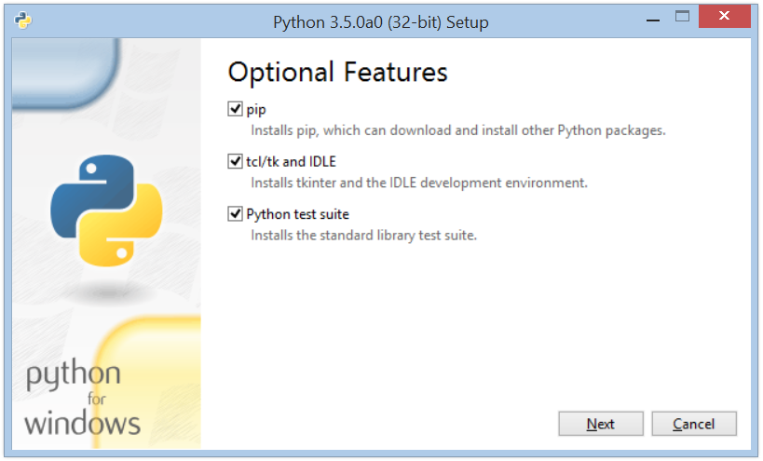
개발 환경 구축 : Python 설치

Slide 4
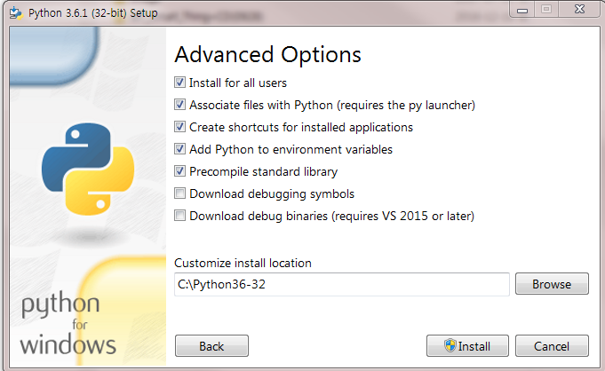
개발 환경 구축 : Python 설치

Slide 5
pyQt & Designer

Slide 6
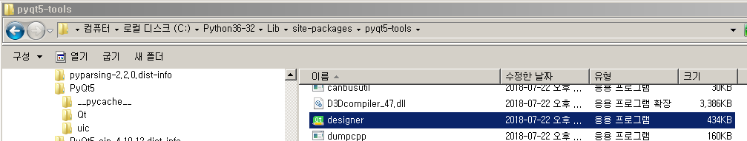
pyQt5 & Tools 설치
Window에서 pyQt 설치하기
pip install pyqt5
pip install pyqt5-tools
설치 파일 확인
C:\Python36-32\Lib\site-packages\pyqt5-tools
C:\Python36-32\Scripts
.ui 파일을 .py 로 변환
pyuic5 -x hello.ui -o hello.py
폴더는 파이썬 버전과 설치 위치에 따라 달라짐

Slide 7
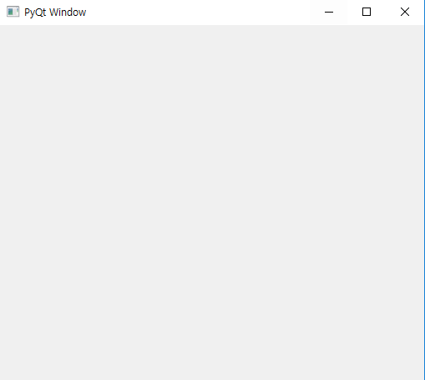
PyQt : Basic winow
import sys
from PyQt5 import QtCore, QtGui, QtWidgets
app = QtWidgets.QApplication(sys.argv)
window = QtWidgets.QWidget()
window.setGeometry(0,0,300,300)
window.setWindowTitle('PyQt Window')
window.show()
sys.exit(app.exec_())

Slide 8
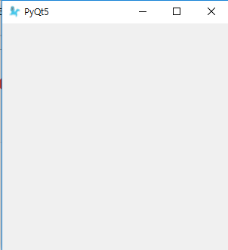
PyQt : Class Basic winow
import sys
from PyQt5 import QtCore, QtGui, QtWidgets
class Window(QtWidgets.QMainWindow):
def __init__(self):
super(Window, self).__init__()
self.setGeometry(50, 50, 300, 300)
self.setWindowTitle('PyQt5')
self.setWindowIcon(QtGui.QIcon('image/bird.png'))
self.show()
app=QtWidgets.QApplication(sys.argv)
GUI = Window()
sys.exit(app.exec_())

Slide 9
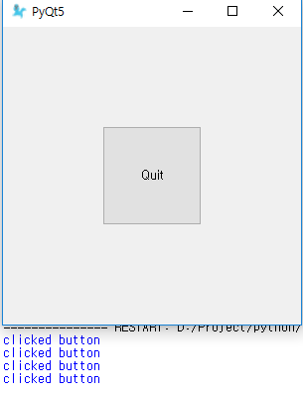
PyQt : Class Basic winow
import sys
from PyQt5 import QtCore, QtGui, QtWidgets
class Window(QtWidgets.QMainWindow):
def __init__(self):
super(Window, self).__init__()
self.setGeometry(50, 50, 300, 300)
self.setWindowTitle('PyQt5')
self.setWindowIcon(QtGui.QIcon('image/bird.png'))
self.home()
def home(self):
btn=QtWidgets.QPushButton('Quit', self)
btn.clicked.connect(self.dodo)
btn.resize(100, 100)
btn.move(100, 100)
self.show()
def dodo(self):
print('clicked button')
app=QtWidgets.QApplication(sys.argv)
GUI = Window()
sys.exit(app.exec_())

Slide 10
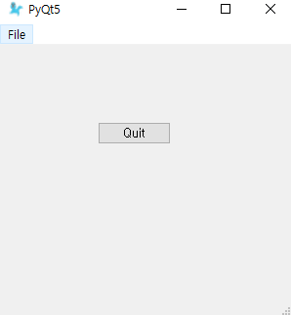
PyQt : Menu
import sys
from PyQt5 import QtCore, QtGui, QtWidgets
class Window(QtWidgets.QMainWindow):
def __init__(self):
super(Window, self).__init__()
self.setGeometry(50, 50, 300, 300)
self.setWindowTitle('PyQt5')
self.setWindowIcon(QtGui.QIcon('image/bird.png'))
extractAction = QtWidgets.QAction("&CLOSE", self)
extractAction.setShortcut("Ctrl+Q")
extractAction.setStatusTip('Leave the App')
extractAction.triggered.connect(self.close_app)
self.statusBar()
mainMenu = self.menuBar()
fileMenu=mainMenu.addMenu('&File')
fileMenu.addAction(extractAction)
self.home()
def home(self):
btn=QtWidgets.QPushButton('Quit', self)
btn.clicked.connect(self.close_app)
btn.resize(btn.sizeHint())
btn.move(100, 100)
self.show()
def close_app(self):
print('close application')
sys.exit()
app=QtWidgets.QApplication(sys.argv)
GUI = Window()
sys.exit(app.exec_())

Slide 11
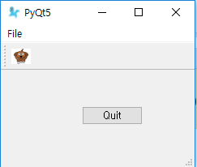
PyQt : Toolbar
def home(self):
btn=QtWidgets.QPushButton('Quit', self)
btn.clicked.connect(self.close_app)
btn.resize(btn.sizeHint())
btn.move(100, 100)
extractAction = QtWidgets.QAction(QtGui.QIcon('image/dog.png'), 'Flee the scene', self)
extractAction.triggered.connect(self.close_app)
self.toolbar = self.addToolBar('Extraction')
self.toolbar.addAction(extractAction)
self.show()

Slide 12
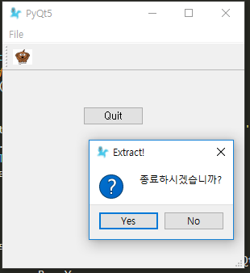
PyQt : MessageBox
def close_app(self):
choice = QtWidgets.QMessageBox.question(self, 'Extract!',
"종료하시겠습니까?", QtWidgets.QMessageBox.Yes | QtWidgets.QMessageBox.No)
if choice==QtWidgets.QMessageBox.Yes:
print ('exit')
sys.exit()
else:
pass

Slide 13
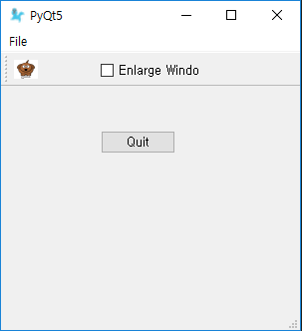
PyQt : CheckBox
checkBox = QtWidgets.QCheckBox('Enlarge Window', self)
checkBox.move(100, 25)
checkBox.stateChanged.connect(self.enlarge_Window)
self.show()
def enlarge_Window(self, state):
print('check box')
if state == QtCore.Qt.Checked:
print ('checked')
self.setGeometry(50, 50, 600, 600)
else:
print ('not checked')
self.setGeometry(50, 50, 300, 300)

Slide 14
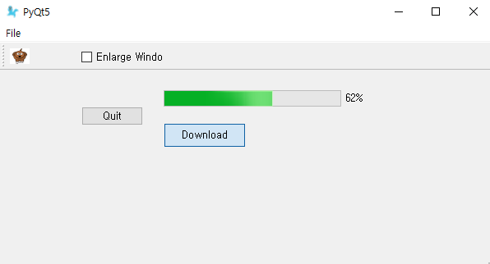
PyQt : Progress Bar
self.progress = QtWidgets.QProgressBar(self)
self.progress.setGeometry(200, 80, 250, 20)
self.btn = QtWidgets.QPushButton("Download", self)
self.btn.move(200, 120)
self.btn.clicked.connect(self.download)
self.show()
def download(self):
self.completed=0
while self.completed < 100:
self.completed += 0.00001
self.progress.setValue(self.completed)

Slide 15
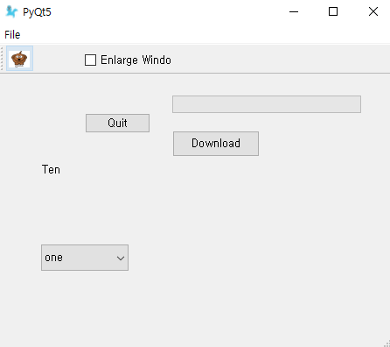
PyQt : ComboBox=DropDown Button
self.styleChoice = QtWidgets.QLabel("Ten", self)
comboBox = QtWidgets.QComboBox(self)
comboBox.addItem("one")
comboBox.addItem("two")
comboBox.addItem("three")
comboBox.addItem("four")
comboBox.addItem("five")
comboBox.move(50, 250)
self.styleChoice.move(50, 150)
comboBox.activated[str].connect(self.style_choice)
self.show()
def style_choice(self, text):
self.styleChoice.setText(text)
QtWidgets.QApplication.setStyle(QtWidgets.QStyleFactory.create(text))

Slide 16
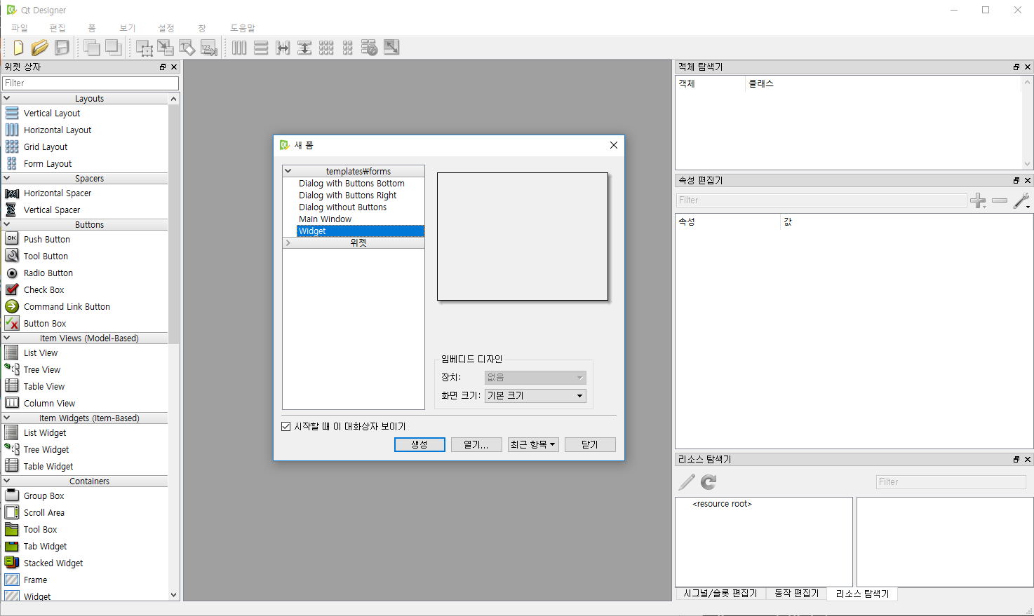
Designer

Slide 17
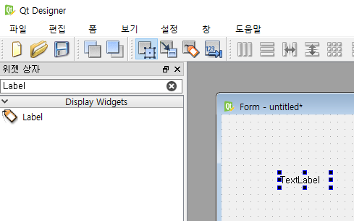
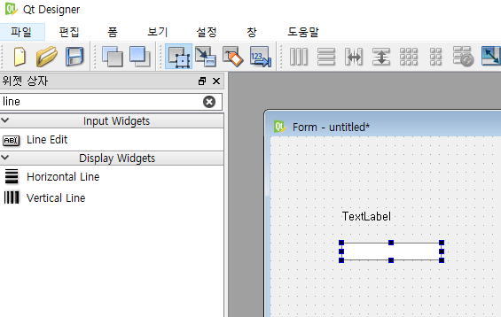
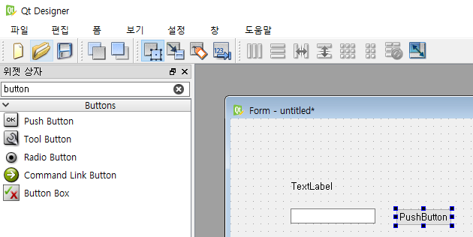
Designer : Label & Button
Label
Line Edit
Push Button

Slide 18
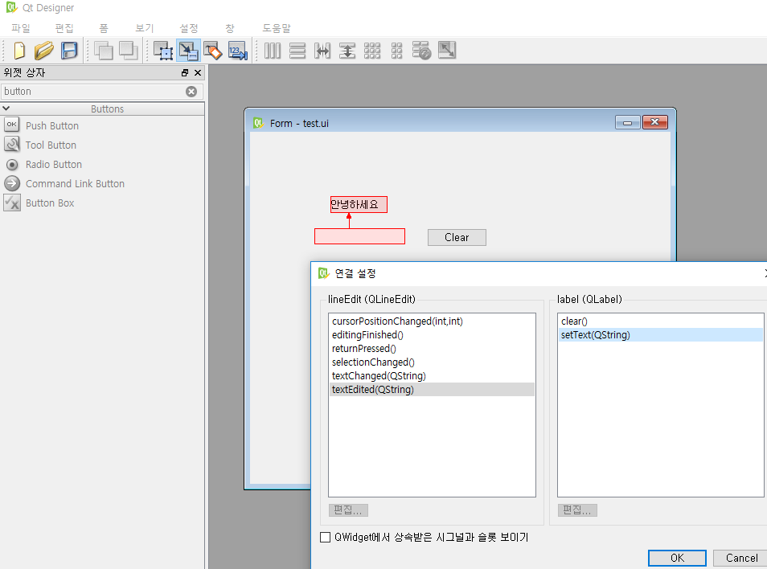
Designer : Label & Button

Slide 19
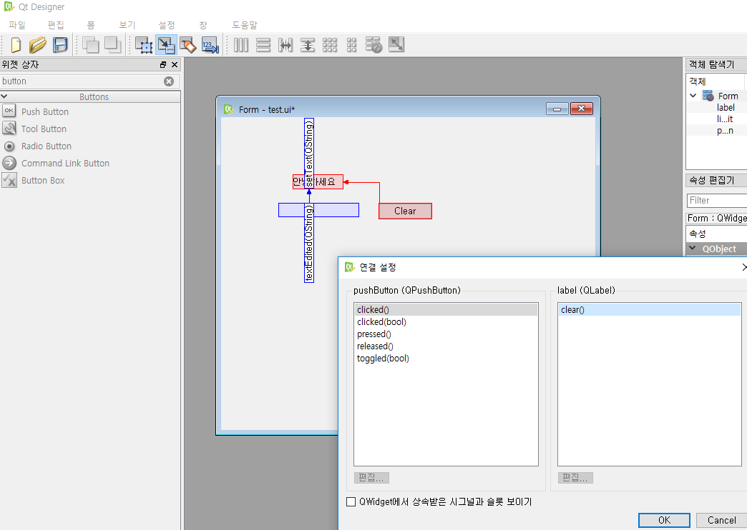
Designer : Label & Button
Ctrl+R 로 실행
저장(.ui)

Slide 20
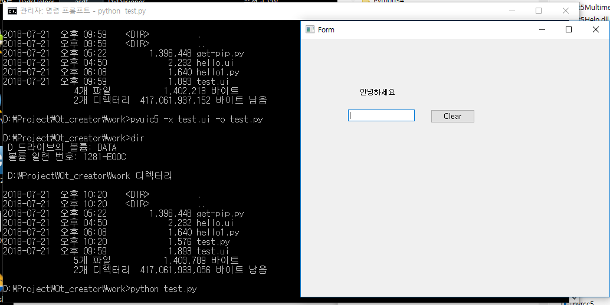
Designer : Label & Button
.ui를 .py 파일로 변경하여 실행하기
pyuic5.bat 는 C:\Python36-32\Lib\site-packages\pyqt5-tools

Slide 21
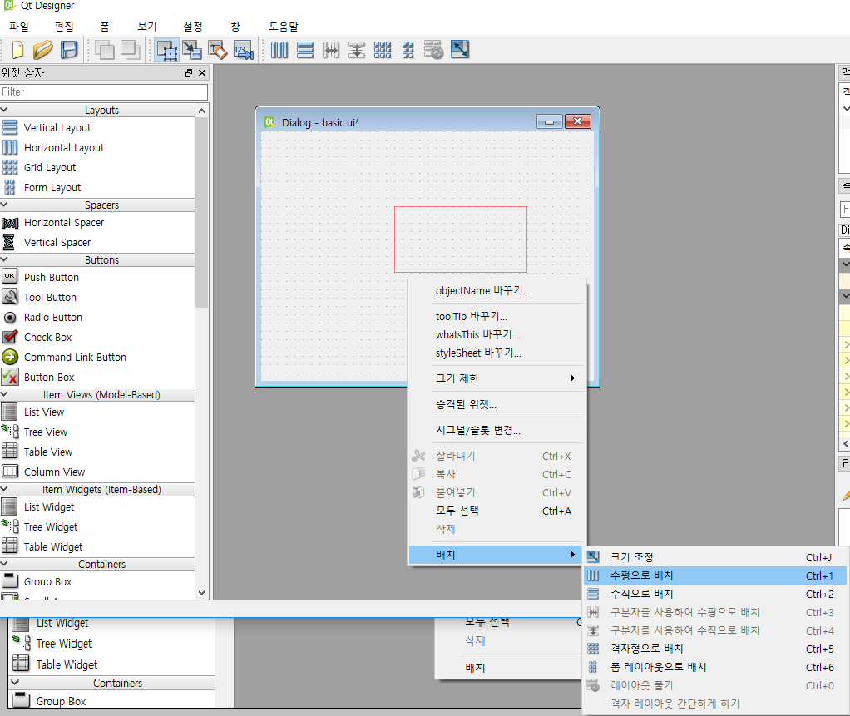
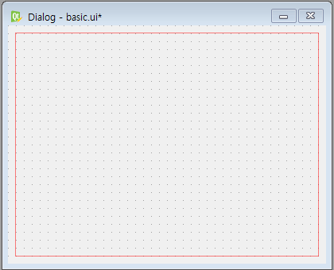
Designer : Layout 연습

Slide 22
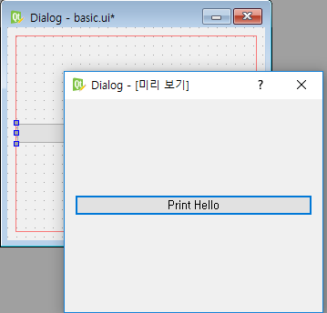
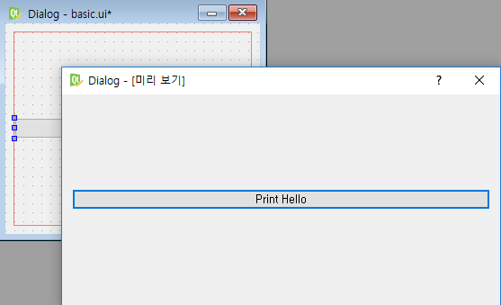
Designer : Layout 연습
Ctrl + R 로 미리보기 실행
화면을 확장하거나 축소하면 버튼 크기가 함께 조절됨

Slide 23
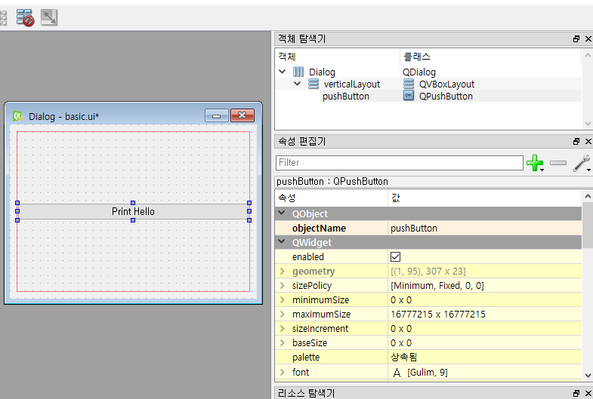
Designer : Layout 연습
Layout 및 속성 편집

Slide 24
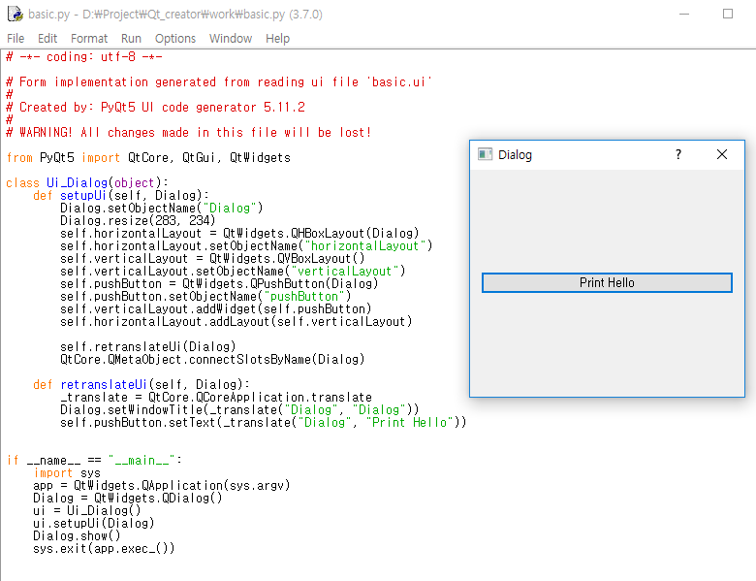
Designer : Layout 연습

Slide 25
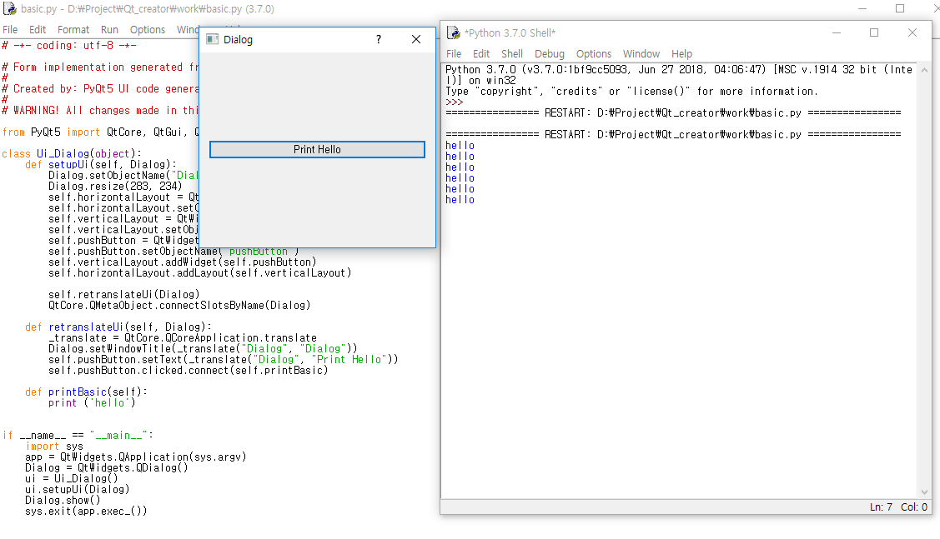
Designer : Layout 연습

Slide 26
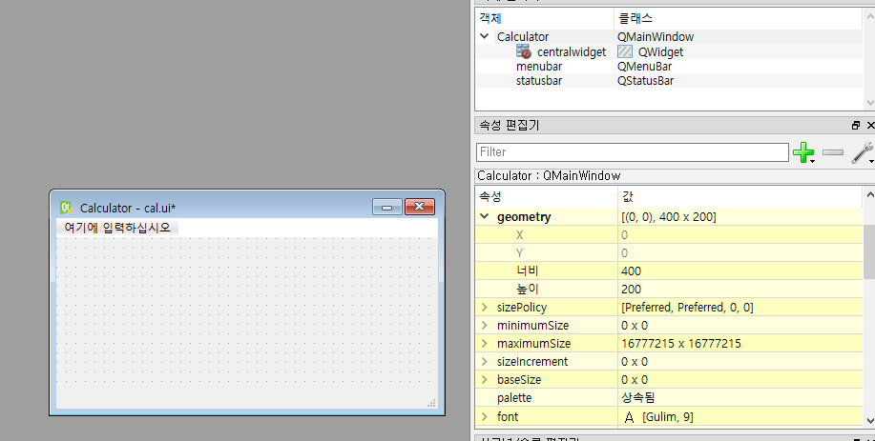
Designer : Calculator 만들기
mainwindow 생성
geometry : 400 x 200

Slide 27
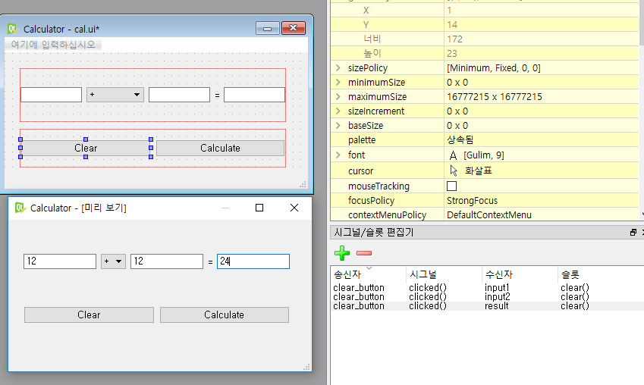
Designer : Calculator 만들기
Line Edit
Combo Box
Label
Push button
Clear 버튼 기능 추가
pyuic5 -x cal_gui.ui -o cal_gui.py

Slide 28
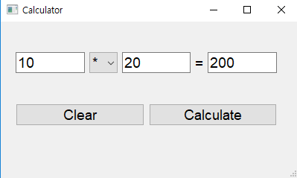
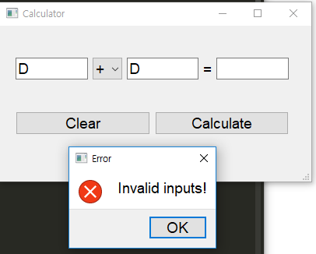
Designer : Calculator 만들기 cal.py
from cal_gui import *
def signals(self):
self.cal_button.clicked.connect(self.calc)
def calc(self):
a = self.input1.text()
b = self.input2.text()
operator = self.comboBox.currentText()
try:
c=eval(a + operator + b)
self.result.setText(str(c))
except:
Qtwidgets.QMessageBox.critical(MainWindow, 'Error', 'Invalid inputs!',
Qtwidgets.QMessageBox.Ok)
Ui_Calculator.signals = signals
Ui_Calculator.calc = calc
if __name__=="__main__":
import sys
app = QtWidgets.QApplication(sys.argv)
MainWindow = QtWidgets.QMainWindow()
ui = Ui_Calculator()
ui.setupUi(MainWindow)
ui.signals()
MainWindow.show()
sys.exit(app.exec_())

Slide 29
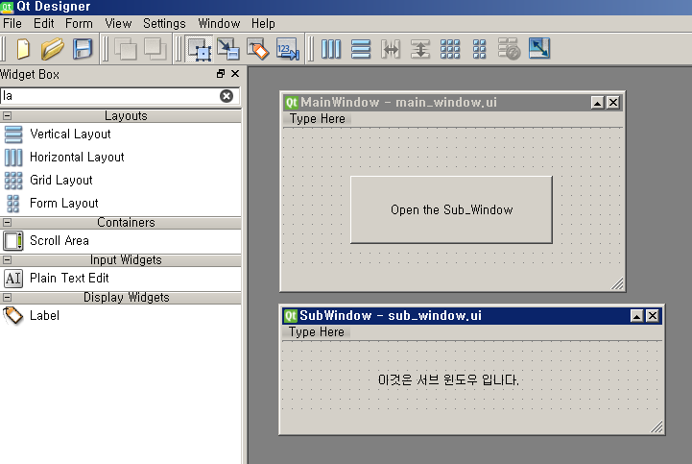
Designer : 버튼 클릭하면 다른 Window 생성
Main window와 sub window 두 개의 ui 파일을 만든다
ui 파일을 .py 파일로 변환 : pyuid5 –x main_window.ui –o main_window.py
: pyuid5 –x sub_window.ui –o sub_window.py

Slide 30
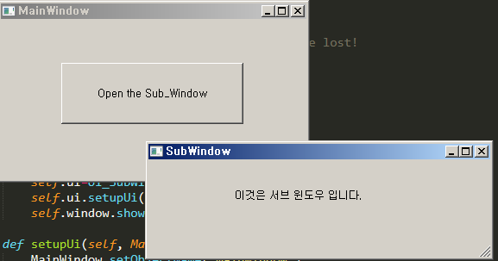
Designer : 버튼 클릭하면 다른 Window 생성
from sub_window import *
class Ui_MainWindow(object):
def openWindow(self):
self.window=QtWidgets.QMainWindow()
self.ui=Ui_SubWindow()
self.ui.setupUi(self.window)
self.window.show()
~~~~~~~~~
def setupUi(self, MainWindow):
MainWindow.setObjectName("MainWindow")
MainWindow.resize(354, 185)
self.centralwidget = QtWidgets.QWidget(MainWindow)
self.centralwidget.setObjectName("centralwidget")
self.pushButton = QtWidgets.QPushButton(self.centralwidget)
self.pushButton.setGeometry(QtCore.QRect(70, 50, 211, 71))
self.pushButton.setObjectName("pushButton")
self.pushButton.clicked.connect(self.openWindow)

Slide 31
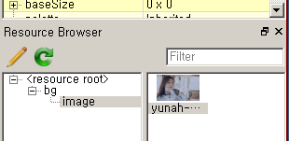
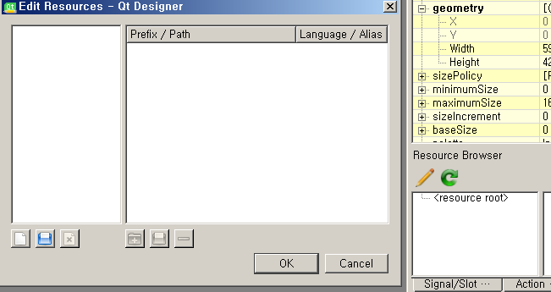
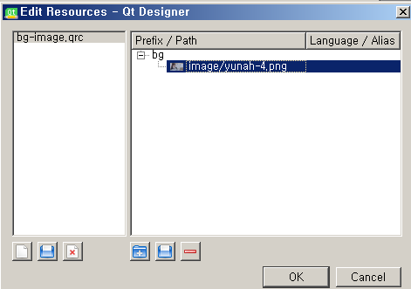
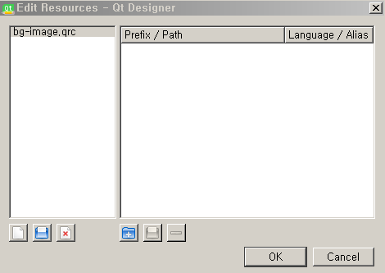
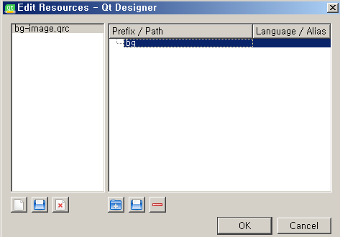
Designer : background image
MainWindow 생성 후
파일 이름 설정
파일 추가

Slide 32
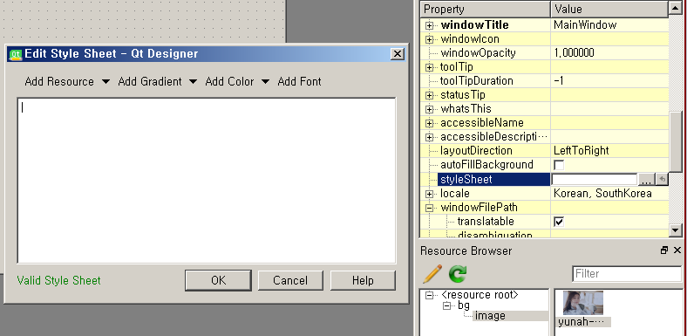
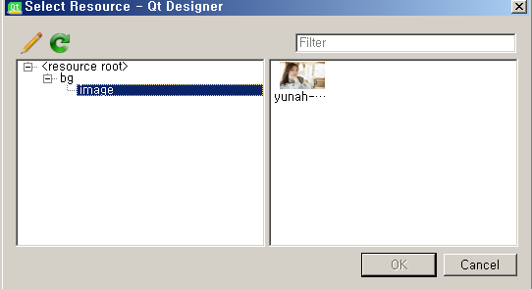
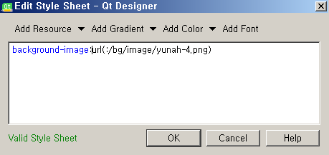
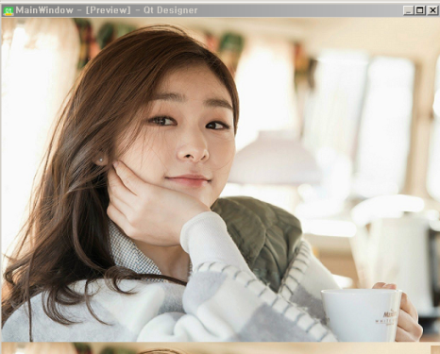
Designer : background image

Slide 33
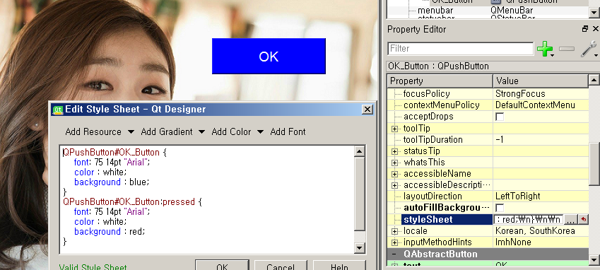
Designer : The Style Sheet Syntax : button

