Slide 1
Serial_asyncio Test

Slide 2
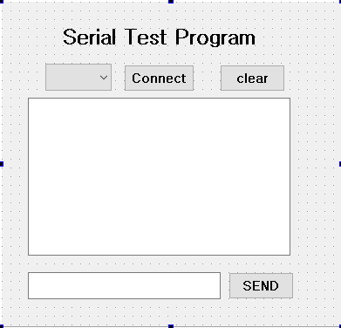
Serial Test Program : GUI 설계 as a designer
push button
combo box
수신창
text Edit
Line Edit
송신창

Slide 3
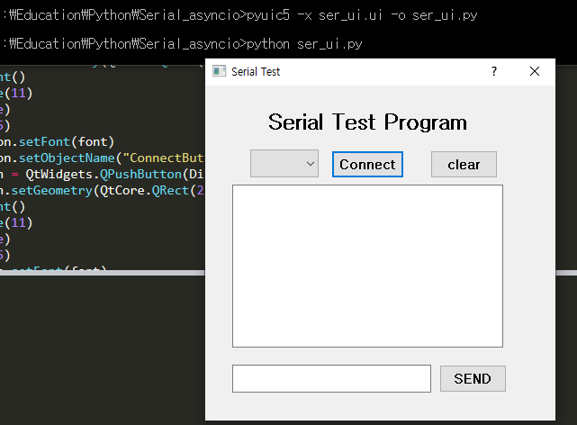
Serial Test Program : .ui → .py

Slide 4
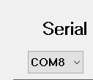
Serial Test Program : serial_test1.py
from PyQt5 import QtCore, QtGui, QtWidgets
from ser_ui import *
import sys
import serial
import asyncio
import serial_asyncio
from threading import Thread
class UartCom():
connect_port=[]
def __init__(self, app):
self.app=app
self.get_com()
app.ConnectButton.clicked.connect(self.connect_serial)
app.Send_Button.clicked.connect(self.sendUart)
self.uart =None
def get_com(self):
if sys.platform.startswith('linux') or sys.platform.startswith('cygwin'):
self.isLinux = True
else:
self.isLinux = False
COM_Ports=self.serial_ports()
for port in COM_Ports:
if port.find('COM') > -1:
self.connect_port.append(port)
print (self.connect_port)
for comport in self.connect_port:
app.comboBox.addItem(comport)
# 유효한 Com port를 찾는 함수

Slide 5
Serial Test Program : serial_test1.py
def run(self, loop):
try:
loop.run_forever()
except KeyboardInterrupt:
pass
print("Closed Uart trhead!")
def connect_serial(self, text):
self.loop = asyncio.new_event_loop()
asyncio.set_event_loop(self.loop)
com_no = str(app.comboBox.currentText())
print (com_no)
if self.isLinux:
self.coro = serial_asyncio.create_serial_connection(self.loop, lambda: UartProtocol(self.app), self.mcuPort, baudrate=115200)
print('Connected mcu port = '+self.mcuPort)
else:
print('com connect')
self.coro = serial_asyncio.create_serial_connection(self.loop, lambda: UartProtocol(self), com_no, baudrate=115200)
self.loop.run_until_complete(self.coro)
t = Thread(target=self.run, args=(self.loop,))
t.start()
#self.loop.call_soon_threadsafe(asyncio.async , self.coro)
pass

Slide 6
Serial Test Program : serial_test1.py
def serial_ports(self):
if sys.platform.startswith('win'):
ports = ['COM%s' % (i + 1) for i in range(256)]
elif sys.platform.startswith('linux') or sys.platform.startswith('cygwin'):
# this excludes your current terminal "/dev/tty"
ports = glob.glob('/dev/tty[A-Za-z]*')
elif sys.platform.startswith('darwin'):
ports = glob.glob('/dev/tty.*')
else:
raise EnvironmentError('Unsupported platform')
result = []
for port in ports:
try:
s = serial.Serial(port)
s.close()
result.append(port)
except (OSError, serial.SerialException):
pass
return result
def printLog(self, msg):
print('<{!r}> {!r}'.format(self.getTimeStamp(), msg))
def sendUart(self):
msg=app.Send_Edit.text()
print (msg)
if self.uart != None:
self.uart.write(msg.encode())
print ('Finished Send')
else :
print ('Not Connected')

Slide 7
Serial Test Program : serial_test1.py
class UartProtocol(asyncio.Protocol):
def __init__(self, app):
self.app = app
def connection_made(self, transport):
self.transport = transport
print('port opened', transport)
transport.serial.rts = False
self.app.uart = transport
def data_received(self, data):
message = data.decode() # repr(data)
print('data received', message)
app.textEdit.append(message)
def connection_lost(self, exc):
print('port closed')
self.transport.loop.stop()

Slide 8
Serial Test Program : serial_test1.py
def stopall(UART_Window):
if UART_Window.uart != None:
UART_Window.uart.close()
if __name__ == '__main__':
import sys
win = QtWidgets.QApplication(sys.argv)
MainWindow = QtWidgets.QMainWindow()
app = Ui_Dialog()
app.setupUi(MainWindow)
UART_Window=UartCom(app)
MainWindow.show()
win.aboutToQuit.connect(lambda: stopall(UART_Window))
sys.exit(win.exec_())

Slide 9
Serial Test Program : Arduino Program
char inChar;
boolean stringComplete = false;
void setup() {
Serial.begin(115200);
}
void loop() {
if (stringComplete) {
Serial.write(inChar);
stringComplete = false;
}
}
void serialEvent() {
while (Serial.available()) {
inChar = (char)Serial.read();
stringComplete=true;
}
}

Slide 10
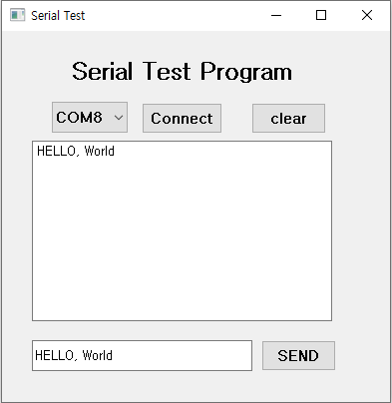
Serial Test Program : 프로그램 실행

