Slide 1
ON predictive Analysis on commercial success of games
Introduction
PROPOSAL
Lets Start

Slide 2
Introduction
SUBMITTED BY:
Sheikh Arafat Rahman shovo
SUPERVISED BY:
ID: 1915002003
Department of CSE
City University
Shaikh Shoriful Hibib
Shafiul Alam
Asst Prof, Dept. of CSE
City University
ID: 1915002033
Department of CSE
City University

Slide 3
Not all of them makes it
03
Introduction
The problem
motivation
objective
tools
Data set
methodology
Expected outcome
reference
12,500
10,394
10,000
9,512
8,109
7,802
7,500
7,123
6,233
5,000
4,369
2,595
2,500
1,582
429
583
118
129
216
334
349
335
2006
2007
2008
2009
2010
2011
2012
2013
2014
2015
2016
2017
2018
2019
2020
2021
2022

Slide 4
04
Introduction
The problem
motivation
objective
tools
Data set
methodology
Expected outcome
reference
The possibility of a game being hit or flop depends on a lot of things. There are lots of uncertainty .While developing and quality assuring a game there can be no certainty that the game will be popular. That why we want to create a prediction model that will give the possibility of game being hit.

Slide 5
Analyze sales data from previously released video games.
05
Introduction
The problem
motivation
objective
tools
Data set
methodology
Expected outcome
reference
01
02
03
To find some cluster to get game trendline.
Create a prediction model to predict possibility of a
game being hit

Slide 6
05
Introduction
The problem
motivation
Related Work
tools
Data set
methodology
Expected outcome
reference
Related Work
Only one related work was found.
Contribution: Author[1] analyzed factors influencing games success after release and suggested estimating this success before release using Naive Bayes ,SVM , RPART, Random Forest, GLM algorithm
Limitation: He didn’t use critics score & ESRB rating in dataset . But impact of these factors on global sale is huge

Slide 7




Git Hub
06
Introduction
The problem
motivation
objective
tools
Data set
methodology
Expected outcome
reference
python
excel
anaconda
LR
RFC
LR
rfc

Slide 8
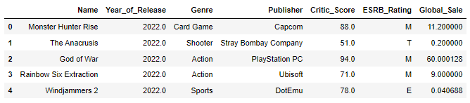
07
Introduction
The problem
motivation
objective
tools
Data set
methodology
Expected outcome
reference

Slide 9
08
Introduction
The problem
motivation
objective
tools
Data set
methodology
Expected outcome
reference
Start
Data collection
Data preprocessing
Processed
Dataset
Split data
Training (67%)
Testing (33%)
Build prediction model
Train the
model with
train data
Test
accuracy of
the model
End
Fig. flowchart of creating prediction model

Slide 10
09
Introduction
The problem
motivation
objective
tools
Data set
methodology
Expected outcome
reference
STEPS:
Two game sale datasets were collected from Kaggle and one was manually collected from meta critics and game spot.
Those data sets were merged.
After relating other attributes with global sale , the most impactful factor on global sale were found.
Rest of column were dropped.
Than any remaining column with null value were dropped .
After that dataset was spilt into train and test data.
Than prediction models were made by LR and RFC algorithm .
Prediction models were trained with train data.
Than accuracy of models were tested with test data.

Slide 11
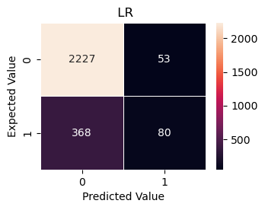
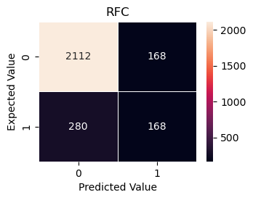
Fig : Confusion matrix of LR and RFC models
10
Performance

Slide 12
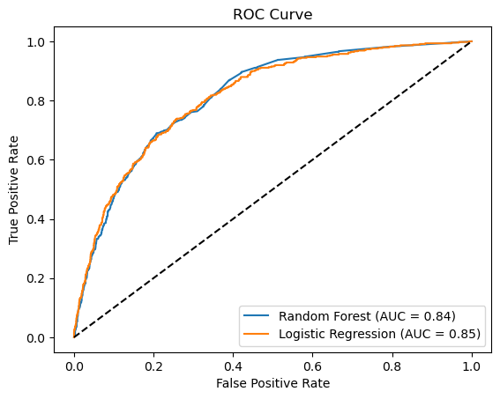
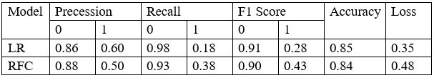
Performance
11
Fig: Classification Report table
Fig: Compressive ROC curve

Slide 13
12
Introduction
The problem
motivation
objective
tools
Data set
methodology
Expected outcome
reference
After this research we will have prediction models with high accuracy.

Slide 14
13
Introduction
The problem
motivation
objective
tools
Data set
methodology
Expected outcome
reference
[1] Trneny, M. (2017). Machine learning for predicting success of video games. Masaryk University, Faculty of Informatics.
[2] BEAUJON, Walter Steven. Predicting Video Game Sales in the European Market. 2012. Available also from: https://www.few.vu.nl/nl/Images/werkstuk-beaujon_tcm243-264134.pdf.
[3] EHRENFELD, Steven Emil. Predicting Video Game Sales Using an Analysis of Internet Message Board Discussions. 2011. Available also from:https://sdsu-dspace.calstate.edu/bitstream/handle/10211.

Slide 15
THANKS

