Slide 1
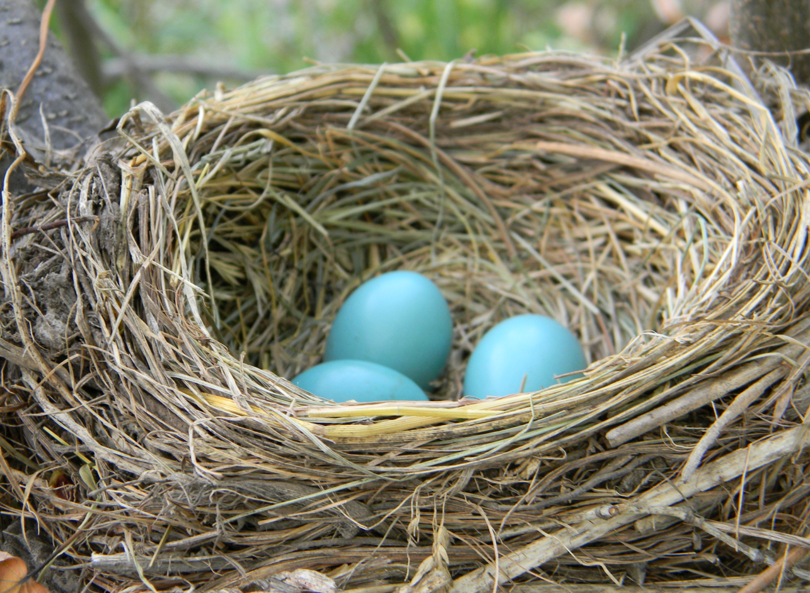
Nested Forms

Slide 2
Why nested forms?(...why?)
Model A is related to model B:
All elements of model B are children of some element in model A
Updates to both models might happen simultaneously (not necessarily always)
Example: Owners (A) and Pets(B)

Slide 3
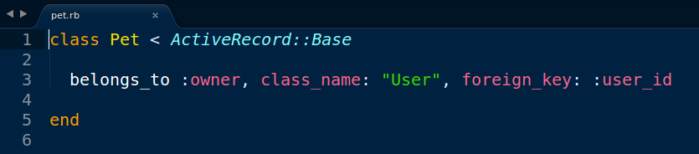
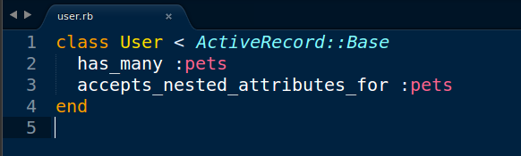
Start with Models
No changes to the Pet model but the User model gets this accepts_nested_attributes_for :pets

Slide 4
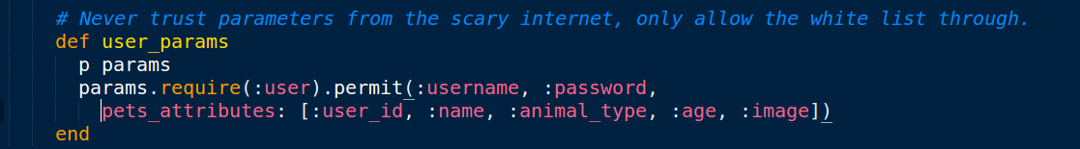
Controller needs strong params
Here are the params, nested! Note the label is pets_attributes; matches what's in the model.

Slide 5
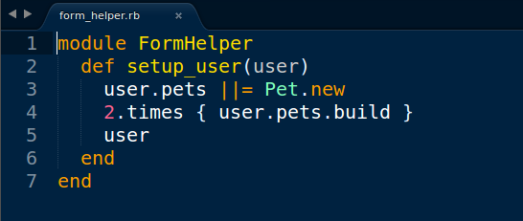
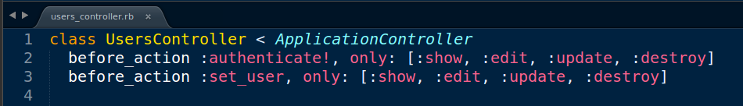
Set up your form
Create a FormHelper to setup_user before you go to a user form.
Call the setup_user method in the UsersController before visiting specific routes.

Slide 6
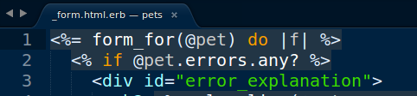
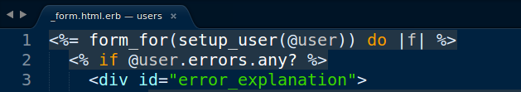
Build your form: two changes
Normal form for the Pet model: send it the @pet object, which could be blank.
In the nested form, you call the setup_user method, feeding it the @user object from the controller. The controller routes (:new, :create, etc.) are no different than usual.

Slide 7
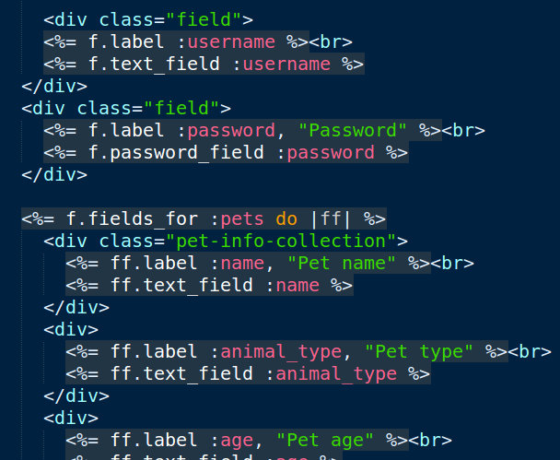
Build your form: two changes
Magic happens!

