Slide 1
Project Presentation
Present by Xiyuan Liu

Slide 2
Table of contents
Research topic
Dataset
Workflow introduction
Data preprocessing + Data statistic (Azure Databricks)
Model-seq2seq (Colab + TPU)
Performance evaluation
Limitations
Further approaches

Slide 3
Research Topic - Text summarization
Text summarization is the process of distilling extensive text into concise and coherent summaries while retaining essential information and meaning. This research explores the critical roles that text summarization plays in various domains:
Information Overload (Content Extraction): Addressing the challenge of overwhelming information by extracting the most relevant content, saving time and effort for users.
Search Engine Optimization (SEO): Enhancing web page visibility on search engines through the use of summarized content as snippets in search results.
Document Skimming: Facilitating efficient review of numerous documents by distilling key insights and enabling quick identification of relevant content.
Content Generation: Supporting the generation of concise and meaningful content, applicable in tasks such as abstract creation for research papers and news headlines.

Slide 4
2. Dataset
Dataset - CNN-DailyMail News:
CNN-DailyMail News is a dataset from Kaggle
CNN-DailyMail News is a collection of more than over 300k unique news articles as written by journalists at CNN and the Daily Mail.
287k training sample + 11k testing samples + 13k validation samples
3 labels : including id(0), article (1), highlights(2).

Slide 5
3. Workflow
Load data
Data preprocessing
Tokenization
Define deep learning model
Train
Define inference model
predict
Evaluate

Slide 6
3. Data preprocessing + Data statistic (Azure Databricks)
Data preprocessing, including lowercase, contraction mapping, remove punctuation + numbers, remove \n (since there are \n in the highlights), remove any unnecessary whitespace, removing stopwords, adding tokens, etc
Data split:
For efficient training, I only use portion of dataset:
Whole dataset |  | Using dataset
Train | 287k rows | Train | First 110, 000 rows
test | 11k rows | Test | First 10,500 rows
Validation | 13k rows | Validation | First 10.500 rows

Slide 7
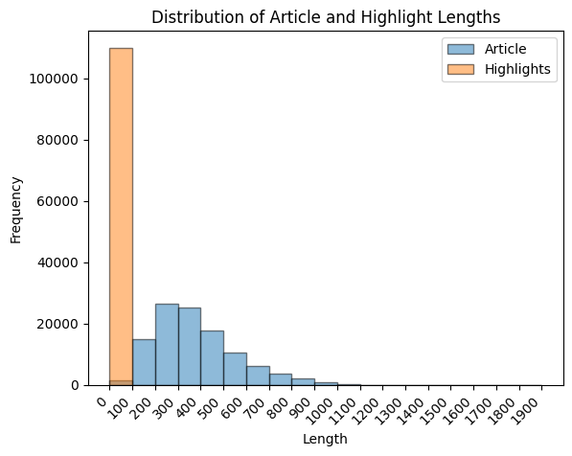
Data statistic
The observations revealed a predominant trend wherein most highlights comprised fewer than 100 tokens, while the majority of articles fell within the range of 200 to 300 tokens.

Slide 8
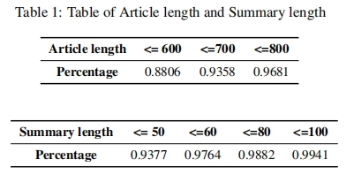
Data statistic
To systematically filter out outliers, an examination of the distribution proportions was undertaken. Consequently, a reasoned determination was made to establish a maximum article length of 700 tokens and a maximum summary length of 60 tokens, as substantiated by the distribution patterns observed

Slide 9
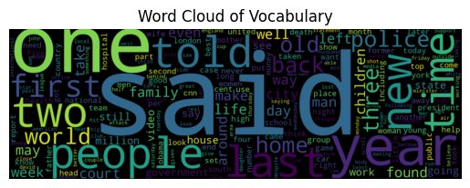
Data statistic
An additional critical consideration pertains to the total tokens within the tokenizer dictionary. The significance lies in the potential resource waste during training if there is an excessive presence of rare tokens. To mitigate this concern, a pruden measure has been implemented—a threshold of 10 occurrences.
Tokens left in Dictionary after filter
Total tokens in article Dictionary | 72,092
Total tokens in summary Dictionary | 21,180

Slide 10
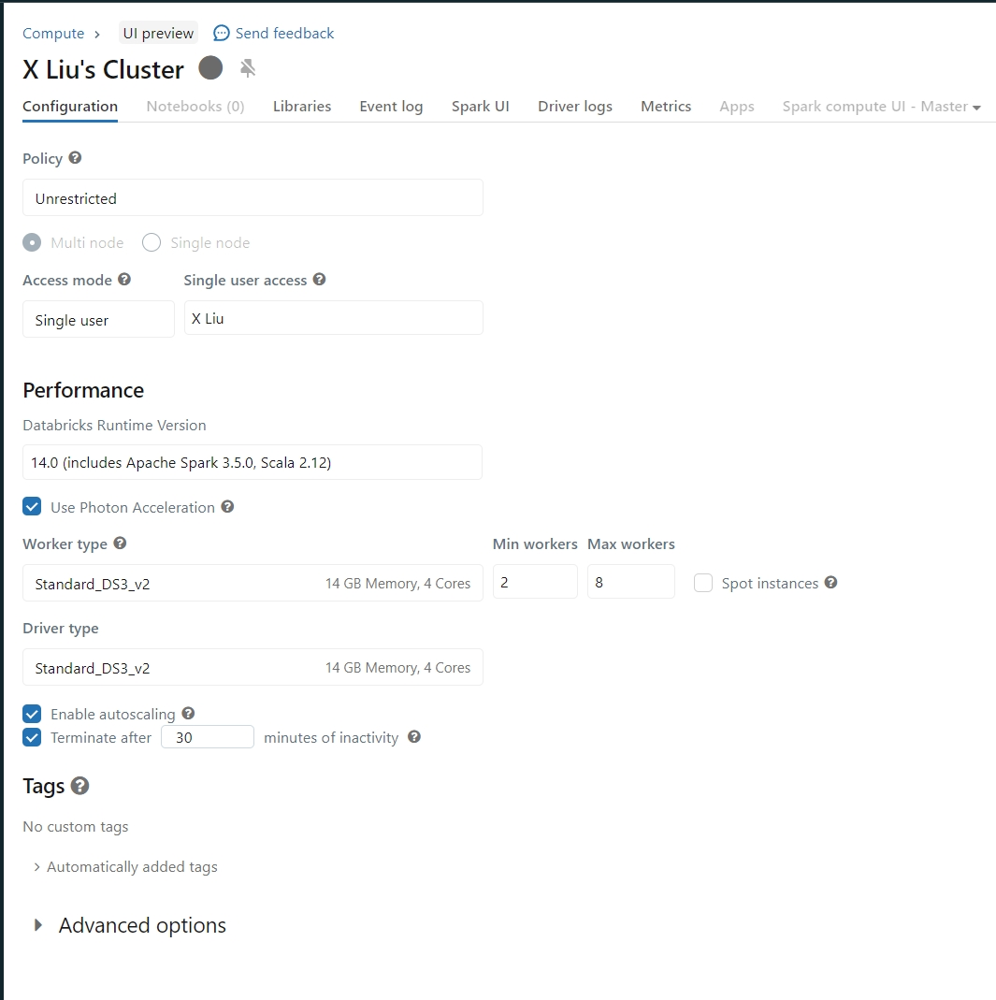
Why Azure databrick?
Easy to set up
No need for environment configuration
Multiple workers for distributed processing
Colab total process time: about 2.5 hours
Databrick process time: about 7 min
If I have larger dataset, I can set more worker to process it quicker
Optimized Performance
Databricks is optimized for performance and includes features like Delta Lake, which provides ACID transactions on big data. This can enhance the reliability and consistency of your data processing tasks.

Slide 11
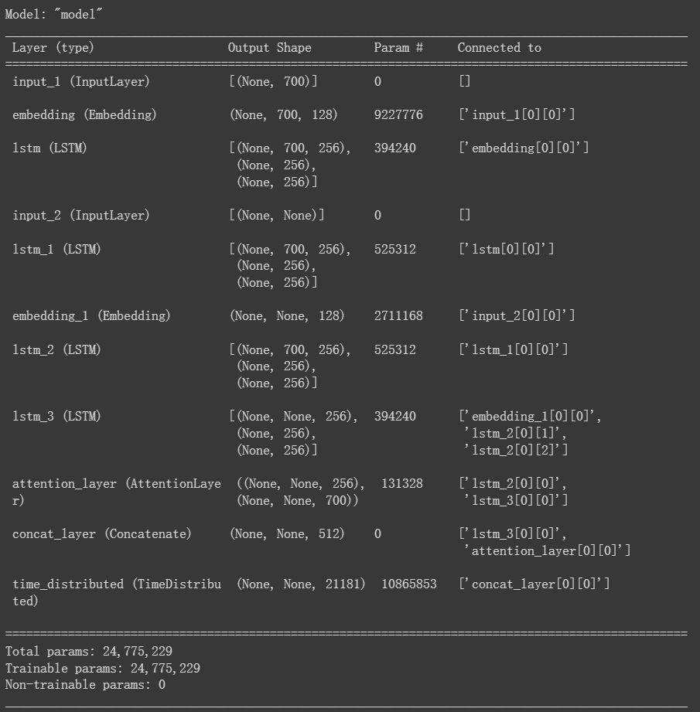
Model-seq2seq (Colab + TPU)
Encoder: The input text, which can be a sequence of words or tokens, is processed by an encoder neural network. The encoder reads the input sequence and transforms it into a fixed-size context vector, also known as the "thought vector" or "encoding." This context vector is a numerical representation that captures the semantic meaning of the input sequence.
Decoder: The decoder neural network takes the context vector generated by the encoder as its initial state. It generates an output sequence by predicting one token at a time. At each step, the decoder considers the previously generated tokens and the context vector to make predictions. This process continues until an end-of-sequence token is generated or a predefined maximum length is reached.
Inference model: In the realm of Sequence-to-Sequence (Seq2Seq) models, the creation of an inference model is indispensable for deploying models in real-world scenarios. During training, Seq2Seq models often process sequences in their entirety, making it impractical for generating predictions one step at a time. An inference model addresses this by separating the encoder and decoder components, allowing the model to generate predictions incrementally.

Slide 12
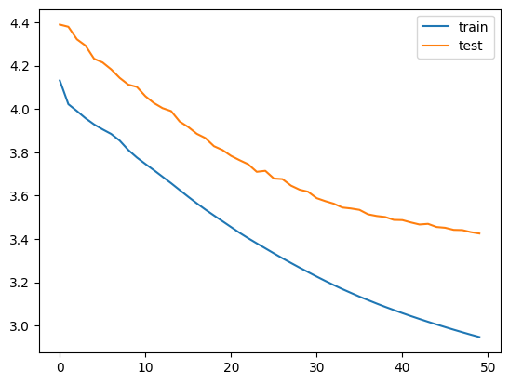

Slide 13
T5:
in the exploration of alter native methodologies, the consideration of the Text-To-Text Transfer Transformer model (T5) comes into play, particularly given the inherent complexity of the summarization task. T5, renowned for its robust capabilities in natural language generation tasks, offers distinct advantages over the previously implemented Seq2Seq model.
One notable advantage is T5’s extensive pretraining on a large data set called c4, comprising over 300 million training samples and 300 thousand validation samples. The utilization of such a large, cleaned pre-training data set contributes to enhanced model performance which leads to better performance compared to the models without pre-training. Another significant advantage lies in T5’s advancements in attention mechanisms. While both T5 and Seq2Seq models leverage attention mechanisms, T5 benefits from sophisticated variants, such as the self-attention mechanism in transformers. This feature enables T5 to effectively capture long-range dependencies and contextual information, presenting a notable improvement compared to traditional Seq2Seq models.

Slide 14
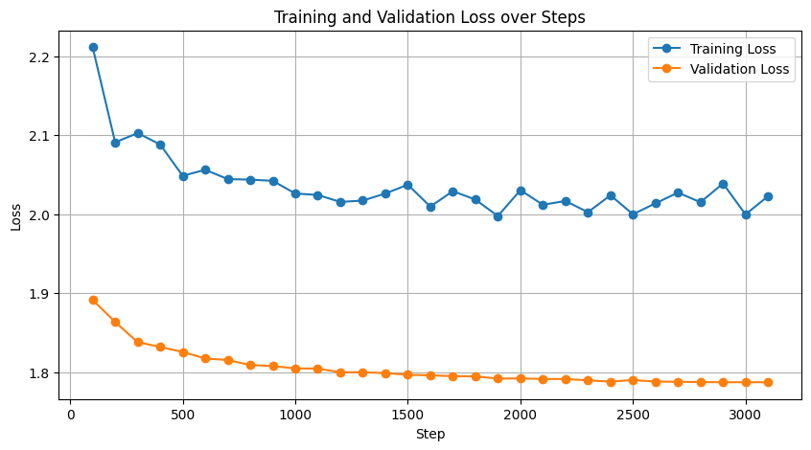

Slide 15
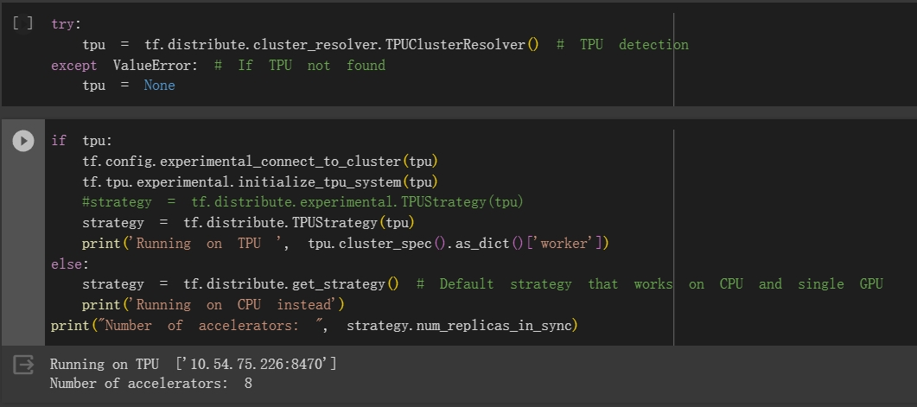
Colab TPU
Google Colab provides free access to Tensor Processing Units (TPUs), which are specialized hardware accelerators designed by Google to accelerate machine learning workloads. TPUs are particularly effective for deep learning tasks and are optimized to handle large-scale neural network computations efficiently.
Each Tensor Core, with 8 GB chip memory (HBM), has been unified. Each of the 8 cores on the TPU can execute user accounts (XLA ops) independently. High-bandwidth interconnection paths allow the chips to communicate directly with each other.
Device | Training time for each Epoch | Cost
V100: System RAM: 51GB GPU RAM: 16GB | About 3 hours | About 7 units /hour
TPU: System RAM: 35.2 GB | 675s | About 2 units /hour

Slide 16
Why switch from databrick to Colab TPU
Free Access to TPUs in Colab
Colab provides free access to TPUs, which can be advantageous for users who want to experiment with larger models without incurring additional costs. Azure Databricks may involve associated costs, and the free access to TPUs in Colab can be particularly beneficial for research and smaller-scale projects.
Cost:
About 2 unit for an hour using Colab TPU (monthly subscription give you 100 units)
Using azure databricks graphic card to train multiple large models will be expensive.
Environment configuration:
Colab is known for its ease of use and accessibility. Setting up a Colab notebook with TPUs is straightforward, and it provides a convenient environment for prototyping and experimenting. Azure Databricks, while powerful, may involve more setup and configuration.
Quick Iterations and Prototyping:
Colab is suitable for quick iterations and prototyping, making it a good choice for experimenting with different model architectures and hyperparameters. The interactive nature of Colab notebooks allows for rapid development and testing.

Slide 17
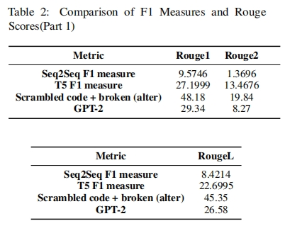
Performance evaluation: Rouge Score

Slide 18
Challenges encountered by the Seq2Seq model
Input text sequence is 700 length
Gradient vanishing problem

Slide 19
7. Limitations
Computational power and time limitation
For this project, I already used 200 computational units in colab, but I still have a lot throughs to try…
Epoch limitations + Process time
Model interpretation
Learning Seq2seq from base.
Lack of experience on incrementing large model.
I try to build an Attention layers by myself but I failed.

Slide 20
Further approaches
Seq2Seq:
self-attention mechanisms
Implement Beam search method to replace the greedy method.
T5:
Switch from T5 small to T5 basic

