Slide 1
Monty hall problem
Heather Bradfield, Kristen Godinez, Robert Aroutiounian

Slide 2
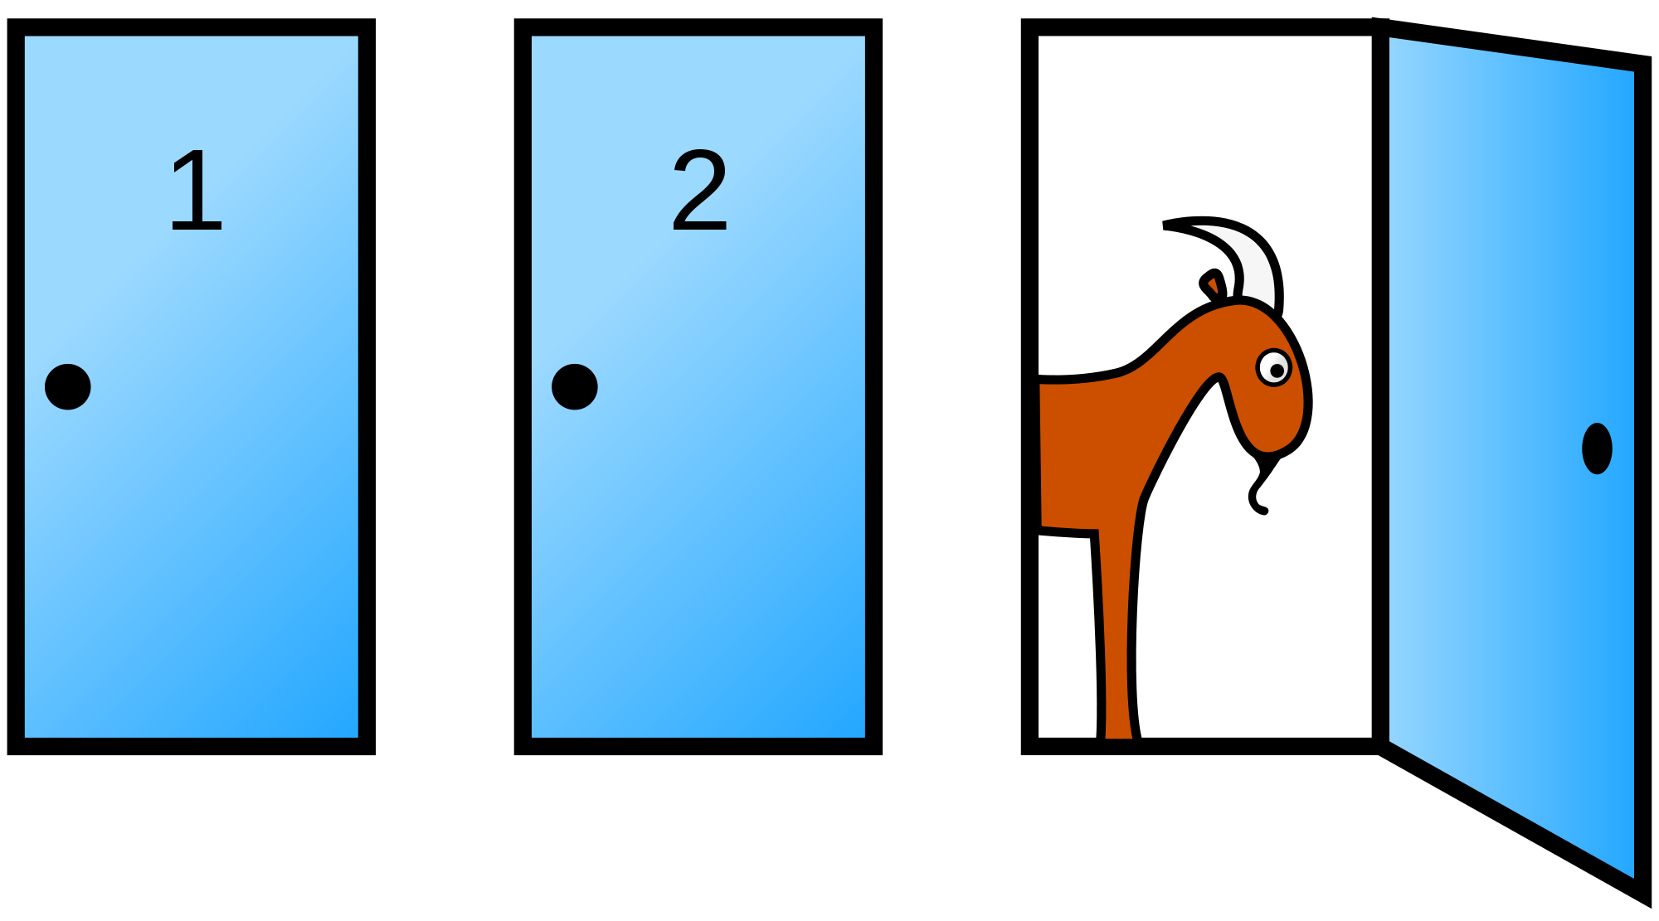
Background
The Monty Hall Problem became popularized by the game show Let’s Make a Deal, and was name after the host of the show, Monty Hall.
You, the contestant, are presented with three doors and are asked to choose one. Then one of the doors, which you did not pick, is opened revealing a goat. You are then asked if you would like to switch doors, or stay with the one you originally picked.

Slide 3
Steve selvin
The Monty Hall Problem was originally proposed and solved in a letter to the American Statistician in 1975 by Steve Selvin.
He was able to come up with a solution using condition probability

Slide 4
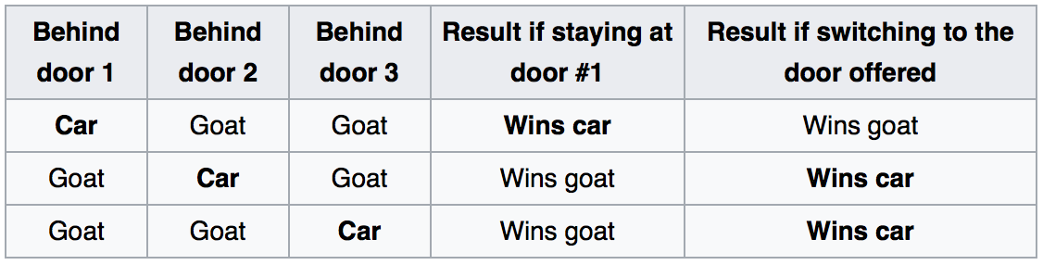

Slide 5
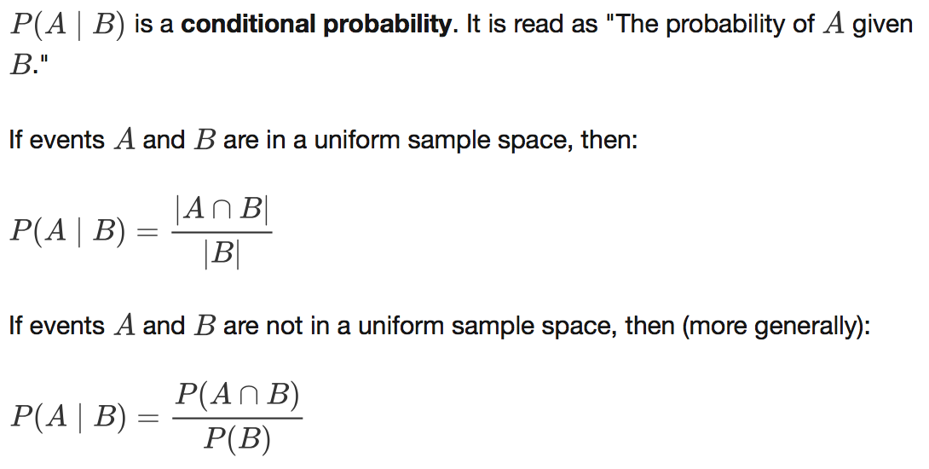
Conditional
Probability

