Slide 1
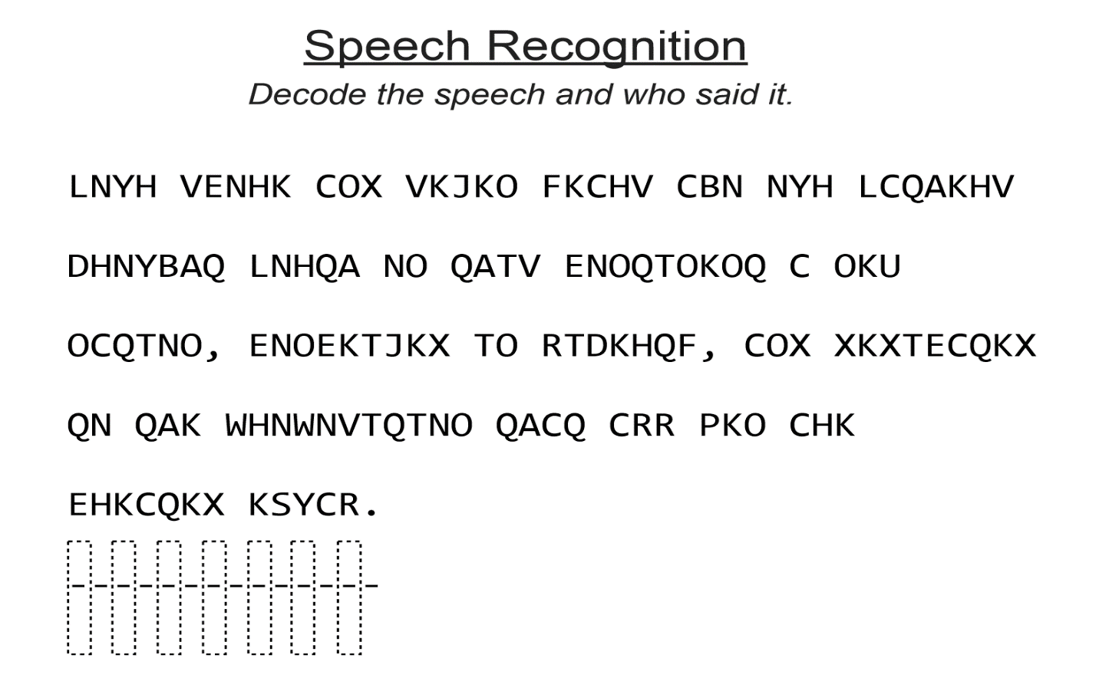
Speech Recognition

Slide 2
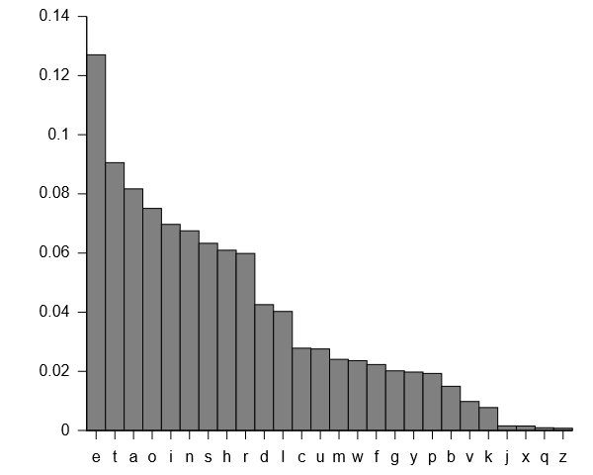
How often do letters show up?

Slide 3
A | 6
B | 2
C | 12
D | 1
E | 6
F | 2
G | 0
H | 8
I | 0
J | 2
K | 16
L | 3
M | 0
N | 13
O | 14
P | 1
Q | 15
R | 3
S | 1
T | 9
U | 1
V | 5
W | 2
X | 6
Y | 1
Z | 0

Slide 4
Class 2 Recaps
Heather Shapiro
Technical Evangelist
@microheather

Slide 5
Independent and Dependent Variables

Slide 6
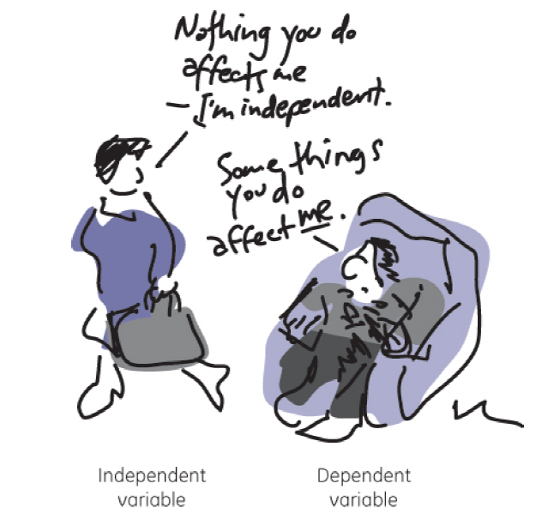

Slide 7
Would you have survived the Titanic?
Class | Name | Age | Ticket # | Fare | Cabin # | Survived
First | Carl A | 25 | 1 | A | 123 | 0
Main | Steven S | 55 | 2 | C | 324 | 1
Independent
Variable
…
Dependent Variable
…
…
…
…
Features

