Slide 1
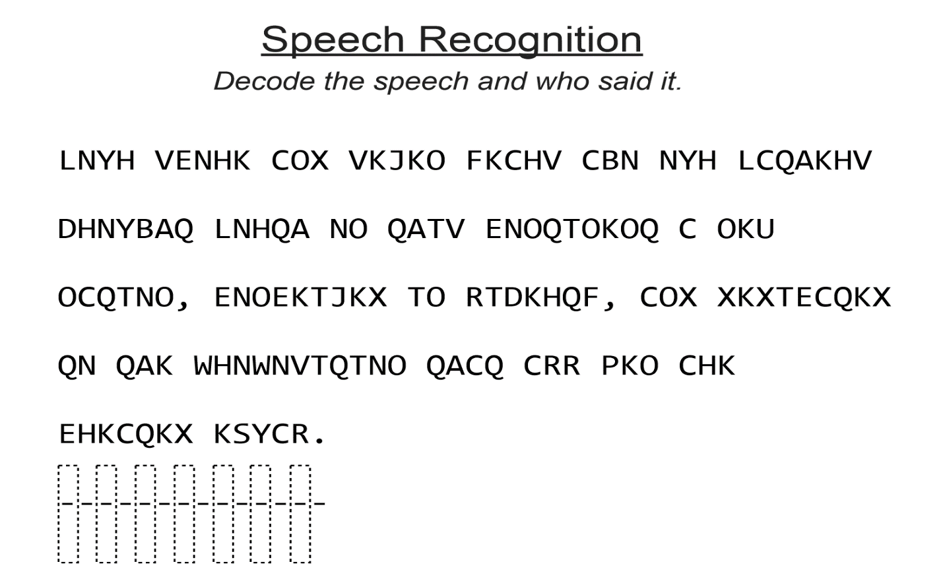
Speech Recognition

Slide 2
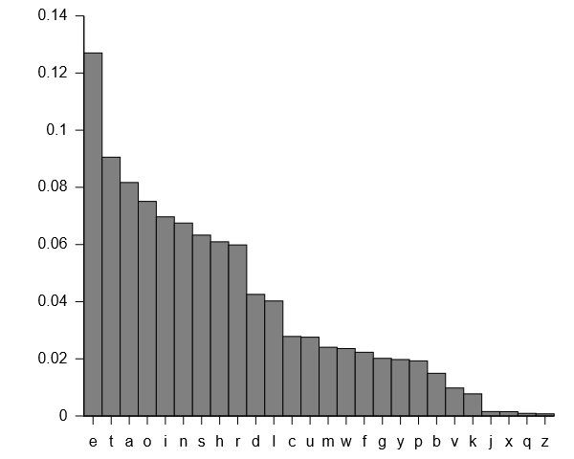
How often do letters show up?

Slide 3
LNYH VENHK COX VKJKO FKCHV CBN NYH LCQAKHV DHNYBAQ LNHQA NO QATV ENOQTOKOQ C OKU OCQTNO, ENOEKTJKX TO RTDKHQF, COX XKXTECQKX QN QAK WHNWNVTQTNO QACQ CRR PKO CHK EHKCQKX KSYCR.
Letter | Count | Letter | Count
A | 6 | N | 13
B | 2 | O | 14
C | 12 | P | 1
D | 1 | Q | 15
E | 6 | R | 4
F | 2 | S | 1
G | 0 | T | 9
H | 8 | U | 1
I | 0 | V | 5
J | 2 | W | 2
K | 16 | X | 6
L | 3 | Y | 1
M | 0 | Z | 0

Slide 4
LNYH VENHK COX VKJKO FKCHV CBN NYH LCQAKHV DHNYBAQ LNHQA NO QATV ENOQTOKOQ C OKU OCQTNO, ENOEKTJKX TO RTDKHQF, COX XKXTECQKX QN QAK WHNWNVTQTNO QACQ CRR PKO CHK EHKCQKX KSYCR.
Letter | Count | Letter | Count
A | 6 | N | 13
B | 2 | O | 14
C | 12 | P | 1
D | 1 | Q | 15
E | 6 | R | 4
F | 2 | S | 1
G | 0 | T | 9
H | 8 | U | 1
I | 0 | V | 5
J | 2 | W | 2
K | 16 | X | 6
L | 3 | Y | 1
M | 0 | Z | 0

Slide 5
Replace the K’s with E’s!
LNYH VENHE COX VEJEO FECHV CBN NYH LCQAEHV DHNYBAQ LNHQA NO QATV ENOQTOEOQ C OEU OCQTNO, ENOEETJEX TO RTDEHQF, COX XEXTECQEX QN QAE WHNWNVTQTNO QACQ CRR PKO CHE EHECQEX ESYCR.
Letter | Count | Letter | Count
A | 6 | N | 13
B | 2 | O | 14
C | 12 | P | 1
D | 1 | Q | 15
E | 6 | R | 4
F | 2 | S | 1
G | 0 | T | 9
H | 8 | U | 1
I | 0 | V | 5
J | 2 | W | 2
K | 16 | X | 6
L | 3 | Y | 1
M | 0 | Z | 0

Slide 6
LNYH VENHE COX VEJEO FECHV CBN NYH LCQAEHV DHNYBAQ LNHQA NO QATV ENOQTOEOQ C OEU OCQTNO, ENOEETJEX TO RTDEHQF, COX XEXTECQEX QN QAE WHNWNVTQTNO QACQ CRR PKO CHE EHECQEX ESYCR.
Letter | Count | Letter | Count
A | 6 | N | 13
B | 2 | O | 14
C | 12 | P | 1
D | 1 | Q | 15
E | 6 | R | 4
F | 2 | S | 1
G | 0 | T | 9
H | 8 | U | 1
I | 0 | V | 5
J | 2 | W | 2
K | 16 | X | 6
L | 3 | Y | 1
M | 0 | Z | 0

Slide 7
Replace the Q’s with T’s!
LNYH VENHE COX VEJEO FECHV CBN NYH LCTAEHV DHNYBAT LNHTA NO TATV ENOTTOEOT C OEU OCTTNO, ENOEETJEX TO RTDEHQF, COX XEXTECTEX TN TAE WHNWNVTTTNO TACT CRR PKO CHE EHECTEX ESYCR.
Letter | Count | Letter | Count
A | 6 | N | 13
B | 2 | O | 14
C | 12 | P | 1
D | 1 | Q | 15
E | 6 | R | 4
F | 2 | S | 1
G | 0 | T | 9
H | 8 | U | 1
I | 0 | V | 5
J | 2 | W | 2
K | 16 | X | 6
L | 3 | Y | 1
M | 0 | Z | 0

Slide 8
LNYH VENHE COX VEJEO FECHV CBN NYH LCTAEHV DHNYBAT LNHTA NO TATV ENOTTOEOT C OEU OCTTNO, ENOEETJEX TO RTDEHQF, COX XEXTECTEX TN TAE WHNWNVTTTNO TACT CRR PKO CHE EHECTEX ESYCR.
Letter | Count | Letter | Count
A | 6 | N | 13
B | 2 | O | 14
C | 12 | P | 1
D | 1 | Q | 15
E | 6 | R | 4
F | 2 | S | 1
G | 0 | T | 9
H | 8 | U | 1
I | 0 | V | 5
J | 2 | W | 2
K | 16 | X | 6
L | 3 | Y | 1
M | 0 | Z | 0
What word has two letters and follows “T”?

Slide 9
LNYH VENHE COX VEJEO FECHV CBN NYH LCTAEHV DHNYBAT LNHTA NO TATV ENOTTOEOT C OEU OCTTNO, ENOEETJEX TO RTDEHQF, COX XEXTECTEX TN TAE WHNWNVTTTNO TACT CRR PKO CHE EHECTEX ESYCR.
Letter | Count | Letter | Count
A | 6 | N | 13
B | 2 | O | 14
C | 12 | P | 1
D | 1 | Q | 15
E | 6 | R | 4
F | 2 | S | 1
G | 0 | T | 9
H | 8 | U | 1
I | 0 | V | 5
J | 2 | W | 2
K | 16 | X | 6
L | 3 | Y | 1
M | 0 | Z | 0
What word has two letters and follows “T”?
“TO”!

Slide 10
LNYH VENHE COX VEJEO FECHV CBN NYH LCTAEHV DHNYBAT LNHTA NO TATV ENOTTOEOT C OEU OCTTNO, ENOEETJEX TO RTDEHQF, COX XEXTECTEX TN TAE WHNWNVTTTNO TACT CRR PKO CHE EHECTEX ESYCR.
Letter | Count | Letter | Count
A | 6 | N | 13
B | 2 | O | 14
C | 12 | P | 1
D | 1 | Q | 15
E | 6 | R | 4
F | 2 | S | 1
G | 0 | T | 9
H | 8 | U | 1
I | 0 | V | 5
J | 2 | W | 2
K | 16 | X | 6
L | 3 | Y | 1
M | 0 | Z | 0

Slide 11
Replace the N’s with O’s!
Replace the N’s with O’s!
LOYH VEOHE COX VEJEO FECHV CBO OYH LCTAEHV DHOYBAT LOHTA OO TATV EOOTTOEOT C OEU OCTTOO, EOOEETJEX TO RTDEHQF, COX XEXTECTEX TO TAE WHOWOVTTTOO TACT CRR PKO CHE EHECTEX ESYCR.
Letter | Count | Letter | Count
A | 6 | N | 13
B | 2 | O | 14
C | 12 | P | 1
D | 1 | Q | 15
E | 6 | R | 4
F | 2 | S | 1
G | 0 | T | 9
H | 8 | U | 1
I | 0 | V | 5
J | 2 | W | 2
K | 16 | X | 6
L | 3 | Y | 1
M | 0 | Z | 0

Slide 12
What letters follow each other? We know it’s not E or O!
LOYH VEOHE COX VEJEO FECHV CBO OYH LCTAEHV DHOYBAT LOHTA OO TATV EOOTTOEOT C OEU OCTTOO, EOOEETJEX TO RTDEHQF, COX XEXTECTEX TO TAE WHOWOVTTTOO TACT CRR PKO CHE EHECTEX ESYCR.
Letter | Count | Letter | Count
A | 6 | N | 13
B | 2 | O | 14
C | 12 | P | 1
D | 1 | Q | 15
E | 6 | R | 4
F | 2 | S | 1
G | 0 | T | 9
H | 8 | U | 1
I | 0 | V | 5
J | 2 | W | 2
K | 16 | X | 6
L | 3 | Y | 1
M | 0 | Z | 0

Slide 13
What letters follow each other? We know it’s not E or O!
LOYH VEOHE COX VEJEO FECHV CBO OYH LCTAEHV DHOYBAT LOHTA OO TATV EOOTTOEOT C OEU OCTTOO, EOOEETJEX TO RTDEHQF, COX XEXTECTEX TO TAE WHOWOVTTTOO TACT CRR PKO CHE EHECTEX ESYCR.
Letter | Count | Letter | Count
A | 6 | N | 13
B | 2 | O | 14
C | 12 | P | 1
D | 1 | Q | 15
E | 6 | R | 4
F | 2 | S | 1
G | 0 | T | 9
H | 8 | U | 1
I | 0 | V | 5
J | 2 | W | 2
K | 16 | X | 6
L | 3 | Y | 1
M | 0 | Z | 0
Let’s try L!

Slide 14
Replace the R’s with L’s!
LOYH VEOHE COX VEJEO FECHV CBO OYH LCTAEHV DHOYBAT LOHTA OO TATV EOOTTOEOT C OEU OCTTOO, EOOEETJEX TO LTDEHQF, COX XEXTECTEX TO TAE WHOWOVTTTOO TACT CLL PKO CHE EHECTEX ESYCL.
Letter | Count | Letter | Count
A | 6 | N | 13
B | 2 | O | 14
C | 12 | P | 1
D | 1 | Q | 15
E | 6 | R | 4
F | 2 | S | 1
G | 0 | T | 9
H | 8 | U | 1
I | 0 | V | 5
J | 2 | W | 2
K | 16 | X | 6
L | 3 | Y | 1
M | 0 | Z | 0

Slide 15
What should we try next?
LOYH VEOHE COX VEJEO FECHV CBO OYH LCTAEHV DHOYBAT LOHTA OO TATV EOOTTOEOT C OEU OCTTOO, EOOEETJEX TO LTDEHQF, COX XEXTECTEX TO TAE WHOWOVTTTOO TACT CLL PKO CHE EHECTEX ESYCL.
Letter | Count | Letter | Count
A | 6 | N | 13
B | 2 | O | 14
C | 12 | P | 1
D | 1 | Q | 15
E | 6 | R | 4
F | 2 | S | 1
G | 0 | T | 9
H | 8 | U | 1
I | 0 | V | 5
J | 2 | W | 2
K | 16 | X | 6
L | 3 | Y | 1
M | 0 | Z | 0

Slide 16
LOYH VEOHE COX VEJEO FECHV CBO OYH LCTAEHV DHOYBAT LOHTA OO TATV EOOTTOEOT C OEU OCTTOO, EOOEETJEX TO LTDEHQF, COX XEXTECTEX TO TAE WHOWOVTTTOO TACT CLL PKO CHE EHECTEX ESYCL.
Letter | Count | Letter | Count
A | 6 | N | 13
B | 2 | O | 14
C | 12 | P | 1
D | 1 | Q | 15
E | 6 | R | 4
F | 2 | S | 1
G | 0 | T | 9
H | 8 | U | 1
I | 0 | V | 5
J | 2 | W | 2
K | 16 | X | 6
L | 3 | Y | 1
M | 0 | Z | 0

Slide 17
LOYH VEOHE COX VEJEO FECHV CBO OYH LCTAEHV DHOYBAT LOHTA OO TATV EOOTTOEOT C OEU OCTTOO, EOOEETJEX TO LTDEHQF, COX XEXTECTEX TO TAE WHOWOVTTTOO TACT CLL PKO CHE EHECTEX ESYCL.
Letter | Count | Letter | Count
A | 6 | N | 13
B | 2 | O | 14
C | 12 | P | 1
D | 1 | Q | 15
E | 6 | R | 4
F | 2 | S | 1
G | 0 | T | 9
H | 8 | U | 1
I | 0 | V | 5
J | 2 | W | 2
K | 16 | X | 6
L | 3 | Y | 1
M | 0 | Z | 0

Slide 18
TADAAA!
“Four score and seven years ago our fathers brought forth on this continent a new nation, conceived in liberty, and dedicated to the proposition that all men are created equal.”
Letter | Count | Letter | Count
A | 6 | N | 13
B | 2 | O | 14
C | 12 | P | 1
D | 1 | Q | 15
E | 6 | R | 4
F | 2 | S | 1
G | 0 | T | 9
H | 8 | U | 1
I | 0 | V | 5
J | 2 | W | 2
K | 16 | X | 6
L | 3 | Y | 1
M | 0 | Z | 0

Slide 19
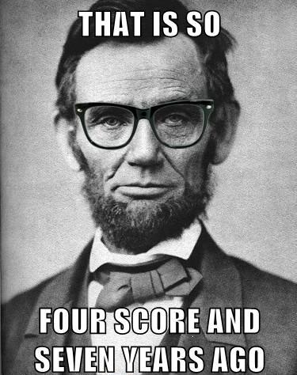

Slide 20
Class 2 Recaps
Heather Shapiro
Technical Evangelist
@microheather

Slide 21
Independent and Dependent Variables

Slide 22
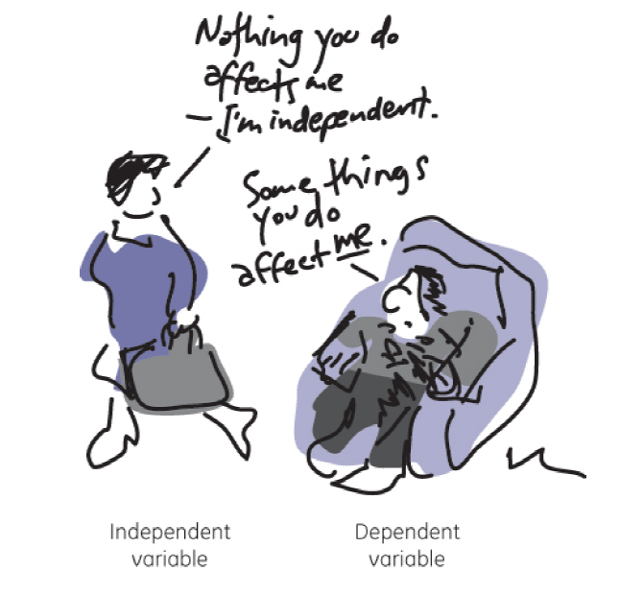

Slide 23
Would you have survived the Titanic?
Class | Name | Age | Ticket # | Fare | Cabin # | Survived
First | Carl A | 25 | 1 | A | 123 | 0
Main | Steven S | 55 | 2 | C | 324 | 1
Independent
Variable
…
Dependent Variable
…
…
…
…
Features

Slide 24
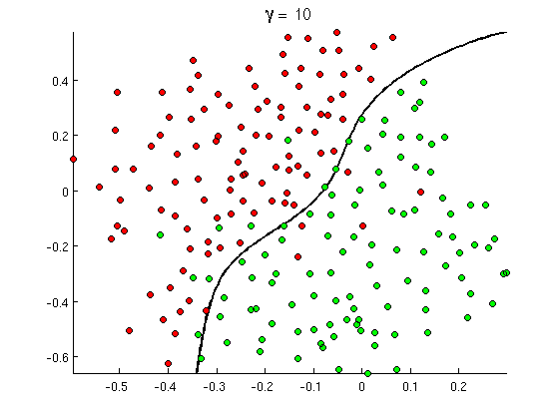
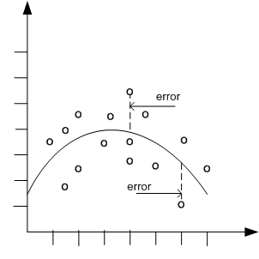

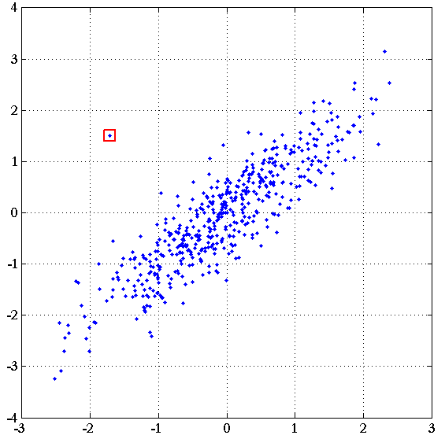
Common Classes of Problems
Classification
Regression
Recommenders
Anomaly
Detection
Notes:
http://openclassroom.stanford.edu/MainFolder/courses/MachineLearning/exercises/ex8materials/ex8b_10.png
http://docs.oracle.com/cd/B28359_01/datamine.111/b28129/img/scatter_plot_nonlinear.gif
http://spectrum.ieee.org/img/RecommendNEWf1-1348253703748.jpg

Slide 25


Problem Requirements
Valuable business problem involving decision
Existing process
Metrics
Available data
Related to the decision
Historical
Outcomes
Notes:
http://us.123rf.com/400wm/400/400/johnkwan/johnkwan1008/johnkwan100800099/7596302-yes-no-or-maybe-concepts-of-making-business-decision.jpg

Slide 26
How can we use this for our WOW projects?

Slide 27
Here’s an example

Slide 28
I looked at data with 225,000 ratings for 15,742 movies by 26,770 users

Slide 29
Trained a model based on user ratings

Slide 30
And found that the top movie recommendations were……….

Slide 31


Slide 32


Slide 33
We can do this too!

Slide 34
By surveying our classmates and seeing how they rank certain movies

Slide 35
Movies not your thing?

Slide 36
We can see what athletes are the most popular too!

Slide 37
How do we do it?

Slide 38
Machine Learning

Slide 39
Sign into Portal.azure.com

Slide 40
Microheather.com for Wordpress tutorial!

