Slide 1
Intro to AzureML
Heather Shapiro
Technical Evangelist
@microheather

Slide 2
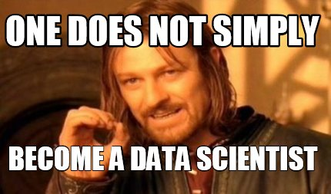

Slide 3
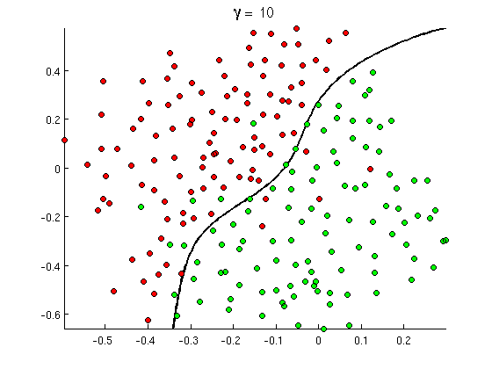
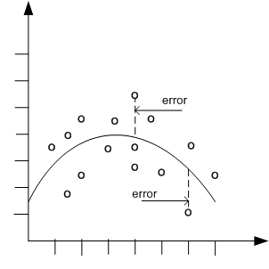

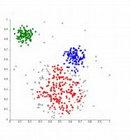
Common Classes of Problems
Classification
Regression
Recommenders
Clustering
Notes:
http://openclassroom.stanford.edu/MainFolder/courses/MachineLearning/exercises/ex8materials/ex8b_10.png
http://docs.oracle.com/cd/B28359_01/datamine.111/b28129/img/scatter_plot_nonlinear.gif
http://spectrum.ieee.org/img/RecommendNEWf1-1348253703748.jpg
Hogwarts

Slide 4
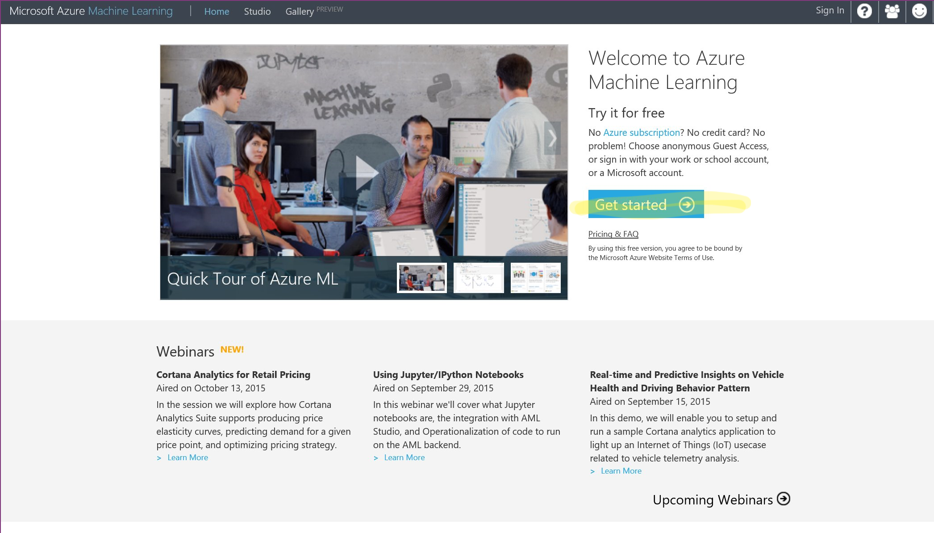

Slide 5
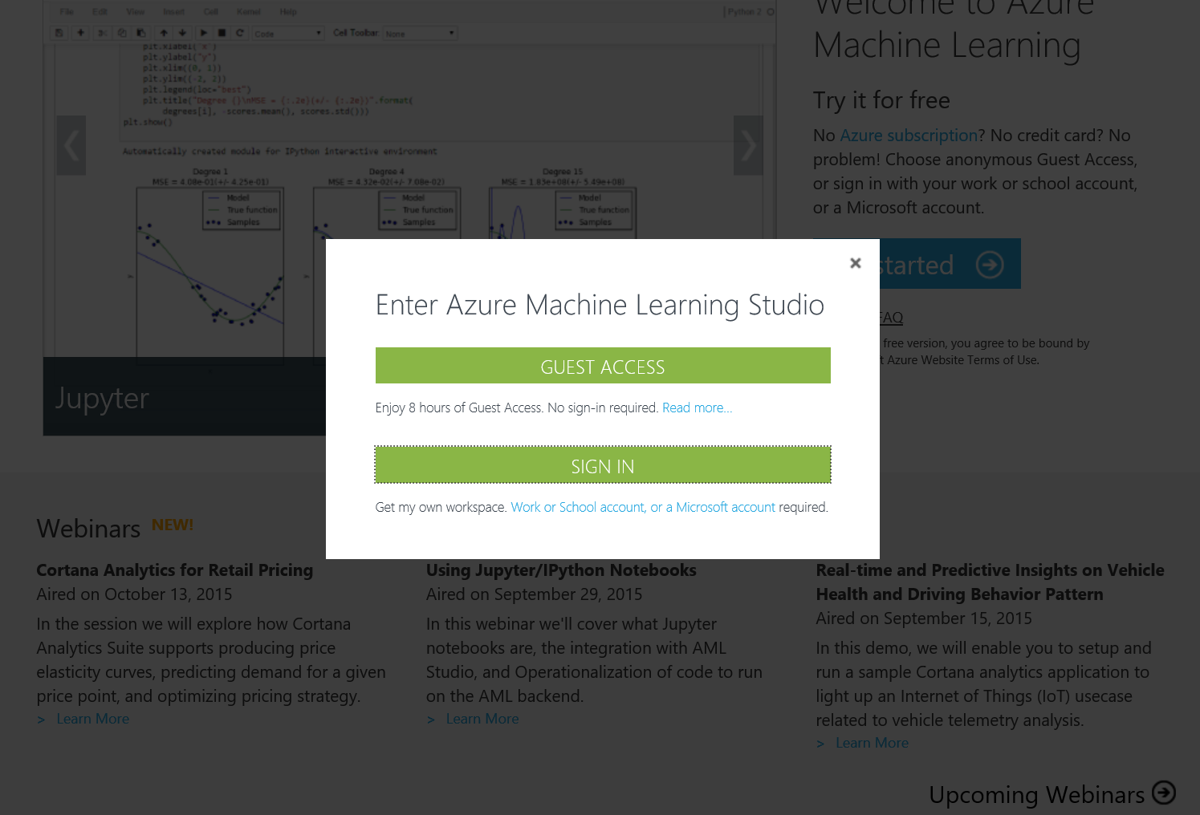

Slide 6
Sign in with the emails we created

Slide 7
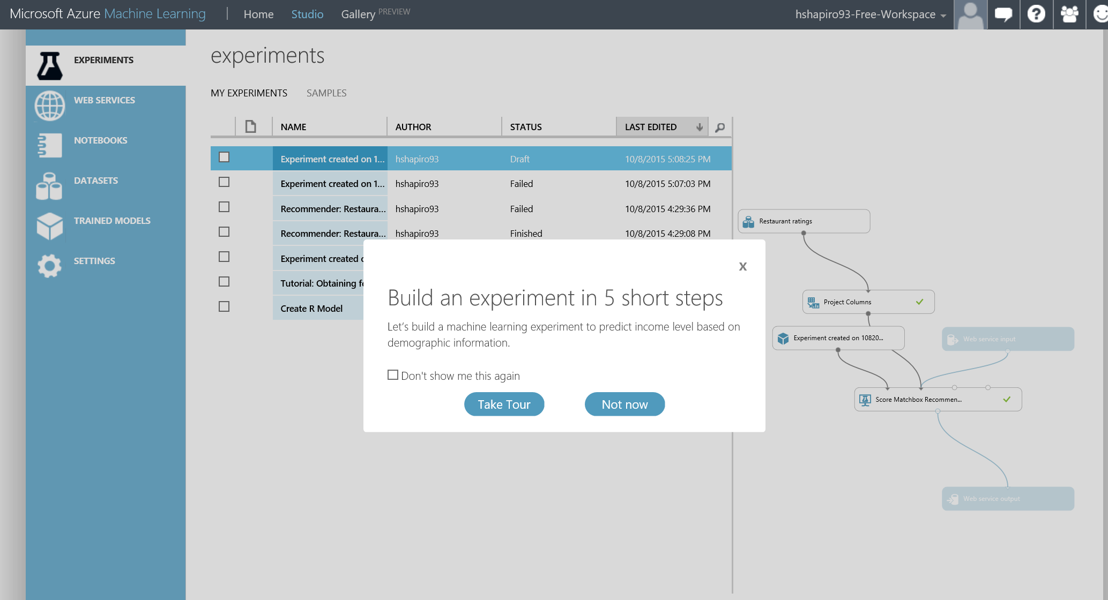

Slide 8
data
Think data in a spreadsheet
Age | Occupation | Gender | Hours/Week | Income
35 | Farming-fishing | Male | 40 | <=50K
23 | Adm-clerical | Female | 30 | <=50K
31 | Sales | Male | 38 | >50K
31 | Prof-specialty | Female | 50 | >50K
Rows are “Data points” (person, for example)
Columns represent “Features”
The set of features for a data point is a “Feature Vector”
Notes:
TO DO: add their data and ask them what predictions can we make from this data
-they should come up with the questions they should ask of the data, which of the four types of problems it is, and tell us a feature that is relevant (or multiple)

Slide 9
data
Think data in a spreadsheet
Age | Occupation | Gender | Hours/Week | Income
35 | Farming-fishing | Male | 40 | <=50K
23 | Adm-clerical | Female | 30 | <=50K
31 | Sales | Male | 38 | >50K
31 | Prof-specialty | Female | 50 | >50K
Rows are “Data points” (person, for example)
Columns represent “Features”
The set of features for a data point is a “Feature Vector”
You may have hundreds of millions of Data Points
You may have many features
Two data sets: training and test
Training data set has the answers labeled
Test data set has known answers but is unmarked
Age | Occupation | Gender | Hours/Week | Income
28 | Adm-clerical | Male | 32 | <=50K
32 | Tech-support | Female | 30 | <=50K
31 | Sales | Female | 38 | >50K
49 | Exec-management | Male | 60 | >50K

Slide 10
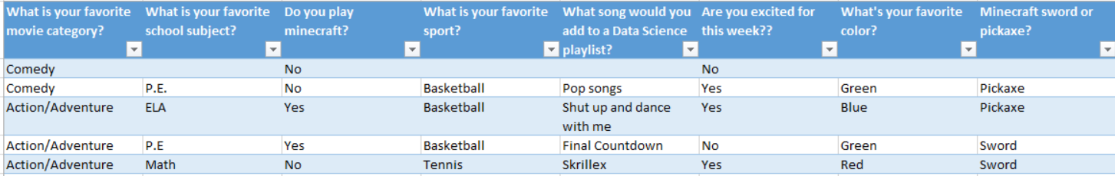
data:features
Features turn a “thing” into a vector
Features are designed specifically for a dataset and desired prediction
Much of the magic of ML is choosing the right feature vectors

Slide 11
prediction
Think generalization, not telling the future
Use a training set to generalize
Use generalizations to perform accurately on new, unseen examples

Slide 12

Data Set
Clean Up
the general process
Split
Training Algorithm
You have a dataset
Clean up your dataset
Separate dataset into training data and test data
Choose an algorithm
Train your algorithm with the training data
Test your algorithm on your test data
Analyze results
Wash rinse repeat
Training Data Set
Test
Data Set
Score
Evaluate
Notes:
Dataset: everyone in room stands up
Clean up: remove non-students
Split: 15/rest
Training: count how many jumping jacks each student can do – regression!

Slide 13
Who can do the most jumping jacks in 30 seconds????

Slide 14
What features might be important?

Slide 15
How do we visualize the results???

Slide 16
app.raw.densitydesign.org

Slide 17
Aka.ms/RSASurvey

