Slide 1
Data Visualizations
Heather Shapiro
Technical Evangelist
@microheather

Slide 2
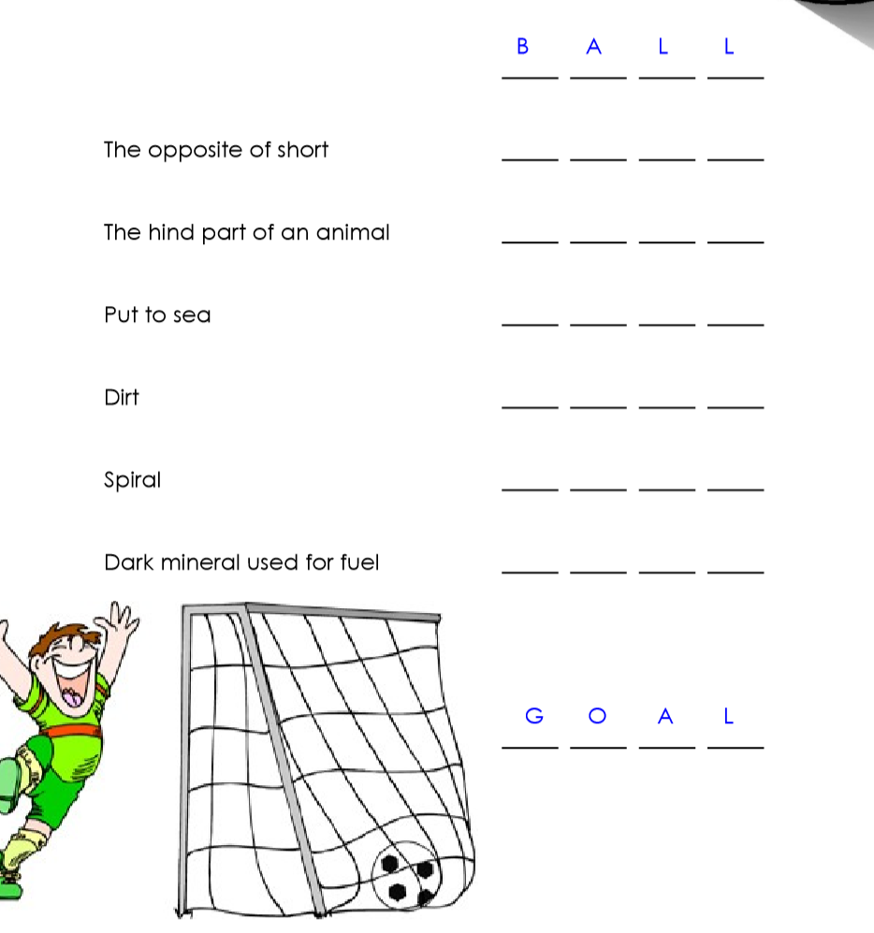
T A L L
T A I L
S A I L
S O I L
C O I L
C O A L

Slide 3
Why does this relate to data science?
Notes:
Identifying patterns is important in data science

Slide 4

Data Science for Everyone Project

Slide 5

What’d we do????
50 people surveyed
Asked about movie and music preferences

Slide 6
Let’s break up into groups and get started!!

