Slide 1

COVID-19
Vaccine Campaign

Slide 2
Recommendations
First campaign should be focussed on Gibraltar
Initial campaigns should avoid the Channel Islands
The hashtag #covid19 should be used for online campaigns
Further analysis is strongly recommended

Slide 3
Exploring the Data
Missing data and zero values
Correcting cumulative figures
Unexpected figures in the data may require adjustment
Request further information – population figures
Note that capitalisation was ignored in hashtag analysis

Slide 4
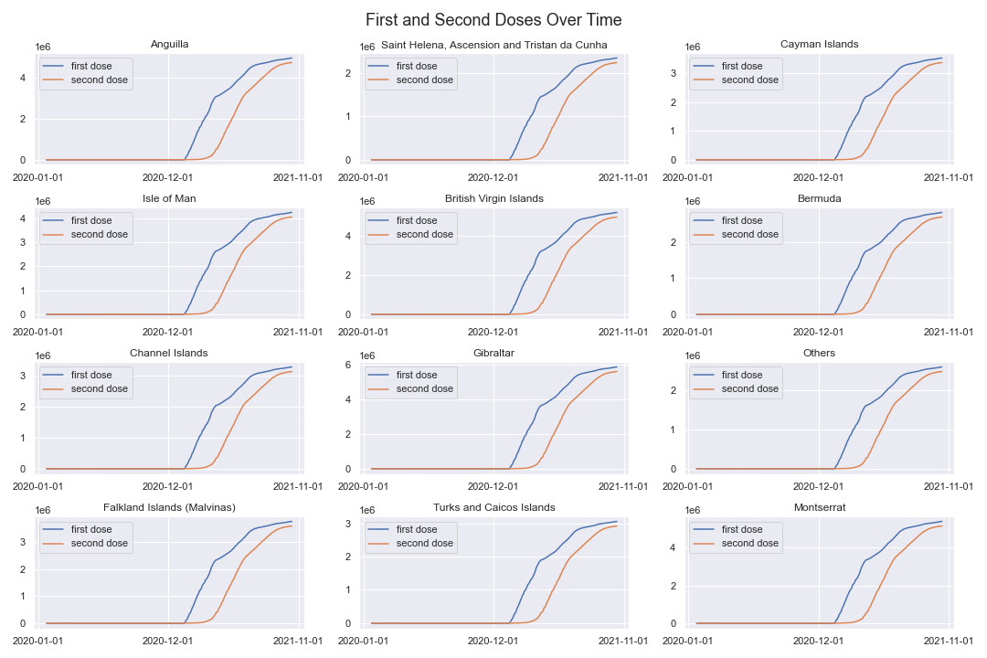
COVID Data: Vaccinations

Slide 5
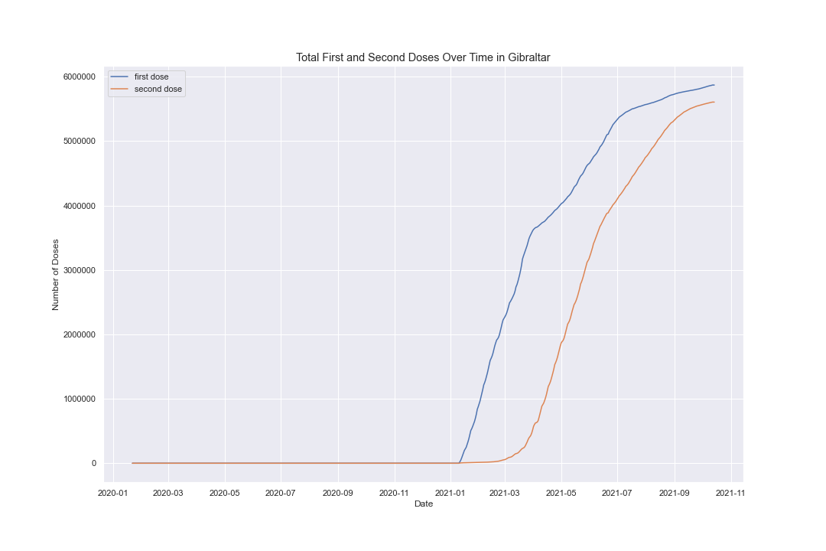
COVID Data: Vaccinations

Slide 6
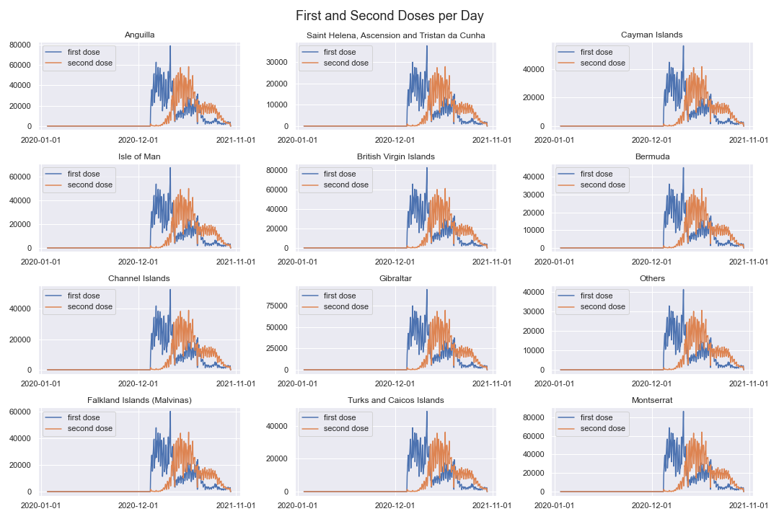
COVID Data: Vaccinations

Slide 7
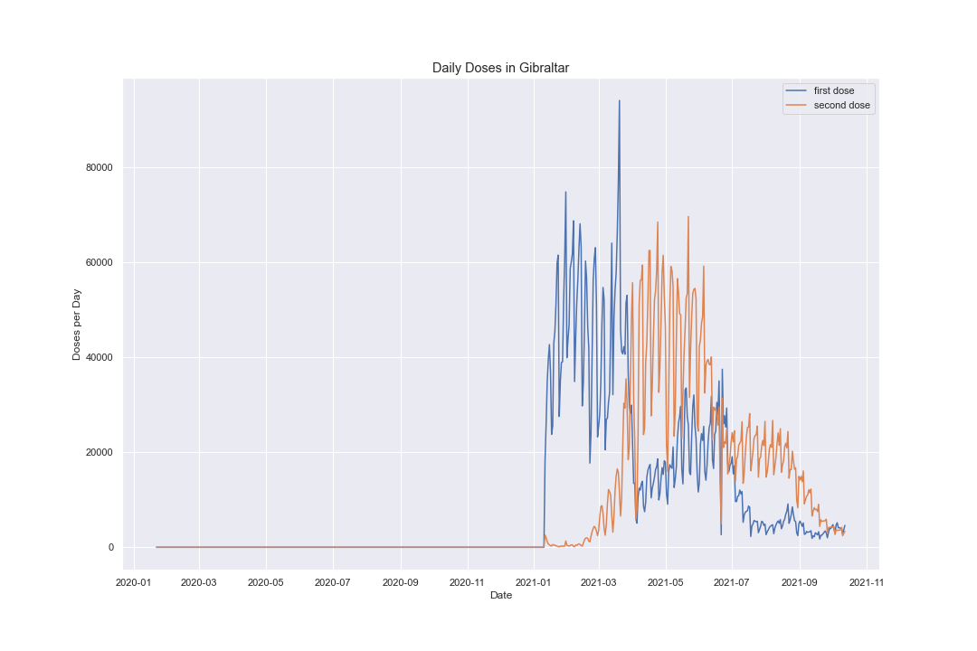
COVID Data: Vaccinations

Slide 8
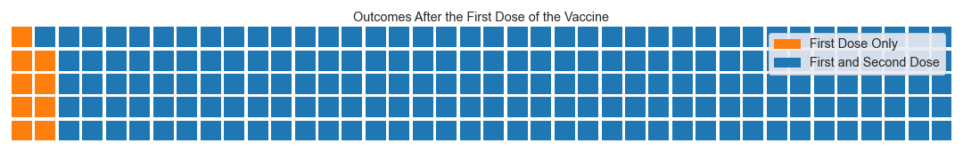
COVID Data: Vaccinations

Slide 9
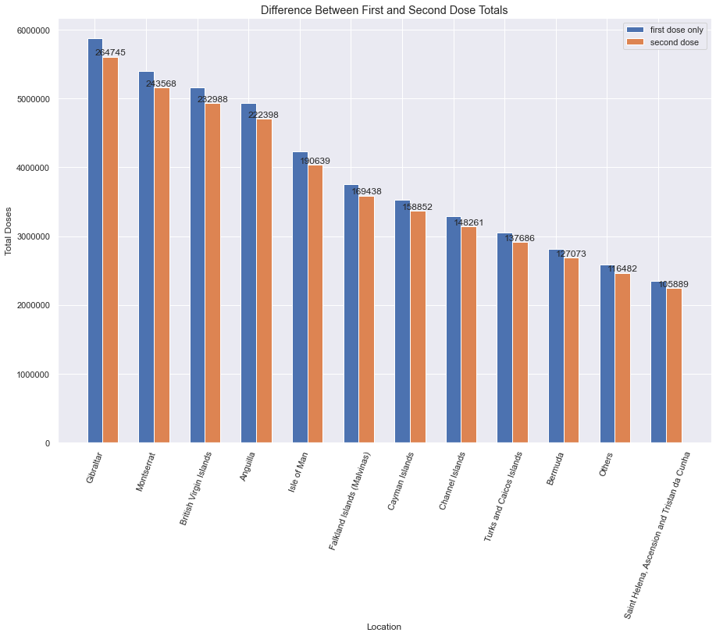
COVID Data: Vaccinations

Slide 10
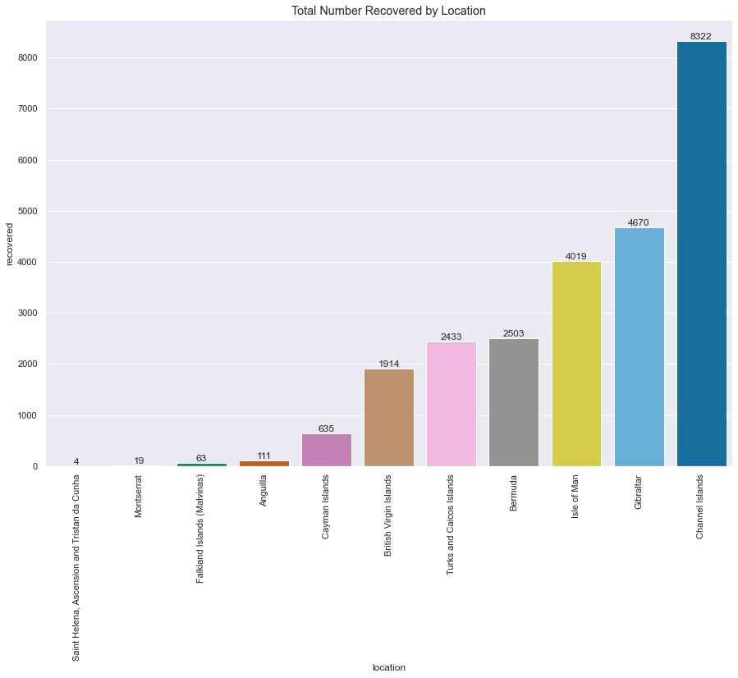
COVID Data: Recoveries

Slide 11
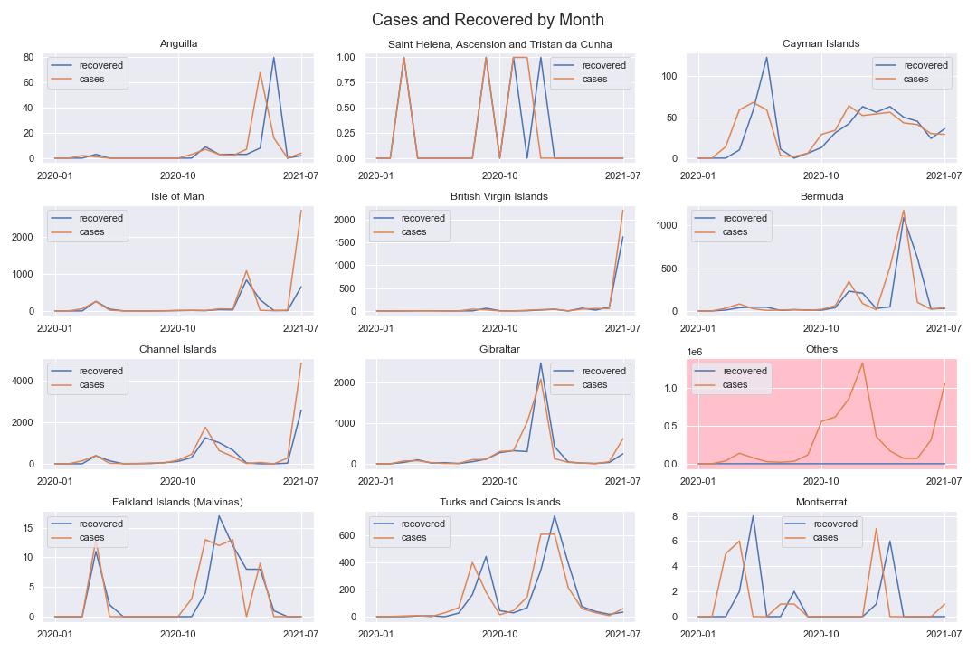
COVID Data: Recoveries

Slide 12
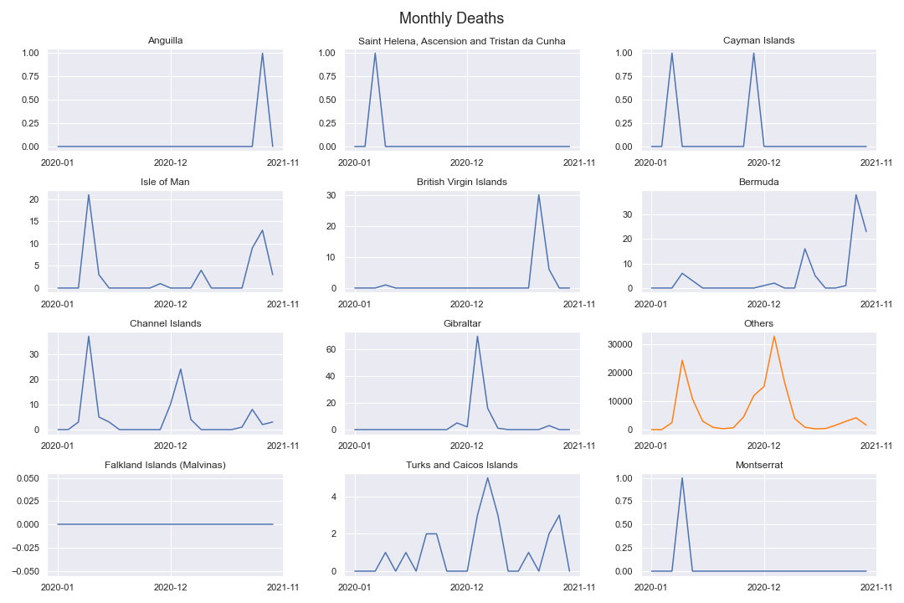
COVID Data: Deaths

Slide 13
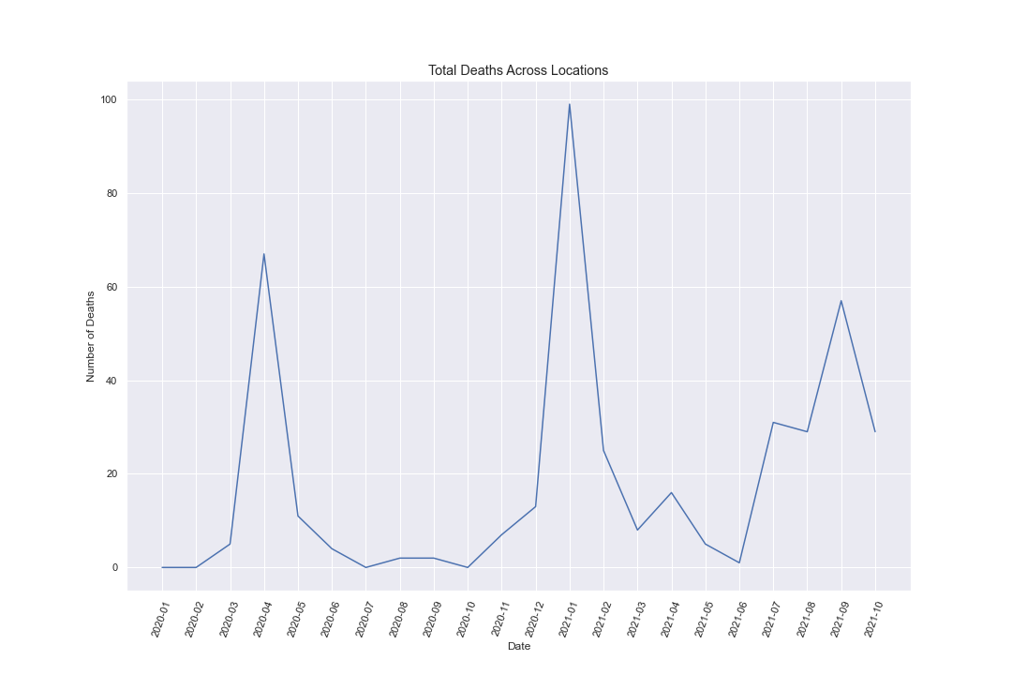
COVID Data: Deaths

Slide 14
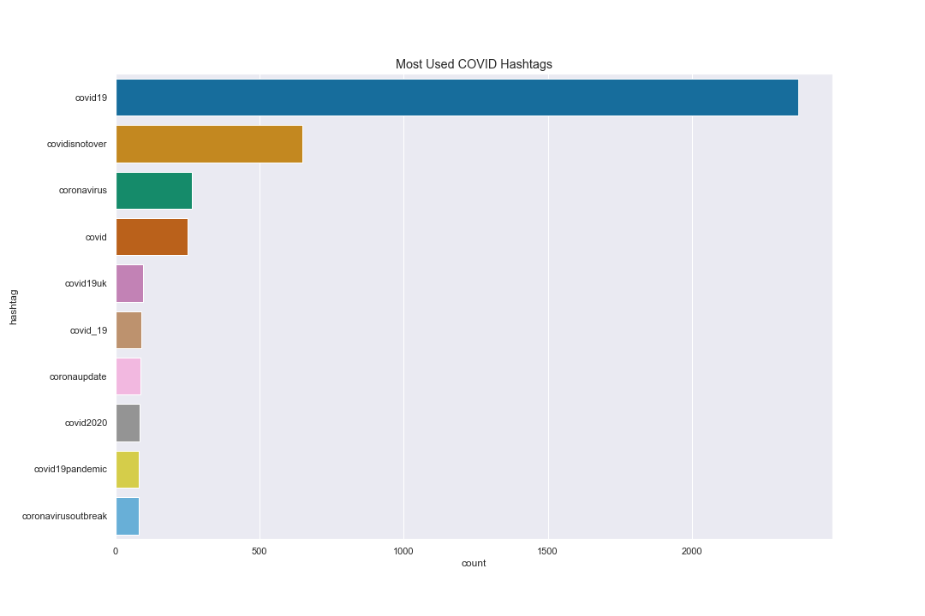
Twitter Data: Hashtags

Slide 15
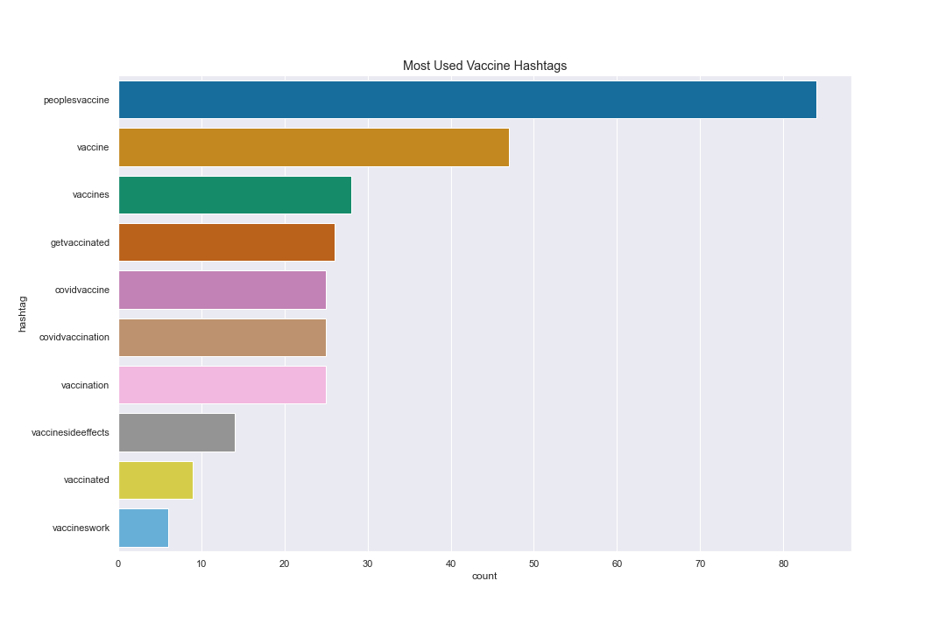
Twitter Data: Hashtags

Slide 16
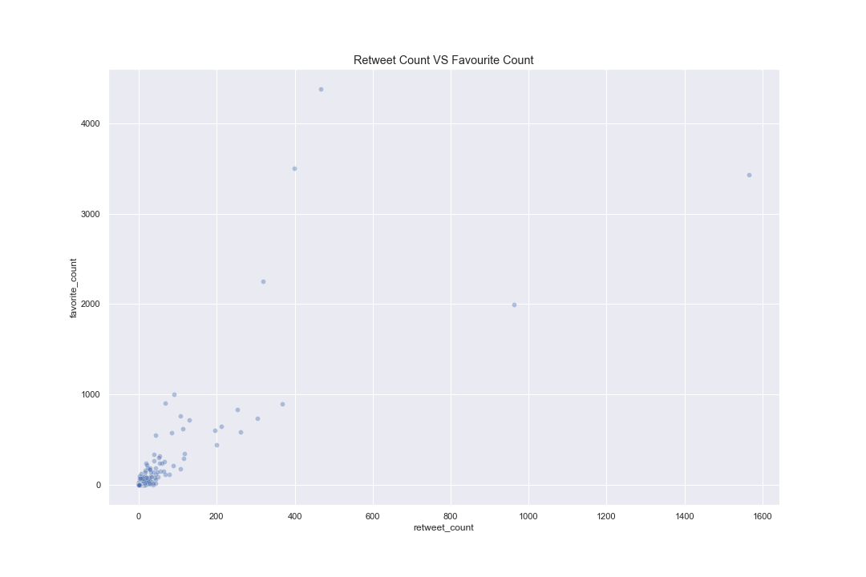
Twitter Data: Retweets

Slide 17
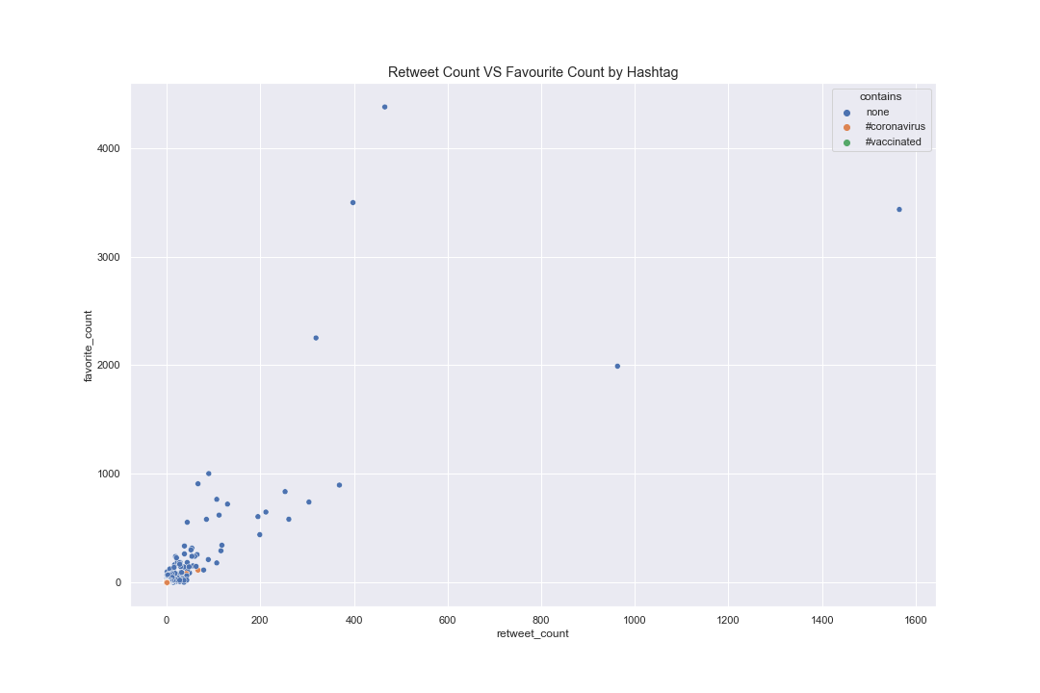
Twitter Data: Retweets

Slide 18
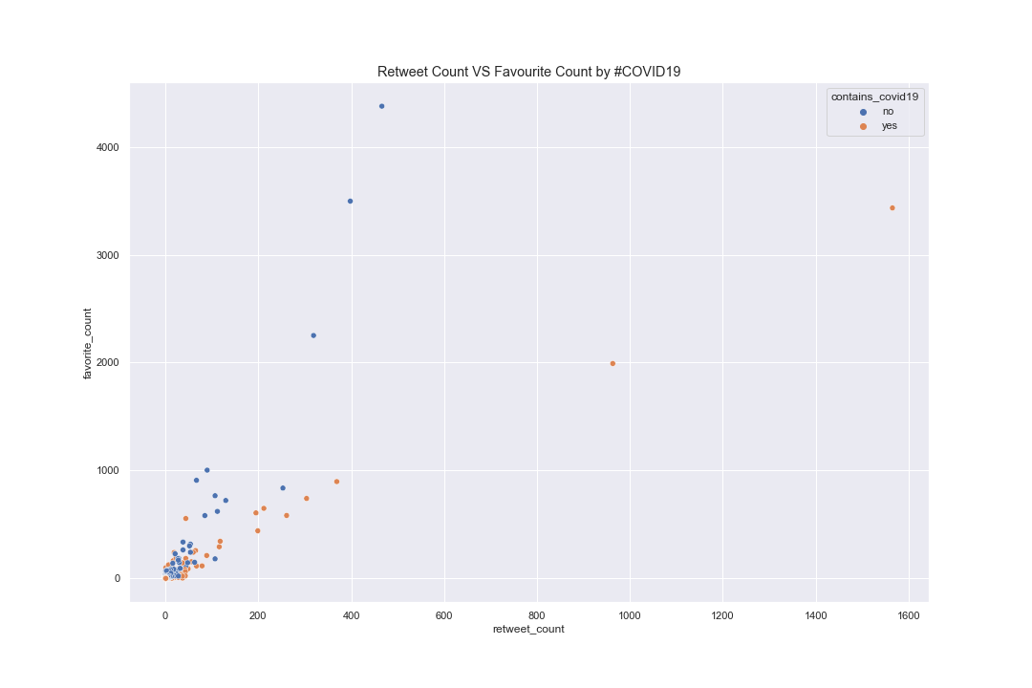
Twitter Data: Retweets

Slide 19
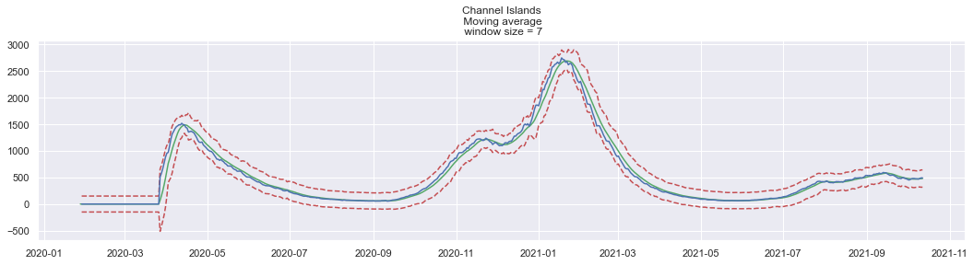
Consultant Function

Slide 20
Concepts
Qualitative and quantitative data
Reasons for continuous improvement
Data ethics considerations

Slide 21
Conclusions
Recommend focusing initial campaign on Gibraltar
Suggest focusing on areas where we might expect a future peak in hospitalisations or death
Further analysis recommended here (ARIMA forecasting)
Recommend use of hashtag #covid19 on social media
Further analysis recommended here (sentiment analysis)

