Slide 1
Analytics exercise
medmen
Heather Cohen

Slide 2
The exercise: You have been tasked to provide top actionable insights to address one, or all, of the following business objectives.
Increase awareness
Increase revenue
Sales forecast and media spend for 2010.Please include what channels to continue, or discontinue spending on and at what levels.
Manage Inventory (supply/demand) and Production Planning for 2010 - what should the teams expect?
Plan cultivation needs for 2011 (assume 2010 is complete) what does the cultivation team need to plant now for future
Product Line Mix recommendations - expansion and contraction- do we have the right mix?

Slide 3
Methodology
Load data into python/pandas
Fix the formatting and make sure the data types are correct
Basic stats and data exploration
Correlation exploration
Insights

Slide 4
Exploratory

Slide 5
Top Selling products
Product Name | Total Sales
Fruit Punch - 100 MG | $267,600.00
Lip Balm - CBD | $95,850.00
Pineappple Express 1G | $62,950.00
WiFi - 1G | $62,100.00
Cookie Brownie Bar - 10MG | $44,050.00
Cannabis T-Shirt | $42,350.00
zen pen - 500mg | $23,360.00
Blue Diamond - 3G | $19,110.00
Nosh OG - 0.3G | $5,580.00
Blue Dream PreRoll | $5,125.00

Slide 6
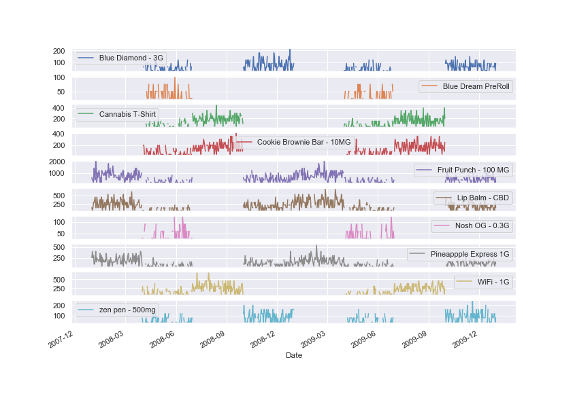
Product sales over time
Some products have different busy seasons than others
Notes:
But there seem to be basically two major trends. Fruit Punch, Lip Balm, and Pineapple Express 1G (the top three sellers) have similar patterns and the rest of them share a different pattern

Slide 7
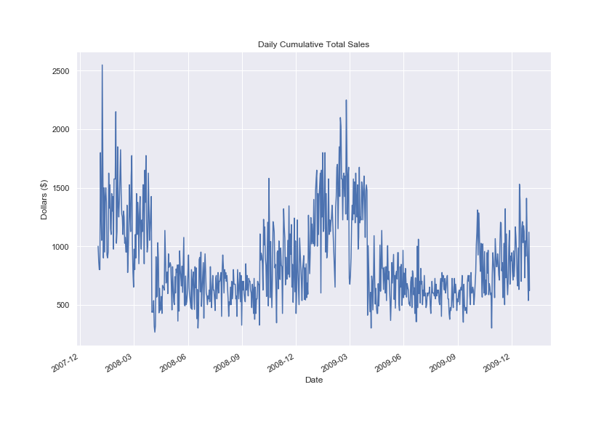
Total sales over time
combined spending trends
Notes:
Overall cumulative spending by date. The first quarter of 2009 and 2008 dominate, maybe there are New Year’s specials

Slide 8
Some products more than others drive the trend

Slide 9
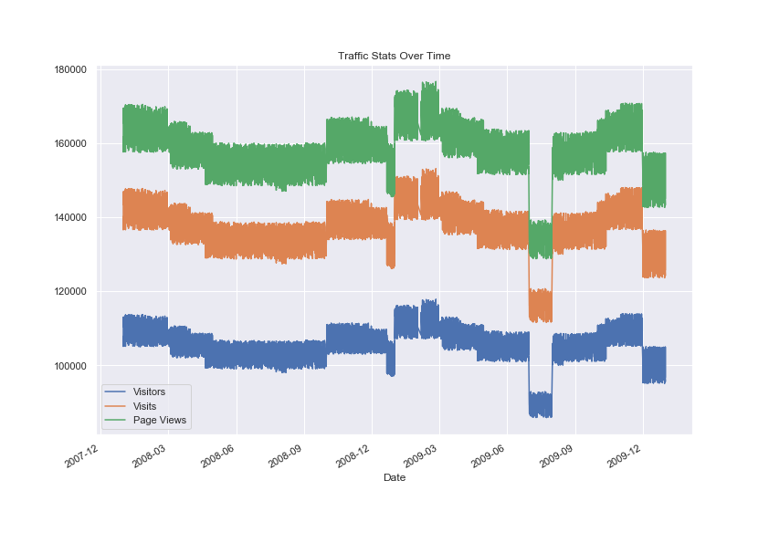
Traffic patterns
Subtitle
Notes:
Traffic patterns seem to mimic those highs but aren’t directly correlated

Slide 10
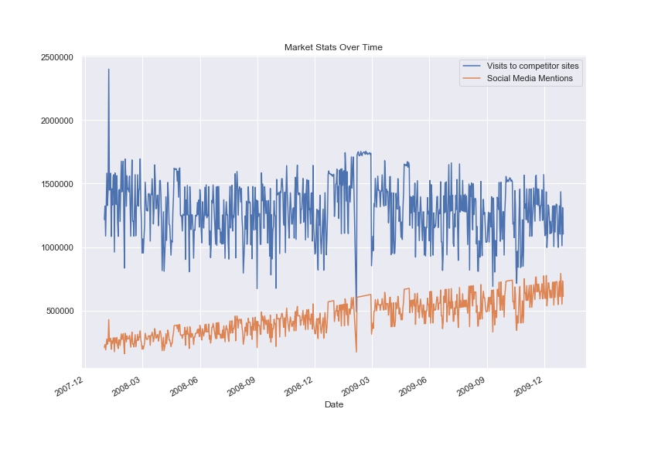
Market Stats over time
Notes:
There’s a drop in market stats during the 2009 first quarter sales bonanza, not what I’d expect

Slide 11
Correlations

Slide 12
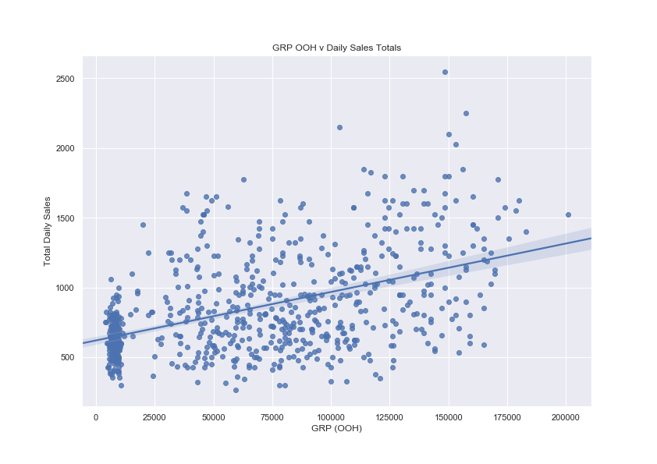
Gross Rating Point for Out of Home
Notes:
GRP OOH is clearly correlated with total daily sales and is on the rise

Slide 13
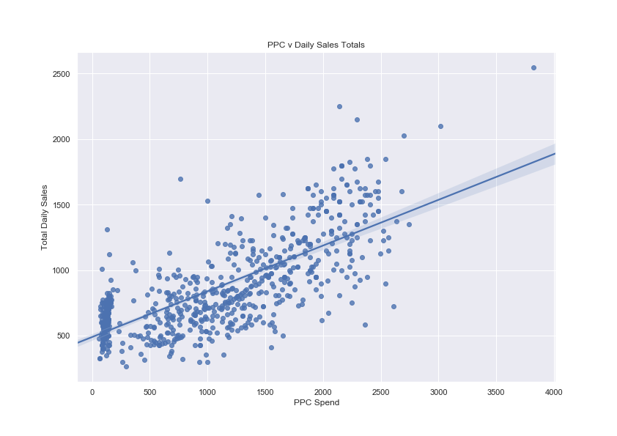
Pay Per Click
Subtitle
Notes:
Pay per click is more highly correlated with total daily sales and so would be the best bet to increase funding for to increase total sales and thus revenue

Slide 14
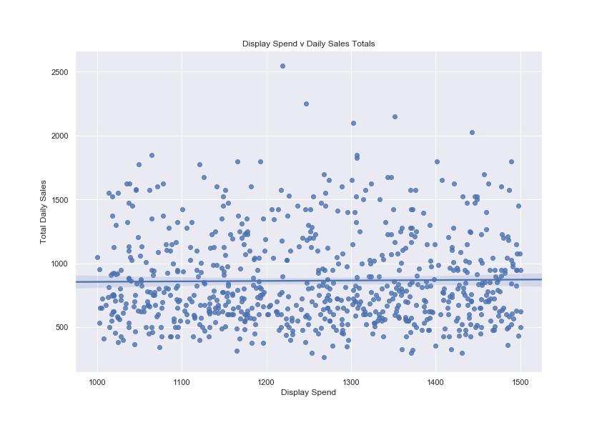
Display spend
Subtitle
Notes:
Not a good candidate, too many people in your demographic have ad-blockers perhaps

Slide 15
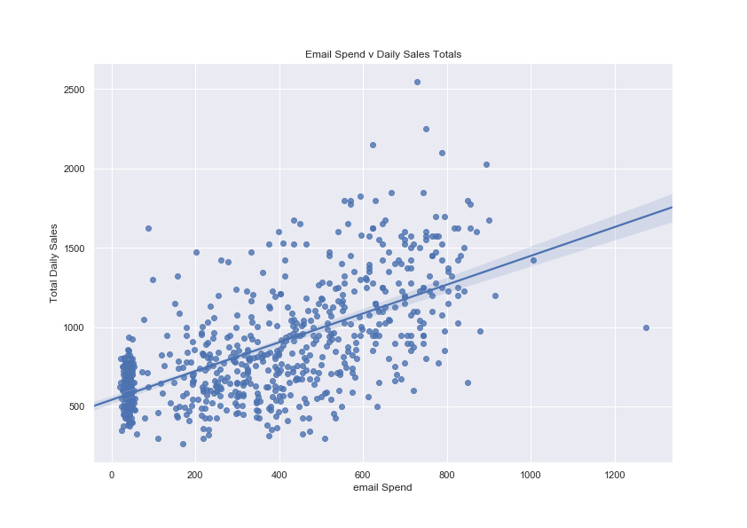
Email spend
Subtitle
Notes:
Correlation is up there with PPC but may plateau, last data point may be an outlier or maybe email marketing doesn’t scale up

Slide 16
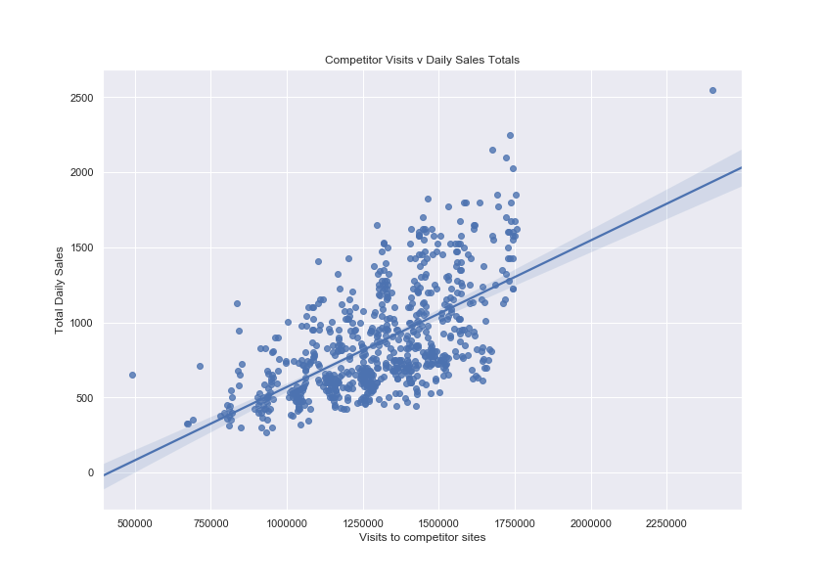
Competitor visits
Subtitle
Notes:
Competitor visits correlate highly with total daily sales but I don’t really understand this variable so I’m not sure how to make conclusions based off it (what does the automotive category mean?)

Slide 17
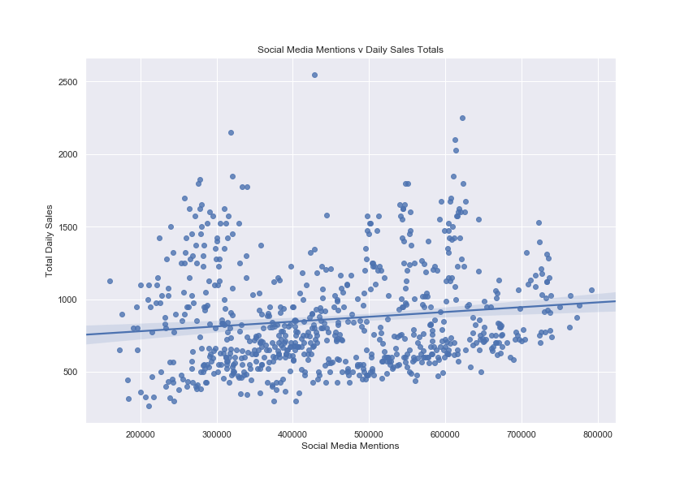
Social media mentions
Subtitle
Notes:
Social media mentions are slightly correlated but not a great ROI

Slide 18
Deeper dive

Slide 19
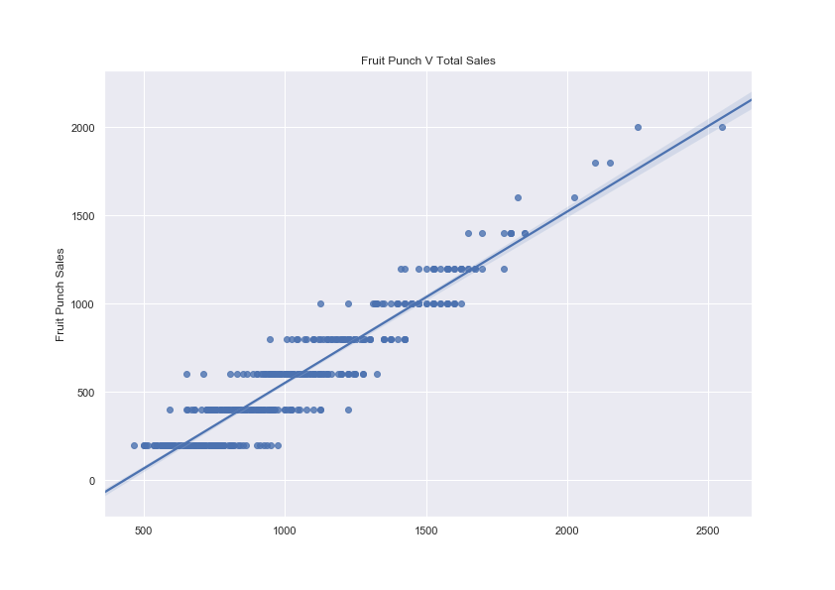
Fruit Punch Sales
Subtitle
Notes:
Sales of the most popular item are the main driving force in over all sales

Slide 20
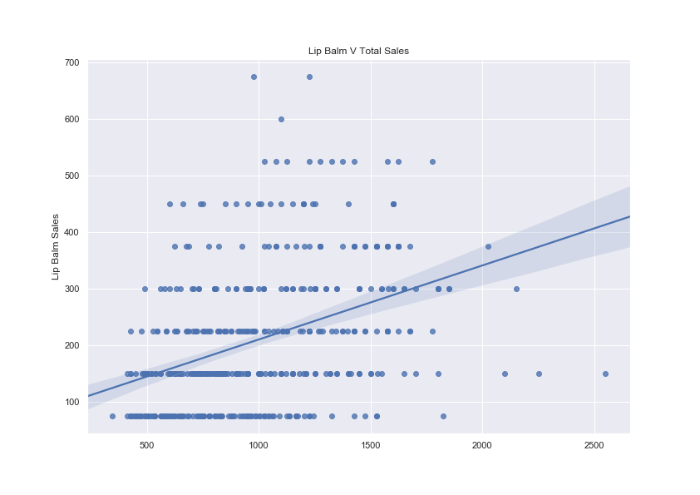
Lip Balm
Subtitle
Notes:
Even in the next most popular is significantly less of a driving force, so let’s focus on Fruit Punch

Slide 21
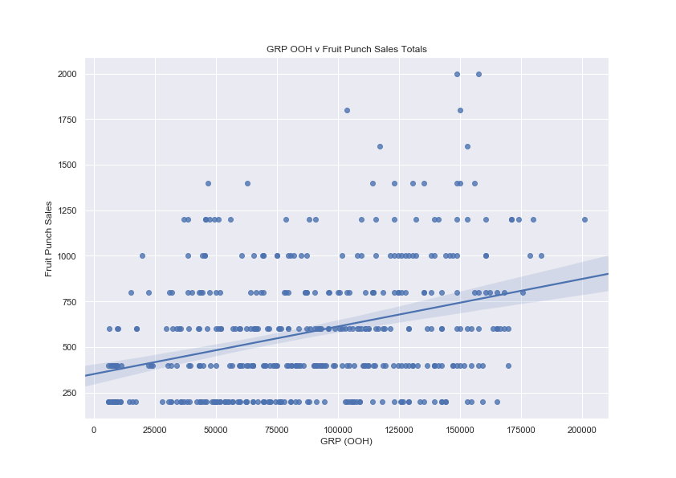
GRP - Fruit Punch
Subtitle

Slide 22
Gross Rating Point for Out of Home
Notes:
Using Fruit Punch is almost the same correlation as total sales

Slide 23
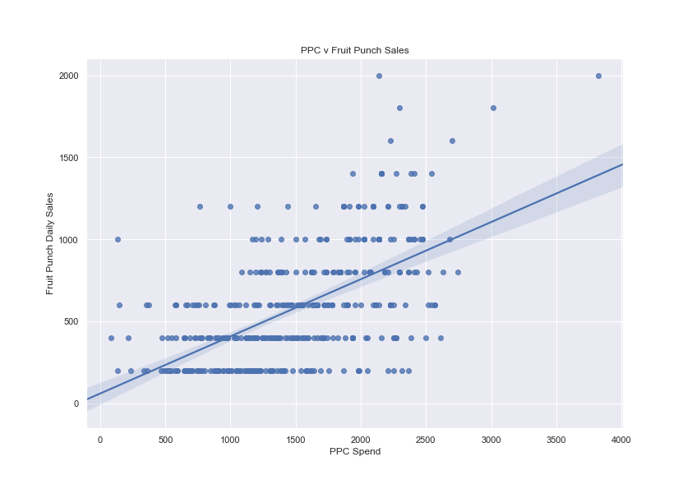
PPC - Fruit Punch
Notes:
Using Fruit Punch is almost the same correlation as total sales

Slide 24
Conclusions
To increase revenue, focus on PPC and Fruit Punch as main drivers
GRP, Email, competitor visits, and lip balm sales are also correlated with increased sale to a lesser extent
Display and social media mentions are not a good ROI and can be reprioritized

Slide 25
further considerations
do a deep dive into the bimodal seasonality patterns of the products, why are the most profitable three making money at completely different times than the other ones?
correlation exploration of what drives each of the products, and not just the most popular
compare spend $ with sales $ to see best ROI
Notes:
with more time and resources, I would

