Slide 1

Card Game App
I wanted to tackle a project which included a user interface
I have previously struggled with game logic and wanted to challenge myself

Slide 2
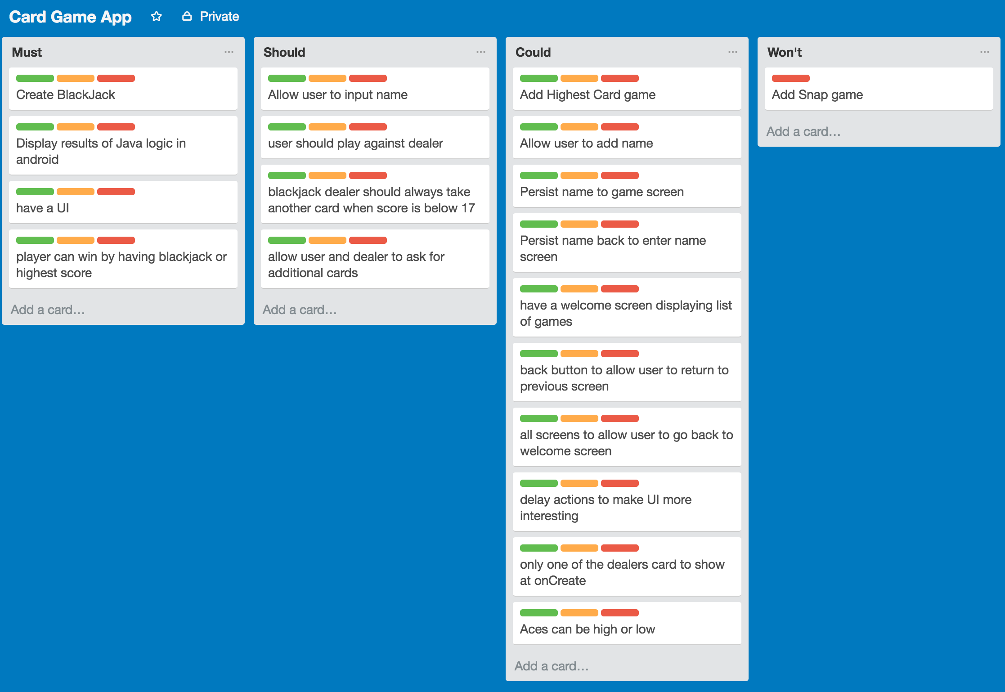

Slide 3
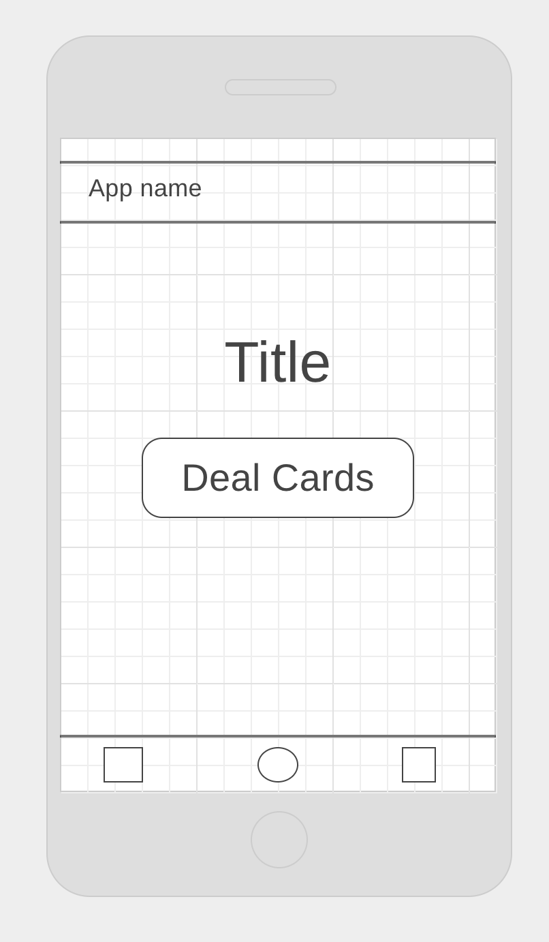
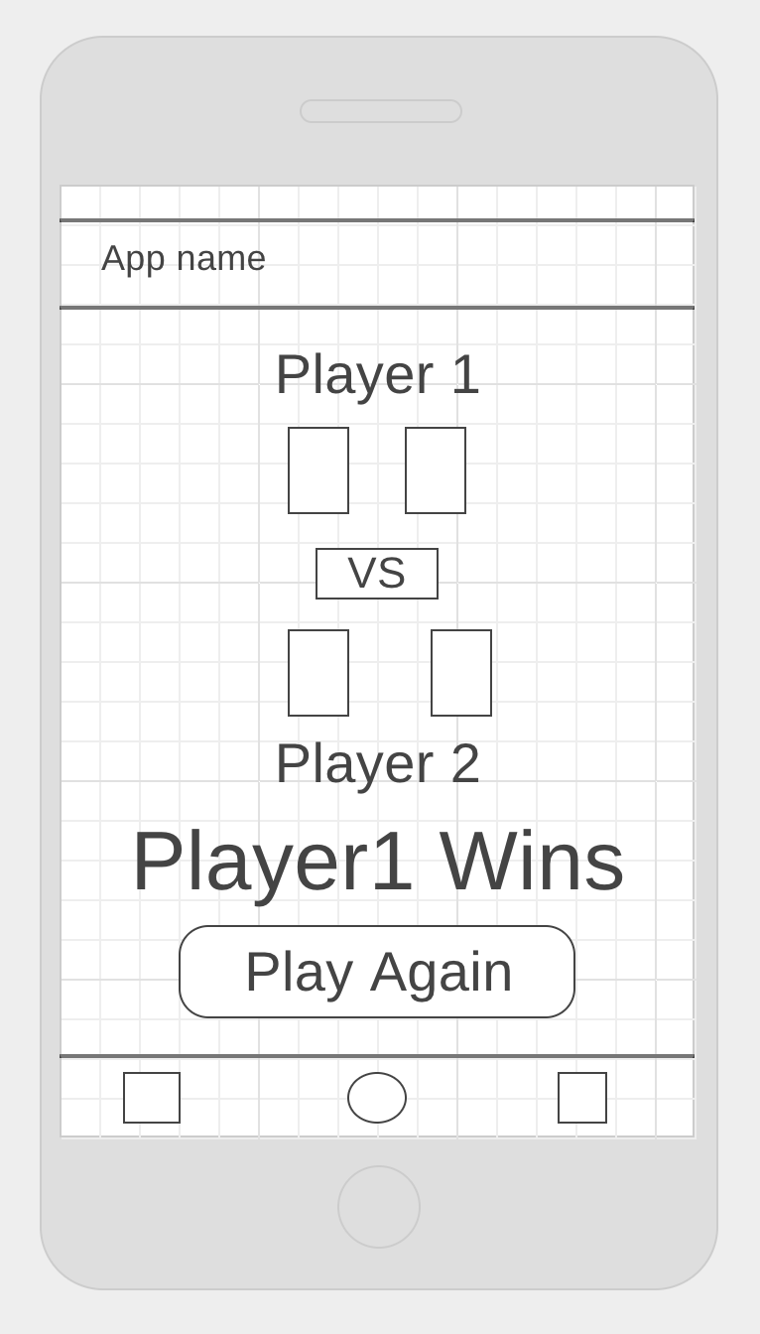

Slide 4
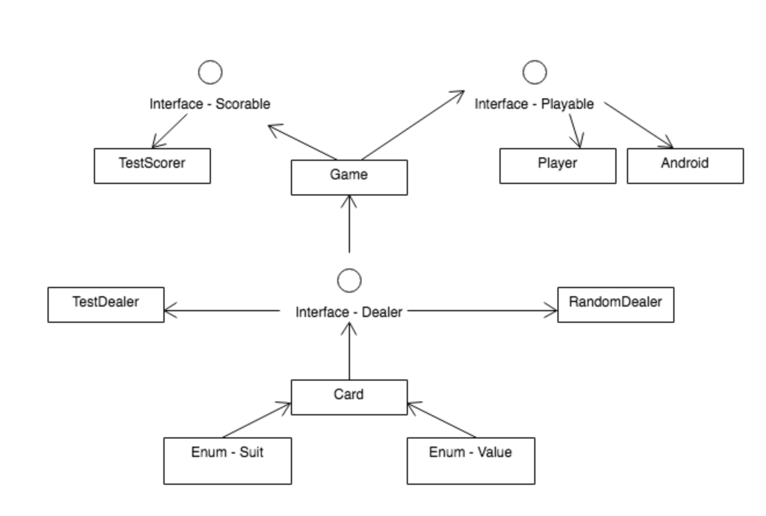

Slide 5
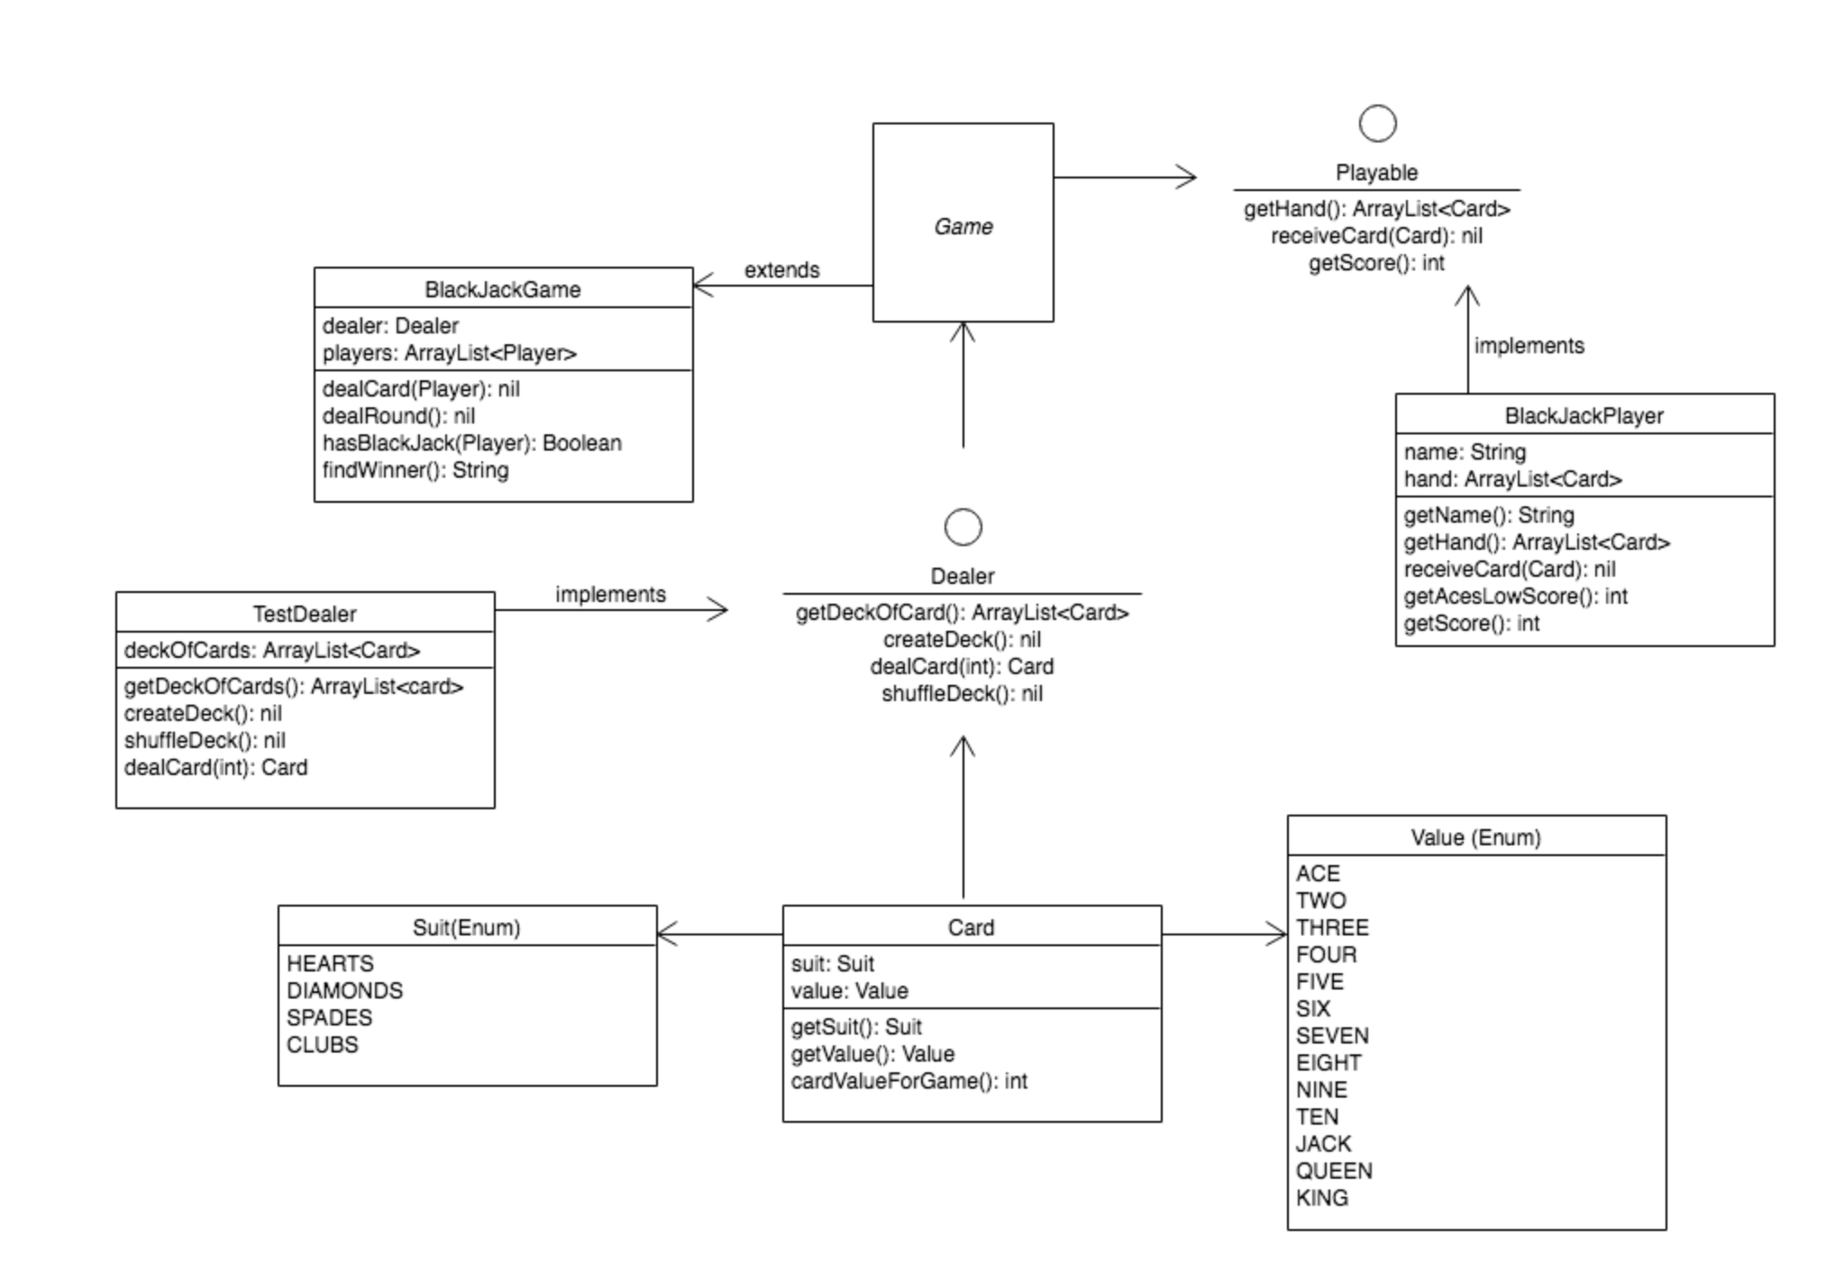

Slide 6
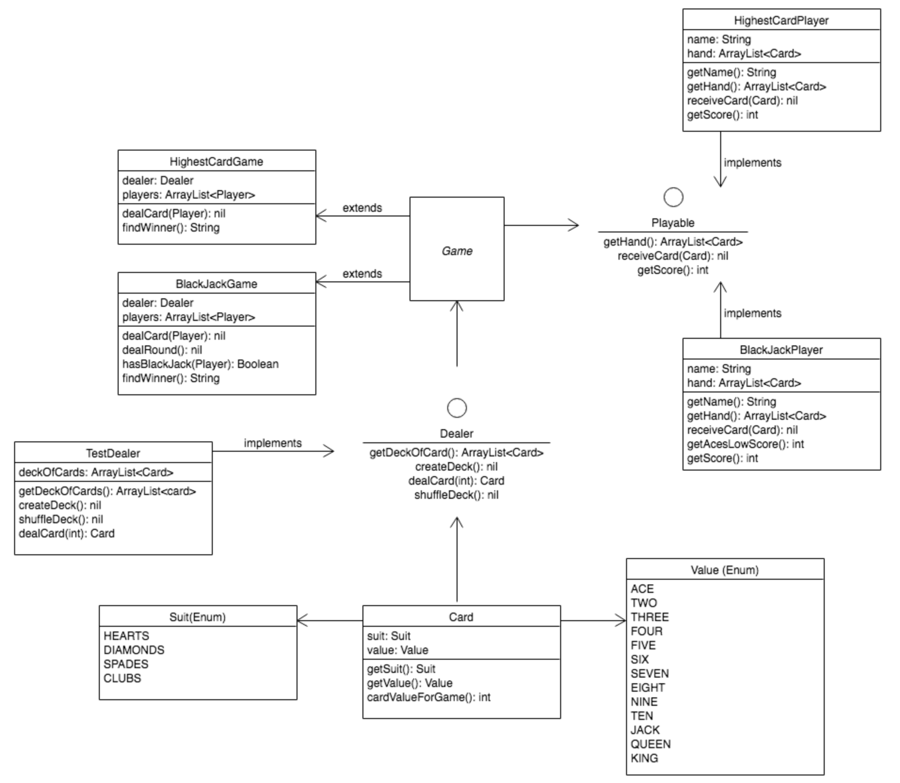

Slide 7
Demo App

Slide 8
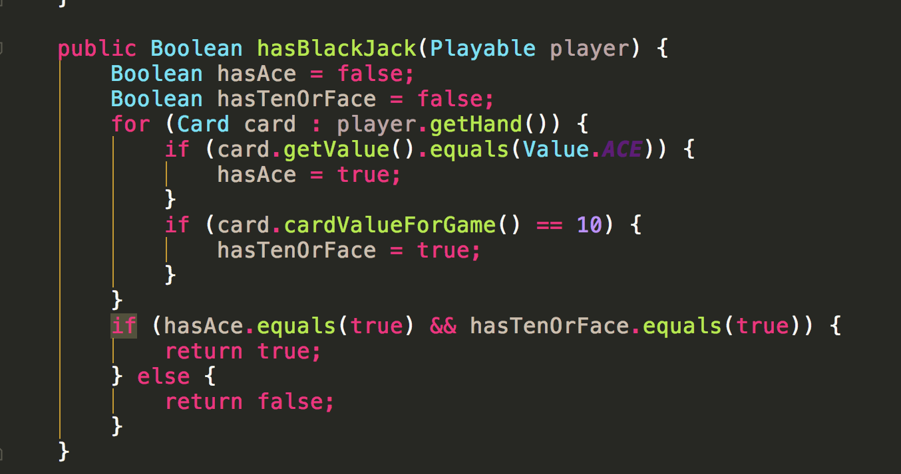
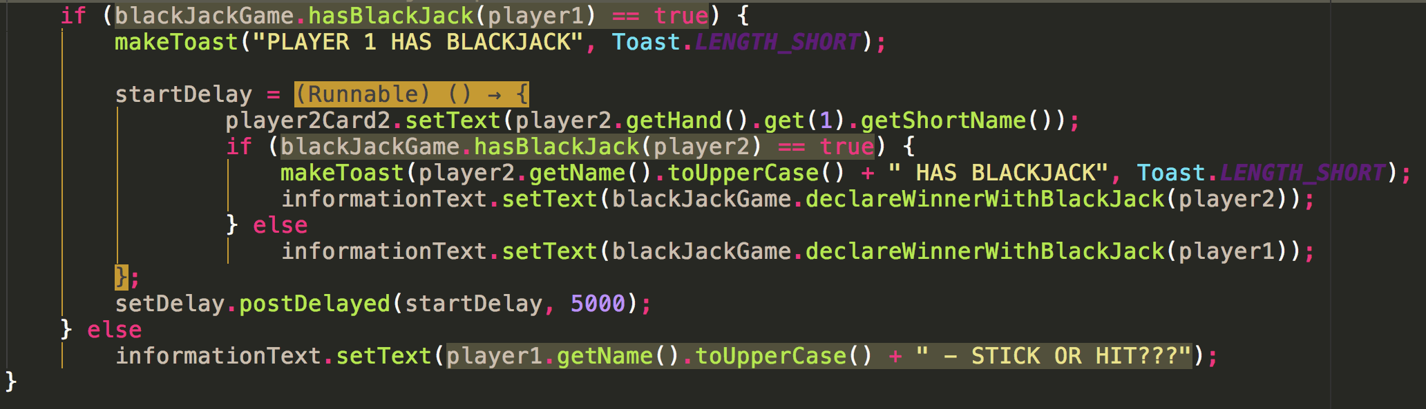
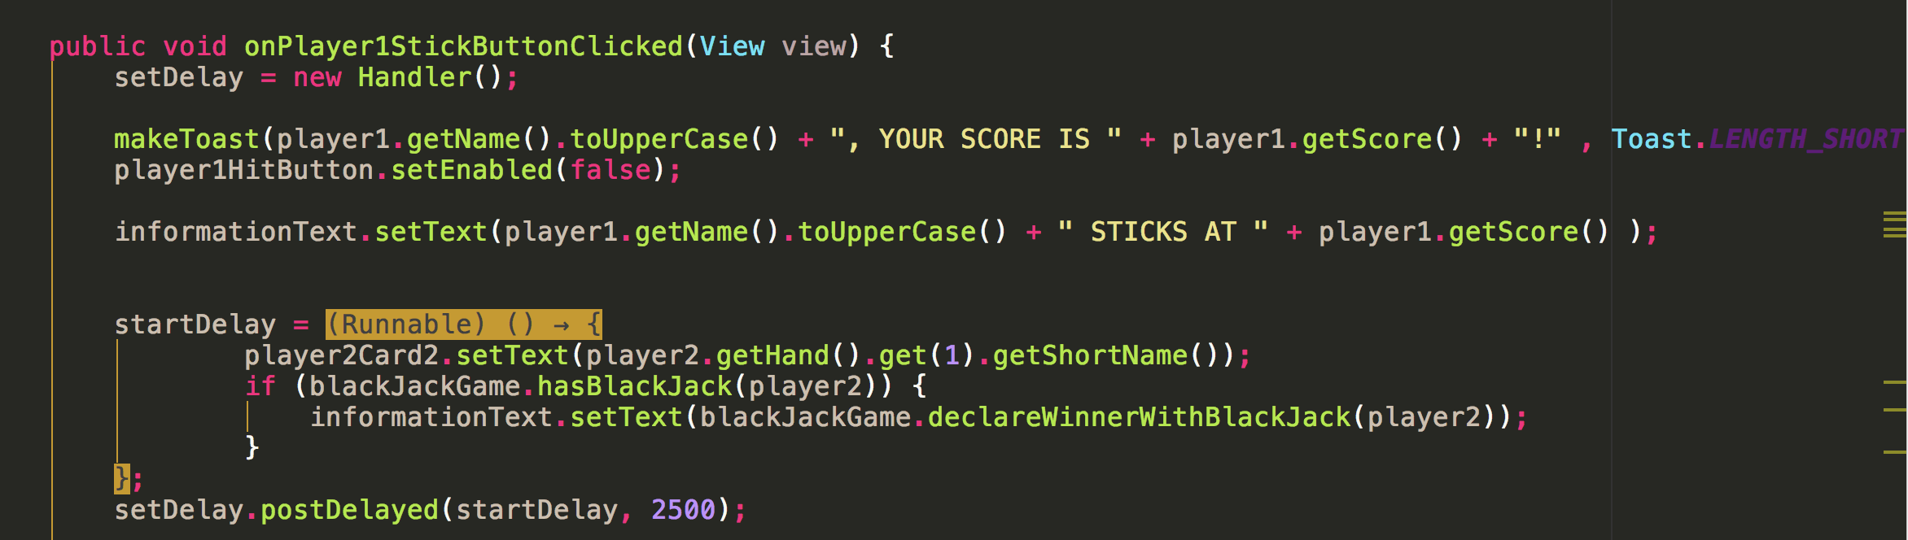
Favorite Code
Code checks if player has BlackJack by checking for and ACE and a card value greater than 9
This is called twice –
Once when the activity is created to see if Player 1 has BlackJack (and if true, if Dealer has BlackJack)
And again, on dealers turn, to determine if BlackJack is present

Slide 9
My learning Points…
I need to make better use of planning aides(eg Trello)
I have written so many loops I think I now know what loops do!
I feel I now have a better understanding of SOLID principles
Refactoring is hard – try to get things in the right place first time

Slide 10
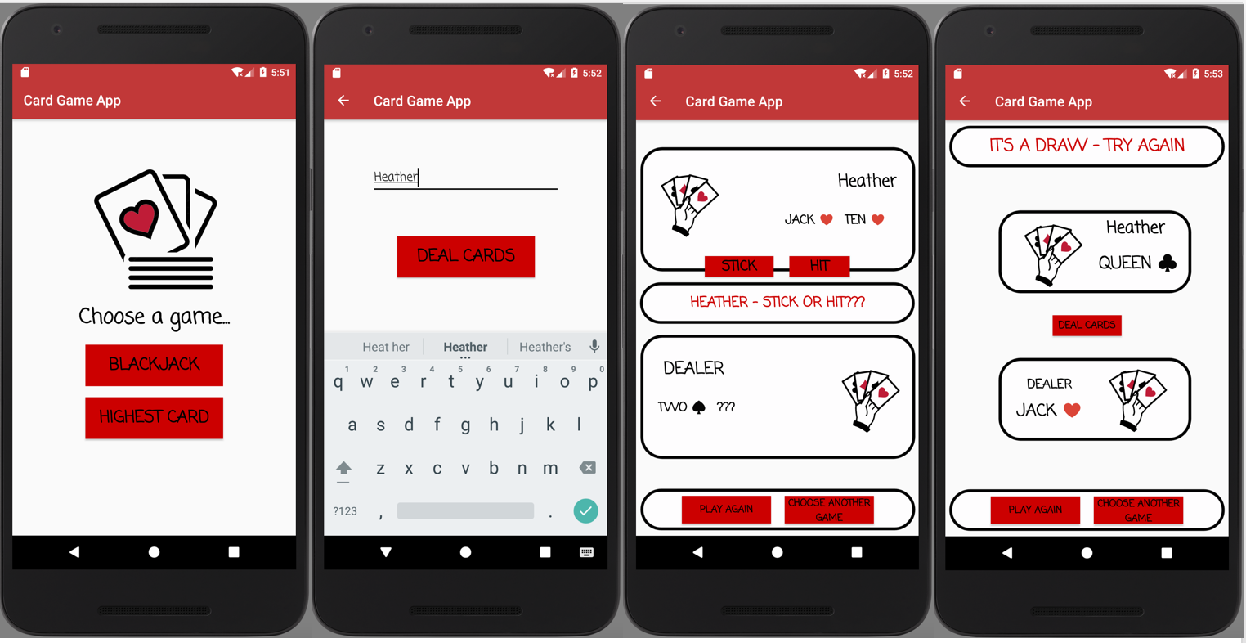
Any Questions?

