Slide 1

JAVA
CARD GAME

Slide 2
Why the Card Game?
I wanted to tackle a project which included a user interface
I have previously struggled with game logic and wanted to challenge myself
Notes:
- I chose to do the card game brief as I enjoy working with user interfaces and wanted to have a go at doing this in android but also felt that I was struggling with the Java so felt the card game would allow me to work on this.
- i found the brief to be challenging but it got easier the more time I spent on it and I felt it has helped me understand Java, as well as some of the. other principles we have been learning, like TDD and SOLID.
- the project has really helped me to consolidate the things we have been learning for the last 8 weeks and I feel like I understand much more now

Slide 3
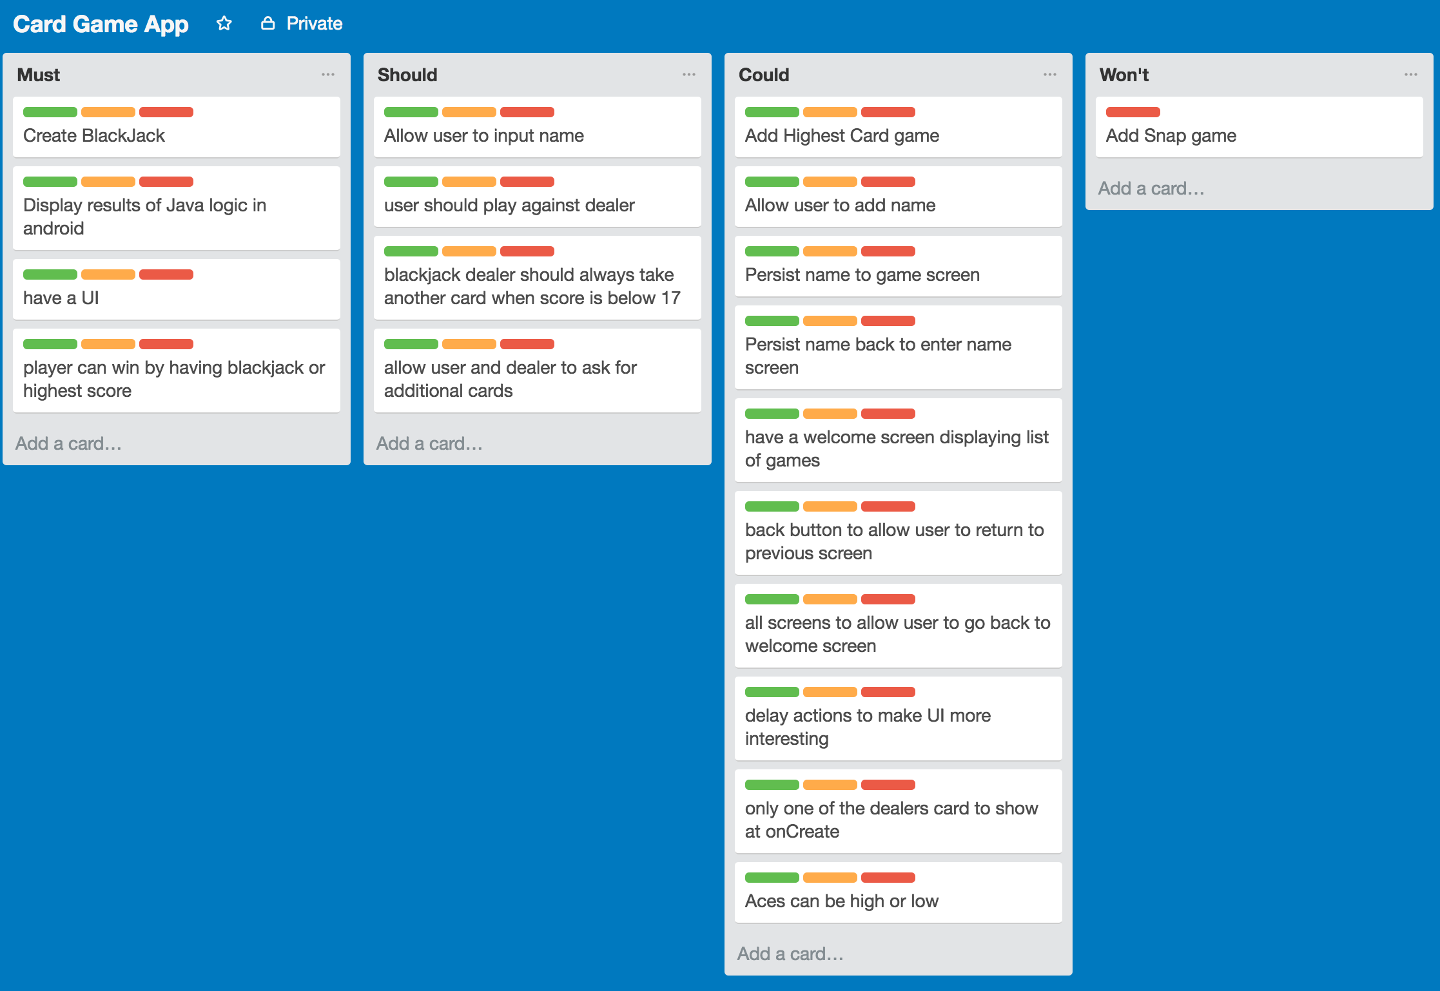
Notes:
- I started with some planning.
-I made a Trello board but must confess I didn't use it very much. I tend to set these up and then forget to back to them so hoping to make more use of this next time.

Slide 4
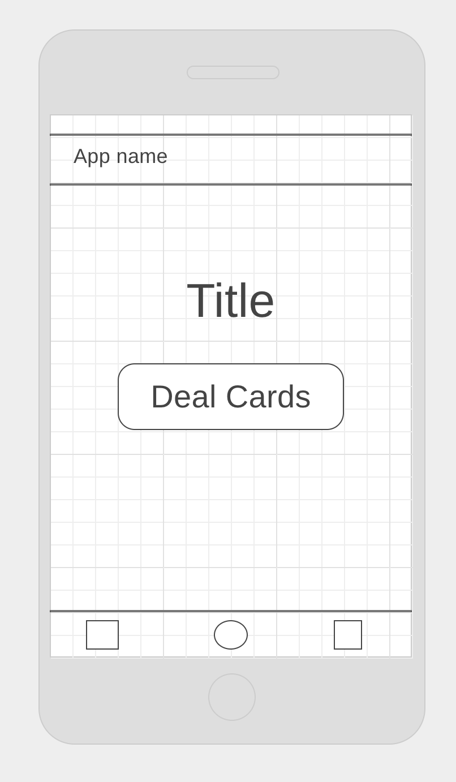
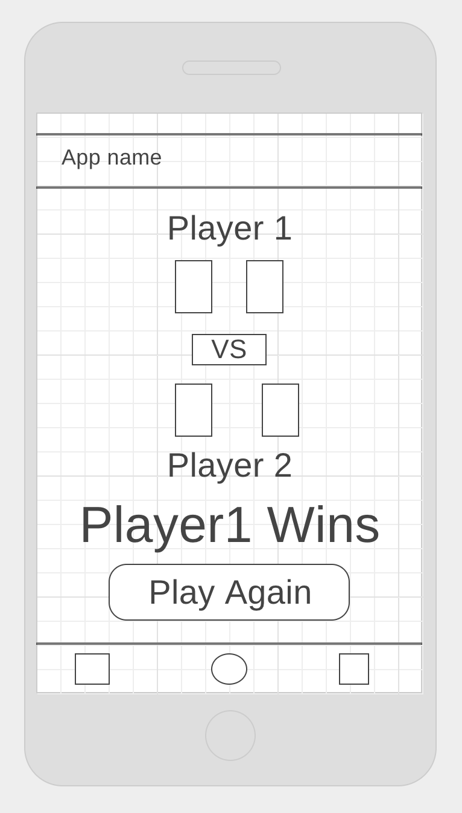
Notes:
- being quite a visual person, I though abot the Ui first and sketched a couple of wireframes of what I thought my app might look like.
- I kept it really simple and designed just 2 activities and not a lot of user interaction as it specified on the brief that it wasn't necessary.

Slide 5
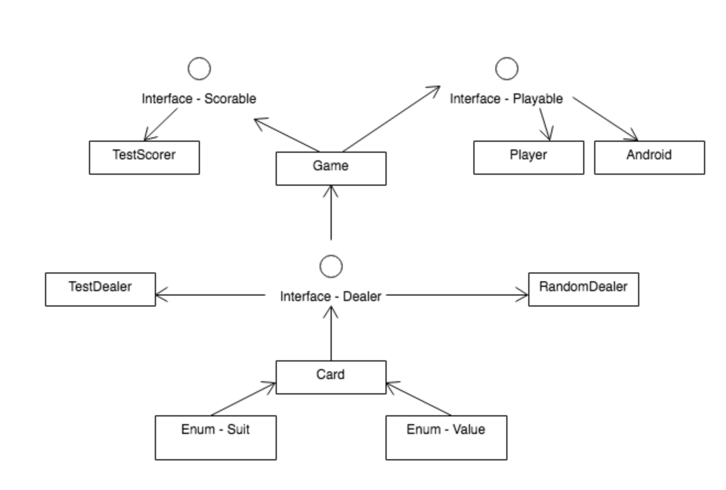
Notes:
- I then thought about the class diagram and quickly noted what I thought the structure would look like.
- I had a card class made of of 2 enums, suit and value.
- A dealer interface which had a random dealer and a test dealer so I wouldn't have to TDD random
- I then had a class of Game which took in Playable Player and also a Scorer method.
- I discussed the plan with one of the instructors who suggested simplifying things until the basics were up and running. You can see that I removed quite a few of the classes.

Slide 6
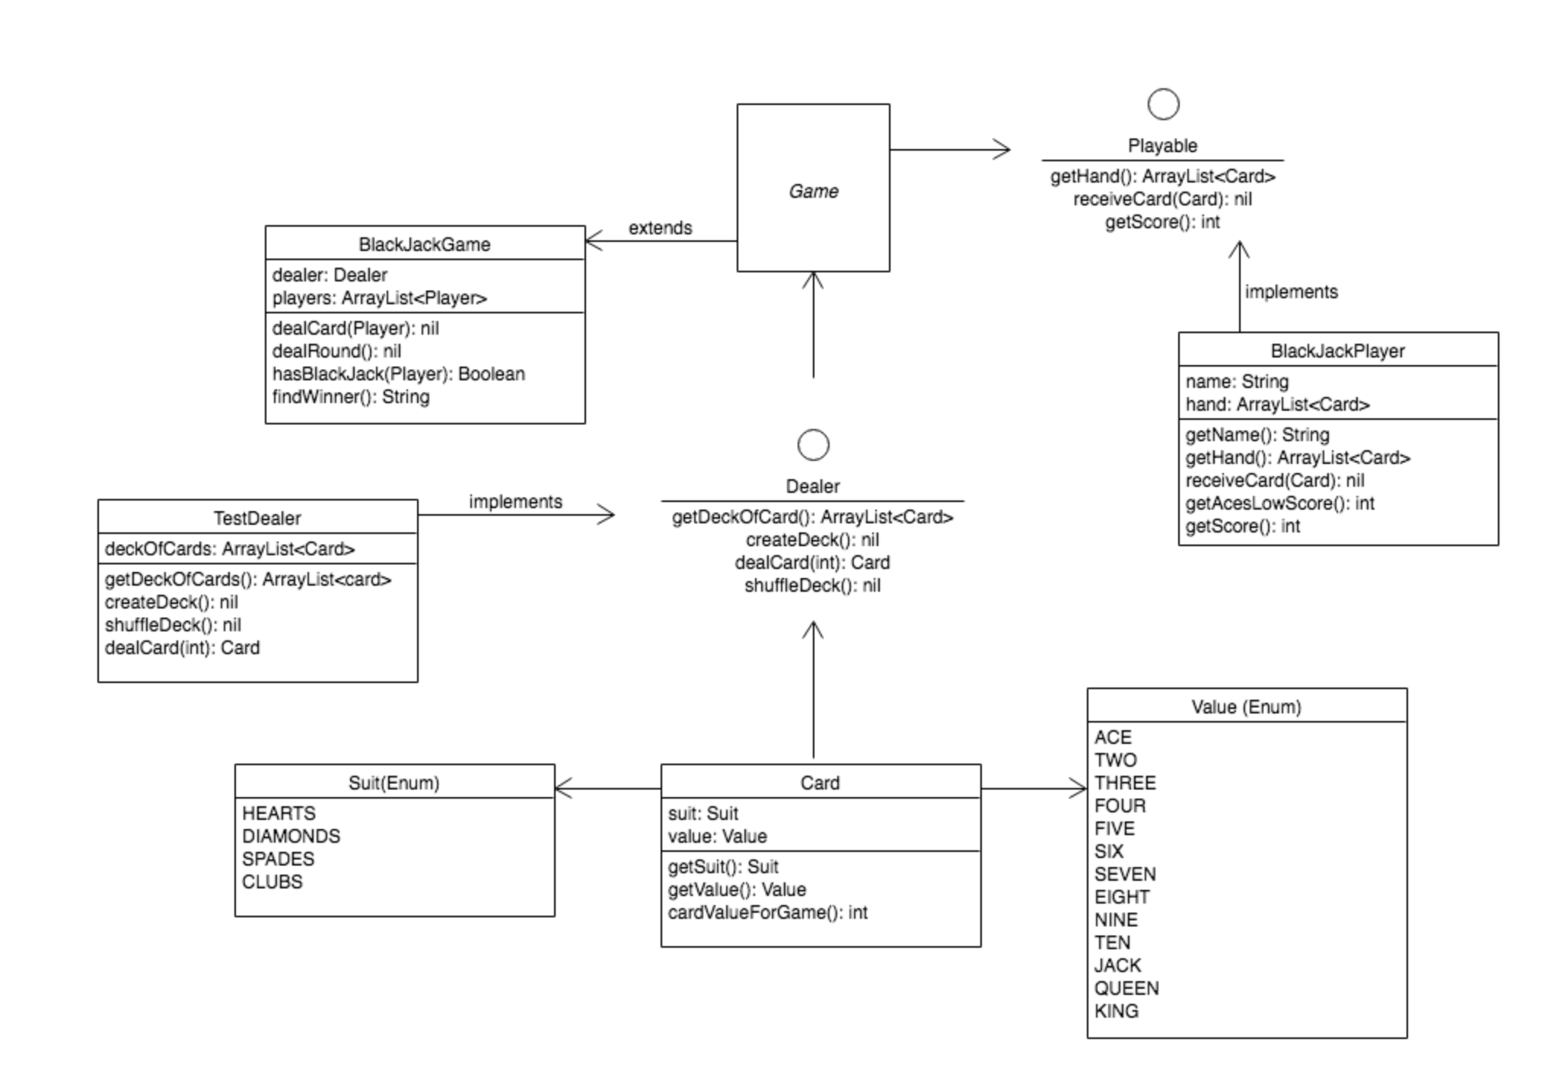
Notes:
- I then completed a full class diagram which was similar but included a Game superclass which was extended by blackJackGame.
-I used the superclass and 2 interfaces to keep the structure as SOLID as possible.
-Once I had all these classes and methods in place and a basic user interface, I was keen to add to my app and wanted to put in an additional game. As I had kept everything quite separate, I was able to add a second game without too much extra work

Slide 7
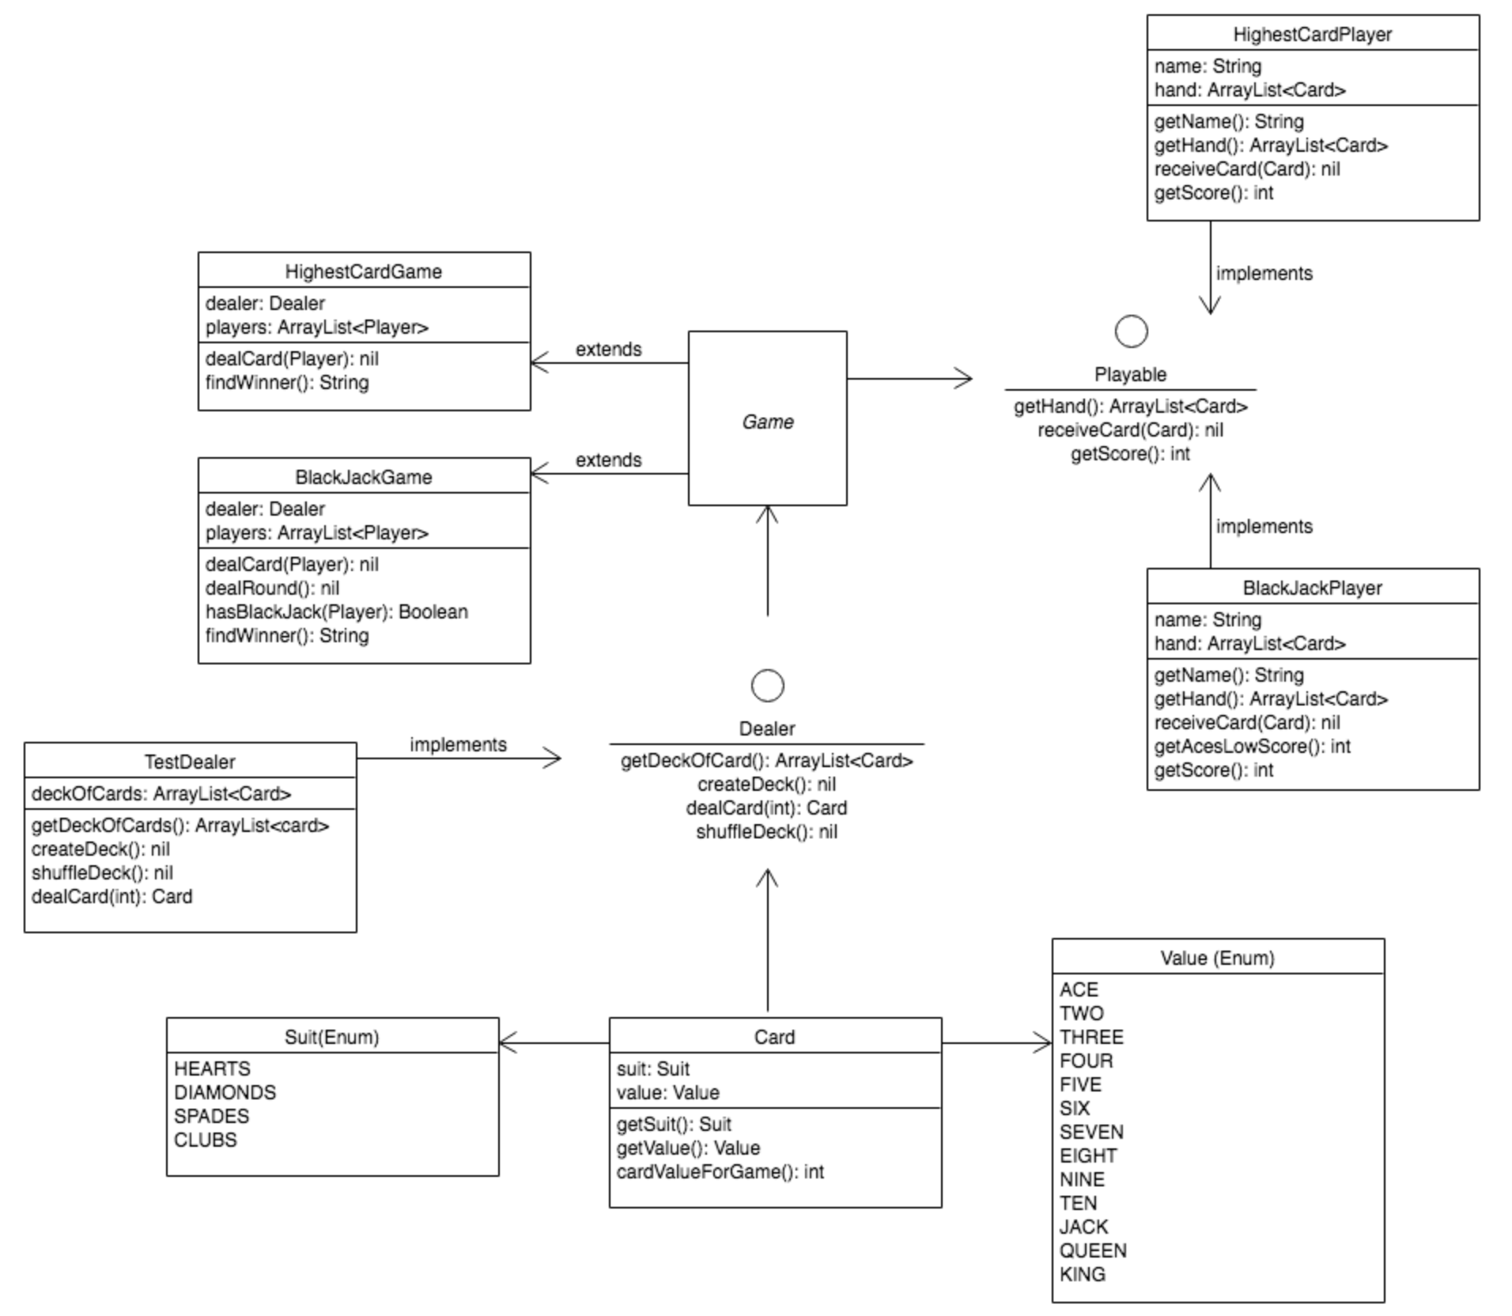
Notes:
I added in highest card and only had to add an additional 2 classes to make it work - HighestCardGame which extends Game, and highestCardPlayer which implements Playable
- the most time consuming part of adding the extra game was adding the extra activties which I can show you now

Slide 8
Demo App

Slide 9
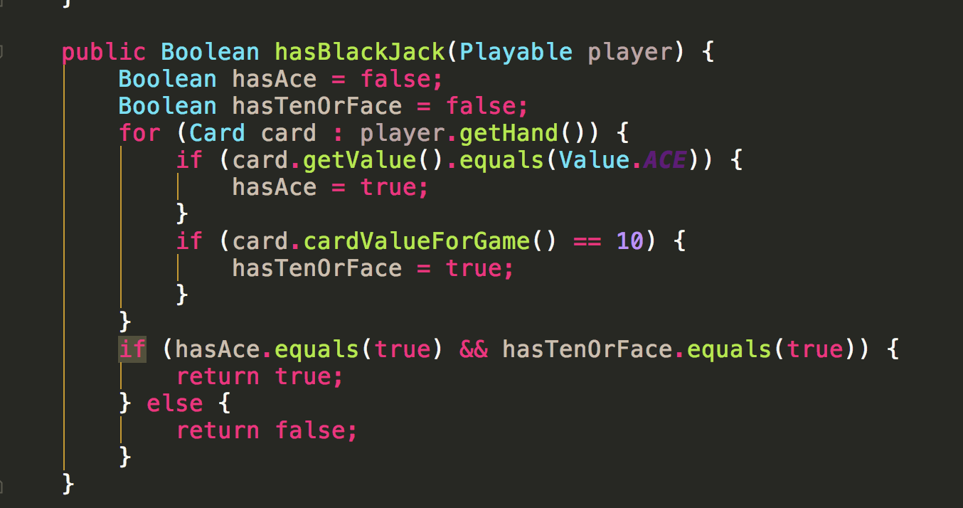
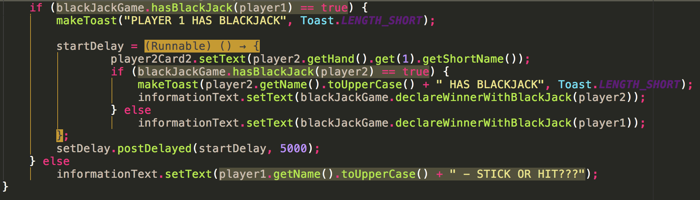
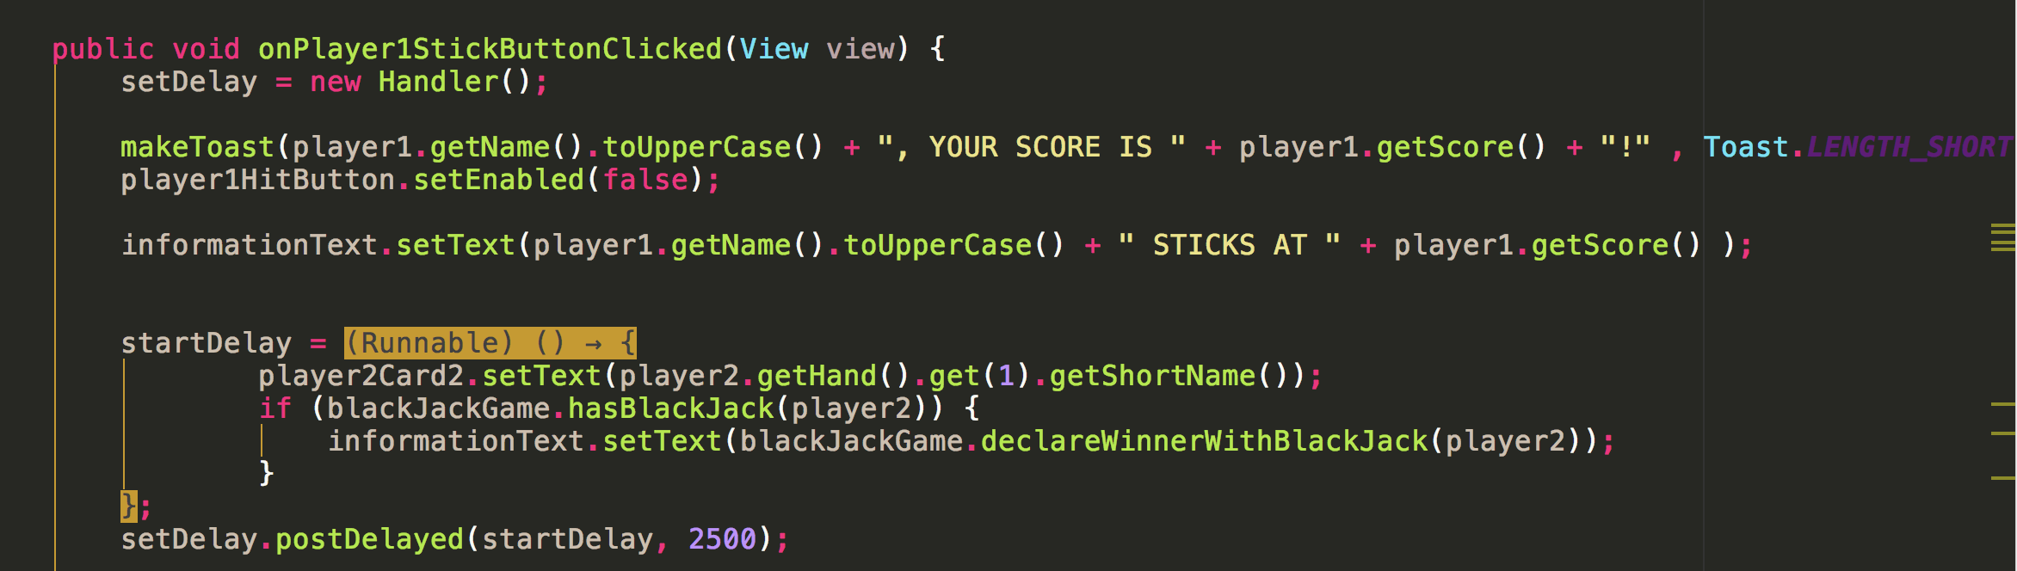
Favorite Code
Code checks if player has BlackJack by checking for and ACE and a card value greater than 9
This is called twice –
Once when the activity is created to see if Player 1 has BlackJack (and if true, if Dealer has BlackJack)
And again, on dealers turn, to determine if BlackJack is present
Notes:
- I don't have a particular piece of code which I would call my favorite. I'm really happy at the amount of logic I have managed to put into the games and show on the UI.
- I did have to ask for help with many of the methods after trying to implement them myself and found that I was usually almost there which was frustrating but also quite encouraging that I seemed to be grasping what needed to happen even if I couldn't always implement it exactly right
- i have put in this piece of code which determines if a player has blackJack. It loops through the players hand and checks to see if they have an ace and the have a card with a value of 10 or more. If both conditions are true then a winner is declared.

Slide 10
My Learning Points…
I need to make better use of planning aides(eg Trello)
I have written so many loops I think I now know what loops do!
I feel I now have a better understanding of SOLID principles
Refactoring is hard – try to get things in the right place first time

Slide 11
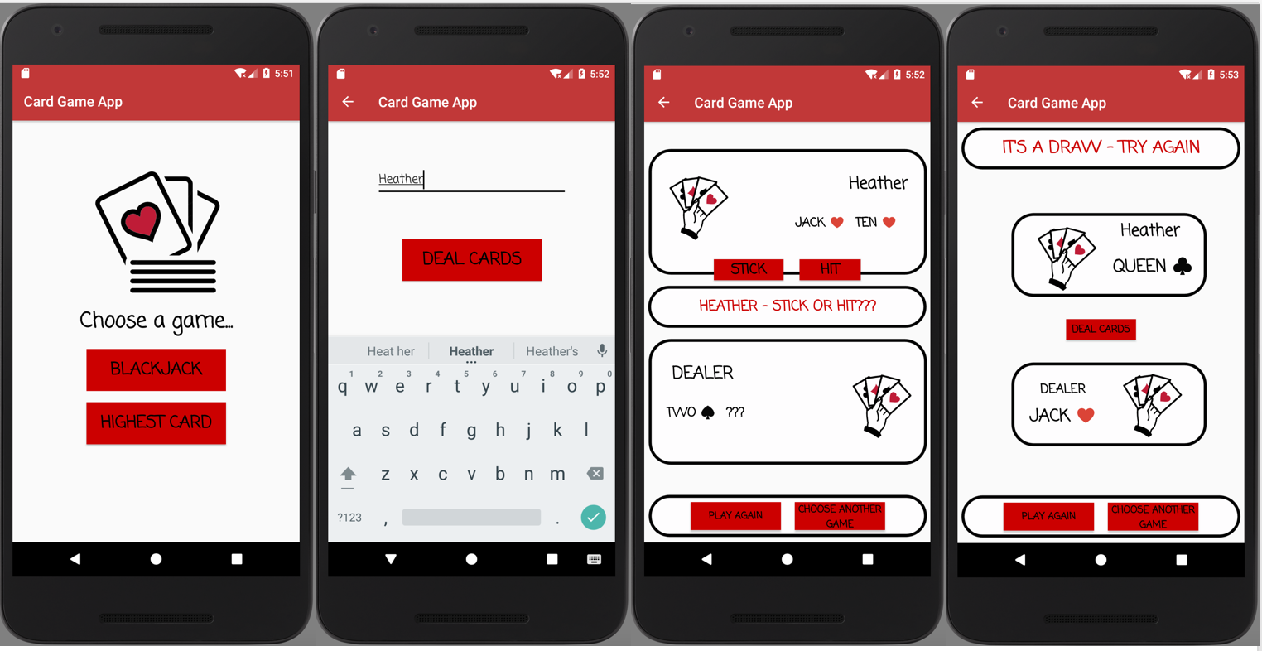
Any Questions?

