Slide 1
Battleships
By Heather…
And alex And michael 🔥

Slide 2
MVP
Practice react
learn more about sockets and real time technology
Create a cool multiplayer game

Slide 3
Initial ideas
Pictionary
Battleships
Both???

Slide 4
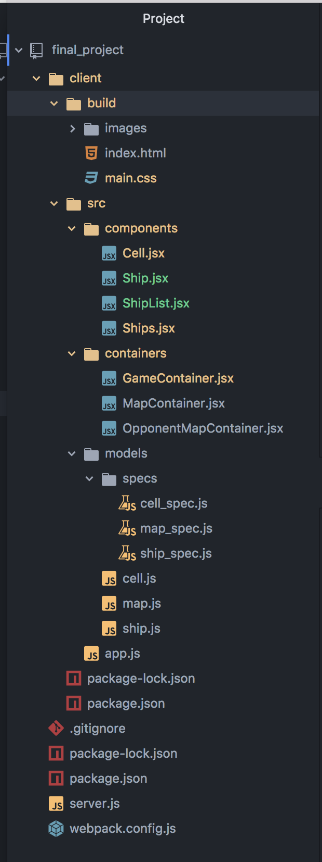
Friday, Saturday, Sunday, Monday…
Issues with bringing code from Node into React front-end
MORE PRACTICE NEEDED WITH FUNCTIONAL PROGRAMMING

Slide 5
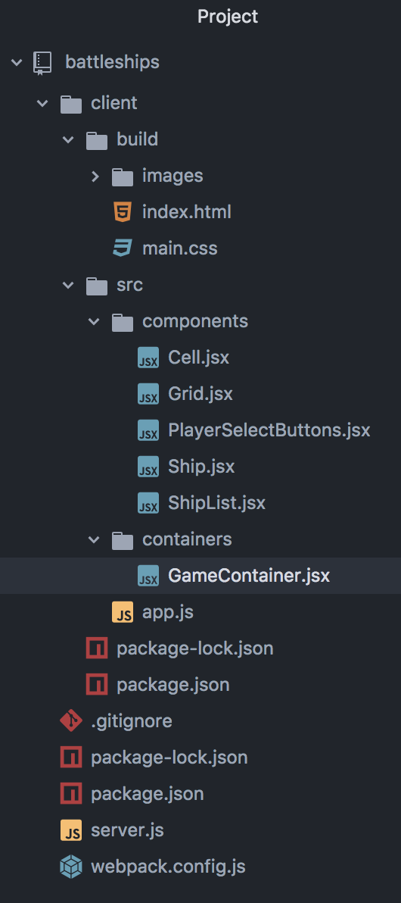
Tuesday, Wednesday…
No Node
No TDD
A working BattleShips game

Slide 6
Demo

Slide 7

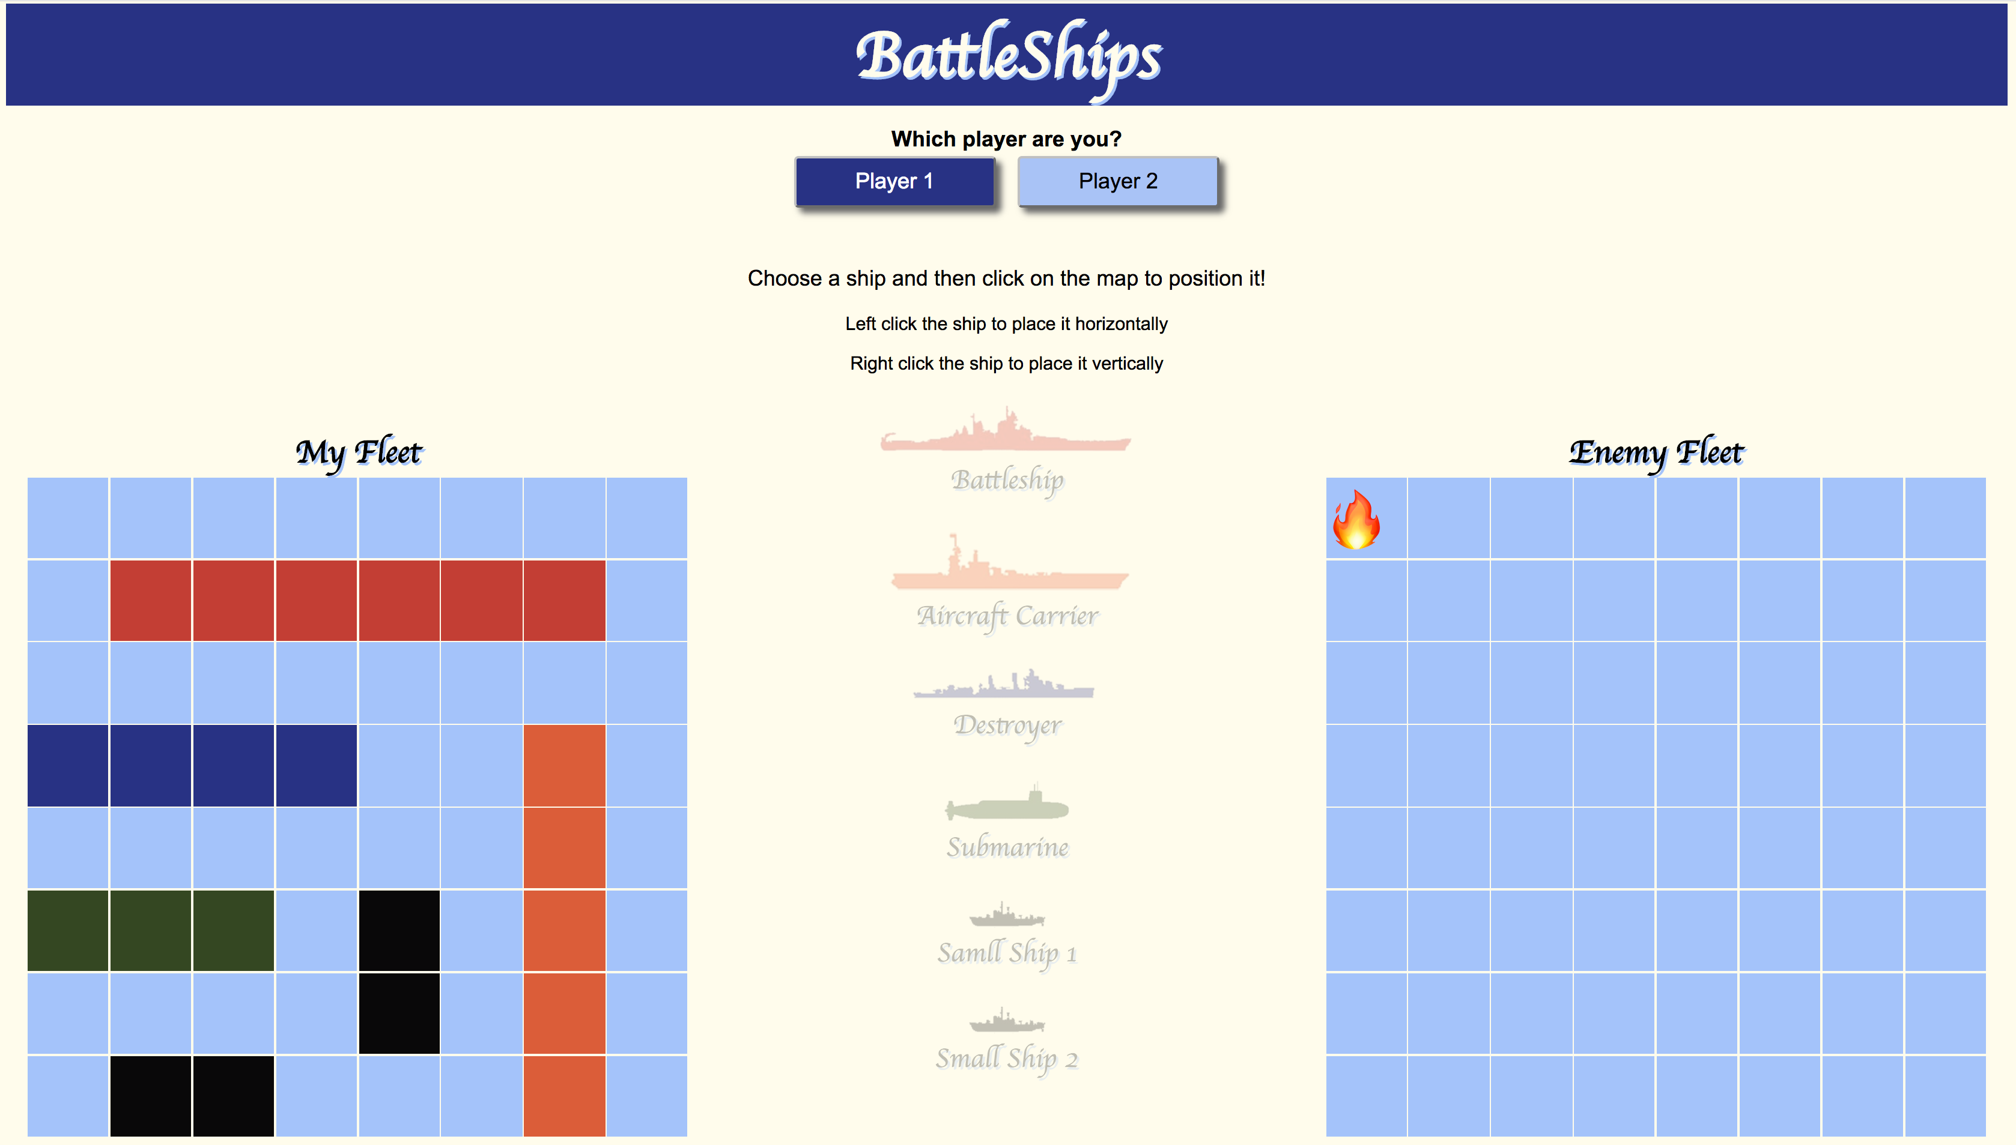
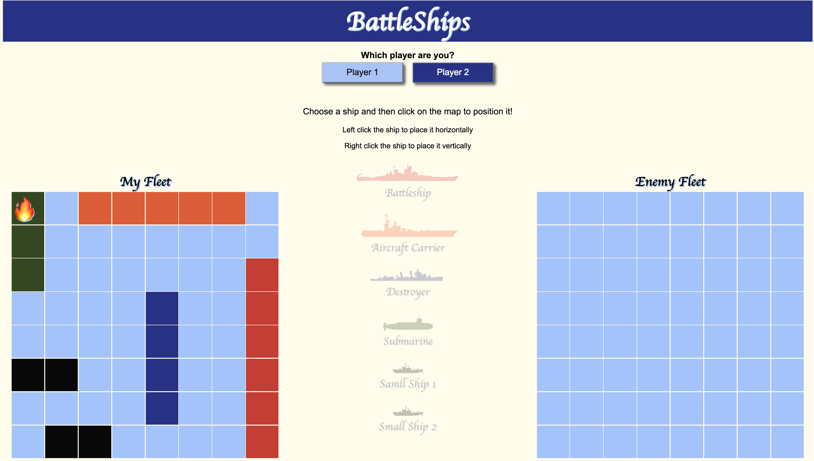
The most difficult part…
Player 1 chooses a square on the opponent grid to make a guess
Player 2 then uses the {guess} to check if it is a hit or miss on it’s own grid
A {guess} is then emitted from the server to all clients
A {guessResponse} is then emitted to all clients – this then renders a hit/miss on oppGrid of player 1 and grid of player 2

Slide 8
What I learnt
I Feel much more comfortable with react
I understand how information is passed around using state and props
Still think sockets are cool, but a bit of a mystery!

Slide 9
thanks

