Slide 1
Github API + JavaScript
and maybe a little more
by: heather larsen

Slide 2
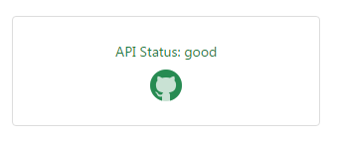
Github API
The Documentation: https://developer.github.com/v3/
General Tidbits:
All API data is accessed from https://api.github.com
All data is sent and received as JSON
Blank fields are included as null
All timestamps are returned in ISO 8601 format
Summary vs Detailed:
When fetching a list, you’ll get a subset of the attributes for that resource
When fetching an individual resource, you’ll get all attributes for that resource
Rate Limits:
Basic Authorization & OAuth Requests: 5,000/hr
Unauthenticated Requests: 60/hr
associated with your IP address

Slide 3
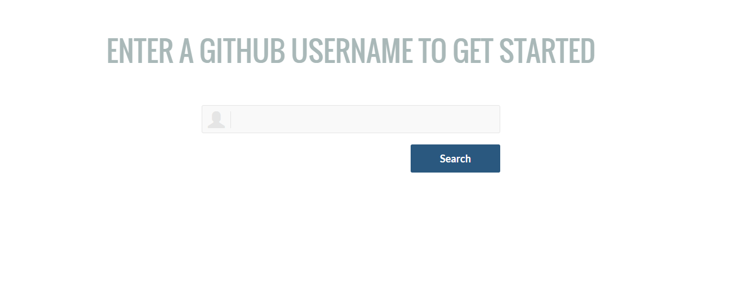
The Demo

Slide 4
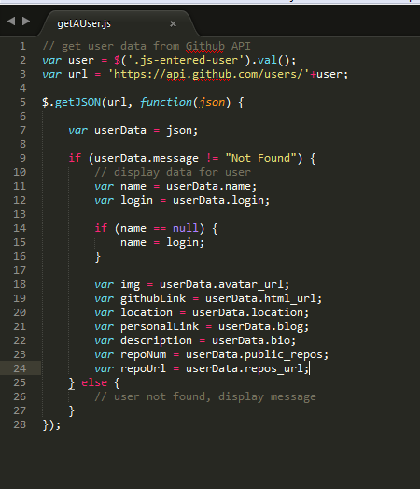
The Code – Get a user
The Documentation: https://developer.github.com/v3/users/
Additional Info for Authenticated Users:
"total_private_repos": 100,
"owned_private_repos": 100,
"private_gists": 81,
"disk_usage": 10000,
"collaborators": 8,
"plan": {
"name": "Medium",
"space": 400,
"private_repos": 20,
"collaborators": 0
}
What can you do with the User API?
Get a single user’s data (authenticated or not)
Update the user’s data (authenticated only)
Get a list of all Github users (in the order they signed up)

Slide 5
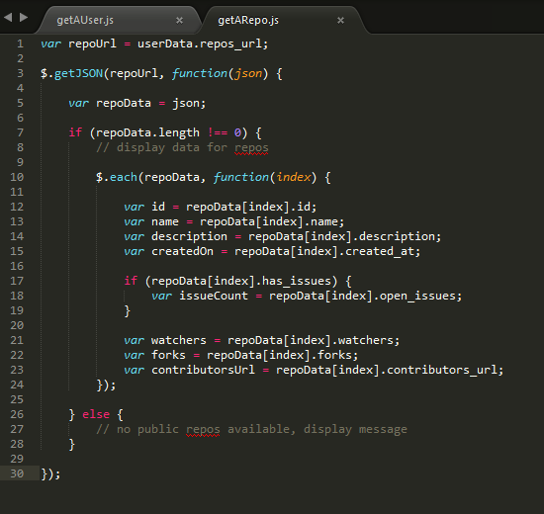
The Code – Get User Repos
The Documentation: https://developer.github.com/v3/repos/
What can you do with the Repositories API?
Get a list of user’s repos
Authenticated – all (public or private)
Unauthenticated – public only
Create, Edit, Delete repos (authenticated only)
Get a list of all public repos on Github (in the order they signed up)
Get lists of various pieces of data about the repo
Contributors
Languages
Teams
Tags
Other Useful APIs for Repositories:
Branches | Forks
Comments | Contents
Commits | Statistics

Slide 6
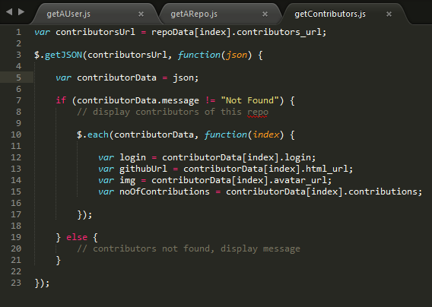
The Code – Get contributors
The Documentation: https://developer.github.com/v3/repos/#list-contributors
How are contributors output:
Sorted by # of commits in descending order
Will only output 30 contributors at a time
To get next 30 you must you pagination

Slide 7
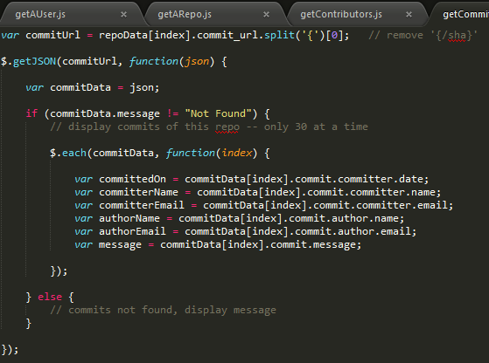
The Code – Get Commits
The Documentation: https://developer.github.com/v3/repos/commits/
Author vs Committer:
“The author is the person who originally wrote the patch, whereas the committer is the person who last applied the patch. So, if you send in a patch to a project and one of the core members applies the patch, both of you get credit — you as the author and the core member as the committer.” - https://git-scm.com/book/ch2-3.html

Slide 8
Challenges
Challenge #1
Currently only gets Public data and limited to 60 requests/hr
Solution
Set up Basic Authorization or oAuth to pull info for private accounts
Challenge #2
Only gives 30 items per lookup (repos, commits, etc)
Solution
Use Github’s Pagination Method
https://developer.github.com/guides/traversing-with-pagination/

Slide 9
What’s Next?
Fix known bug: Repos not clearing when new lookup has no repos found (or private repos)
Allow user to go between User Data and User Repo sections w/o re-search
Add OAuth (server side)
Get more than 30 contributors and commits (Pagination & Search API)
Use Github Method https://developer.github.com/guides/traversing-with-pagination/
Add capability to filter commits by user
Add contributions graph to User Data section
Clean up interface and make fully responsive
The possibilities are endless…

Slide 10
Gitlo An integration of Github with Trello
A brief demonstration…
Gitlo: http://gitlo.co/repo_boards#linked
Trello: https://trello.com/b/HIRwYaq4/portfolio
Github: https://github.com/heatherlarsen/portfolio

Slide 11
The End

