Slide 1
MinuteClinic Clinic Locator & Details Redesign
Chris Gioranino
03/22/2019

Slide 2
Goals, Methods, Participants
Goals
Methods
Participants
Evaluate redesigns for clinic locator and clinic details pages
Explore new approaches to communicating wait time and clinic availability
Solicit user feedback on various design approaches and feature enhancements
9 total moderated remote tests via Usertesting.com
Each participant interacted with designs from both CVS and RIO.
The order of design exposure alternated every session to reduce bias.
Participants explore the designs, completed specific tasks, and provided overall and detailed feedback.
Participants between the ages of 18 and 65.

Slide 3
Detailed Findings – Clinic Locator Results

Slide 4
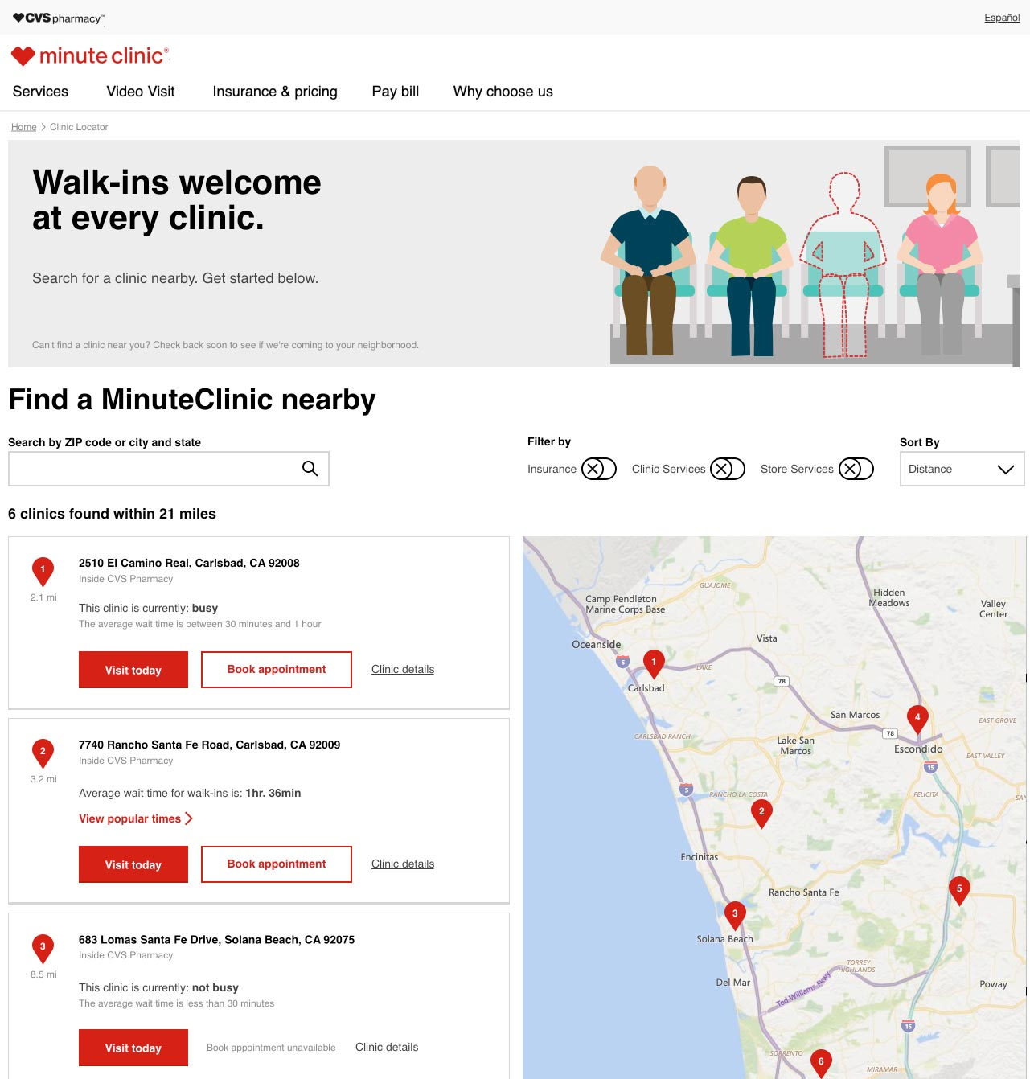
RIO Clinic Locator Results - Desktop
Most users were able to easily locate the filters.
Although users were able to easily select a filter, they assumed the results would automatically update and did not know to click on “refresh results”

Slide 5
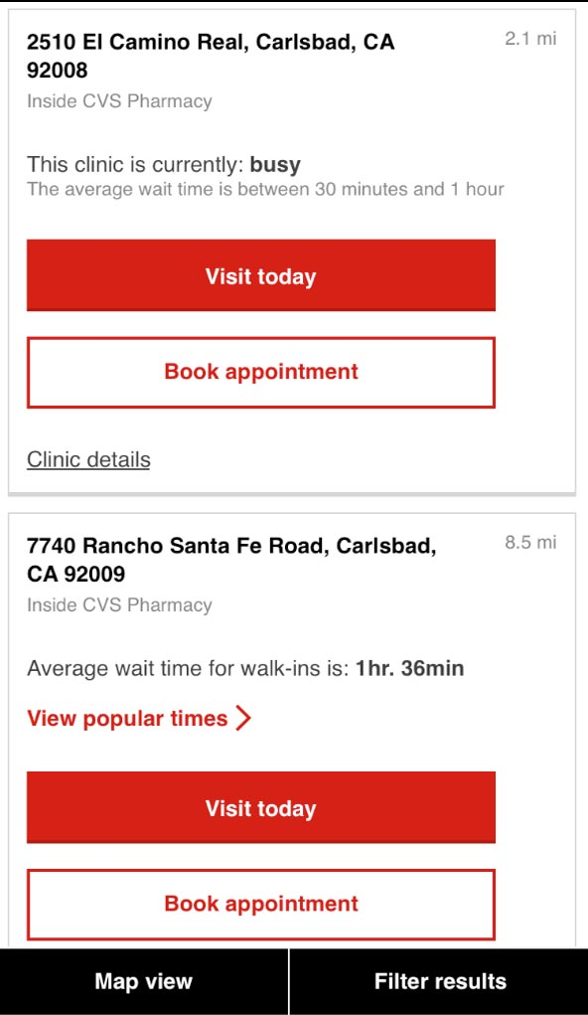
RIO Clinic Locator Results - Mobile
Users were generally able to perform most tasks on this page without issues.
Most users preferred to see the actual wait time over the busy/not busy approach.
Most users preferred a specific wait time versus a range.
The “Book appointment” and “Visit today” buttons were problematic for most users.

Slide 6
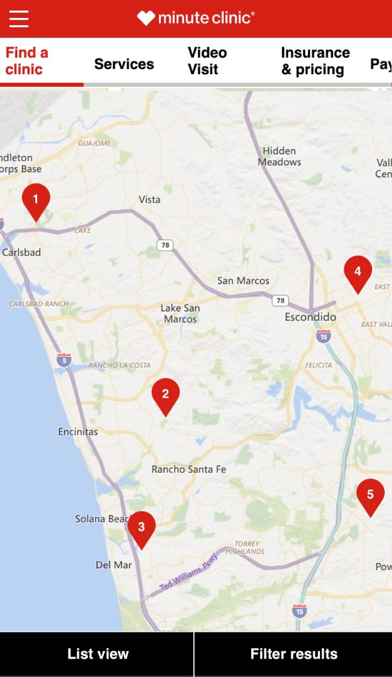
RIO Clinic Locator Results - Mobile
Most users felt this map view was what they expected.
Users liked the ability to click on each pin for details.
Users desired more information to be shown upfront (wait times, distance, and clinic hours)

Slide 7
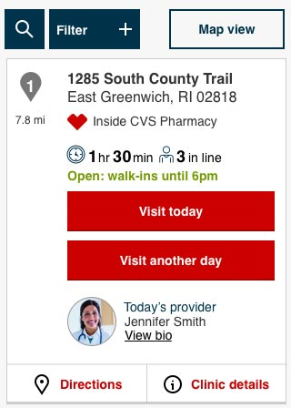
CVS Clinic Locator Results - Mobile
Most users liked the idea of seeing how many people are in line.
Users seemed to understand the difference between “walk-ins until…” and clinic closing time.
Most users appreciated having the provider bio.

Slide 8
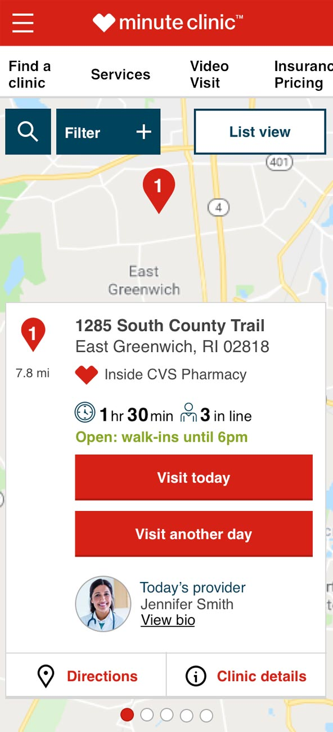
CVS Clinic Locator Results - Mobile
Users generally liked having clinic details below the map.
Most users expected to see more location pins on the map.
It was unclear to some users they could swipe to see additional clinics.

Slide 9
Detailed Findings – Clinic Details

Slide 10
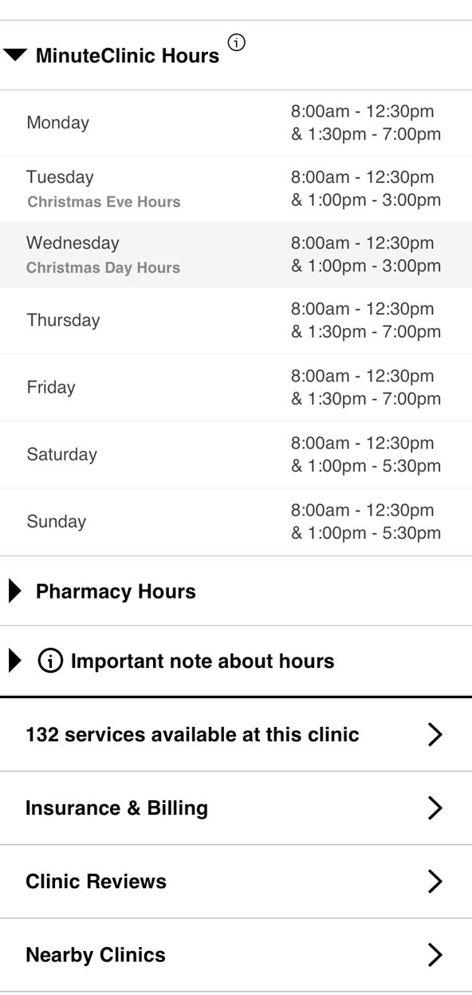
RIO Clinic Details - Mobile
Most users understood actual holiday hours were being displayed.
When asked about pricing, some users weren’t sure where to find the information and others thought it could be under services or insurance & billing.
When asked what they expected to see if they clicked on “Visit length tool”
“I would expect to see the current wait for the clinic”
“Would expect to see questions about the nature of the visit and it would estimate how long the visit would take”

Slide 11
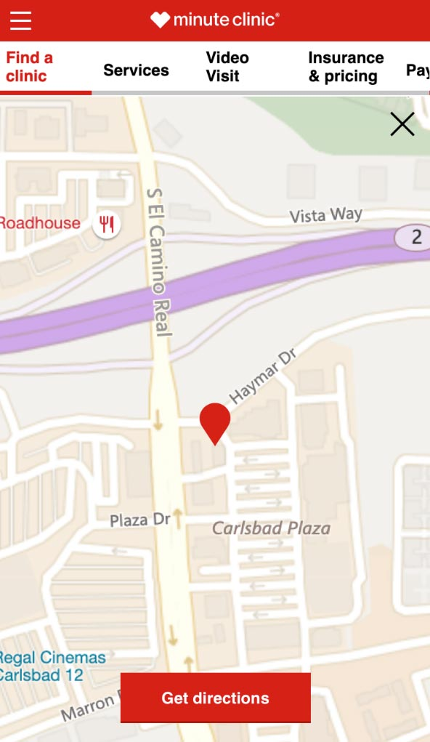
RIO Clinic Details - Mobile
Users preferred a “get directions” button on mobile and expected it to launch their preferred navigation app.

Slide 12
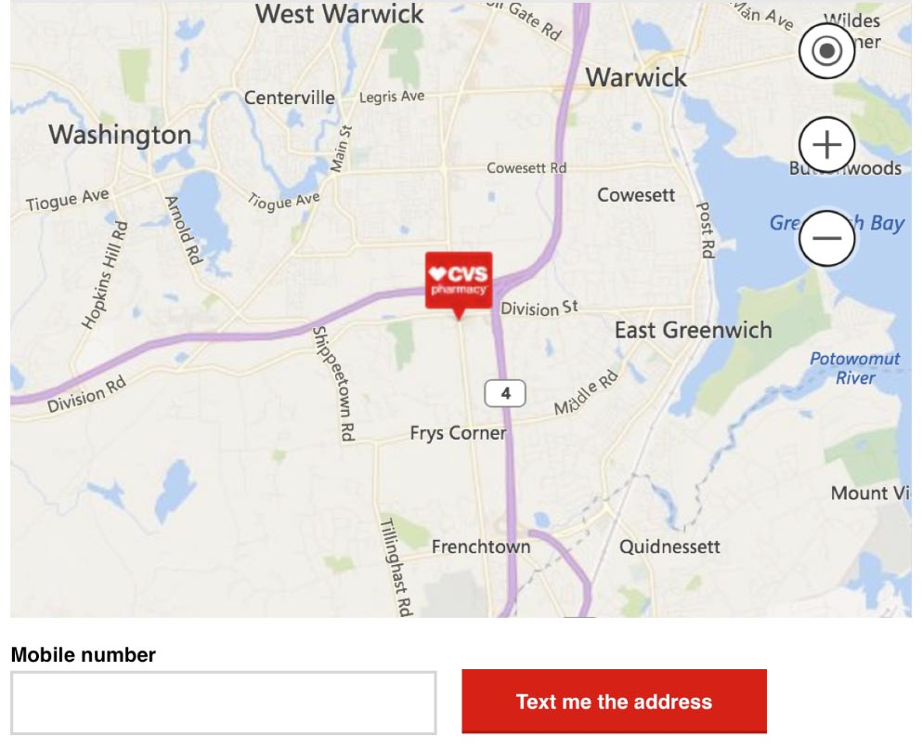
CVS Clinic Details - Desktop

Slide 13
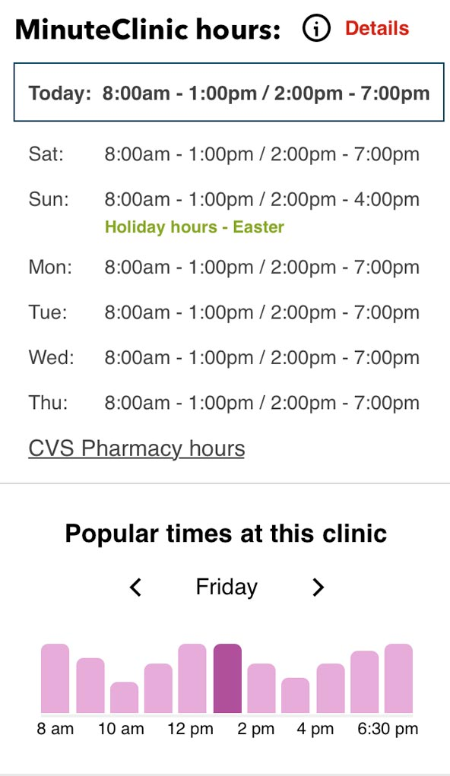
CVS Clinic Details - Mobile
Text of this holiday hours treatment led users to expect to click on the text to view the actual hours.
Participants understood and appreciated having today’s hours at the top and highlighted.

Slide 14
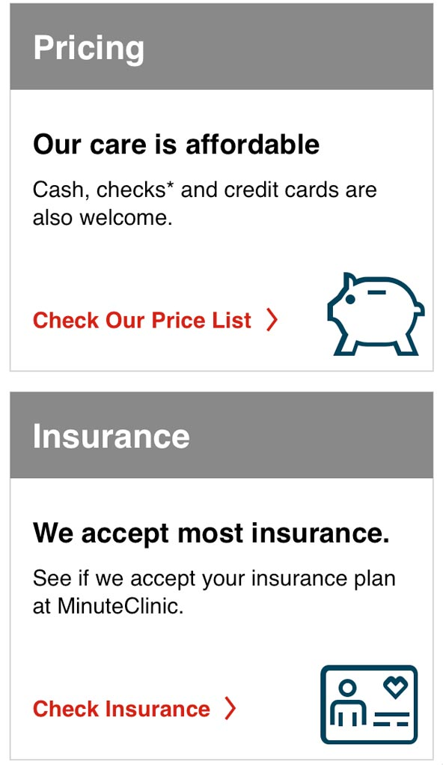
CVS Clinic Details - Mobile
Participants were able to quickly locate pricing and insurance information.
Some participants had trouble locating nearby clinic information (lowest on the page).

Slide 15
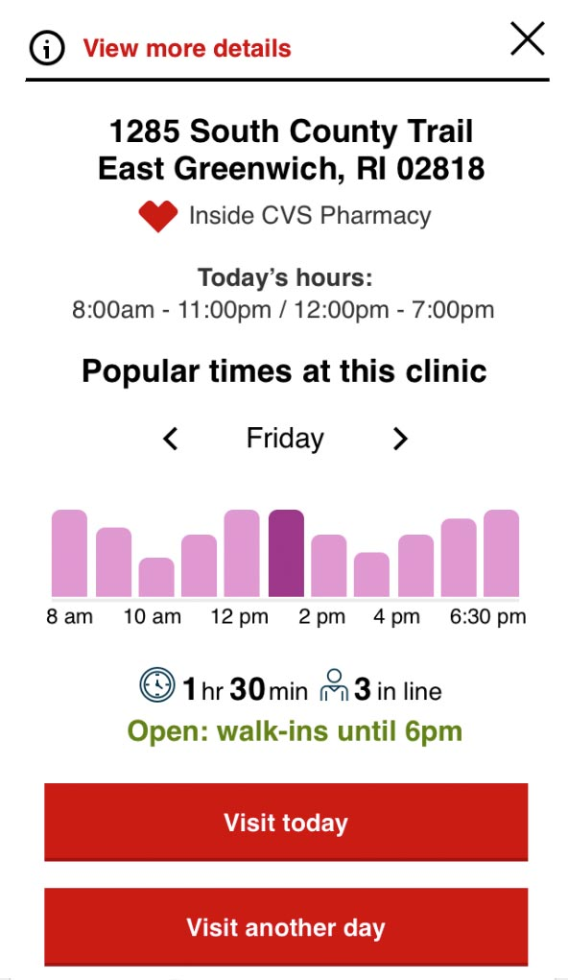
CVS Quick View - Mobile
Most users felt the quick-view offered them all the information they would need.
Some users struggled to locate the “view more details” link.

Slide 16
Session Links
Session 1
Session 2
Session 3
Session 4
Session 5
Session 6
Session 7
Session 8
Session 9

