Slide 1
Sun Thumbs Mobile Application
The Build gradle includes the first elements that are included in the app when you press load.
Without loading permissions to tell you weather to load bluetooth or the internet the app would not know where to connect.
AndroidManifest tells you the name of the app, the id (package used to store information and unique ID for for the app /playstore, icons to display on the app and xml for layouts.
Roundicon, label, theme for example is layout information.
Main activity is where notification is given as to which activity will be loaded first.
Main Activity is loaded first I.e the frame containing all the images.
Then Detail Activity is loaded once a person clicks on a single image. The selected image plus a text label will be displayed on the whole screen.

Slide 2
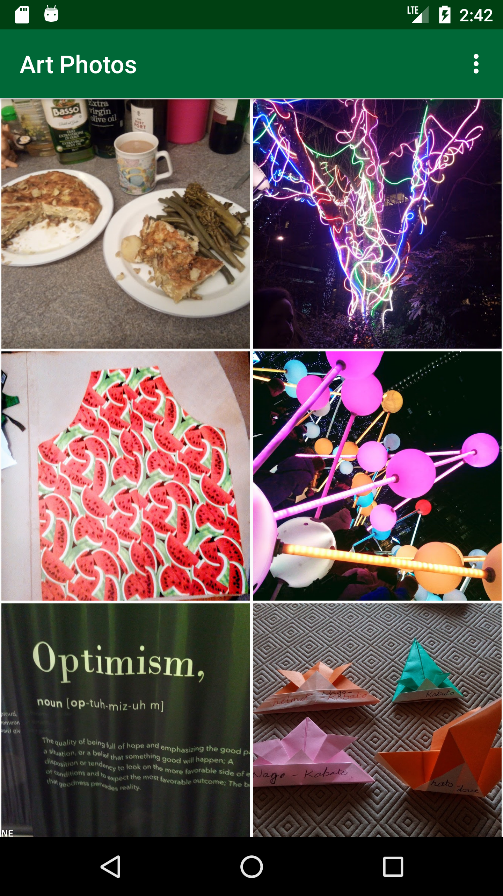
Main Activity Screen

Slide 3
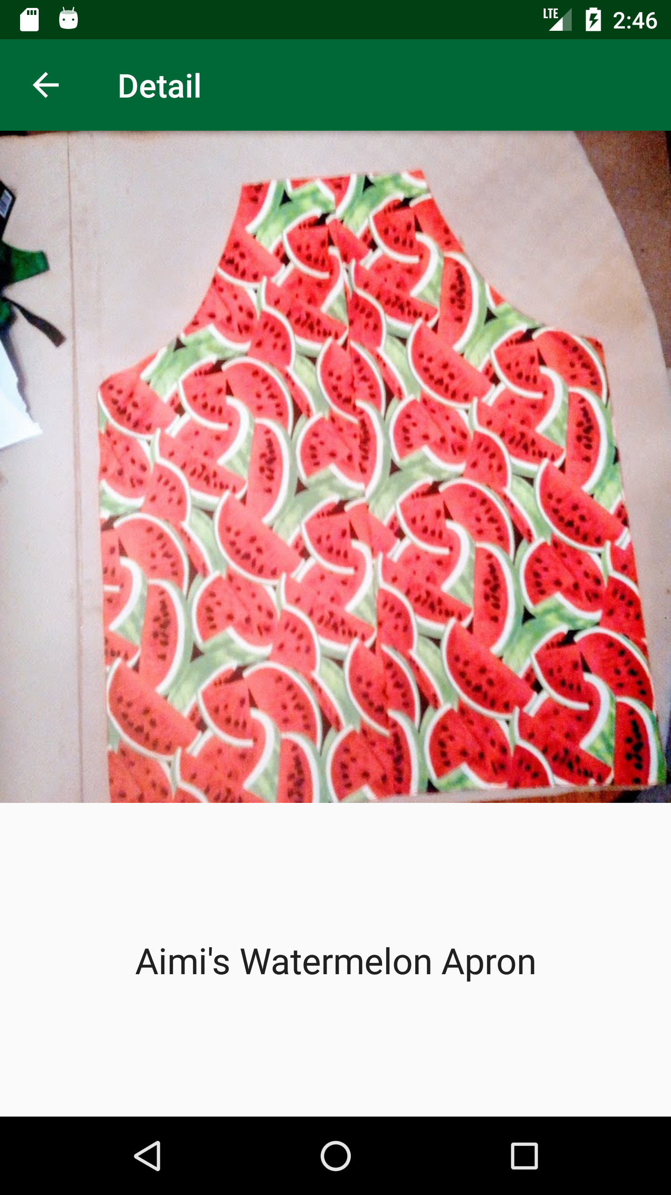
Detail Activity

Slide 4
OnOptionsItemSelected:
ClearCache is an option that you can select from the Settings menu to clear memory. So anything that is cached i.e. photos in memory can be cleared from the memory.

