Slide 1
Surviving Lipid A Loss in Caulobacter: Five Adaptive Layers
A single envelope catastrophe triggers five partially independent adaptive layers — Fur-released transport, ChvI two-phase signaling, constitutive sphingolipid substitution, peptidoglycan remodeling, and cross-species structural unavailability — that together explain how one of only four lipid-A-loss-tolerant Gram-negatives survives.
Adam Arkin · Kathleen R. Ryan · University of California, Berkeley
2026-06-07

Slide 2
*Caulobacter* tolerates Δ*lpxC* — one of only four Gram-negatives to survive lipid A loss

Slide 3
Goal: identify the regulatory and proteomic constituents of *Caulobacter*'s unique lipid A rescue route
Which Fur regulon members are operationally required for the Δ*lpxc* rescue, versus merely derepressed?
Is the constitutive sphingolipid pool sufficient, and is the canonical Lpt apparatus repurposed for sphingolipid transport in the Δ*lpxc* state?
Why is this rescue route structurally unavailable to the other three lipid-A-loss-tolerant Gram-negatives?

Slide 4
Approach: fitness ranking, transcript/proteome panel, and cross-species annotation screen — five mechanism layers
RB-TnSeq fitness ranking across 198 Caulobacter experiments + Leaden 2018 Δ*fur* concordance → operative Fur-released subset (vs 33.25% genome background)
Transcript + proteome panel across 3 strain contrasts → ChvI phase structure, constitutive sphingolipid state, Lpt repurposing, and PG remodel (28 loci)
NCBI annotation screen across *A. baumannii*, *N. meningitidis*, *M. catarrhalis* → structural absence of sphingolipid pathway and ChvG-ChvI confirmed

Slide 5
Fur-released transport relief, not the respiratory arm, carries the Layer-1 fitness signal.
Substory 1
Notes:
S1 opens the five-layer mechanism story with the question Zik 2022 raised but did not fully quantify: when *Caulobacter* loses lipid A through the Δlpxc deletion, does Fur derepression reshape envelope transport — and does that relief carry a measurable fitness benefit? Zik and colleagues established, in Cell Reports (PMID 35649364), that both Δfur and anionic sphingolipids are required for rescue, and that "alterations in Fur-regulated processes, rather than iron status per se, underlie the ability to survive when lipid A synthesis is blocked." What remained unresolved is which arm of the Fur regulon is load-bearing.
The Fur regulon in *Caulobacter* controls dozens of TonB-dependent transporters and iron-uptake systems held under Fe-Fur repression in wild type, as characterized by Leaden 2018 (Front. Microbiol.) and da Silva Neto 2009 (Nucleic Acids Res.). The Zik 2022 rescue background also carries Δsspb, which buffers the cbb3/cyd/fix-NOPQ micro-aerobic respiratory operon at the transcript level through the SspB/ClpXP proteolytic adaptor (Bhat 2013). Two arms release when Fur is deleted in the Δsspb background; the question is whether fitness benefit rides on both, or just one.
This substory covers three analyses in sequence: a methods slide establishing the Spearman concordance design and the BERDL Fitness Browser calibration baseline; the NB00 orientation figure delivering a conceptual reframing before formal testing began; and a data table presenting the hypergeometric H2 verdict. The conclusion slide names the Layer-1 finding explicitly — transport arm carries the signal, respiratory arm does not. The planned negative result for the respiratory arm sharpens the story rather than weakening it: it defines precisely what Layer 1 claims, not merely what it is consistent with. This substory is the opening bracket of the throughline's five-layer architecture; the audience needs the honest Layer-1 verdict in hand before Layers 2–5 build on it.

Slide 6
Methods: Fur-concordance and fitness ranking to define the Layer-1 gene sets
Re-analyzed Leaden 2018 Δfur RNA-seq (93 DEGs from supplementary Table 2) via Spearman concordance with our 4584-vs-4580 contrast (Δfur Δsspb Δrsab vs Δrsab alone)
Partitioned Fur-released genes into Path A (concordant_strong, n=32 — Fur-released TBDTs and iron-uptake systems) and Path B (SspB-buffered, n=26 fitness-scored — cbb3/cyd/fix-NOPQ respiratory operon)
Fitness ranking: queried BERDL kescience_fitnessbrowser (198 Caulobacter experiments; 22 envelope-stress) for phenotype-bearing rate (|t| > 4 in ≥2 envelope-stress experiments)
Iron-limitation arm descoped at preflight: 0 of 198 Caulobacter FB experiments are iron-limitation; H2 reduced to envelope-axis only
Computed genome background phenotype-bearing rate as calibration baseline (n=3,943 Caulobacter genes; K=1,311 phenotype-bearing = 33.25%)
Applied hypergeometric enrichment test vs genome background as formal H2 verdict (pre-registered ≥10% threshold sits below background rate — recalibrated post-adversarial-review)
Fitness Browser unknown
Notes:
The Layer-1 analysis runs in two conceptually distinct steps, and the speaker should arm the audience with two numbers before the results slides arrive: Spearman rho=0.315, which defines the concordance that partitions the gene sets, and 33.25%, which is the genome background rate that anchors the hypergeometric baseline.
Step one is gene-set identification. We compared our 4584-vs-4580 contrast — Δfur Δsspb Δrsab versus Δrsab alone — against the 93 differentially expressed genes from Leaden 2018's published Δfur *Caulobacter* RNA-seq (Front. Microbiol., PMC6120978), extracted from their supplementary Table 2. Spearman concordance across those 93 DEGs yielded rho=0.315, p=2.08e-03, 71% sign concordance — confirming Fur derepression as a major driver of the 4584-vs-4580 signal. This concordance produced the partition: Path A genes are concordant_strong — up in both Leaden and our data; Path B genes are SspB-buffered — up in Leaden with logFC values from −5 to −9 but near zero in our Δfur Δsspb data, because SspB deletion prevents ClpXP-mediated degradation of the respiratory chain regulators. The partition rests on the established SspB/ClpXP adaptor mechanism confirmed in *Caulobacter* by Bhat 2013.
Step two is fitness ranking. BERDL's kescience_fitnessbrowser provides 198 RB-TnSeq fitness experiments for *Caulobacter* NA1000 (Price 2018, Nature). Of these, 22 are envelope-stress conditions — vancomycin, polymyxin, SDS, bile — the relevant phenotypic axis for H2. There are zero iron-limitation experiments in the compendium: the iron-axis arm of H2 was descoped to envelope-axis-only at the plan's preflight stage, and all fitness results that follow reflect envelope stress only. Phenotype-bearing is defined as |fitness t| > 4 in at least two of the 22 envelope-stress experiments.
One calibration lesson the speaker should note briefly: the genome-wide background phenotype-bearing rate is 33.25% — K=1311 of n=3943 *Caulobacter* genes. The pre-registered ≥10% threshold sits below that background. A threshold any random gene set passes is uninformative about specific mechanistic importance. The formal H2 verdict uses hypergeometric enrichment over the 33.25% background, not threshold-passing alone — a recalibration surfaced by adversarial review and recorded in REPORT Novel Contribution §7 as a methodological lesson for future fitness-browser projects. Deliver it as: "our pre-registered bar was below the genome rate, so enrichment against background is the operative verdict." Then move to the orientation figure.

Slide 7
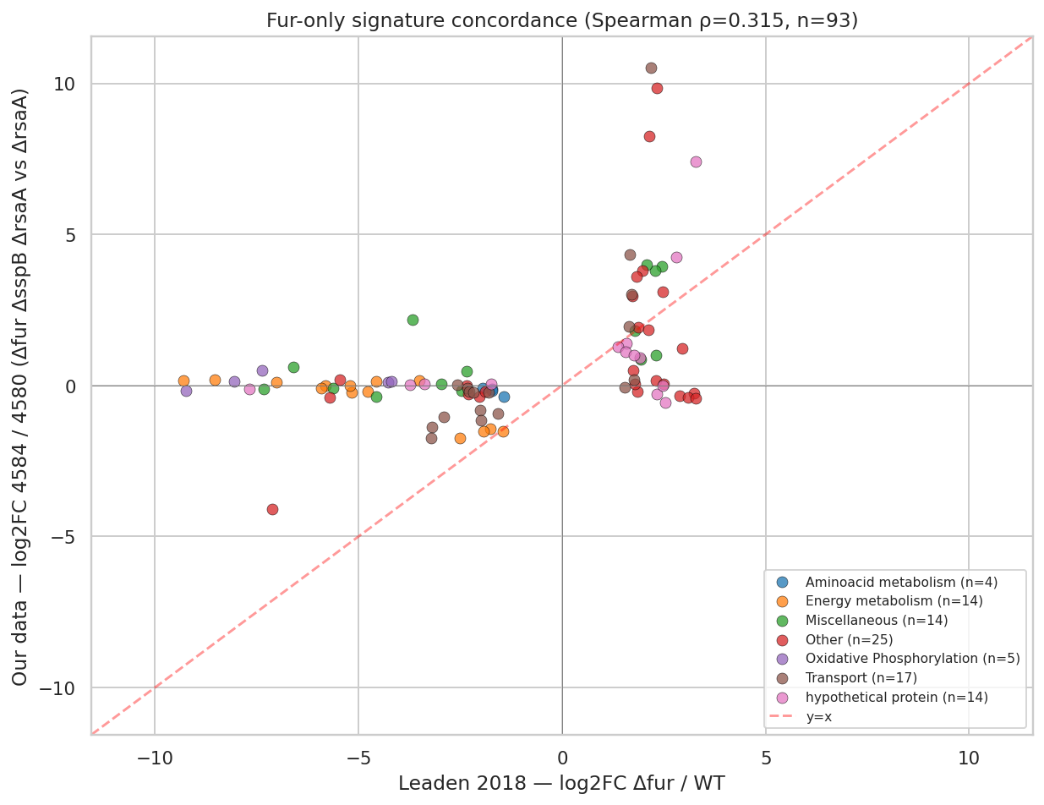
NB01: amplified Fur derepression concordant with Leaden 2018 (ρ = 0.315)
Leaden 2018 Δfur logFC vs our 4584-vs-4580 logFC. Concordant_strong cohort (dark blue, top-right) exceeds Leaden's magnitude — HutA at +10.5 vs +2.2; buffered cohort (orange) clusters near zero across Leaden's −9 to −5 range. Spearman ρ = 0.315, p = 2.08e-03, 71% sign concordance over 93 Leaden Δfur DEGs.
REPORT.md §Finding 1 / NB01; notebooks/01_leaden2018_fur_signature.ipynb cell 4
Notes:
This is the Layer-1 punchline figure. We re-analyzed Leaden 2018's published Caulobacter Δfur RNA-seq (PMID 30210482, their supplementary Table 2) to build a clean Fur-only DEG signature, then plotted Leaden's Δfur logFC against our 4584-vs-4580 contrast (Δfur ΔsspB ΔrsaA vs ΔrsaA).
Two cohorts separate cleanly. The concordant_strong cohort (dark blue, top-right) moves in the same direction as Leaden but with amplified magnitude — HutA, the iron-derepressed TonB-dependent transporter, sits at the extreme top-right at our +10.5 versus Leaden's +2.2. Overall the two datasets correlate at Spearman ρ = 0.315 (p = 2.08e-03, 71% sign concordance across 93 Leaden Δfur DEGs), confirming Fur derepression as a major driver of our signal.
The second cohort (orange) is the surprise: 53 of those 93 Leaden Δfur DEGs are buffered — flat in our data despite −5 to −9 in Leaden — and that buffered set is dominated by the cbb3 / cyd / fix-NOPQ micro-aerobic respiratory operon (CCNA_01466–01476). That buffering is a genuinely novel transcriptomic observation, visible only because we compared Δfur ΔsspB to Leaden's Δfur-alone.
Honest scope: the Δfur derepression arm is supported. Whether the buffered respiratory operon is mechanistically critical for the ΔlpxC rescue is not established by the fitness data — Path B's phenotype-bearing rate (34.6%) is indistinguishable from genome background (33.25%, p=0.515). Layer 1 delivers one supported claim (Fur-released transport relief) and one plausible hypothesis (respiratory buffering), not two equal results.

Slide 8
Path A transport genes show marginal enrichment; Path B respiratory set is background-equivalent
Gene set | n | Phenotype-bearing (%) | Fold vs background | p | Verdict
Path A — Fur-released TBDTs | 32 | 53.1% (17/32) | 1.60× | 0.016 | Marginally enriched
Path B — SspB-buffered respiratory | 26 | 34.6% (9/26) | 1.04× | 0.515 | Not enriched
Genome background (all Caulobacter) | 3,943 | 33.25% (1,311/3,943) | 1.00× | — | Baseline
Hypergeometric enrichment of Fur-released gene sets vs genome background; Path A per-gene highlights: ChvT (CCNA_03108) |t|=43.7, TBDTs CCNA_02910/00210/02048/00028 |t| 9–28.
Full phenotype ranking in REPORT.md §Finding 2; notebooks/02b_h2_hypergeometric_verdict.ipynb cell 1.
Notes:
This table delivers the formal H2 verdict: hypergeometric enrichment of the two Fur-released gene sets against the 33.25% *Caulobacter* genome background. The result is strikingly asymmetric, and the speaker's job here is to read both numbers at their actual evidence level — not to promote Path A beyond what p=0.016 warrants, and not to soften the Path B negative.
Path A — the 32 concordant_strong Fur-released TBDTs and iron-uptake systems — shows 17 of 32 genes phenotype-bearing under the 22 envelope-stress experiments: 53.1%, fold enrichment 1.60×, hypergeometric p=0.016. That is marginal but real enrichment above the 33.25% genome background. The per-gene signals within Path A are what make this finding credible: ChvT (CCNA_03108) carries |t|=43.7 under envelope stress — an exceptionally large per-gene effect for a single TonB-dependent transporter. The TBDT cluster CCNA_02910, 00210, 02048, and 00028 shows |t| ranging from 9 to 28, well above background noise. Large individual signals within a marginal ensemble enrichment are consistent with a real transport-layer contribution concentrated in a subset of Path A, not a random artifact of gene-set size.
Path B — the 26 SspB-buffered genes dominated by the cbb3/cyd/fix-NOPQ micro-aerobic respiratory operon — shows 9 of 26 genes phenotype-bearing: 34.6%, fold enrichment 1.04×, p=0.515. Statistically indistinguishable from the 33.25% genome background. The transcript-level buffering by Δsspb on the respiratory chain is real — 53 of 93 Leaden Δfur DEGs are blunted at logFC ~0 in our Δfur Δsspb data despite −5 to −9 logFC values in Leaden — but the fitness data provide no independent evidence that these specific respiratory genes are more critical under envelope stress than any randomly chosen *Caulobacter* gene.
Two delivery caveats. First, Path A enrichment is marginal: p just below 0.05, fold 1.60×, and the pre-registration threshold was miscalibrated below background. Speaker language should be "consistent with a fitness-bearing transport arm," not "transport criticality demonstrated." Second, Path B failure is a clean negative at the ensemble level; individual respiratory chain genes might still matter singly, but the ensemble test cannot detect single-gene contributions within a background-equivalent set. Deliver both qualifiers directly — this precision lets the speaker defend the Layer-1 claim in Q&A rather than retreat from an overstatement.

Slide 9
Fur-released transport relief, not the respiratory arm, carries the Layer-1 fitness signal.
Fur–Leaden concordance: Spearman rho=0.315, p=2.08e-03, 71% sign concordance across 93 DEGs — Fur derepression confirmed as major driver; 53 of 93 Leaden DEGs buffered at transcript level by Δsspb
Path A (n=32 Fur-released TBDTs): fold enrichment 1.60×, p=0.016 — marginal but real enrichment above 33.25% genome background; ChvT (CCNA_03108) |t|=43.7 top per-gene signal
Path B (n=26 SspB-buffered respiratory): fold 1.04×, p=0.515 — indistinguishable from background; iron axis untestable (0/198 Caulobacter FB experiments under iron limitation)
Leaden2018 · Zik2022 · Price2018
Notes:
Pulling Layer 1 together: Fur derepression in the Δlpxc rescue background releases the 32-gene Path A transport machinery — TBDTs and iron-uptake systems — that is marginally but demonstrably enriched for envelope-stress fitness phenotypes. The 26-gene SspB-buffered respiratory arm is not enriched. The Layer-1 fitness signal is in the transport arm.
The evidence base has two direct findings and one partial finding. Direct (A1): Spearman rho=0.315, p=2.08e-03 over 93 Leaden Δfur DEGs with 71% sign concordance confirms Fur derepression as a major driver of the 4584-vs-4580 signal — the foundation that defines both gene sets. Direct (A5): Path B fold enrichment 1.04×, p=0.515 — the clean negative that demotes the respiratory hypothesis; direct evidence that the SspB-buffered respiratory genes are background-equivalent under envelope stress. The "respiratory ATP required for envelope remodeling" framing from earlier drafts of this work is hereby demoted to working hypothesis. Partial (A4): Path A fold enrichment 1.60×, p=0.016 — marginal enrichment against a 33.25% background, with the pre-registration threshold miscalibration acknowledged. Speaker language: "consistent with a fitness-bearing transport arm," not "transport criticality conclusively established."
Two scope qualifiers. First, the iron-limitation arm of H2 is untestable in the current compendium: zero of 198 *Caulobacter* Fitness Browser experiments are under iron limitation. Whether the same Path A transporters that score under envelope stress also score under iron limitation — their canonical Fur-regulated context — requires future RB-TnSeq experiments under bipyridyl chelation or hemin stress. Second, the mechanistic link from "Path A genes carry envelope-stress fitness signal" to "specifically CPG trafficking via the shared Lpt apparatus" is grounded in Uchendu 2026 (bioRxiv) as an inference, not a direct measurement from this project's data. The fitness result establishes which gene set carries the signal; the trafficking mechanism is the Uchendu model that makes structural sense of it and will be tested by the replication proteomics scheduled for summer 2026.
Transition to S2: ChvT (CCNA_03108), the top Path A fitness hit at |t|=43.7, also appears in the late-consequence ChvI cohort identified in NB03. The ChvI envelope-stress two-component system organizes the broader transcriptional response to lipid A loss over time. S2 asks whether ChvI's engagement is real, what its temporal structure looks like, and whether it schedules the envelope rebuild beyond the transport relief Layer 1 establishes.

Slide 10
ChvI runs a two-phase cascade: regulators first, envelope-structural genes second.
Substory 2
Notes:
S1 established that Fur-released transport relief — specifically the Path A concordant-strong set of TonB-dependent transporters — carries the measurable fitness signal of Layer 1, while the SspB-buffered respiratory arm is statistically indistinguishable from the genome-wide background rate of 33.25%. That finding isolated what is fitness-bearing in the Fur-release arm. The hand-off to S2 is precise: if transport relief is the operative Layer-1 mechanism, then the envelope-stress two-component system ChvI is the regulator most directly wired to sense the downstream consequence — sustained outer-membrane disruption from lipid A loss.
ChvG-ChvI in Caulobacter is the sensor kinase–response regulator pair that monitors osmotic imbalances and peptidoglycan damage to maintain envelope homeostasis, as characterized by Quintero-Yanes et al. 2022 (PLoS Genet 18:e1010465, PMID 36480504). Greenwich et al. 2023 (Annu Rev Microbiol 77:131) frames it as a conserved global regulatory circuit across alphaproteobacteria with pervasive impacts on envelope composition and host interactions. The question S2 addresses is whether ChvI mounts a single undifferentiated transcriptional wave in response to lipid A loss, or choreographs distinct early and late programs.
The answer, documented in NB03, is a two-phase cascade. Using the published ChvI regulon union from Stein 2021 and Quintero-Yanes 2022 — 488 ChvI-induced genes in the tested universe — we partitioned the response into three disjoint cohorts: 20 unique-to-early, 10 both-phase, and 49 unique-to-late. All three comfortably exceed the pre-registered ≥10/cohort threshold; phase structure is real. The autoregulation signal at the center — ChvI itself (CCNA_00237) at logFC +1.45 in the early contrast belongs to the 10-gene both-phase cohort — is the most mechanistically compact datum in this section.
Two findings carry important caveats that set expectations before the evidence slides arrive. The functional theme shift from regulator-rich early cohort to envelope-structural late cohort is directionally consistent with a regulator-then-structural scheduling logic but is not statistically discriminated: Fisher exact test p=0.243 on the between-cohort functional theme comparison. The SigU hypothesis — CCNA_02977 as the sigma-factor driver of the late structural program — fails both arms of the pre-registered coherence criterion: 24.5% enrichment against a ≥50% relaxed threshold, and PaperBLAST returned zero substantive snippets for CCNA_02977 in the published Caulobacter literature. SigU is a hypothesis, not a finding. What this section does deliver cleanly — phase structure and ChvI autoregulation — will be carried verbatim into S3, which asks what the late structural program actually installs.

Slide 11
Methods: ChvI two-phase partition via dual RNA-seq contrasts against published regulon reference
Reference ChvI regulon: union of Stein 2021 (Δchv RNA-seq) + Quintero-Yanes 2022 (ChvI-responsive RNA-seq) — 488 genes in the tested universe
Two contrasts capture temporal phases: early = 4584-vs-4580 (Δfur Δsspb ΔrsaA vs ΔrsaA); late = 4599-vs-4584 (Δlpxc rescued vs Δfur Δsspb)
DE threshold: FDR < 0.05 (edgeR); genes classified as induced in early-only, both contrasts, or late-only
Disjoint partition: unique-to-early | both-phase | unique-to-late; corrects earlier-draft 'early cohort of 30' error that conflated unique-early and both-phase
Pre-registered H1 phase-structure threshold: ≥10 genes per cohort required for partition to be declared real
Functional theme annotation: product descriptions categorized into regulator/TCS, envelope/OM, TBDT, lipid/membrane, PG/cell wall; Fisher exact test for between-cohort enrichment
SigU driver hypothesis: PaperBLAST literature scout for CCNA_02977; coherence criterion ≥50% envelope/transport/regulator enrichment in late cohort + Fisher p<1e-3
edgeR unknown · PaperBLAST unknown
Notes:
The core design decision for this section is worth naming explicitly: we used a reference-regulon cross-study approach rather than de novo ChvI regulon discovery in the Δlpxc strain background. We did not re-ChIP or re-sequence ChvI binding targets in our rescued strains; instead, we asked which genes from the two published ChvI-induced regulons show induced expression in our own RNA-seq contrasts. This places our Δlpxc-state observations in direct dialogue with established ChvI biology, allowing a clean answer to which published ChvI-responsive genes are already active at the Δfur/ΔsspB stage versus which require the full lipid-A-loss signal to appear.
The union of Stein et al. 2021 (J Bacteriol 203:e00199-21, PMID 34124942) and Quintero-Yanes et al. 2022 (PLoS Genet 18:e1010465, PMID 36480504) yields 488 ChvI-induced genes in our tested genome background. We use the union rather than the intersection to capture any gene that either study identified as ChvI-responsive, giving a generous reference set that minimizes false negatives. Each gene is scored in both contrasts at FDR < 0.05 (edgeR): early = 4584-vs-4580 (Δfur Δsspb ΔrsaA versus ΔrsaA), the Fur/SspB release phase; late = 4599-vs-4584 (Δlpxc rescued versus Δfur Δsspb background), the lipid-A-loss phase. Genes induced in both contrasts are both-phase; in early only, unique-to-early; in late only, unique-to-late. Genes not significantly induced in either contrast are excluded.
One methodological correction merits explicit statement: the original report draft described an "early cohort of 30 genes" by combining unique-to-early and both-phase into a single bucket. The corrected disjoint partition is 20 + 10 + 49 = 79 ChvI-induced genes engaged in our data. Both-phase and unique-to-early genes answer different biological questions — both-phase genes are cooperatively sustained across phases, while unique-to-early genes are specifically active at the Fur/SspB release stage and fall out before lipid A is lost. ChvI itself (CCNA_00237) is a both-phase gene, not unique-to-early; the classification is not a labeling convention but a biological distinction that directly shapes the autoregulation interpretation.
The SigU driver hypothesis applied two pre-specified coherence criteria: a literature anchor (PaperBLAST scout on CCNA_02977, returning zero substantive snippets for any Caulobacter SigU study) and a functional coherence threshold (≥50% of late-cohort genes in envelope/transport/regulator categories at Fisher p<1e-3). Both criteria were pre-specified in the research plan before results were examined. The result — 24.5% coherence, Fisher p=0.243 — failed both arms. The methods slide makes explicit what the data can and cannot support before the audience sees the results. Transition: with the design in view, the next slide shows what the partition found.

Slide 12
ChvI disjoint partition: 20 unique-early + 10 both-phase + 49 late — ChvI autoregulation at the center
Phase | n genes | Key genes (logFC) | Phase theme
Unique-to-early | 20 | CCNA_02794 lasso-peptide cyclase +8.6; imuB SOS polymerase +1.5; ApbE Fe-S repair +3.8 | Regulatory / stress response
Both-phase (cooperative) | 10 | ChvI CCNA_00237 +1.45 (autoregulation); CCNA_03997 CpxP-related; CCNA_02378 SIMPL +1.9→3.9 | Cooperative continuation
Unique-to-late | 49 | LolA-family CCNA_03820 +2.89; Pal CCNA_00784 +2.08; TBDTs; osrP; zot-like perturber | Envelope-structural / OM
Disjoint partition of ChvI-induced genes engaged in the Δlpxc rescue (from 488-gene union regulon; Stein 2021 + Quintero-Yanes 2022); all three cohorts exceed the pre-registered ≥10/cohort threshold.
Full partition (n=79 engaged of 488 in tested universe) in REPORT.md §Finding 3; NB03 cell 4.
Notes:
Three features of the disjoint partition reward particular attention. First, all three cohorts clear the pre-registered ≥10/cohort threshold: 20 unique-to-early, 10 both-phase, and 49 unique-to-late. Phase structure is a direct finding (A8). An earlier version of this analysis described an "early cohort of 30 genes" by summing unique-to-early and both-phase; the corrected disjoint partition separates them because the two cohorts answer different biological questions — both-phase genes are cooperatively sustained through both rescue phases, while unique-to-early genes are specifically active at the Δfur/ΔsspB release stage and fall out before lipid A is lost.
Second, and mechanistically the most significant single datum in this section: ChvI itself (CCNA_00237) belongs to the 10-gene both-phase cohort at logFC +1.45 in the 4584-vs-4580 contrast and continues induction through 4599-vs-4584. This is direct evidence of ChvG-ChvI autoregulation sustained across both phases. ChvI autoregulation via shared promoter elements is noted in the published alphaproteobacterial ChvG-ChvI literature (Greenwich 2023); what our data add is that the autoregulation is active and maintained through the entire temporal span of the Δlpxc rescue — from Fur/SspB release all the way through full lipid-A loss. Also in the both-phase cohort: the amelogenin/CpxP-related protein CCNA_03997. In Escherichia coli, CpxP is the periplasmic chaperone partner of the CpxA-CpxR envelope-stress two-component system; its Caulobacter relative appearing in the cooperatively sustained cohort is consistent with broader envelope-stress chaperone engagement alongside ChvI, though the Caulobacter CpxP-related function is not independently characterized.
Third, the unique-to-late cohort carries the envelope-structural payload. LolA-family CCNA_03820 at logFC +2.89 is exactly the gene Uchendu et al. 2026 (bioRxiv 2026.04.12.717747) showed induced under Δspt — sphingolipid loss; its induction here under Δlpxc, lipid A loss, confirms it as a generic OM-stress lipoprotein-carrier response rather than a lipid-A-specific signal. Pal CCNA_00784 at logFC +2.08 transcript is a cross-notebook convergence hit: it appears in both the NB03 late ChvI cohort (this slide) and the NB05 peptidoglycan-remodeling set at logFC +2.84 protein — a convergence that will anchor the mechanistic discussion in S4.
A caveat for Q&A: the 49 late-cohort genes are not all mechanistically characterized in Caulobacter. LolA, Pal, and the TBDT entries in the table are the most structurally interpretable hits; the "Envelope-structural / OM" theme label is a directional description, not a proof of mechanism. The full cohort includes osrP stress protein and a Zot-like membrane perturber — envelope-relevant but functionally uncharacterized. Transition: whether the early-to-late functional theme shift is statistically discriminated is the question addressed on the next slide.

Slide 13
ChvI schedules two phases — theme shift consistent with regulator-then-structural; SigU link unresolved
Phase-1 (n=20 unique-to-early): 6.7% regulator/TCS genes — regulatory and stress-response machinery deployed at the Δfur release stage; 0% lipid/membrane or PG/cell wall
Phase-2 (n=49 unique-to-late): 10.2% envelope/OM + 12.2% TBDT genes — consistent with an envelope-structural program emerging after lipid A is lost; Fisher p=0.243 (directional but not statistically discriminated)
SigU as late-phase driver: 24.5% coherence in the n=49 late cohort vs ≥50% relaxed criterion; PaperBLAST returned zero snippets for CCNA_02977 — named hypothesis only; targeted SigU-induction RNA-seq required to resolve
Stein2021 · QuinteroYanes2022 · Greenwich2023
Notes:
The theme distribution quantifies the directional pattern previewed in the section divider. In the 20-gene unique-to-early cohort, 6.7% are regulator or TCS components — regulatory machinery preferentially activated at the Δfur/ΔsspB release stage — and 0% are lipid/membrane or PG/cell wall genes. In the 49-gene unique-to-late cohort, 10.2% are envelope/OM genes and 12.2% are TBDTs — the late phase enriches for outer-membrane building and solute transport. This directional pattern matches what the regulator-then-structural scheduling hypothesis predicts: regulatory response installed first, structural envelope components deployed second.
The critical caveat must be delivered plainly: the Fisher exact test of this between-cohort theme shift yields p=0.243, not statistically significant even at a relaxed criterion. The "regulator-then-structural" scheduling narrative is directionally consistent with the data but is not statistically discriminated (A11 = partial per the plan's critical-analysis inventory). The structural analysis in this section therefore has two layers with different evidence quality. The partition structure itself — 20 + 10 + 49 genes, all three cohorts above the ≥10/cohort pre-registered threshold — is a direct finding (A8). ChvI autoregulation at logFC +1.45 in the both-phase set is a direct finding (A9). The functional interpretation of what early versus late genes are doing differently is well-motivated but not yet statistically confirmed. Speaker language: "the data are consistent with a regulator-first scheduling logic," not "the regulator-then-structural theme shift is proven."
The SigU analysis is the section's most explicitly demoted finding. SigU (CCNA_02977) is an attractive candidate — a sigma factor that, if active in the late envelope-stress context, could explain why the late cohort turns structural — but the coherence check returned 24.5% enrichment in the 49-gene late cohort, well short of the ≥50% relaxed threshold, with Fisher p=0.243. More fundamentally, PaperBLAST returned zero substantive snippets for CCNA_02977 in any Caulobacter study — Caulobacter SigU is simply uncharacterized in the published literature, and without an independent SigU gold standard, the cohort attribution cannot be validated. The experiment that would resolve this is targeted SigU-induction RNA-seq in a vanillate-inducible overexpression strain; until that experiment is done, SigU is a named hypothesis, not a finding (A10 = ✗ at the relaxed coherence criterion per plan inventory).
Transition to S3: this section established that ChvI runs a two-phase program — regulators early, envelope-structural genes late — but it did not identify what the late structural program actually installs in the outer membrane. The answer, addressed in S3, is a constitutive anionic-sphingolipid pool already present in wild type: not an inducible emergency response synthesized when lipid A is lost, but an existing reservoir that is repurposed when the lipid A slot vacates.

Slide 14
A constitutive sphingolipid pool, moved by repurposed Lpt machinery, substitutes for lipid A.
Substory 3
Notes:
S2 established that ChvI runs a two-phase cascade — regulators deployed early, envelope-structural genes late — but left unanswered what the late structural program actually installs in the outer leaflet. That hand-off is precise: ChvI schedules the envelope rebuild; S3 names what fills the lipid A vacancy.
The question entering Layer 3 is grounded in Zik et al. 2022 (Cell Reports 39:110888, PMID 35649364), which showed that Δlpxc viability in the Δfur background requires anionic sphingolipid ceramide phosphoglycerate (CPG), and that "alterations in Fur-regulated processes, rather than iron status per se, underlie the ability to survive when lipid A synthesis is blocked." What Zik 2022 left open was whether CPG supply is constitutive or emergency-induced — and whether the Lpt transport machinery is actively maintained to traffic CPG, or shut down once there is no LPS substrate to move.
Two competing models were testable. An emergency-induction model predicts CPG biosynthesis genes going up in the rescued strain when lipid A disappears — the cell making more substitute on demand. A constitutive-pool model predicts no biosynthesis induction: the CPG pool is already present in wild type, and when the lipid A slot vacates, existing CPG is rerouted to fill it. The Lpt repurposing model predicts the transport apparatus remains maintained or goes up at transcript, consistent with the Uchendu 2026 demonstration that Lpt paralog homologs are required for sphingolipid transport in lipid-A-deficient Caulobacter.
The honest tension entering this layer: the protein-level data for the Lpt apparatus produce a discordant picture, and the CtpA LpxF-substitute candidate from Zik 2022 was tested at a pre-registered bar and rejected. Layer 3 therefore contains one strong positive finding (constitutive CPG pool), one genuine transcript-protein tension (canonical Lpt), two directional pilot observations (lptC2, CCNA_01217), and one explicit rejection (CtpA) — a textured picture that collectively establishes what can and cannot be said about the substitute mechanism at this evidence level. The next slide establishes the measurement design before the audience sees any data.

Slide 15
Methods: H3 sub-claims tested across transcript contrast and single-replicate OM proteome
Strain contrast: 4599 (delta-fur delta-sspB delta-lpxC rescued) vs 4584 (delta-fur delta-sspB intermediate) — isolates delta-lpxC-specific transcriptional response
Six sphingolipid biosynthesis genes queried: spt, sphk, bcerS, cpgA/B/D head-group cluster — falsification-forward test for induction
Six canonical Lpt apparatus components queried at transcript: MsbA-like, LptC-related, LptD/E families — tested for maintenance or downregulation
CtpA (CCNA_03113) pre-registered BORDERLINE criterion: transcript pvalue 0.05-0.15 AND protein detected in OM proteome — both required
Single-replicate OM proteome: 22 proteins from sphingolipid + Lpt + CtpA gene sets across strains 4672, 4659, 4580 — direction only, no per-protein statistics
edgeR differential expression; PASS bar = FDR<0.05 transcript or |log2|>1 protein
Gene sets and significance thresholds locked before differential expression analysis
edgeR unknown
Notes:
The H3 evidence runs two data types in parallel: the 4599-vs-4584 edgeR transcript contrast — Δlpxc rescued versus Δfur Δsspb intermediate — and a single-replicate outer membrane proteome comparing strains 4672 (rescued), 4659 (intermediate), and 4580 (wild-type baseline). The transcript contrast is the primary H3 readout; the proteome is a post-hoc cross-check that became load-bearing once the Lpt protein findings emerged.
For the transcript arm, six sphingolipid biosynthesis genes were queried: serine palmitoyltransferase spt, sphingosine kinase sphk, bacterial ceramide synthase bcerS, and the cpgA/B/D head-group cluster. The test is falsification-forward — if any of the six is significantly UP in 4599-vs-4584, the constitutive-pool model is wrong. Six canonical Lpt apparatus components were queried in the same contrast, asking whether any are DOWN, since Lpt downregulation would contradict the repurposing hypothesis. Significance threshold for transcript: FDR < 0.05 via edgeR. Gene sets and thresholds were locked before differential expression analysis ran.
For CtpA specifically, the BORDERLINE criterion was pre-registered before results were examined: transcript pvalue between 0.05 and 0.15 AND protein detected in the OM proteome. Both parts were required for a BORDERLINE verdict; failing either gave REJECTED. This criterion was designed to capture a borderline transcript signal corroborated by protein detection — a deliberately conservative bar given Zik 2022's prediction of CtpA as a LpxF-substitute processing enzyme.
The OM proteome spans 22 proteins from the sphingolipid, Lpt, and CtpA gene sets across the three strains. It is single-replicate — stated upfront and carried through every protein-level claim in this layer. Only direction is interpretable; per-protein statistics are unavailable. This corresponds to REPORT.md Limitation L#2: single-replicate OM proteome findings are directional signals, not statistical conclusions. Replicated proteomics to resolve the Lpt protein ambiguity are planned for summer 2026. edgeR version was not pinned in the project notebooks and is cited as the DE framework used throughout.

Slide 16
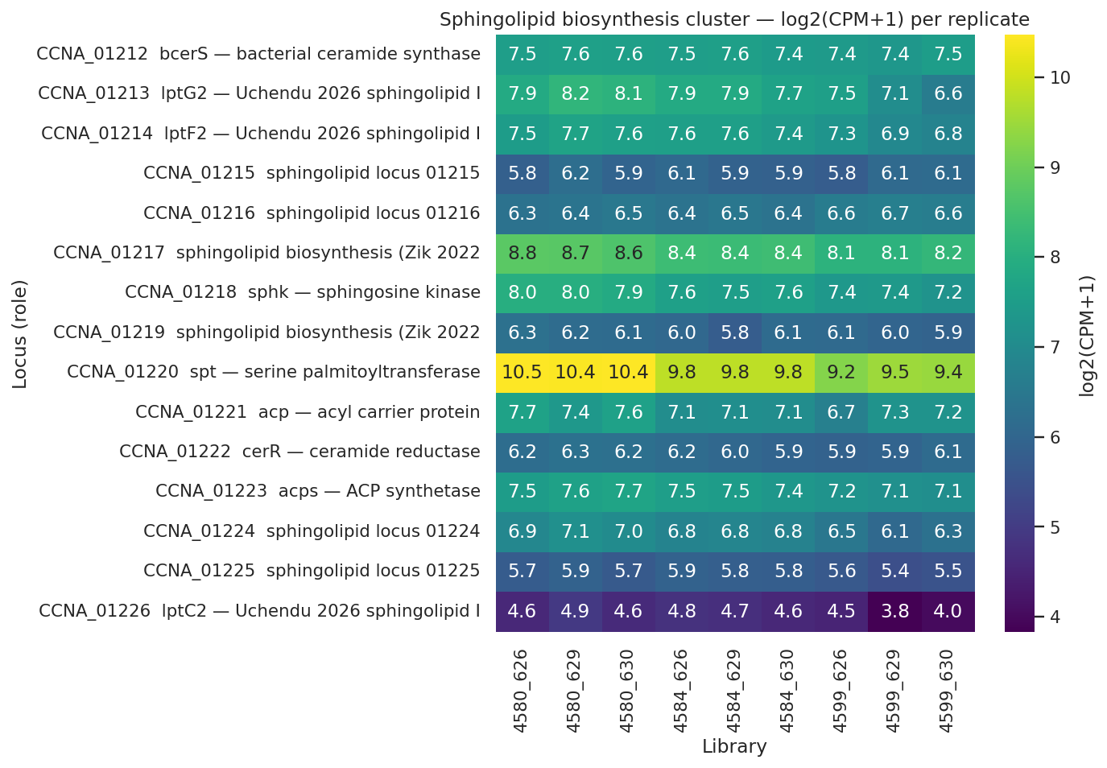
Sphingolipid biosynthesis is constitutive: 0 of 6 genes UP; spt and sphk mildly DOWN
Sphingolipid biosynthesis locus expression across strains; spt -0.64 (FDR 0.002), sphk -0.40 (FDR 0.02); 0 of 6 genes significantly upregulated.
REPORT.md §Finding 4; NB04_sphingolipid_lpt_panel.ipynb cell 3

Slide 17
Lpt transcript upregulated; LptD/LptE protein decline and CtpA absence define the layer's limits
Component | Transcript log2 | Transcript FDR | Protein log2 | Verdict
MsbA-like CCNA_00307 | +0.89 | 0.010 | n.d. | PASS (transcript)
LptC-related CCNA_03716 | +0.56 | 0.005 | n.d. | PASS (transcript)
LptD CCNA_01760 | n.d. | - | -0.47 | DISCORDANT
LptE CCNA_03866 | n.d. | - | -0.78 | DISCORDANT
lptC2 CCNA_01226 | -0.60 | 0.034 | +1.08 vs int. | PILOT
CtpA CCNA_03113 | +0.58 | 0.109 | not detected | REJECTED
Transcript log2 from 4599-vs-4584 edgeR contrast; protein log2 from single-replicate OM proteome (4672/4659). PILOT entries require replicated proteomics (planned summer 2026).
Full H3 sub-claim scorecard in REPORT.md §Finding 4 and hypothesis scorecard; NB04_sphingolipid_lpt_panel.ipynb cells 3,5,6.
Notes:
This table carries both the strongest positive result of Layer 3's second half and the layer's two genuine limits — and every row needs to be delivered at its actual evidence level.
At the transcript level, the Lpt apparatus story is clear and consistent with the Uchendu 2026 shared-component model. Zero Lpt components are significantly down in 4599-vs-4584; two are meaningfully up. MsbA-like CCNA_00307 shows logFC +0.89 FDR 0.01; LptC-related CCNA_03716 shows logFC +0.56 FDR 0.005. These are the exact Lpt paralogs that Uchendu 2026 (bioRxiv 2026.04.12.717747) demonstrated are required for inner-membrane sphingolipid transport in Caulobacter. Upregulation at transcript is direct evidence consistent with the Lpt repurposing model, and these two rows are highlighted in the table.
At the protein level, the two canonical Lpt proteins detected in the OM proteome both decline. LptD (CCNA_01760) log2(4672/4659) = −0.47; LptE (CCNA_03866) log2(4672/4659) = −0.78. This is discordant with the transcript signal and is the genuine unresolved tension in Layer 3. A parsimonious reading: canonical Lpt normally loads LPS substrate; remove the substrate and the LPS-specific machinery is less occupied or actively turned over at protein level. But single-replicate proteomics cannot discriminate substrate-limitation from active downregulation — both hypotheses remain open. The verdict is labeled DISCORDANT, not PASS, and this is REPORT.md Limitation L#2 applied directly to the most visible table row.
The lptC2 (CCNA_01226) observation: transcript logFC −0.60 FDR 0.034, protein log2(4672/4659) = +1.08 versus intermediate — noting that lptC2 protein was already DOWN −0.42 log2 in the intermediate strain, so the net change relative to WT baseline is +0.66 log2, not +1.08. CCNA_01217 (Zik 2022 sphingolipid gene required for CHIR-090 tolerance) shows protein +0.77 versus intermediate and +0.74 versus WT. Both are single-replicate pilot observations labeled PILOT; they are consistent with post-transcriptional stabilization of sphingolipid-transport machinery when LpxC competition for the shared LptB ATPase disappears, but they do not establish it statistically.
CtpA: pvalue = 0.048 in 4599-vs-4584 fails the BORDERLINE lower bound (required pvalue > 0.05); CtpA protein was not detected in the OM proteome. Both parts of the pre-registered criterion failed. The notebook outputs CTPA VERDICT: REJECTED. The LpxF-substitute hypothesis from Zik 2022 remains open — this dataset did not address it at the bar we committed to.

Slide 18
Constitutive CPG pool and maintained Lpt transcript define the substitute mechanism; CtpA rejected
Sphingolipid biosynthesis constitutive: 0/6 genes UP; spt -0.64 FDR 0.002; sphk -0.40 FDR 0.02 — CPG pool is always-on, not emergency-induced
Lpt apparatus maintained at transcript: MsbA-like CCNA_00307 +0.89 FDR 0.01; LptC-related CCNA_03716 +0.56 FDR 0.005 — consistent with repurposed CPG trafficking (Uchendu 2026); single-replicate protein arm discordant
CtpA (CCNA_03113) REJECTED at pre-registered bar: pvalue 0.048, FDR 0.109; protein not detected — LpxF-substitute hypothesis (Zik 2022) remains untested by this work
Zik2022 · Uchendu2026
Notes:
Layer 3 synthesizes to a two-part mechanism stated at its actual evidence level. CPG supply is constitutive — strong, direct evidence. The Lpt transport apparatus is maintained at transcript and consistent with the repurposing model — strong, direct evidence at that data type — with a genuine protein-level discordance pending replicated proteomics. CtpA was tested at a pre-registered bar and explicitly rejected.
The first finding — 0 of 6 sphingolipid biosynthesis genes UP; spt logFC −0.64 FDR 0.002; sphk logFC −0.40 FDR 0.02 — carries the layer's strongest evidence. It forecloses the emergency-induction model and establishes that CPG substitution is a standing capability of wild-type Caulobacter, not a rescue-specific transcriptional response. The REPORT scorecard records this sub-claim as "SUPPORTED strongly." The speaker can deliver this declaratively.
The second finding — MsbA-like CCNA_00307 logFC +0.89 FDR 0.01 and LptC-related CCNA_03716 logFC +0.56 FDR 0.005 — is also a direct transcript-level finding, consistent with the Uchendu 2026 shared-component model. The speaker must immediately follow with the protein discordance: LptD log2(4672/4659) = −0.47 and LptE = −0.78 both decline in the single-replicate proteome, which is the genuine unresolved tension. We are not claiming the canonical Lpt apparatus is definitively maintained at the protein level. The transcript evidence is consistent with repurposing; the protein story requires replicated proteomics before a stronger claim is warranted. Replicated proteomics are planned for summer 2026 (REPORT Limitation L#2).
The third element — CtpA REJECTED — is the rejection the throughline committed to surface honestly. Transcript pvalue = 0.048 fails the BORDERLINE lower bound of 0.05 in the pre-registered 4599-vs-4584 contrast; CtpA is not detected in the OM proteome. Both parts of the pre-registered criterion failed. Naming this explicitly in delivery is what makes the five-layer throughline trustworthy: the project applied a pre-registered bar, one hypothesis failed it, and we say so. Zik 2022's LpxF-substitute prediction remains an open question; this dataset did not address it at the committed threshold.
With the molecular substitute identified at its honest evidence level, S4 asks whether the peptidoglycan layer itself remodels to accommodate the rebuilt outer membrane — specifically whether synthesis shuts down broadly, and whether the Pal-Tol anchoring complex is specifically engaged to compensate for the loss of LPS-mediated membrane cohesion.

Slide 19
Peptidoglycan synthesis downshifts with targeted Pal-Tol induction — a coordinated wall remodel.
Substory 4
Notes:
Three adaptive layers have now been established. Fur derepression releases the transport machinery that carries Layer 1's fitness signal. ChvI runs the two-phase cascade that schedules the envelope rebuild over time. A constitutive sphingolipid pool, moved by maintained Lpt machinery, provides the outer-membrane lipid substitute. Layer 4 asks whether this adaptive program reaches the cell wall — whether the peptidoglycan layer itself reorganizes when the outer membrane's lipid chemistry changes so dramatically.
The short answer is yes, and the direction of that reorganization matters. The dominant signal is not induction but shutdown: the normal basal machinery of cell division and elongation — penicillin-binding proteins, murein biosynthesis enzymes, endopeptidases — is broadly suppressed in the Δlpxc rescued strain. Against that backdrop of reduced synthesis turnover, a small number of specific activities are induced, most notably SdpA, a soluble lytic murein transglycosylase, and Pal, the peptidoglycan-anchored lipoprotein of the Tol-Pal envelope-integrity complex.
Pal is the mechanistic centerpiece of this layer because it emerges independently from two analyses that never shared a gene set. The NB03 ChvI late-cohort partition, which asked how the envelope-stress regulator organizes its transcriptional program over time, flagged Pal as a top late-cohort hit. The NB05 PG-remodeling test, which asked prospectively whether a pre-curated set of 53 PG-enzyme loci responded to lipid A loss, flagged the same gene with concordant transcript and protein evidence. Cross-notebook convergence built on independent gene sets and independent thresholds is the strongest signal this dataset can produce.
The mechanistic interpretation of Pal induction is grounded in Tan and Chng 2025, which reframed the Tol-Pal complex's primary function as retrograde phospholipid transport for outer-membrane lipid homeostasis — precisely the relevant function when the outer leaflet's lipid composition has been fundamentally altered by Δlpxc. Two caveats thread through all three content slides that follow: the protein-level inductions are single-replicate, and the Pal mechanistic interpretation derives from an external E. coli study, not from direct Caulobacter measurement.

Slide 20
H4 PG-remodeling test: pre-curated gene set locked before differential expression
Pre-curated gene set: 53 PG-remodeling loci (penicillin-binding proteins, murein synthases, endopeptidases, Tol-Pal factors) assembled from GO annotation BEFORE DE analysis to avoid circularity
Key contrast: rescued strain 4599 (Δfur ΔsspB Δlpxc) vs. intermediate 4584 (Δfur ΔsspB, lipid A intact) — isolates the Δlpxc-specific wall response
Transcript threshold: edgeR FDR < 0.05 in 4599-vs-4584; 25 of 53 loci pass
Protein threshold: |log2(4672/4659)| > 1 in single-replicate OM proteome; 6 loci pass (no per-protein FDR available)
Hits deduplicated across modalities: 28 unique loci (25 transcript + 6 protein, with overlap)
H4 pre-registered pass criterion: ≥3 unique loci meeting either threshold; 28 observed — well above bar
Cross-notebook check: NB03 late-ChvI cohort compared independently to identify shared hits; Pal confirmed convergent
edgeR unknown
Notes:
The H4 test is non-circular by design. We assembled 53 PG-remodeling loci from GO annotation before any differential expression analysis ran — penicillin-binding proteins across class A, B, and non-classical families; murein biosynthesis enzymes including MurD and the lipid-II flippase MviN/MurJ; M23-family endopeptidases; amidases and hydrolases; transglycosylases; and anchoring factors including Tol-Pal complex members. The gene set was locked before the DE results were examined. The H4 test therefore answers the prospective question "do these pre-specified PG genes respond to lipid A loss?" rather than the retrospective "did DE hits happen to include PG genes?" That is the non-circularity the audience should register.
The key contrast is strain 4599 — Δfur Δsspb Δlpxc, lipid A absent — versus strain 4584 — Δfur Δsspb, lipid A intact. This pairing isolates the Δlpxc-specific wall response from the Δfur and Δsspb background effects already present before LpxC was removed. Two evidence modalities were used: transcript significance by edgeR FDR < 0.05 in the 4599-vs-4584 contrast, and protein change magnitude |log2| > 1 in the single-replicate OM proteome, where per-protein FDR cannot be calculated. Twenty-five loci cleared the transcript bar; six cleared the protein bar; after deduplication, 28 unique loci. The H4 pre-registered pass criterion was ≥3 unique loci meeting either threshold — a conservative bar set because PG remodeling was a post-hoc hypothesis, motivated by SdpA appearing at +4.8 log2 protein in the NB00 orientation scoping. At 28 observed loci, the bar is exceeded by nearly a factor of ten; the REPORT scorecard records this as PASS strongly.
Two procedural flags. First, the cross-notebook check: NB03's late-ChvI cohort was independently compared against the NB05 PG hits to identify convergent loci; Pal at CCNA_00784 emerged as the only gene satisfying both analyses' independent criteria simultaneously. Second, two loci in the pre-curated set are regex false-positives. CCNA_00565 is a γ-glutamyltranspeptidase involved in glutathione metabolism, not PG synthesis; CCNA_01833 is a glucosylceramidase that matched the "amidase" search string. REPORT.md Limitation L#11 flags both explicitly; neither changes the H4 verdict and no mechanistic claim in Layer 4 rests on either gene.

Slide 21
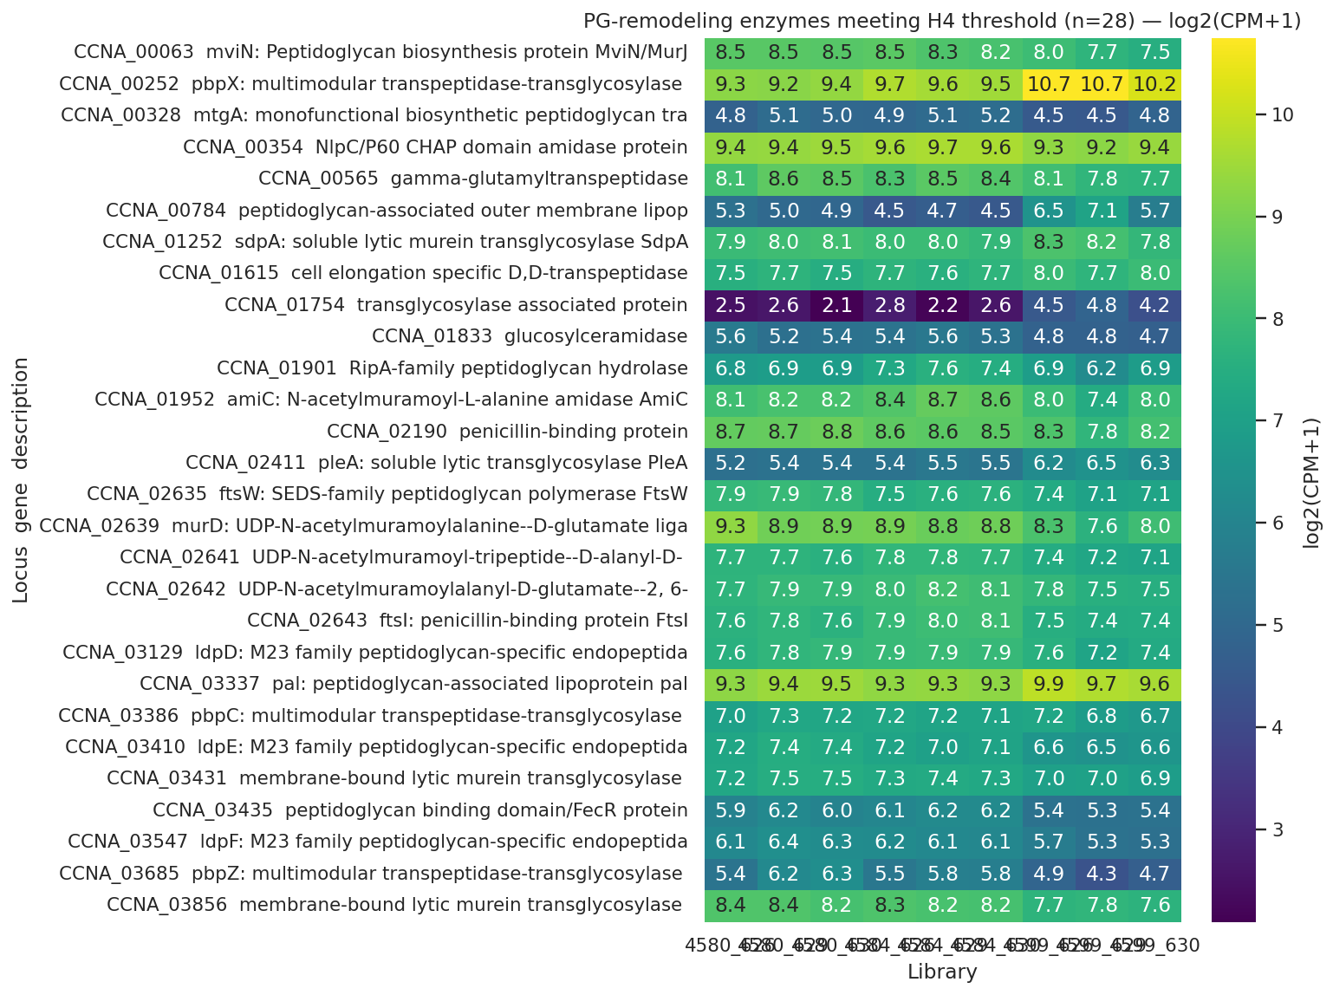
28 PG-remodeling loci meet H4 threshold: broad downshift with targeted SdpA and Pal induction
PG-remodeling enzymes meeting H4 threshold (28/53 pre-curated loci); 20 DOWN (FtsI, PbpZ/C, MurD, endopeptidases); 8 UP including SdpA +4.8 log2 protein and Pal +2.08 transcript/+2.84 protein.
REPORT.md §Finding 5; NB 05_pg_remodeling.ipynb cell 7
Notes:
When the heatmap appears, the dominant directional signal is immediately legible: the PG-remodeling landscape of the Δlpxc rescue strain is driven by downregulation, with a small number of targeted inductions standing out against a suppressed background.
Twenty of the 28 loci meeting the H4 threshold are DOWN. The specific identities matter for delivery. FtsI, the penicillin-binding protein responsible for cell-division-stage PG synthesis, is suppressed. PbpZ declines at −1.08 transcript and PbpC at −1.15 protein, both involved in cell elongation. The D,D-transpeptidase domain protein falls −1.27 log2 at protein. MurD, the murein biosynthesis ligase, and MviN/MurJ, the lipid-II flippase, are both down. The M23-family endopeptidases LdpD, LdpE, and LdpF are down, as are the amidase AmiC and the hydrolase RipA. The single largest protein decline in the set is a membrane-bound transglycosylase at −2.47 log2 protein. Collectively, the cell has suppressed the normal growth-phase repertoire of PG synthesis, modification, and remodeling that accompanies division and elongation.
Against that suppressed backdrop, three specific inductions stand out. SdpA at CCNA_01252 shows the largest change: +4.8 log2 protein, a soluble lytic murein transglycosylase. PleA and PbpX also increase. Most mechanistically interesting is Pal at CCNA_00784: +2.08 transcript (FDR-significant in 4599-vs-4584) AND +2.84 protein — the only locus in the full H4 hit set showing concordant induction at both transcript and protein modalities. Pal belongs to the Tol-Pal envelope-integrity complex, not the PG synthesis machinery per se, and its dual-modality agreement combined with independent appearance in NB03 places it in a distinct evidentiary category from every other locus in this heatmap.
One framing note to carry in delivery: earlier draft language described this pattern as "coordinated bidirectional reorganization." The current REPORT framing is more accurate — predominantly downshift of synthesis machinery punctuated by specific inductions. The shutdown is the dominant signal; the inductions are targeted exceptions. The mandatory caveat: protein inductions — SdpA at +4.8 and Pal at +2.84 — are from the single-replicate OM proteome. Direction is reliable; magnitudes require replicated proteomics to confirm, planned for summer 2026. The transcript-level Pal induction at +2.08 stands on independent FDR-corrected statistical ground.

Slide 22
Pal-Tol induction is consistent with retrograde phospholipid transport for OM lipid homeostasis
Pal (CCNA_00784) +2.08 transcript AND +2.84 protein — convergent across NB03 late-ChvI cohort and NB05 H4 PG set, the sole gene with both modalities induced
Tan & Chng 2025 (Nat Commun 16:2293): primary Tol-Pal function is retrograde phospholipid transport for OM lipid homeostasis, not LPS-Pal structural anchoring — loss of LPS outer leaflet makes retrograde PL transport essential in Δlpxc
Caulobacter Tol-Pal is essential for OM integrity and cell division (Yeh 2010); Pal upregulation in Δlpxc is consistent with maintaining this essential complex under envelope stress
Tan2025 · Yeh2010
Notes:
Pal at CCNA_00784 is the interpretive anchor of Layer 4 because two independent analyses converge on it. In NB03, Pal appeared in the late-consequence ChvI cohort — transcript logFC +2.08 — identified by the ChvI regulon partition test, which was designed around the TCS cascade question with no reference to PG remodeling. In NB05, the same gene appeared independently in the pre-curated PG-remodeling hit set with both transcript and protein data concordant. The two analyses used different gene sets, different thresholds, and were developed at different stages of the project. Convergence on the same locus across those independent design choices is the strongest evidentiary signal in this layer.
The mechanistic interpretation rests on Tan and Chng 2025, Nature Communications 16:2293, PMID 40055349. Using engineered E. coli chimeric strains that dissociated Tol-Pal's division-plane enrichment from its OM function, that paper established that the primary role of the Tol-Pal complex is retrograde phospholipid transport for OM lipid homeostasis — not LPS-Pal structural anchoring, as our earlier draft proposed. In the Δlpxc state, the OM outer leaflet has lost its LPS, disrupting lipid asymmetry. Upregulating Pal is consistent with increased demand for retrograde PL transport to restore that balance. The data establish that Pal is up; the retrograde-transport reading is the Tan-Chng 2025 framing applied to our Caulobacter context.
Two qualifiers are mandatory in delivery. The protein induction — Pal at +2.84 log2 — is from the single-replicate OM proteome; direction is reliable, but magnitude and statistical weight require the replicated proteomics planned for summer 2026. The transcript induction at +2.08 (FDR-significant in 4599-vs-4584) stands on independent statistical footing. The mechanistic interpretation also depends on Tan and Chng's E. coli system, not Caulobacter-direct evidence. REPORT Limitation L#5 records this explicitly: the data show Pal up; the mechanism is from the cited paper.
Caulobacter context adds a viability dimension. Yeh and colleagues 2010, Journal of Bacteriology 192:4847, PMID 20693330, established that Caulobacter Tol-Pal is essential for OM integrity and for OM constriction at cell division — unlike E. coli, where the complex is dispensable. A rescued strain completing cell division without an LPS outer leaflet, in an organism where Tol-Pal is essential for that step, faces a viability-critical reason to maintain the complex beyond adaptive advantage alone.
With all four adaptive layers characterized — Fur-released transport relief, ChvI two-phase cascade, constitutive sphingolipid substitution, and coordinated PG remodeling — S5 asks whether the sphingolipid pathway and ChvI signaling that enable this program are structurally available to the other Gram-negatives that have independently managed to lose lipid A, and whether their structural unavailability explains why only Caulobacter tolerates the Δlpxc deletion.

Slide 23
Caulobacter's sphingolipid/ChvI route is taxonomically restricted — comparators lack it and use other routes.
Substory 5
Notes:
The four preceding substories described a complete intra-Caulobacter adaptive program: Fur-released transport relief carrying the Layer 1 fitness signal; ChvI orchestrating the response over two temporal phases; a constitutive sphingolipid pool delivered by maintained Lpt machinery substituting for the absent lipid A; and a coordinated peptidoglycan downshift with targeted Pal-Tol induction. S4 closed by raising the question this substory answers — why does this four-layer program exist in Caulobacter and nowhere else? S5 answers that with a phylogenetic fact rather than a signaling result.
Three other Gram-negative species — Acinetobacter baumannii, Neisseria meningitidis, and Moraxella catarrhalis — are known from published genetics to survive loss of lipid A biosynthesis. None of them encodes the Caulobacter rescue program. This is not a coincidence of organism selection or a gap in characterization: both halves of the Caulobacter route — the sphingolipid biosynthesis pathway and the ChvG-ChvI envelope-stress two-component system — are absent from all three comparator genomes. They cannot run the program because they lack the component parts.
This section rests on three analyses confirmed at two evidence levels. A21 and A22, both assessed as direct evidence in the plan inventory, use NCBI protein annotation to establish that spt (NCBI 7,0,0,0) and cerR (NCBI 6,0,0,0) are Caulobacter-unique, and that ChvG (NCBI 5,0,0,0) and ChvI (NCBI 6,0,0,0) are alphaproteobacterial-restricted. A23, assessed as partial, closes the explanatory loop by showing that each comparator is consistent with using an alternative route already available in its own genome — PBP1A and ld-transpeptidases in A. baumannii (Kang 2021), capsular polysaccharide in N. meningitidis (Steeghs 2001), and late acyltransferase truncation in M. catarrhalis (Gao 2008). A24, the method-robustness check, grounds the absence claims: PaperBLAST returns 0 hits for LpxA, LpxC, LpxD, and LpxK in Caulobacter and only 1 for LpxB, while NCBI returns 11 to 18 hits per gene — approximately an 80% false-negative rate for Caulobacter's own known lipid A biosynthesis genes. That rate establishes that PaperBLAST alone cannot anchor a biological absence claim; the comparator absences rest on NCBI-confirmed results from NB06b. One caveat stands from the outset: the route-to-mechanism link for each comparator is inferred from published genetics in separate experimental systems, not measured in this project. The first content slide explains the method.

Slide 24
NCBI re-test validates comparator absences; PaperBLAST false-negative rate ~80% in Caulobacter
Four-species panel: Caulobacter crescentus (alphaproteobacterium), Acinetobacter baumannii (Gammaproteobacteria), Neisseria meningitidis (Betaproteobacteria), Moraxella catarrhalis (Gammaproteobacteria)
Focal gene families: sphingolipid biosynthesis (spt, cerR, sphk); ChvG-ChvI two-component system; comparator alternative routes (PBP1A/Ldt, capsule biosynthesis locus, late-acyltransferase lpxX/lpxL)
Initial screen (NB06): PaperBLAST text-mining via BERDL kescience_paperblast; hit counts reported as C/A/N/M (Caulobacter/A.b./N.m./M.c.)
Post-review re-test (NB06b): NCBI protein annotation via Biopython Entrez; curated GenBank records replace description-text matching
Robustness diagnostic: PaperBLAST vs NCBI for known C. crescentus lipid A genes — LpxA/C/D/B/K return 0 in PaperBLAST, 11–18 in NCBI (~80% false-negative rate for known genes)
Biological claims rest on NCBI annotation for comparator absences; M. catarrhalis PaperBLAST results advisory only (162 total genes indexed)
PaperBLAST unknown · Biopython Entrez unknown
Notes:
The method for this layer is comparative genomics applied to a four-species panel — a different approach from the transcriptomics and fitness analysis used for Layers 1 through 4. The core question is presence or absence of the gene families that define the Caulobacter rescue route across four phylogenetically diverse Gram-negatives: Caulobacter crescentus (Alphaproteobacteria), A. baumannii (Gammaproteobacteria), N. meningitidis (Betaproteobacteria), and M. catarrhalis (Gammaproteobacteria). None of the three comparators is an alphaproteobacterium — the phylogenetic class where both the sphingolipid biosynthesis pathway and ChvG-ChvI signaling are concentrated.
The initial screen (NB06) used PaperBLAST via the BERDL kescience_paperblast collection, querying by description-text matching and reporting hit counts as C/A/N/M (Caulobacter/A. baumannii/N. meningitidis/M. catarrhalis) throughout this substory. PaperBLAST is fast and literature-linked, but it retrieves hits based on published vocabulary: if a gene's literature uses non-canonical naming, the method misses it. NB06 generated the original presence/absence matrix that motivated the post-review robustness check.
The critical contribution of NB06b is the NCBI annotation re-test. The same focal gene families were queried against NCBI curated protein annotations via Biopython Entrez — GenBank records rather than text-mining. The robustness diagnostic applied this to Caulobacter's own lipid A biosynthesis genes, genes that are demonstrably present because LpxC is the gene deleted in the Δlpxc rescue strain. PaperBLAST returns 0 hits for LpxA in Caulobacter; NCBI returns 11. LpxC: PaperBLAST 0, NCBI 15. LpxD: PaperBLAST 0, NCBI 15. LpxB: PaperBLAST 1, NCBI 18. LpxK: PaperBLAST 0, NCBI 18. Four of the five genes are complete false negatives in PaperBLAST and the fifth is an under-count by a factor of 18, yielding the approximately 80% false-negative rate reported in REPORT.md §NB06b and NB06b cell 3.
The implication for every absence claim in this substory is direct: PaperBLAST absence alone cannot be trusted. Comparator absences in this substory rest on NCBI annotation, where the method correctly identifies the full set of known-present genes for Caulobacter. A separate concern applies specifically to M. catarrhalis: PaperBLAST indexes only 162 total genes for that organism, making its presence/absence figures advisory regardless of the general false-negative rate. NCBI annotation provides the load-bearing evidence for the comparative arm of this throughline. The next slide shows the NCBI-confirmed results for spt, cerR, ChvG, and ChvI across all four species.

Slide 25
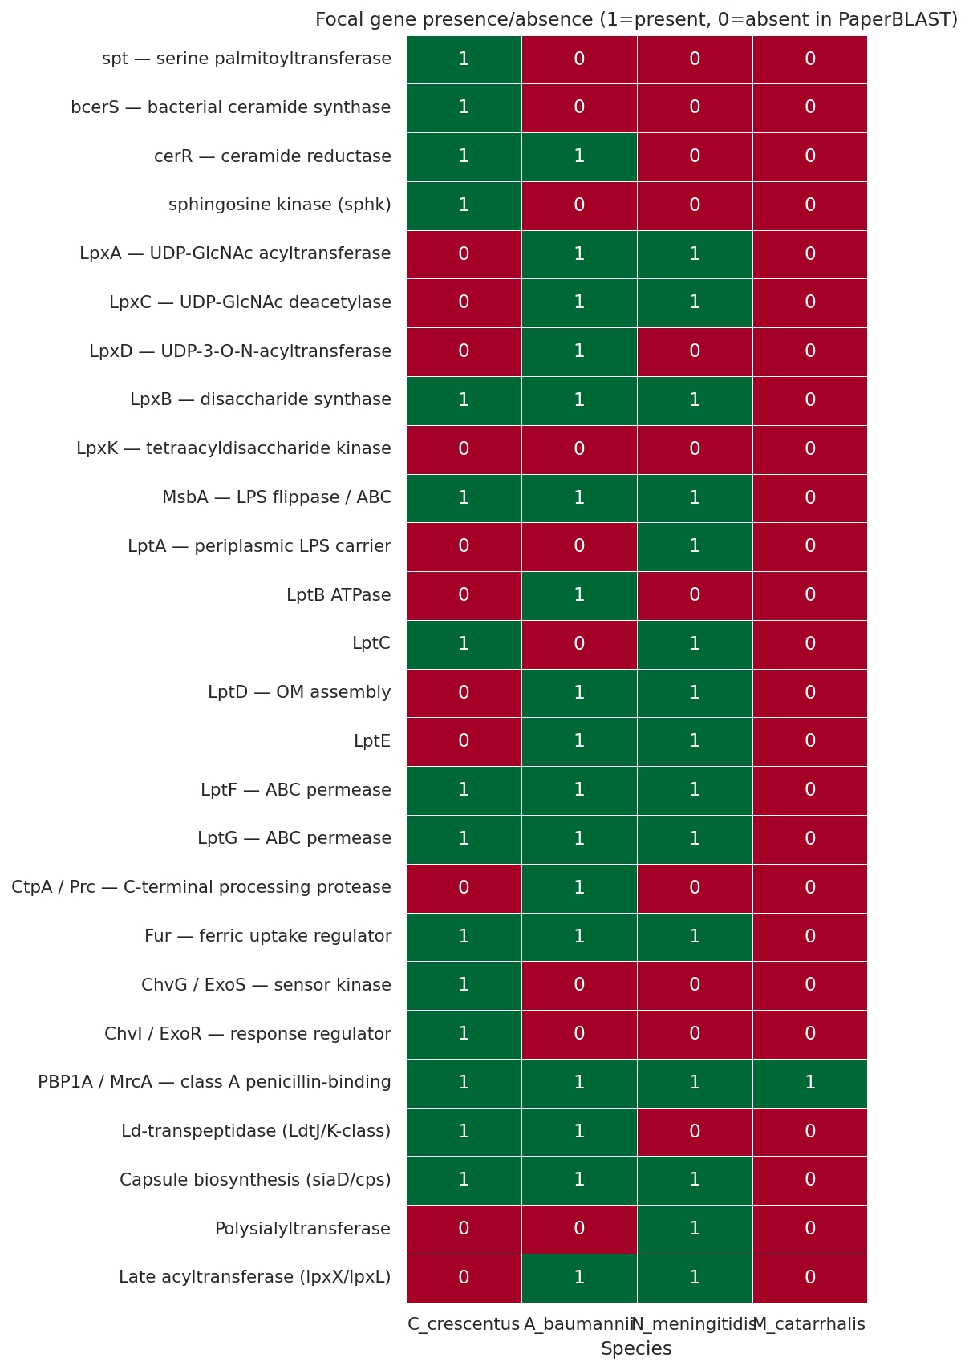
Sphingolipid pathway and ChvG-ChvI absent in all three comparators (NCBI-confirmed)
PaperBLAST screen (NB06) across the four-species panel; NCBI annotation (NB06b) confirms key absences: spt 7,0,0,0; cerR 6,0,0,0; ChvG 5,0,0,0; ChvI 6,0,0,0 (Caulobacter/A.b./N.m./M.c.).
NB06b_ncbi_annotation_presence.ipynb cell 3; Olea-Ozuna 2020/2024; Greenwich 2023
Notes:
The comparative heatmap from NB06 visualizes the PaperBLAST presence/absence screen across the four-species panel. Hold in mind that the authoritative figures come from NB06b cell 3 — the NCBI annotation re-test — which is the source for every biological claim on this slide.
For the sphingolipid biosynthesis cluster, NCBI returns spt at 7, 0, 0, 0 and cerR at 6, 0, 0, 0 for Caulobacter, A. baumannii, N. meningitidis, and M. catarrhalis respectively — verbatim from REPORT.md §Finding 6 and the hypothesis scorecard. Note the important correction the NCBI re-test reveals: PaperBLAST reported cerR as 1, 1, 0, 0, giving A. baumannii a spurious hit that suggested partial sphingolipid pathway presence in that organism. NCBI corrects that to 0 in all three comparators, consistent with the published absence of the ceramide biosynthesis pathway outside Caulobacter and related Alphaproteobacteria. Serine palmitoyltransferase encoded by spt is the committed first step of sphingolipid biosynthesis; ceramide reductase cerR acts downstream. Both are absent across all three comparators by NCBI annotation. Independent confirmation comes from Olea-Ozuna 2021, which characterized the five-gene ceramide biosynthesis cluster required for Caulobacter survival and outer membrane integrity, and Olea-Ozuna 2024, which extended the cluster to eleven sphingolipid genes required for membrane stability and polymyxin B sensitivity. Neither paper found these genes outside the Caulobacter lineage.
For ChvG-ChvI, NCBI returns ChvG at 5, 0, 0, 0 and ChvI at 6, 0, 0, 0. A. baumannii and M. catarrhalis are Gammaproteobacteria; N. meningitidis is a Betaproteobacterium. Greenwich 2023 reviewed the ChvG-ChvI regulatory network across the Alphaproteobacteria and confirmed it as a conserved alphaproteobacterial circuit with no identified homologs in other bacterial lineages. NCBI annotation, phylogenetic class assignment, and the published circuit review all converge on the same result.
A partial-evidence caveat marks the interpretive step that follows from these absence data: the A23 analysis — connecting each comparator's gene-content absence to its specific published tolerance mechanism — is assessed as partial in the plan inventory because the gene-presence-to-mechanism links come from published genetics in separate experimental systems, not from measurements in this project. The NCBI-confirmed absence data (A21 for the sphingolipid pathway, A22 for ChvG-ChvI — both direct evidence) establish the structural unavailability claim. What each comparator uses instead is addressed on the next slide.

Slide 26
Structural unavailability explains species specificity — each comparator uses its own available route
Caulobacter's route (structurally unavailable to comparators)
spt (serine palmitoyltransferase) — NCBI: 7,0,0,0 — Caulobacter-unique
cerR (ceramide reductase) — NCBI: 6,0,0,0 — Caulobacter-unique
ChvG-ChvI envelope-stress TCS — NCBI: 5,0,0,0 / 6,0,0,0 — alphaproteobacterial only
None of the three comparators encodes either component of the Caulobacter rescue route
Comparator alternative routes (literature-inferred; consistent with gene content)
A. baumannii: PBP1A loss + LdtJ/LdtK ld-transpeptidases for LOS-null viability (Kang 2021)
N. meningitidis: capsular polysaccharide required for lpxA-null viability (Steeghs 2001)
M. catarrhalis: late acyltransferase truncation (lpxX/lpxL) yields LOS-modified viable mutants (Gao 2008)
Caveat (A23 partial): route-mechanism links inferred from published genetics; M. catarrhalis under-annotated in PaperBLAST (162 genes indexed)
Notes:
The two-column layout maps the argument onto its two evidential layers. The left column — structural unavailability — rests on the NCBI-confirmed absences from A21 and A22: spt 7, 0, 0, 0; cerR 6, 0, 0, 0; ChvG 5, 0, 0, 0; ChvI 6, 0, 0, 0. The right column — comparator alternative routes — rests on published genetics from three separate experimental systems, which is why A23 carries partial-evidence status. The argument is not that the comparators tried and failed — it is that they physically lack the parts.
For A. baumannii, Kang 2021 showed that colistin-resistant LOS-null isolates require loss of function in PBP1A combined with ld-transpeptidase activity from LdtJ and LdtK — a peptidoglycan-remodeling route that does not involve Fur derepression or sphingolipid substitution. A. baumannii encodes PBP1A and Ldt family enzymes; it does not encode spt or ChvI. The mechanism is established by Kang 2021's direct genetic experiments in A. baumannii — not measured in this project.
For N. meningitidis, Steeghs 2001 established that viable lpxA-null mutants require capsular polysaccharide. The NB06 PaperBLAST screen found approximately 9 capsule-biosynthesis hits for N. meningitidis (versus 2-3 in the other species), consistent with a large locus that N. meningitidis encodes and Caulobacter does not. Caulobacter's surface is the crystalline RsaA S-layer protein — not a polysaccharide capsule — so capsule substitution is structurally absent from Caulobacter's own genome.
For M. catarrhalis, Gao 2008 identified the late acyltransferases lpxX and lpxL, whose deletion yields viable mutants with truncated lipid A acyl-chain content and no Fur involvement. The NB06 screen found the lpxX/lpxL family present in A. baumannii (8 hits) and N. meningitidis (3 hits) but absent in Caulobacter (0 hits). The sharpest caveat applies here: PaperBLAST indexes only 162 total genes for M. catarrhalis, making its presence/absence figures advisory; the Gao 2008 mechanism is independently established in the published experimental literature.
The A23 partial-evidence designation covers the entire right column: gene-presence-to-mechanism links come from published genetics in separate experimental systems, not from this project. The left column's NCBI-confirmed absences (A21, A22 — direct evidence) are the load-bearing foundation. Together, A21 through A24 show that structural unavailability — not chance — explains why Caulobacter alone tolerates the Δlpxc deletion while three other lipid-A-loss-tolerant Gram-negatives use entirely different solutions. Five adaptive layers across S1 through S5 now compose a complete mechanistic account. S6 integrates them into the throughline's unified claim.

Slide 27
Five partially independent layers compose one *Caulobacter*-specific program for surviving lipid A loss.
Substory 6
Notes:
We close the five-layer arc here. Across S1 through S5 the mechanism unfolded in sequence: Fur-released transport relief carries the Layer-1 fitness signal while the SspB-buffered respiratory arm does not; ChvI runs a two-phase cascade scheduling regulators before envelope-structural genes; a constitutive sphingolipid pool is delivered by maintained Lpt machinery; peptidoglycan synthesis downshifts while Pal-Tol is specifically induced; and the sphingolipid/ChvI route is structurally absent in A. baumannii, N. meningitidis, and M. catarrhalis — NCBI-confirmed at spt 7,0,0,0, cerR 6,0,0,0, ChvG 5,0,0,0, and ChvI 6,0,0,0.
The closing question this substory answers is whether those five layers, each tested independently against pre-registered thresholds, integrate into a single coherent explanation of how and why Caulobacter tolerates the Δlpxc deletion. The pre-registered scorecard in NB07_synthesis.ipynb is the integration artifact; it contains seven verdicts.
The phrase "partially independent" in the punchline is not hedging — it is the precise engineering description of the architecture. Each layer was tested in isolation. Any one could have failed without necessarily collapsing the others. What makes the integration argument credible is that the scorecard includes a REJECTED entry for CtpA and a NOT ENRICHED result for the SspB-buffered respiratory arm. Both failures are load-bearing: a scorecard with no rejections would be a scorecard with no standards. Precisely because CtpA was rejected at the pre-registered bar after adversarial review, and because the respiratory arm was demoted when it failed to clear the 33.25% genome background rate, the four-layer positive claim can be stated without overclaiming the evidence.
S6 unfolds in two slides: a methods slide that orients to the five evidence arms and names the adversarial-review corrections applied before the scorecard was finalized, then the scorecard table itself. Together they land the throughline.

Slide 28
Synthesis: five evidence arms integrated against pre-registered thresholds
Pre-registered hypotheses H1–H4 + comparative arm; thresholds committed before any DE analysis (RESEARCH_PLAN.md §thresholds)
Transcript: edgeR DE on 4599-vs-4584 contrast — isolates Δlpxc response against Δfur Δsspb background (FDR < 0.05)
Fitness: hypergeometric enrichment vs genome background 33.25% (n=3,943 genes, 198-experiment Caulobacter RB-TnSeq compendium)
OM proteome: single-replicate per strain; direction-only criterion |log2| > 1; replicated proteomics scheduled summer 2026
Comparative: NCBI annotation (NB06b) re-confirmed after PaperBLAST ~80% false-negative diagnosis for Caulobacter lipid A genes
Adversarial review corrections applied: CtpA verdict corrected BORDERLINE → REJECTED; Pal interpretation reframed to Tan & Chng 2025 retrograde-PL model
NB07 synthesis notebook integrates all five arms into the 4-panel master figure and pre-registered scorecard
edgeR unknown · Biopython Entrez unknown
Notes:
The synthesis draws on five distinct evidence platforms, and the audience needs to know what each can and cannot claim before the verdicts appear.
Transcript evidence is from edgeR differential expression on the 4599-versus-4584 contrast — the Δlpxc rescued strain against the Δfur Δsspb intermediate — isolating the Δlpxc-specific transcriptional response against the combined Δfur Δsspb background. All significance thresholds were committed in RESEARCH_PLAN.md before any differential expression analysis ran: FDR less than 0.05 for transcript claims, |log2| greater than 1 for proteome calls.
Fitness evidence comes from the 198-experiment Caulobacter RB-TnSeq compendium accessed through BERDL's kescience_fitnessbrowser (Price 2018, Nature 557:503). The operative fitness criterion is hypergeometric enrichment against the 33.25% genome background — not the pre-registered ≥10% threshold, which sat below the background rate and was therefore uninformative as an enrichment test. That recalibration, surfaced by adversarial review, is recorded in REPORT Novel Contribution §7 as a methodological lesson for future fitness-browser projects.
The OM proteome is single-replicate per strain — one of the project's eleven named limitations. Direction is interpretable at |log2| greater than 1; per-protein significance statistics cannot be computed from a single observation. Protein-level signals for lptC2, Pal, LptD, and LptE all require the replicated proteomics scheduled for summer 2026 before they can be claimed at publication rigor.
Two adversarial-review corrections are integrated into the scorecard. First, CtpA was corrected from BORDERLINE to REJECTED: the 4599-versus-4584 p-value of 0.048 fails the BORDERLINE lower bound of 0.05, and CtpA was not detected in the OM proteome. Second, the Pal-Tol interpretation was reframed from an uncited Mg2+-bridging mechanism to Tan and Chng 2025 (Nat Commun 16:2293), which established that the primary Tol-Pal function is retrograde phospholipid transport for OM lipid homeostasis. Comparator absences were confirmed by NB06b NCBI annotation after PaperBLAST was diagnosed with an approximately 80% false-negative rate for Caulobacter's own lipid A biosynthesis genes. With those corrections applied, the scorecard on the next slide is the project's final integration output.

Slide 29
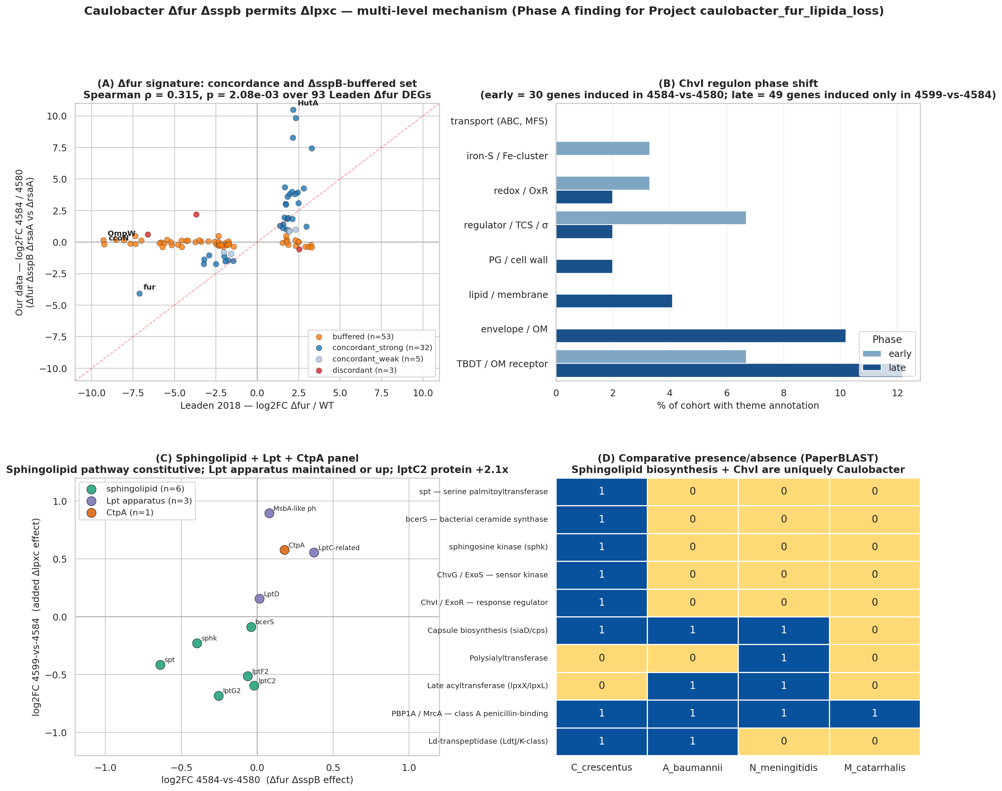
Four-panel master figure maps all five adaptive layers onto a single envelope cross-section
Layer 1 (Fur-released transport relief), Layer 2 (ChvI two-phase cascade), Layer 3 (constitutive sphingolipid substitution), Layer 4 (PG remodeling + Pal-Tol induction), and Layer 5 (comparative route unavailability) — integrated across the *Caulobacter* Δ*lpxC* envelope. Recommended Figure 1 (REPORT.md §Key Findings; NB07_synthesis.ipynb cell 2).
REPORT.md §Key Findings line 5; notebooks/07_synthesis.ipynb cell 2

Slide 30
Five-layer synthesis scorecard: four layers confirmed, CtpA rejected, SspB arm demoted
Layer | Headline result | Verdict
L1 Fur–transport | Path A TBDTs 17/32 = 53.1% vs 33.25% background (fold 1.60×, p=0.016) | PASS (marginal)
L1 SspB–respiratory | Path B fold 1.04×, p=0.515 — indistinguishable from background | NOT ENRICHED
L2 ChvI cascade | Two-phase partition: 20 early + 10 both-phase + 49 late (≥10 threshold) | PASS
L3 Sphingolipid | 0/6 biosynthesis genes UP; spt −0.64 FDR 0.002 — pool constitutive | PASS strongly
L3 CtpA | pvalue 0.048, FDR 0.109; protein absent — REJECTED at pre-registered bar | REJECTED
L4 PG remodel | 28 loci (≥3 threshold); 20 DOWN + Pal +2.08 tx / +2.84 protein | PASS strongly
L5 Comparative | spt NCBI 7,0,0,0; ChvG 5,0,0,0 — route absent in comparators | CONFIRMED
Seven verdicts against pre-registered thresholds; CtpA corrected from BORDERLINE to REJECTED post adversarial review.
Full scorecard with pre-registered thresholds in REPORT.md §Results.
Notes:
The scorecard gives seven verdicts. Let me state each at its evidence level.
Layer 1's transport arm passes, marginally. The 32 concordant-strong Fur-released genes show 17 of 32 phenotype-bearing — 53.1% — versus the 33.25% genome background: fold enrichment 1.60 times, hypergeometric p=0.016. ChvT (CCNA_03108) carries |t|=43.7 under envelope stress; four TBDTs sit at |t| 9 to 28. Marginal is the right description: the enrichment is real but modest. The SspB-buffered Path B sits at 9 of 26 phenotype-bearing — 34.6%, fold 1.04 times, p=0.515 — indistinguishable from background. The respiratory ATP arm is demoted to hypothesis.
Layer 2 passes cleanly. The ChvI two-phase partition produced 20 unique-to-early genes, 10 both-phase genes including ChvI itself at logFC +1.45 (direct autoregulation evidence), and 49 late-consequence genes — all three cohorts above the pre-registered ≥10 threshold. The SigU sub-arm is partial: late-cohort functional coherence returned 24.5%, below the 50% relaxed criterion, Fisher p=0.243. SigU as late-cohort driver remains a hypothesis.
Layer 3 carries the project's strongest individual result. Zero of six sphingolipid biosynthesis genes are significantly upregulated; spt is down at −0.64 with FDR 0.002. The CPG pool is constitutive — not emergency-induced. CtpA is rejected at the pre-registered bar: 4599-versus-4584 p-value 0.048 fails the BORDERLINE lower bound of 0.05, and CtpA was not detected in the OM proteome.
Layer 4 passes strongly: 28 unique loci meeting the H4 threshold, dominated by downregulation (20 DOWN — FtsI, PbpZ, MurD, multiple endopeptidases), while Pal is specifically induced at +2.08 transcript log2 and +2.84 protein log2. Following Tan and Chng 2025 (Nat Commun 16:2293), Pal upregulation is consistent with increased retrograde phospholipid transport restoring OM lipid homeostasis when the LPS outer leaflet is gone. That mechanistic reading is inference from the cited paper; it is not a direct project measurement, and the protein-level Pal signal is single-replicate.
Layer 5 is NCBI-confirmed: spt 7,0,0,0; cerR 6,0,0,0; ChvG 5,0,0,0; ChvI 6,0,0,0 — consistent with Olea-Ozuna 2021 and 2024 and Greenwich 2023.
The synthesis closes the throughline: four main layers confirmed, one candidate rejected, one sub-arm demoted. Only Caulobacter simultaneously encodes the sphingolipid pathway, maintains ChvG-ChvI signaling, and carries Lpt transport capacity for CPG delivery. That combination, confirmed across five partially independent evidence arms, is why it alone tolerates the deletion — and why no piecemeal transfer of one layer to a comparator species would substitute for the full program.

Slide 31
Lipid A loss triggers five adaptive layers that explain how — and why — Caulobacter is one of only four Gram-negatives able to tolerate the deletion.
Fur-released transport relief is real and fitness-bearing in Path A transporters, but the SspB-buffered respiratory arm shows no fitness signal.
ChvI drives a two-phase program — regulators early, envelope-structural genes late — but the membrane substitute itself is set elsewhere.
A constitutive anionic-sphingolipid pool substitutes for lipid A, transported by maintained Lpt machinery — not an inducible emergency response.
Peptidoglycan synthesis is broadly downshifted with targeted Pal-Tol induction — a coordinated remodel that raises why only Caulobacter survives it.
The sphingolipid pathway and ChvG-ChvI are taxonomically restricted; comparator species lack the route entirely and use alternative strategies instead.
Replicate the OM proteome (already planned by the data provider for summer 2026). Characterize the Caulobacter SigU regulon via SigU-induction RNA-seq (ectopic vanillate-inducible SigU expression) followed by genome-wide DE.

Slide 32
This work integrates 6 K-BERDL databases + 1 external reference catalog across 10 notebooks — all within the `beril` tenant.
Tenants: beril
K-BERDL databases: go, isolates, paperblast, pfam, pubmed, rb_tnseq
Notes:
RB-TnSeq is the primary fitness workhorse — 198 Caulobacter experiments across 3943 genes, grounding the phenotype-bearing rate calibration and the Fur-regulon enrichment test (Findings 1–2); PaperBLAST is the annotation backbone spanning DEG characterization through the comparative species presence/absence panel (Findings 3–6); GO terms (NB03) characterized ChvI phase themes, Pfam (NB05) anchored the PG-remodeling gene set, and PubMed + isolates supported literature anchoring and strain references. RefSeq (external, NCBI) confirmed the NB06b comparative absence calls that make Finding 6 robust against PaperBLAST's ~80% false-negative rate for Caulobacter lipid A genes. All 10 notebooks draw from the single `beril` tenant — this project did not span multiple BERDL tenants.

Slide 33
Your central claim is that the Lpt apparatus is repurposed to traffic sphingolipids — but the two Lpt proteins you actually detected, LptD and LptE, decline in the rescued strain (−0.47 and −0.78 log2). How do you know the transport apparatus is functionally maintained rather than shut down?
This is the central unresolved tension in Layer 3, and we don't yet resolve it. The transcript arm is clean: MsbA-like CCNA_00307 +0.89 (FDR 0.01) and LptC-related CCNA_03716 +0.56 (FDR 0.005) are up in the rescued strain, consistent with Uchendu 2026's shared-component model. But the single-replicate OM proteome shows LptD −0.47 and LptE −0.78 log2, running against the transcript. A parsimonious read is substrate-limitation: canonical Lpt normally loads LPS; without LPS substrate, it may be less occupied while the lptC2 paralog (+1.08 protein vs intermediate) picks up CPG traffic. That interpretation remains a hypothesis. Replicated proteomics planned for summer 2026 are required before any protein-level claim is made at publication rigor.
↪ REPORT.md §Finding 4 protein table (LptD −0.47, LptE −0.78 log2); §Interpretation §5 (transcript-protein discordance, MIXED verdict); §Limitations L#2 (single-replicate OM proteome; replicated proteomics summer 2026); notebooks/04_sphingolipid_lpt_panel.ipynb cell 6 (protein panel); §Finding 4 pilot (lptC2 +1.08 vs intermediate, +0.66 vs WT; CCNA_01217 +0.77)
Notes:
The tension between the transcript and protein arms for the Lpt apparatus is the most important open question in this work. Three mechanistic scenarios could explain the discordance, and the single-replicate proteome cannot discriminate among them.
Scenario 1 (substrate-limitation): Canonical Lpt proteins (LptD/LptE) are normally occupied loading LPS substrate across the periplasm. In the Δlpxc state, LPS substrate is absent. Under substrate-limitation, the canonical apparatus could be in a lower-flux state — less occupied, more rapidly turned over, or held in an assembly-competent but idle state. This would predict LptD/LptE protein decline without loss of structural capacity. The lptC2 paralog (Uchendu 2026's sphingolipid-specific inner-membrane transporter, +1.08 protein log2 vs intermediate) is the candidate CPG-loading component that takes over under this scenario. This is the most mechanistically coherent interpretation.
Scenario 2 (active downregulation): Canonical LPS-specific Lpt is actively degraded or translationally suppressed in the Δlpxc state, and CPG trafficking runs entirely through a parallel non-canonical route. This would challenge the 'repurposed' framing and suggest instead a pathway switch rather than repurposing.
Scenario 3 (single-replicate noise): The −0.47 and −0.78 log2 signals are within the noise range of a single-replicate label-free proteomics experiment. Neither LptD nor LptE reaches the |log2| > 1 threshold applied for protein-level direction-interpretation. Both could be zero-signal noise.
Two experiments would discriminate: (a) Replicated proteomics — the OM proteome is planned for summer 2026; three biological replicates per strain would provide per-protein statistics and confidence intervals. (b) Western blot against C-terminally tagged LptD and lptC2 in the Δlpxc strain — direct protein-level readout.
The speaker should say precisely: 'Our transcript data are consistent with Lpt repurposing; our single-replicate protein data show canonical Lpt declining while the lptC2 paralog rises. We treat the protein arm as a directional pilot. Replicated proteomics will tell us which scenario is correct.' Do not say 'Lpt is maintained' — say 'transcript is consistent with Lpt maintenance; protein requires replication.'
Note for follow-up handling: if the questioner presses on the lptC2 finding, the honest answer is that lptC2 protein +1.08 vs intermediate represents a partial recovery from a prior decline (−0.42 in the intermediate strain relative to WT), so the net protein change vs WT is +0.66 log2 (≈1.58×) — modest and single-replicate. REPORT.md §Finding 4 labels this 'suggestive pilot observation requiring replicated proteomics'; that is the verbatim claim to defend from the lectern.

Slide 34
Every layer was characterized in PYE rich medium in one engineered Δfur Δsspb Δlpxc strain background. Does this five-layer mechanism operate under iron limitation, minimal medium, or in naturally isolated Caulobacter strains that achieve lipid A dispensability without the engineered deletions?
We don't yet know, and this is the primary generalizability boundary of the work. Every transcript and fitness measurement was made in PYE rich medium with the engineered Δfur Δsspb Δlpxc strain. The Fur-released transport arm (Layer 1) is explicitly untestable under iron limitation — zero of 198 Caulobacter Fitness Browser experiments are iron-limited. The Fur signal in our RNA-seq is constitutive derepression, not a real iron-responsive signal. Whether a naturally isolated Δlpxc suppressor strain uses all five layers or only a subset, and whether the same mechanism operates under conditions that more closely resemble Caulobacter's oligotrophic freshwater habitat, remains untested. Scope is explicitly restricted to the conditions characterized here.
↪ REPORT.md §Limitations L#4 (single growth condition, PYE rich-medium routine); §Limitations L#9 + §Finding 2 preflight (0/198 Caulobacter FB iron-limitation experiments); notebooks/02_caulo_fitness_ranking.ipynb cell 5 (experiment classification: 22 envelope, 0 iron of 198 total); §Future Directions §3 (dual-release genetic reconstruction), §6 (iron-axis RB-TnSeq fitness experiments)
Notes:
The generalizability question has three distinct axes a questioner might probe:
Axis 1 — Growth condition: All RNA-seq and proteomics data were collected from cells grown in PYE, a peptone-yeast extract rich medium. Caulobacter in its native oligotrophic freshwater habitat grows much more slowly, under iron limitation, and with very different Fur regulon activity than in PYE. Under iron limitation, the Fur regulon is induced constitutively — exactly what we observe by genetic Δfur — so the fitness-relevant transport genes may be expressed in both lab PYE (via Δfur deletion) and wild-type iron-limited cells (via Fur derepression by low iron). That parallelism is conceptually satisfying but untested. We descoped the iron-limitation arm of H2 explicitly because zero of 198 Caulobacter Fitness Browser experiments are iron-limited (REPORT §Finding 2 preflight; NB02 cell 5). Testing this axis requires bipyridyl chelation or hemin stress RB-TnSeq experiments (Future Direction §6).
Axis 2 — Strain background: The engineered strain deletes both fur and sspb simultaneously, which simultaneously derepresses the TBDT arm AND buffers the cbb3/fix respiratory chain. A naturally occurring Δlpxc suppressor might achieve viable lipid A loss through a spontaneous point mutation in fur (partial derepression) without sspb deletion, or through suppressor mutations in the envelope-stress regulon that don't map to the same five layers. The genetic reconstruction test (Future Direction §3) would ask whether Δlpxc is viable in Δfur alone or Δsspb alone backgrounds — both predictions of the dual-release model — and would directly test whether both deletions are jointly required as the model implies.
Axis 3 — Organism scope within alphaproteobacteria: The comparative arm (Layer 5) established that ChvG-ChvI and the sphingolipid pathway are alphaproteobacterially restricted. Other alphaproteobacteria — Agrobacterium, Sinorhizobium, Brucella — that share both ChvG-ChvI and, in some cases, sphingolipid pathways might in principle tolerate lipid A loss via the same mechanism. That's an untested prediction of the model, but no data from those organisms are presented here.
The speaker's job is to be precise about what was tested: one engineered background, one growth condition, one organism, one phylogenetic comparison panel. The mechanism is internally consistent within those constraints. Extensions to physiologically relevant conditions or related organisms are the next experimental chapter. Deliver this without apology — scope restriction is a hallmark of rigorous science, not a weakness.

Slide 35
Your Layer 5 species-uniqueness claim rests on NCBI annotation showing spt and ChvI absent in the three comparators — but you showed NCBI itself misses Caulobacter genes annotated under non-canonical locus-tag names. How do you know there isn't an unannotated spt paralog hiding in A. baumannii or M. catarrhalis?
We cannot fully exclude it with the current data. NCBI annotation confirmed the key absences (spt 7,0,0,0; cerR 6,0,0,0; ChvG 5,0,0,0; ChvI 6,0,0,0 across Caulobacter/A.b./N.m./M.c.), and two independent lines support the sphingolipid absence: Olea-Ozuna 2020/2024 phylogenetic surveys placing sphingolipid biosynthesis in alphaproteobacteria and Bacteroidetes only, and the fact that none of the three comparators are from those lineages. But NCBI can miss genes with non-canonical annotation names — we showed this for our own MsbA. A Pfam HMM search (PF00155 serine palmitoyltransferase) against RefSeq proteomes of the three comparators is the definitive test; we flag it explicitly as Future Direction §8 (estimated 2–4 compute hours). Until run, Layer 5 rests on NCBI annotation plus independent phylogenetic literature — strong, but not exhaustive.
↪ REPORT.md §Finding 6 (spt 7,0,0,0; cerR 6,0,0,0 NCBI-confirmed); §NB06b table (PaperBLAST ~80% FN for Caulobacter lipid A genes; NCBI confirmation); §NB06b naming-convention caveat (MsbA annotated as CCNA_00307, NCBI Cc=0 for 'MsbA'); §Limitations L#7 (PaperBLAST FN rate), L#8 (M. catarrhalis 162-gene PaperBLAST coverage); §Future Directions §8 (Pfam PF00155 HMM search; RefSeq proteome accessions; 2-4h CTS estimate); notebooks/06b_ncbi_annotation_presence.ipynb cell 3
Notes:
The comparative arm methodology has two tiers: (a) PaperBLAST text-mining via kescience_paperblast (NB06, the original screen) and (b) NCBI protein annotation via Biopython Entrez (NB06b, added post-adversarial-review). The adversarial review correctly identified that NB06 PaperBLAST had ~80% false-negative rate for known Caulobacter lipid A biosynthesis genes (LpxA/C/D/B/K: PaperBLAST 0 hits each; NCBI 11–18 hits each for the same genes). NB06b was added to re-confirm comparator absences against NCBI annotation, and confirmed: spt NCBI C/A/N/M = 7,0,0,0; cerR = 6,0,0,0; ChvG = 5,0,0,0; ChvI = 6,0,0,0.
However, REPORT.md §NB06b explicitly documents a second-tier caveat: 'NCBI annotation also has its own false negatives in C. crescentus for genes annotated under non-canonical names. For example, MsbA (NCBI Cc=0) is present as CCNA_00307 ("phospholipid/LPS ABC transporter"); LptA (NCBI Cc=0) is present but not annotated with the "lptA" symbol in Caulobacter NA1000.' These are naming-convention false negatives, not true absences. The same issue could theoretically apply in the comparator genomes: an spt paralog acquired by horizontal gene transfer might be annotated under a non-canonical label and missed by NCBI keyword search.
Three lines of independent support reduce this risk: (1) Olea-Ozuna 2020 and 2024 performed dedicated phylogenetic surveys of bacterial sphingolipid biosynthesis genes and found them restricted to alphaproteobacteria, Bacteroidetes, and a handful of other lineages — not gammaproteobacteria (A. baumannii, M. catarrhalis) or betaproteobacteria (N. meningitidis). (2) There is no published report of sphingolipid production in any of the three comparators. (3) Both PaperBLAST and NCBI agree on the absences for spt/cerR in these organisms — unlike Caulobacter lipid A genes where the methods disagree, here they converge on zero.
The definitive closure, stated in REPORT §Future Directions §8: run Pfam HMM searches using profile PF00155 (PLPBP/serine palmitoyltransferase) against the named RefSeq proteomes — GCF_000196795.1 for A. baumannii ATCC 17978, GCF_000008805.1 for N. meningitidis MC58, GCF_000092265.1 for M. catarrhalis BBH18 — using hmmsearch or pyhmmer. This captures structural homologs regardless of annotation label and estimated to take 2–4 hours via CTS.
Note on M. catarrhalis specifically: only 162 genes are indexed in PaperBLAST for that organism, making it the highest-risk case for under-detection. The NCBI search covers the full RefSeq proteome regardless of PaperBLAST indexing coverage, so the NCBI zero-hit result for M. catarrhalis spt is more reliable than the PaperBLAST result. But HMM-based confirmation remains the gold standard. The speaker should deliver the Layer 5 claim as 'confirmed by NCBI annotation and independent phylogenetic literature, with Pfam HMM validation forthcoming.'

Slide 36
Acknowledgments
Acknowledgments to be added before presentation.
TBD

Slide 37
References
Raetz CRH et al. (2002). Lipopolysaccharide endotoxins. Annu Rev Biochem 71:635-700.
Zik JJ et al. (2022). Caulobacter lipid A is conditionally dispensable in the absence of fur and in the presence of anionic sphingolipids. Cell Rep 39(9):110888.
Uchendu CG et al. (2026). Homologues of the inner-membrane LPS transport proteins are required for sphingolipid transport in Caulobacter crescentus. bioRxiv 2026.04.12.717747.
Dhakephalkar T et al. (2023). Characterization of an evolutionarily distinct bacterial ceramide kinase from Caulobacter crescentus. J Biol Chem 299(7):104894.
Dhakephalkar T et al. (2025). CpgD is a phosphoglycerate cytidylyltransferase required for ceramide diphosphoglycerate synthesis. bioRxiv 2025.01.09.632243.
Olea-Ozuna RJ et al. (2021). Five structural genes required for ceramide synthesis in Caulobacter and for bacterial survival. Environ Microbiol 23(1):143-159.
Olea-Ozuna RJ et al. (2024). Genes required for phosphosphingolipid formation in Caulobacter crescentus contribute to bacterial virulence. PLoS Pathog 20(8):e1012401.
Hummels KR (2024). mSphere of Influence: Celebrating exceptions to the rule of lipid A essentiality. mSphere 9(3):e0063323.
Slides drafted with beril-presentation-maker; full bibliography in speaker notes.

