Slide 1


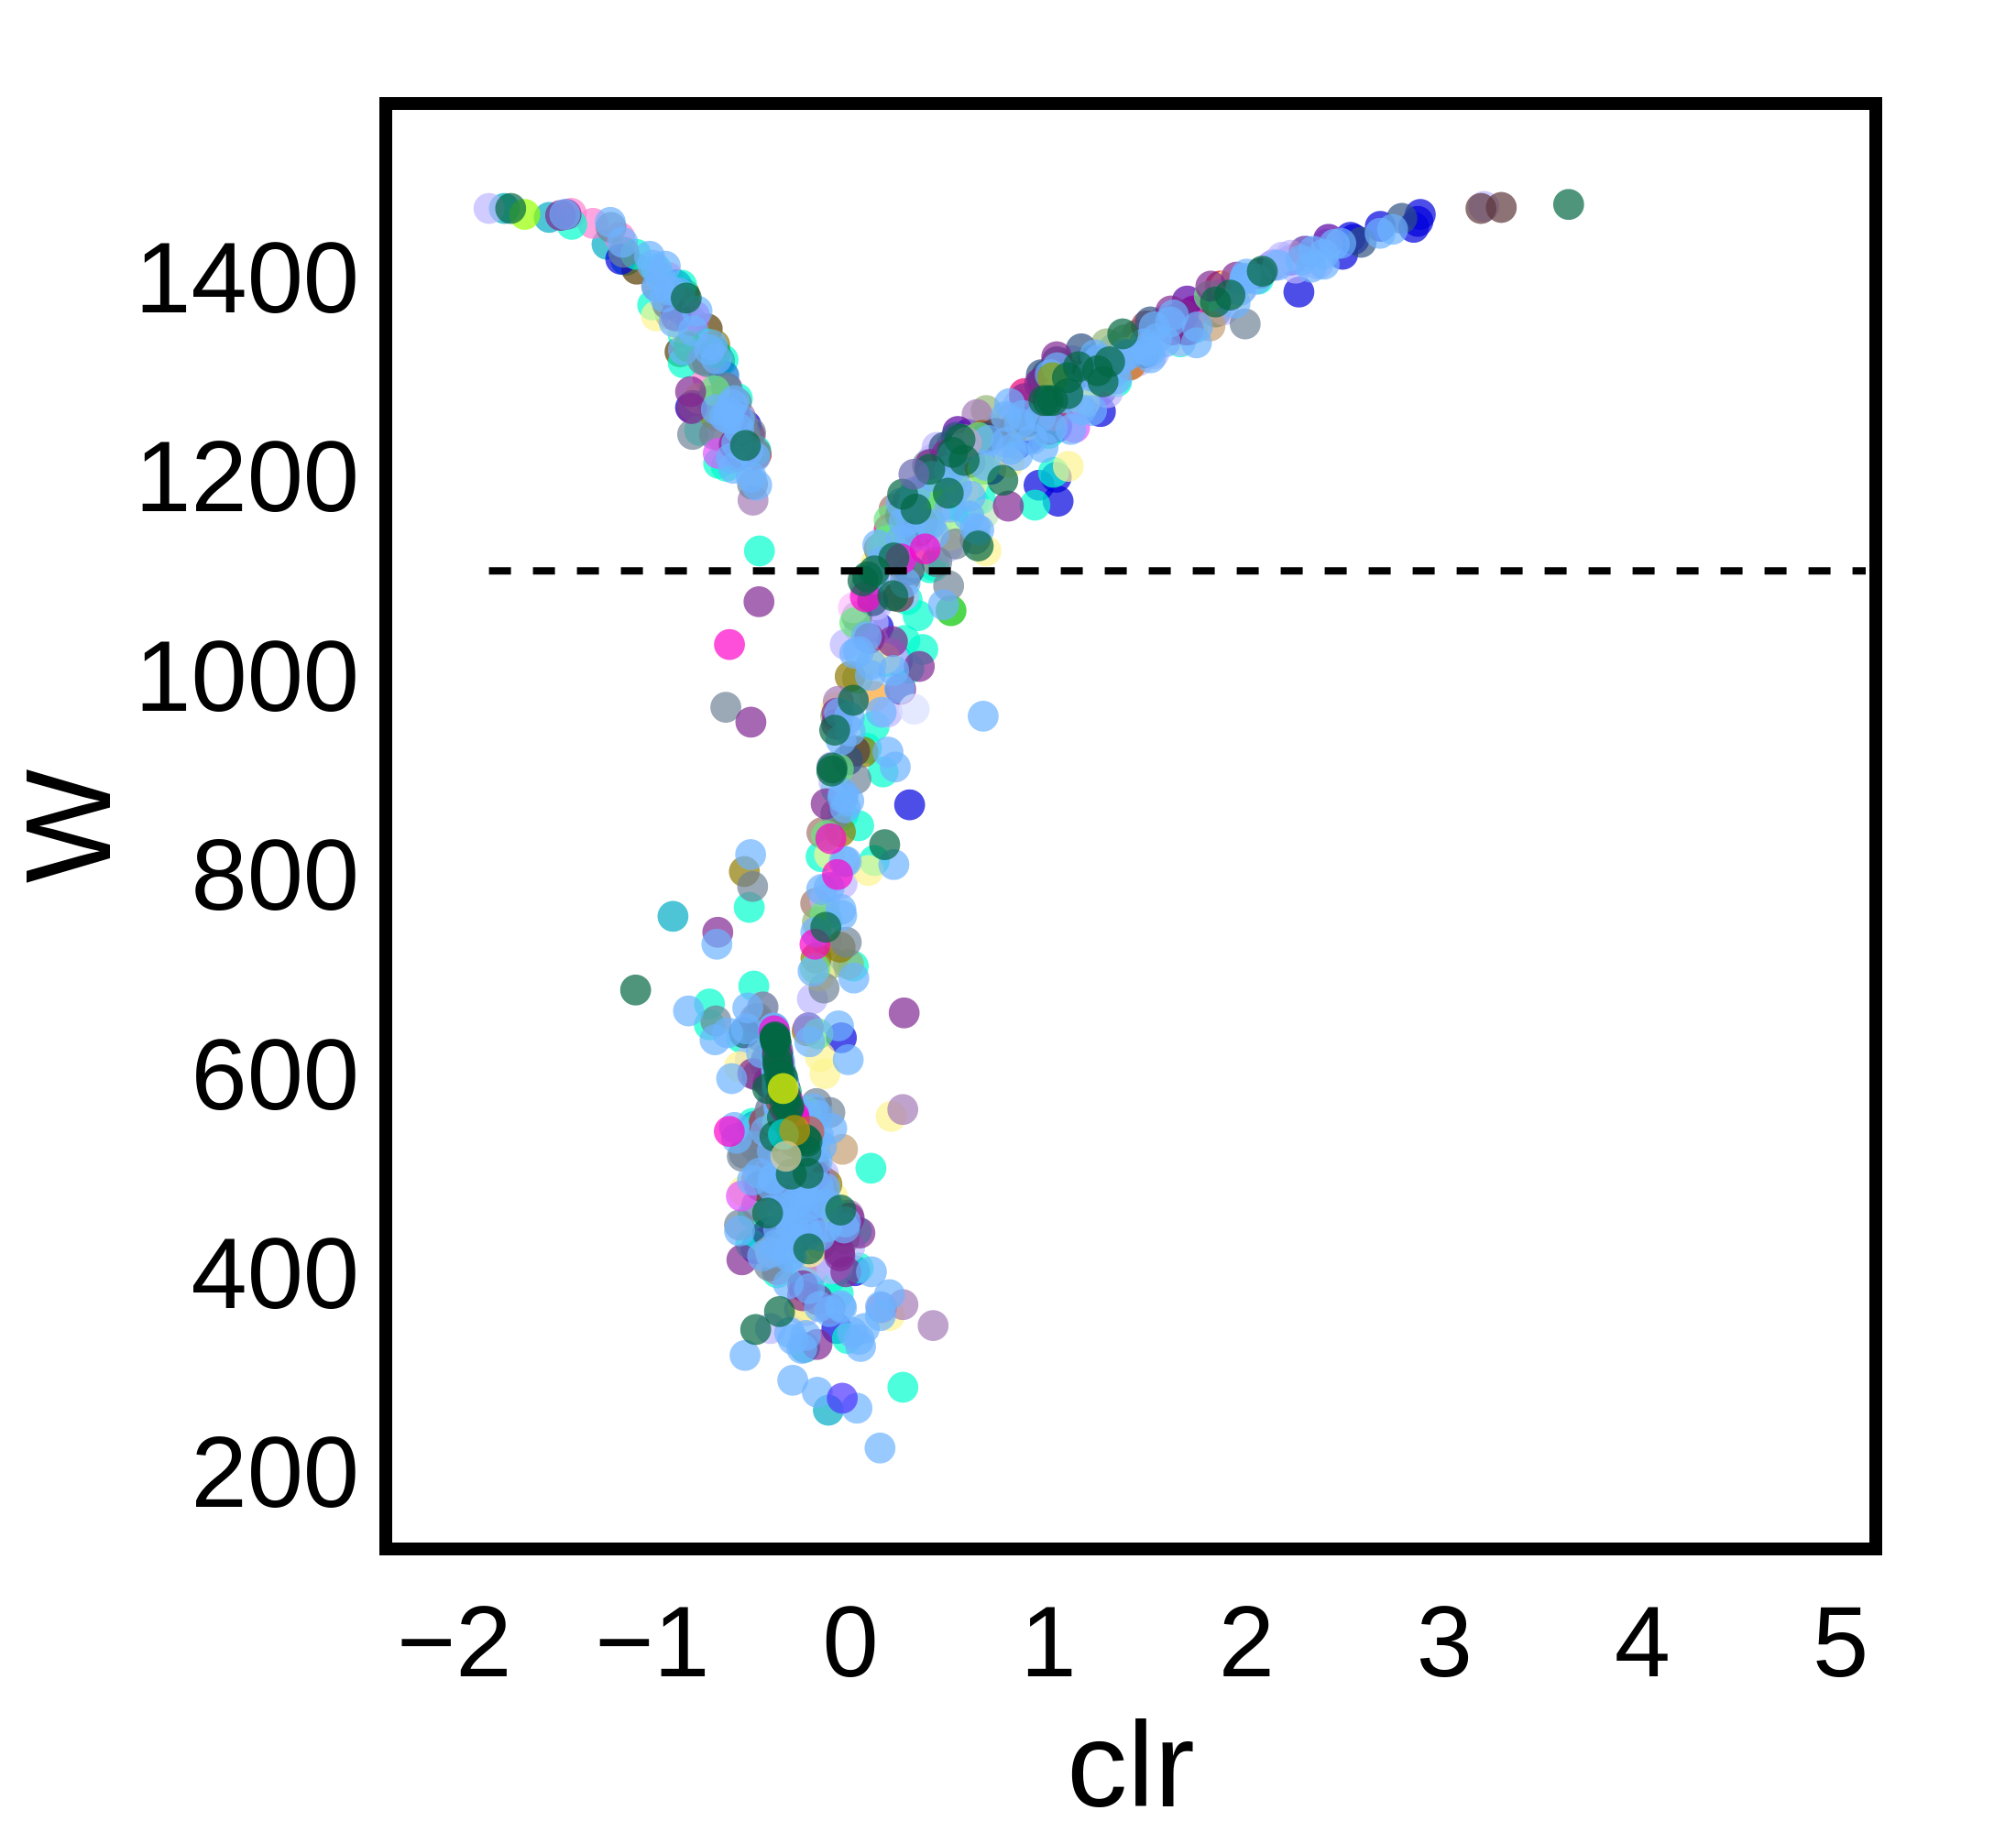
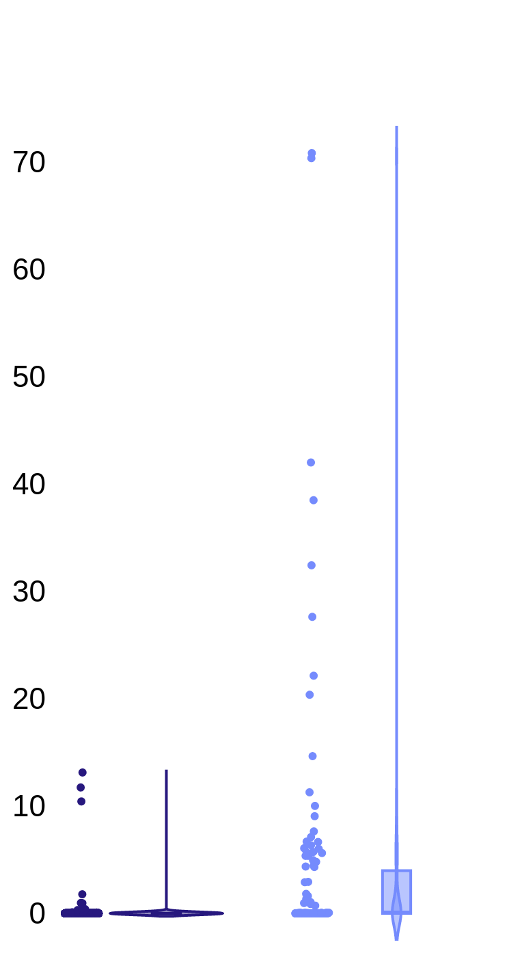
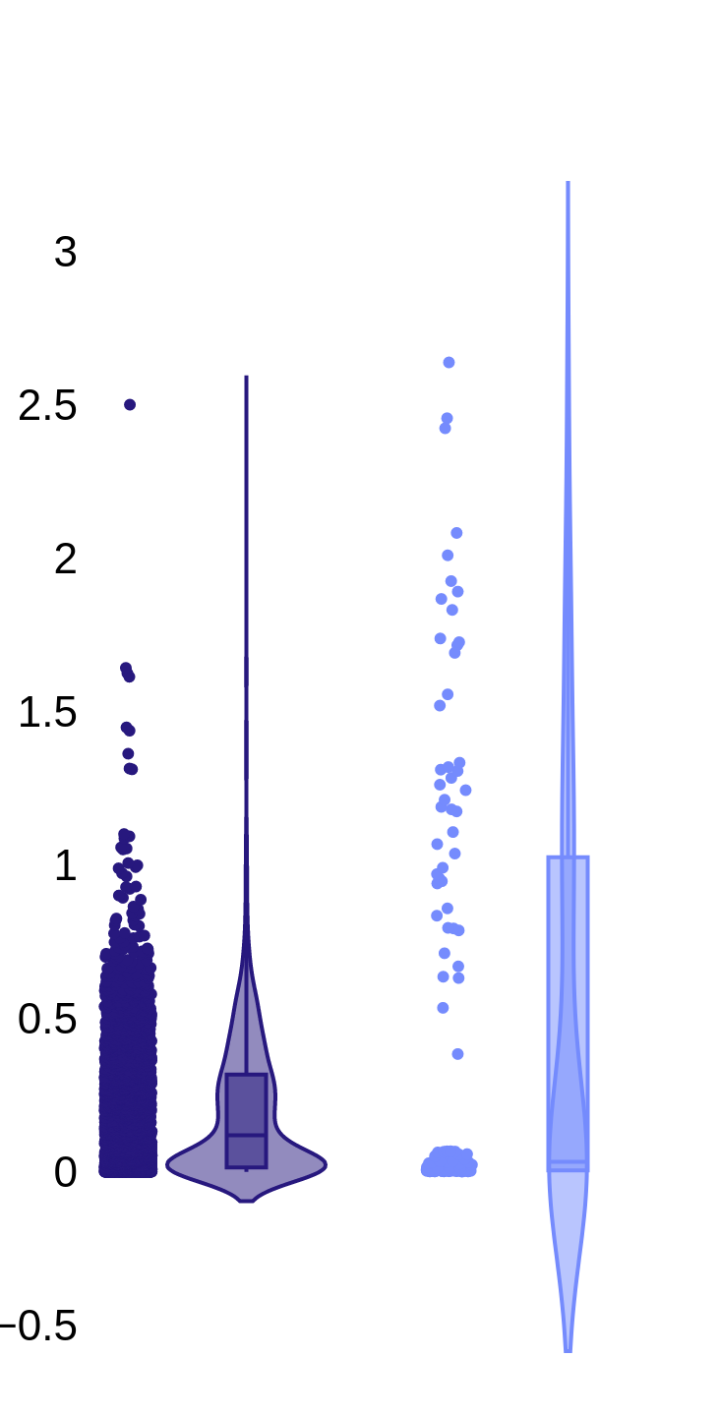
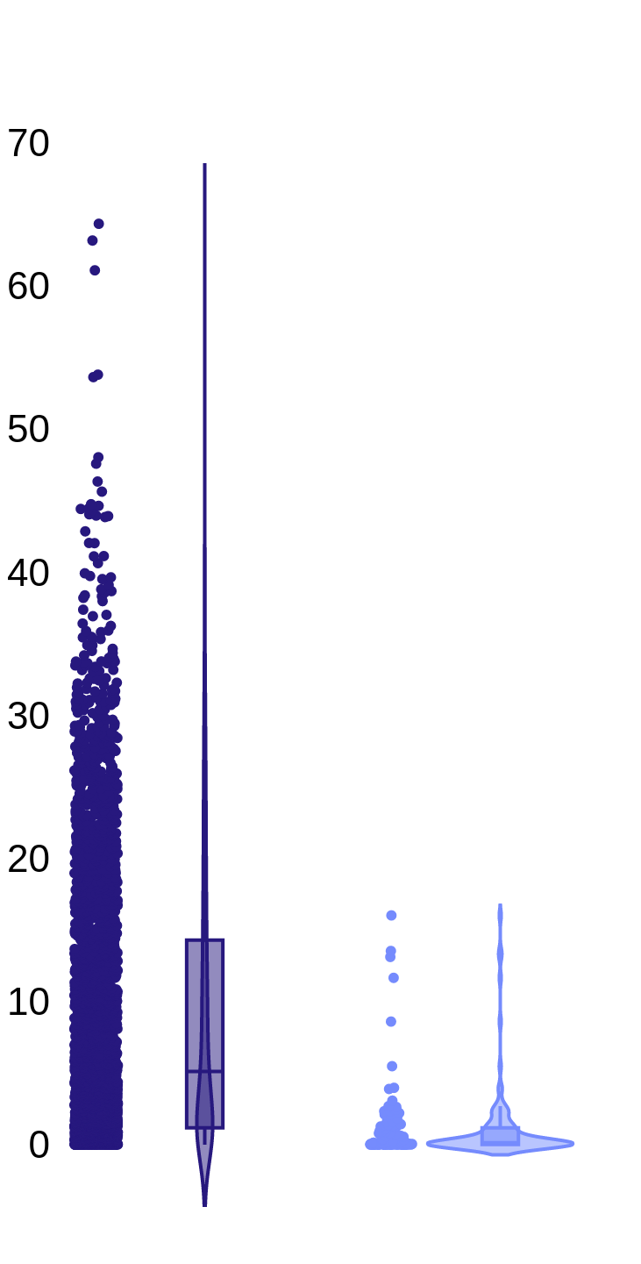
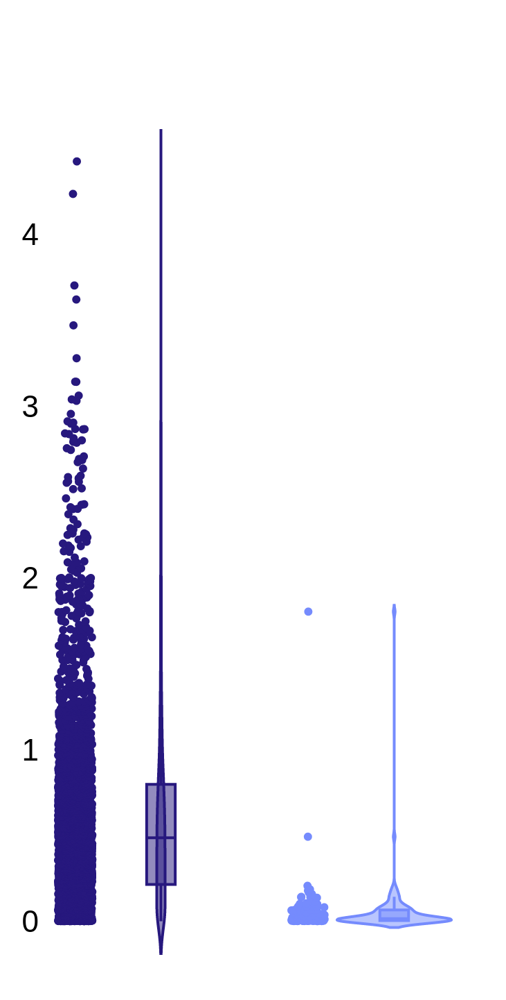
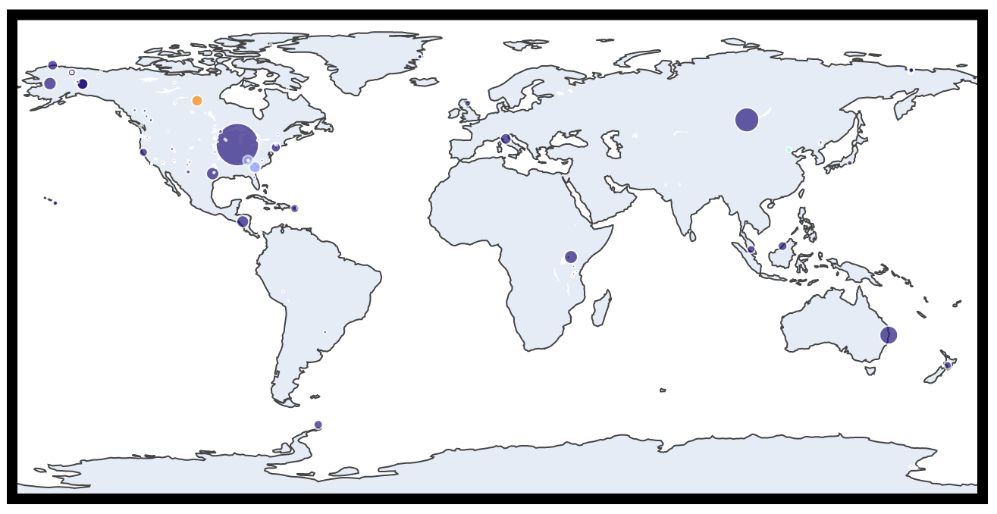
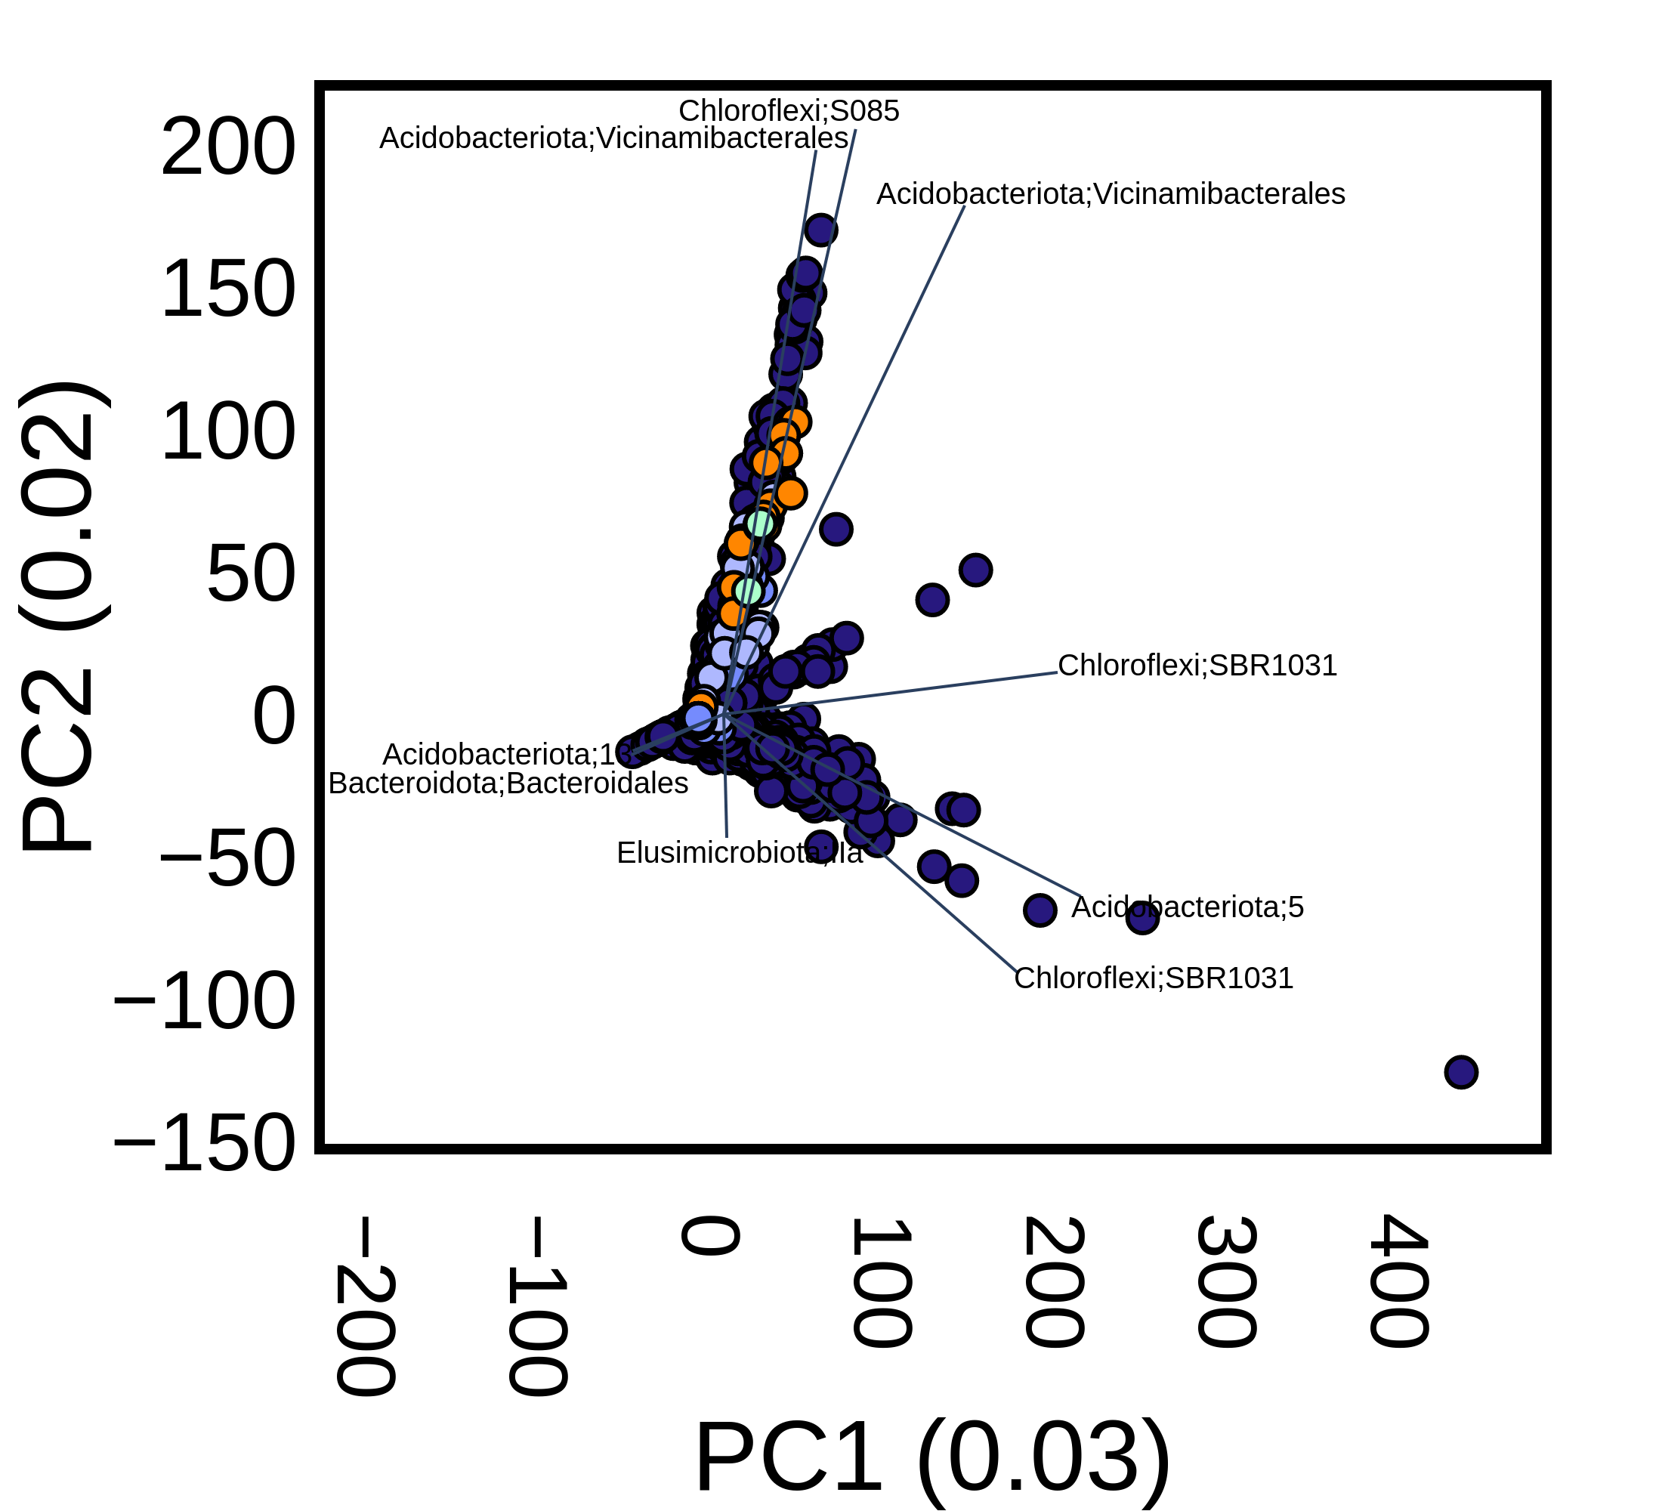
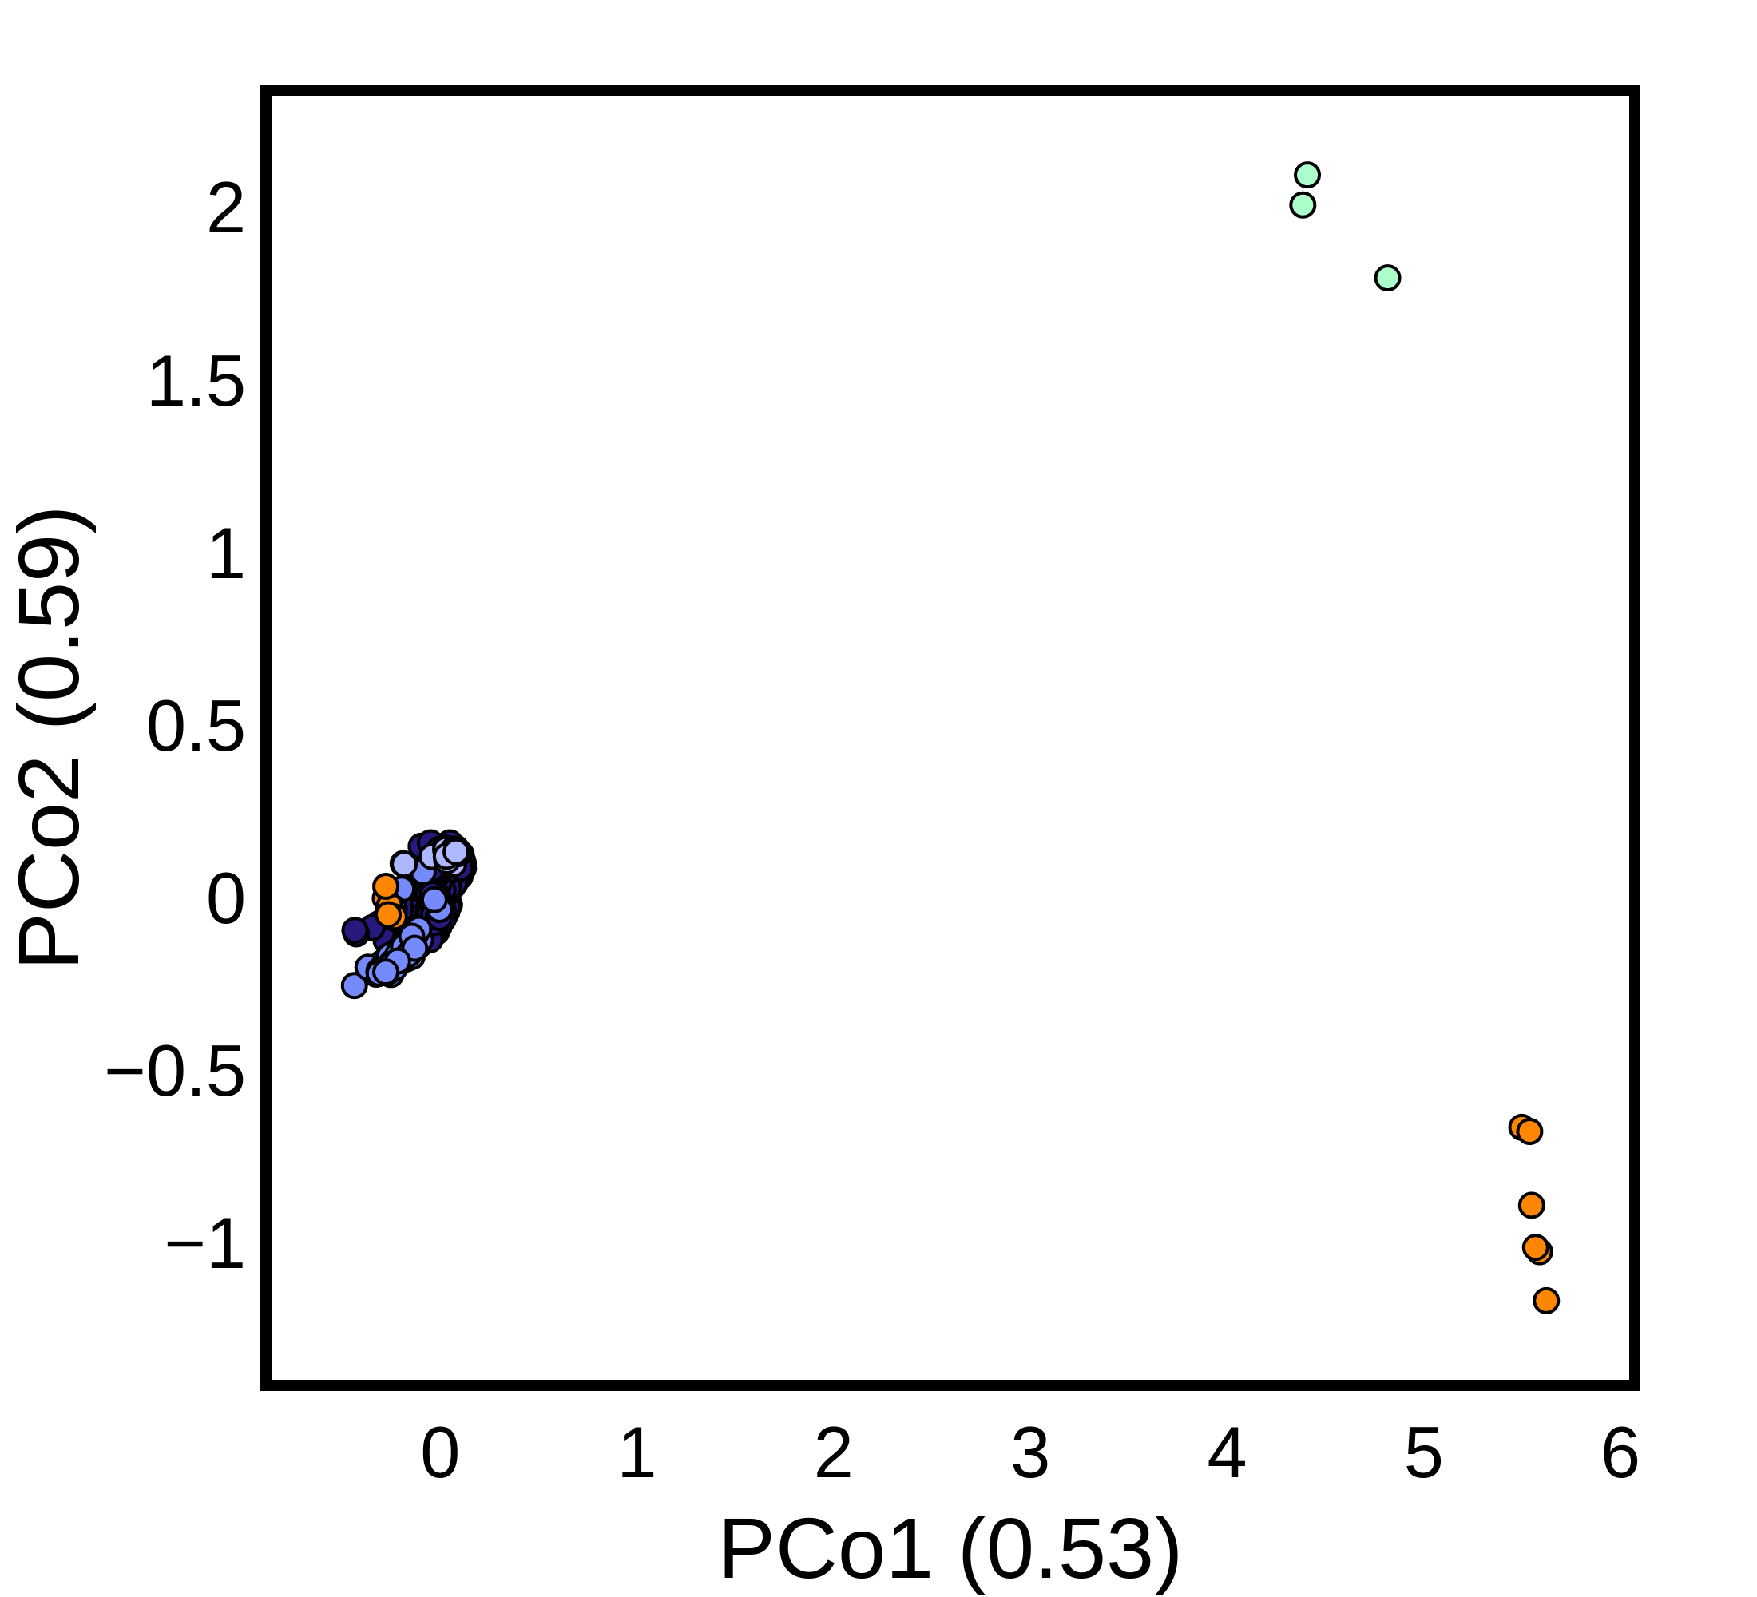
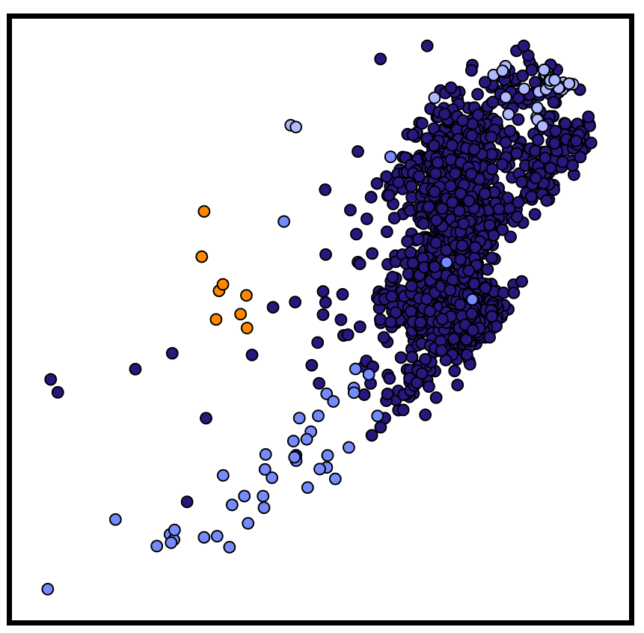
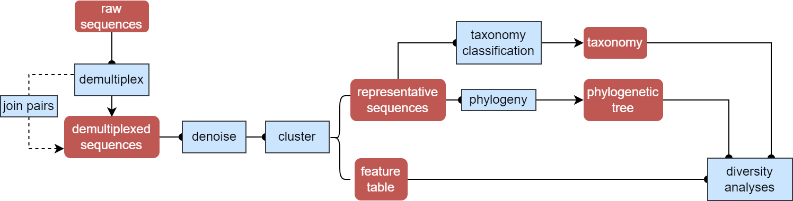








Assessing the Impact of Nuclear Contamination on Soil Microbial Communities
Assessing the Impact of Nuclear Contamination on Soil Microbial Communities
Heather MacGregor¹, Isis Fukai², Kurt Ash², Terry Hazen², and Adam Arkin¹
¹University of California, Berkeley ²The University of Tennessee
Introduction
Mission Relevance
MTV Impact
Nuclear processing (NP) activities often lead to the dissemination of materials and wastes into the surrounding environment.¹
The environment undergoes changes as a result of the reciprocal impact between these materials, leading to shifts in the spatial and temporal distribution of microbes around the material source.
The contaminants involved (e.g., heavy metals, nitrate, and other organics) can change which microbes can thrive and survive.²
These models, in conjunction with an environmental surveillance protocol, can enable remote diagnostics to be performed at locations where such activities are taking place.
Understanding the mechanistic basis of microbial responses could aid both in detection and remediation of the signal.
Integration with a community studying diverse aspects of nuclear processing and technology gives context and constraints on our work.
The opportunity to collaborate across the university and national labs allows us access to sites, nuclear process information, and intellectual collaboration we might not have otherwise.
Specifically, the ability to operate at Y12 and Savannah River as exemplars of different nuclear processing sites is valuable, amplified by the collaboration between the Arkin, Hazen, Alm and Duff labs.
Results + Discussion
Analysis of composition of microbiomes (ANCOM) analysis (Fig. 3) can be used to compare the composition of microbiomes in 2+ populations and identify significantly different taxa.⁶
484 taxa (at the genus level) were considered to be significantly different between the nuclear- contaminated and background samples.
Microbial community variation around sites of known nuclear contamination history can train a machine learning model to predict the contamination source's type, age, and distance.
a
b
c
d
e
Conclusions + Next Steps
Materials and Methods
It is critical to have a standard protocol for collection and processing of the data.
Although it is possible to use data from the global community to help train the model, differences in data type (amplicon vs. metagenomics) and sequencing/extraction protocols can present challenges that we need to address.
The metadata of a site and its history is essential to good data science, and this remains challenging as few standards applicable to this type of study exist.
However, even with relatively low-resolution measurements, we see strong association of samples from similar contaminated sites clustering across studies.
To better power our models, further (and higher resolution) measurements from contaminated sites will be added to the dataset.
The Earth Microbiome Project (EMP) contains over 2,000 16S sequencing data from soil samples across the globe.³
Using the EMP dataset as a background can help minimize the false positive rate (FPR).
Additionally, the dataset includes nuclear-contaminated soil data obtained from MTV collaborators and publicly available data from the European Nucleotide Archive (ENA)⁴ (Fig. 1).
It is crucial to process all the data using the same common workflow (Fig. 2).⁵
51e10040c3cef5c97511d3e7b72dd5ea
TACGGAGGGGACTAGCGTTGTTCGGAATTACTGGGCGTAAAGCGCACGTAGGCGGATTTGTAAGTCAGGGGTGAAATCCCGGGGCTCAAC
e2a41da842c89fe3e2962eb8ccd8544d
TACAGAGGGTGCGAGCGTTGTCCGGAATCACTGGGCGTAAAGGGCGCGTAGGCGGCTTGGGAAGTCCGTGGTGAAAGCTCGTGGCTCAAC
No Yes
No Yes
No Yes
No Yes
Contaminated
Contaminated
Contaminated
Contaminated
Fig. 3: (a) ANCOM of the OTUs at genus level (nuclear- contaminated vs. background) colored by phylum. Violin plots of relative abundances of selected taxa that were (b)-(c) more or (d)-(e) less abundant in the contaminated samples.
Principal Component Analysis (PCA) is a dimensionality-reduction method (Fig. 4a) that can increase the interpretability of large datasets while minimizing information loss.⁷
Each PC captures very little variation from the data.
Principal Coordinate Analysis (PCoA) is a statistical method (Fig. 4b) that converts a matrix of distances between samples to a map of the dimensions that account for the maximum distances.⁸
Two clusters of contaminated samples differ greatly; separations of contaminated samples from background samples are apparent.
a
b
EMP
Acknowledgements
EMP
MTV
BRC
FAM
RLITMF
MTV
I would like to thank the members of the Arkin Lab for their guidance and support, especially David Bernstein, as well as our collaborators from the Hazen Lab for their contribution to data collection.
This work was funded in-part by the Consortium for Monitoring, Technology, and Verification under DOE-NNSA award number DE-NA0003920.
Fig. 1: Map of soil sample locations used in the analyses.
BRC
FAM
RLITMF
Fig. 2: QIIME2⁶ workflow.
Fig. 4: (a) PCA score plot overlaid with loadings of the most important features in PC1 and PC2; (b) PCoA plot (with closer view of the left cluster embedded); each point represents a sample.
References + Interactive Plots + Video Presentation

Slide 2
a
b
EMP
MTV
BRC
FAM
RLITMF
Fig. 4: (a) PCA score plot overlaid with loadings of the most important features in PC1 and PC2; (b) PCoA plot (with closer view of the left cluster embedded); each point represents a sample.

Slide 3
a
b
c
d
e
51e10040c3cef5c97511d3e7b72dd5ea
TACGGAGGGGACTAGCGTTGTTCGGAATTACTGGGCGTAAAGCGCACGTAGGCGGATTTGTAAGTCAGGGGTGAAATCCCGGGGCTCAAC
e2a41da842c89fe3e2962eb8ccd8544d
TACAGAGGGTGCGAGCGTTGTCCGGAATCACTGGGCGTAAAGGGCGCGTAGGCGGCTTGGGAAGTCCGTGGTGAAAGCTCGTGGCTCAAC
No Yes
No Yes
No Yes
No Yes
Contaminated
Contaminated
Contaminated
Contaminated
Fig. 3: (a) ANCOM of the OTUs at genus level (nuclear- contaminated vs. background) colored by phylum. Violin plots of relative abundances of selected taxa that were (b)-(c) more or (d)-(e) less abundant in the contaminated samples.

