Slide 1
MNIST Digit Classification with K-nearest Neighbors
CS455

Slide 2
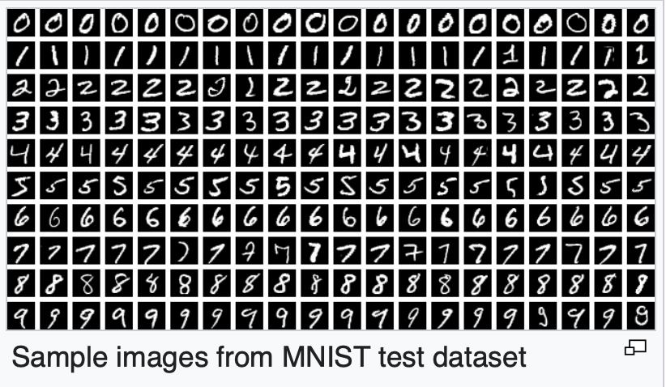
MNIST Database
MNIST - Modified National Institute of Standards and Technology contains 60,000 training images and 10,000 testing images with a single digit 0-9 in various handwriting. Image recognition and classifying these digits correctly is like the Hello World problem of Machine Learning.
Notes:
https://en.wikipedia.org/wiki/MNIST_database

Slide 3
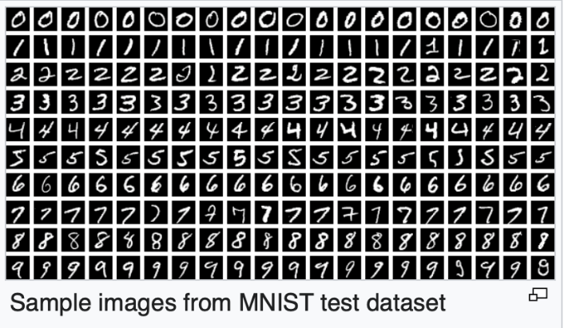
MNIST Database
Canvas has 4 compressed files:
t10k-images-idx3-ubyte.gz – 10,000 testing images of digits t10k-labels-idx1-ubyte.gz – 10,000 labels for the testing images
train-images-idx3-ubyte.gz – 60,000 training images of digits train-labels-idx1-ubyte.gz – 60,000 labels for the training images
Notes:
https://en.wikipedia.org/wiki/MNIST_database

Slide 4
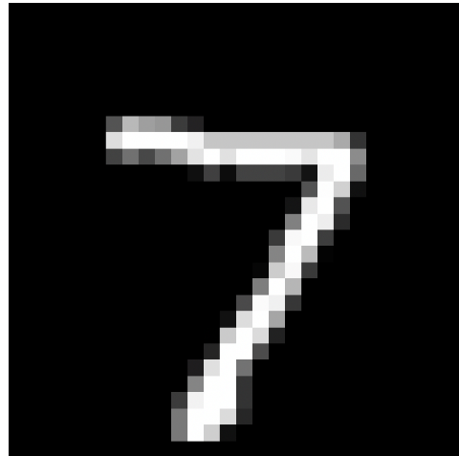
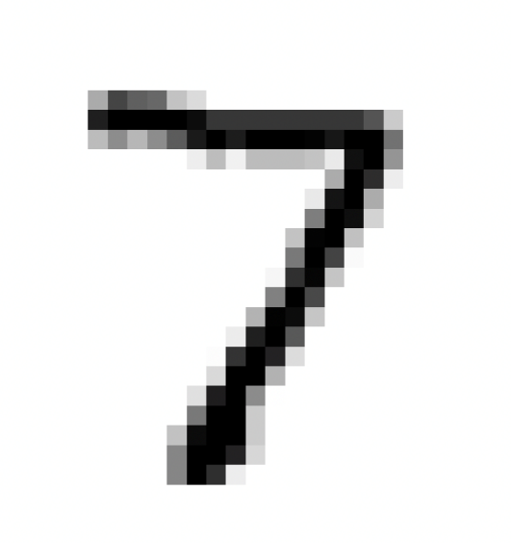
Reading the Data
This code reads in the 10,000 Test images picks one and displays it.
To reverse black and white colors:
plt.imshow(digit, cmap="gray_r")
import numpy as np
import gzip
import struct
import matplotlib.pyplot as plt
def load_images(filename):
with gzip.open(filename, 'rb') as f:
_, n_images, rows, cols = struct.unpack('>IIII', f.read(16))
data = np.frombuffer(f.read(), dtype=np.uint8)
return data.reshape(n_images, rows, cols)
images = load_images("t10k-images-idx3-ubyte.gz")
digit = images[0]
plt.imshow(digit, cmap="gray")
plt.axis("off")
plt.show()
Notes:
import numpy as np
import gzip
import struct
import matplotlib.pyplot as plt
def load_images(filename):
#the file is compressed using GNU zip(gzip) format
#open binary file for reading 'rb'
#
with gzip.open(filename, 'rb') as f:
#> means big-endian (most sig byte first)
#I means unsigned 32-bit int so IIII is 4 unsigned integers
#each int is 4 bytes and you have 4 = 16 bytes
#this first line reads the header bytes:
# magic byte, number images, rows, columns
_, n_images, rows, cols = struct.unpack('>IIII', f.read(16))
#this line reads all the data from the file values are unsigned
#8-bit ints
data = np.frombuffer(f.read(), dtype=np.uint8)
print(f"Read {n_images} images. Image sizes={rows}x{cols}")
#reshape changes the shape of the array from a 1D array of 784 (28x28)
#to 2D array of 28x28
return data.reshape(n_images, rows, cols)
# Load images from the 10,000 testing MNIST images
images = load_images("t10k-images-idx3-ubyte.gz")
# Pick one digit
digit = images[2]
# Display it
plt.imshow(digit, cmap="gray")
plt.axis("off")
plt.show()

Slide 5
To Do
Update the code to look at a few other digits?
Are the number randomized or all are the 7s together and all the 8s together….

Slide 6
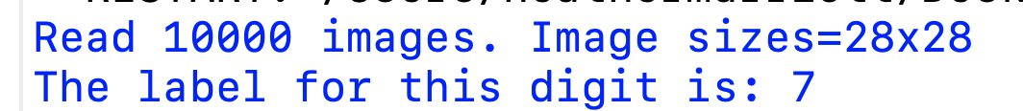
Matching Labels
The matching labels are stored in a different file.
We can see the 1st image is a 7. Let’s make sure the label matches.
def load_labels(filename):
with gzip.open(filename, 'rb') as f:
# header: magic + number
magic, n_labels = struct.unpack(">II", f.read(8))
labels = np.frombuffer(f.read(), dtype=np.uint8)
return labels
Y_test_all = load_labels("t10k-labels-idx1-ubyte.gz")
# Pick one digit
n=0
digit = images[n]
print(f"The label for this digit is: {Y_test_all[n]}")
Notes:
import numpy as np
import gzip
import struct
import matplotlib.pyplot as plt
def load_images(filename):
#the file is compressed using GNU zip(gzip) format
#open binary file for reading 'rb'
#
with gzip.open(filename, 'rb') as f:
#> means big-endian (most sig byte first)
#I means unsigned 32-bit int so IIII is 4 unsigned integers
#each int is 4 bytes and you have 4 = 16 bytes
#this first line reads the header bytes:
# magic byte, number images, rows, columns
_, n_images, rows, cols = struct.unpack('>IIII', f.read(16))
#this line reads all the data from the file values are unsigned
#8-bit ints
data = np.frombuffer(f.read(), dtype=np.uint8)
print(f"Read {n_images} images. Image sizes={rows}x{cols}")
#reshape changes the shape of the array from a 1D array of 784 (28x28)
#to 2D array of 28x28
return data.reshape(n_images, rows, cols)
def load_labels(filename):
with gzip.open(filename, 'rb') as f:
# header: magic + number
magic, n_labels = struct.unpack(">II", f.read(8))
labels = np.frombuffer(f.read(), dtype=np.uint8)
return labels
# Load images from the 10,000 testing MNIST images
images = load_images("t10k-images-idx3-ubyte.gz")
#load the labels
Y_test_all = load_labels("t10k-labels-idx1-ubyte.gz")
# Pick one digit
n=0
digit = images[n]
print(f"The label for this digit is: {Y_test_all[n]}")

Slide 7
To Do
Right now, we are only reading the 10,000 test images and labels.
Update the code to also read in the 60,000 training data images and labels.
train-images-idx3-ubyte.gz
train-labels-idx1-ubyte.gz
Notes:
# Load images from the 60,000 training MNIST images
images_train = load_images("train-images-idx3-ubyte.gz")
Y_train_all = load_labels("train-labels-idx1-ubyte.gz")

Slide 8
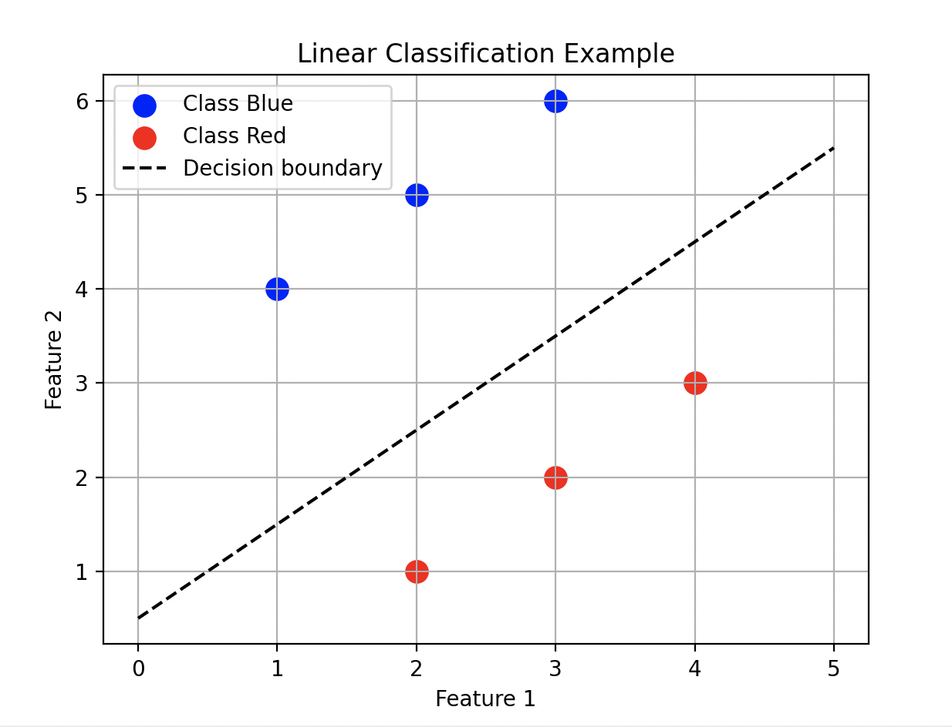
Linear Classification
Let’s say we have data points for 2 features and labels(classification). Linear classification will look for the best line to spit the data. If I give you a new data point, you can tell me if it’s in the Blue Class or the Red Class
Which class is this new point?

Slide 9
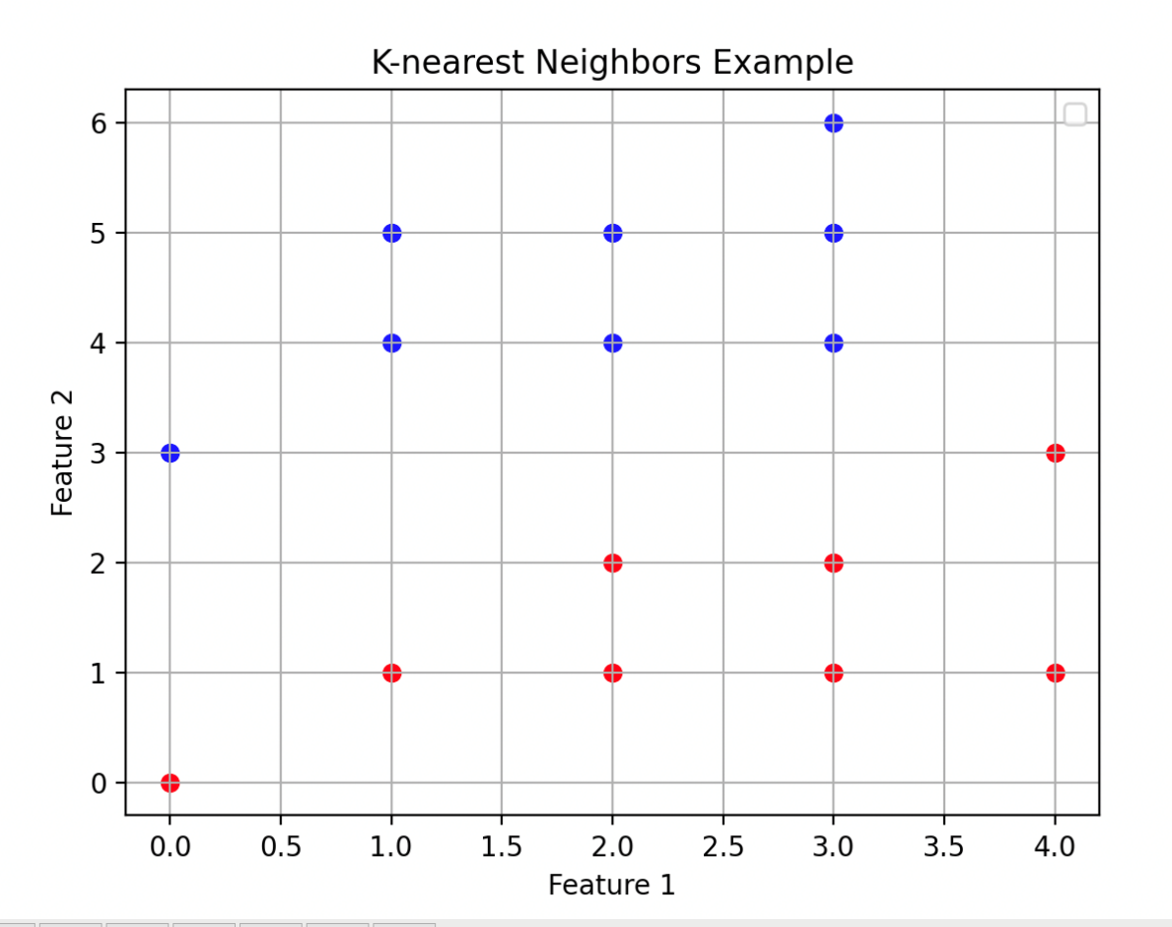
K-nearest Neighbors
K-nearest neighbors algorithm does not need a decision line. Instead, it uses the K-Nearest Neighbors classifications to decide on the new point’s classification. (K is number of neighbors you consider, ex 1, 2, 3)
Which class is this new point?
Notes:
import matplotlib.pyplot as plt
# Blue points (class 1)
x_blue = [1, 2, 3, 1, 0, 2, 3, 3]
y_blue = [4, 5, 6, 5, 3, 4, 5, 4]
# Red points (class 2)
x_red = [2, 3, 4, 3, 0, 1, 2, 4, 3]
y_red = [1, 2, 3, 1, 0, 1, 2, 1, 2]
plt.scatter(x_blue, y_blue, color='blue')
plt.scatter(x_red, y_red, color='red')
# --- Labels and legend ---
plt.xlabel('Feature 1')
plt.ylabel('Feature 2')
plt.title('K-nearest Neighbors Example')
plt.legend()
plt.grid(True)
plt.show()

Slide 10


How to Determine Nearest Neighbors
There are several ways to decide on the nearest neighbors. For example….
Euclidean distance
Manhattan distance

Slide 11
Majority Classification
If your neighbors have different classes, pick the majority.
Looking at the 3-nearest neighbors of our yellow point, 2 neighbors are red and 1 is blue. So, we classify this as a red point.
It’s a good idea to pick an odd number for k to avoid ties.

Slide 12
MNIST - K Nearest Neighbors
The MNIST data images are 28x28, 784 pixels total.
Each pixel can be treated as a feature.
It’s easy for humans to visualize 2 D graphs (2 features), and 3 D graphs (3 features), but visualizing a 784 D graph is not so easy. There is no way to create a scatter plot for that.
Notes:
import numpy as np
import gzip
import struct
from sklearn.neighbors import KNeighborsClassifier
# --- Load functions ---
def load_images(filename):
with gzip.open(filename, 'rb') as f:
_, n_images, rows, cols = struct.unpack('>IIII', f.read(16))
data = np.frombuffer(f.read(), dtype=np.uint8)
return data.reshape(n_images, rows, cols)
def load_labels(filename):
with gzip.open(filename, 'rb') as f:
magic, n_labels = struct.unpack(">II", f.read(8))
labels = np.frombuffer(f.read(), dtype=np.uint8)
return labels
# --- Load MNIST data ---
X_train = load_images("train-images-idx3-ubyte.gz")
Y_train = load_labels("train-labels-idx1-ubyte.gz")
X_test = load_images("t10k-images-idx3-ubyte.gz")
Y_test = load_labels("t10k-labels-idx1-ubyte.gz")
# --- Flatten images for classifier ---
X_train_flat = X_train.reshape(len(X_train), -1) # 60,000 x 784
X_test_flat = X_test.reshape(len(X_test), -1) # 10,000 x 784
# --- Create and train kNN classifier ---
knn = KNeighborsClassifier(n_neighbors=3)
knn.fit(X_train_flat, Y_train)
# --- Predict on test set ---
y_pred = knn.predict(X_test_flat)
# --- Calculate accuracy ---
accuracy = (y_pred == Y_test).mean()
print("Test accuracy:", accuracy)
# --- Optional: check one prediction ---
n = 0
print(f"True label: {Y_test[n]}, Predicted: {y_pred[n]}")

Slide 13
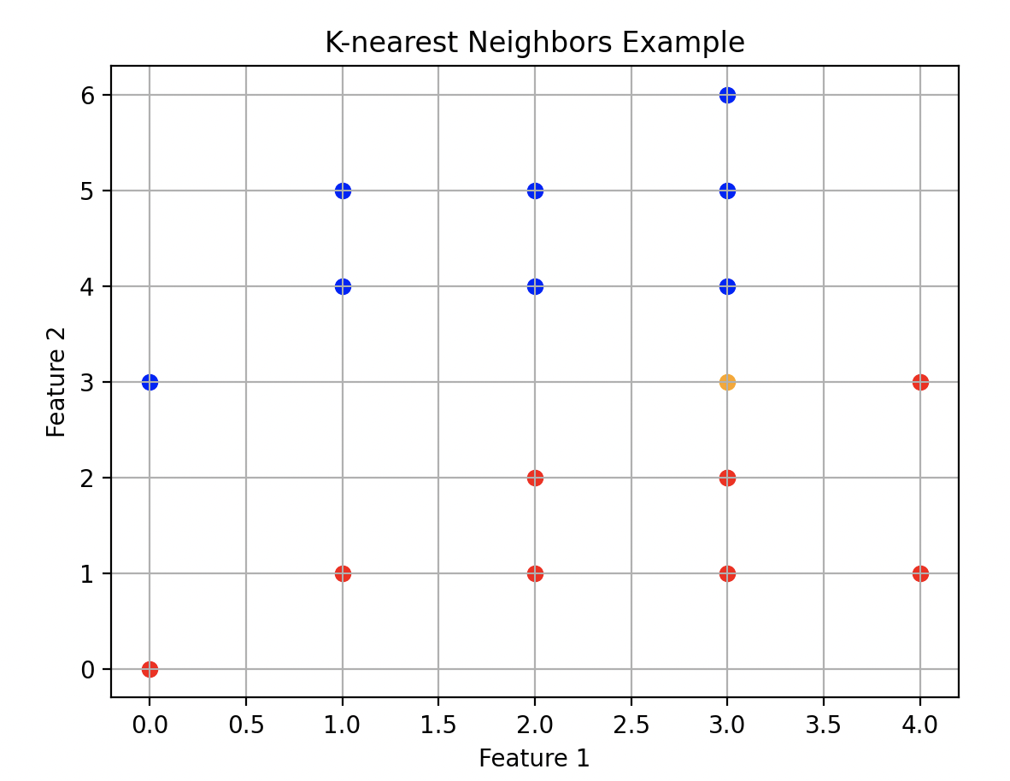
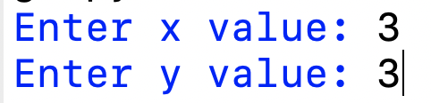
Scikit-Learn KNeighborsClassifier
The Scikit-Learn Module has a KNeighborsClassifier class that can assist in K-nearest Neighbor Classification.
We can use it on our Blue Red example to classify a new point.
https://scikit-learn.org/stable/modules/generated/sklearn.neighbors.KNeighborsClassifier.html
Notes:
import matplotlib.pyplot as plt
from sklearn.neighbors import KNeighborsClassifier
# Blue points (class 1)
x_blue = [1, 2, 3, 1, 0, 2, 3, 3]
y_blue = [4, 5, 6, 5, 3, 4, 5, 4]
# Red points (class 2)
x_red = [2, 3, 4, 3, 0, 1, 2, 4, 3]
y_red = [1, 2, 3, 1, 0, 1, 2, 1, 2]
plt.scatter(x_blue, y_blue, color='blue')
plt.scatter(x_red, y_red, color='red')
x=int(input('Enter x value: '))
y=int(input('Enter y value: '))
plt.scatter(x, y, color='yellow')
# --- Labels and legend ---
plt.xlabel('Feature 1')
plt.ylabel('Feature 2')
plt.title('K-nearest Neighbors Example')
plt.grid(True)
plt.show()

Slide 14
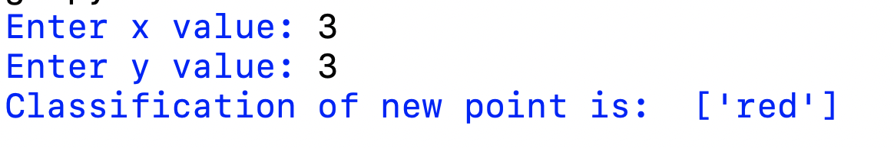
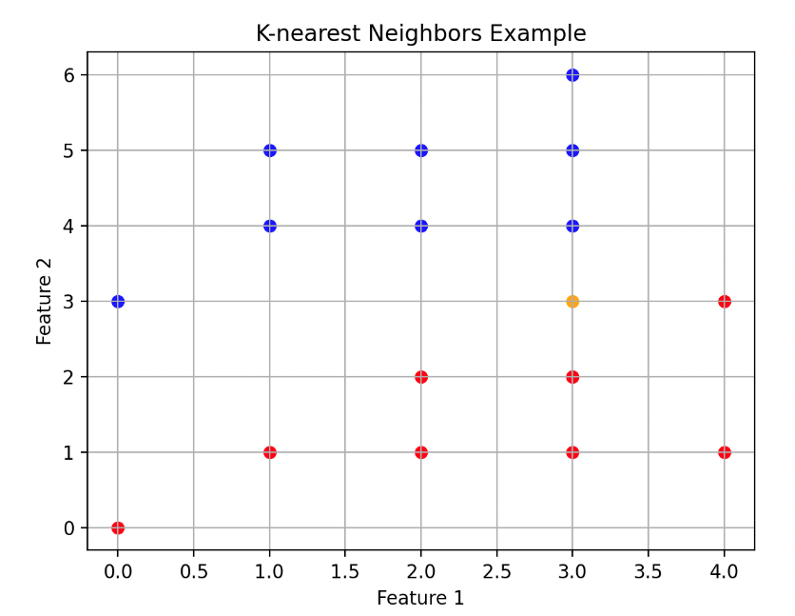
Scikit-Learn KNeighborsClassifier
#training data must be 2D array
X_train = [[x_blue[i], y_blue[i]] for i in range(len(x_blue))] + \
[[x_red[i], y_red[i]] for i in range(len(x_red))]
y_train = ['blue']*len(x_blue) + ['red']*len(x_red)
# --- Create and train kNN classifier ---
knn = KNeighborsClassifier(n_neighbors=3)
knn.fit(X_train, y_train)
print("Classification of new point is: ", knn.predict([[x,y]]) )
https://scikit-learn.org/stable/modules/generated/sklearn.neighbors.KNeighborsClassifier.html
Notes:
import matplotlib.pyplot as plt
from sklearn.neighbors import KNeighborsClassifier
# Blue points (class 1)
x_blue = [1, 2, 3, 1, 0, 2, 3, 3]
y_blue = [4, 5, 6, 5, 3, 4, 5, 4]
# Red points (class 2)
x_red = [2, 3, 4, 3, 0, 1, 2, 4, 3]
y_red = [1, 2, 3, 1, 0, 1, 2, 1, 2]
plt.scatter(x_blue, y_blue, color='blue')
plt.scatter(x_red, y_red, color='red')
x=int(input('Enter x value: '))
y=int(input('Enter y value: '))
#training data must be 2D array
X_train = [[x_blue[i], y_blue[i]] for i in range(len(x_blue))] + \
[[x_red[i], y_red[i]] for i in range(len(x_red))]
y_train = ['blue']*len(x_blue) + ['red']*len(x_red)
# --- Create and train kNN classifier ---
knn = KNeighborsClassifier(n_neighbors=3)
knn.fit(X_train, y_train)
print("Classification of new point is: ", knn.predict([[x,y]]))
plt.scatter(x, y, color='orange')
# --- Labels and legend ---
plt.xlabel('Feature 1')
plt.ylabel('Feature 2')
plt.title('K-nearest Neighbors Example')
plt.grid(True)
plt.show()

Slide 15

MNIST - 3 Nearest Neighbors
from sklearn.neighbors import KNeighborsClassifier
# --- Create and train kNN classifier ---
knn = KNeighborsClassifier(n_neighbors=3)
knn.fit(X_train_flat, Y_train)
# --- Predict on test set ---
y_pred = knn.predict(X_test_flat)
# --- Calculate accuracy ---
accuracy = (y_pred == Y_test).mean()
print("Test accuracy:", accuracy)
Notes:
import numpy as np
import gzip
import struct
from sklearn.neighbors import KNeighborsClassifier
# --- Load functions ---
def load_images(filename):
with gzip.open(filename, 'rb') as f:
_, n_images, rows, cols = struct.unpack('>IIII', f.read(16))
data = np.frombuffer(f.read(), dtype=np.uint8)
#updated from data.reshape(n_images, rows,cols) because
#keeping as 1D array is better for K-nearest Neighbors
return data.reshape(n_images, rows*cols)
def load_labels(filename):
with gzip.open(filename, 'rb') as f:
magic, n_labels = struct.unpack(">II", f.read(8))
labels = np.frombuffer(f.read(), dtype=np.uint8)
return labels
# --- Load MNIST data ---
X_train = load_images("train-images-idx3-ubyte.gz")
Y_train = load_labels("train-labels-idx1-ubyte.gz")
X_test = load_images("t10k-images-idx3-ubyte.gz")
Y_test = load_labels("t10k-labels-idx1-ubyte.gz")
# --- Create and train kNN classifier ---
# look at the 3 closest neighbors when deciding classification
knn = KNeighborsClassifier(n_neighbors=3)
knn.fit(X_train, Y_train)
# --- Predict on test set ---
y_pred = knn.predict(X_test)
# --- Calculate accuracy ---
accuracy = (y_pred == Y_test).mean()
print("Test accuracy:", accuracy)
# --- Optional: check one prediction ---
n = 0
print(f"True label: {Y_test[n]}, Predicted: {y_pred[n]}")

Slide 16
To Do
The 3-nearest neighbors claims a 97% accuracy. How is the accuracy impacted if you change k?
k | Accuracy
1 | ?
2 | ?
3 | 97.05%
4 | ?
5 | ?
Notes:
1 - 96.91%
2 - 96.27%
4 - 96.82%

Slide 17
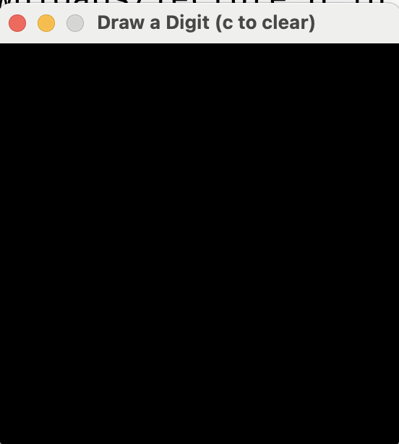
User Input with Pygame
Let’s build a python program that lets the user draw a 0-9 digit and then use our KNN model to classify it.
import pygame
size=28
def run():
pygame.init()
# Square size instead of a 1x1 pixel, ratio 10x10
# so it's easier to draw
# visually scale whole image up by 10 (does not change what is stored)
SQUARE_SIZE = 10
# Window size
WIDTH, HEIGHT = size*SQUARE_SIZE, size*SQUARE_SIZE
screen = pygame.display.set_mode((WIDTH, HEIGHT))
pygame.display.set_caption("Draw a Digit (c to clear)")
running = True
while running:
for event in pygame.event.get():
if event.type == pygame.QUIT: # Window close button
running = False
# Quit pygame
pygame.quit()
run()
Notes:
#version 1 just displays a 28x28 box (scaled up by a factor of 10) where the user will
#eventually be able to draw their numbers
import pygame
size=28
def run():
pygame.init()
# Square size instead of a 1x1 pixel, ratio 10x10
# so it's easier to draw
# visually scale whole image up by 10 (does not change what is stored)
SQUARE_SIZE = 10
# Window size
WIDTH, HEIGHT = size*SQUARE_SIZE, size*SQUARE_SIZE
screen = pygame.display.set_mode((WIDTH, HEIGHT))
pygame.display.set_caption("Draw a Digit (c to clear)")
running = True
while running:
for event in pygame.event.get():
if event.type == pygame.QUIT: # Window close button
running = False
# Quit pygame
pygame.quit()
run()

Slide 18
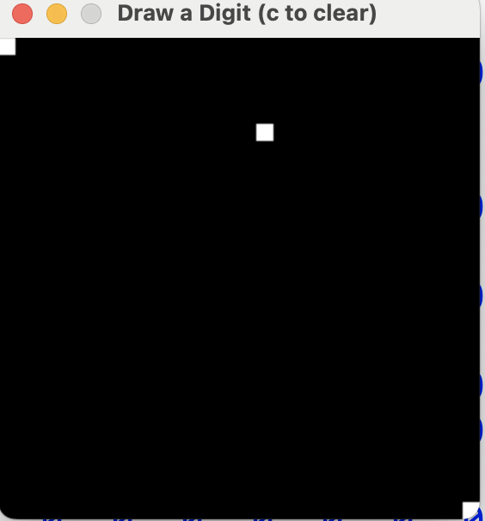
User Input with Pygame V2
Our original board is 28x28 list of all 0s. Just to test out, let’s change the color of a few to white(255)
#store a 28x28 list of 0s, we will use this in redisplay when
#we clear the board
store = [[0]*size for _ in range(size)]
store[0][0]=255 #hard code 1 pixel drawn
store[5][15]=255
store[27][27]=255 #hard code 1 pixel drawn
print(store)
def redraw():
print("calling redraw")
for row in range(0, len(store)):
for col in range(0, len(store[0])):
#draw a square to represent store[row][col]
#Rect need the top left corner (x,y) is (col, row), and width and height
rect = pygame.Rect(col*SQUARE_SIZE,
row*SQUARE_SIZE,
SQUARE_SIZE, SQUARE_SIZE)
pygame.draw.rect(screen, (store[row][col], store[row][col], store[row][col]),rect)
pygame.display.update()
position (0, 0)
position (5, 15)
color (255,255,255) is white color (0,0,0) is black
position (27, 27)
Notes:
# version2 we are experimenting with adding some white boxes in 3 locations to see how the drawing will eventually work
#
import pygame
size=28
# Square size instead of a 1x1 pixel, ratio 10x10
# so it's easier to draw
# visually scale whole image up by 10 (does not change what is stored)
# Window size
SQUARE_SIZE = 10
def run():
pygame.init()
WIDTH, HEIGHT = size*SQUARE_SIZE, size*SQUARE_SIZE
screen = pygame.display.set_mode((WIDTH, HEIGHT))
pygame.display.set_caption("Draw a Digit (c to clear)")
#store a 28x28 list of 0s, we will use this in redisplay when
#we clear the board
store = [[0]*size for _ in range(size)]
store[0][0]=255 #hard code 1 pixel drawn
store[5][15]=255
store[27][27]=255 #hard code 1 pixel drawn
print(store)
def redraw():
print("calling redraw")
for row in range(0, len(store)):
for col in range(0, len(store[0])):
#draw a square to represent store[row][col]
#Rect need the top left corner (x,y) is (col, row), and width and height
rect = pygame.Rect(col*SQUARE_SIZE,
row*SQUARE_SIZE,
SQUARE_SIZE, SQUARE_SIZE)
pygame.draw.rect(screen, (store[row][col], store[row][col], store[row][col]),rect)
pygame.display.update()
redraw()
running = True
while running:
for event in pygame.event.get():
if event.type == pygame.QUIT: # Window close button
running = False
elif event.type == pygame.MOUSEBUTTONDOWN:
redraw()
# Quit pygame
pygame.quit()
run()

Slide 19
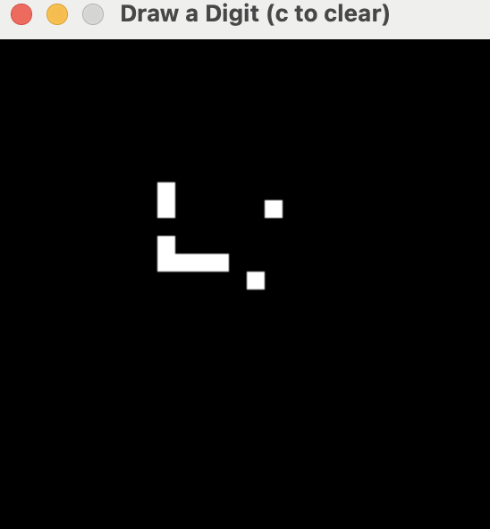
User Input with Pygame V3
Update the 28x28 list using the position the user clicks on.
elif event.type == pygame.MOUSEBUTTONDOWN:
x, y = event.pos # Get click position
x_scaled, y_scaled = x//SQUARE_SIZE, y//SQUARE_SIZE
store[y_scaled][x_scaled] = 255 #make pixel white
redraw()
Notes:
# add a white box where the user clicks
import pygame
size=28
# Square size instead of a 1x1 pixel, ratio 10x10
# so it's easier to draw
# visually scale whole image up by 10 (does not change what is stored)
# Window size
SQUARE_SIZE = 10
def run():
pygame.init()
WIDTH, HEIGHT = size*SQUARE_SIZE, size*SQUARE_SIZE
screen = pygame.display.set_mode((WIDTH, HEIGHT))
pygame.display.set_caption("Draw a Digit (c to clear)")
#store a 28x28 list of 0s, we will use this in redisplay when
#we clear the board
store = [[0]*size for _ in range(size)]
def redraw():
print("calling redraw")
for row in range(0, len(store)):
for col in range(0, len(store[0])):
#draw a square to represent store[row][col]
#Rect need the top left corner (x,y) is (col, row), and width and height
rect = pygame.Rect(col*SQUARE_SIZE,
row*SQUARE_SIZE,
SQUARE_SIZE, SQUARE_SIZE)
pygame.draw.rect(screen, (store[row][col], store[row][col], store[row][col]),rect)
pygame.display.update()
redraw()
running = True
while running:
for event in pygame.event.get():
if event.type == pygame.QUIT: # Window close button
running = False
elif event.type == pygame.MOUSEBUTTONDOWN:
x, y = event.pos # Get click position
x_scaled, y_scaled = x//SQUARE_SIZE, y//SQUARE_SIZE
store[y_scaled][x_scaled] = 255 #make pixel white
redraw()
# Quit pygame
pygame.quit()
run()

Slide 20
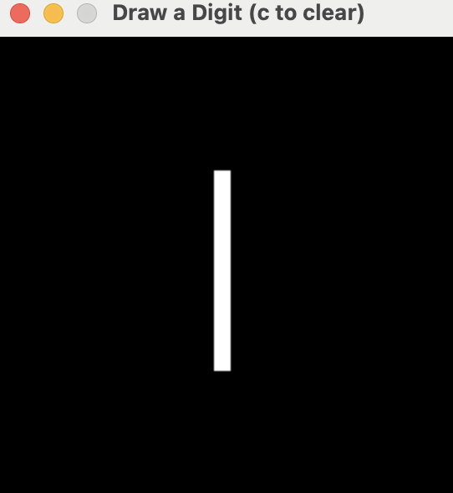
User Input with Pygame V4
Update the code so the user can click OR drag the mouse to draw.
while running:
for event in pygame.event.get():
if event.type == pygame.QUIT: # Window close button
running = False
elif event.type == pygame.MOUSEBUTTONDOWN or \
(event.type == pygame.MOUSEMOTION and drawing): # Mouse click
drawing = True
x, y = event.pos # Get click position
x_scaled, y_scaled = x//SQUARE_SIZE, y//SQUARE_SIZE
store[y_scaled][x_scaled] = 255 #make pixel white
redraw()
else:
drawing = False
Notes:
import pygame
size=28
# Square size instead of a 1x1 pixel, ratio 10x10
# so it's easier to draw
# visually scale whole image up by 10 (does not change what is stored)
# Window size
SQUARE_SIZE = 10
def run():
pygame.init()
WIDTH, HEIGHT = size*SQUARE_SIZE, size*SQUARE_SIZE
screen = pygame.display.set_mode((WIDTH, HEIGHT))
pygame.display.set_caption("Draw a Digit (c to clear)")
#store a 28x28 list of 0s, we will use this in redisplay when
#we clear the board
store = [[0]*size for _ in range(size)]
def redraw():
print("calling redraw")
for row in range(0, len(store)):
for col in range(0, len(store[0])):
#draw a square to represent store[row][col]
#Rect need the top left corner (x,y) is (col, row), and width and height
rect = pygame.Rect(col*SQUARE_SIZE,
row*SQUARE_SIZE,
SQUARE_SIZE, SQUARE_SIZE)
pygame.draw.rect(screen, (store[row][col], store[row][col], store[row][col]),rect)
pygame.display.update()
redraw()
running = True
while running:
for event in pygame.event.get():
if event.type == pygame.QUIT: # Window close button
running = False
elif event.type == pygame.MOUSEBUTTONDOWN or \
(event.type == pygame.MOUSEMOTION and drawing): # Mouse click
drawing = True
x, y = event.pos # Get click position
x_scaled, y_scaled = x//SQUARE_SIZE, y//SQUARE_SIZE
store[y_scaled][x_scaled] = 255 #make pixel white
redraw()
else:
drawing = False
# Quit pygame
pygame.quit()
run()

Slide 21
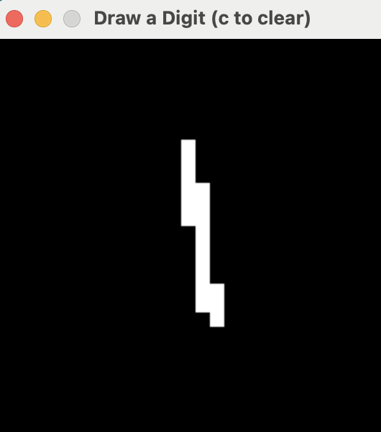
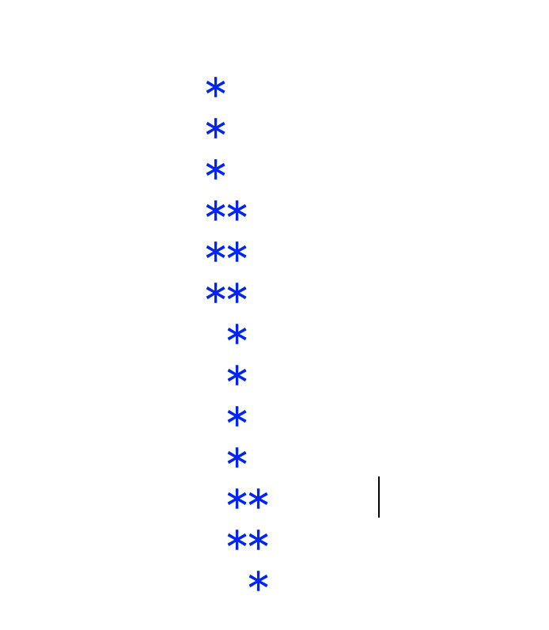
User Input with Pygame V5
Display the drawn number to the screen for debugging
elif event.type == pygame.MOUSEBUTTONUP: # Mouse button released
drawing = False
#print(store)
for r in range(size):
for c in range(size):
if store[r][c] > 0:
print("*", end="")
else:
print(" ", end="")
print()#newline
Notes:
# This version of the file will display the image of what the user drew after
#they stop holding down the mouse
import pygame
size=28
# Square size instead of a 1x1 pixel, ratio 10x10
# so it's easier to draw
# visually scale whole image up by 10 (does not change what is stored)
# Window size
SQUARE_SIZE = 10
def run():
pygame.init()
WIDTH, HEIGHT = size*SQUARE_SIZE, size*SQUARE_SIZE
screen = pygame.display.set_mode((WIDTH, HEIGHT))
pygame.display.set_caption("Draw a Digit (c to clear)")
#store a 28x28 list of 0s, we will use this in redisplay when
#we clear the board
store = [[0]*size for _ in range(size)]
def redraw():
#print("calling redraw")
for row in range(0, len(store)):
for col in range(0, len(store[0])):
#draw a square to represent store[row][col]
#Rect need the top left corner (x,y) is (col, row), and width and height
rect = pygame.Rect(col*SQUARE_SIZE,
row*SQUARE_SIZE,
SQUARE_SIZE, SQUARE_SIZE)
pygame.draw.rect(screen, (store[row][col], store[row][col], store[row][col]),rect)
pygame.display.update()
redraw()
running = True
drawing = False
while running:
for event in pygame.event.get():
if event.type == pygame.QUIT: # Window close button
running = False
elif event.type == pygame.MOUSEBUTTONDOWN or \
(event.type == pygame.MOUSEMOTION and drawing): # Mouse click
drawing = True
x, y = event.pos # Get click position
x_scaled, y_scaled = x//SQUARE_SIZE, y//SQUARE_SIZE
store[y_scaled][x_scaled] = 255 #make pixel white
redraw()
elif event.type == pygame.MOUSEBUTTONUP: # Mouse button released
drawing = False
#print(store)
for r in range(size):
for c in range(size):
if store[r][c] > 0:
print("*", end="")
else:
print(" ", end="")
print()#newline
# Quit pygame
pygame.quit()
run()

Slide 22
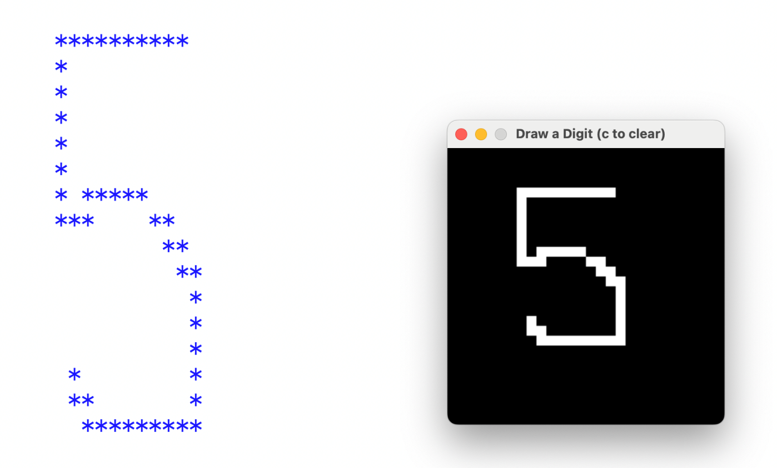
User Input with Pygame V6
Give the user a way to erase the drawing and start again if they type ‘c’
while running:
for event in pygame.event.get():
if event.type == pygame.QUIT: # Window close button
running = False
elif event.type == pygame.MOUSEBUTTONDOWN or \
(event.type == pygame.MOUSEMOTION and drawing): # Mouse click
drawing = True
x, y = event.pos # Get click position
x_scaled, y_scaled = x//SQUARE_SIZE, y//SQUARE_SIZE
store[y_scaled][x_scaled] = 255 #make pixel white
redraw()
else:
drawing = False
Notes:
#Give the user a way to erase the drawing and start again if they type ‘c’
#Give the user a way to erase the drawing and start again if they type ‘c’
import pygame
size=28
# Square size instead of a 1x1 pixel, ratio 10x10
# so it's easier to draw
# visually scale whole image up by 10 (does not change what is stored)
# Window size
SQUARE_SIZE = 10
def run():
pygame.init()
WIDTH, HEIGHT = size*SQUARE_SIZE, size*SQUARE_SIZE
screen = pygame.display.set_mode((WIDTH, HEIGHT))
pygame.display.set_caption("Draw a Digit (c to clear)")
#store a 28x28 list of 0s, we will use this in redisplay when
#we clear the board
store = [[0]*size for _ in range(size)]
#store[0][0]=255 #hard code 1 pixel drawn
#store[5][15]=255
#store[27][27]=255 #hard code 1 pixel drawn
def redraw():
#print("calling redraw")
for row in range(0, len(store)):
for col in range(0, len(store[0])):
#draw a square to represent store[row][col]
#Rect need the top left corner (x,y) is (col, row), and width and height
rect = pygame.Rect(col*SQUARE_SIZE,
row*SQUARE_SIZE,
SQUARE_SIZE, SQUARE_SIZE)
pygame.draw.rect(screen, (store[row][col], store[row][col], store[row][col]),rect)
pygame.display.update()
redraw()
running = True
drawing = False
while running:
for event in pygame.event.get():
if event.type == pygame.QUIT: # Window close button
running = False
elif event.type == pygame.MOUSEBUTTONDOWN or \
(event.type == pygame.MOUSEMOTION and drawing): # Mouse click
drawing = True
x, y = event.pos # Get click position
x_scaled, y_scaled = x//SQUARE_SIZE, y//SQUARE_SIZE
store[y_scaled][x_scaled] = 255 #make pixel white
redraw()
elif event.type == pygame.MOUSEBUTTONUP: # Mouse button released
drawing = False
#print(store)
for r in range(size):
for c in range(size):
if store[r][c] > 0:
print("*", end="")
else:
print(" ", end="")
print()#newline
elif event.type == pygame.KEYDOWN: #if c is typed, clear screen
if event.key == pygame.K_c:
store = [[0]*size for _ in range(size)]
redraw()
# Quit pygame
pygame.quit()
run()

Slide 23
User Input with Pygame V7
To make this a module, put everything in a function that requires the KNN model as input
# update the code so that all the magic happens when you call the run function.
# the run function expects you to pass in a K-Nearest Neighbor model
# that has already been trained.
# flatten the 28x28 into a 1D array and call predict
# knn.predict([numpy_array])
import pygame
import numpy as np
size=28
# Square size instead of a 1x1 pixel, ratio 10x10
# so it's easier to draw
# visually scale whole image up by 10 (does not change what is stored)
# Window size
SQUARE_SIZE = 10
def run(knn):
# ….
pygameDraw_v7.py
Notes:
# update the code so that all the magic happens when you call the run function.
# the run function expects you to pass in a K-Nearest Neighbor model
# that has already been trained.
# flatten the 28x28 into a 1D array and call predict
# knn.predict([numpy_array])
import pygame
import numpy as np
size=28
# Square size instead of a 1x1 pixel, ratio 10x10
# so it's easier to draw
# visually scale whole image up by 10 (does not change what is stored)
# Window size
SQUARE_SIZE = 10
def run(knn):
pygame.init()
WIDTH, HEIGHT = size*SQUARE_SIZE, size*SQUARE_SIZE
screen = pygame.display.set_mode((WIDTH, HEIGHT))
pygame.display.set_caption("Draw a Digit (c to clear)")
#store a 28x28 list of 0s, we will use this in redisplay when
#we clear the board
store = [[0]*size for _ in range(size)]
#store[0][0]=255 #hard code 1 pixel drawn
#store[5][15]=255
#store[27][27]=255 #hard code 1 pixel drawn
def redraw():
#print("calling redraw")
for row in range(0, len(store)):
for col in range(0, len(store[0])):
#draw a square to represent store[row][col]
#Rect need the top left corner (x,y) is (col, row), and width and height
rect = pygame.Rect(col*SQUARE_SIZE,
row*SQUARE_SIZE,
SQUARE_SIZE, SQUARE_SIZE)
pygame.draw.rect(screen, (store[row][col], store[row][col], store[row][col]),rect)
pygame.display.update()
redraw()
running = True
drawing = False
while running:
for event in pygame.event.get():
if event.type == pygame.QUIT: # Window close button
running = False
elif event.type == pygame.MOUSEBUTTONDOWN or \
(event.type == pygame.MOUSEMOTION and drawing): # Mouse click
drawing = True
x, y = event.pos # Get click position
x_scaled, y_scaled = x//SQUARE_SIZE, y//SQUARE_SIZE
store[y_scaled][x_scaled] = 255 #make pixel white
redraw()
elif event.type == pygame.MOUSEBUTTONUP: # Mouse button released
drawing = False
#print(store)
for r in range(size):
for c in range(size):
if store[r][c] > 0:
print("*", end="")
else:
print(" ", end="")
print()#newline
#flatten so 28x28 => 1D array
flat = []
for row in store:
flat += row
numpy_array = np.array(flat)
print(knn.predict([numpy_array]))
elif event.type == pygame.KEYDOWN: #if c is typed, clear screen
if event.key == pygame.K_c:
store = [[0]*size for _ in range(size)]
redraw()
# Quit pygame
pygame.quit()

Slide 24
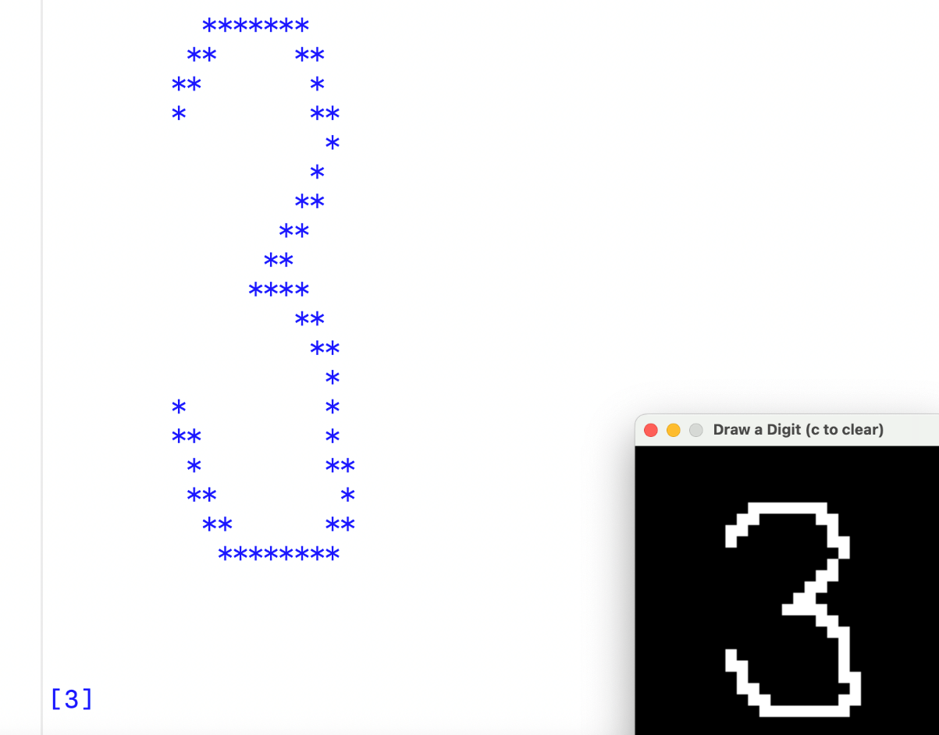
User Input with Pygame V7
Tie this in with your KNN model for live digit prediction!!!!
mport numpy as np
import gzip
import struct
from sklearn.neighbors import KNeighborsClassifier
import pygameDraw_v7
# ….
# --- Calculate accuracy ---
accuracy = (y_pred == Y_test).mean()
print("Test accuracy:", accuracy)
pygameDraw_v7.run(knn)
mnist_knn_userDraw.py
pygameDraw_v7.py
Notes:
import numpy as np
import gzip
import struct
from sklearn.neighbors import KNeighborsClassifier
import pygameDraw_v7
# --- Load functions ---
def load_images(filename):
with gzip.open(filename, 'rb') as f:
_, n_images, rows, cols = struct.unpack('>IIII', f.read(16))
data = np.frombuffer(f.read(), dtype=np.uint8)
#updated from data.reshape(n_images, rows,cols) because
#keeping as 1D array is better for K-nearest Neighbors
return data.reshape(n_images, rows*cols)
def load_labels(filename):
with gzip.open(filename, 'rb') as f:
magic, n_labels = struct.unpack(">II", f.read(8))
labels = np.frombuffer(f.read(), dtype=np.uint8)
return labels
# --- Load MNIST data ---
X_train = load_images("train-images-idx3-ubyte.gz")
Y_train = load_labels("train-labels-idx1-ubyte.gz")
X_test = load_images("t10k-images-idx3-ubyte.gz")
Y_test = load_labels("t10k-labels-idx1-ubyte.gz")
# --- Create and train kNN classifier ---
# look at the 3 closest neighbors when deciding classification
knn = KNeighborsClassifier(n_neighbors=3)
knn.fit(X_train, Y_train)
# --- Predict on test set ---
y_pred = knn.predict(X_test)
# --- Calculate accuracy ---
accuracy = (y_pred == Y_test).mean()
print("Test accuracy:", accuracy)
pygameDraw_v7.run(knn)

Slide 25
When to use K-nearest Neighbors
It’s an easy algorithm, and a good choice when similar things are close together. It’s good when there is a small or medium sized data set (if you are comparing a new point to every existing point, runtime will be longer the larger the dataset is).
kNN works well even with curvy and irregular boundaries (does not need to be a line).
Selecting the k is critical. Selecting the proper distance formula is critical.

Slide 26
No In Class Exercise, just have fun with your Digit Classifier

