Slide 1

RUNTIME ANALYSIS
Big O NOTATION

Slide 2
Join the Nearpod Lecture:
join.nearpod.com

Slide 3
Review
Name one of the data structures we discussed last class
Name one of the sort algorithms we discussed
Notes:
Queue, Stack
Insertion sort, Bubble Sort

Slide 4
Bubble Sort
def bubble_sort(x):
n = len(x)
# Traverse through all elements
for i in range(n):
# Flag to detect any swap
swapped = False
# Last i elements are already sorted
for j in range(1, n - i):
# Swap if the element found is greater than the next element
if x[j - 1] > x[j]:
x[j - 1], x[j] = x[j], x[j - 1]
swapped = True
# If no elements were swapped, break
if not swapped:
break
Which array values would result in the quickest execution?
12, 5, 67, 34, 2, 37, 97, 99
2, 5, 12, 34, 37 ,67 ,97, 99
99, 97, 67, 37, 34, 12, 5, 2
Notes:
# Function to implement bubble sort
def bubble_sort(x):
n = len(x)
# Traverse through all elements
for i in range(n):
print(f'i = {i}')
# Flag to detect any swap
swapped = False
# Last i elements are already sorted
for j in range(1, n - i):
# Swap if the element found is greater than the next element
if x[j - 1] > x[j]:
x[j - 1], x[j] = x[j], x[j - 1]
swapped = True
# If no elements were swapped, break
if not swapped:
break
array=[12, 5, 67, 34, 2, 37, 97, 99]
bubble_sort(array)
print(array)
array=[2, 5, 12, 34, 37 ,67 ,97, 99]
bubble_sort(array)
print(array)
array=[99, 97, 67, 37, 34, 12, 5, 2]
bubble_sort(array)
print(array)

Slide 5
How many lines of code will be executed if n=1, n=2, n=3, n=100?
int x=1;
while (x <= n){
printf("%d ", x); //print all numbers 1 to n
x+= 1;
}
Notes:
3n+2 (int line and last check of while loop is 2), 3n because 3 lines in loop and going through n times
n=1 5
n=2 8
n=3 11
n=100 302

Slide 6
Time Complexity
int x=1;
while (x <= n){
printf("%d ", x); //print all numbers 1 to n
x+= 1;
}
3n+ 2
As n grows larger, it dominates the time required, so we will end up dropping the constants.
Notes:
3n+2 (int line and last check of while loop is 2), 3n because 3 lines in loop and going through n times

Slide 7
Runtime
We can time our program
*Randomly assign values for array of size N
*Start a Timer
*Run the Bubble Sort
*Stop the Timer
Notes:
import random
import time
# Function to implement bubble sort
def bubble_sort(x):
n = len(x)
for i in range(n):
for j in range(0, n-i-1):
if x[j] > x[j+1]:
x[j], x[j+1] = x[j+1], x[j]
# Read number of elements from user
num_elements = int(input("Enter the # of values: "))
# Assign random values to the array
array = [random.randint(0, 1000) for _ in range(num_elements)]
#print(array)
# Time the algorithm
start_time = time.time()
bubble_sort(array)
end_time = time.time()
# Calculate and store the time taken
print('Execution Time', end_time - start_time)
print(array)

Slide 8
Two competing developers have their own algorithm that matches players for a multiplayer game that is being played by millions.
Developer A is running an algorithm on her 10 year old laptop. It takes 3 minutes.
Developer B is running another algorithm in the ERAU Sim Lab. It takes 59 seconds.
Which algorithm should be used?

Slide 9
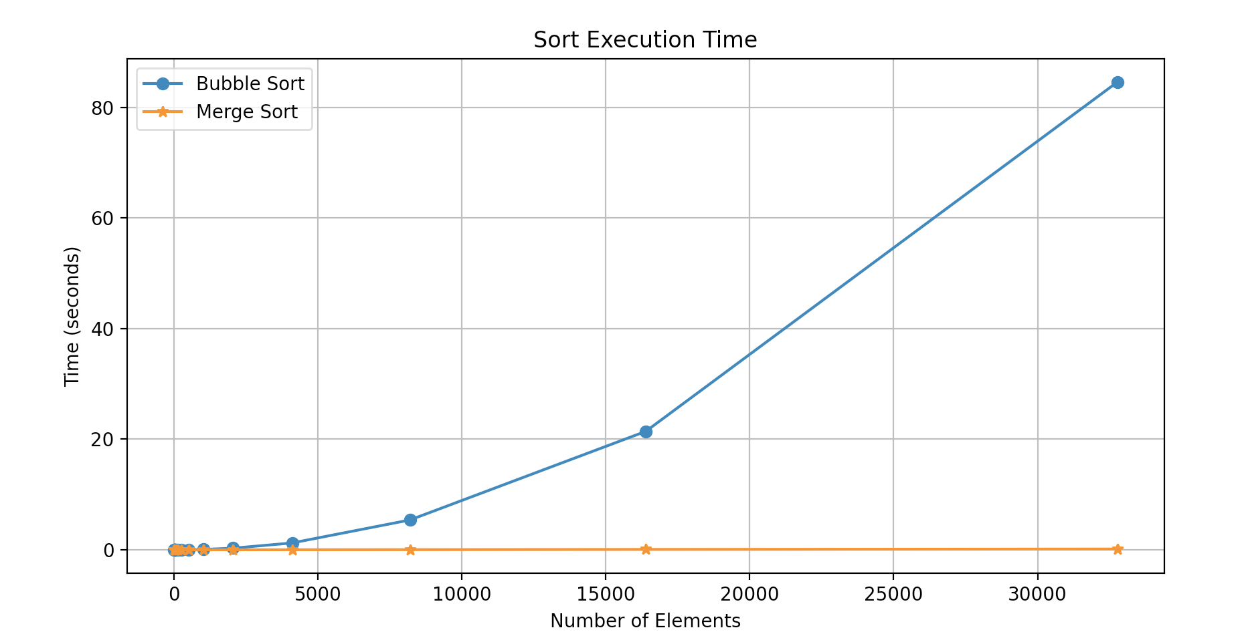
Runtime
What is the relationship between the size of input and runtime?
Runtime will vary based on input values and computer speed.
We often use theoretical analysis of the runtime instead of actual runtimes.
Notes:
import random
import time
import matplotlib.pyplot as plt
# Function to implement bubble sort
def bubble_sort(x):
n = len(x)
for i in range(n):
for j in range(0, n-i-1):
if x[j] > x[j+1]:
x[j], x[j+1] = x[j+1], x[j]
# Initialize lists to store the number of elements and corresponding execution times
num_elements_list = list(range(0, 1001, 50)) # Test sizes from 0 to 1000 in steps of 50
execution_times = []
# Measure execution time for different array sizes
for num_elements in num_elements_list:
# Assign random values to the array
array = [random.randint(0, 1000) for _ in range(num_elements)]
# Time the algorithm
start_time = time.time()
bubble_sort(array)
end_time = time.time()
# Calculate and store the time taken
execution_times.append(end_time - start_time)
# Plot the results
plt.figure(figsize=(10, 5))
plt.plot(num_elements_list, execution_times, marker='o')
plt.title('Bubble Sort Execution Time')
plt.xlabel('Number of Elements')
plt.ylabel('Time (seconds)')
plt.grid(True)
plt.show()

Slide 10

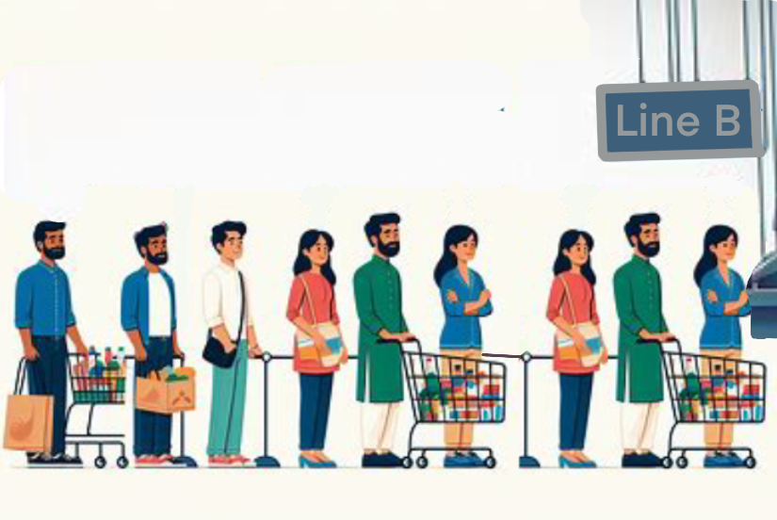

Which LINE WOULD YOU CHOSE?
Worst Case: 20-minute wait | Average Case: 15-minute wait | Quickest Case: 5-minute wait
Which line would you choose?
Notes:
art created by AI bing.com
We definitely don’t want C because could have worst case of 1 week.
B can’t be as bad because if 1 person was too long, it would effect average
Moral of story is we care most about Worst Case (big-O)

Slide 11
Big-O: Context and Motivation
Just as Boeing doesn’t build an airplane without first analyzing its design to predict its performance, software engineers need to be able to analyze proposed data structures and algorithms in the abstract, before spending the time to code and debug them and only afterwards trying to measure their performance
CS315 is titled Data Structures and the Analysis of Algorithms because data structures and algorithms are strongly linked ‒ an algorithm can’t be described, much less analyzed, without reference to the data structure(s) it accesses.

Slide 12
Time Complexity
How many lines of code are run if n=0? n=1? n=3?
int x=1;
while (x <= n){
printf("%d ", x); //print all odd numbers 1 to n
x+= 2;
}
Notes:
3 * ceil(n/2)+2
ex. if n =0, 2 steps
n=1, 5 steps 3*ceil(1/2) +2 = 3(1) + 2
n=2, 5 steps 3*ceil(2/2) + 2
n=3, 8 steps 3* ceil(3/2) + 2

Slide 13




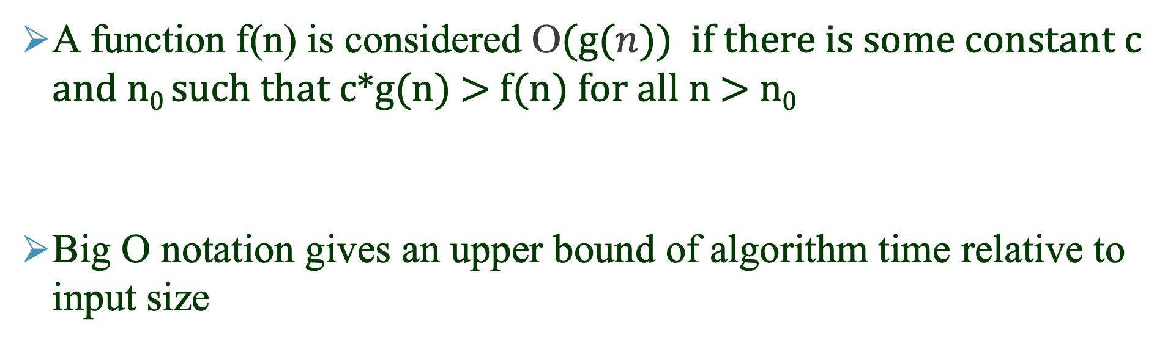
O-notation ‒ the Math
A function f(n) is considered O(g($n$)) if there is some constant c and n₀ such that c*g(n) > f(n) for all n > n₀
Big O notation gives an upper bound of algorithm time relative to input size
1.2 ·$g$($n$)
$g$($n$)
$$f(n)$$
N
$\left.n\right.$-axis
Notes:
An upper bound is not unique, there will be multiple functions that can bound

Slide 14
Rate of Growth
If you are going shopping for: the latest iPhone and an orange
You will probably just say “I’m going to buy an iPhone”.
The price of the iPhone plays the biggest role in your overall bill.
With time complexity, if the complexity is 3n + 2
we can abbreviate to just O(3n) and just O(n)

Slide 15
Constant Time
Looking up a value in an array only takes 1 line of code:
x[i]
We say this is constant time or : O(1)
Performing a math equations not related to size of input:
a=1+2+3*5; //this is constant time O(1)

Slide 16
LINEAR Time
//We say this is O(n)
for (i=0; i< n; i++){
//your O(1) code here
}

Slide 17
QUADRATIC Time
//We say this is O(n²)
for (i=0; i< n; i++){
for (j=0; j< n; j++){
//your O(1) code here
}
}

Slide 18
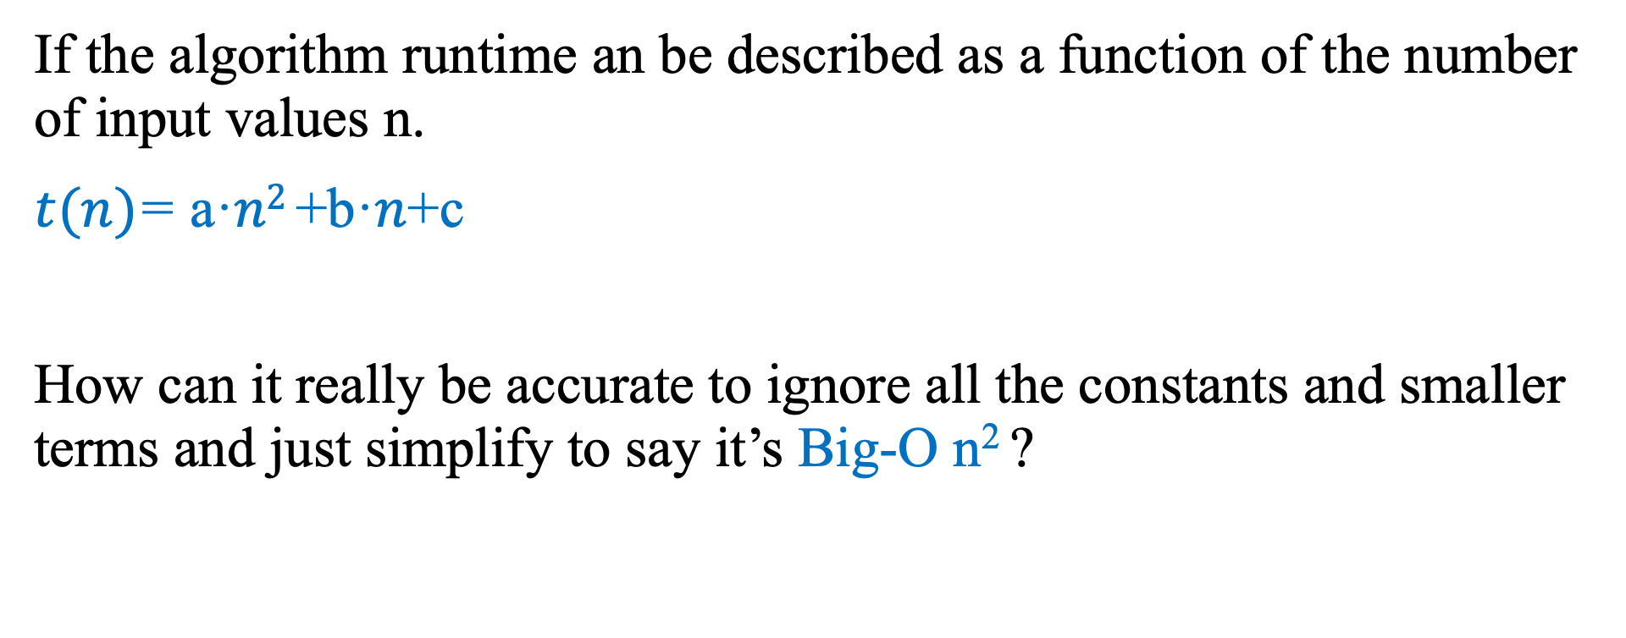
Rate of Growth
If the algorithm runtime an be described as a function of the number of input values n.
$t(n)$= a·$n2$+b·$n$+c
How can it really be accurate to ignore all the constants and smaller terms and just simplify to say it’s Big-O n² ?

Slide 19
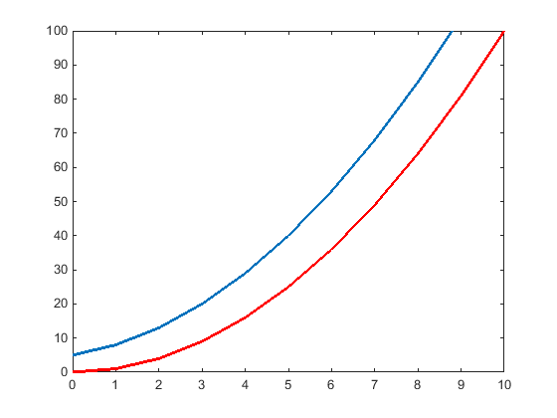
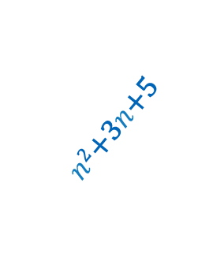
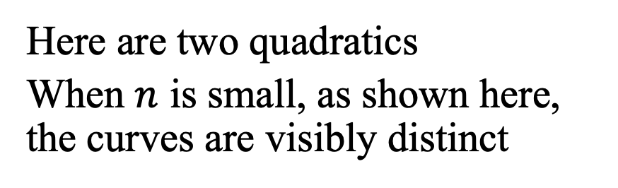

Ignore Constants and Smaller Terms
Here are two quadratics
When $n$ is small, as shown here, the curves are visibly distinct
$n$²+3$n$+5
$n$²

Slide 20
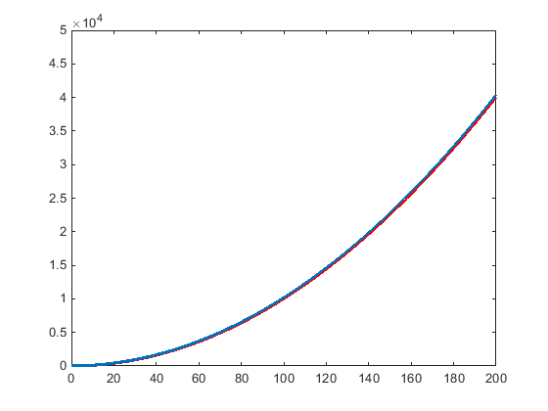

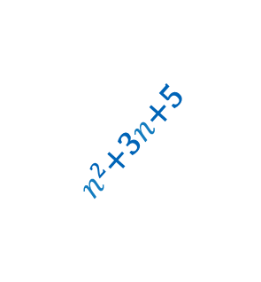
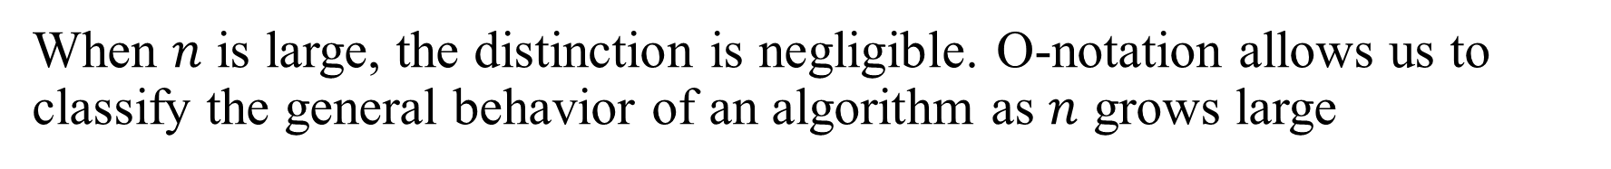
Ignore Constants and Smaller Terms
When $n$ is large, the distinction is negligible. O-notation allows us to classify the general behavior of an algorithm as $n$ grows large
$n$²+3$n$+5
$n$²+3$n$+5
$n$²
$n$²

Slide 21
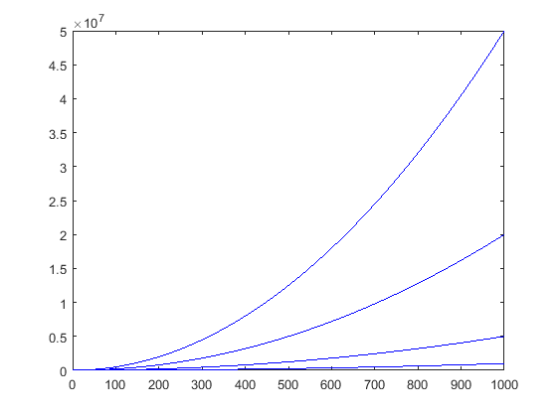

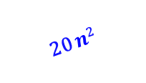

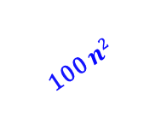
Ignore Constants and Smaller Terms
Here are 4 different quadratic functions with 4 different coefficients.
For smaller values of n less than 1,000 there is a noticeable difference in the values.
100 $n$²
20 $n$²
5$n$²
$n$²

Slide 22
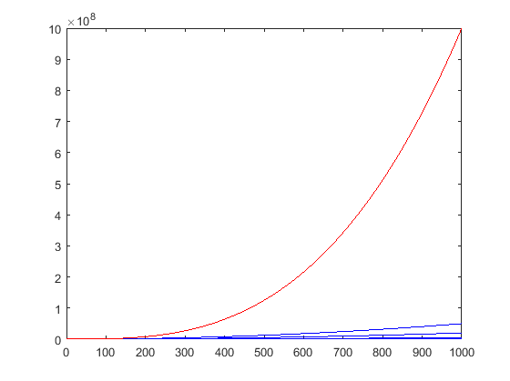
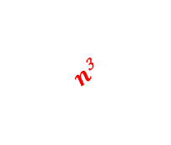

Ignore Constants and Smaller Terms
When compared with a cubic growth rate, even the quadratic with the largest coefficient eventually lags far behind.
100 $n$²
$n$³
20 $n$²
5$n$²
100$n$²
$n$²

Slide 23
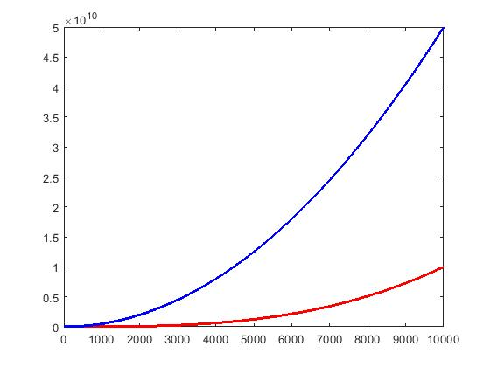
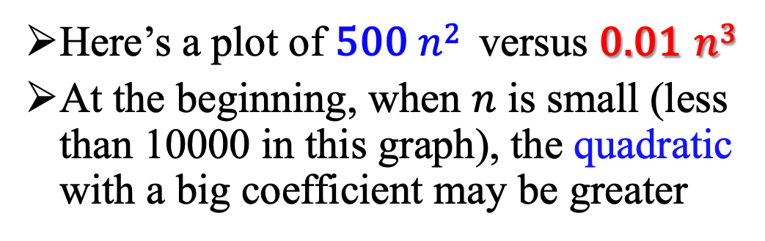
Larger Terms
Here’s a plot of 500 $n$² versus 0.01 $n$³
At the beginning, when $n$ is small (less than 10000 in this graph), the quadratic with a big coefficient may be greater

Slide 24
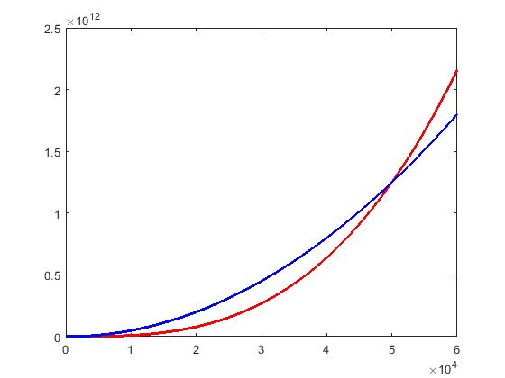



Larger Terms Dominate
Any Cubic Eventually Dominates Any Quadratic, Regardless of the Coefficients.
0.01 $n$³
… by the time $n$ reaches 50,000, the cubic has caught up …
500 $n$²

Slide 25
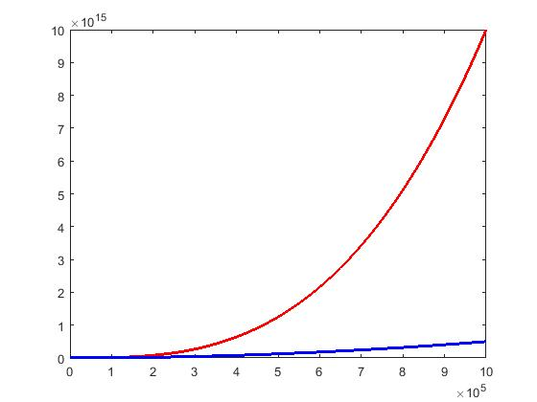

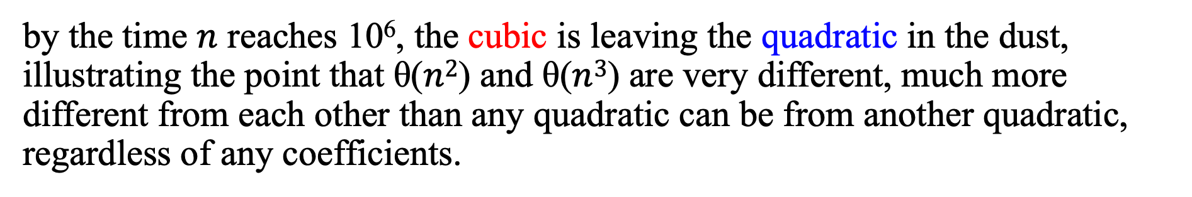

Larger Terms Dominate
by the time $n$ reaches 10⁶, the cubic is leaving the quadratic in the dust, illustrating the point that θ($n$²) and θ($n$³) are very different, much more different from each other than any quadratic can be from another quadratic, regardless of any coefficients.
0.01 $n$³
500 $n$²

Slide 26
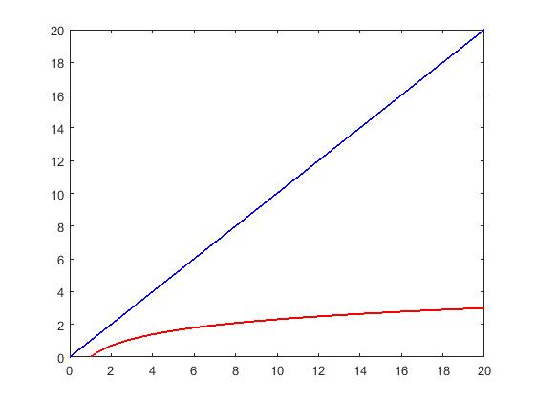
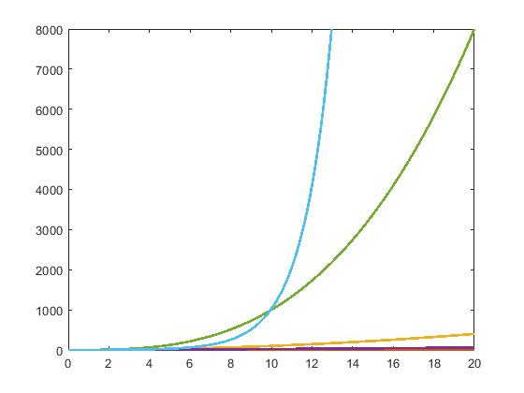


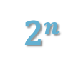
And Exponential Growth Is Faster Still
2$n$
$n$³
$n$²

Slide 27
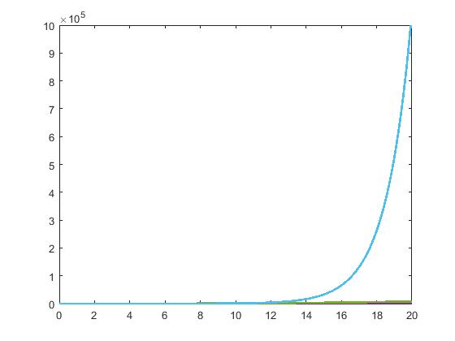
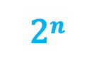
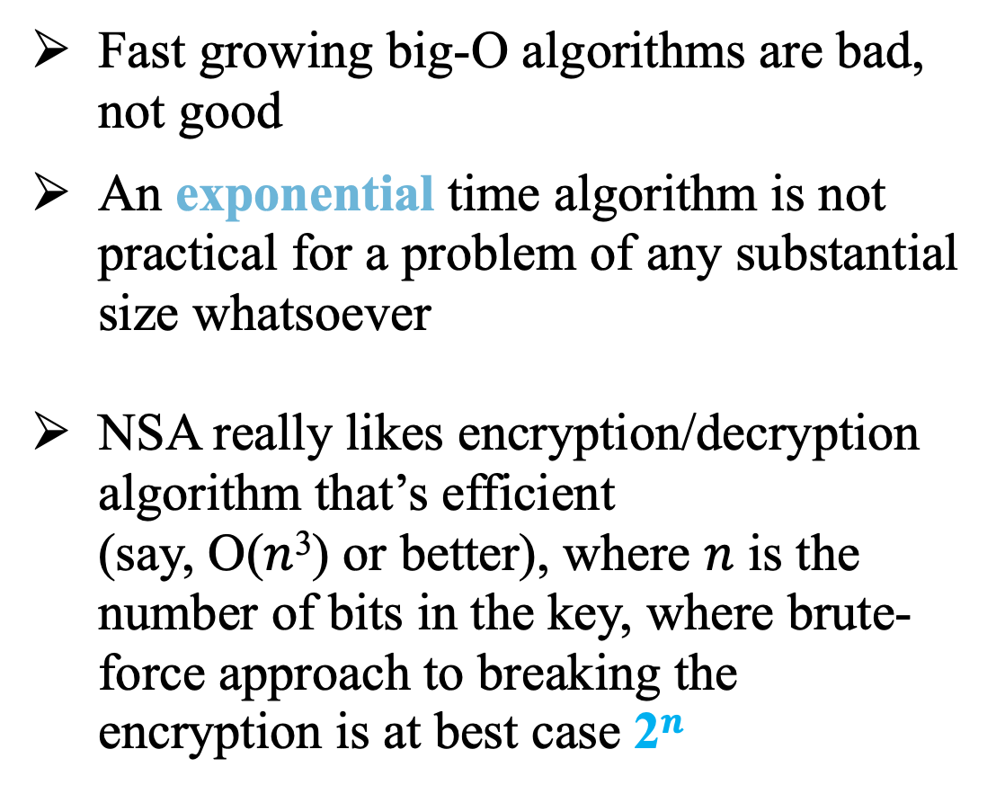
Note: Exponential Growth is Really Faster
Fast growing big-O algorithms are bad, not good
An exponential time algorithm is not practical for a problem of any substantial size whatsoever
NSA really likes encryption/decryption algorithm that’s efficient
(say, O($n$³) or better), where $n$ is the number of bits in the key, where brute-force approach to breaking the encryption is at best case 2$n$
2$n$

Slide 28
Time Complexity
If n=10, What will print when we run this?
(for a super challenge, what is the time complexity)
int x=1;
while (x <= n){
printf("%d ", x);
x*= 2;
}
Notes:
//1 2 4 8 16 32 64
//we are printing 2^x for all numbers where x >=1 until <= n
time complexity:
floor(log2(n) + 1) * 3 + 2
n=1, log2(1)=0 floor (1) *3 + 2 = 5
n=2, log2(2)=1 floor(2) *3+2 = 8
n=3, log2(3)=(number>1 and <2) (1+1)*3+2 = 8
n=4, log2(4)= 2 floor(2+1)*3+2 = 11
n=5/6/7, (number>2 and<3) (2+1)*3+2=11
n=8 4*3+2=14
every time you go through loop add 3 lines
n=20 n=17
#include <stdio.h>
int main(){
int x=1, n=100;
while (x <= n){
printf("%d ", x);
x*= 2;
}
return 0;
}
//1 2 4 8 16 32 64
//we are printing 2^x for all numbers where x >=1 until <= n

Slide 29
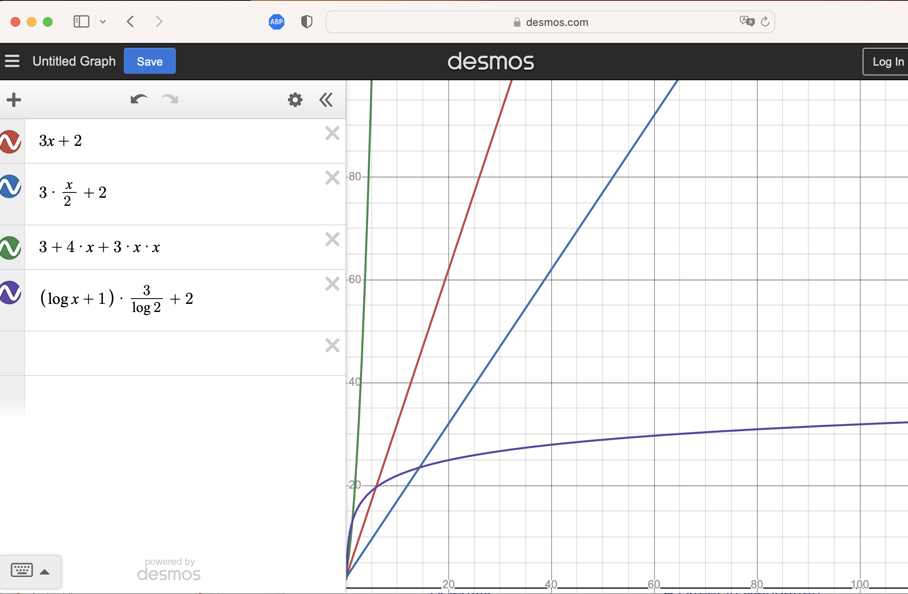
Time Complexity
O(n²) is SLOW
O(n) is GOOD
Notice that our first 2 examples were similar.
1) printing n values
2) printing n/2 values
3) printing n² values
4) printing log₂(n) values
O(n/2) is GOOD, and same as O(n)
log₂(n) is FAST
Notes:
//1 2 4 8 16 32 64
//we are printing 2^x for all numbers where x >=1 until <= n
time complexity:
floor(log2(n) + 1) * 3 + 2
n=1, log2(1)=0 floor (1) *3 + 2 = 5
n=2, log2(2)=1 floor(2) *3+2 = 8
n=3, log2(3)=(number>1 and <2) (1+1)*3+2 = 8
n=4, log2(4)= 2 floor(2+1)*3+2 = 11
n=5/6/7, (number>2 and<3) (2+1)*3+2=11
n=8 4*3+2=14
every time you go through loop add 3 lines
n=20 n=17
#include <stdio.h>
int main(){
int x=1, n=100;
while (x <= n){
printf("%d ", x);
x*= 2;
}
return 0;
}
//1 2 4 8 16 32 64
//we are printing 2^x for all numbers where x >=1 until <= n

Slide 30
Which LINE WOULD YOU CHOSE?
X
X
Worst Case: 20-minute wait | Average Case: 15-minute wait | Quickest Case: 5-minute wait
Yes, you could analyze an algorithm and talk about worst case, average case, and best case. But usually, people are most interested in the worst case. This is what Big O describes.
Notes:
art created by AI bing.com

Slide 31

Questions?

Slide 32
In Class Exercise
See Canvas for the starting code. MAXROWs and MAXCOLs is set to 15. You can think about this as the n-value. As the size of the grid increases, the runtime will increase.
Determine the Big-O time complexity for each function and defend your answer.
Note: There will be a Quiz next week. Study PPT and Nearpod questions to prepare.

