Slide 1

Hash Tables

Slide 2
Feedback in class exercise Lect7
#include <stdio.h>
int S(int n){
if (n <=1)
return 2;
else
return S(n-1) + 2*n;
}
int main() {
int num;
printf("Enter n = ");
scanf("%d", &num);
printf("S(%d)=%d \n", num, S(num));
return 0;
}

Slide 3
Feedback in class exercise Lect7 Challenge
#include <iostream>
using namespace std;
void printBits(string prev, int num) {
if (num <=1){
cout<<prev<<"0"<<endl;
cout<<prev<<"1"<<endl;
}
else {
printBits(prev+"0", num-1);
printBits(prev+"1", num-1);
}
}
int main() {
int num;
cout<<"Enter the number of bits:";
cin>>num;
string prev ="";
printBits(prev, num);
return 0;
}

Slide 4
Verbal defense hw1
If your last name begins with A-C stick around at the end of class after today’s quiz for your verbal defense of HW1.
More verbal defense lined up for Friday.

Slide 5
Most common issues with hw1
Hard coding the filename instead of using command line arguments:
int main( int argc, char** argv) {
Person buyer[100];
Person seller[100];
if (argc < 2) {
printf("Run as: a.out fileName.txt ");
return -1;
}
FILE* f = fopen( argv[1], "r");

Slide 6
Most common issues with hw1
Creating 2 structures when 1 would work.
typedef struct person {
  char name[100];
  char sell_buy[100];
  float price;
} Person;
typedef struct buyer{
  char name[100];
  float price;
} Buyer;
typedef struct seller{
  char name[100];
  float price;
} Seller;
Person buyer[100];
Person seller[100];

Slide 7
Most common issues with hw1
Sorting the buyers and sellers the same way. Buyers should have been high price to low price. Sellers low to high. Secondary sort by name.
Reading the entire file AND then doing the sorting and matching. The ChatGPT solutions did it this way, resulting in a different answers for file2 and file4.

Slide 8
Review
What is the Big-O complexity for
Finding an element in a linked list?
Removing an element from a linked list?
Adding an element to a linked list?
start
-4
17
2
78
52
Notes:
finding O(n)
for removing: finding what you need to remove is O(n) and the removal process is O(1)
adding O(1) if you need to add somewhere specific it might take longer

Slide 9
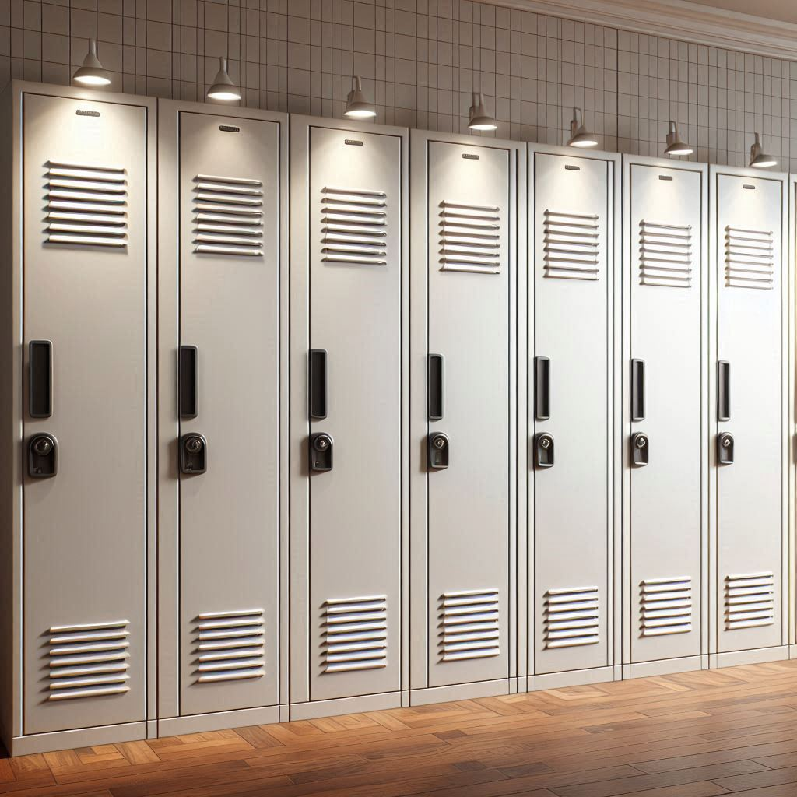

Imagine one of these lockers has the solution to the final exam.
There are no labels on the lockers or clues, and you need to search them all. Worst case is the last locker you search has what you want. If there are 7 lockers, it takes you 7 tries.
If there are 26 lockers, worst case is 26 tries. O(n) problem.
Notes:
Generated with AI ∙ September 16, 2024 at 1:02 PM
Bing.com/images

Slide 10
What if I told you there was a way we could turn this into a O(1) solution.

Slide 11
Guess which locker has the exam solutions.
Notebooks
Pencils
Paper
Exams Solutions
Erasers
Post its
Pens
Notes:
Generated with AI ∙ September 16, 2024 at 1:02 PM
Bing.com/images

Slide 12
Hash Tables (hash maps)
Hash tables are dynamic data structures that support the operations search/find, insertion, and deletion.
A hash table can be very fast, potentially O(1), for all three operations (search/insert/delete)
In other languages you might call hash tables/maps, dictionaries or associative arrays.

Slide 13
Example
We design a hash table
  storing entries as (Phone#, Name)
  Phone# is a ten-digit positive integer
Our hash table uses
  array of size N = 10,000 and
  hash function
  h(x) = last four digits of x
0
∅
1
025-612-0001
2
981-101-0002
3
∅
4
451-229-0004
…
9997
∅
9998
200-751-9998
9999
∅

Slide 14
Example
If you want to look people up by last name, you could have a hash table like this.
It’s possible to hash a string and come up with an integer you can use as an index into the hash table ex. ‘A’ in ascii is 65, so if we take the first letter of last name – 65, we get a number that can be used as the position in the hash table.
Adams
ht[0]
ht[1]
ht[2]
ht[3]
ht[4]
ht[5]
ht[6]
ht[7]
ht[8]
ht[9]
ht[10]
ht[11]
ht[12]
Davis
Jones

Slide 15
Collisions: The Reason We Usually Can’t
Get Perfect O(1) Performance
If we need to insert another name like: Apple, there will be a collision.
Ideally you want a hash function that minimizes (and in some cases even eliminates!) collisions
You need a collision resolution strategy, for use when collisions can’t be completely prevented
ht[0]
ht[1]
ht[2]
ht[3]
ht[4]
ht[5]
ht[6]
ht[7]
ht[8]
ht[9]
ht[10]
ht[11]
ht[12]
Adams
Apple
Davis
Jones

Slide 16
Chaining
With chaining, each element in the hash table is the start of a list of all the elements that have collided at that entry in the hash table
Advantage: Very simple, the logic for search, insertion, and removal is obvious, there are no hidden complications
Disadvantage: Wasteful of space ‒ why add a chain when there is often, as in this example, lots of open space in the underlying array itself; using that open space is the idea behind open addressing (next up)
ht[0]
ht[1]
ht[2]
ht[3]
ht[4]
ht[5]
ht[6]
ht[7]
ht[8]
ht[9]
ht[10]
ht[11]
ht[12]
Adams
Davis
Doe
Dean
Jones

Slide 17
Open Addressing to Resolve Collisions
ht[0]
ht[1]
ht[2]
ht[3]
ht[4]
ht[5]
ht[6]
ht[7]
ht[8]
ht[9]
ht[10]
ht[11]
ht[12]
Adams
Open Addressing - when there is a collision, search for the next available spot in the hash table.
1) Use the hash function to find the ideal position. If that is free, use it.
2) If the ideal position is taken the new position will be the ideal position + some step (determined by which collision handling option you use)
Davis
Jones
Notes:
look for an open slot
Open Addressing: In this method, if a collision occurs, the algorithm searches for
another open slot in the table using a probing sequence (e.g., linear probing, quadratic probing, double hashing).

Slide 18
Open Addressing to Resolve Collisions
Linear probing ‒ the distance between successive probes is fixed at 1
Quadratic probing ‒ the distance between successive probes increases quadratically
Double hashing ‒ the distance between successive probes is fixed for each key but differs from one key to another, the fixed delta being computed by a second hash function
ht[0]
ht[1]
ht[2]
ht[3]
ht[4]
ht[5]
ht[6]
ht[7]
ht[8]
ht[9]
ht[10]
ht[11]
ht[12]
Adams
Davis
Jones
Notes:
look for an open slot
Open Addressing: In this method, if a collision occurs, the algorithm searches for
another open slot in the table using a probing sequence (e.g., linear probing, quadratic probing, double hashing).

Slide 19
Open Addressing - LINEAR
Look within the hash table itself for an open slot to store an item that cannot be stored at its "proper" location because of a collision
But if our strategy is just to put the item in the next open slot, what happens if we later get a B name: Baker. Now the ht[1] is already taken up, so we lose our O(1) time and end up having to search item by item in the table.
ht[0]
ht[1]
ht[2]
ht[3]
ht[4]
ht[5]
ht[6]
ht[7]
ht[8]
ht[9]
ht[10]
ht[11]
ht[12]
Adams
Apple
Ant
Davis
Arrow
Delta
Jones

Slide 20
Probing the Hash table to find AN open spot
The probes into our hash table, looking for an open spot.
3
0 1 2 3 4 5 6 7 8 9
//Probe Function Pseudocode
int linearProbingPosition(int tries, key){ //ex. findIndex(0, 3);
//Use a hash function to figure out where to put the value
//ex. if your hash function is %10 3%10=3, you should put 3 at index 3
// 13%10=3, you should put 13 at index 3
//add on tries
//if this puts you outside bounds of array, adjust %10 (ARRAY_SIZE)
}

Slide 21
Probing the Hash table to find AN open spot
The probes into our hash table, looking for an open spot
Our probe generator, will find the next spot to check
3
0 1 2 3 4 5 6 7 8 9
P(i, key)= H(key)+ f(i)
P(0, 3) we are using the prob generator to try to add 3 to our array.
Let’s say our Hashing Function is %10, so 3%10 = 3
For linear probing f(i)=i.
H(3) + f(0)
3 + 0
try to put number is position 3
This is the first time we have tried to put 3 in the array, so i = 0 (number of times we have tried to add an item)

Slide 22
Probing the Hash table to find AN open spot
Try to add 13
3
13
0 1 2 3 4 5 6 7 8 9
P(i, key)= H(key)+ f(i)
P(0, 13) = H(13) + f(0)
This is the first time we have tried to put 13 in the array, so i = 0. P(0,13) = 3 But there is already something there so try again
H(13) + f(1)
3 + 1
try to put number is position 4

Slide 23
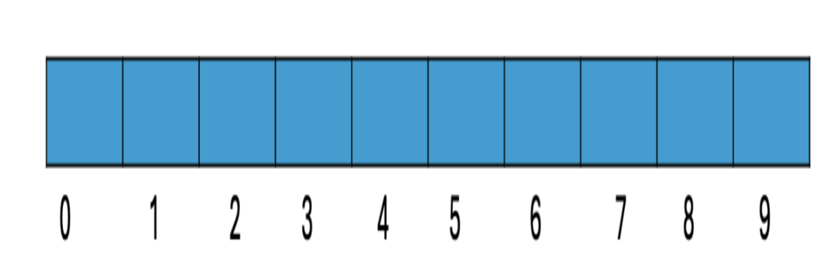
Linear probing for collisions - SOLUTION
Table size 10
The hashing algorithm is h(key) = key%10
Using linear probing for hash collisions, place the following numbers: 7, 12, 102, 3, 44, 77, 92

Slide 24
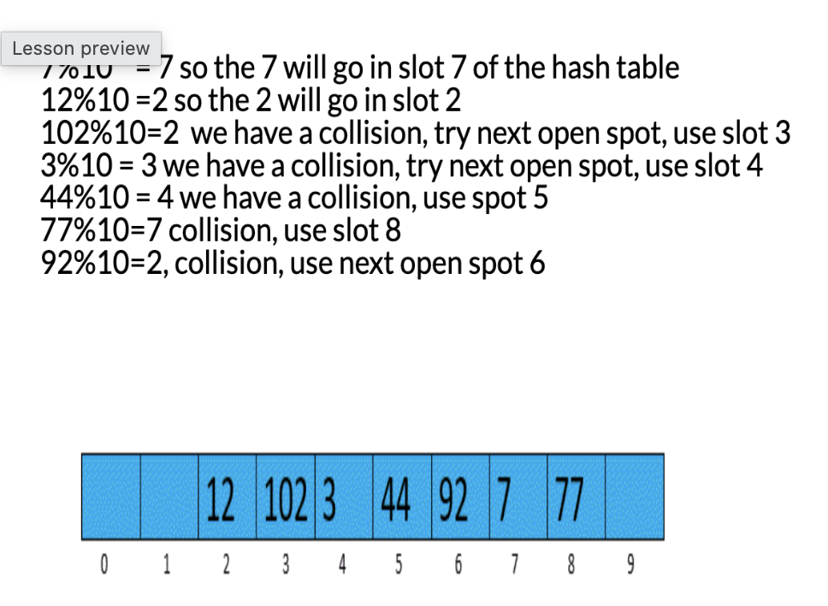

Slide 25
Probing the Hash table to find AN open spot
Try to add 43
3
13
0 1 2 3 4 5 6 7 8 9
P(i, key)= H(key)+ f(i)
P(0, 43) = H(43) + f(0)
This is the first time we have tried to put 43 in the array, so i = 0. P(0,43) = 3 But there is already something there so try again.
P(1, 43) but there is something in 4 already.
P(2, 43) will give you H(43) + f(2) = 3+2 = 5

Slide 26
Clustering
The disadvantage to using linear open addressing is primary clustering
Primary clusters tend to expand. The larger they are, the more likely they are to get even larger, since an attempt to insert a new entry anywhere in the cluster will wind up using the open slot at its end, thus making the cluster even larger
ht[0]
ht[1]
ht[2]
ht[3]
ht[4]
ht[5]
ht[6]
ht[7]
ht[8]
ht[9]
ht[10]
ht[11]
ht[12]
Adams
Apple
Ant
Davis
Arrow
Delta
Jones

Slide 27
Quadratic PROBING
P(i, key)= H(key)+ f(i)
For Linear Probing f(i) = i
For Quadratic probing f(i) = i²
If you need to place 71 and the Hashing function H(key)=key%10
Try to place in pos 1
Try to place in pos 2 H(key) + i² 1+1² = 2
1
2
71
0 1 2 3 4 5 6 7 8 9
Try to place pos 3 H(key) + 2² = 1 + 4

Slide 28
Quadratic probing for collisions
Table size 10
The hashing algorithm is h(key) = key%10
Using linear probing for hash collisions, place the following numbers: 1, 11, 21, 8, 51, 9, 99

Slide 29
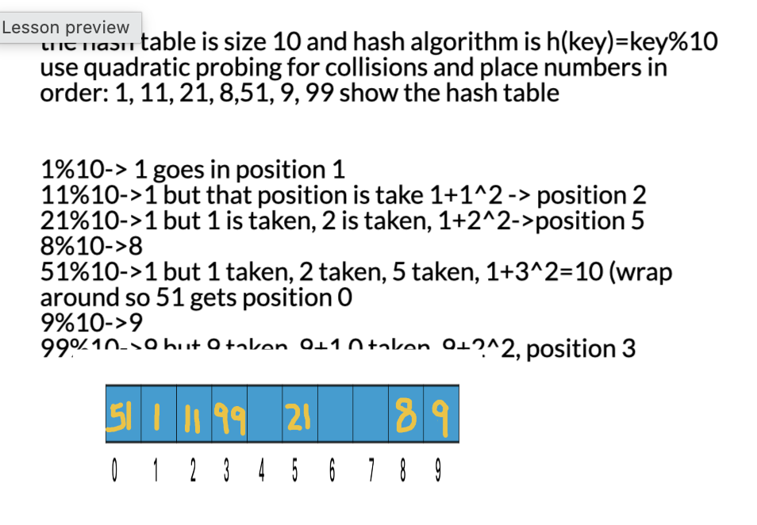

Slide 30
Lazy Deletion and Occupied/Empty/Deleted Slot
Suppose we want to delete Earl, if we find him, we delete him, no problem
But now look what happens when we try to find Calle, Since H("Calle") is 2, we start probing at ht[2] and when we hit the empty slot at ht[4] we quit and declare the search unsuccessful, Calle is not in the hash table ‒ oops
The solution is lazy deletion ‒ to delete an entry we just set a status marker of some sort to indicate that the data that used to be there has been deleted
ht[0]
ht[1]
ht[2]
ht[3]
ht[4]
ht[5]
ht[6]
ht[7]
ht[8]
ht[9]
ht[10]
ht[11]
ht[12]
Cook
Davis
Frank
Earl
Calle

Slide 31
Lazy Deletion and Occupied/Empty/Deleted Slot Status
So open addressing (all three types, not just linear open) needs to distinguish among 3 conditions:
  Currently occupied
  Previously deleted
  Never occupied
The search function can skip over previously deleted slots and keep probing to terminate successfully if the key is found in a currently occupied slot, unsuccessfully if the probe sequence hits a never occupied slot
But insertion can use an empty or a previously deleted slot
ht[0]
ht[1]
ht[2]
ht[3]
ht[4]
ht[5]
ht[6]
ht[7]
ht[8]
ht[9]
ht[10]
ht[11]
ht[12]
Cook
Davis
Frank
Earl
Calle

Slide 32
size of hash table
How does the size of the hash table influence the number of collisions?
Let’s try running an example and changing the size of the hash table.
Notes:
#include <stdio.h>
#define TABLE_SIZE 10
// Hash function for linear probing
int P(int tries, int key) {
int f = tries; // for linear probing f(i) = i
int h = key % TABLE_SIZE;
return (f + h) % TABLE_SIZE;
}
// Function to add a key to the hash table
void add(int array[], int key) {
int tries = 0;
int position = P(tries, key);
// Linear probing to find an empty slot
while (array[position] != 0) {
printf("COLLISION\n");
tries++;
position = P(tries, key);
}
array[position] = key;
}
// Main function to test the add function
int main() {
// Initialize hash table with zeros
int a[TABLE_SIZE] = {0};
// Add keys and print the table
add(a, 3);
add(a, 13);
add(a, 43);
add(a, 2);
add(a, 4);
for (int i = 0; i < TABLE_SIZE; i++) {
printf("%d ", a[i]);
}
printf("\n");
return 0;
}

Slide 33
Perfect Hashing
Table sizes should be prime numbers (no factors) if you want to reduce collisions.
A constant trade-off with hash tables is that increasing the array size to improve performance by reducing collisions wastes space; decreasing the array size to conserve space increases collisions and thus decreases performance
But sometimes (not always) we can develop a perfect hash function which never has collisions, thus guaranteeing Ɵ(1) performance without wasting space with a low load factor
Notes:
double hashing is where you don’t want factors

Slide 34

Questions?

Slide 35
In Class Exercise

