Slide 1

Data structures and Algorithms
Data Structures, ADT, Algorithms
Notes:
ADT = Abstract Data Type (ex. queue, stack)

Slide 2

Today’s Lecture
Data Types, Data Structures
Algorithms
Sort Algorithm Example
Introduction
Syllabus

Slide 3
Data Types
Primitive Data Types (built-in, defined by the language)
For example, C has: char, short, int, long int, long long int, float, double, long double
User Defined Data Types most languages allow user defined data types. Ex – C allows struct
C++ has struct and class
// Define a struct for a Person
struct Person {
char name[50];
int age;
float height;
};

Slide 4
Data Structures
Linear Data Structures - elements can be accessed in order (not necessarily stored in order), Ex. arrays, stacks, and queues
0 1 2 3 4 5
Non-Linear Data Structures – elements are stored/accessed in a non-linear order Ex. trees and graphs
6 | 2 | 10 | 7 | 1 | 5

Slide 5
Abstract Data Types (ADT)
In this class we will often talk about data structures and the operations that can be performed using them without getting into implementation details. Common ADTs: linked lists, stacks, queues, binary trees, hash maps/dictionaries.
Lectures will often contain pseudocode. A data structures class can be taught in a variety of languages. Because CS125 is a pre-requisite for this class, many of our examples will be in C.

Slide 6
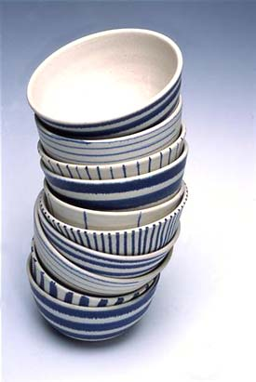
Stacks
A stack is a data structure where the insertions and deletions occur at the same end of the stack, the top.
When you unload a dishwasher you make a stack of dishes. The last bowl you put in a stack will be the first one that you take off the stack when you need a clean bowl.
The behavior of a stack is LIFO
LIFO - Last-In, First-Out

Slide 7
Stacks
When you put an item on the stack, it’s called a push.
When you take an item off the stack, it’s called a pop.
You will need to have a way to determine if the stack is empty, find out the size of the stack etc.
Examples uses: Un-Do Button, Calling Functions (return address put on stack)

Slide 8

Queues
A queue is a list where the insertions and deletions occur at opposite ends. Just like when people stand in line at a store. Customers are served in the order they arrived.
A queue exhibits FIFO behavior- First In, First Out.

Slide 9

Queues
Queues operation allow you to:
construct a queue
enqueue items on the queue
dequeue items off the queue
check to see if the queue is empty
find out the size of the queue etc.

Slide 10

Algorithms
Input | Algorithm | Output
An algorithm is a series of steps you take to get a result.
Notes:
art created by AI bing.com

Slide 11
Algorithms
Pseudocode for an Algorithm
Well-defined series of steps
Can have 0 or more inputs
Produces output/results
The time and space complexity should be considered
Algorithm MaxValue(L)
Input: List L of n elements
Output: Maximum value in L
max ← L[0]
for i ← 1 to n-1 do
if L[i] > max then
max ← L[i]
return max

Slide 12
Why Study Algorithms?
There is often more than one way to solve a problem. We want to be aware of the run-time and memory requirements of our selected algorithms.
Studying Data Structures equips you with the tools and knowledge needed to tackle complex programming challenges and develop efficient, high-performing software solutions.

Slide 13
Sort Algorithm #1 – Insertion Sort
unsorted
6 | 2 | 10 | 7 | 1 | 5
Insertion Sort
Imagine you have 2 arrays of numbers: unsorted and sorted(initially empty).
Remove an element from the unsorted array and put it in the sorted array.
[ ] (empty)
sorted
unsorted
2 | 10 | 7 | 1 | 5
sorted
6
Notes:
def insertion_sort(unsorted):
# Initialize an empty list for sorted elements
sorted = []
# Iterate over each element in the unsorted list
for element in unsorted:
# Insert the element into the correct position in the sorted list
inserted = False
for i in range(len(sorted)):
if element < sorted[i]:
sorted.insert(i, element)
inserted = True
break
# If the element is greater than all elements in the sorted list, append it
if not inserted:
sorted.append(element)
return sorted
# Example usage
unsorted = [6, 2, 10, 7, 1, 5]
print("Unsorted list:", unsorted)
sorted_list = insertion_sort(unsorted)
print("Sorted list:", sorted_list)

Slide 14
Sort Algorithm #1 – Insertion Sort
unsorted
2 | 10 | 7 | 1 | 5
sorted
6
Remove another item from the unsorted array and put in the the correct position in the sorted array.
10 | 7 | 1 | 5
unsorted
sorted
2 | 6

Slide 15
Sort Algorithm #1 – Insertion Sort
unsorted
10 | 7 | 1 | 5
sorted
2 | 6
Continue until the unsorted array is empty.
unsorted
7 | 1 | 5
sorted
2 | 6 | 10

Slide 16
Sort Algorithm #1 – Insertion Sort
unsorted
7 | 1 | 5
sorted
2 | 6 | 10
unsorted
1 | 5
sorted
2 | 6 | 7 | 10

Slide 17
Sort Algorithm #1 – Insertion Sort
1 | 5
unsorted
sorted
2 | 6 | 7 | 10
unsorted
5
1 | 2 | 6 | 7 | 10
sorted

Slide 18
Sort Algorithm #1 – Insertion Sort
unsorted
5
sorted
1 | 2 | 6 | 7 | 10
unsorted
[ ] (empty)
1 | 2 | 5 | 6 | 7 | 10
sorted
Notes:
def insertion_sort(unsorted):
# Initialize an empty list for sorted elements
sorted = []
# Iterate over each element in the unsorted list
for element in unsorted:
# Insert the element into the correct position in the sorted list
inserted = False
for i in range(len(sorted)):
if element < sorted[i]:
sorted.insert(i, element)
inserted = True
break
# If the element is greater than all elements in the sorted list, append it
if not inserted:
sorted.append(element)
return sorted
# Example usage
unsorted = [6, 2, 10, 7, 1, 5]
print("Unsorted list:", sorted_list)
sorted_list = insertion_sort(unsorted)
print("Sorted list:", sorted_list)

Slide 19
#include <stdio.h>
#define SIZE 6
void insertion_sort(int unsorted[], int sorted[], int size) {
int sorted_size = 0;
for (int u = 0; u < size; u++) {
int element = unsorted[u];
int inserted = 0; //0 means not yet inserted
// Try to insert into the correct position
for (int i = 0; i < sorted_size; i++) {
if (element < sorted[i]) {
// Shift elements to the right
for (int j = sorted_size; j > i; j--) {
sorted[j] = sorted[j - 1];
}
sorted[i] = element;
inserted = 1; //1 means inserted
sorted_size++;
break;
}
}
// If not inserted, append to end
if (!inserted) {
sorted[sorted_size] = element;
sorted_size++;
}
}
}
https://github.com/heathermarriott/DataStructures/blob/main/insertionSortV1.c
Notes:
#include <stdio.h>
#define SIZE 6
void insertion_sort(int unsorted[], int sorted[], int size) {
int sorted_size = 0;
int u, i, j; //counters
int element; //current element you are positioning
int inserted=0; //0= not yet inserted, 1= inserted
for (u = 0; u < size; u++) {
element = unsorted[u];
inserted = 0; //0 means not yet inserted
// Try to insert into the correct position
for (i = 0; i < sorted_size; i++) {
if (element < sorted[i]) {
// Shift elements to the right
for (j = sorted_size; j > i; j--) {
sorted[j] = sorted[j - 1];
}
sorted[i] = element;
inserted = 1; //1 means inserted
sorted_size++;
break;
}
}
// If not inserted, append to end
if (!inserted) {
sorted[sorted_size] = element;
sorted_size++;
}
}
}
int main() {
int unsorted[SIZE] = {6, 2, 10, 7, 1, 5};
int sorted[SIZE]; // same size as unsorted
int i; //loop counter
printf("Unsorted list: ");
for (i = 0; i < SIZE; i++) {
printf("%d ", unsorted[i]);
}
printf("\n");
insertion_sort(unsorted, sorted, SIZE);
printf("Sorted list: ");
for (i = 0; i < SIZE; i++) {
printf("%d ", sorted[i]);
}
printf("\n");
return 0;
}

Slide 20
Wasted Memory
unsorted
6 | 2 | 10 | 7 | 1 | 5
[ ] (empty)
sorted
In C, unless you are using dynamic memory allocation, you define the size of the array at the beginning of a function.
int unsorted[6] = {6, 2, 10, 7, 1, 5};
int sorted[6];
In my example, having two separate arrays makes is conceptionally very easy to understand, but you are wasting space. The number of used positions in the two arrays combined is always 6.

Slide 21
In Place Insertion Sort
Insertion Sort
You can start with position 0 and say that’s the sorted part of the array and the rest is unsorted.
Index i goes from 1 to end of array. Compare array[i] with the element to the left of it (array[i-1]) and if array[i] is smaller, swap.
While there is still something smaller to the left, keep swapping.
6 | 2 | 10 | 7 | 1 | 5
Notes:
#python
def insertion_sort(list):
# Traverse through 1 to len(arr)
for i in range(1, len(list)):
current = list[i]
j = i - 1
# Move elements of arr[0..i-1], that are greater than key,
# to one position ahead of their current position
while j >= 0 and current < list[j]:
list[j + 1] = list[j]
j -= 1
list[j + 1] = current
x = [12, 11, 13, 5, 6]
print(f"Original array: {x}")
insertion_sort(x)
print(f"Sorted array: {x}")
// C **********************************************************************************************************
#include <stdio.h>
// Function to perform Insertion Sort
void insertionSort(int arr[], int n) {
for (int i = 1; i < n; i++) {
int key = arr[i];
int j = i - 1;
// Move elements of arr[0..i-1] that are greater than key
// to one position ahead of their current position
while (j >= 0 && arr[j] > key) {
arr[j + 1] = arr[j];
j = j - 1;
}
arr[j + 1] = key;
}
}
// Function to print an array
void printArray(int arr[], int size) {
for (int i = 0; i < size; i++) {
printf("%d ", arr[i]);
}
printf("\n");
}
// Main function to test the insertion sort
int main() {
int arr[] = {12, 11, 13, 5, 6};
int n = sizeof(arr) / sizeof(arr[0]);
printf("Original array: \n");
printArray(arr, n);
insertionSort(arr, n);
printf("Sorted array: \n");
printArray(arr, n);
return 0;
}

Slide 22
In Place Insertion Sort
2 | 6 | 10 | 7 | 1 | 5
6 | 2 | 10 | 7 | 1 | 5
purple = sorted
1 | 2 | 6 | 7 | 10 | 5
2 | 6 | 7 | 10 | 1 | 5
1 | 2 | 5 | 6 | 7 | 10
2 | 6 | 10 | 7 | 1 | 5
Pseudocode:
insertion_sort(array):
for i values i to n-1:
j= i - 1
while array[j] > array[i] and j>=0:
swap array[j] and array[i]
j = j - 1
Notes:
def insertion_sort(list):
# Traverse through 1 to len(arr)
for i in range(1, len(list)):
current = list[i]
j = i
# Move elements of arr[0..i-1], that are greater than key,
# to one position ahead of their current position
while j > 0 and current < list[j-1]:
list[j], list[j-1] = list[j-1], list[j]
j -= 1
x = [12, 11, 13, 5, 6]
print(f"Original array: {x}")
insertion_sort(x)
print(f"Sorted array: {x}")
//**********************************************************************************************************
#include <stdio.h>
// Function to perform Insertion Sort
void insertionSort(int arr[], int n) {
int key, j, temp;
for (int i = 1; i < n; i++) {
key = arr[i];
j = i;
// Move elements of arr[0..i-1] that are greater than key
// to one position ahead of their current position
while (j > 0 && arr[j-1] > key) {
temp = arr[j];
arr[j] = arr[j - 1];
arr[j - 1] = temp;
j = j - 1;
}
}
}
// Function to print an array
void printArray(int arr[], int size) {
for (int i = 0; i < size; i++) {
printf("%d ", arr[i]);
}
printf("\n");
}
// Main function to test the insertion sort
int main() {
int arr[] = {12, 11, 13, 5, 6};
int n = sizeof(arr) / sizeof(arr[0]);
printf("Original array: \n");
printArray(arr, n);
insertionSort(arr, n);
printf("Sorted array: \n");
printArray(arr, n);
return 0;
}

Slide 23
#include <stdio.h>
#define SIZE 6
void insertion_sort(int list[], int size) {
int u, j;
int element;
for (u = 1; u < size; u++) {
element = list[u];
j = u;
while (j > 0 && list[j - 1] > element) {
list[j] = list[j - 1];
j--;
}
list[j] = element;
}
}
int main() {
int list[SIZE] = {6, 2, 10, 7, 1, 5};
int i;
printf("Unsorted list: ");
for (i = 0; i < SIZE; i++) {
printf("%d ", list[i]);
}
printf("\n");
insertion_sort(list, SIZE);
printf("Sorted list: ");
for (i = 0; i < SIZE; i++) {
printf("%d ", list[i]);
}
printf("\n");
return 0;
}
https://github.com/heathermarriott/DataStructures/blob/main/insertionSortV2.c
Notes:
#include <stdio.h>
#define SIZE 6
void insertion_sort(int list[], int size) {
int u, j;
int element;
for (u = 1; u < size; u++) {
element = list[u];
j = u;
while (j > 0 && list[j - 1] > element) {
list[j] = list[j - 1];
j--;
}
list[j] = element;
}
}
int main() {
int list[SIZE] = {6, 2, 10, 7, 1, 5};
int i;
printf("Unsorted list: ");
for (i = 0; i < SIZE; i++) {
printf("%d ", list[i]);
}
printf("\n");
insertion_sort(list, SIZE);
printf("Sorted list: ");
for (i = 0; i < SIZE; i++) {
printf("%d ", list[i]);
}
printf("\n");
return 0;
}

Slide 24
Sort Algorithm #2 – Bubble Sort
Bubble Sort
Start with numbers in position 0 and position 1. If item in position 1 is smaller than item in position 0, swap.
Continue with position 1 and 2, 2 and 3, …. n-2 and n-1. By the end of this, the last number will be in the correct position.
Repeat
6 | 2 | 10 | 7 | 1 | 5
2 | 6 | 10 | 7 | 1 | 5
2 | 6 | 7 | 1 | 5 | 10

Slide 25
Sort Algorithm #2 – Bubble Sort
6 | 2 | 10 | 7 | 1 | 5
2 | 6 | 10 | 7 | 1 | 5
2 | 6 | 7 | 10 | 1 | 5
2 | 6 | 7 | 1 | 5 | 10
2 | 6 | 7 | 1 | 10 | 5
purple = sorted
2 | 6 | 1 | 7 | 5 | 10
2 | 6 | 7 | 1 | 5 | 10
2 | 6 | 1 | 5 | 7 | 10
2 | 1 | 5 | 6 | 7 | 10
1 | 2 | 5 | 6 | 7 | 10
Notes:
def bubble_sort(x):
n = len(x)
# Traverse through all elements
for i in range(n):
# Flag to detect any swap
swapped = False
# Last i elements are already sorted
for j in range(1, n - i):
# Swap if the element found is greater than the next element
if x[j - 1] > x[j]:
x[j - 1], x[j] = x[j], x[j - 1]
swapped = True
# If no elements were swapped, break
if not swapped:
break
numbers = [6, 2, 10, 7, 1, 5]
print(f"Original array: {numbers}")
bubble_sort(numbers)
print(f"Sorted array: {numbers}")
//**********************************************************************************************************
#include <stdio.h>
// Function to perform Bubble Sort
void bubbleSort(int arr[], int n) {
int i, j;
int swapped;
for (i = 0; i < n - 1; i++) {
swapped = 0;
// Last i elements are already in place
for (j = 1; j < n - i; j++) {
// Compare and swap if the previous element is greater
if (arr[j - 1] > arr[j]) {
int temp = arr[j];
arr[j] = arr[j - 1];
arr[j - 1] = temp;
swapped = 1;
}
}
// If no two elements were swapped by the inner loop, then break
if (swapped == 0)
break;
}
}
// Function to print the array
void printArray(int arr[], int size) {
for (int i = 0; i < size; i++) {
printf("%d ", arr[i]);
}
printf("\n");
}
// Main function to test the bubble sort
int main() {
int arr[] = {64, 34, 25, 12, 22, 11, 90};
int n = sizeof(arr) / sizeof(arr[0]);
printf("Original array: \n");
printArray(arr, n);
bubbleSort(arr, n);
printf("Sorted array: \n");
printArray(arr, n);
return 0;
}

Slide 26

Other Sorting Algorithms
Selection Sort
Heap Sort
Quick Sort
Merge Sort
The next lecture will discuss how we analyze an algorithm so we can select the best one for our problem.
Notes:
https://youtu.be/koMpGeZpu4Q?si=TTk7ukL90WmMxQIw

Slide 27

Questions?
Good resources: https://youtu.be/JU767SDMDvA?si=S_06SwIbh1O9ti9M Insertion sort in 2 minutes
https://youtu.be/xli_FI7CuzA?si=RlkIpG0zN81b-KRP Bubble sort in 2 minutes
https://www.cs.usfca.edu/~galles/visualization/ComparisonSort.html

Slide 28
In Class Assignment
Our first homework assignment will involve file I/O in C and structures. Practice with this shorter in class exercise and submit on Canvas.
Create a C structure to hold information about an Order:
price, quantity, and customer name.
Hard code the values for an Order object. Write this information to a file: order.txt
Write a function that will read the information from this file into another Order object.

Slide 29
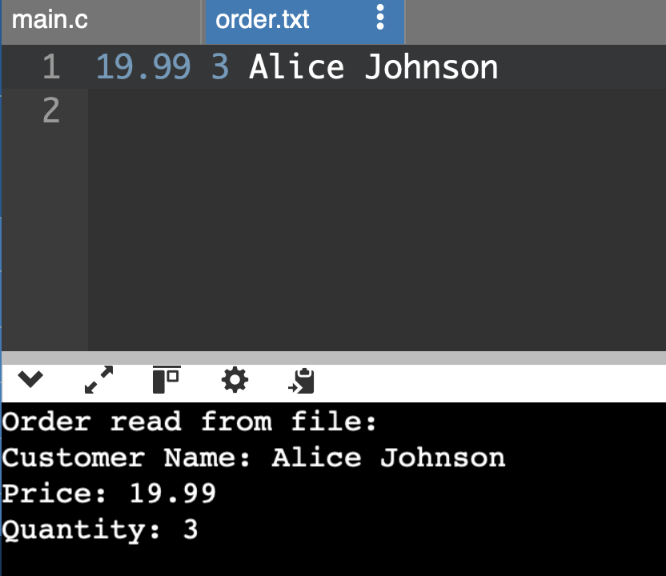
In Class Assignment CHALLENGE
Use a typedef with your structure
Always check that the file open command worked. If not, print an error message.

