Slide 1

RUNTIME ANALYSIS Cont.
O, Ω, θ NOTATION

Slide 2
Join the Nearpod Lecture:
join.nearpod.com

Slide 3
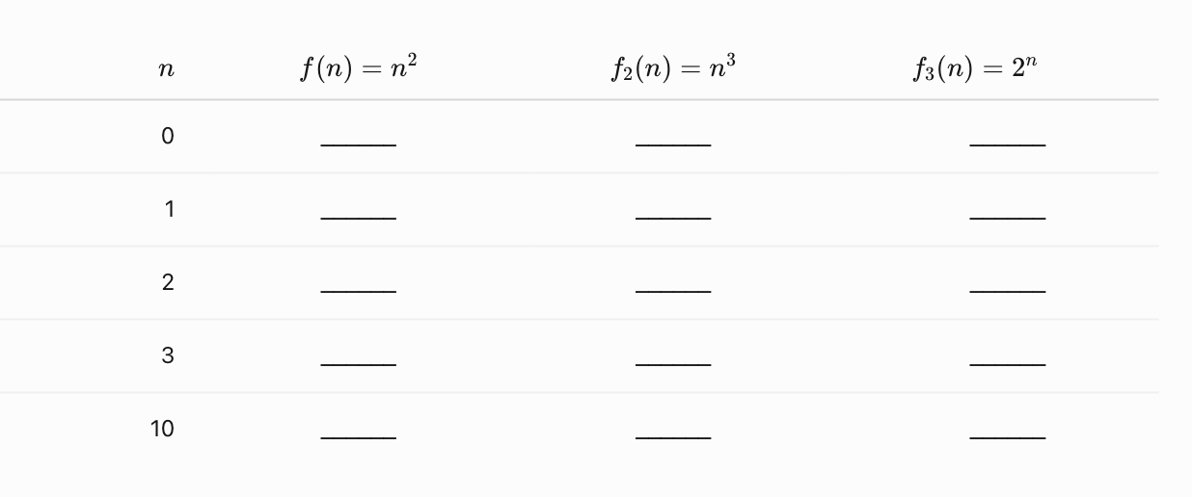
Fill in the Values

Slide 4
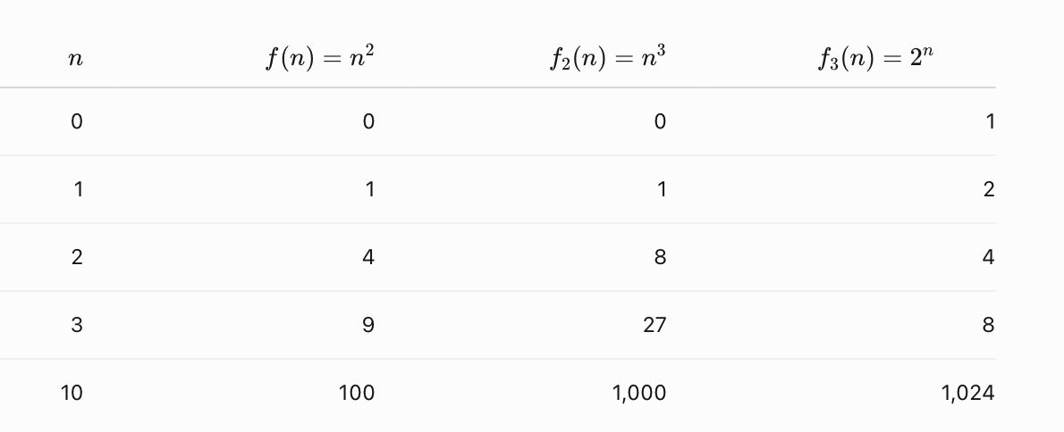
Fill in the Values - Solution
When we say 2^n is SLOWER THAN N^2 or N^3 it's not for every value of n, just as n gets past a certain point

Slide 5
Review
When we say an algorithm has a big O time complexity of O(n)
As n grows, the dominant factor in the algorithm's runtime (whether it involves a for loop, while loop, do-while loop, or recursive calls) in the worst-case scenario will be n operations, disregarding constant factors.
do {
printf("%d\n", i);
i++;
} while (i < n);
for (int i = 0; i < n; i++) {
}
while (i < n) {
}

Slide 6
Review
What is the Big O time complexity for this algorithm?
#include <stdio.h>
int main(){
int n;
printf("Enter n: ");
scanf("%d", &n);
do{
printf("n=%d\n", n);
n=n-1;
} while (n>0);
return 0;
}
Notes:
O(n)

Slide 7
Review
What is the Big O time complexity for this algorithm? (careful, this might be a trick)
#include <stdio.h>
int main(){
int n;
printf("Enter n: ");
scanf("%d", &n);
do{
printf("n=%d\n", n);
n=0;
} while (n>0);
return 0;
}
Notes:
O(1)

Slide 8
Review
Find an upper bound (Big-O) for:
f(n) = n² + 5n + 1
Notes:
O(N^2)

Slide 9
Review
What is the Big O time complexity:
for (k=N-5; k<N+5; k++){
for (j=0; j<N; j++){
for (i=0; i<N; i++){
abc = 3;
}
}
}
Notes:
O(N^2) ***note the outer loop only executes 10 times

Slide 10
Test Log Understanding
What is log₂ 64 ?
Notes:
6

Slide 11
Review of Logs
//solve for p
2^{p} = 8
//solve for p
2^{p} = 4096
log₂ 4096 = p
Notes:
p= 3
p=12 https://www.calculator.net/log-calculator.html

Slide 12
What will print?
n=8;
while ( n > 1 ){
printf(“%d\n”, n);
n= n/2;
}
Notes:
8 4 2
(remember log base 2 of 8 is 3

Slide 13
Why Talk About Logs in CS
//What is Big O of this loop?
while ( n > 1 ){
n= n/2;
}
//What is Big O of this loop?
while ( n > 1 ){
n= n/3;
}
//What is Big O of this loop?
while ( n > 1 ){
n= n/10;
}
Notes:
n=4, 2, 1 O(log(n)) // log base 2
O(log(n)) // log base 3
O(log(n)) // log base 10

Slide 14
Why Talk About Logs in CS
//What is Big O of this loop?
while ( n > 1 ){
n= n/2;
}
O(log₂ (n))
//What is Big O of this loop?
while ( n > 1 ){
n= n/3;
}
//What is Big O of this loop?
while ( n > 1 ){
n= n/10;
}
O(log₃ (n))
O(log₁₀ (n))
Notes:
n=4, 2, 1 O(log(n)) // log base 2
O(log(n)) // log base 3
O(log(n)) // log base 10

Slide 15
Log Bases
In math class log refers to log₁₀ as a default.
And the natural log, ln refers to log_{e}.
In computer science we most often mean log₂ because computers are a binary system dealing with 1s and 0s. We will use log₂ to describe the time complexity for binary searching, heights of heap, skip lists, quick sort, merge sort, etc.
Notes:
Common Logarithm (base 10):
Notation: log⁡(x)log(x) or log⁡10(x)log10​(x)
Definition: The power to which the base 10 must be raised to obtain the number xx.
Example: log⁡10(100)=2log10​(100)=2 because 102=100102=100.
Natural Logarithm (base ee):
Notation: ln⁡(x)ln(x)
Definition: The power to which the base ee (where e≈2.71828e≈2.71828) must be raised to obtain the number xx.
Example: ln⁡(e3)=3ln(e3)=3 because e3=e3e3=e3.
Logarithm with Other Bases:
Notation: log⁡b(x)logb​(x)
Definition: The power to which the base bb must be raised to obtain the number xx.
Example: log⁡2(8)=3log2​(8)=3 because 23=823=8.

Slide 16
Log Bases
When discussing Big O notation, the base of the logarithm—whether it's log₁₀​, log₂​, or any other base —doesn't really matter.
This is because of the logarithm base change rule, which allows you to convert between different bases.
log_{b}​(x)= log_{k}​(x)
------------
log_{k}​(b)​
Notes:
log8 64 => log 2(64)/log 2 (8) = 6/3

Slide 17
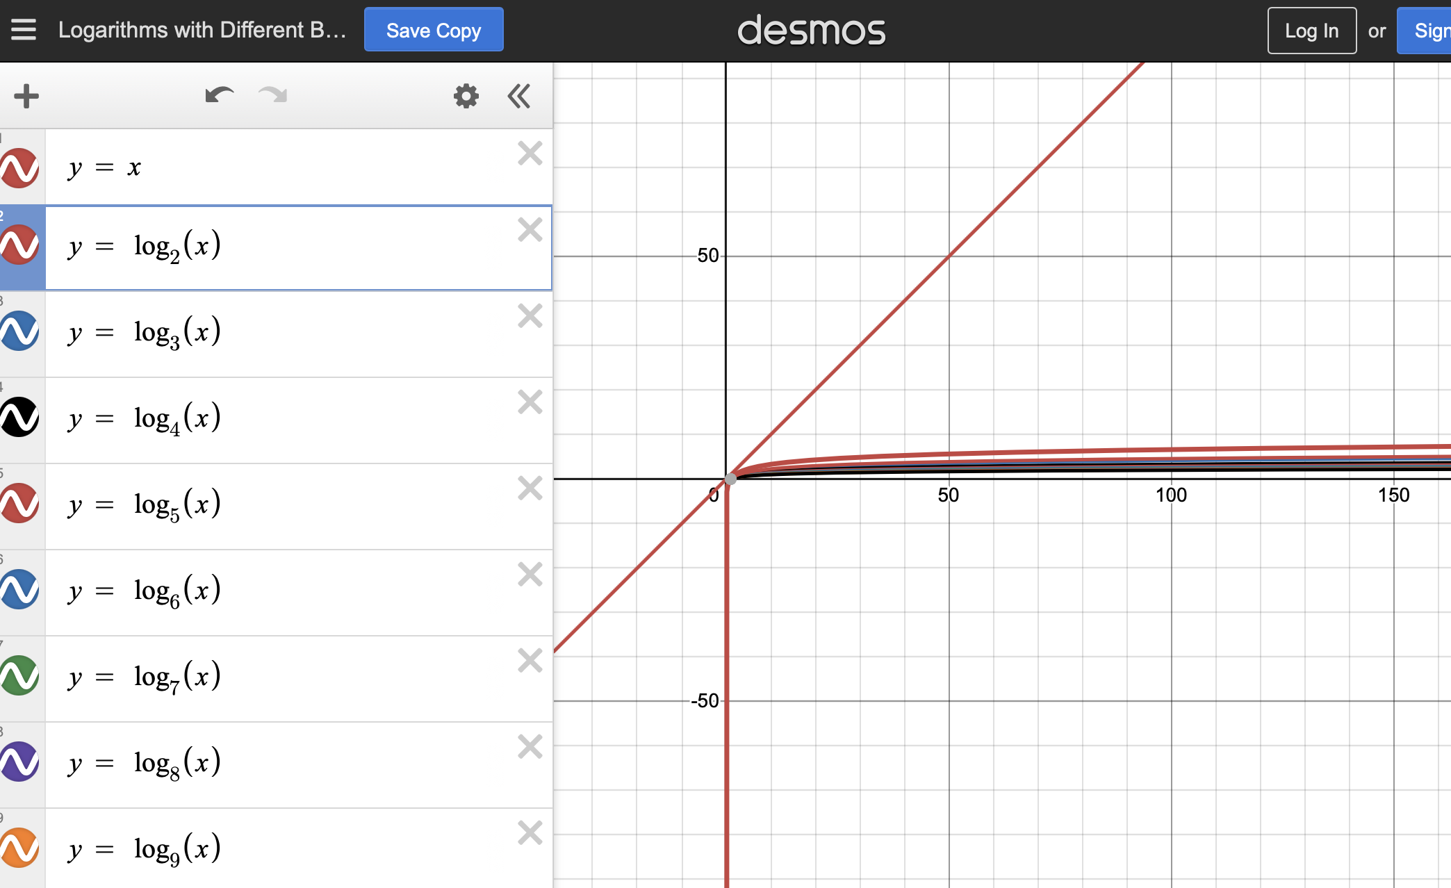
Log Bases
The relative rate of growth for a log of any base is much smaller than O(n).
Notes:
https://www.desmos.com/calculator/iuc4aiabt6
note, as log base gets bigger, growth rate slower

Slide 18
Common Rates of Growth
Time Complexity | Name | Description
1 | Constant | Regardless of input size, functions take a constant time
log(n) | Logarithmic | Increases logarithmically as the input size increases, Slower than linear growth
n | Linear | Function grows linearly with size of input
n log(n) | Linear Logarithmic | Faster growing than linear, but slower than quadratic
n² | Quadratic | Polynomial function of degree 2
n³ | Cubic | Polynomial function of degree 3
2^{n} | Exponential | Quickly growing function when positive number (like 2) raised to n
n! | Factorial
Notes:
log 2 1 = 0 2 to the power of 0 is 1
log 2 2 = 1 2 to the power 1 is 2
log 2 8 = 3 2 to the power 3 is 8

Slide 19
#include <stdio.h>
#include <stdlib.h>
int main() {
int n, x = 0, i;
int* array;
printf("Enter n: ");
scanf("%d", &n);
array = (int*) malloc(sizeof(int) * n);
while (x < n) { //initialize array to 0s
array[x] = 0;
x = x + 1;
}
while (array[n-1] != n){
x = 0;
array[x]++;
while (array[x] > n){
array[x] = 0;
x++;
array[x]++;
}
}
printf("\n");
free(array);
return 0;
}
Will the customer be happy if n= 10 ?
Notes:
#include <stdio.h>
#include <stdlib.h>
int main() {
int n, x = 0, i;
int* array;
printf("Enter n: ");
scanf("%d", &n);
array = (int*) malloc(sizeof(int) * n);
while (x < n) { //initialize array to 0s
array[x] = 0;
x = x + 1;
}
while (array[n-1] != n){
x = 0;
array[x]++;
while (array[x] > n){
array[x] = 0;
x++;
array[x]++;
}
}
printf("\n");
free(array);
return 0;
}

Slide 20
#include <stdio.h>
#include <stdlib.h>
void printArray(int a[], int size){
int i;
for(i=0; i< size; i++){
printf("%d ", a[i]);
}
printf("\n");
}
int main() {
int n, x = 0, i;
int* array;
printf("Enter n: ");
scanf("%d", &n);
array = (int*) malloc(sizeof(int) * n);
while (x < n) { //initialize array to 0s
array[x] = 0;
x = x + 1;
}
printArray(array, n);
while (array[n-1] != n){
printf("Outer while\n");
x = 0;
array[x]++;
printArray(array, n);
while (array[x] > n){
array[x] = 0;
printf("Inner while\n");
printArray(array, n);
x++;
array[x]++;
printArray(array, n);
}
}
printArray(array, n);
printf("\n");
free(array);
return 0;
}
What is the Big O for this algorithm?
Notes:
// THIS IS N^N for N=10 it’s 10 billion
#include <stdio.h>
#include <stdlib.h>
void printArray(int a[], int size){
int i;
for(i=0; i< size; i++){
printf("%d ", a[i]);
}
printf("\n");
}
int main() {
int n, x = 0, i;
int* array;
printf("Enter n: ");
scanf("%d", &n);
array = (int*) malloc(sizeof(int) * n);
while (x < n) { //initialize array to 0s
array[x] = 0;
x = x + 1;
}
printArray(array, n);
while (array[n-1] != n){
printf("Outer while\n");
x = 0;
array[x]++;
printArray(array, n);
while (array[x] > n){
array[x] = 0;
printf("Inner while\n");
printArray(array, n);
x++;
array[x]++;
printArray(array, n);
}
}
printArray(array, n);
printf("\n");
free(array);
return 0;
}

Slide 21
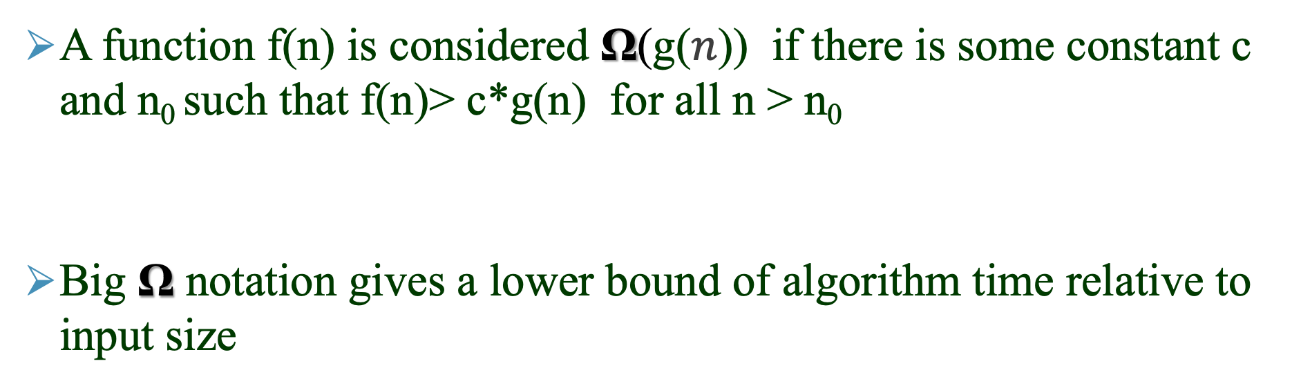



Ω (Omega) -notation ‒ the Math
A function f(n) is considered Ω(g($n$)) if there is some constant c and n₀ such that f(n)> c*g(n) for all n > n₀
Big Ω notation gives a lower bound of algorithm time relative to input size
$f$($n$)
$g$($n$)
$\left.n\right.$-axis
N
Notes:
lower bound is not unique, there will be multiple functions that can bound
You can say Big Omega or more commonly just Omega

Slide 22
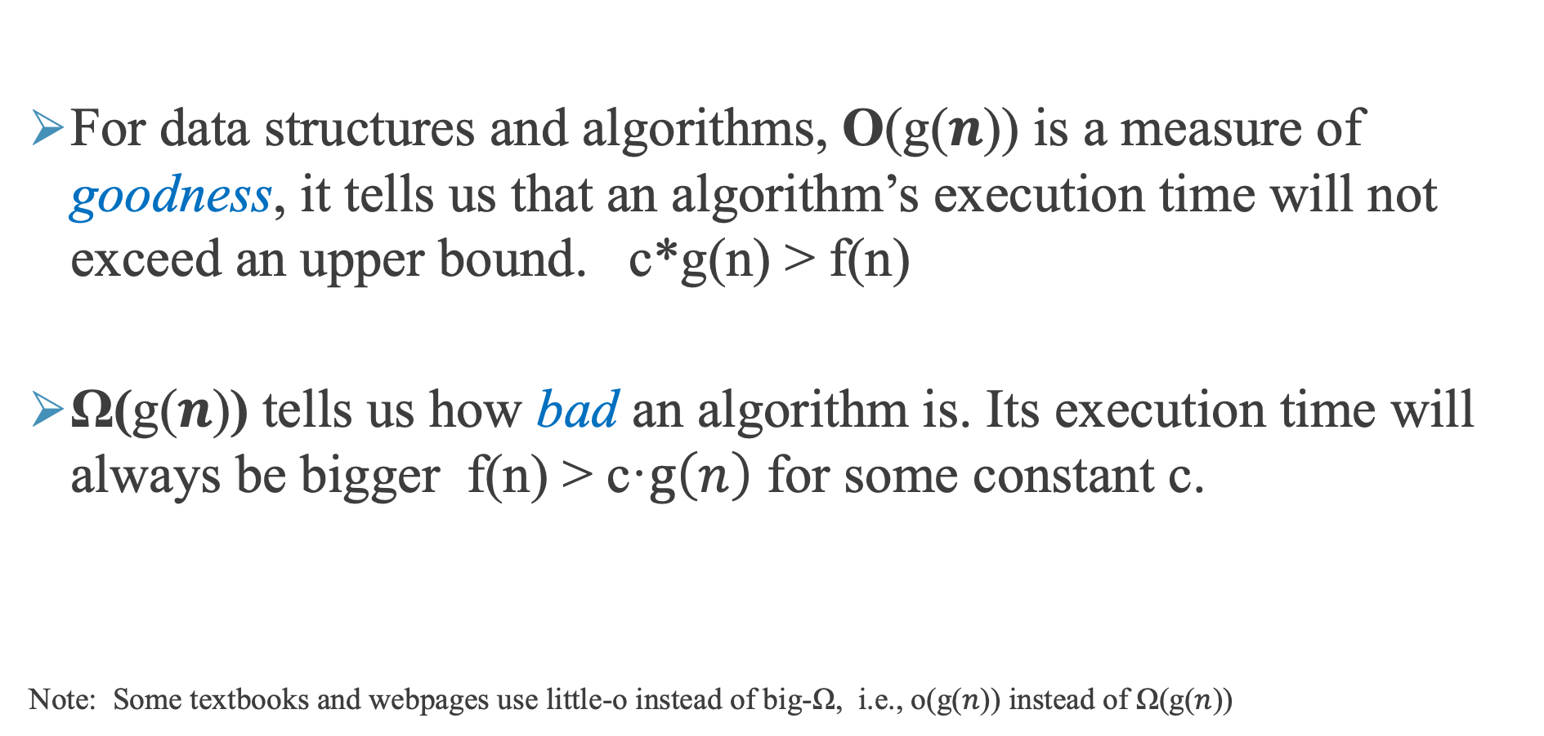
Big-Ω (Big Omega)
For data structures and algorithms, O(g($n$)) is a measure of goodness, it tells us that an algorithm’s execution time will not exceed an upper bound. c*g(n) > f(n)
Ω(g($n$)) tells us how bad an algorithm is. Its execution time will always be bigger f(n) > c·$g\left(n\right)$ for some constant c.
Note: Some textbooks and webpages use little-o instead of big-Ω, i.e., o(g($n$)) instead of Ω(g($n$))

Slide 23
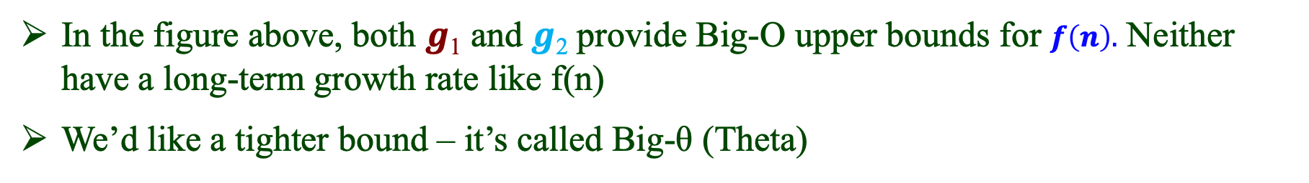




Problem: The Bound Provided By An O(g($n$)) Function Is Not Unique And Need Not Be Tight
$$g1\left(n\right)$$
$$g2\left(n\right)$$
$$f\left(n\right)$$
$\left.n\right.$-axis
In the figure above, both $g$₁ and $g$₂ provide Big-O upper bounds for $f\left(n\right).$ Neither have a long-term growth rate like f(n)
We’d like a tighter bound ‒ it’s called Big-θ (Theta)

Slide 24

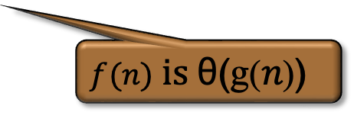
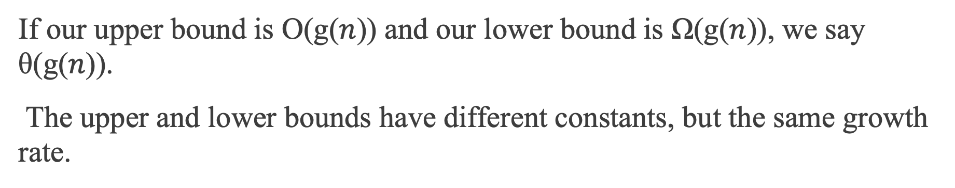



Big-θ (Theta)
If our upper bound is O(g($n$)) and our lower bound is Ω(g($n$)), we say θ($\text{g}\text{(}n\text{)}$).
The upper and lower bounds have different constants, but the same growth rate.
1.2· $g$($n$)
$$f\left(n\right)$$
0.9·$g$($n$)
$f(n)$ $is \text{θ}\text{(}\text{g}\text{(}n\text{)}\text{)}$
$\left.n\right.$-axis

Slide 25
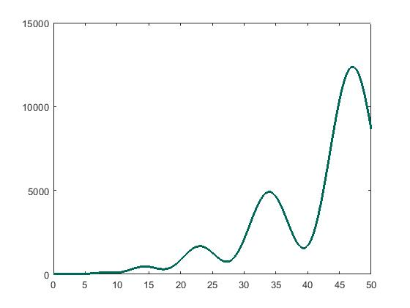
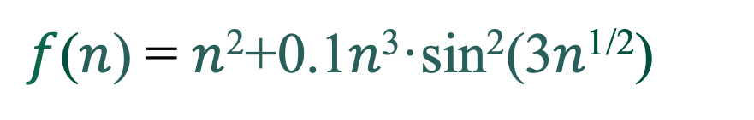
Note That Mathematically, Some Functions Don’t Have A Standard Big-θ Description
$f$($n$) = $n$²+0.1$n$³·sin²(3$n$^{1/2})

Slide 26
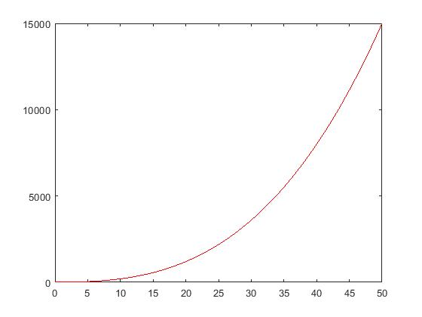
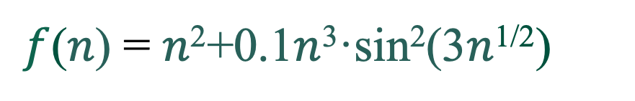

Note That Mathematically, Some Functions Don’t Have A Standard Big-θ Description
$f$($n$) = $n$²+0.1$n$³·sin²(3$n$^{1/2})
Upper bound is $n$²+0.1 $n$³ so $f$($n$) is O($n$³ ), and that’s a tight upper bound

Slide 27
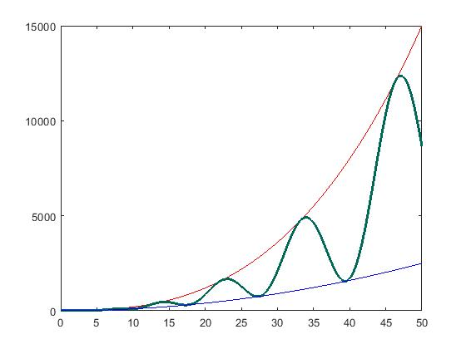
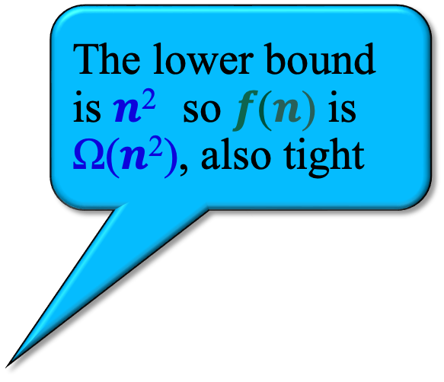
Note That Mathematically, Some Functions Don’t Have A Standard Big-θ Description
$f$($n$) = $n$²+0.1$n$³·sin²(3$n$^{1/2})
The lower bound is $n$² so $f$($n$) is Ω($n$²), also tight

Slide 28
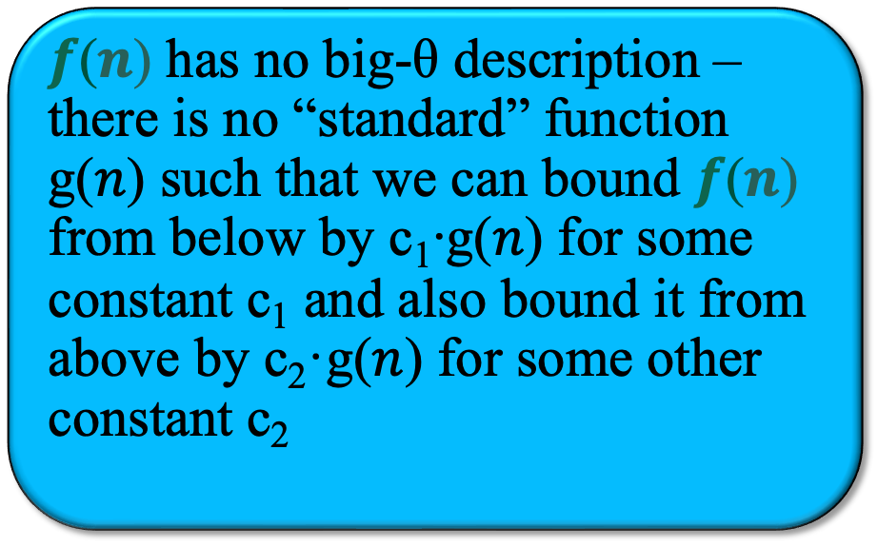
Note That Mathematically, Some Functions Don’t Have A Standard Big-θ Description
$f$($n$) has no big-θ description ‒ there is no “standard” function g($n$) such that we can bound $f$($n$) from below by c₁∙g($n$) for some constant c₁ and also bound it from above by c₂·g($n$) for some other constant c₂

Slide 29
Summary
Execution times can be influenced by hardware differences like CPU speed, RAM speed, and Disk I/O speed. They can be impacted by system load, background processes, compiler optimizations.
We use what is generically called O-notation to describe the complexity of our algorithms and data structures, independent of execution platform and programming language.

Slide 30
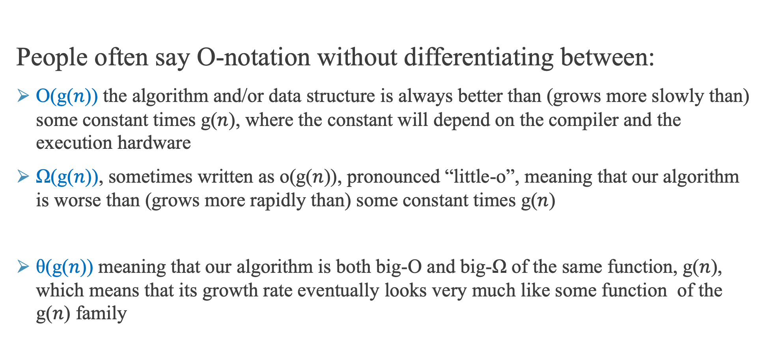
Summary
People often say O-notation without differentiating between:
O(g($n$)) the algorithm and/or data structure is always better than (grows more slowly than) some constant times g($n$), where the constant will depend on the compiler and the execution hardware
Ω(g($n$)), sometimes written as o(g($n$)), pronounced “little-o”, meaning that our algorithm is worse than (grows more rapidly than) some constant times g($n$)
θ(g($n$)) meaning that our algorithm is both big-O and big-Ω of the same function, g($n$), which means that its growth rate eventually looks very much like some function of the g($n$) family

Slide 31

Questions?

Slide 32
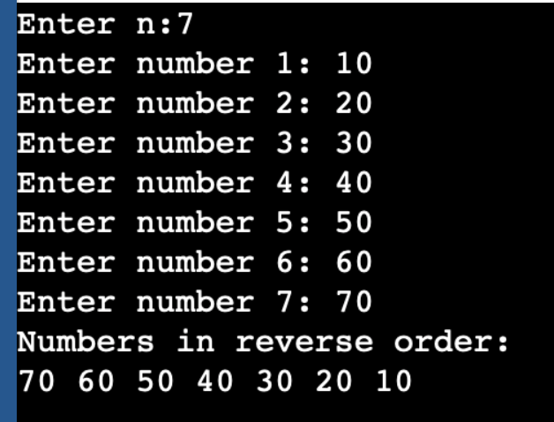
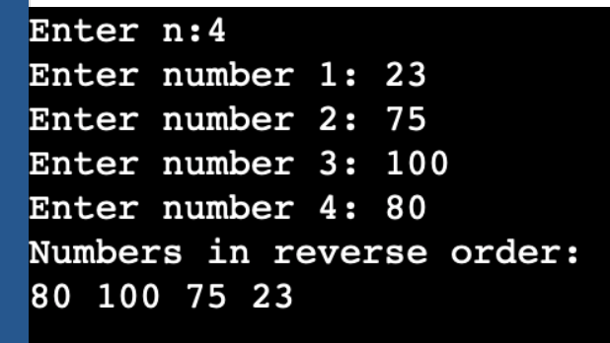
In Class Exercise
Create a C program that reads an integer n (at most 25) and then reads a list of n numbers and prints the list in reverse order.
(Do not use any dynamic memory allocation. We expand on this example to use dynamic memory allocation in Lect5.)

Slide 33
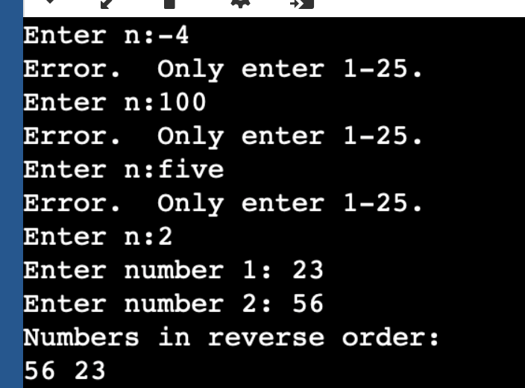
In Class Exercise - Challenge
Add error handling. If the user types in a number that is < 1, >25, or not a number, re-prompt.

