Slide 1

Stacks
Notes:
ADT = Abstract Data Type (ex. queue, stack)

Slide 2
Finish Nearpod from last Class.

Slide 3
Review
What is Big-O Notation?
Give a code example that is O(n²)?

Slide 4
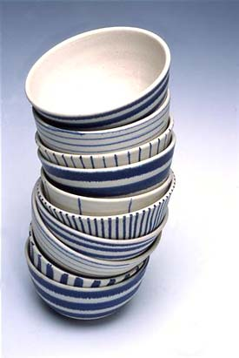
Stacks
A stack is a data structure where the insertions and deletions occur at the same end of the stack, the top.
When you unload a dishwasher, you make a stack of dishes. The last bowl you put in a stack will be the first one that you take off the stack when you need a clean bowl.
The behavior of a stack is LIFO
LIFO - Last-In, First-Out

Slide 5
Stacks
When you put an item on the stack, it’s called a push.
When you take an item off the stack, it’s called a pop.
You will need to have a way to determine if the stack is empty, find out the size of the stack etc.
Examples uses: Un-Do Button, Calling Functions (return address put on stack)

Slide 6
Real World Application of Stack
Postfix Expression
Page-visited history in a Web browser
Undo button
Memory addresses when function called
HTML tag matching
Compilers use stacks to parse programs and produce code
Used in other data structures

Slide 7
Postfix Expression
Postfix Expression - Reverse Polish Notation (RPN), the operators are shown after the operands
infix | postfix
3 + 5 | 3 5 +
5 * (6 + 2) | 5 6 2 + *
(8 - 3) / (2 + 1) | 8 3 - 2 1 + /
Parentheses are not needed. Easier for computers to evaluate using a stack.

Slide 8
Postfix Expression
infix | postfix
3 + 5 | 3 5 +
5 * (6 + 2) | 5 6 2 + *
(8 - 3) / (2 + 1) | 8 3 - 2 1 + /
HOW TO DECODE POSTFIX
Read from left to right
If it’s a number, push to the stack.
If it’s an operator (+, -, *, /), Pop the 2 values off stack and apply operation, push result back to stack.
At the end stack contains 1 value, the result.

Slide 9
Postfix Expression
Evaluate: 6 2 3 + - 3 8 2 / + *
Notes:
Step by step:
Push 6 → [6]
Push 2 → [6, 2]
Push 3 → [6, 2, 3]
+ → Pop 3 and 2 → 2 + 3 = 5 → push → [6, 5]
- → Pop 5 and 6 → 6 - 5 = 1 → push → [1]
Push 3 → [1, 3]
Push 8 → [1, 3, 8]
Push 2 → [1, 3, 8, 2]
/ → Pop 2 and 8 → 8 / 2 = 4 → push → [1, 3, 4]
+ → Pop 4 and 3 → 3 + 4 = 7 → push → [1, 7]
* → Pop 7 and 1 → 1 * 7 = 7 → push → [7]
✅ Final result: 7

Slide 10
HTML Tag Matching
For fully-correct HTML, each <name> should pair with a matching </name>
The Little Boat
The storm tossed the little boat
like a cheap sneaker in an old
washing machine. The three
drunken fishermen were used to
such treatment, of course, but not
the tree salesman, who even as
a stowaway now felt that he had
overpaid for the voyage.
1. Will the salesman die?
2. What color is the boat?
3. And what about Naomi?
<body>
<center>
<h1> The Little Boat </h1>
</center>
<p> The storm tossed the little
boat like a cheap sneaker in an
old washing machine. The three
drunken fishermen were used to
such treatment, of course, but
not the tree salesman, who even as
a stowaway now felt that he
had overpaid for the voyage. </p>
<ol>
<li> Will the salesman die? </li>
<li> What color is the boat? </li>
<li> And what about Naomi? </li>
</ol>
</body>
Based on 2014 Goodrich, Tamassia, Goldwasser
Notes:
#include <stdio.h>
struct stack{
int num[100];
int head;
};
void push(struct stack* s, int x){
//TO-DO
printf("pushing %d to stack\n", x);
}
int pop(struct stack* s){
//TO-DO
}
int main(){
struct stack s;
s.head=-1;
push(&s, 5);
push(&s, 6);
push(&s, 7);
pop(&s);
pop(&s);
pop(&s);
}

Slide 11
Array Based Stack
Which position in the array should correspond to the TOP of the stack?
Try adding: 5, 10, 15
0 1 2 3 4
Notes:
Last position. Otherwise every time you add a value, you need to move everything over.
Would be less efficient.

Slide 12
Array Based Stack
#include <stdio.h>
struct stack{
int num[100];
int top;
};
void push(struct stack* s, int x){
//TO-DO for in class exercise
printf("pushing %d to stack\n", x);
}
int pop(struct stack* s){
//TO-DO for in class exercise
}
Notes:
#include <stdio.h>
struct stack{
int num[100];
int top;
};
void push(struct stack* s, int x){
//TO-DO
printf("pushing %d to stack\n", x);
}
int pop(struct stack* s){
//TO-DO
}
int main(){
struct stack s;
s.top=-1;
push(&s, 5);
push(&s, 6);
push(&s, 7);
pop(&s);
pop(&s);
pop(&s);
}

Slide 13
Write the Code to see if Empty Stack
#include <stdio.h>
struct stack{
int num[100];
int head;
};
Notes:
#include <stdio.h>
struct stack{
int num[100];
int top;
};
void push(struct stack* s, int x){
//TO-DO
printf("pushing %d to stack\n", x);
}
int pop(struct stack* s){
//TO-DO
}
int empty(struct stack* s){
if (s->top == -1){
return 1; //true, empty stack
}
return 0;
}
int main(){
struct stack s;
s.top=-1;
printf("Is empty: %d\n", empty(&s));
push(&s, 5);
push(&s, 6);
push(&s, 7);
pop(&s);
pop(&s);
pop(&s);
}

Slide 14
Write the Code to see if Stack Full
#include <stdio.h>
struct stack{
int num[100];
int head;
};

Slide 15

Questions?

Slide 16
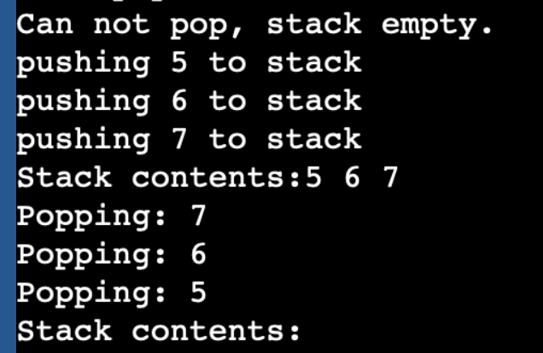
In Class Assignment
Finish the Array Based Stack code and write code to:
Push an int onto the stack
Pop an int off the stack.
Display the contents of the stack.
Notes:
#include <stdio.h>
struct stack{
int num[100];
int head;
};
void push(struct stack* s, int x){
//TO-DO
printf("pushing %d to stack\n", x);
}
int pop(struct stack* s){
//TO-DO
}
int empty(struct stack* s){
if (s->head == -1){
return 1; //true, empty stack
}
return 0;
}
int full(struct stack* s){
if (s->head == 99){
return 1; //true, empty stack
}
return 0;
}
int main(){
struct stack s;
s.head=-1;
printf("Is empty: %d\n", empty(&s));
push(&s, 5);
push(&s, 6);
push(&s, 7);
pop(&s);
pop(&s);
pop(&s);
}

