Slide 1

Linked Lists
Pointer Review, linked lists

Slide 2
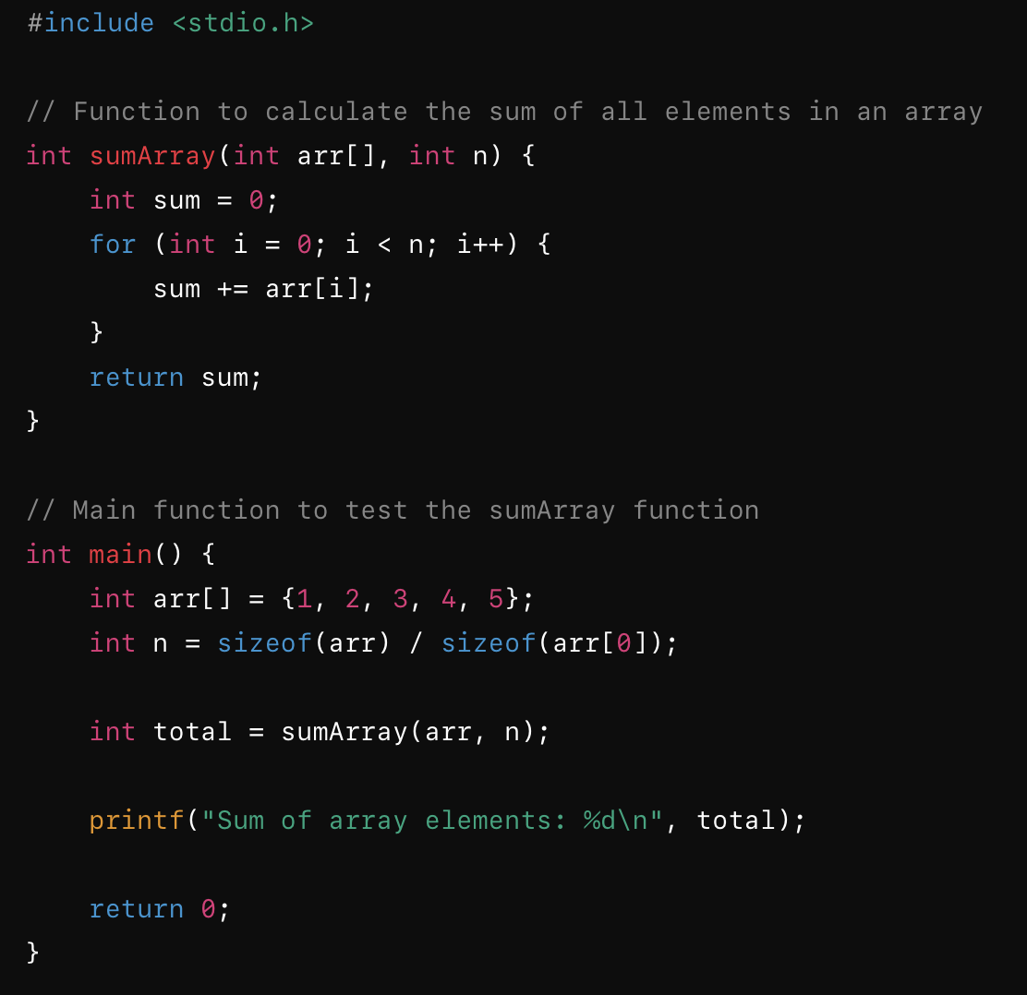
Would the big O for each of these be the same?
Notes:
Knowing that array is only 5, the whole program runs in O(1)
If you do not know the size of array, sumArray by itself is O(n)

Slide 3
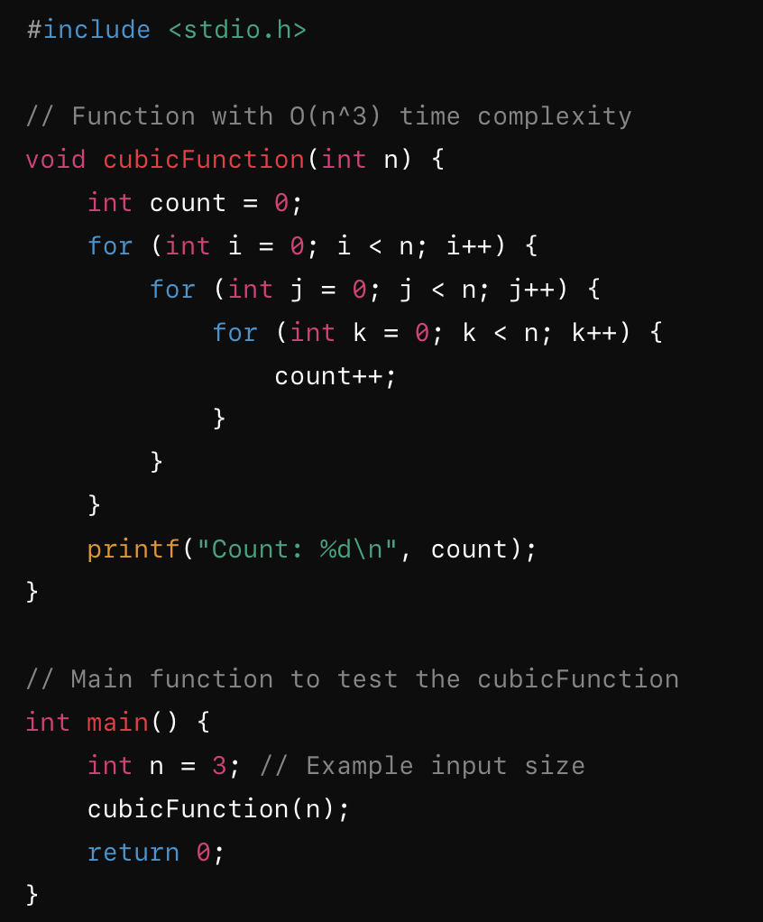
Would the big O for each of these be the same?

Slide 4
Which of these Big O time complexities would result in the FASTEST algorithm:
  O(n)
  O(log n)
  O(n²)
  O(n³)
Notes:
O(log n)

Slide 5
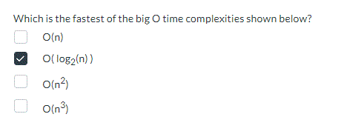
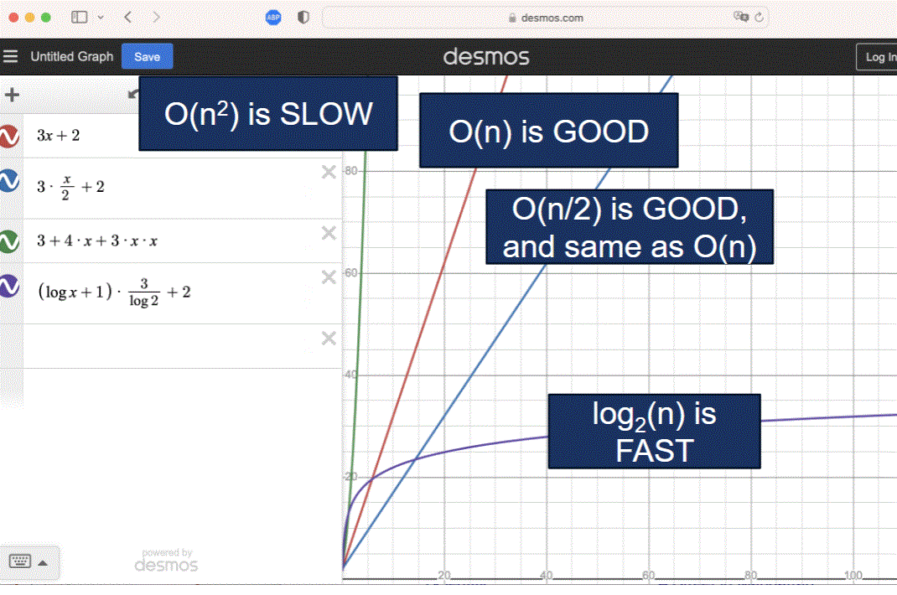
From Lect2, slide 28

Slide 6
Addresses in Memory
We use & to see the address in memory
#include <stdio.h>
int main() {
int num=5;
printf("num=%d &num=%p\n", num, &num);
return 0;
}
num=5 &num=0x7ffc07b899e4
0x7ffc07b899e4 num
5

Slide 7
Creating a Pointer
You can create a pointer data type by using * after the variable type.
int* x; //x is a pointer to an int
char *c; //c is a pointer to a char
float * gpa; //gpa is a pointer to a float
int* and int * are the same.

Slide 8
Pointers
The ptr variable holds the address of num.
int num=5;
int* ptr = &num; //store address of num
int *ptr2 = &num; //int * and int* are same
ptr2
0x7ffc07b899e4
num
5
ptr
0x7ffc07b899e4

Slide 9
Pointers
Pointers can be used to store memory addresses.
int age=5;
int* agePtr=&age;
char initial='H';
char *c=&initial;
float gpa=3.5;
float * gpaPtr=&gpa;
age
agePtr
5
initial
c
H
gpa
gpaPtr
3.5

Slide 10
Pointers
ptr stores the address, *ptr to de-reference the pointer
#include <stdio.h>
int main() {
int num=5;
int* ptr = &num;
printf("num=%d &num=%p\n", num, &num);
printf("ptr=%p *ptr=%d\n", ptr, *ptr);
return 0;
}
Notes:
#include <stdio.h>
int main() {
int num=5;
int* ptr = &num;
printf("num=%d &num=%p\n", num, &num);
printf("ptr=%p *ptr=%d\n", ptr, *ptr);
return 0;
}

Slide 11
Pointers
You can make a change to the variable num through the pointer or the variable.
int num=5;
int* ptr = &num;
num++; //add 1 to num
(*ptr)++; //add 1 to num (because ptr points at num)
Notes:
#include <stdio.h>
int main() {
int num=5;
int* ptr = &num;
printf("num is set to: %d %d\n", num, *ptr);
printf("num is stored at: %p %p\n", &num, ptr);
num++;
(*ptr)++;
printf("new num is %d\n", num);
return 0;
}

Slide 12
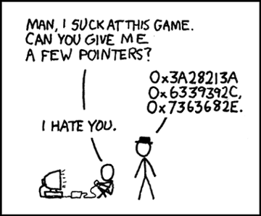
Pointers

Slide 13
Why use Pointers
One of the main reasons to use pointers is you want the function to have the ability to make changes to memory instead of working with a copy.
It can be a huge performance improvement when working with large arrays.
Pointers will also allow us to create more complex data structures like linked lists.

Slide 14
Passing Arguments To Functions In C
The only way C passes argument values into functions is by copying (pass-by-value)
param1
int funct1(int param1)
{
/* function body */
}
Compiler generates code that causes each separate execution of the function to request new cells for the temporary storage of the function’s parameters before the statements in the body of the definition start executing
10
int main()
{
int x;
while (…)
x = 2*funct1( 5*2 );
}
Notes:
5*2 math is done and you need a spot in memory to store 10

Slide 15
Passing Arguments To Functions In C
… and all function’s local variables are destroyed (unless the variable was static)
param1
int funct1(int param1)
{
/* function body */
}
10
When a function ends, the returned value (if any) is substituted for the function call, which is why in C a function is said to “return a value through its name”
int main()
{
int x;
while (…)
x = 2*funct1(5*2 );
}

Slide 16
Passing Pointers (Addresses) To A Function
int main()
{
int x = 5;
... funct1(&x);
}
x
int funct1(int *param1)
{
*param1 = 17;
}
5
•
param1
•
•
•
•
•
Whenever this function call gets executed ...
... this (integer pointer type) cell gets created …

Slide 17
Passing Pointers (Addresses) To A Function
Now when this statement gets executed ...
int main()
{
int x = 5;
... funct1(&x);
}
x
int funct1(int *param1)
{
*param1 = 17;
}
17
•
param1
•
•
•
•
•
… the value in main’s cell named x is changed; so funct1 has produced a side-effect

Slide 18
What is a Linked List
You can use C structs to create nodes that contain data as well as pointers to the next node. This is what we call a linked list.
front
5
9
8
2 | NULL
https://youtu.be/TmdsSTua6Ps?si=75K_Vps8TG3Gczbn

Slide 19

Struct Review
How would you create a structure to represent a Pokemon? Each Pokemon has a name(50 characters or less), a type(ex. rock, water, fire), and a combat power(int).
How can we create a linked list of Pokemon?

Slide 20
Linked List of Pokémon
How would you create an Empty linked list of Pokémon?
typedef struct pokemon{
char name[30];
int cp;
struct pokemon* next;
} Pokemon;
yourList
NULL
Notes:
Pokemon* mine=NULL;

Slide 21

Linked List of Pokémon
How would you add an item to the linked list?
typedef struct pokemon{
char name[30];
int cp;
struct pokemon* next;
} Pokemon;
Pikachu
500
yourList
NULL
Notes:
Pokemon* addPokemon(Pokemon* list){
if(list== NULL){ //This will be the first Pokemon in the list
list=malloc(sizeof(Pokemon)); //dynamically allocate memory for Pokemon
strcpy(list->name, "squirtle");
list->cp=400;
list->next=NULL;
return list;
}
else{ //Find the end of the list and add a new Pokemon
Pokemon* frontOfList=list;
while(list->next != NULL){
list=list->next;
}
list->next=malloc(sizeof(Pokemon));
Pokemon* newPokemon=list->next;
strcpy( (*newPokemon).name, names[rand()%10]); //newPokemon->name
newPokemon->cp=rand()%2000;
newPokemon->next=NULL;
return frontOfList;
}
}

Slide 22



Linked List of Pokémon
How to add to a linked list…
yourList
Squirtle
400
Eevee
50
Charmander
170
Pikachu
500
NULL
Notes:
#include <stdio.h>
#include <stdlib.h>
#include <string.h>
typedef struct pokemon{ //define the Pokemon data type alias to:struct pokemon
char name[30];
int cp;
struct pokemon* next;
} Pokemon;
//a 2D array with 10 pokemon names that are all less than 50 characters
char names[10][50]={ "pikachu", "magik carp", "eevee", "charmander", "squirtle",
"vaporeon", "ditto", "jigglypuff", "hypno", "drowzee"};
//***********************************************************
//* The printPokemon function expects a Pokemon pointer
//* that is a pointer to the beginning of the linked list.
//* It will print the pokemon info and then traverse the
//* until it reaches the end of the list.
//**********************************************************
void printPokemon(Pokemon* list){
printf("Your Pokemon Are: \n****************\n");
while(list != NULL){
printf("Pokemon: %s cp:%d\n", (*list).name, (*list).cp);
list=(*list).next; //or list->next
}
printf("\n");
}
//***********************************************************
//* addPokemon adds a new Pokemon object to the end of the list.
//* dynamic memory allocation is used. The name of the new
//* Pokemon is randomly selected from the list. The cp is
//* randomly selected (0-1999).
//***********************************************************
Pokemon* addPokemon(Pokemon* list){
if(list== NULL){ //This will be the first Pokemon in the list
list=malloc(sizeof(Pokemon)); //dynamically allocate memory for Pokemon
strcpy(list->name, "squirtle");
list->cp=400;
list->next=NULL;
return list;
}
else{ //Find the end of the list and add a new Pokemon
Pokemon* frontOfList=list;
while(list->next != NULL){
list=list->next;
}
list->next=malloc(sizeof(Pokemon));
Pokemon* newPokemon=list->next;
strcpy( (*newPokemon).name, names[rand()%10]); //newPokemon->name
newPokemon->cp=rand()%2000;
newPokemon->next=NULL;
return frontOfList;
}
}
int main(){
Pokemon* mine=NULL;
int catch=1;
while(catch==1){
printf("A Pokemon appears in the wild. \n");
printf("Would you like to catch it? (0=no,1=yes) ");
scanf("%d", &catch);
if(catch==1){
mine=addPokemon(mine);
}
printPokemon(mine);
}
//Note: the dynamically allocated memory should be released.
//This step is left as an exercise.
return 0;
}

Slide 23
Linked List of Pokémon
How do you print all the items in the linked list?
yourList
Squirtle
400
Eevee
50
Charmander
170
Pikachu
500
NULL
Notes:
#include <stdio.h>
#include <stdlib.h>
#include <string.h>
typedef struct pokemon{ //define the Pokemon data type alias to:struct pokemon
char name[30];
int cp;
struct pokemon* next;
} Pokemon;
//a 2D array with 10 pokemon names that are all less than 50 characters
char names[10][50]={ "pikachu", "magik carp", "eevee", "charmander", "squirtle",
"vaporeon", "ditto", "jigglypuff", "hypno", "drowzee"};
//***********************************************************
//* The printPokemon function expects a Pokemon pointer
//* that is a pointer to the beginning of the linked list.
//* It will print the pokemon info and then traverse the
//* until it reaches the end of the list.
//**********************************************************
void printPokemon(Pokemon* list){
printf("Your Pokemon Are: \n****************\n");
while(list != NULL){
printf("Pokemon: %s cp:%d\n", (*list).name, (*list).cp);
list=(*list).next; //or list->next
}
printf("\n");
}
//***********************************************************
//* addPokemon adds a new Pokemon object to the end of the list.
//* dynamic memory allocation is used. The name of the new
//* Pokemon is randomly selected from the list. The cp is
//* randomly selected (0-1999).
//***********************************************************
Pokemon* addPokemon(Pokemon* list){
if(list== NULL){ //This will be the first Pokemon in the list
list=malloc(sizeof(Pokemon)); //dynamically allocate memory for Pokemon
strcpy(list->name, "squirtle");
list->cp=400;
list->next=NULL;
return list;
}
else{ //Find the end of the list and add a new Pokemon
Pokemon* frontOfList=list;
while(list->next != NULL){
list=list->next;
}
list->next=malloc(sizeof(Pokemon));
Pokemon* newPokemon=list->next;
strcpy( (*newPokemon).name, names[rand()%10]); //newPokemon->name
newPokemon->cp=rand()%2000;
newPokemon->next=NULL;
return frontOfList;
}
}
int main(){
Pokemon* mine=NULL;
int catch=1;
while(catch==1){
printf("A Pokemon appears in the wild. \n");
printf("Would you like to catch it? (0=no,1=yes) ");
scanf("%d", &catch);
if(catch==1){
mine=addPokemon(mine);
}
printPokemon(mine);
}
//Note: the dynamically allocated memory should be released.
//This step is left as an exercise.
return 0;
}

Slide 24
Linked List of Pokemon
How do you delete an item from a linked list?
yourList
Squirtle
400
Eevee
50
Charmander
170
Pikachu
500
NULL
Notes:
// how to delete Charmander, need ptr to eevee. Also keep ptr to Charmander to free.
// ptr->next- = ptr->next->next;
// free(charmanderPtr);
#include <stdio.h>
#include <stdlib.h>
#include <string.h>
typedef struct pokemon{ //define the Pokemon data type alias to:struct pokemon
char name[30];
int cp;
struct pokemon* next;
} Pokemon;
//a 2D array with 10 pokemon names that are all less than 50 characters
char names[10][50]={ "pikachu", "magik carp", "eevee", "charmander", "squirtle",
"vaporeon", "ditto", "jigglypuff", "hypno", "drowzee"};
//***********************************************************
//* The printPokemon function expects a Pokemon pointer
//* that is a pointer to the beginning of the linked list.
//* It will print the pokemon info and then traverse the
//* until it reaches the end of the list.
//**********************************************************
void printPokemon(Pokemon* list){
printf("Your Pokemon Are: \n****************\n");
while(list != NULL){
printf("Pokemon: %s cp:%d\n", (*list).name, (*list).cp);
list=(*list).next; //or list->next
}
printf("\n");
}
//***********************************************************
//* addPokemon adds a new Pokemon object to the end of the list.
//* dynamic memory allocation is used. The name of the new
//* Pokemon is randomly selected from the list. The cp is
//* randomly selected (0-1999).
//***********************************************************
Pokemon* addPokemon(Pokemon* list){
if(list== NULL){ //This will be the first Pokemon in the list
list=malloc(sizeof(Pokemon)); //dynamically allocate memory for Pokemon
strcpy(list->name, "squirtle");
list->cp=400;
list->next=NULL;
return list;
}
else{ //Find the end of the list and add a new Pokemon
Pokemon* frontOfList=list;
while(list->next != NULL){
list=list->next;
}
list->next=malloc(sizeof(Pokemon));
Pokemon* newPokemon=list->next;
strcpy( (*newPokemon).name, names[rand()%10]); //newPokemon->name
newPokemon->cp=rand()%2000;
newPokemon->next=NULL;
return frontOfList;
}
}
int main(){
Pokemon* mine=NULL;
int catch=1;
while(catch==1){
printf("A Pokemon appears in the wild. \n");
printf("Would you like to catch it? (0=no,1=yes) ");
scanf("%d", &catch);
if(catch==1){
mine=addPokemon(mine);
}
printPokemon(mine);
}
//Note: the dynamically allocated memory should be released.
//This step is left as an exercise.
return 0;
}

Slide 25
Linked List of Pokémon
How would you print the LAST item in a linked list?
How would you print the Pokémon in reverse order?
yourList
Squirtle
400
Eevee
50
Charmander
170
Pikachu
500
NULL
Notes:
To print the last item, start at the head and follow next until you hit NULL.
a singly linked list can not move backwards, so a common solution is a recursive one.
#include <stdio.h>
#include <stdlib.h>
struct Node
{
int data;
struct Node *next;
};
/* Prints the list in its normal order */
void printForward(struct Node *current)
{
while (current != NULL)
{
printf("%d ", current->data);
current = current->next;
}
printf("\n");
}
/* Prints the list in reverse order using recursion */
void printBackward(struct Node *current)
{
/* Base case: the end of the list */
if (current == NULL)
{
return;
}
/* Travel to the end of the list first */
printBackward(current->next);
/* Print while the recursive calls return */
printf("%d ", current->data);
}
/* Releases the dynamically allocated memory */
void freeList(struct Node *head)
{
struct Node *current = head;
while (current != NULL)
{
struct Node *nextNode = current->next;
free(current);
current = nextNode;
}
}
int main(void)
{
/* Create four nodes */
struct Node *first = malloc(sizeof(struct Node));
struct Node *second = malloc(sizeof(struct Node));
struct Node *third = malloc(sizeof(struct Node));
struct Node *fourth = malloc(sizeof(struct Node));
/* Check that memory allocation succeeded */
if (first == NULL || second == NULL ||
third == NULL || fourth == NULL)
{
printf("Memory allocation failed.\n");
free(first);
free(second);
free(third);
free(fourth);
return 1;
}
/* Assign hard-coded data and connect the nodes */
first->data = 10;
first->next = second;
second->data = 20;
second->next = third;
third->data = 30;
third->next = fourth;
fourth->data = 40;
fourth->next = NULL;
/* The head points to the first node */
struct Node *head = first;
printf("Forward: ");
printForward(head);
printf("Backward: ");
printBackward(head);
printf("\n");
freeList(head);
return 0;
}

Slide 26

Questions?
Questions

Slide 27
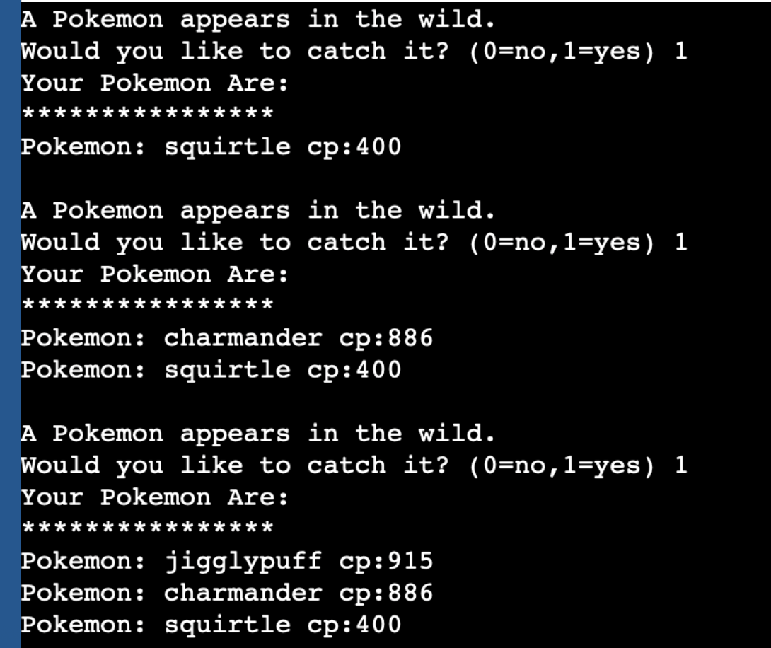
In Class Exercise
The Pokémon example code adds each new Pokémon to the end of the linked list. (like a queue)
Change the code so it is a STACK of Pokémon (add each item to the front of the linked list).
Notes:
#include <stdio.h>
#include <stdlib.h>
#include <string.h>
typedef struct pokemon{ //define the Pokemon data type alias to:struct pokemon
char name[30];
int cp;
struct pokemon* next;
} Pokemon;
//a 2D array with 10 pokemon names that are all less than 50 characters
char names[10][50]={ "pikachu", "magik carp", "eevee", "charmander", "squirtle",
"vaporeon", "ditto", "jigglypuff", "hypno", "drowzee"};
//***********************************************************
//* The printPokemon function expects a Pokemon pointer
//* that is a pointer to the beginning of the linked list.
//* It will print the pokemon info and then traverse the
//* until it reaches the end of the list.
//**********************************************************
void printPokemon(Pokemon* list){
printf("Your Pokemon Are: \n****************\n");
while(list != NULL){
printf("Pokemon: %s cp:%d\n", (*list).name, (*list).cp);
list=(*list).next; //or list->next
}
printf("\n");
}
//***********************************************************
//* addPokemon adds a new Pokemon object to the end of the list.
//* dynamic memory allocation is used. The name of the new
//* Pokemon is randomly selected from the list. The cp is
//* randomly selected (0-1999).
//***********************************************************
Pokemon* addPokemon(Pokemon* list){
if(list== NULL){ //This will be the first Pokemon in the list
list=malloc(sizeof(Pokemon)); //dynamically allocate memory for Pokemon
strcpy(list->name, "squirtle");
list->cp=400;
list->next=NULL;
return list;
}
else{ //Find the end of the list and add a new Pokemon
Pokemon* frontOfList=list;
while(list->next != NULL){
list=list->next;
}
list->next=malloc(sizeof(Pokemon));
Pokemon* newPokemon=list->next;
strcpy( (*newPokemon).name, names[rand()%10]); //newPokemon->name
newPokemon->cp=rand()%2000;
newPokemon->next=NULL;
return frontOfList;
}
}
int main(){
Pokemon* mine=NULL;
int catch=1;
while(catch==1){
printf("A Pokemon appears in the wild. \n");
printf("Would you like to catch it? (0=no,1=yes) ");
scanf("%d", &catch);
if(catch==1){
mine=addPokemon(mine);
}
printPokemon(mine);
}
//Note: the dynamically allocated memory should be released.
//This step is left as an exercise.
return 0;
}

Slide 28
In Class Exercise CHALLENGE
Currently the random number generator is not seeded, so it produces the same results with each run.
Release any dynamically allocated memory at the end of the program

