Slide 1
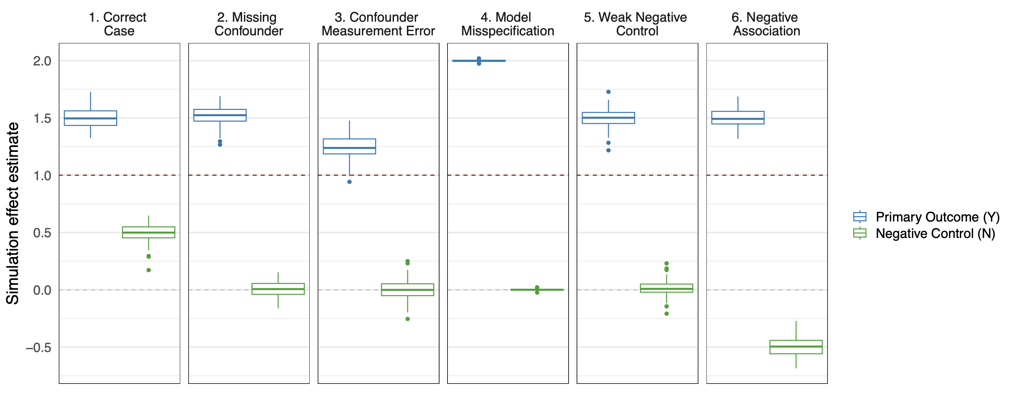
True effect of exposure
on outcome (β =1.0)

Slide 2
Simulation scenario | 1. Correct case | 2. Missing confounder | 3. Confounder Measurement Error | 4. Model misspecification | 5. Weak negative control | 6. Negative association
Mean effect estimate for primary analysis | 1.50 | 1.51 | 2.00 | 1.25 | 1.50 | 1.50
Mean effect estimate for negative control | 0.49 | 0.00 | 0.00 | 0.00 | 0.01 | -0.50
% of negative control 95% confidence intervals that included 0 | 1 | 97 | 94 | 94 | 94 | 0

