Slide 1
Modeling Stock Trends through Twitter Sentiment Analysis
Heather Pieszala, David Peletz, Sumedh Shah

Slide 2

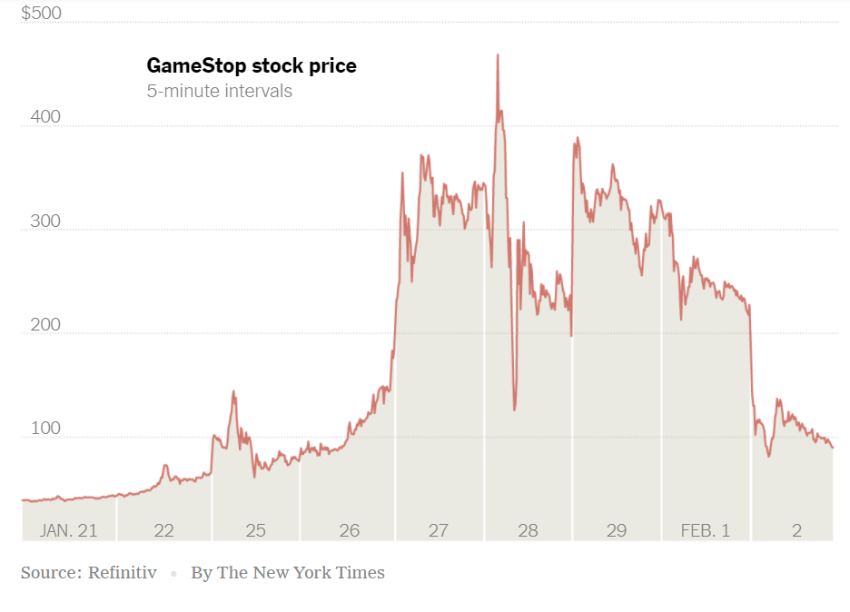

Problem Statement
Can public opinion be used to predict the direction a stock will move on a given day?
APPL
TSLA
AMZN
MSFT
GOOG
GOOGL
Apple
Tesla
Amazon
Microsoft
Google
Notes:
Use machine learning algorithms to predict whether or not a stock price will move a certain direction.
why relevant:
many people argue the market is random
microblogging can lead to unexpected market movements, like gamestop example - though are these rare? How is a stock trading relative to the overall market?
twitter provides fast news for stock price impact - platform that can outpace news vendors
metrics like likes, followers, retweets, comments can act as indicators for the reliance of a reaction to a particular tweet
some stocks can also be more volitile than others
knowing a particular market movement direction can help banks keep the market stable - monitor supply and demand (volume vs. price)

Slide 3
Sentiment Analysis
Analyzer | Trained On | Details | Output
Vader | Social Media Data | Uses list of lexical features that are labeled based on their semantic orientation; sensitive to polarity AND intensity | Sum valence scores of each word in the lexicon (dictionary) and gives positive, negative, and neutral scores → normalized to between -1 (most negative) and +1 (most positive)
Flair | IMDb Data (i.e. movie reviews) | Splits the text into character-level tokens and converts text into a numerical representation in a high-dimensional space | Returns sentiment classification (POSITIVE, NEGATIVE) and intensity from 0 to 1
TextBlob | Product Reviews | focuses on words (mainly adjectives) that it already knows | Returns polarity score between -1 and 1 and subjectivity score between 0 and 1
Notes:
Mention how Vader uses a list of lexical features (e.g. word) which are labeled as positive or negative according to their semantic orientation to calculate the text sentiment. AND it’s from NLTK library
sensitive to both Polarity (whether the sentiment is positive or negative) and Intensity (how positive or negative is sentiment) of emotions
People rated words and this was put into lexicon or dictionary; takes CAPITALIZATION and punctuation into account → Don’t really need any preprocessing because of the important of punctuation; could still remove whitespaces or symbols like hashtags and @
Flair - mention how there’s a scalability/limitation issue because it was taking 2+ hours to run on 4M+ tweets
Textblob - Subjective sentences generally refer to personal opinion, emotion, or judgment; FOCUSES ON ADJECTIVES and based on library called pattern; looks at words in customer reviews

Slide 4
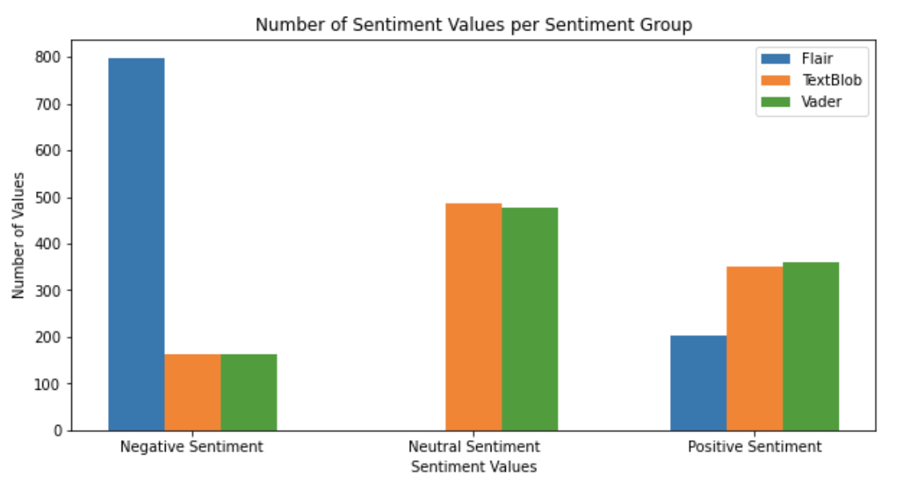
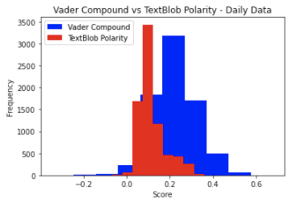
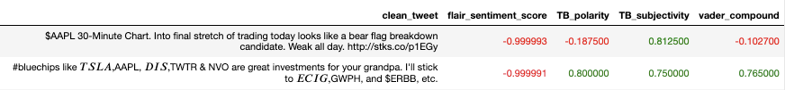
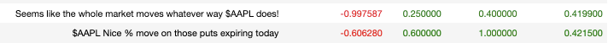
Comparing all Sentiment Analyzers
Notable Tweets
Notes:
Read Tweets out loud that show biggest discrepancy (e.g. flair classifies it negative but TB and vader correctly classify as positive)
Include grandpa tweet - could go either way, to show nuance of different classifiers
Talk about how vader can not only analyze sentiment but intensity of sentiment, whereas textblob looks more at words and gives overall sentiment based on adjectives but can’t really recognize intensity of emotions

Slide 5
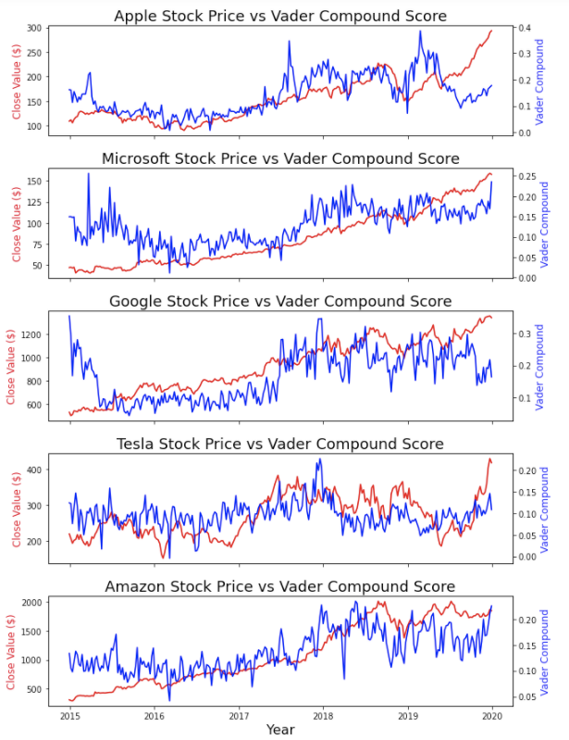
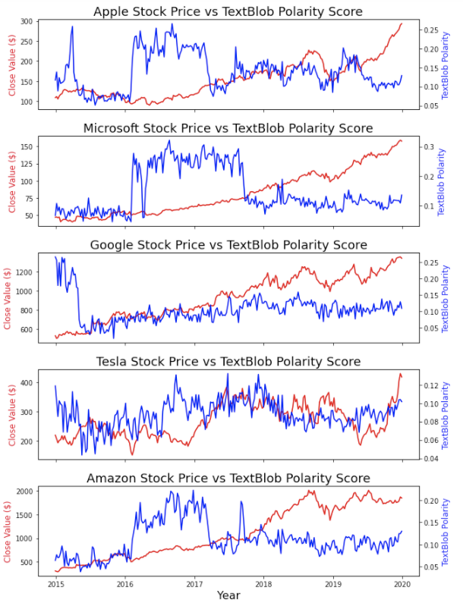
Stock Price vs Sentiment Scores - Vader and TextBlob
vs
Notes:
Point out how vader compound score seems to trend with with stock price but TextBlob polarity is a bit arbitrary

Slide 6
Limitations & Challenges:
Sentiment Classification
Scalability of sentiment analysis libraries (ex: Flair was too slow to run on all tweets)
>4 Million
Tweets
~10 K
Trade Days
~260
Weeks
Sentiment Analysis Performance (edge cases, more neutral leans towards positive indication)
Notes:
Not only did Flair heavily lean toward negative sentiment classification - it was always extremely slow to run. Also more steps because requires more data cleaning - cleaning of individual tweets.
TextBlob also didn’t have the best performance but was ok - VADAR (sentiment intensity analyzer actually worked pretty well (remind trained on tweet data) and was decently efficient). However, there were some edge cases in the classification.
Started with weekly data - learned more about stock market - not geared toward weekly trade volume
Moved to daily - considered trade days only (no weekends or holidays)

Slide 7
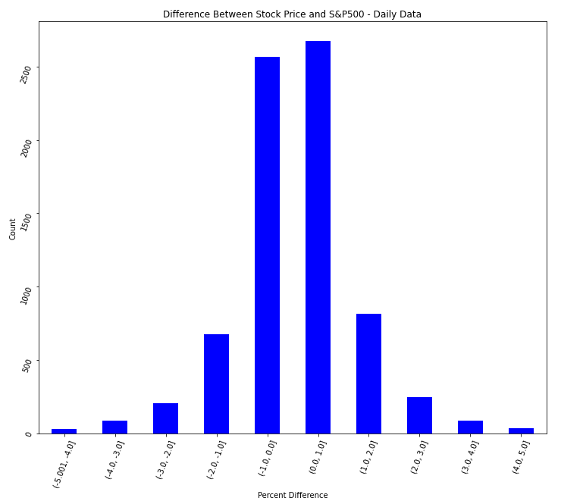
Feature Selection
Variable, per Stock | Derived From
reaction_num | likes, comments, retweets
pct_change* | close value percent change from previous day (1 if pos, 0 if neg)
ratio_pos | VADER compound >0, (Total positive/total pos+neg)
ratio_neg | VADER compound <0, (Total negative/total pos+neg)
Other Variables Used (Derived per Stock)
Volume, total tweets/day, total number unique writers Open value, high value, low value, close value
% Difference in Daily Stock Price vs. S&P 500
2500
-1 to 1 %
Count
0
Percent difference (%)
*indicates predictor variable
Notes:
Determined not to integrate S&P data as predictor/feature because of similarity to the companies used.
Future recommendation would be to deploy model on larger market and create a variable that determines the variation from the S&P data to that of smaller companies. May be able to capture larger shifts that are indicative of/derived from public sentiment

Slide 8
Modeling
Built a total of 12 models:
Started off with a focus on regression, then shifted to classification
2 general modeling approaches for classification models:
Individual model with company as a feature
“Combined” model with one model for each company (6 total)
Used simple linear regression models for regression tasks
Used both decision tree and logistic regression models for classification tasks
Improved performance for classification models through hyperparameter tuning using GridSearchCV
Hyperparameters tuned:
Logistic regression: solvers, penalties, C values
Decision tree: max depth
Notes:
Discuss why we chose to focus on decision trees and logistic regression
Mention response variables for models (close value)
Talk about hyperparameters tuned

Slide 9
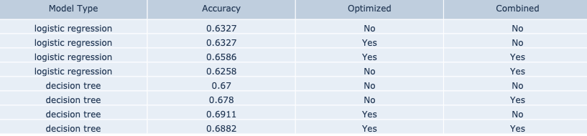
Performance
“Optimized”: used hyperparameter tuning
“Combined”: averaged unique models for each company
Notes:
Mention that sometimes the “combined” model gave a boost and other times it didn’t (similar thing for the hyperparameter tuning)
Best accuracy achieved: 0.6911 (almost 70%)
Mention that logistic regression might have performed better than decision trees with more data

Slide 10
Results Interpretation
Go with optimized decision tree
Better than coin flip
Focused on stock price change (up or down) for now but can expand in future

Slide 11
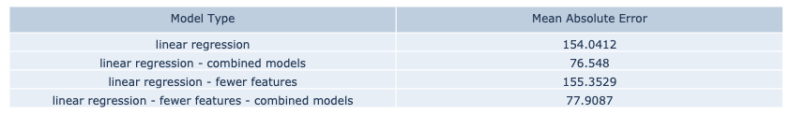
Limitations & Challenges
Other/Model Specific
Predicting actual price change is more challenging than predicting directionality
Depending on the stock, there can be high or low volatility
Use acceptable absolute error as an indicator

Slide 12
Next Steps
Experiment with more modeling approaches
Try to model volume of stock trades based on tweets
Integration of more companies’ stock data
Create an “ensemble” sentiment analyzer that integrates multiple libraries and creates a best guess for sentiment of tweet
Notes:
Talk about comparing different sentiment analyzers as a feature and mention how we don’t care as much about accuracy of sentiment as accuracy of model
Could have built a sentiment analyzer on our own as well if we had more time

Slide 13
Questions?
Thank you all for listening!

