Slide 1
Fingerprint Scanner
Barret Heaton

Slide 2
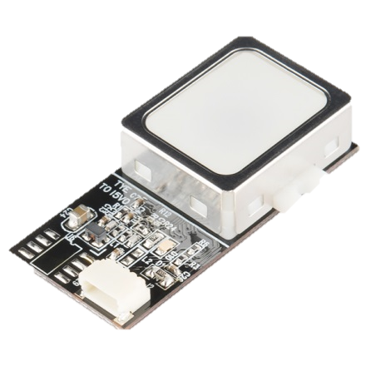
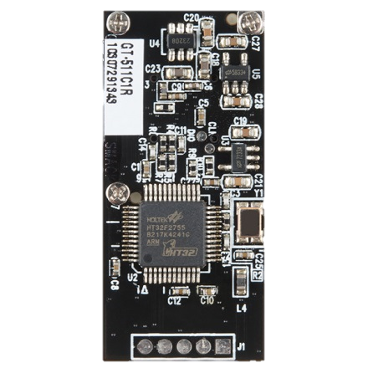
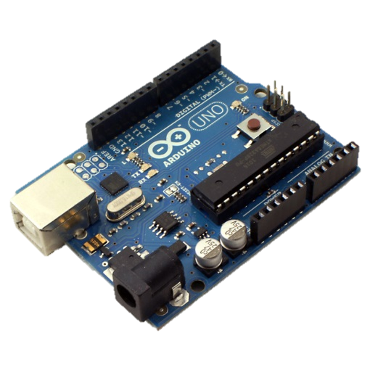
Fingerprint identification
The overall goal was to interface the Arduino Uno with a module that provides functionality towards a smart, secure house, while also being unique in its own right.
Front
Back

Slide 3
GT-511C1R Specs
Simple UART protocol
Baudrate: 9600 bps (default)
2 Byte checksum
SmackFinger 3.0 Algorithm (ID logic)
ARM Cortex M3 Core Processor
On board memory storage (up to 20 fingerprint entities)
1:1 and 1:N identification
Dimensions: 37x17x9.5 mm

Slide 4
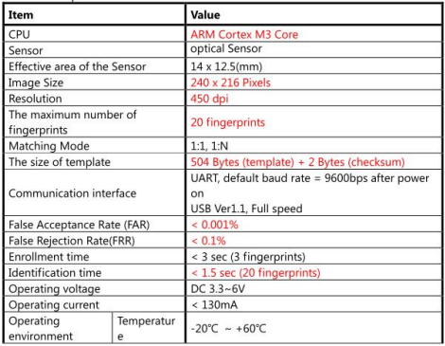
GT-511C1R Specs

Slide 5
Parts & Cost
Low End : $55.33
Arduino Uno (R3): $20.88
GT-511C1R : $31.95
JST SH Jumper 4 cable: $2.50
1.3k resistor
640 resistor
High End : $85.40
Arduino Mega 2560: $32.95
GT-511C3 : $49.95
JST SH Jumper 4 cable: $2.50
1.3k resistor
640 resistor

Slide 6
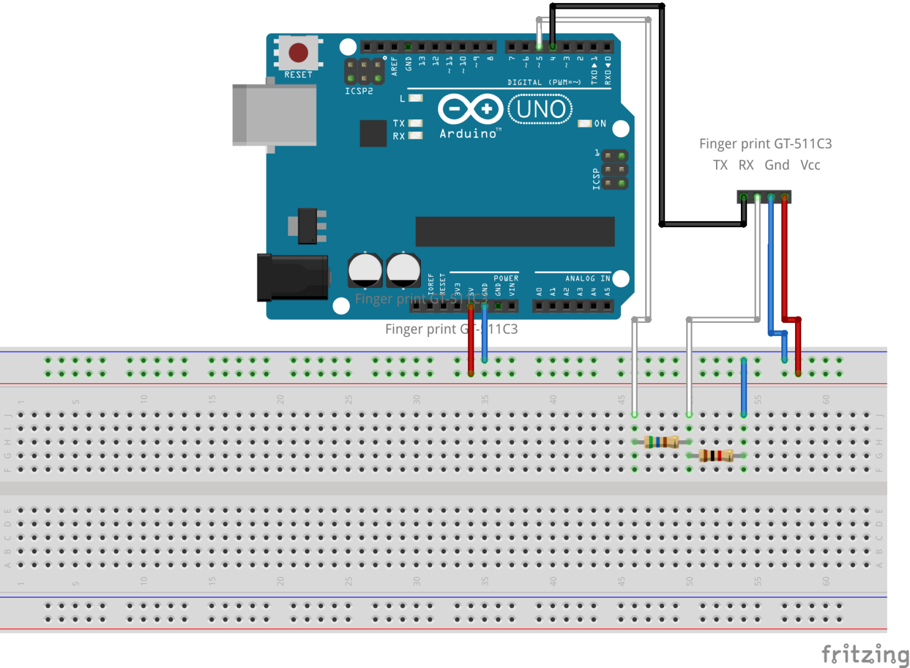
Schematic

Slide 7
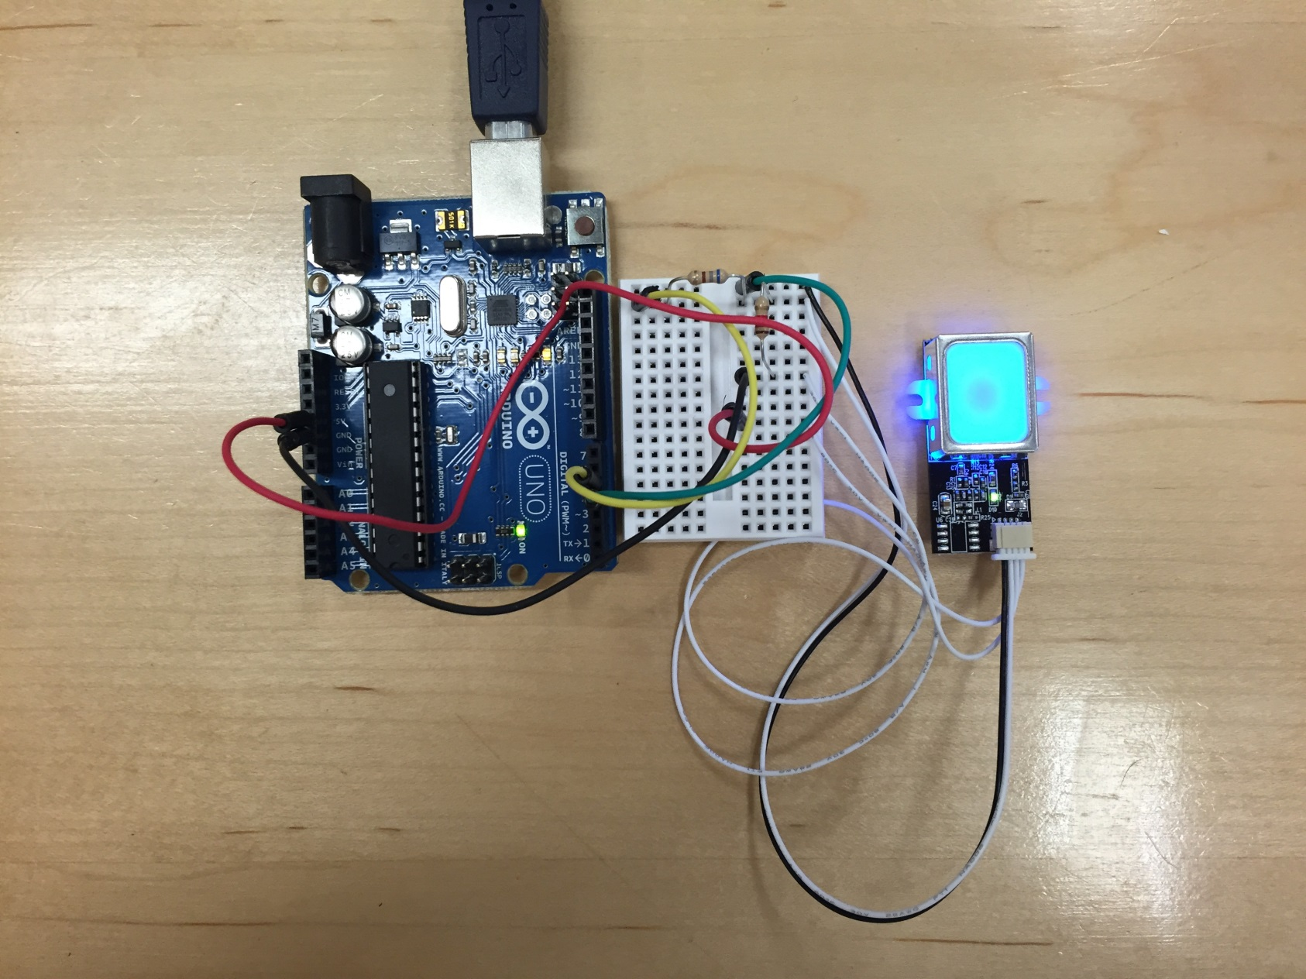
SCHEMAtic

Slide 8
Scalability
For the group project:
The RFID Door Lock system can utilize the fingerprint scanner in multiple ways:
Backup system when RFID reader fails
2-way authentication system when security protocol is heightened
Enrollment system of new ID tags, to tie a unique tag to single person
Enrollment system of guests, to securely connect a ID tag to a specific person

Slide 9
Scalability
Expansion:
Looking towards a fully secure, smart household, the fingerprint module can be used for more private or valuable access points of the house (safe, medicine cabinet, etc.) where misplacement of the RFID tag would be dangerous.
Adding a wifi or BLE module so that identification of a user can trigger house- wide events (lights, heat/AC, etc.)

Slide 10
Technical Issues
Difference between the C3 and C1R modules:
C3 has increased memory (200 fingerprints)
C1R (20 fingerprints
C3 has much more library support, less prone to damage from current/voltage
Uno:
The original Arduino Uno has a fatal design flaw to the way the library works. Because the way the USB line is connected to the reset pin, calling the serial monitor is used by calling the DTR line, which resets the board. The module (and its library) does not expect this and the serial communication crashes.
The Uno R3 changed this design flaw by adding a diode across the ATMEGA pin pull-up resistor as well as adding a 1k pull-down resistor to the DTR line. Therefore it does not crash and the library can handle the serial monitor call.
In regards to the Mega, the module can be setup more simply with the use of the boards second serial line, circumventing the need for the SoftwareSerial library.

Slide 11
References
http://cdn.sparkfun.com/datasheets/Sensors/Biometric/GT-511C3_datasheet_V1%201_20130411[4].pdf
https://github.com/sparkfun/Fingerprint_Scanner-TTL
http://www.homautomation.org/2014/10/11/playing-with-finger-print-scanner-fps-on-arduino/
http://wordpress.hawleyhosting.com/ramblings/?p=375

