Slide 1

Efficient Marketing
Prediction

Slide 2
Problem statement
Due to so many uncertainties in insurance industry and its low return on investment, it is harder for them to always maintain a competitive position.
Our client, a car insurance company, is one of the biggest insurance companies in the past few years. But it suffered from decreasing profit recently. Therefore, they wanted to hire a predictive analysis team to help them deal with the data and optimize their marketing efforts.
Our team is here to help them find which set of customers the firm should contact to maximize profit. The solution is aiming to increase their efficiency and earn more profit in order to attain a sustainable development.
Notes:
Insurance companies must try their best to increase their efficiency and target more precisely on certain consumers segments in order to make profit.
But it suffered from inefficient management and did not achieve their marketing goals recently.
They suffered a loss of profits because they did not process the data effectively.

Slide 3




Executive Summary
Findings
Euribor 3 month rate, profession and schooling are the most important factors to predict whether the customers would respond
Question
Need to determine what customers the company should contact and the profits the company can get from those customers
Solution
data cleaning; find critical variables; set up a predictive model in order to predict customers’ response and profit; verify the model performance and validation
Recommendation
Establish a predictive system to help companies make decisions on their target customers; use different methodologies to improve the model

Slide 4


Table of contents
Problem statement
Executive summary
Background
Methodology
Data
Descriptive analyses
Modeling framework
Findings
Summary and conclusions
Recommendations

Slide 5

Background
Fixed cost: $30 per customer. This cost is paid regardless of whether the customer responds or not
Profit: There is a profit only if a customer responds
Data: A historical data set and a list of potential customers
Future: Use this model into similar business scenario and apply it to other appropriate industries
Company X is commissioned by an insurance company
Goal: Develop a tool to optimize their marketing efforts by finding which set of customers the firm should contact to maximize their profit

Slide 6

Background
Known:
Historical data set
Testing data set
Different variables
Gaps:
Combine data with response (profit)
Deal with missing data
Tech & Business

Slide 7
Methodology
Data
Data Description
Data Processing
Descriptive analysis
Relationship+Assumption+Evidence
Models
Classification+Regression
Model selection
Model evaluation

Slide 8
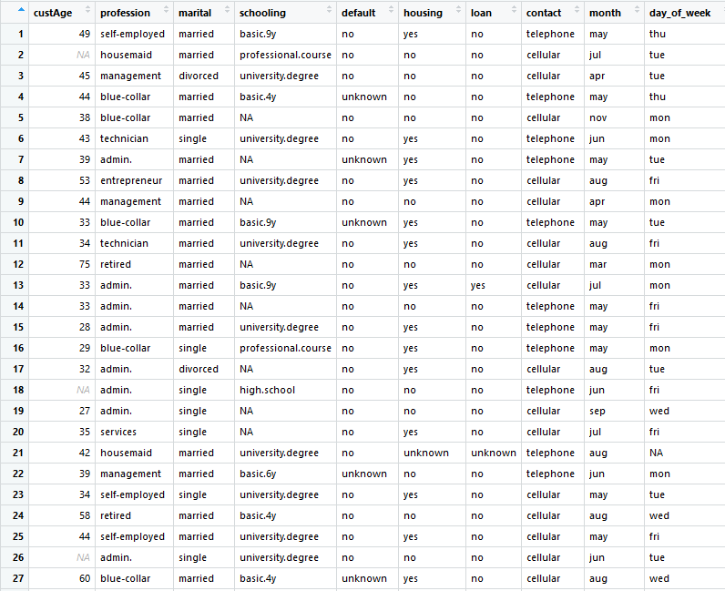
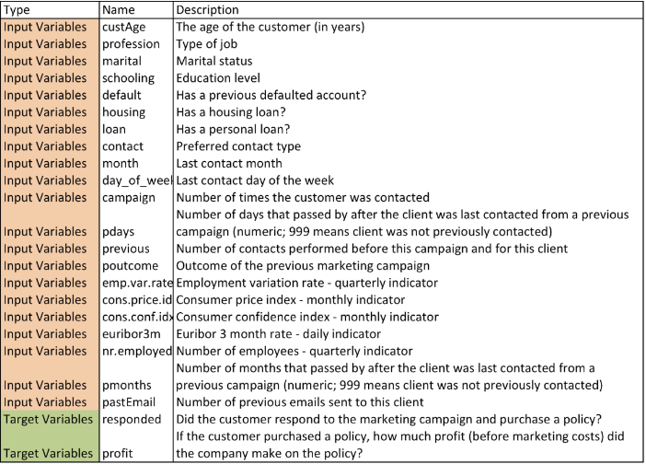
Data--description
missing values?

Slide 9
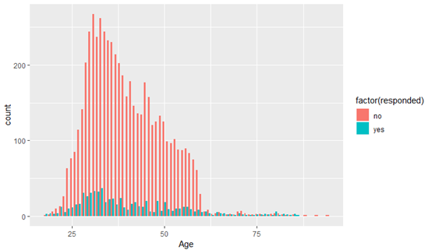
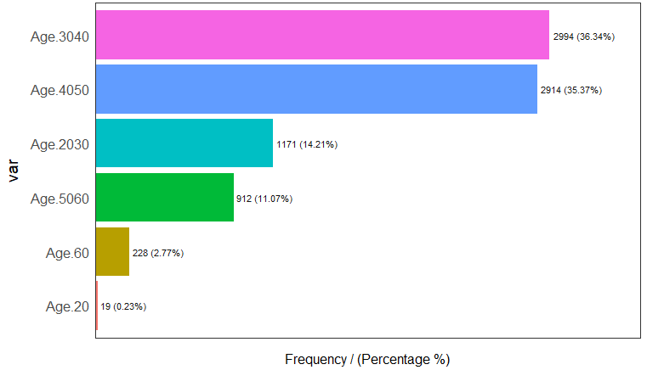
Data distribution & exploration
custAge with response
custAge after binning

Slide 10
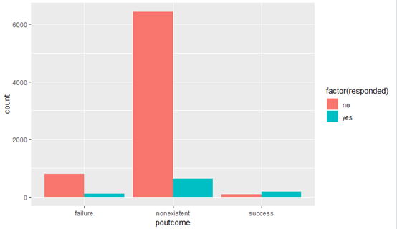
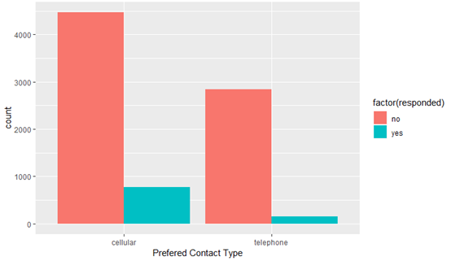
Data distribution & exploration
poutcome: outcome of the previous campaign
Customers with success previous marketing campaign are more likely to response
Contact: prefered contact type
Customers choose cellular as prefered contact type are more likely to respond "yes"

Slide 11
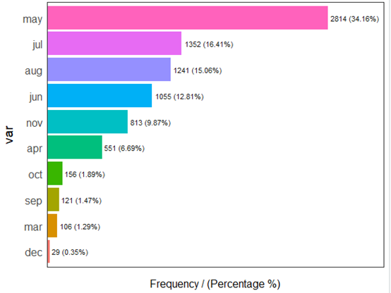
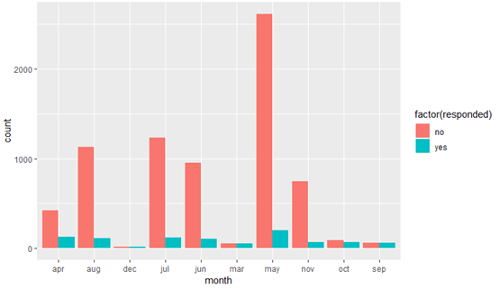
Data distribution & exploration
month
Month with response

Slide 12
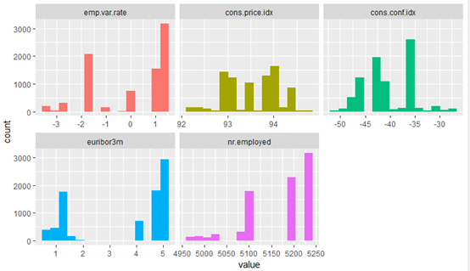
Data distribution & exploration
Other numerical data distribution:

Slide 13



Data--Processing
Main Tasks
Check abnormal values in the data
To fill in the NAs
To transfer the continual variables into categorical variables
Check the correlation relationship among the variables
Dimensionality reduction
By making groups
Fill in the missing values in “schooling” and “custAge”
concentrate on the features instead of the real continual values
preparation for classification
definition check
correlation check
PCA

Slide 14
Descriptive Analysis
In order to provide a view of the data and the relationship between data
Random Forest is used to decide the weight of each predictors
Due to the lack of the test data’s response variables, we validate our model by split the training dataset

Slide 15
Model Framework
Classification
Random Forest + Logistic models + QDA
Each observation belongs to the commonly occurring class of training observations in the region to which it belongs
Advantages
easy to explain
Base
multi-dimensional
to predict the “responded” only needs to categorize the group.
most of the variables are converted into categorical factors and the remaining numerical variables have limited values
Evaluation
accuracy
precision
Notes:
in the classification setting, RSS cannot be used as a criterion for making the binary splits, so we use the classification error rate.

Slide 16
Classification

Slide 17
Analysis Method
Training data set
8238
6000
2238
Testing data set
32950

Slide 18
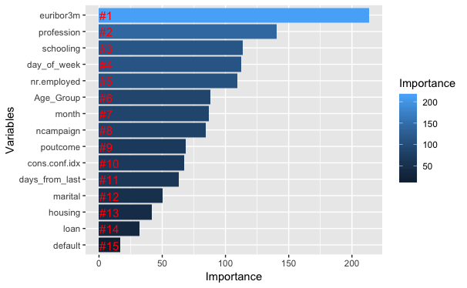
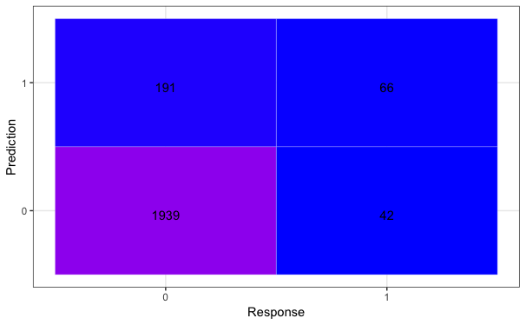
Random Forest
Accuracy
Overall acurracy:0.9
Accuracy for “yes”: 0.2

Slide 19
Logistic models
Logistic thresholds
Logistic 1
Variables:
Age_Group, ncampaign, profession, schooling, marital, default, housing, loan, month, day_of_week, poutcome, cons.conf.idx, euribor3m, nr.employed, days_from_last
Logistic 2
Variables:
Age_Group, profession, schooling ,default, month, day_of_week, poutcome, cons.conf.idx, euribor3m, nr.employed, days_from_last
 | p>0.5 | p>0.2 | p>0.1 | p>0.05
Logistic 1 | 0.9/0.24 | 0.86/0.52 | 0.81/0.63 | 0.61/0.78
Logistic 2 | 0.9/0.2 | 0.86/0.52 | 0.81/0.62 | 0.6/0.79
In a format of “Overall accuracy/True Positive Accuracy”

Slide 20
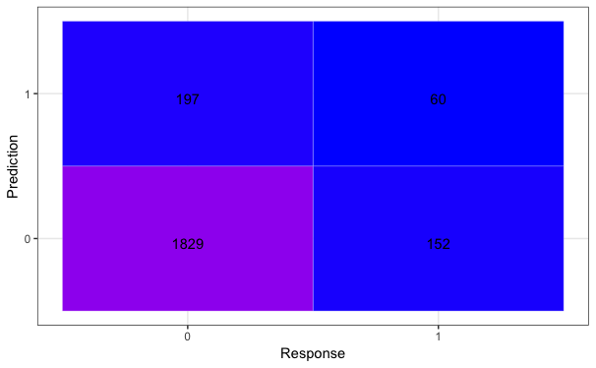
QDA
Predictors
-euribor3m
-profession
-day_of_week
Accuracy
Overall acurracy:0.9
Accuracy for “yes”: 0.2

Slide 21
Classification Overall
Model | Random Forest | Logistic | QDA
Accuracy | 0.9/0.2 | 0.82/0.62 | 0.9/0.2
In a format of “Overall accuracy/True Positive Accuracy”
Among the 32950 observations of test data, 7075 will respond. With a response rate of 21.47%.

Slide 22
Model Framework
Regression
linear + lasso
We filter out those who did not respond the company (only need those who made ‘yes’)
The company got the same profit (-$30) from those who made ‘no’ so they are redundant
set up a linear regression model and predict the profit using filtered testing data
lm.fit <- lm(profit ~ custAge + ncampaign + profession + schooling + marital + default + housing + loan + month + poutcome + cons.conf.idx + euribor3m +nr.employed + days_from_last, data=trainwithprofit)
Notes:
in the classification setting, RSS cannot be used as a criterion for making the binary splits, so we use the classification error rate.

Slide 23

Analysis Method
Training data set
928
728
200
Testing data set
1601

Slide 24
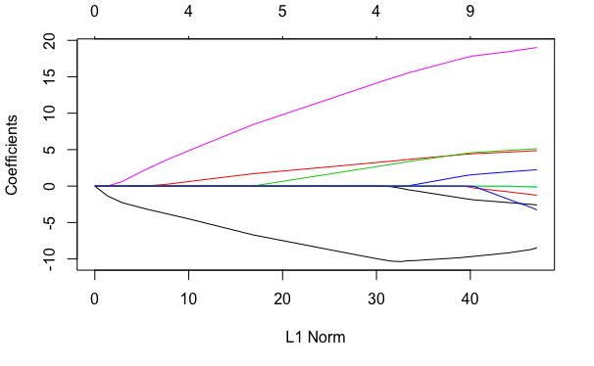
Lasso
Variables:
euribor3m,
profession,
schooling,
day_of_week,
nr.employed,
Age_Group,
month,
ncampaign,
cons.conf.idx,
poutcome

Slide 25

Summary of conclusions
1. Goals and Achievements
we try to classify the people into two groups “respond”+”not respond”, then predict how much we could earn from those who “respond”.
2. Methods
Using random forest tree and logistic models to do classification and linear regression to figure out the profit.
3. Limitations
In the classification part, using classification error is not sufficiently sensitive for tree-growing. Linear regression is not flexible to recognize complex mode and it is difficult to add effective interaction items.
Not inlcude more methods to do comparison
Did not have a better solution to which variable should be chosen, even if we have tried to do dimensional reduction. Lack of effective ways to maximize the total profits.

Slide 26
Recommendations
1. For future business use
Euribor 3 month rate, profession and schooling are the most important factors to predict whether the customers would respond.
Improve the prediction function we could predict how much we could earn in total.
Establish a predictive system to help companies make decisions on their target customers. E.g. promotion list , risk forcast
2. For future improvements
Embrace data challenge in the real world, deal with abnormal values
Improve the skills of applying knowledge in statistics and predictive analysis
Using different methodology, like reinforcement learning, neural network to improve the model while adding dynamic mechanism to catch up with trend

Slide 27

Thanks for listening

