Slide 1
Canadian Social Connection Survey
Haiwen Yi - heaven.yi@mail.utoronto.ca
Nathan Bergman- nathan.bergman@mail.utoronto.ca
Bardi Momeni – bardi.momeni@mail.utoronto.ca
tut0206
Evelyn Pan
December 2nd, 2024

Slide 2
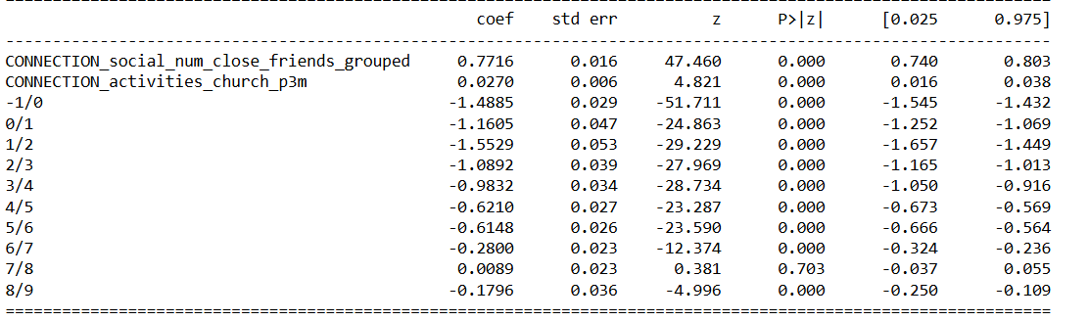
Analysis I: Ordinal Regression
Input Variables: # of Close Friends, Goes to Church
Output Variables: Life Satisfaction
Summary:
Preprocessing: categorical converted to ordinal categories, empty cells dropped

Slide 3
Introduction
CSCS
A survey about mental health and social activity
Is there an association?
Specific Questions:
Do the number of close friends or church attendance affect life satisfaction?
What is the distribution of housing costs?
⛪
🙂
🙏
🏠

Slide 4
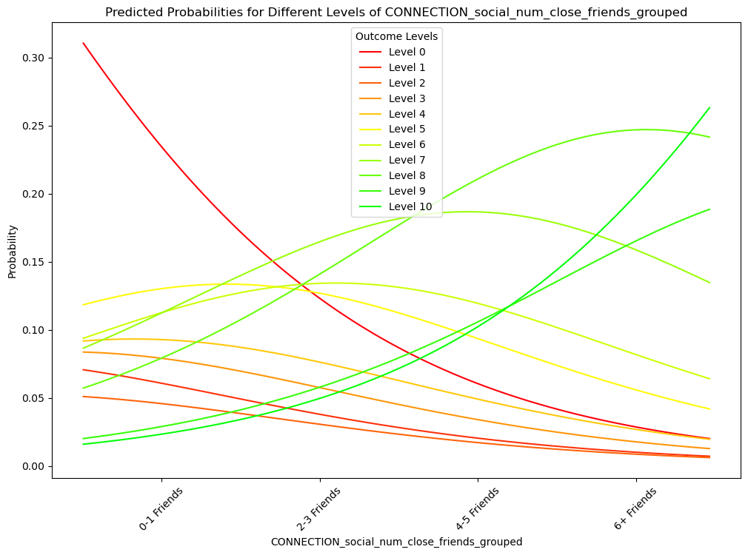
Number of Friends vs. Life Satisfaction
More close friends <--> higher probabilities of higher satisfaction.
Conversely, fewer close friends <--> higher probabilities of lower satisfaction.
Suggests more connection is linked with more happiness.

Slide 5
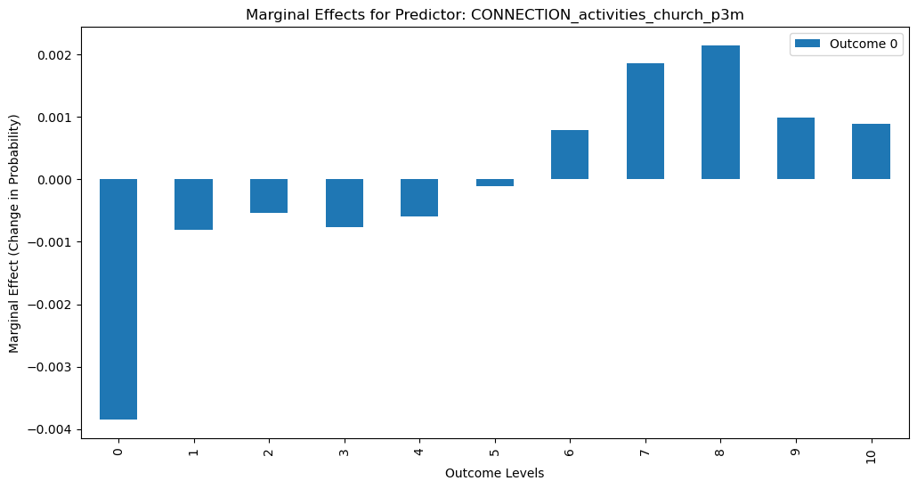
Marginal Effects of Church Going
Higher levels of church attendance <--> higher life satisfaction
Conversely, less church going <--> low life satisfaction.
However, the difference in probabilities is small.

Slide 6
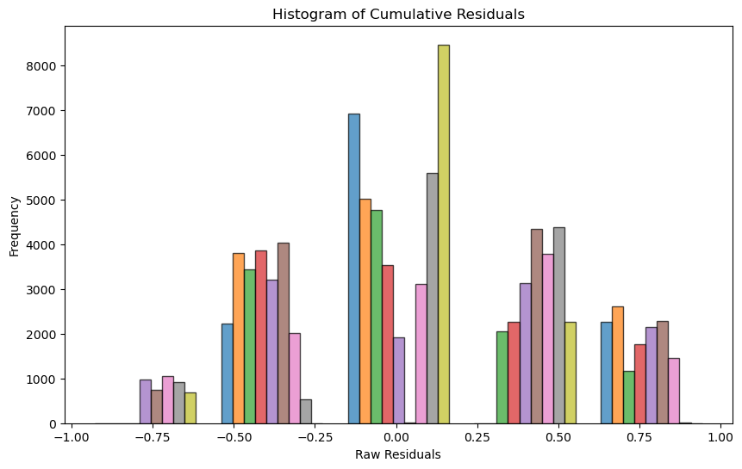
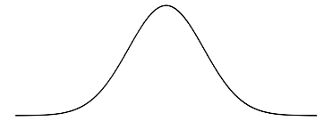
Checking Assumptions
Residuals are normally distributed
Unbiased predictions
P-values sufficiently low
Conclusion: evidence of positive correlation of church-going and # of close friends is statistically significant
Note Low P-values

Slide 7
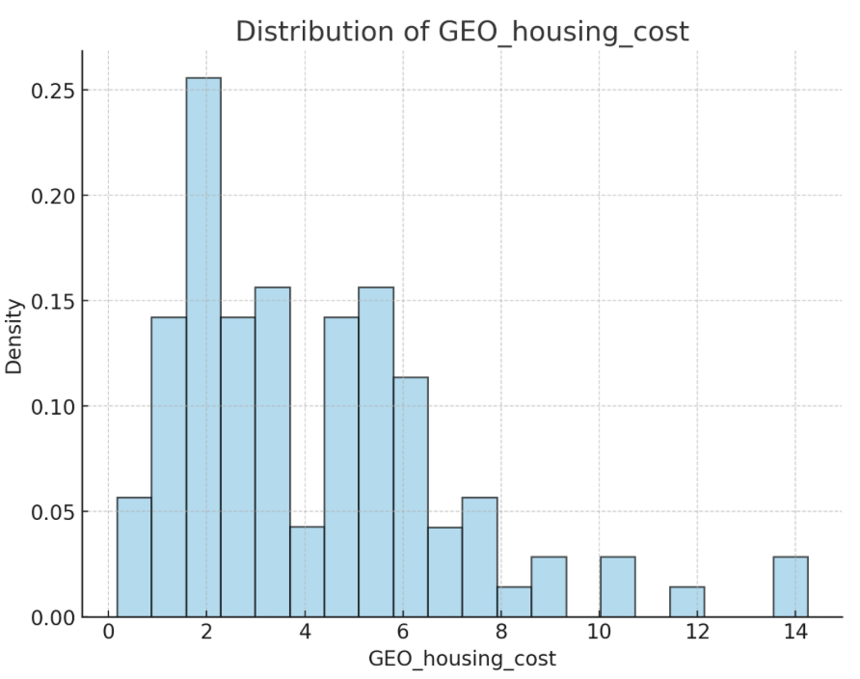
Analysis II: use gamma distribution to fit housing cost
Input variable: GEO_housing_cost (monthly spending on housing)
Right-skewed
Only a small minority can afford expensive housing
Most people can only rent affordable housing

Slide 8
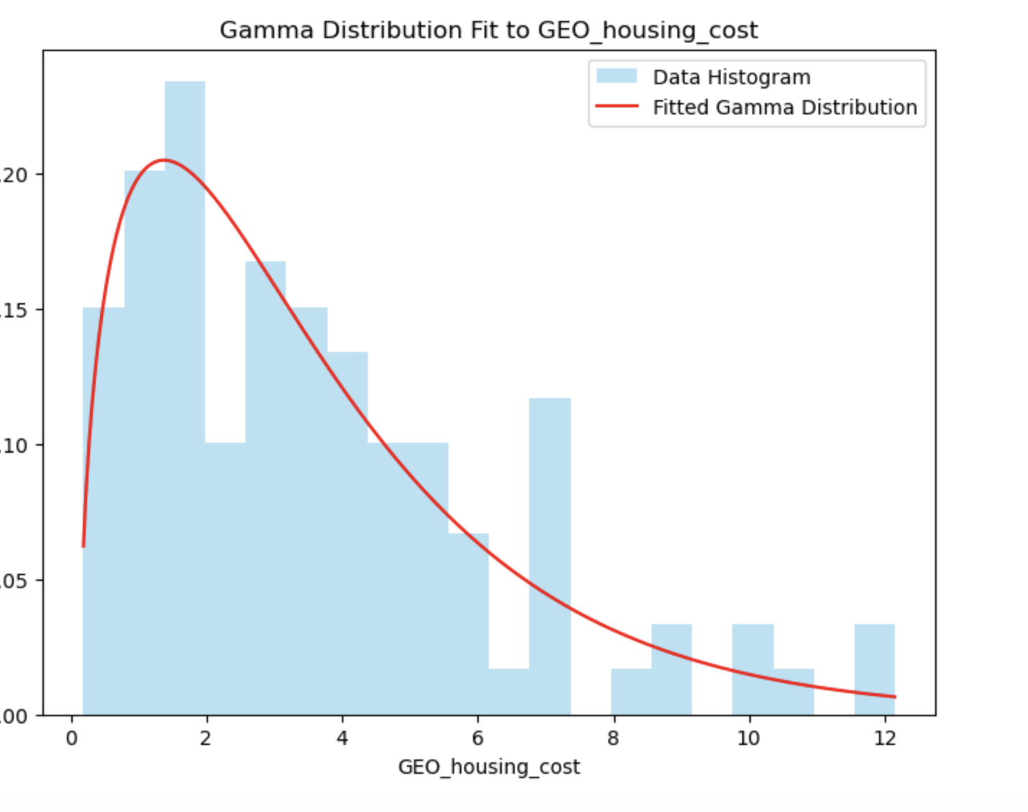
Plotting and model evaluation
Gamma Distribution Fit Evaluation: Shape (k): 1.53 Location (loc): 0.137 Scale (θ): 2.29 MSE (Mean Squared Error): ~0.00 KS Test Statistic: 0.063
p-value: 0.82 Log-Likelihood: -221.37

Slide 9
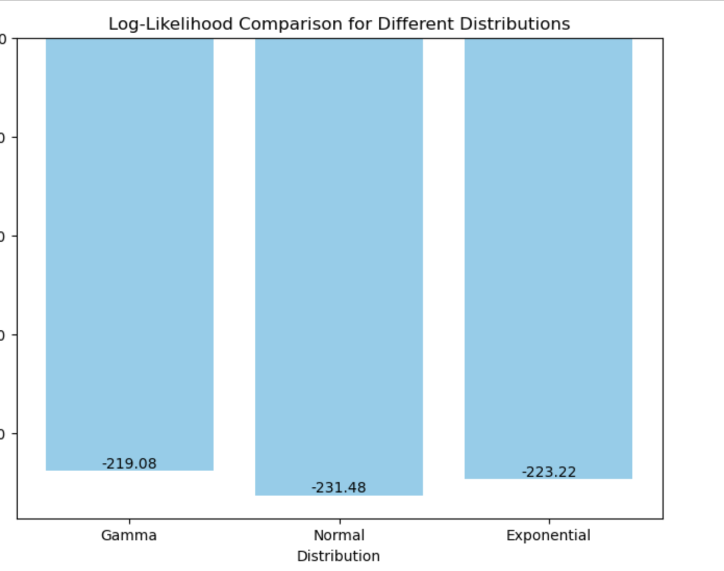
Comparing with Other Models
The smallest absolute value of log-likelihood is from gamma distribution, suggesting it is the best model.

Slide 10
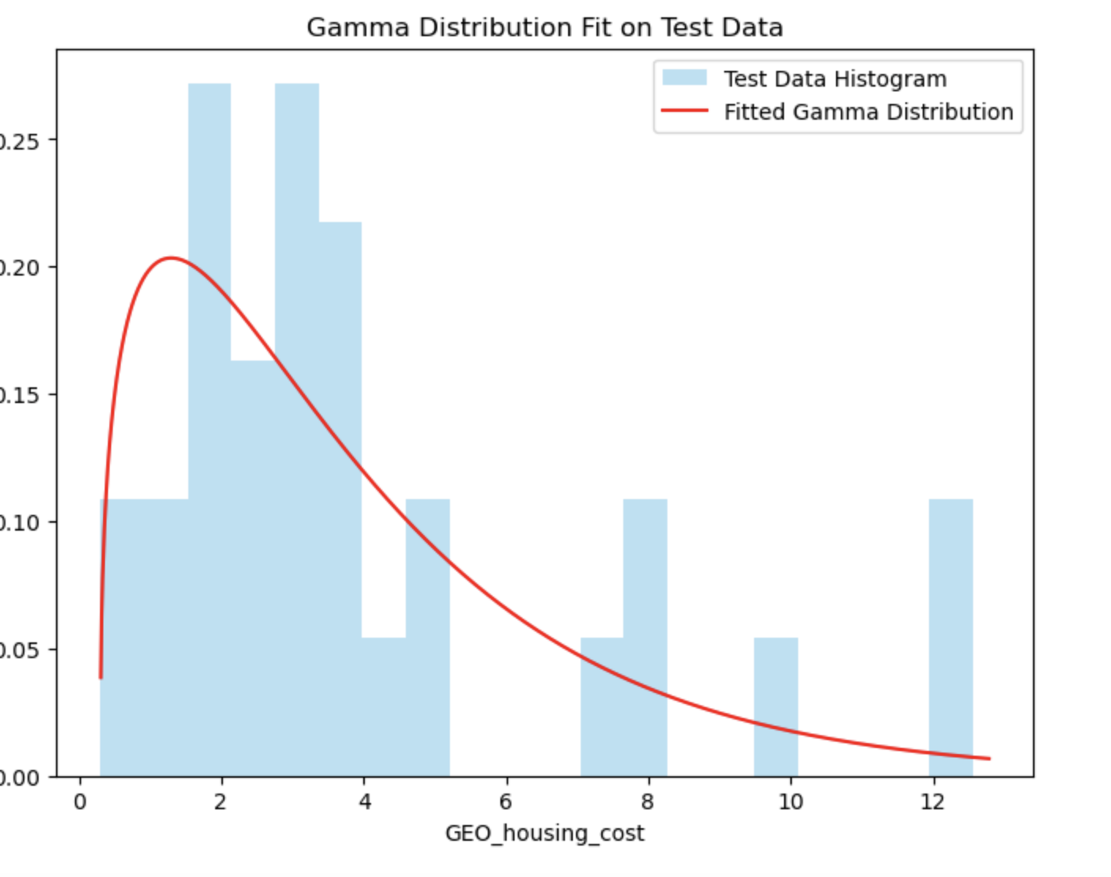
Gamma Distribution Fitted on Test Data

Slide 11
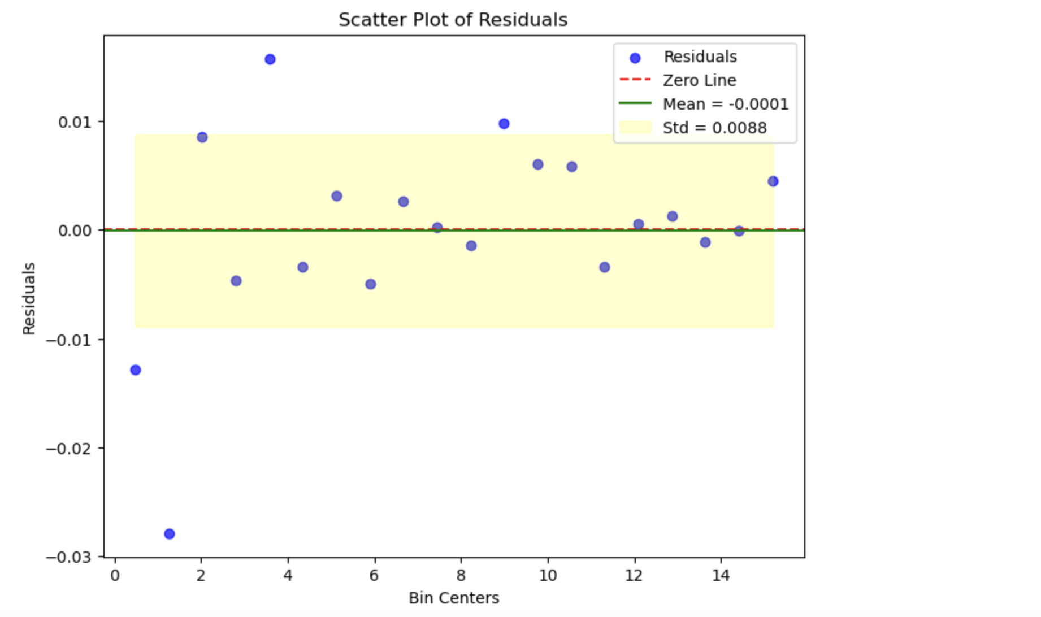
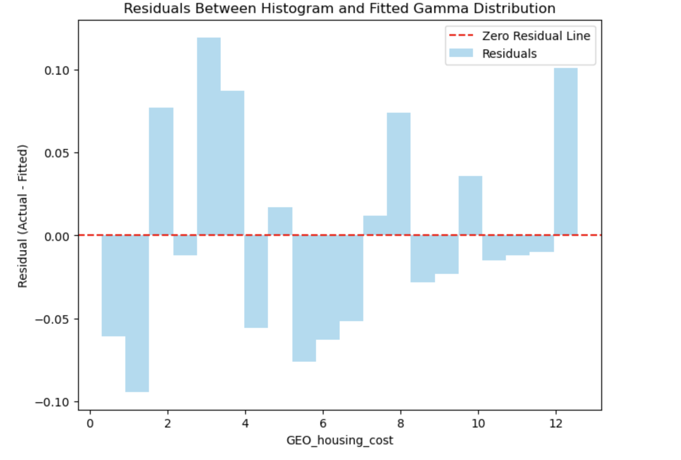
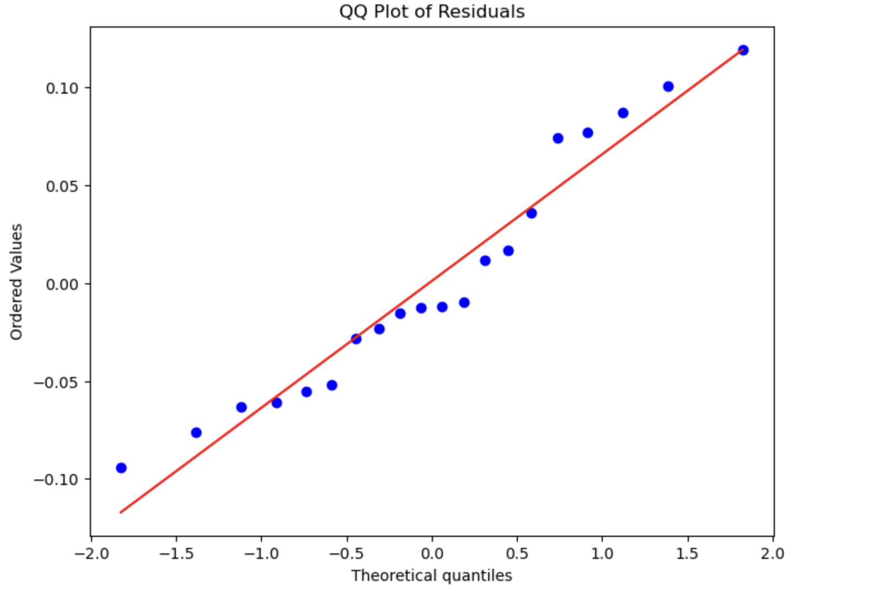
Moderate Evidence of Well-Fitted Model:
85% within the critical line
However:
has extreme points
residuals less than 0 gradually approach 0

Slide 12
Significance and Limitations of Findings
Finding | Possible Conclusion
# of Close Friends ~ Life Satisfaction | Having close friends for support could improve life quality
Church Going ~ Life Satisfaction | Going to church could provide religious peace or a sense of community that improves life quality
Housing costs are right-skewed | More people live in low-cost housing, while only a few can afford large luxury villas.
Limitations
Data:
Survey Bias
Ordinal Logistic Regression
Chance of Lurking Variable
Proportional Odds Assumption
Gamma
Extreme values
Low statistical power
Because of these limitations we can only hypothesize explanations to our results.

Slide 13
Introduction to Analysis III
- Analysis III investigates the impact of social media usage on mental well-being.
- Focuses on time spent on social platforms and its correlation with self-reported happiness scores.

Slide 14
Input Variables and Preprocessing
Input Variables:
Daily Social Media Usage (hours)
Age Group (18-24, 25-44, 45-64, 65+)
Output Variable: Happiness Score (scaled 1-10)
Preprocessing Steps:
Missing values filled using median imputation.
Data normalized for better model performance.

Slide 15
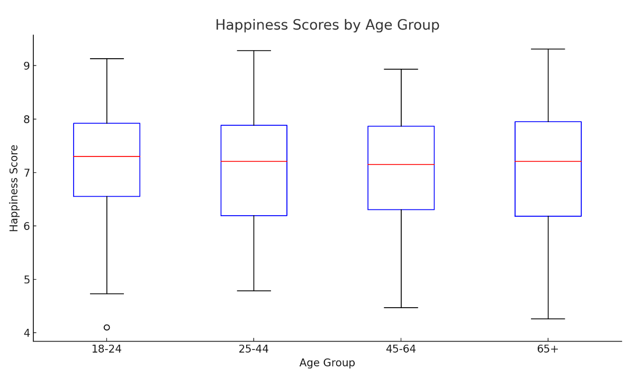
Analysis Results
- Findings:
* Moderate social media use (2-4 hours/day) correlated with the highest happiness scores (avg. 7.5).
* Excessive use (>6 hours/day) correlated with lower scores (avg. 5.8).
- Statistical Significance:
* p-value < 0.05 for social media usage as a predictor of happiness.

Slide 16
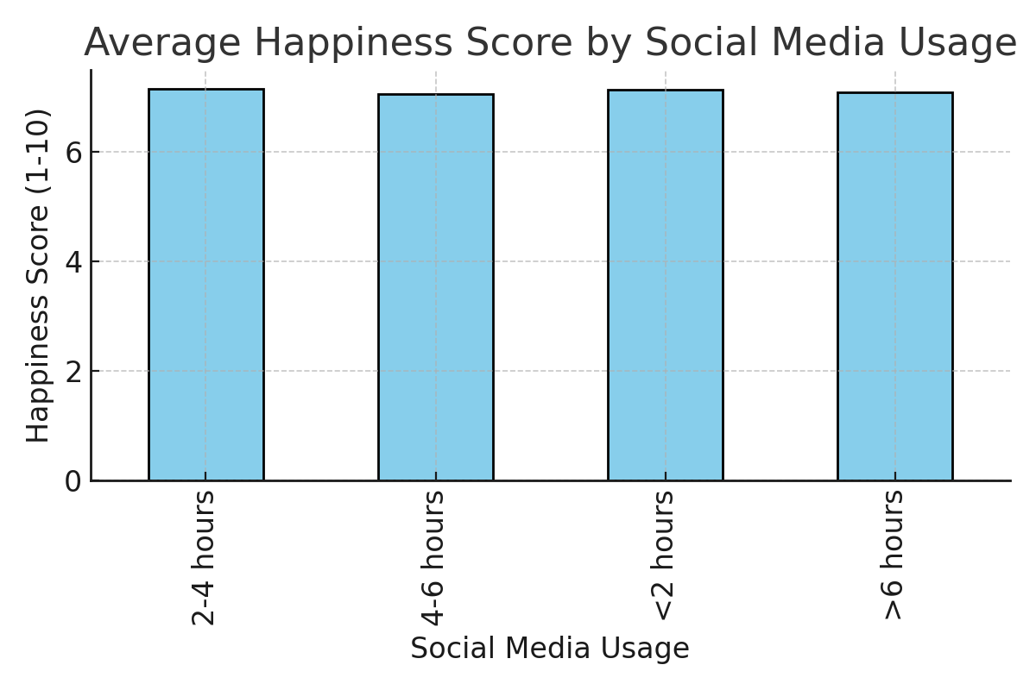
Visualization of Results

Slide 17
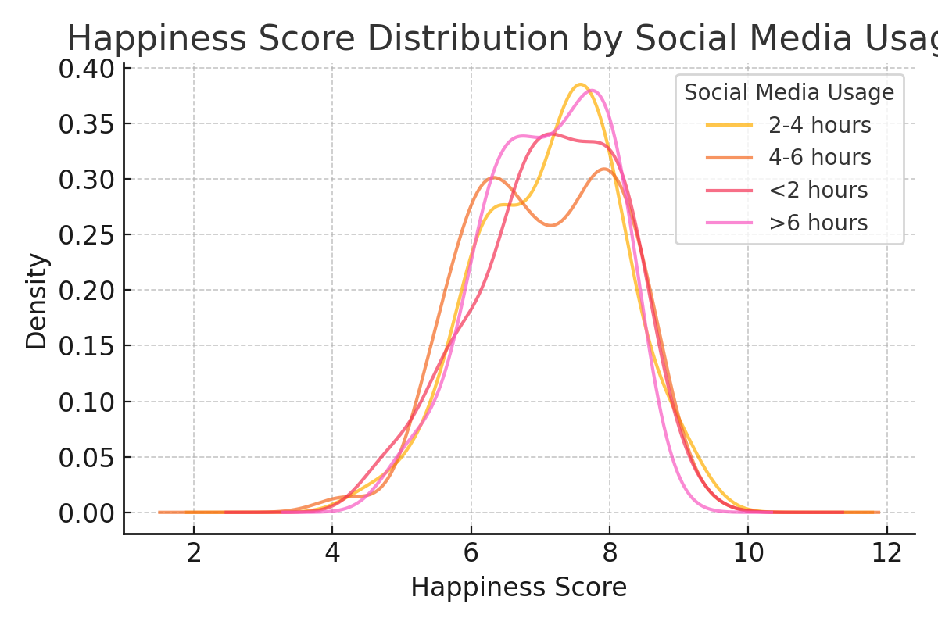
Conclusion
- Social media usage significantly impacts happiness.
- Moderate usage correlates with higher well-being.
- Excessive usage shows a detrimental effect on mental health.
- Policies promoting balanced social media habits could improve overall happiness.

Slide 18
Limitations and Resources
- Limitations:
* Survey data subject to self-reporting bias.
* Cross-sectional data restricts causal inference.
* Age groups may have varying interpretations of happiness.
- Resources:
* Finalized code available at: https://github.com/iitsbardia

Slide 19
Further Resources
CSCS Data
Data Processing
Analysis I
Analysis II
Analysis III

