Slide 1
Kangaroo Kids Portal
Comprehensive System Walkthrough & Feature Overview
Created: July 2026 Target Audience: School Administration & Stakeholders

Slide 2
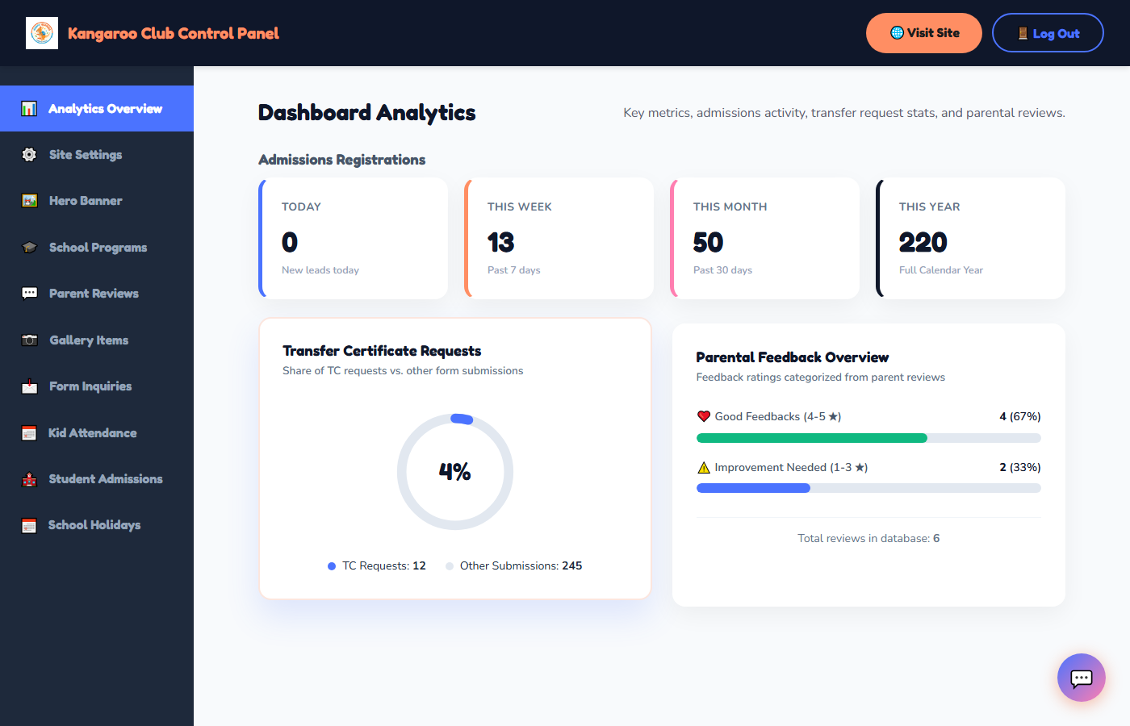
⚙️ Site Settings & Global Branding
Branding & Configuration
• School Logo Upload: Supports editing and configuring the global logo.
• Name & Branding: Configurable school name synced across all parent headers.
• Contact Information: Dynamic address, phone, and official support email entries.
• Government Approval Details: Added dedicated approval input fields for Karnataka education regulations.
• Dynamic Binding: Automatically inserts registration codes on promotion cards and leaving forms.

Slide 3
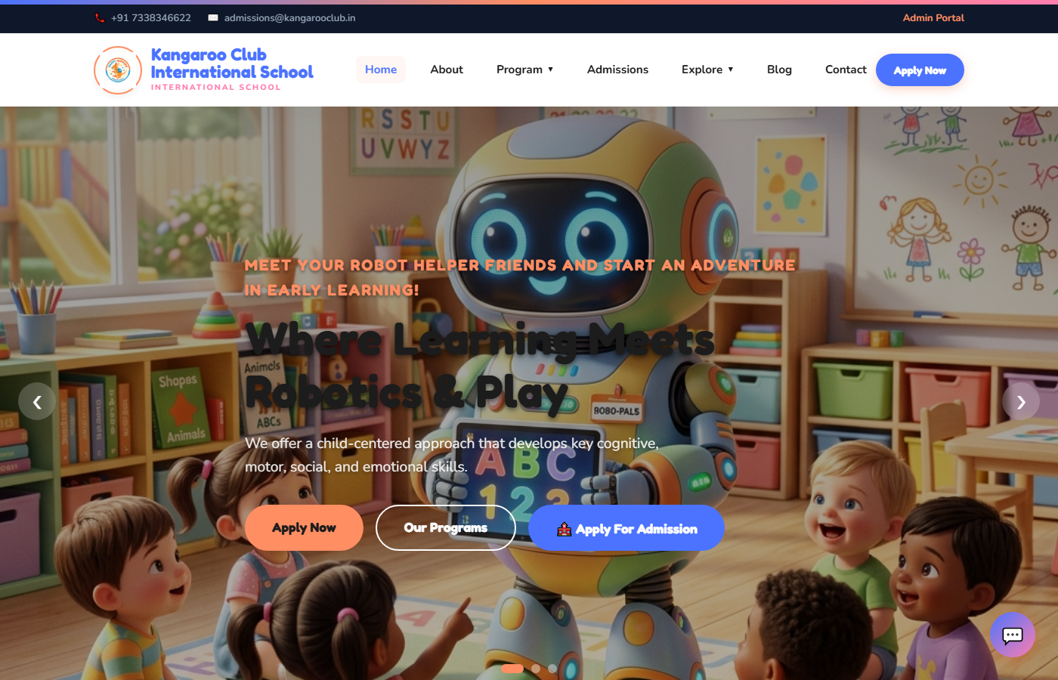
🖼️ Homepage & Parent Experience
Public Interface Features
• Dynamic Hero Slider: Engaging custom banners highlighting preschool events.
• Learning Programs: Curated cards describing Toddler, Preschool, and Kindergarten curricula.
• Parent Reviews Slider: Visual, animated slider displaying positive parent testimonials.
• School Photo Gallery: Slide preview showcasing creative playtime activities.
• Virtual Assistant Chatbot: Smart support chatbot answering visitor questions regarding admissions, fees, and timings.

Slide 4
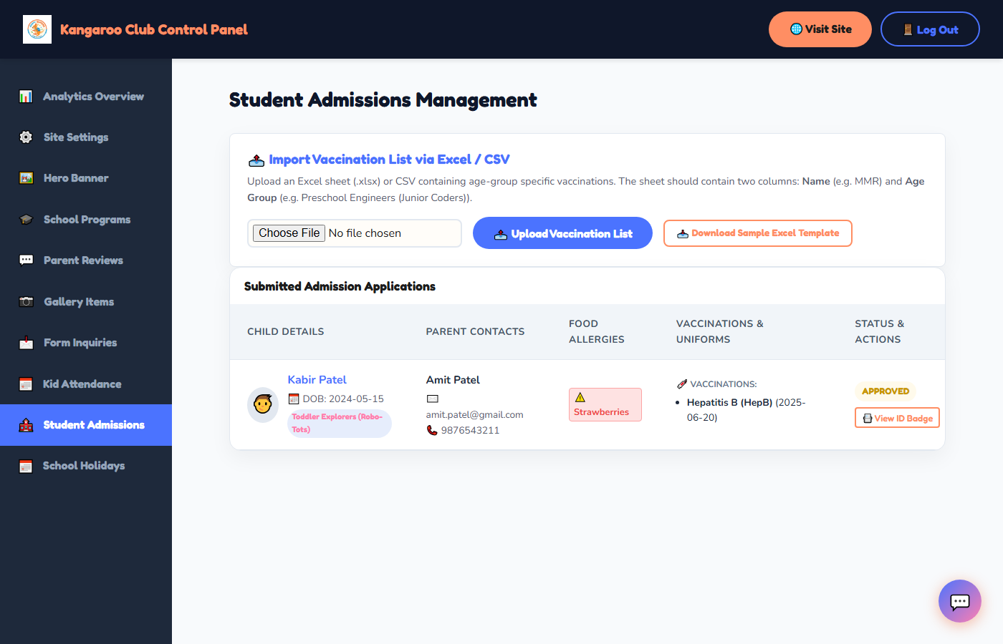
🏫 Admissions & Vaccinations Manager
Student Admissions Portal
• Digital Onboarding Form: Simple parent inputs for child, parent, email, and phone.
• Age-Group Admissions: Automated grade-specific enrollment paths.
• Uniform Checklist: Built-in selections for issued uniforms, bags, caps, and shoes.
• Contact Records: Collects emergency phone contacts and student blood groups.
• Medical Safety Tracker: Integrates immunization schedules with registration.

Slide 5
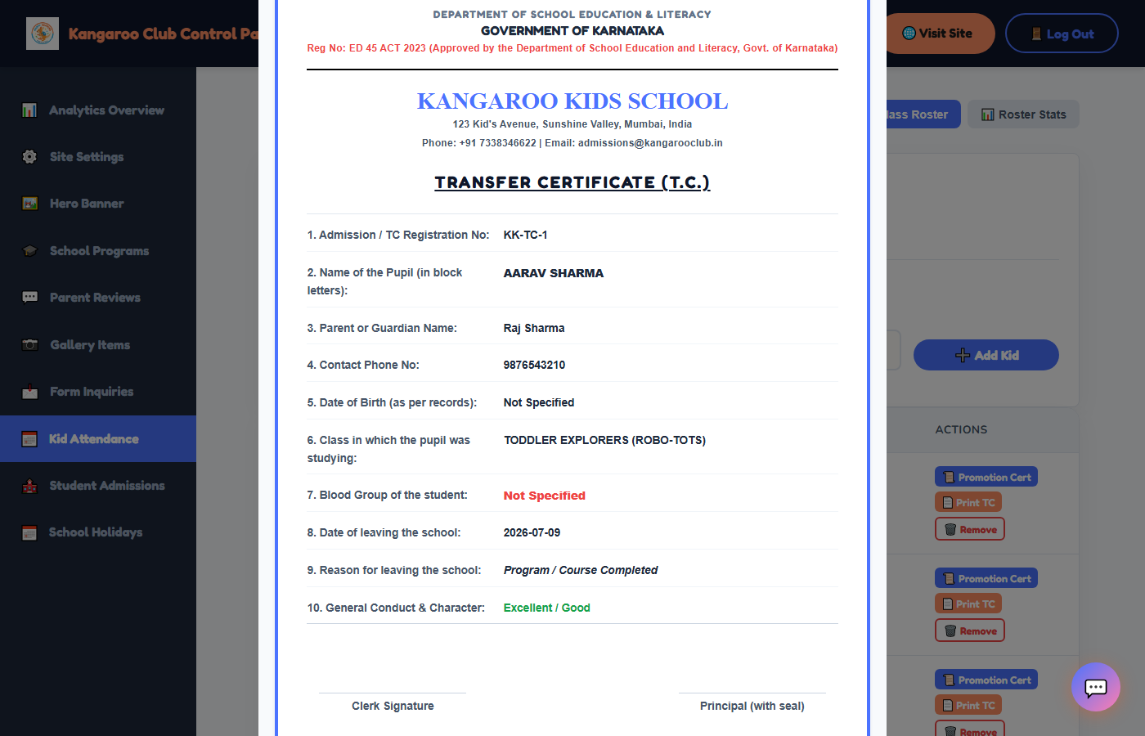
📅 Daily Attendance & Class Roster
Attendance marking & Class Roster
• Class Selector: Easy dropdown filter to pick classes (e.g. Preschool Engineers).
• Student Checklist: Generates a list of students with photo thumbnails.
• Status Toggle: Mark Present or Absent with one click.
• Quick Save: Real-time update to the attendance log database.
• Enrolled Class Roster: Highlights student details, issued items, and interactive certificate controls.

Slide 6
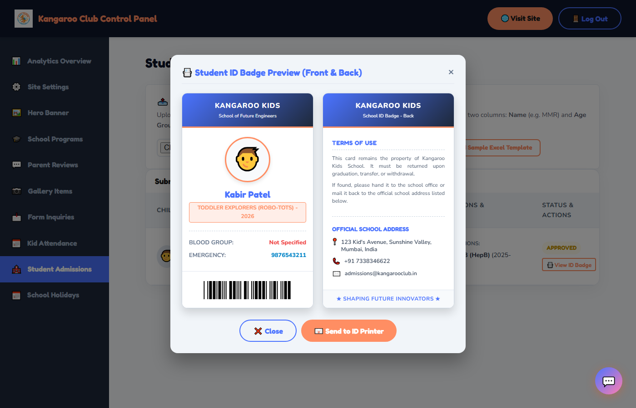
📇 Automated Student ID Badges
ID Card Design & Mailing
• Widescreen Double-Sided Badge: Renders both Front and Back cards side-by-side.
• Front Details: Child Name, Photo, Grade, Class Current Year (e.g. 2026), Blood Group, and Emergency Phone.
• Privacy Focus: Removed parent names from the badge front for student safety.
• Scannable Barcode: Embeds a scannable Libre Barcode 39 font linked to student ID.
• One-Click Mailing: Send button formats and requests badges directly from printshops.

Slide 7
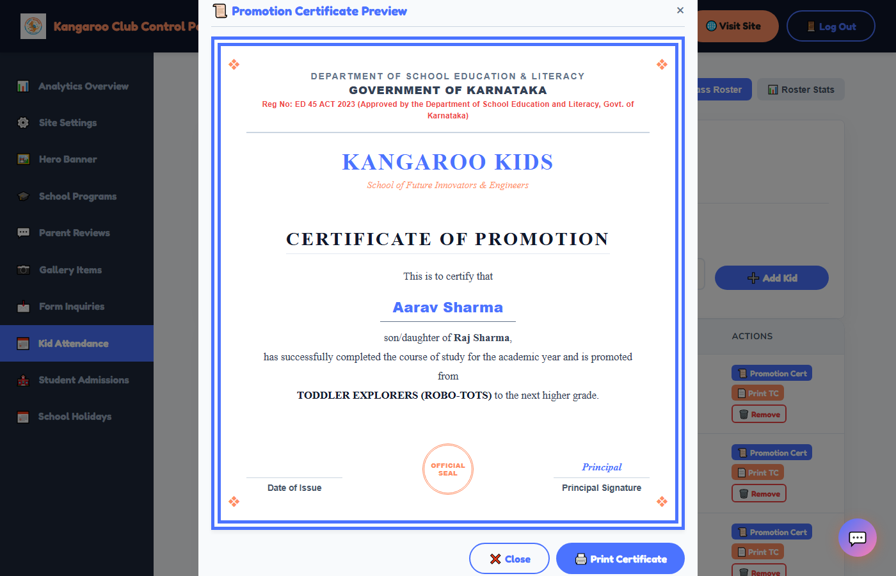
📜 Govt. Certificates & TC Printing
Promotion & Transfer Cards
• Department Compliance: Formal certificate layout featuring Govt. of Karnataka approval.
• School Registration Code: Dynamically binds ED 45 ACT registration details.
• Dynamic Student Records: Fills student name, grade, date of birth, and promotion details.
• Transfer Certificates (T.C.): Pupil Leaving Document featuring details table (name, parent, DOB).
• Single-Page Printing: Custom CSS rules avoiding print overlaps.

Slide 8
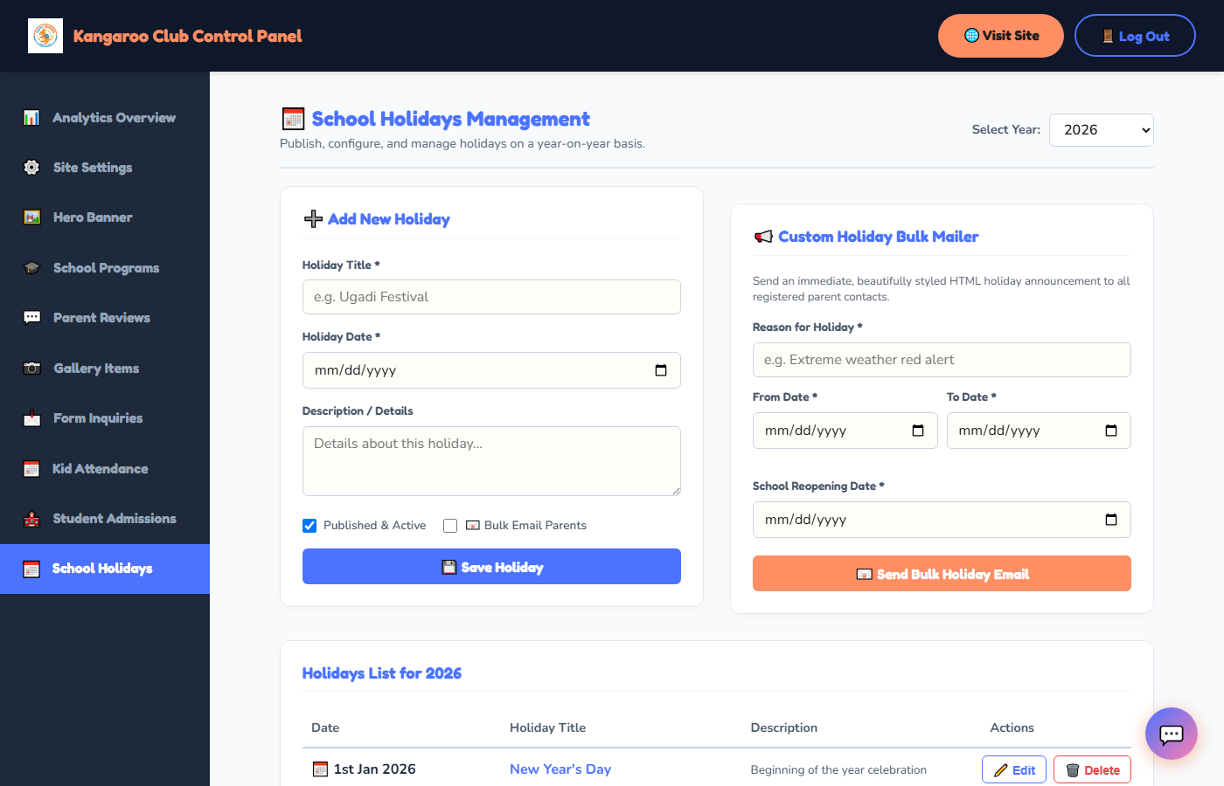
📅 School Holidays & Bulk Mailer
Holiday Calendar & Mailer Portal
• Published Calendar: Homepage calendar showing scheduled breaks year-on-year.
• Ordinal Date Format: Custom dates formatted in title-cased style (e.g., 1st Jan 2026, 19th Mar 2026).
• Interactive CRUD Panel: Full-width table allowing easy additions, edits, and deletions.
• Scheduled Auto-Mailer: Ticking 'Bulk Email Parents' checkbox sends auto-emails to parents.
• Custom Bulk Holiday Mailer: Specialized form to send weather alarms or ad-hoc school breaks.

Slide 9
Thank You!
Kangaroo Kids Portal - Shaping Future Innovators For questions or developer configuration, please access the Settings Panel.

