Slide 1
状态管理机制 (cookie)模块功能介绍
邹海阳
无线唯科科技有限公司

Slide 2
目录
模块功能介绍
预期开发软硬件环境
  软件环境
  硬件环境
模块总体结构
模块总体软件开发思路
模块开发技术难点及解决方案
建议

Slide 3
预期开发软硬件环境
  软件环境
  Arena 模拟环境
  硬件环境
  Arena 硬件环境

Slide 4
模块功能介绍
Cookie一般也称为“小甜饼”，是一种能够让网站服务器把少量数据储存到客户端的硬盘或内存，或是从客户端的硬盘读取数据的一种技术。是一种可让Web站点用来跟踪用户的候选机制 .
主要用于以下三种情况:
1) 如果服务器要求身份认证，但又不想在同一用户每次访问本Web站点时都麻烦他输入用户名和口令，那么可以设置一个cookie。
2) 如果服务器想要记住用户的偏好，以便在他们后续访问期间有目的地提供广告，那么可以设置一个cookie。
3) 如果web站点提供购物服务，那么服务器可以使用cookie跟踪用户购买的物品，就是建立一个虚拟的购物车。

Slide 5
set-cookie = “Set-Cookie2:” cookies
cookies = 1#cookie
cookie = NAME “=” VALUE *(“;” set-cookie-av)
NAME = attr
VALUE = value
set-cookie-av = “Comment” “=” value
| “CommentURL” “=” <“> http_URL <”>
| “Discard”
| “Domain” “=” value
| “Max-Age” “=” value
| “Path” “=” value
| “Port” [ “=” <“> portlist <”> ]
| “Secure”
| “Version” “=” 1*DIGIT
portlist = 1#portnum
portnum = 1*DIGIT
NAME和Ｖersion是必选的．

Slide 6
cookie = "Cookie:" cookie-version 1*((";" | ",") cookie-value)
cookie-value = NAME "=" VALUE [";" path] [";" domain] [";" port]
cookie-version = "$Version" "=" value
NAME = attr
VALUE = value
path = "$Path" "=" value
domain = "$Domain" "=" value
port = "$Port" [ "=" <"> value <"> ]

Slide 7
NAME=VALUE
The name of the state information ("cookie") is NAME,
and its value is VALUE. NAMEs that begin with $ are reserved and
MUST NOT be used by applications.
Comment the value of the Comment attribute
allows an origin server to document how it intends to use the
cookie. The user can inspect the information to decide whether to
initiate or continue a session with this cookie.
CommentURL the CommentURL attribute allows an
origin server to document how it intends to use the cookie. The
user can inspect the information identified by the URL to decide
whether to initiate or continue a session with this cookie.

Slide 8
Discard The Discard attribute instructs the user agent to discard the cookie unconditionally when the user agent terminates.
Domain=value
The value of the Domain attribute specifies the domain for which the cookie is valid. If an explicitly specified value does not start with a dot, the user agent supplies a leading dot.（contain at least one dot.）
Path=value
The value of the Path attribute specifies the subset of
URLs on the origin server to which this cookie applies.

Slide 9
Port[="portlist"]
The Port attribute restricts the port to which a cookie
may be returned in a Cookie request header. Note that the syntax
REQUIREs quotes around the OPTIONAL portlist even if there is onlyone portnum in portlist.
Secure
The Secure attribute (with no value) directs the user
agent to use only (unspecified) secure means to contact the origin
server whenever it sends back this cookie, to protect the
confidentially and authenticity of the information in the cookie. Set-Cookie 的 secure 属性就是处理这方面的情况用的，它表示创建的 cookie 只能在 HTTPS 连接中被浏览器传递到服务器端进行会话验证，如果是 HTTP 连接则不会传递该信息，所以绝对不会被窃听到。凡是计划采用 HTTPS 来保证用户帐户安全的同志们都要注意对这个参数的使用，搞不好木桶上的最短板就在这里。
Version=value
The value of the Version attribute, a decimal integer,
identifies the version of the state management specification to
which the cookie conforms. For this specification, Version=1
applies.

Slide 10
例：Set-Cookie2:
Part_Number=“Rocket_Launcher_0001”;
Version=“1”;
Path=“/acme”;
Domain=“.yahoo.com”

Slide 11
模块总体软件开发思路
typedef struct tagwkCookieItem
{
char * name;
int name_lenth;
char * path;
int path_lenth;
unsigned long max_age;/过期时间
char* expire_ time;/过期的时间GMT格式
int expire_time_lenth;
char * domain;
int domain_lenth;
unsigned long data_lenth;
void* data; /*指向消息数据的指针的值*/
struct tagwkCookieItem * pNext; /*单元的后向指针*/
} wkCookieItem;

Slide 12
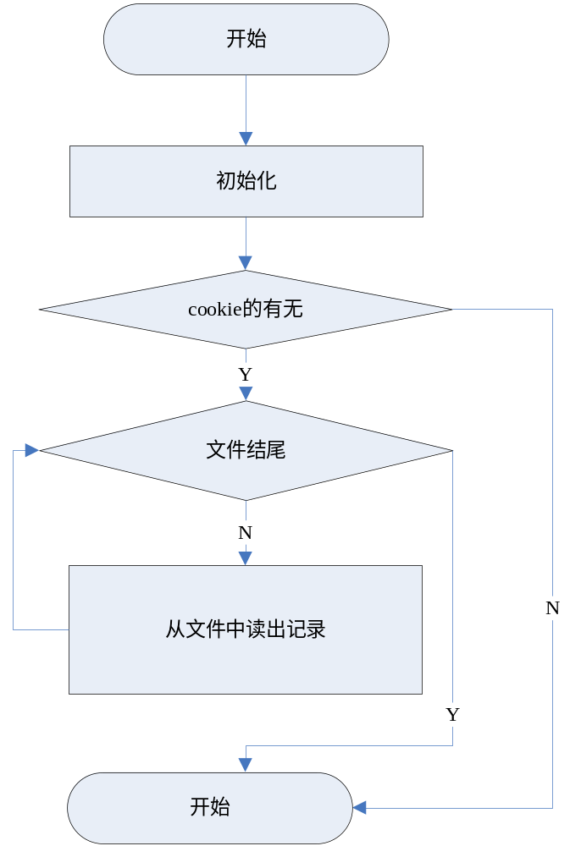
模块总体软件开发思路
初始化
(每次用cookie前,先确定是否过期.)

Slide 13
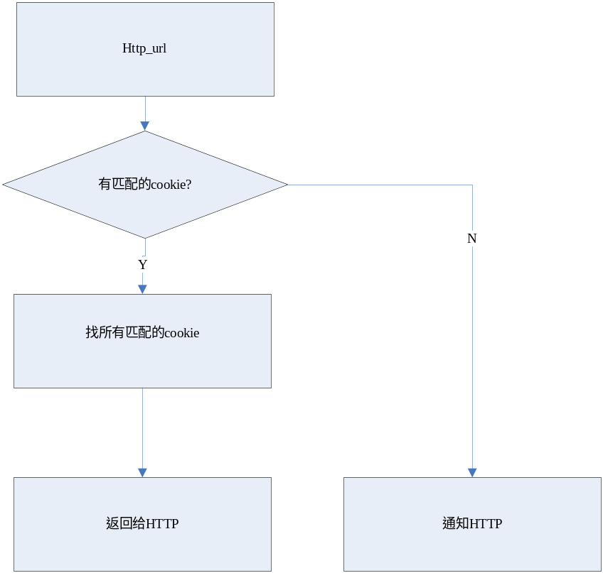
模块总体软件开发思路
查询

Slide 14
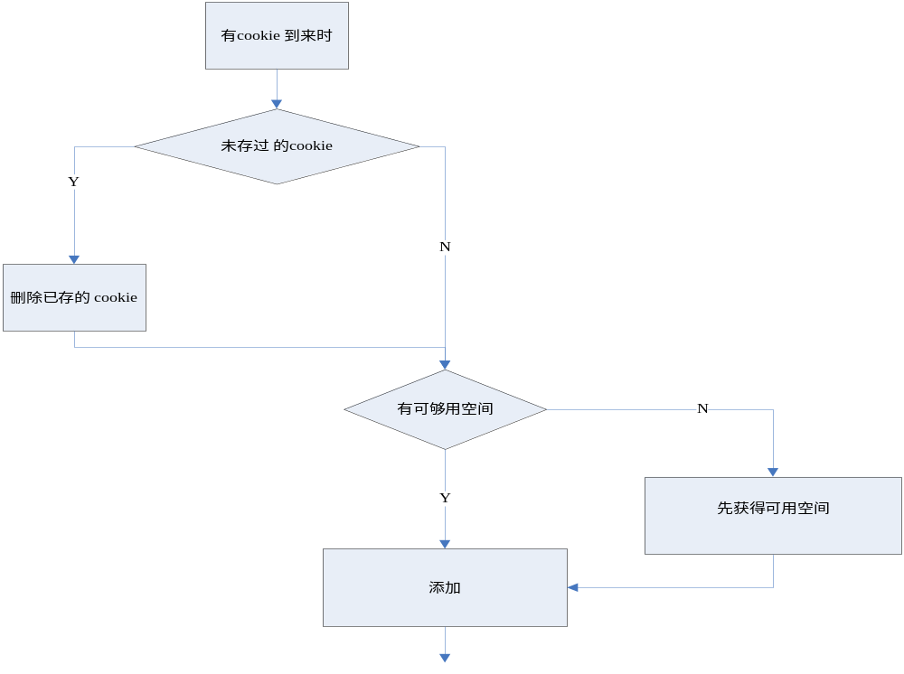
模块总体软件开发思路
有cookie
到来时

Slide 15
模块开发技术难点及解决方案
Cookie中是否支持comment,comment_url？
可能给Ｍax_Age或expires 怎么定义处理（结构体）？

Slide 16
THANKS
THANKS

