Slide 1
MediSlot
DEVOPS CAPSTONE PROJECT
A clinic appointment app shipped from laptop to a monitored, autoscaling Kubernetes cluster on AWS
FastAPI · React · PostgreSQL · GitHub Actions · Terraform · EKS · Helm · Prometheus
Notes:
MediSlot is the vehicle; the real subject is the end-to-end DevOps pipeline that takes it to production on AWS.

Slide 2
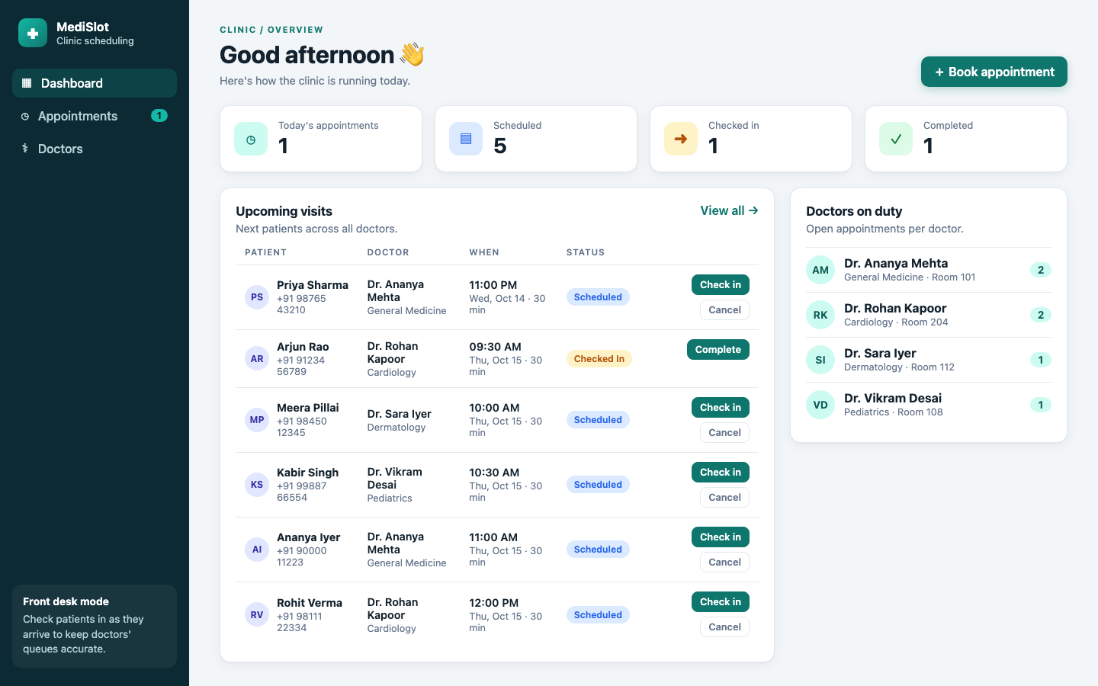
Clinic scheduling that refuses double-bookings
THE APPLICATION
Front-desk staff manage doctors and book appointments. Each visit moves Scheduled → Checked in → Completed, or Cancelled.
The API returns 409 whenever a doctor would have two overlapping active appointments.
Notes:
Responsive React UI, FastAPI backend with Swagger docs, four seeded doctors via migration 0002.

Slide 3

From git push to a running pod
Git push
Actions
GHCR
Helm → EKS
GitHub repo
Test, build, Trivy scan
Image tagged by SHA
Rolling upgrade
ingress-nginx (NLB)
Backend 2–8 pods
PostgreSQL
/ → React + Nginx
/api → FastAPI
Scaled by HPA at 60% CPU
StatefulSet on EBS gp3
Notes:
Terraform provisions the VPC and EKS; Prometheus scrapes /metrics via a ServiceMonitor and Grafana visualises it.

Slide 4
Technology stack
Layer | Technology
Frontend | React 19 + Vite 8, served by unprivileged Nginx
Backend | FastAPI, SQLAlchemy 2, Pydantic 2, Alembic
Database | PostgreSQL 18
Containers | Multi-stage Dockerfiles, non-root, Docker Compose
CI/CD | GitHub Actions, Trivy, GitHub Container Registry
Infrastructure | Terraform: AWS VPC + EKS 1.36, Pod Identity, IAM
Platform | Kubernetes, Helm, ingress-nginx, HPA, PDBs
Observability | kube-prometheus-stack: Prometheus, Grafana, Alertmanager
Notes:
Each layer is a separate folder in the repo: backend, frontend, terraform, helm, monitoring.

Slide 5
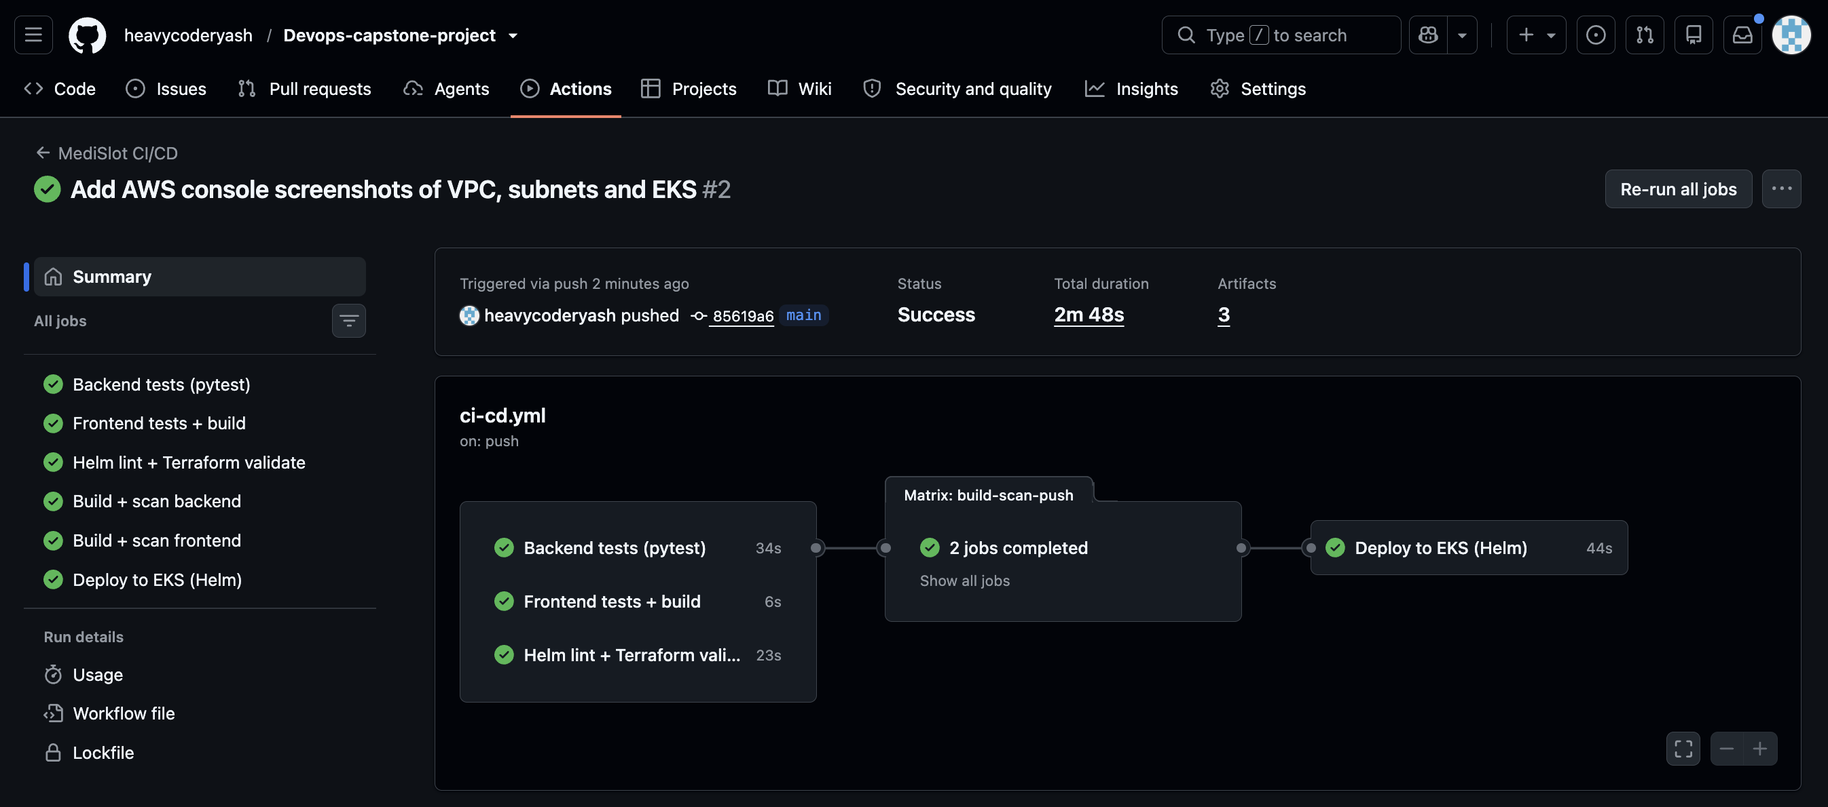
Every push is tested, scanned and deployed
CI/CD PIPELINE
22 pytest tests + Alembic check on real PostgreSQL
Frontend tests, helm lint, terraform validate
Docker build tagged with the commit SHA
Trivy fails on fixable HIGH/CRITICAL CVEs
Push to GHCR, helm upgrade, smoke test
Notes:
Images are pushed only from main, never from PRs. Deploy uses --rollback-on-failure.

Slide 6
Security built into every layer
No secrets in Git
Non-root containers
DB password injected at deploy; AWS via OIDC or a deploy user limited to eks:DescribeCluster.
All pods pass the restricted Pod Security Standard; capabilities dropped, seccomp on.
Scan before push
Supply-chain pinning
Trivy gate plus SARIF in GitHub Security; pip removed from the runtime image.
trivy-action pinned to a commit SHA after its tags were hijacked (CVE-2026-33634).
Notes:
CI token is least-privilege: packages:write only in build, id-token:write only in deploy.

Slide 7
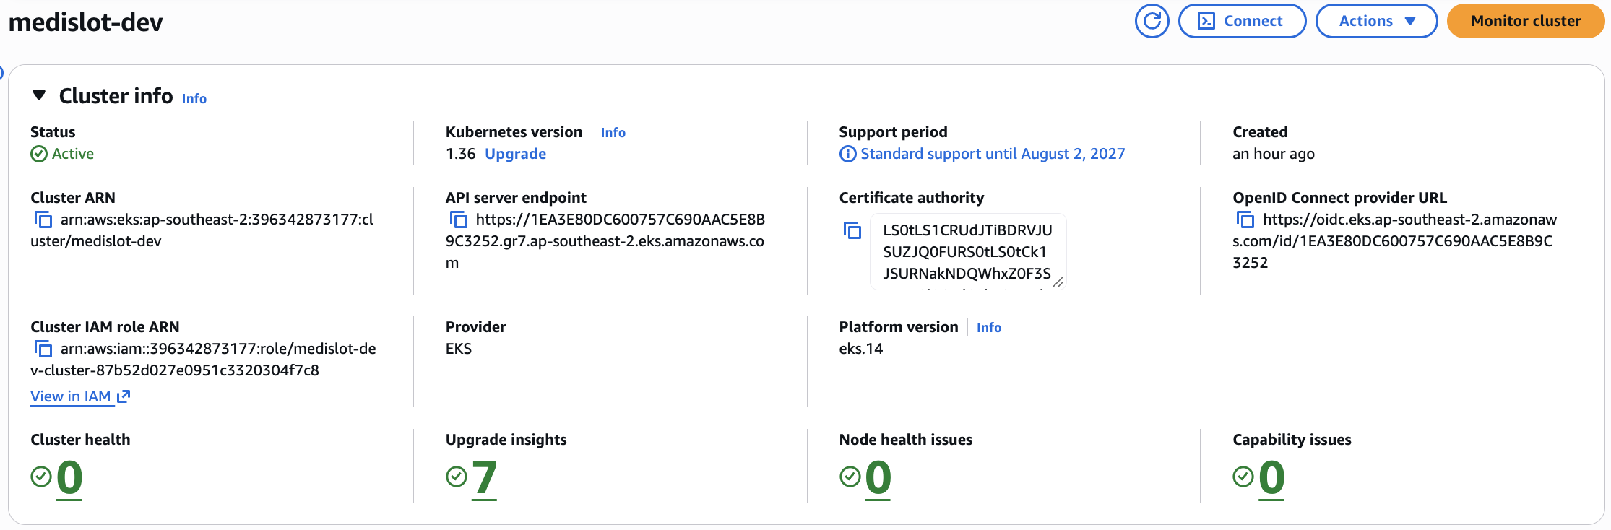
Terraform builds the AWS foundation
INFRASTRUCTURE AS CODE
VPC 10.20.0.0/16 across two AZs, one NAT gateway
2 public subnets for load balancers, 2 private for nodes
EKS 1.36, managed nodes: 2× c7i-flex.large, scales 2–4
Add-ons: EBS CSI via Pod Identity, metrics-server
≈ US$0.40/hour; destroyed after evaluation
Notes:
Region ap-southeast-2. c7i-flex.large chosen because Free plan accounts reject t3.medium.

Slide 8
One Helm chart deploys the whole app
Workloads
Data
Migrations
Backend and frontend Deployments with startup, readiness and liveness probes
PostgreSQL StatefulSet with a persistent EBS volume
Helm-hook Job runs Alembic once per release, so replicas never race
Routing
Resilience
Monitoring
ClusterIP Services plus an Ingress for / and /api
HPA 2 → 8 pods and PodDisruptionBudgets
ServiceMonitor and a Grafana dashboard ConfigMap
Notes:
values-dev.yaml and values-prod.yaml; rehearsed locally on kind before EKS.

Slide 9
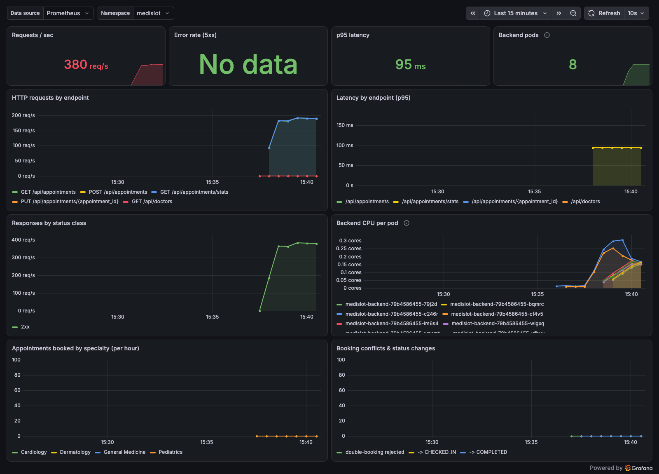
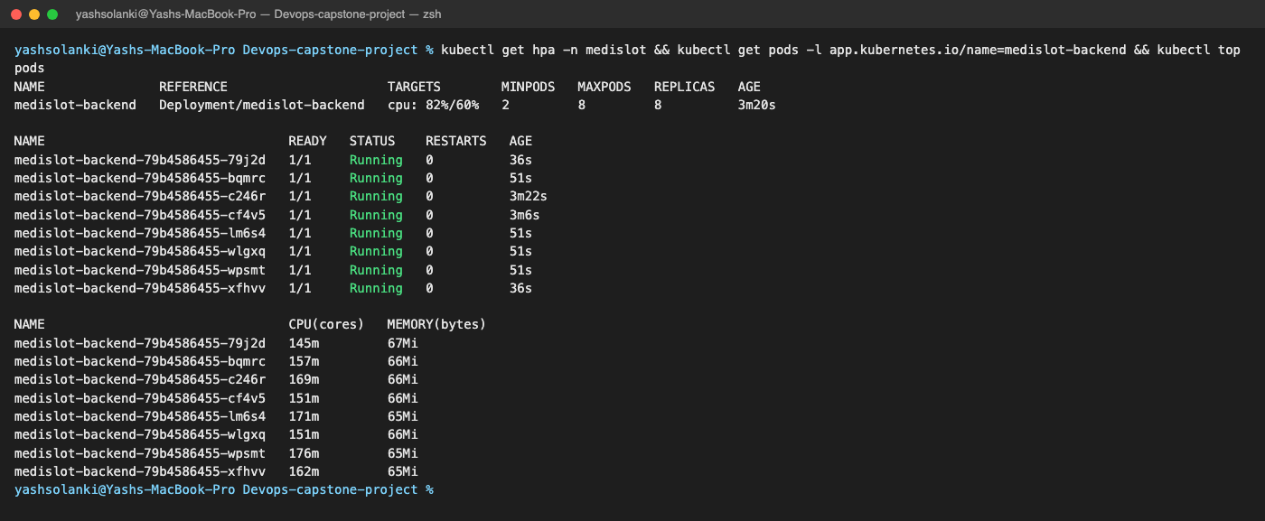
Autoscaling and monitoring under load
HPA scales the backend out as CPU climbs
Grafana: request rate, 5xx ratio, p95 latency, pods
Notes:
Alerts: backend down, error rate above 5%, p95 above 1s. Custom metrics: bookings per specialty, status changes, booking conflicts.

Slide 10
TROUBLESHOOTING LAB
CLEAN TEARDOWN
Three broken manifests, diagnosed and fixed
Order matters to avoid stuck resources
ImagePullBackOff
Service with no endpoints: wrong selector and targetPort
CrashLoopBackOff from a bad DATABASE_URL
Uninstall ingress-nginx and delete PVCs before terraform destroy: the NLB and EBS volume are created by Kubernetes, not Terraform, and would block VPC deletion.
Notes:
Each lab case ships the kubectl commands that find the cause plus the fix.

Slide 11
Every running pod traces back to an exact commit
28
0
2–8
1
automated tests
secrets in Git
autoscaled backend pods
push to deploy
ghcr.io/heavycoderyash/medislot-backend:<sha>
Notes:
28 = 22 backend pytest + 6 frontend unit tests. Thank you; questions.

