Slide 2
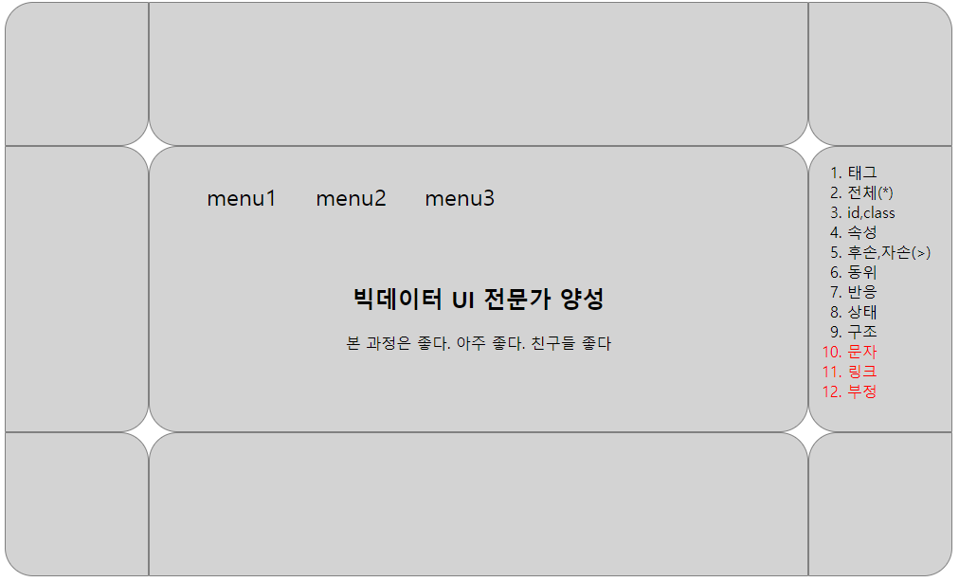
id=header
1000px
class=left
class=center
class=right
id=content
300px
class=left
class=center
class=right
id=footer
150px
693px
150px
class=left
class=center
class=right

Slide 3
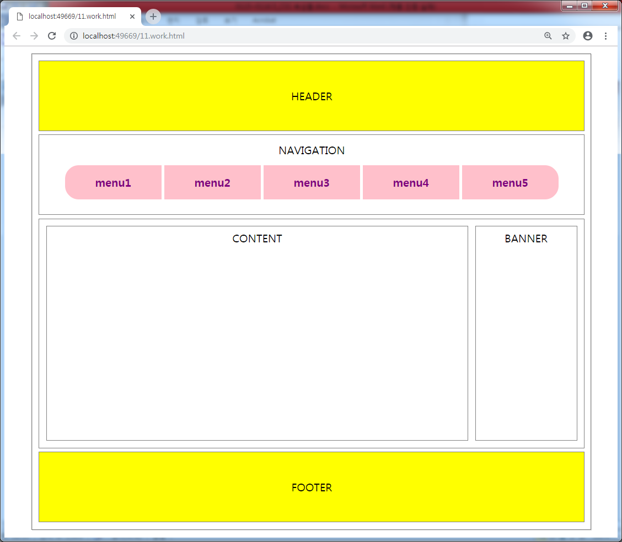

Slide 4
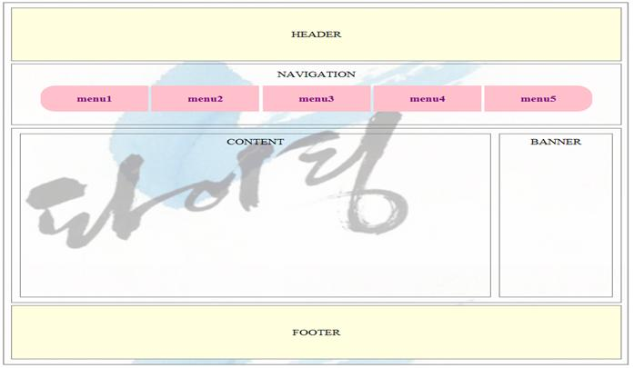

Slide 5


