Slide 1


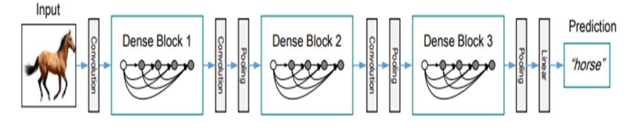
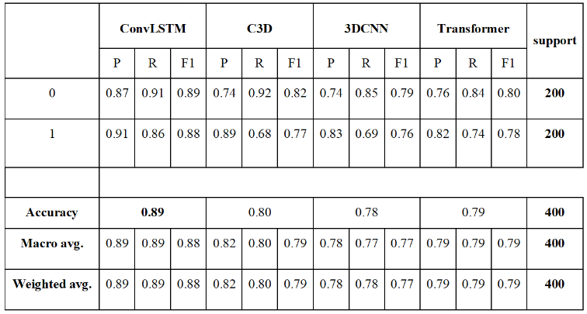
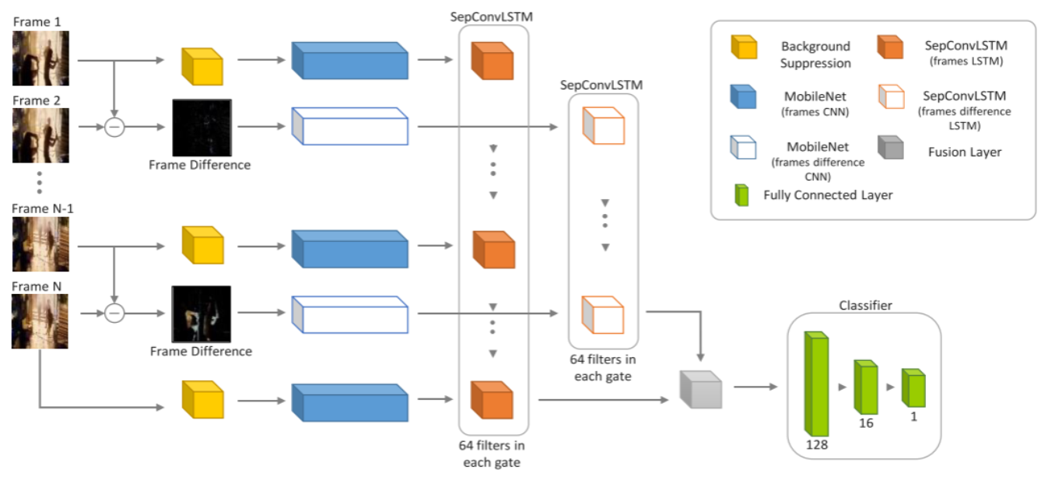
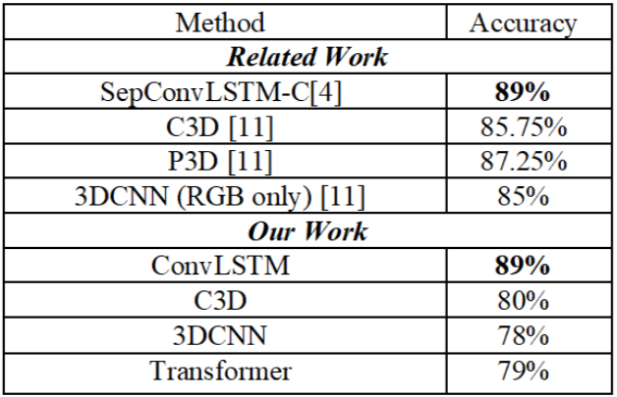
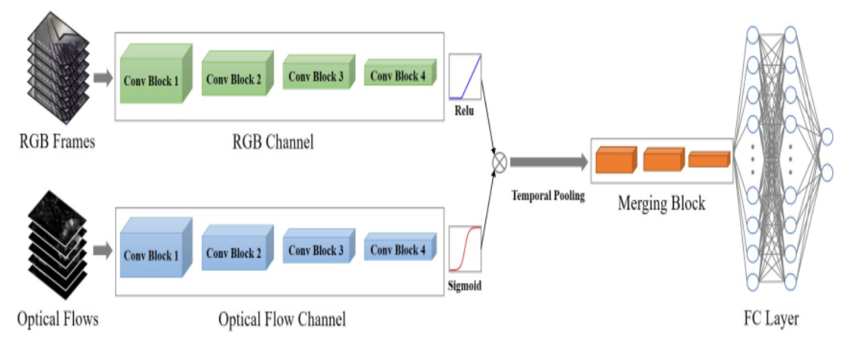
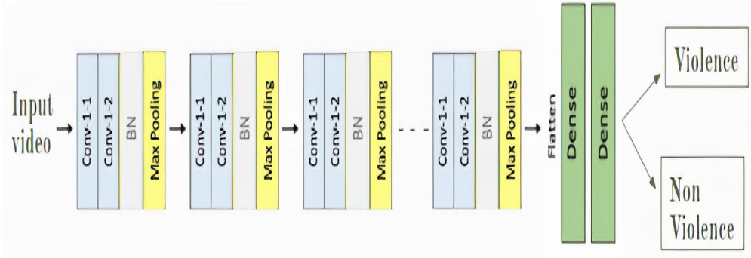
Violence Detection System
By: Hesham Ayman – Mohamed Nasr
Heba Mohamed – Maryam Ahmed – Sama Hegazy
Supervised by: Prof. Dr. Abeer Mahmoud
TA. Mirna Al-Shetairy
Faculty of Computer and Information Sciences - Ain Shams University
Introduction
D. Transformer-based Model
Transformers are neural network architectures that learn sequence relationships for transformation. DenseNet-12 efficiently extracts video features using dense connections. Positional encoding adds order information. Transformer encoders employ multi-head self-attention, feed-forward networks, and layer normalization. Trials with different settings were conducted to extract 1024 video features, but some preprocessing techniques lowered accuracy and caused overfitting.
In recent years, due to the abundance of digital video capturing, storage, and processing technologies, as well as the rise in crime rates, the deployment of video surveillance cameras has become very common all over the globe. it requires great human effort to keep track of all surveillance cameras 24/7, which makes their efficiency heavily dependent on the person monitoring them, also it is extremely time consuming.
Video classiﬁcation using human action recognition is a popular research topic in recent times and is relevant to the ﬁeld of violence detection [1]. While older research focused on various traditional machine-learning techniques for automated violence detection, recent advancements have shown that deep-learning methods yield far better results, as they can effectively extract spatio-temporal features - data that is collected across both space and time - from videos.
In addition to being able to determine whether a footage is violent or not, building a model that can accurately cluster similar types of violence together can prove to be extremely useful, as different types of violence have different severities, and require different courses of action.
Figure 3.4. DenseNet Architecture
Results
Methods
Accuracy and Confusion Matrix are used to evaluate the models. As shown in Table.1, we combined classification reports for the best trials of each model.
Violence detection as a concept relies on a model's ability to detect human action in the first place, and then classify whether it is violent or not. While older research focused on various traditional machine-learning techniques, recent advancements have shown that deep-learning methods yield far better results​. For all methods, video frames were resized and normalized before the models were trained.
A. ConvLSTM
ConvLSTM combines LSTM and CNN models to handle spatiotemporal data. SepConvLSTM [2] utilizes deepwise separable convolution to extract robust spatiotemporal features. It consists of two streams with condensed MobileNet modules for spatial feature extraction. SepConvLSTM generates local spatiotemporal features from the CNN's output feature maps.
Figure 1. Structure of the two CNN-LSTM streams that comprise the proposed model
B. C3D [3]
C3D is a popular 3D-CNN architecture for learning spatiotemporal features from video data. It incorporates a self-learned temporal pooling mechanism using an optical flow branch as a gate to determine information preservation. The model consists of RGB and Optical Flow channels, a Merging Block, and a Fully Connected layer. The model is trained for 30 epochs, focusing on maximizing accuracy with optimization techniques.
Figure 2. The structure of the Flow Gated Network
C. 3DCNN [3]
CNNs are widely used in computer vision tasks to extract features from images. They consist of convolution layers, pooling layers, and fully connected layers. The proposed model follows a structure of convolution layers, batch normalization layers, pooling layers, and ends with fully connected layers. CNNs capture both spatio and temporal features, including edges, textures, shapes, motion patterns, and temporal dependencies.
Table 1. Results of all models on the RWF-2000 dataset.
As shown in Table 2., we achieved high accuracy with the ConvLSTM model compared with other models, which is 89% test accuracy.
Table 2. Comaprison between previous work and our work.
The study compared the ConvLSTM model with fine-tuning and achieved similar results. The C3D model's performance varied due to preprocessing, layer changes, and resource limitations. The 3DCNN model achieved 78% test accuracy using RGB channels. The transformer model was not used due to resource constraints, resulting in different outcomes when trained from scratch with varied hyperparameters and preprocessing techniques.
Conclusions
The project aimed to facilitate the detection of widespread violence by aiding government institutions and individuals like parents, and facilitating prompt action from competent authorities The study uses innovative methods, such as SepConvLSTM, to detect violent activity in surveillance footage. The network effectively learns discriminative spatiotemporal features, achieving high recognition accuracy. It's computationally efficient, suitable for time-sensitive applications and low-end devices, and offers a compact alternative to ConvLSTM.
Bibliography
V. Huszar, V. Adhikarla, I. Negyesi, and C. Krasznay, “Toward Fast and Accurate Violence Detection for Automated Video Surveillance Applications,” IEEE Access, vol. PP, p. 1, Jun. 2023, doi: 10.1109/ACCESS.2023.3245521.
Z. Islam, M. Rukonuzzaman, R. Ahmed, Md. H. Kabir, and M. Farazi, “Efficient Two-Stream Network for Violence Detection Using Separable Convolutional LSTM,” Feb. 2021, doi: 10.1109/IJCNN52387.2021.9534280.
M. Cheng, K. Cai, and M. Li, “RWF-2000: An Open Large Scale Video Database for Violence Detection,” Nov. 2019.
A. Vaswani et al., “Attention Is All You Need,” Jun. 2017.

