Slide 1
Introduction to Magnetic Resonance Imaging

Slide 2
Schedule for the Day
10:15 – 11:00 Intro to fMRI
11:00 – 11:30 Intro to Data Analysis
11:30 – 12:30 Scan 2 students
12:30 – 1:30 Lunch
1:30 – 3:00 Hands-on data analysis
3:00 – 4:00 VBM/DTI/CT

Slide 3
OUTLINE
I. Practical considerations for a subject visit
II. Taking measurements
III. Data analysis and presentation

Slide 4
OUTLINE
I. Practical considerations for a subject visit
II. Taking measurements
III. Data analysis and presentation

Slide 5
Practical Considerations
- Confined space
- Have to lie VERY still for a long time
- NO METAL (well, a very minimum)
- Very loud
- Repetitive task
But we get cool pictures of your brain in action!

Slide 6
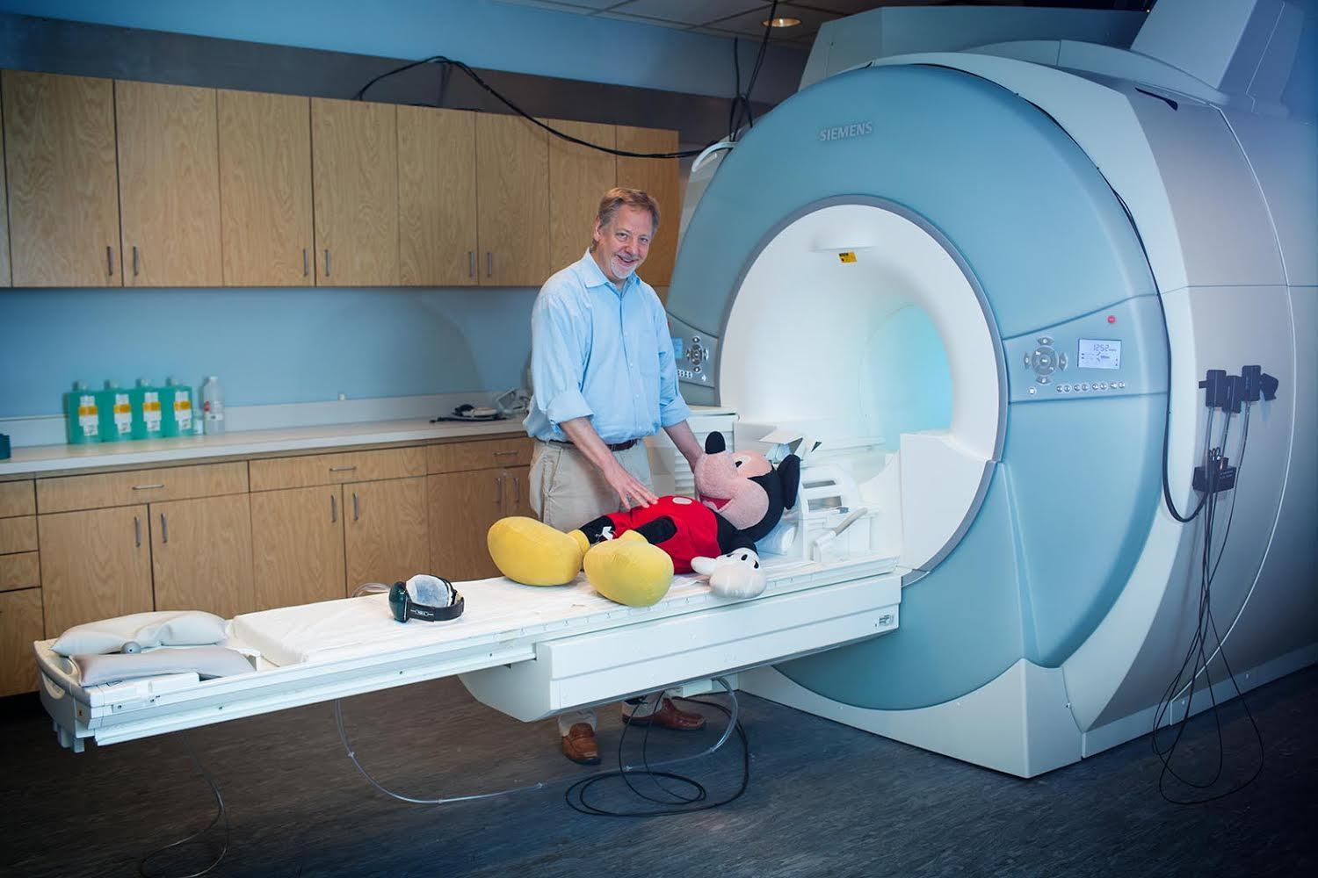
IT'S A CONFINED SPACE

Slide 7
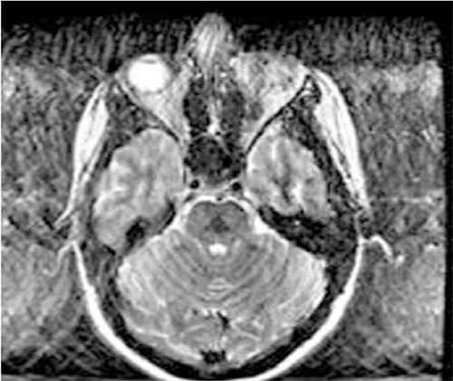
YOU HAVE TO LIE VERY STILL

Slide 8
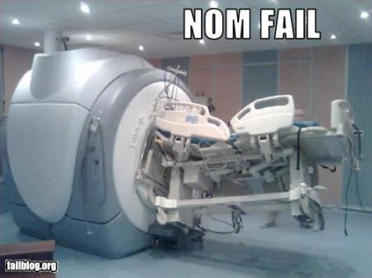
NO METAL!!!

Slide 9
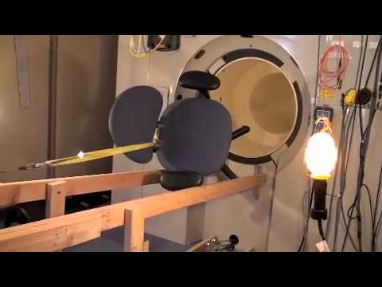
DANGERS OF MRI

Slide 10
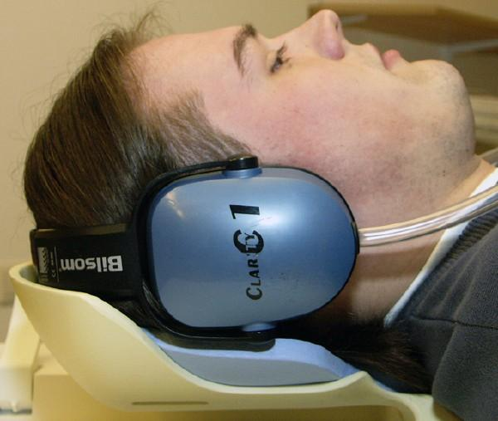
IT'S VERY LOUD

Slide 11
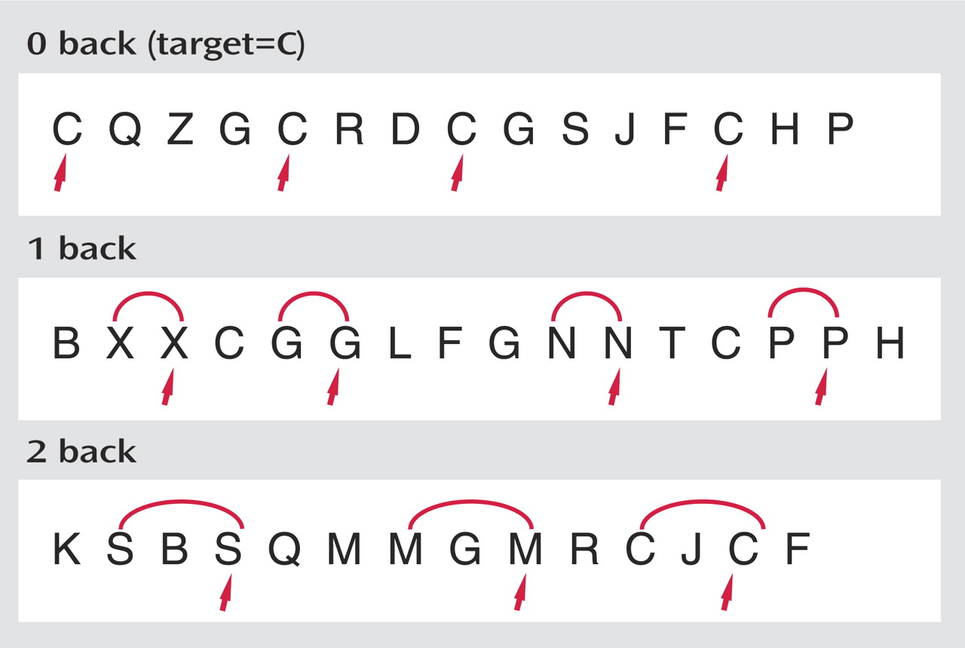
IT'S A REPETITIVE TASK
Notes:
from Wishart, et al. “Increased Brain Activation During Working Memory in Cognitively Intact Adults With the APOE ε4 Allele” Am J Psychiatry 2006;163:1603-1610.

Slide 12
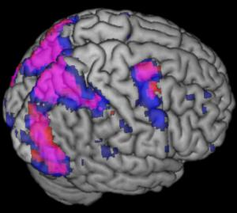
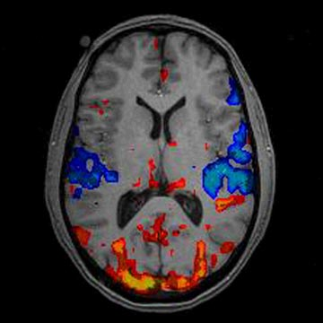
BUT WE GET COOL BRAIN PICTURES!

Slide 13
OUTLINE
I. Practical considerations for a subject visit
II. Taking measurements
III. Data analysis and presentation

Slide 14
Physiological Measures - MRI
Protons spin and have angular momentum
This also gives them a magnetic moment
+
N
S
A moving charge creates a current, a current creates a magnetic field (and vice versa)
Think of brain as bulk matter with anisotropic distribution of magnetic moments (from H20 atoms)

Slide 15
Physiological Measures - MRI
Protons spin and have angular momentum
This also gives them a magnetic moment
B
N
o
M_{o}
+
S
A moving charge creates a current, a current creates a magnetic field (and vice versa)
An externally applied magnetic field will
align the net magnetic moment in it’s own direction. Ions are still spinning – but out of phase with each other.

Slide 16
Physiological Measures - MRI
Protons spin and have angular momentum
This also gives them a magnetic moment
B₀
B
o
M_{o}
+
An externally applied magnetic field will
align the net magnetic moment in it’s own direction. Ions are still spinning – but out of phase with each other.

Slide 17
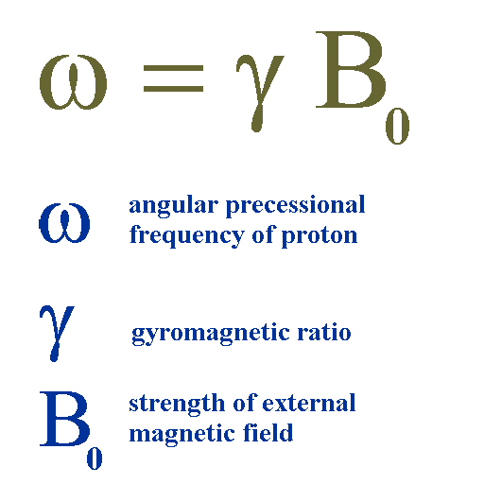
Physiological Measures - MRI
Protons spin and have angular momentum
This also gives them a magnetic moment
B₀
+
Notes:
The angular frequency equals the gyromagnetic ratio times the magnetic field strength for a given nuclear isotope (e.g., hydrogen nucleus).
So we KNOW which type of atom at which we are looking given a particular field strength because it has a singular angular frequency, its Larmor Frequency.

Slide 18
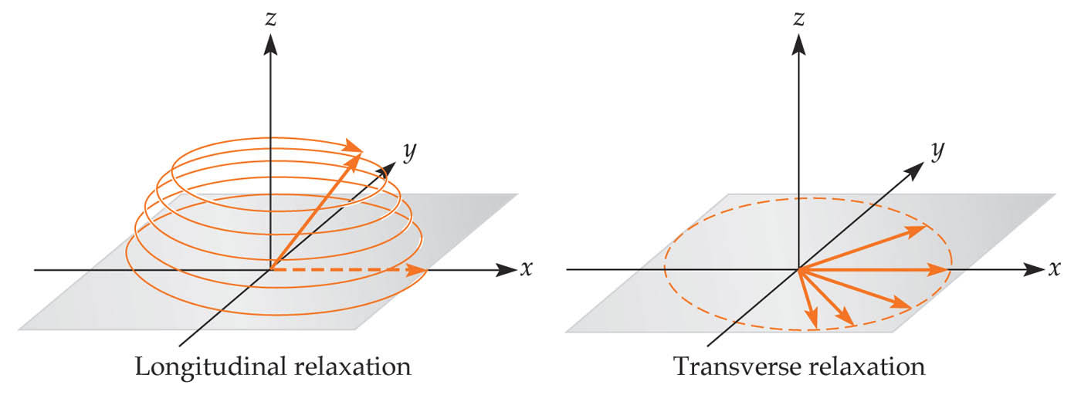
Physiological Measures - MRI
z
y
x
* Align phases with a transient RF pulse at Larmor frequency. This tips over the atoms so that the magnetization is now in the x-y plane (transverse).
* After RF pulse is removed, we measure the decay of the transverse magnetization (T2) and increase in the longitudinal magnetization (T1).
* Relaxation emits radiation that we can use to measure proton density and magnetic field inhomogeneities (i.e. T2*, BOLD).

Slide 19
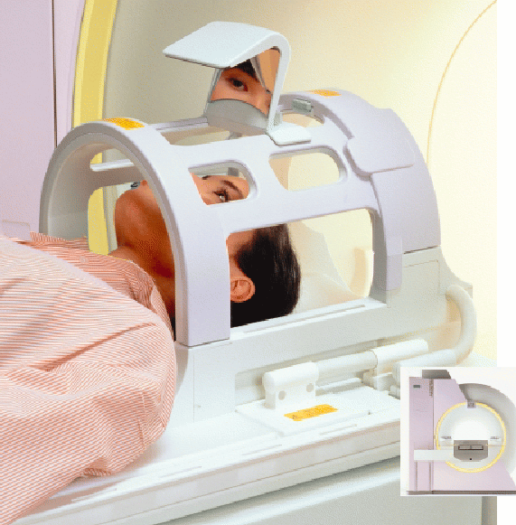
Measuring EM Radiation
TR
Time between RF pulses
TE
Time of measurement
(relative to TR)

Slide 20
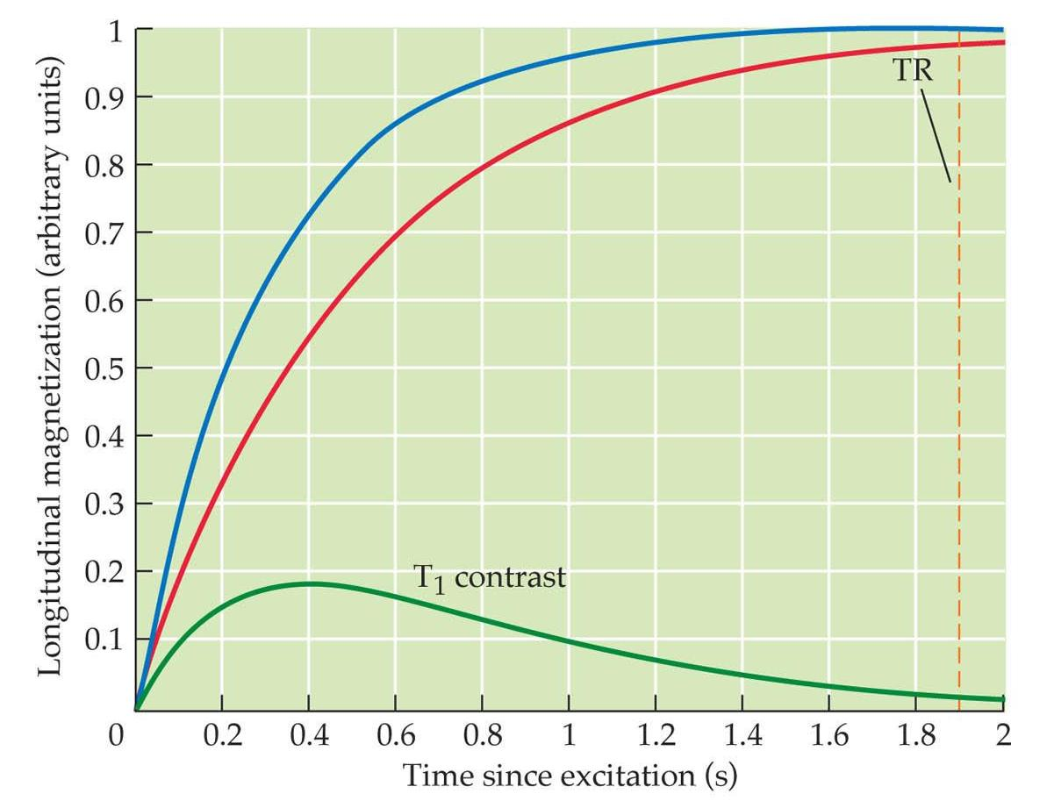
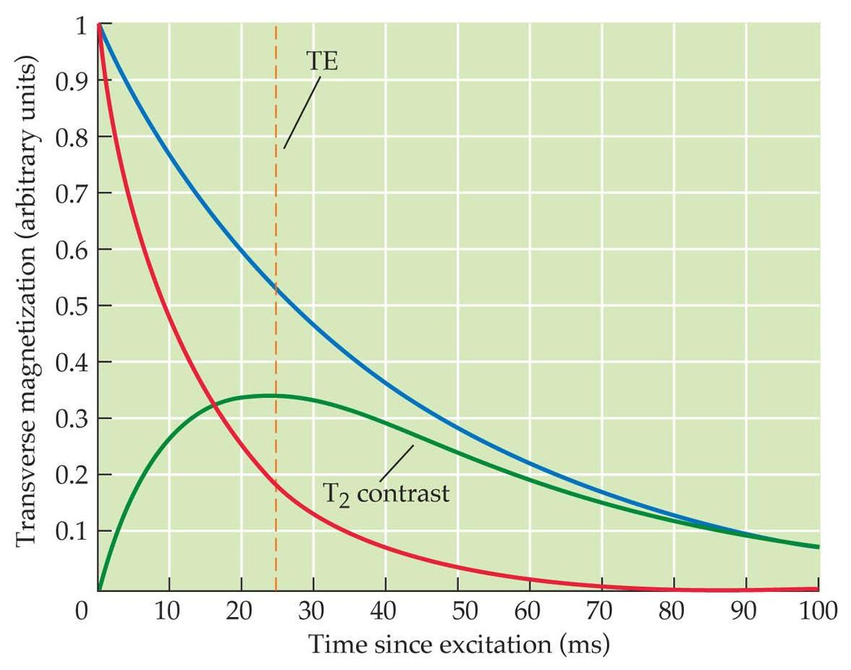
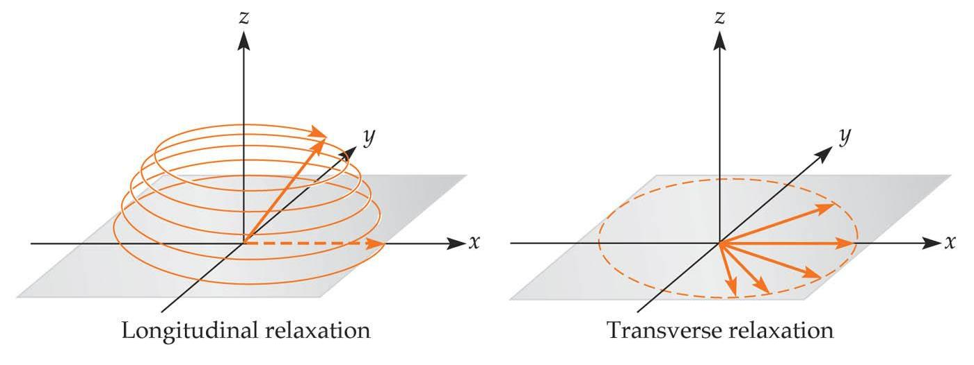
MRI Signal :: T1 and T2 Relaxation

Slide 21
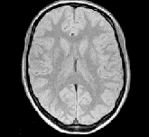
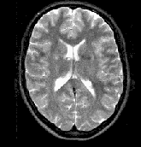
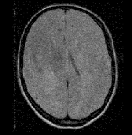
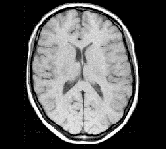
Tissue Contrast Dependence on TR, TE
PDW
T2
TR (seconds)
T1
poor!
TE milliseconds

Slide 22
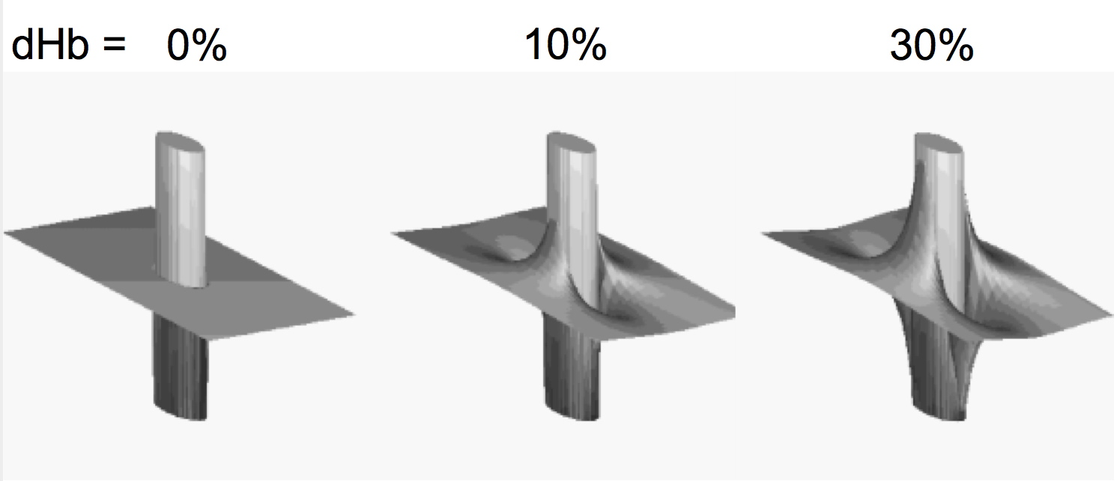
Oxygenated hemoglobin is diamagnetic (little distortion)
Deoxygenated hemoglobin is paramagnetic → signal dropout
T2* :: Measuring Signal Inhomogenities
Blood Oxygen Level Dependent Imaging
(BOLD)
Notes:
Magnetic field around a cylinder oriented perpendicularly to the external static field containing 0%, 10%, and 30% deoxyhemoglobin. The susceptibility between inside and outside the cylinder was taken to be the same at 0% deoxyhemoglobin. The field magnitude is represented as a three dimensional plot.
Oxygenated hemoglobin is diamagnetic (less signal dropout).
Deoxygenated hemoglobin is paramagnetic (gives you signal dropout).
The signal dropout is caused by shorter T2 times; the precession angle of the hydrogen protons in that physical environment disperses more quickly.

Slide 23
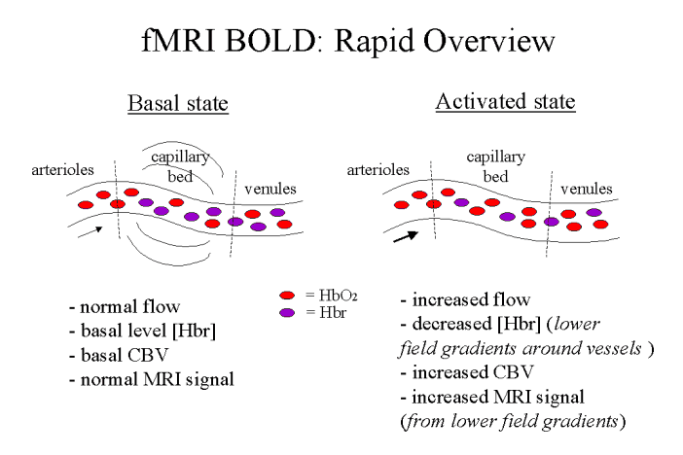
BOLD Effect
Notes:
Oxygenated hemoglobin is diamagnetic (less signal dropout).
Deoxygenated hemoglobin is paramagnetic (gives you signal dropout).
Blood flow increases in response to neural activity and provides an increase in oxygenated hemoglobin greater than the increase in deoxygenated hemoglobin → the environment becomes more diamagnetic → there is less signal dropout → the image in that location appears brighter.

Slide 24
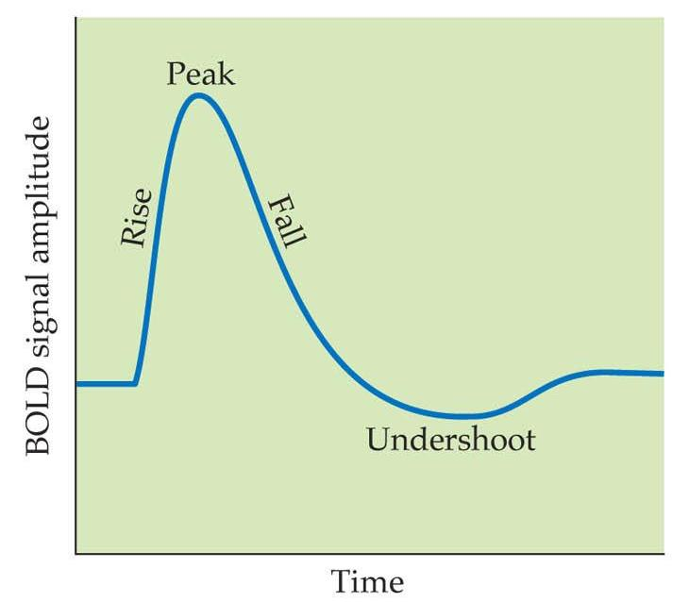
HDR (Hemodynamic Response) HRF (Hemodynamic Response Function)
Change in MR signal related to neuronal activity
Initial dip (not always seen; need to scan very fast)
Rise delayed by 1-2 sec after activity
5-6 sec time to peak
Under/overshoot follows ~6s after peak
Adds linearly with stimulus duration (in most cases)
Notes:
*
We are measuring a physiological response to neuronal activity: the local changes in blood oxygenation ratio. This is why fMRI is said to be an “indirect” measurement of neuronal activity. The timescale of the hemodynamic response limits the temporal resolution of fMRI.
If the stimuli occur <3sec apart, the HRF adds sublinearly.

Slide 25
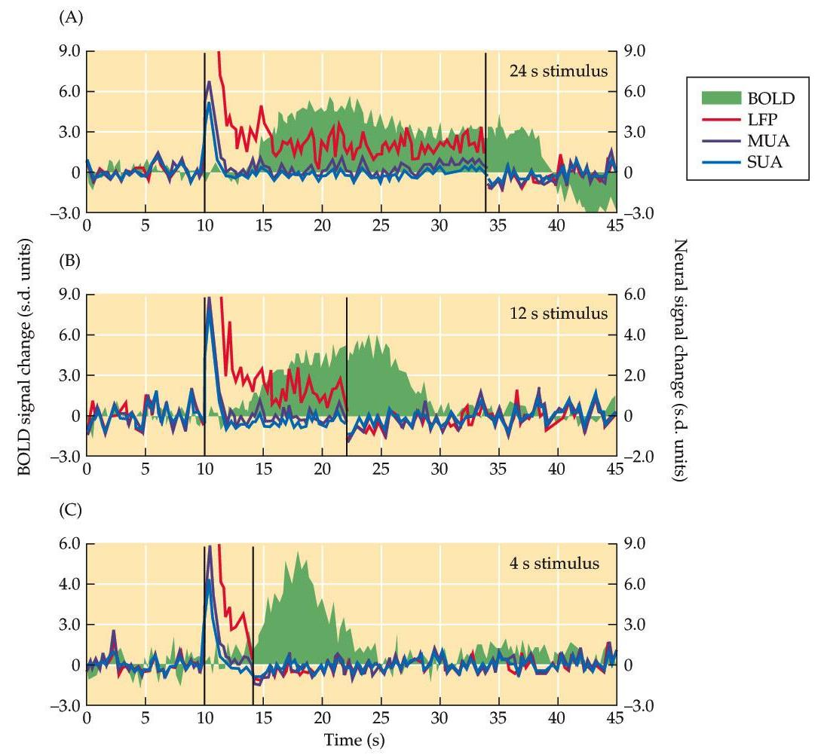
BOLD vs Neuronal Activity
- Recorded LFP, MUA, SUA, and BOLD simultaneously
- BOLD response best explained by changes in LFP
- BOLD reflects “incoming input and local processing rather than spiking activity”
- ”The BOLD contrast mechanism directly reflects the neural responses elicited by a stimulus.”
Logothetis, et al. (2001) Nature, 412:450-57
Notes:
*
Stimulus duration varied from a) 24s, b) 12s, c) 4s
This is imilar to the summation of activity seen in EEG recordings, based on dedrosomatic (incoming) neural activity.

Slide 26
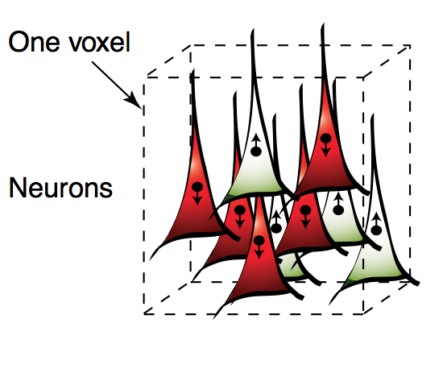
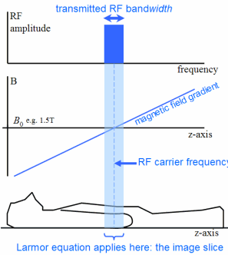
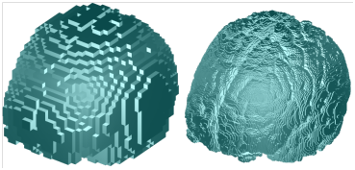
What is a voxel?
* RF pulse limited to a single slice at a time at coordinate z.
* Each slice is a landscape where each x, y coordinate corresponds to a unique frequency of relaxation (due to a gradient magnetic field).
* Fundamental limit of MRI resolution

Slide 27
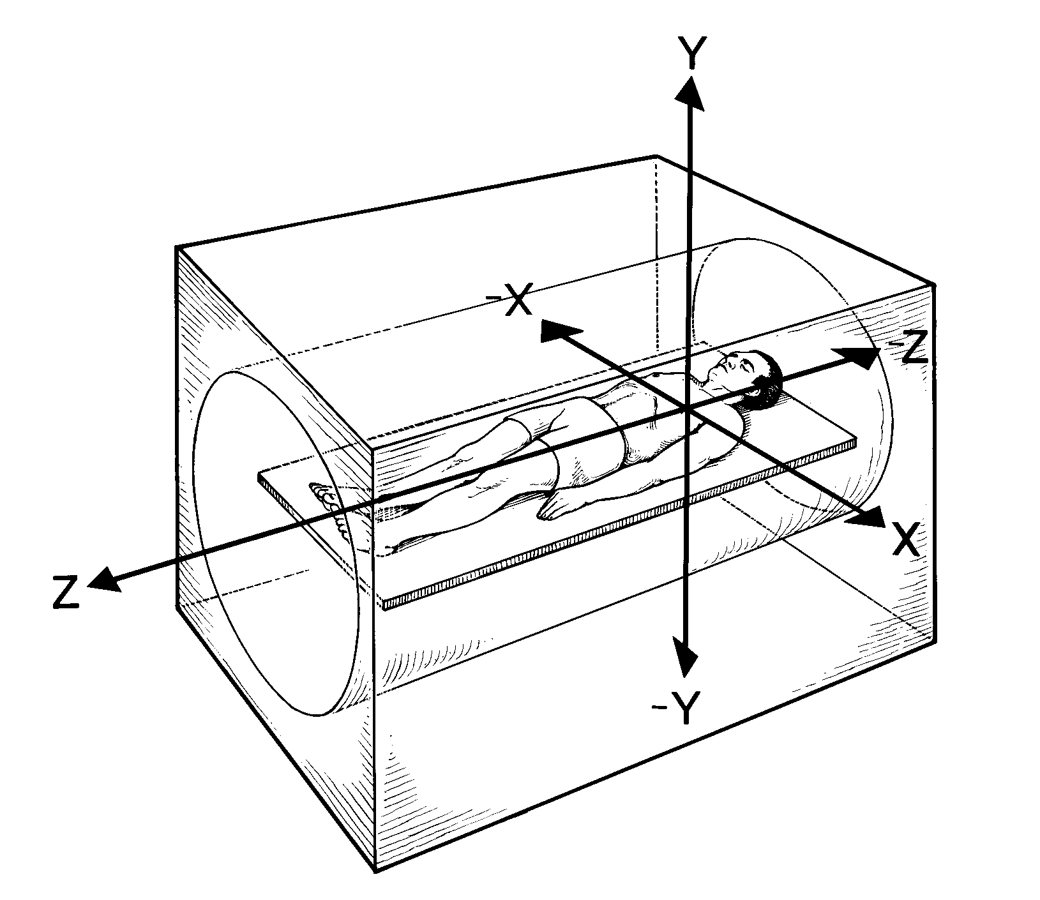
How to get position information?
Notes:
The amplitude of the signal determines how bright our image will be.

Slide 28
LOCALIZING MAGNETIZATION
We can
Excite only the protons in the desired slice (z-direction)
Encode x-direction with different frequencies
Encode y-direction with different phases
Read out amplitude at each frequency and phase

Slide 29
LOCALIZING MAGNETIZATION
We can
Excite only the protons in the desired slice (z-direction)
Encode x-direction with different frequencies
Encode y-direction with different phases
Read out amplitude at each frequency and phase

Slide 30
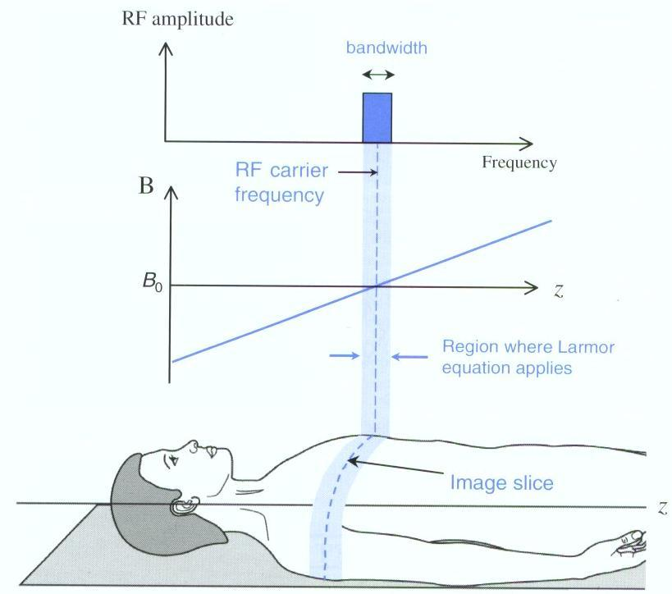
LOCALIZING MAGNETIZATION
Select a z-direction slice

Slide 31
LOCALIZING MAGNETIZATION
We can
Excite only the protons in the desired slice (z-direction)
Encode x-direction with different frequencies
Encode y-direction with different phases
Read out amplitude at each frequency and phase

Slide 32
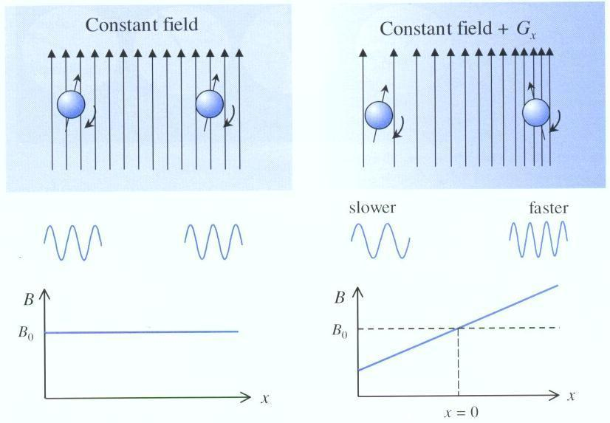
LOCALIZING MAGNETIZATION USING GRADIENTS (Nobel Prize Winning Idea!)
Effect of a Gradient
Notes:
Paul Lauterbur and Peter Mansfield.
The change from B0 is small, maybe up to 1%, but it is enough to induce a measurable change in the rate of precession of protons.

Slide 33
Prior to Gradient
Col 1
Col 2
Col 3
Uniform Field
Uniform Field

Slide 34
Gradient Applied
Lower Field
Higher Field
Col 1
Col 2
Col 3

Slide 35
LOCALIZING MAGNETIZATION
We can
Excite only the protons in the desired slice (z-direction)
Encode x-direction with different frequencies
Encode y-direction with different phases
Read out amplitude at each frequency and phase

Slide 36
Prior to Gradient
Row 1
Row 2
Row 3
Uniform Field
Uniform Field

Slide 37
Gradient Applied
Lower Field
Higher Field
Row 1
Row 2
Row 3

Slide 38
Gradient Turned Off
Row 1
Row 2
Row 3
Uniform Field
Uniform Field

Slide 39
LOCALIZING MAGNETIZATION
We can
Excite only the protons in the desired slice (z-direction)
Encode x-direction with different frequencies
Encode y-direction with different phases
Read out amplitude at each frequency and phase

Slide 40
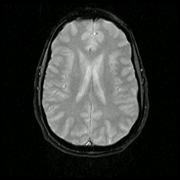
Sum Corresponds to Received Signal
Row 1, Col 1
Row 2, Col 2
Row 3, Col 3
+
+

Slide 41
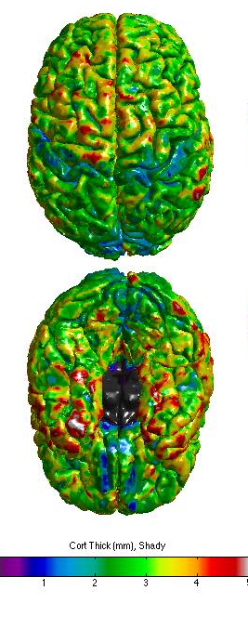
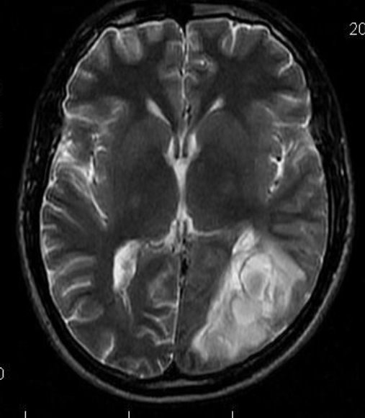
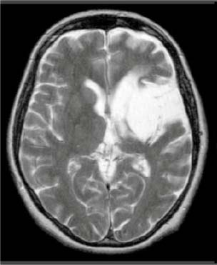
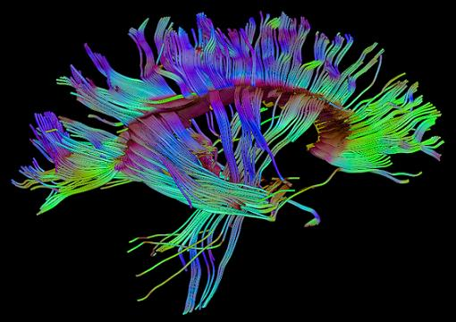
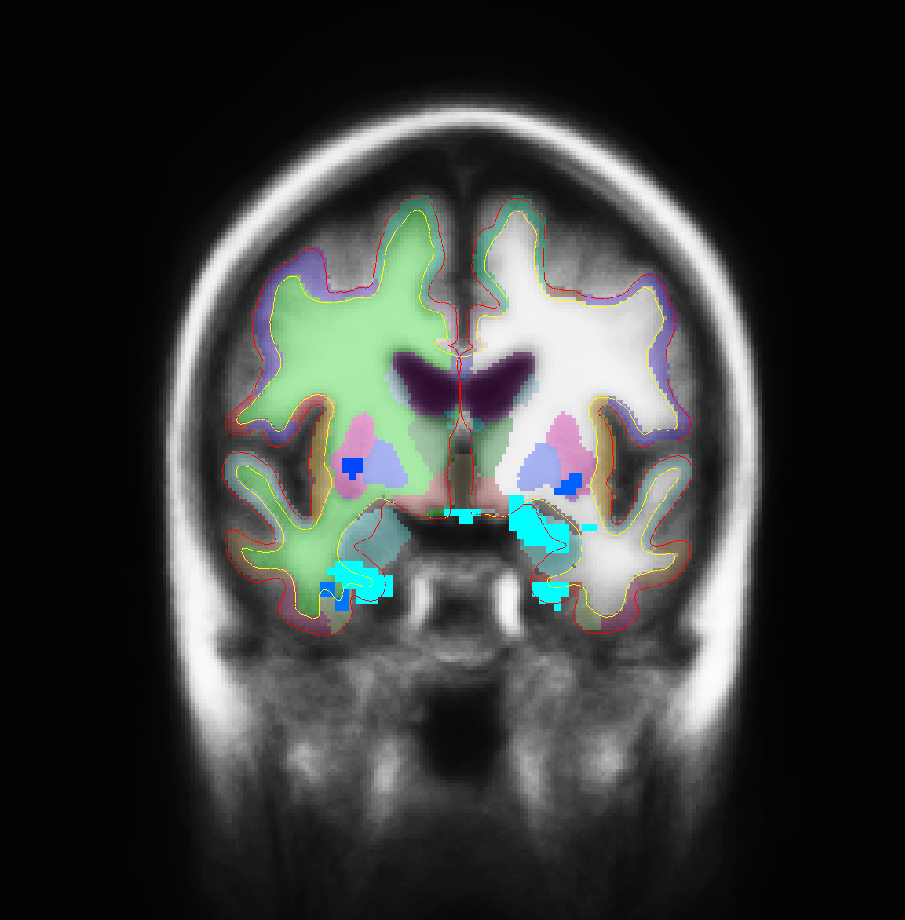
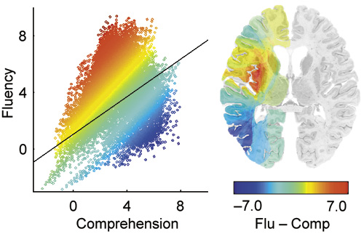
§ Measurements in Cognitive Neuroscience
Physiological measures – MRI: variations on a theme
T1
T2
DTI
VBLM
Cortical Thickness
BOLD
Notes:
Biological substrates – are they sufficient for a particular cognitive function? Answer this with morphometric and functional techniques.

Slide 42
OUTLINE
I. Practical consideration for a subject visit
II. Taking measurements
III. Data analysis and presentation

Slide 43
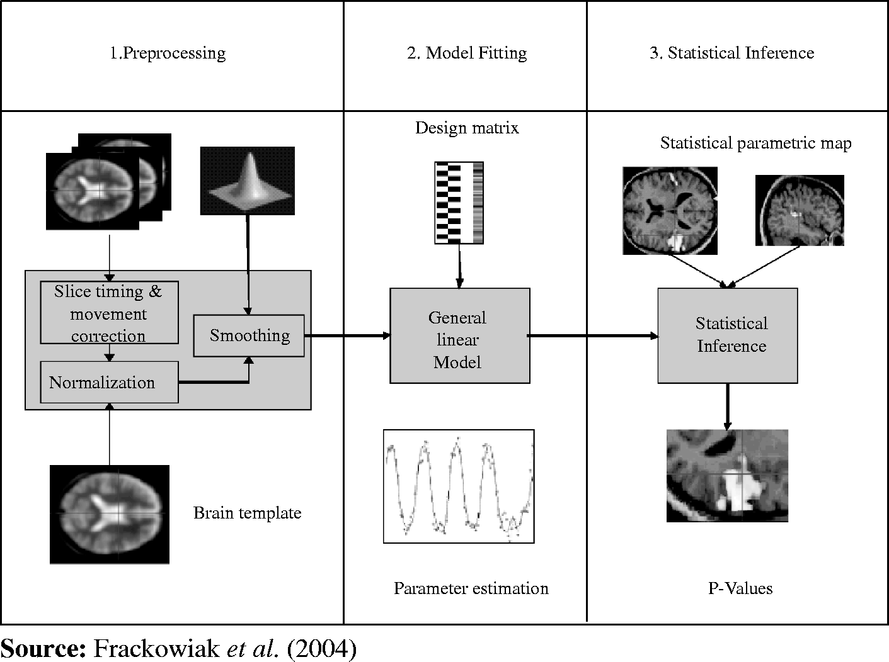
DATA ANALYSIS and PRESENTATION

Slide 44
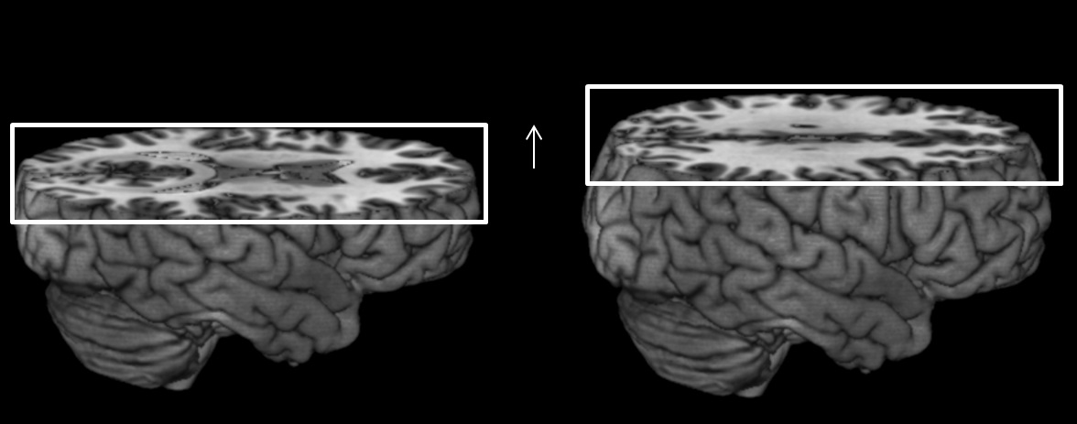
Preprocessing
Slice Time Correction -
slices acquired at different times
statistical analysis is easier if we can model every slice within a volume as being acquired at the same time

Slide 45
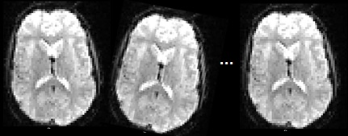
Preprocessing
Realignment
subjects move
statistical analysis is performed on a voxel-by-voxel basis
time

Slide 46
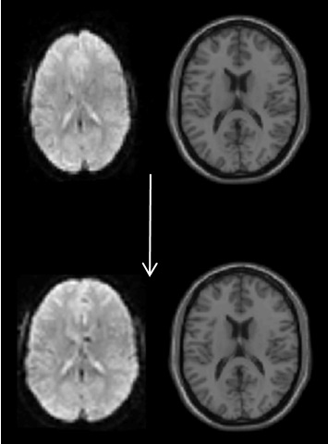
Preprocessing
Normalization -
can reference a standard atlas
warping everybody’s head to the same atlas space allows for group analyses

Slide 47
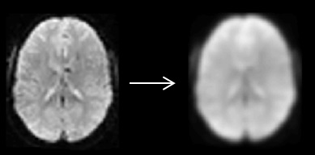
Preprocessing
Smoothing -
removes spatial noise
ensures parametric statistical conditions are met

Slide 48
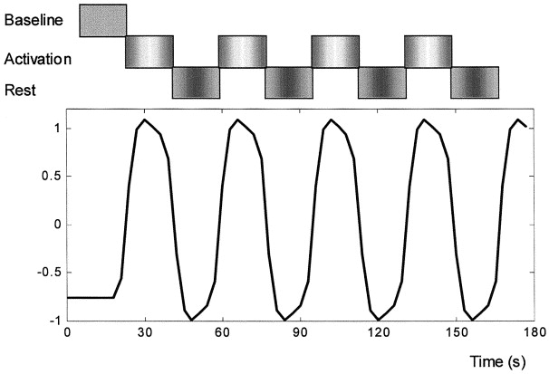
DATA ANALYSIS

Slide 49
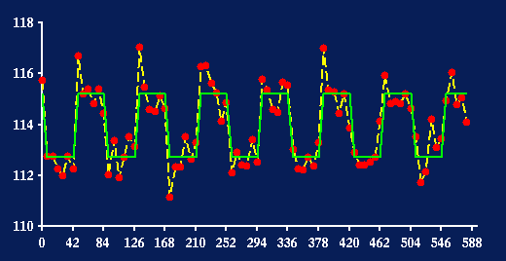
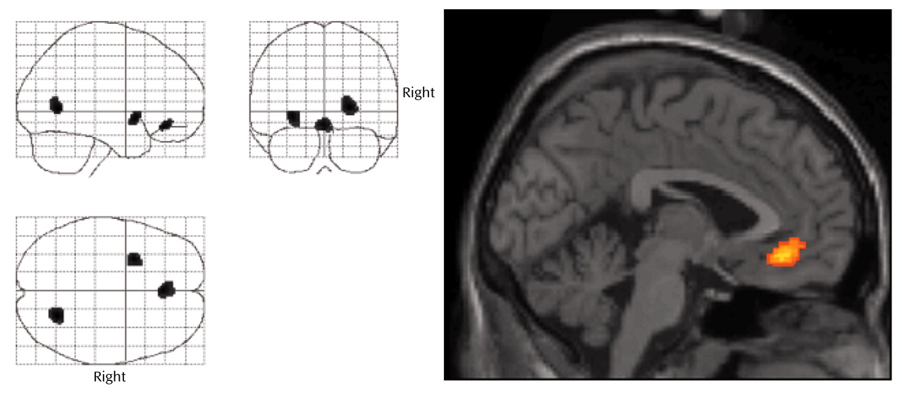
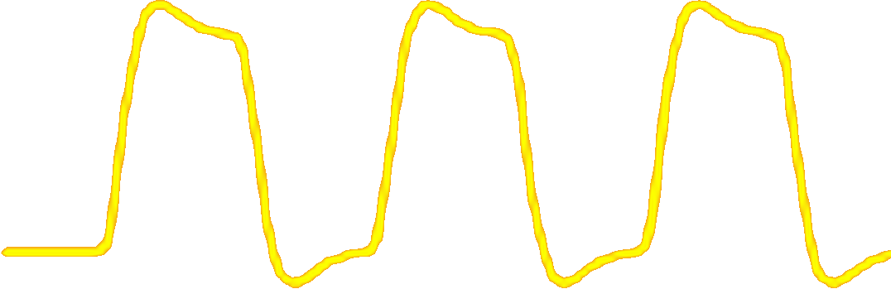
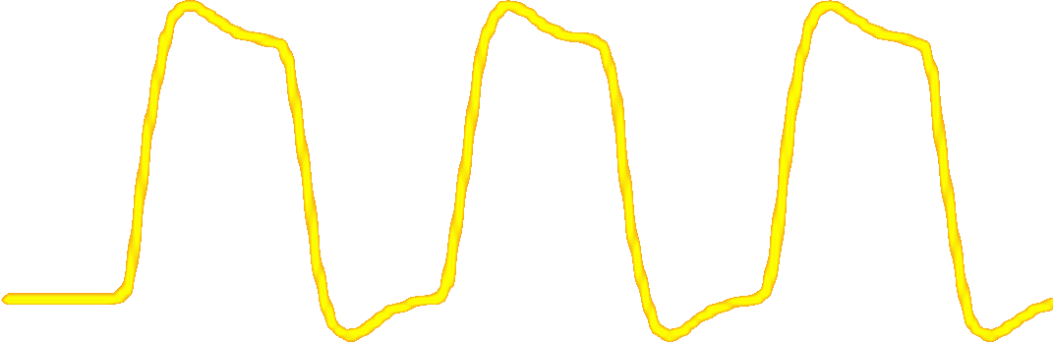
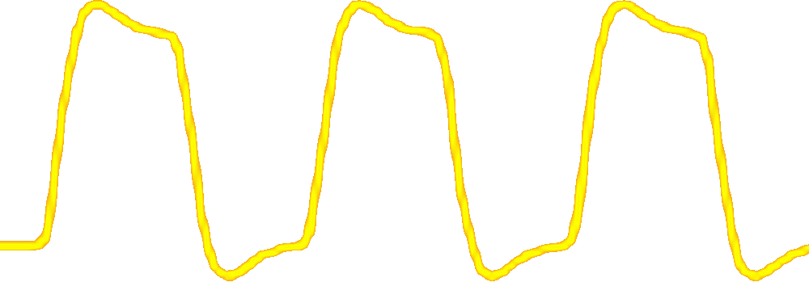
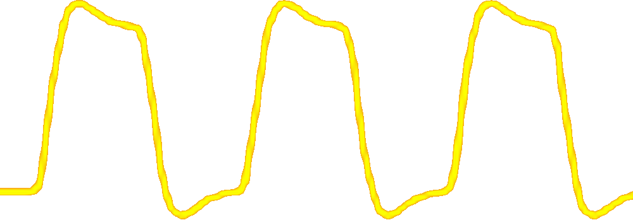
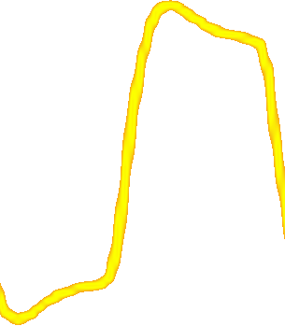
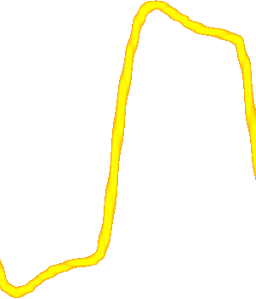
Correlation/Regression
1) Model a representative waveform representing the on-off periodicity of the design convolved with HRF.
2) Correlate MRI signal change in each voxel, across all scans, with the model.

Slide 50
DATA PRESENTATION
“Glass Brain” Overlay on structural
Statistical parametric map, corrected for multiple comparisons.

Slide 51
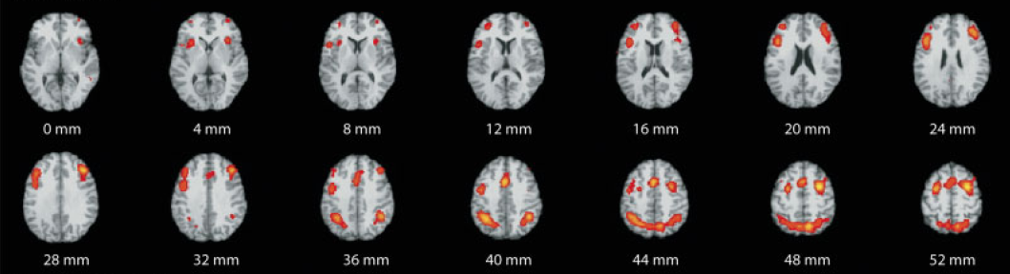
Expected Results for N-Back Task
- Lateral and medial premotor cortex
- Lateral and medial posterior parietal cortex
- Dorsolateral and ventrolateral prefrontal cortex
- Frontal poles
Owen, et al. (2005) Human Brain Mapping, 25:46-59

Slide 52
Let’s go scanning...

