Slide 1
BELLAFIT

Slide 2
Project description.
This project entails an analysis of fitness data to deduct how the findings can be tailored to improve sales and profit for Bella Fit, a company that focuses on fitness products for women.
Key analyses include the age distribution to identify the target market.
Analysis of types of activities
Health conditions in relation to fitness.
Stress levels based on sleep, steps and activity levels.
Data source: Kaggle

Slide 3
Questions answerd
Which activity burns the most calories?
How does hydration level affect fitness?
How does health conditions influence fitness ?
Which age category practices fitness more?

Slide 4
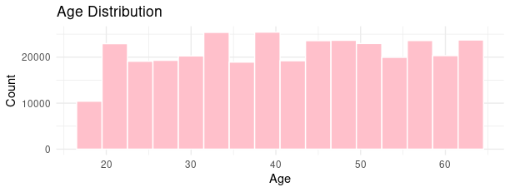
Age Distribution

Slide 5
Target market
Women aged 25-40
From the Age distribution, Bella fit can target their new marketing campaigns to 25-40 year old women.

Slide 6
Activity Types
HIIT (High Intensity training) is the most common activity followed by running and cycling.
Company can maximize profit by pushing and marketing products for HIIT such training shoes, watches and bracelets that measure heart rate and calorie burn.

Slide 7
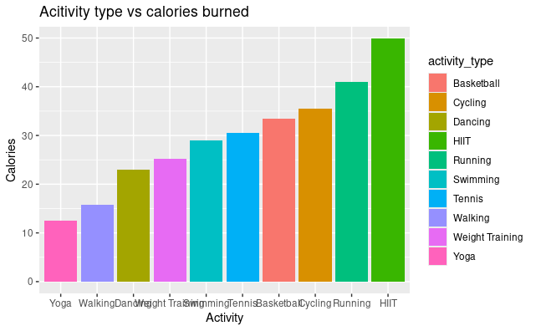
Activity vs Calories burned

Slide 8
Health Conditions
Hypertension is the leading condition amongst people that practice fitness followed by Asthma.
All together people with health conditions participate more in fitness programs as compared to those without any health challenges.
Company should design products and develop campaigns for products focused on these groups

Slide 9
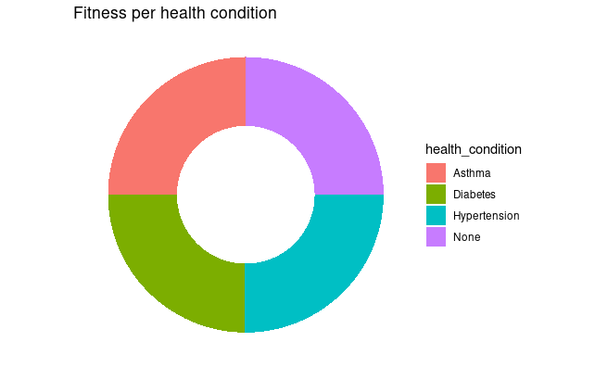
Fitness levels based on health condition

Slide 10
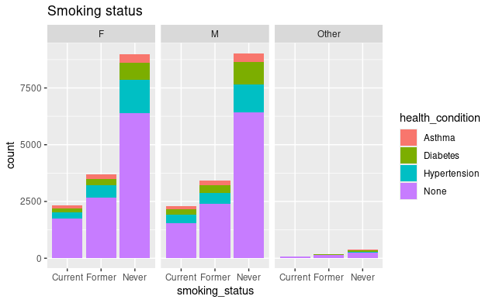
Smoking Status

Slide 11
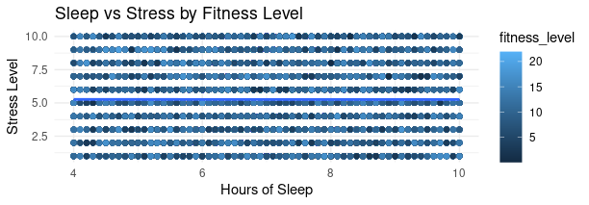
Sleep vs Stress levels

Slide 12
Stress levels
Stress levels are lower when people are hydrated.
The marketing team can promote their water bottle with this campaign.

Slide 13
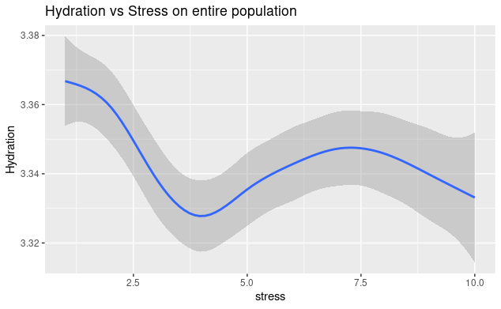
Hydration vs Stress

Slide 14
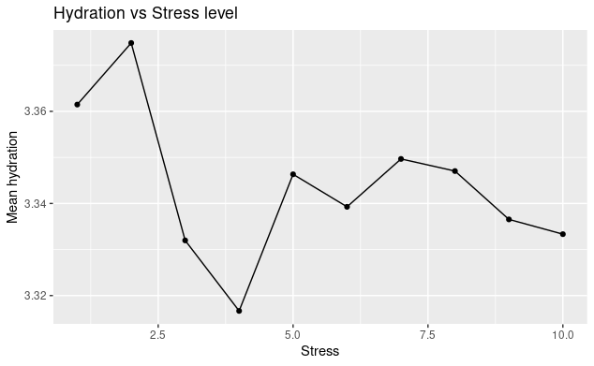
Hydration(mean) vs Stress Level

Slide 15
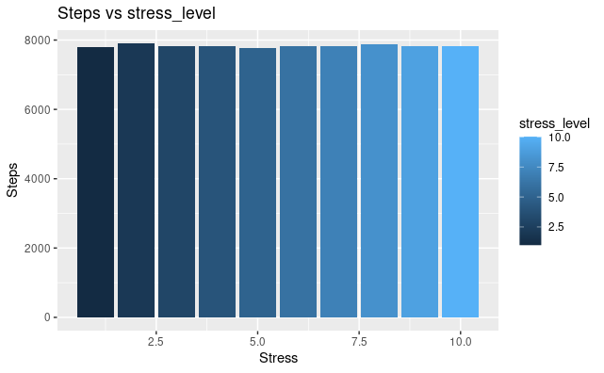
STEPS VS STRESS

Slide 16
Conclusion and recommendations.
From the Age distribution, Bella fit can target their new marketing campaigns to 40 year old women.
HIIT (High Intensity training) is the most common activity followed by running and cycling. Company can maximize profit by pushing and marketing products for HIIT such training shoes, watches and bracelets that measure heart rate and calorie burn.
Stress levels are lower when people are hydrated. The marketing team can promote their water bottle with this campaign.

