Slide 1
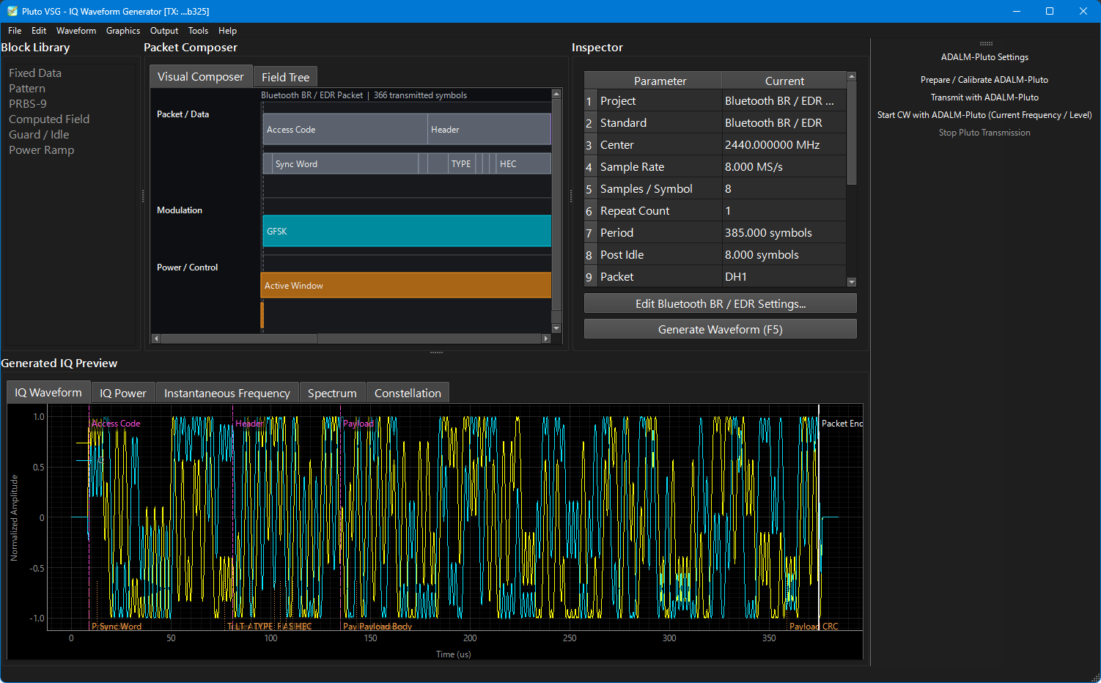
VSG Control
RF
ON
Mod
ON
Continuous
ON
Power
-20.5 dBm
▲
▼
Estimated Peak Power: -17.0 dBm
Power Step
10 dB
Frequency
2440.000 000 MHz
Freq Settings
Inst Settings

