Slide 1
Milky Way 2A

Slide 2
China Upgraded MilkyWay 2 Supercomputer
What is Supercomputer
Previous version of MilkyWay
MilkyWay 2A specs
Usage & Challenges

Slide 3
What is Supercomputer computer with a high level of computing performance compared to a general-purpose computer. Performance measurement – floating-point operations per second
 | MilkyWay2A | Intel Core i7 – 7700K
Computing Power | 9.497×10¹⁶ floating-point operations/s | 5.1×10⁹ floating-point operations/s
Power Consumption | 18×10⁶W (5.28×10⁹ flops/W) | 91W (5.26×10⁷ flops/W)

Slide 4
Previous Version
Milky Way
4.7×10¹⁵ floating-point operations/s
Oct 2009
Rank 48 (June 2017)
National University of Defense Technology Changsha, China
Milky Way 2
5.49×10¹⁶ floating-point operations/s
May 2013
Rank 2 (June 2017)
National University of Defense Technology Changsha, China (cause the whole school to black out)
National Supercomputer Center Guangzhou, China (Sun Yat-Sen University, Zhongshan University)

Slide 5
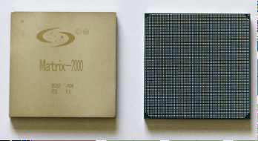
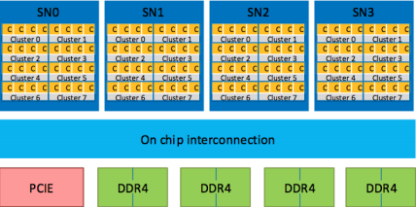
MilkyWay 2A Specs
Upgrades 1
Intel Xeon Phi Knights Corner accelerators to Matrix-2000 accelerators
(February 2015, US Department of Commerce banned export)
Accelerator — computer hardware used to perform some functions more efficiently than is possible in a more general-purpose CPU (example Graphic Card)

Slide 6
MilkyWay 2A Specs
Upgrades 2 & 3
16000 nodes to 17792 nodes
each node uses two matrix-2000 accelerators and two Intel Core Ivy Bridge CPUs (12 cores clocked at 2.2 GHz) 5.3376 ×10¹² flops
35,584 Ivy Bridge CPUs + 35,584 Matrix-2000 accelerators total 4,981,760 compute cores
1.4PB DDR4 2400MHz memory to 3,4 PB DDR4 2400MHz memory

Slide 7
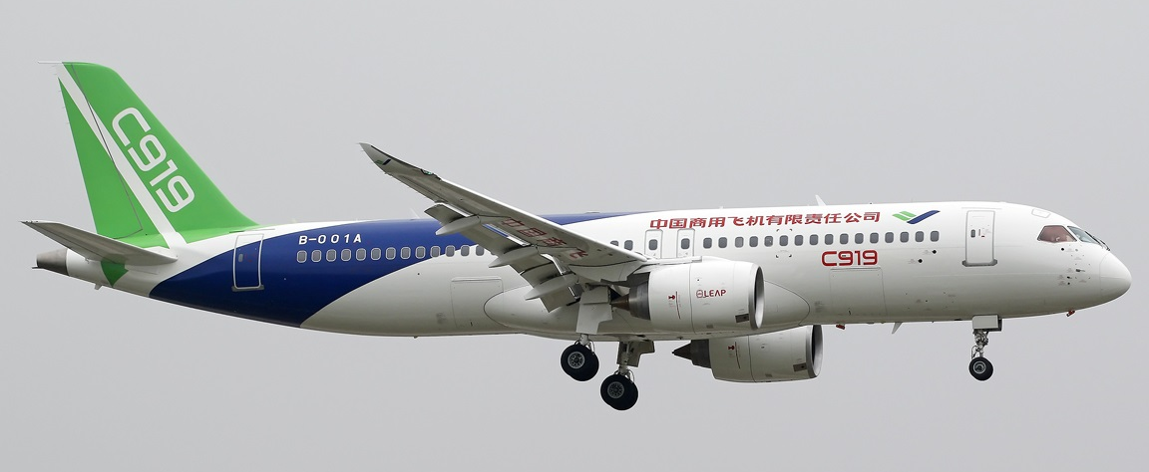
Use Cases of MilkyWay 2
Comac C919 Flight Aerodynamic outflow
Organic small compounds’ binding affinity for Shanghai Institute of Materia Medica
Guangzhou electronic government management system

Slide 8
Challenges
Difficult to use “the function of the supercomputer is still way behind, some users would need years or even a decade to write the necessary code” Chi Xuebin, deputy director of the Computer Network and Information Center
Low efficiency Rmax(max calculation power)/Rpeak(theoretical calculation power) Tianhe 2A – 64.0% Piz Daint (rank 3)–77.4% Titan (rank 4) – 64.9% Sequoia (rank 5) – 85.3%
Oversupply Building objective is the rank Built by supercomputer center sell calculation to users, however potential user: Research University—have own supercomputers, impossible to go all the way to Guangzhou Military — Security of open computer center Industries — slow software greatly reduce actual problem-solving ability

