Slide 1
同位素效应
(Isotope Effect)

Slide 2
主要内容
背景介绍
基本原理
反应实例
一种新测定方法的简介
在反应机理研究中的应用
同位素标记实验及应用

Slide 3
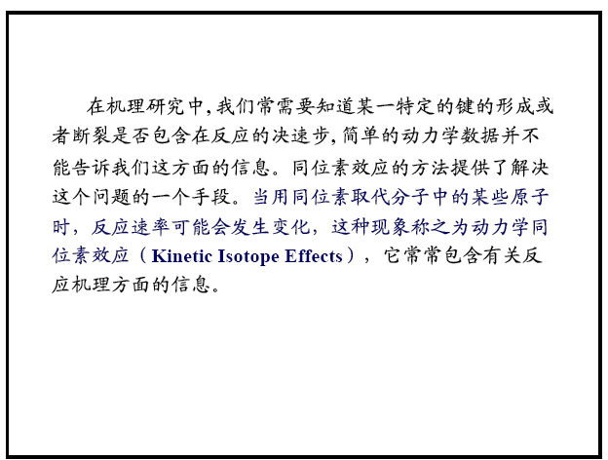
背景介绍

Slide 4
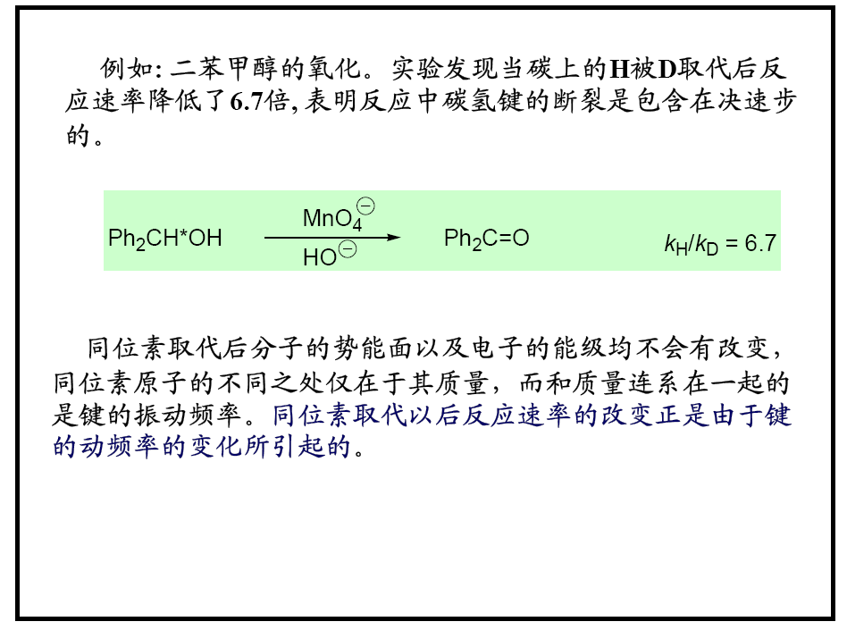

Slide 5
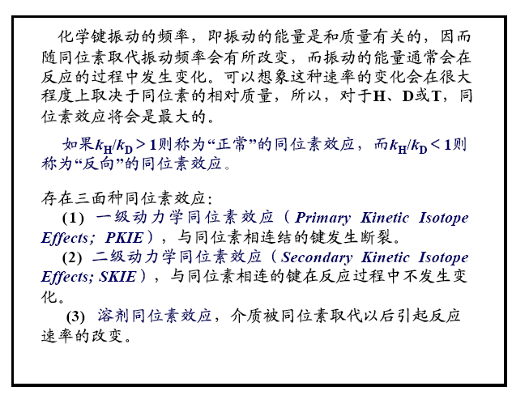

Slide 6
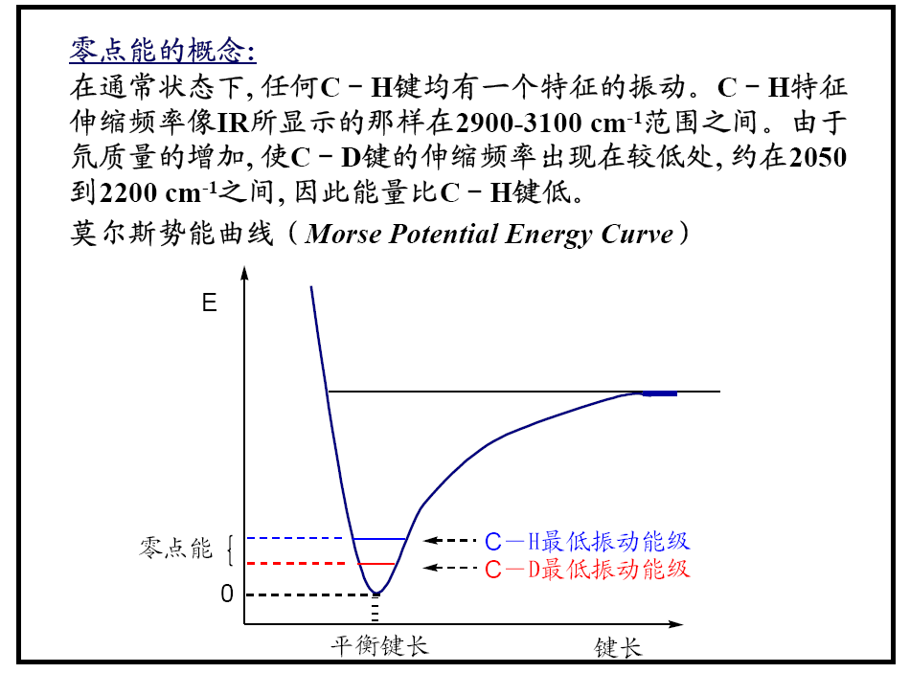
基本原理

Slide 7
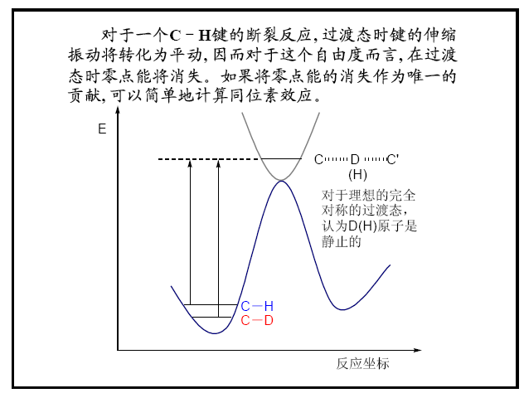

Slide 8
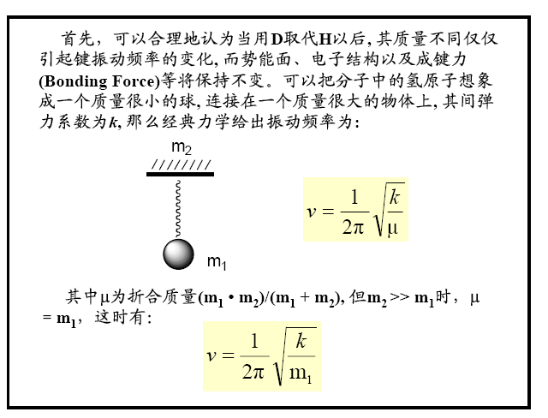

Slide 9
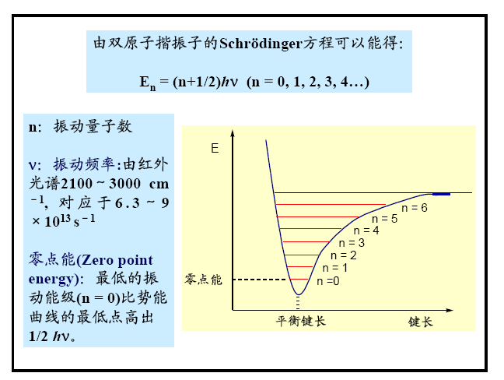

Slide 10
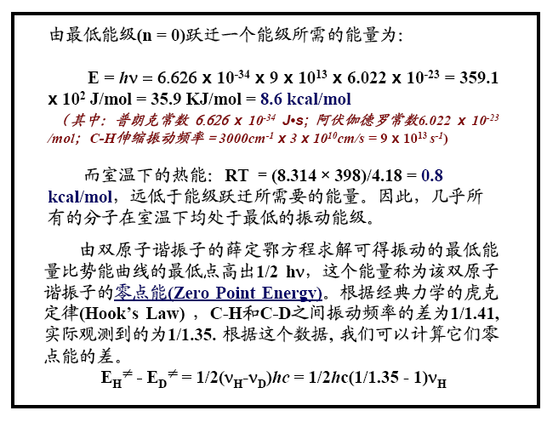

Slide 11
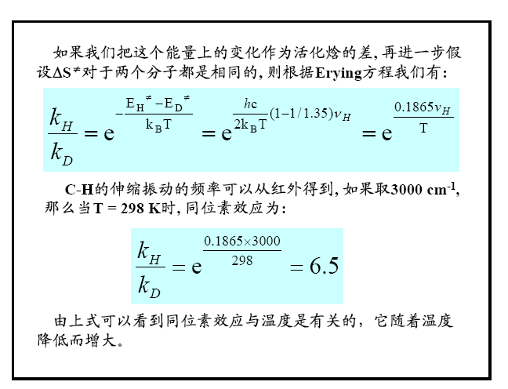
1/1.02 for C12−C13

Slide 12
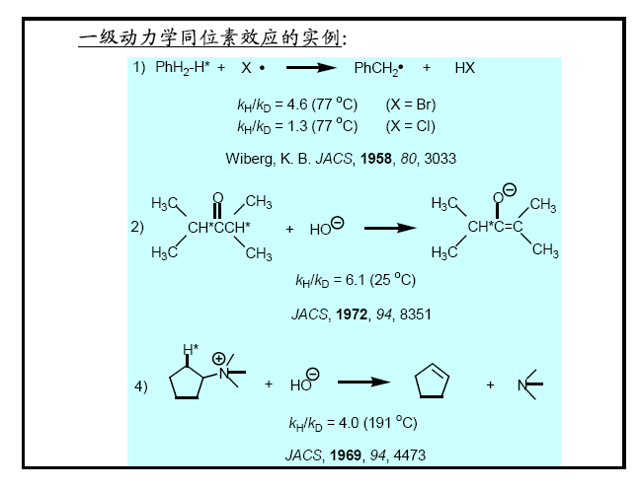
反应实例
Notes:
1）为什么Br是4.6，Cl是1.3？
因为Cl自由基活性强，过渡态比较早，过渡态的键长短，所以过渡态中振动保留得多（更像原料），抵消得少。

Slide 13
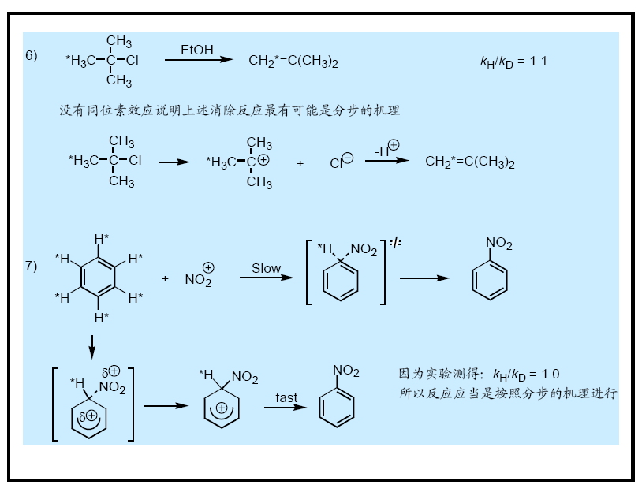
Notes:
6）同位素效应微弱，说明碳氘键断裂不是决速步。

Slide 14
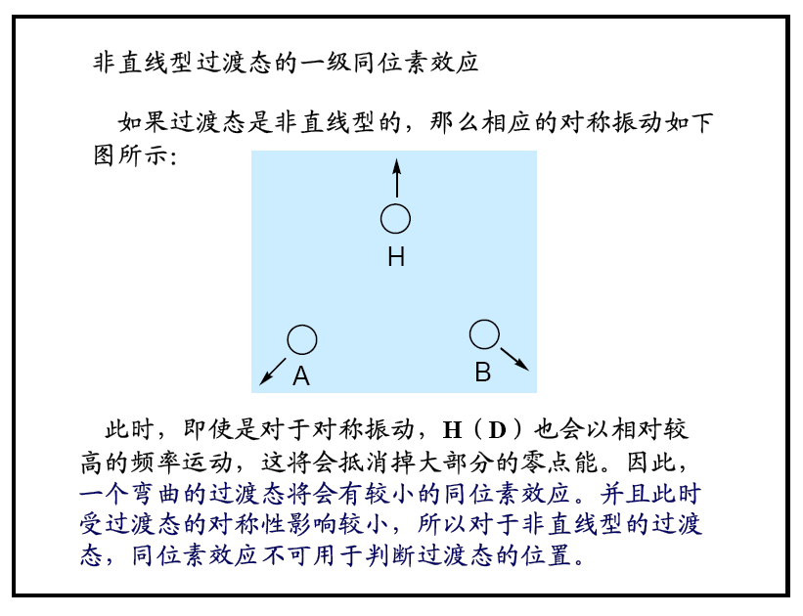

Slide 15
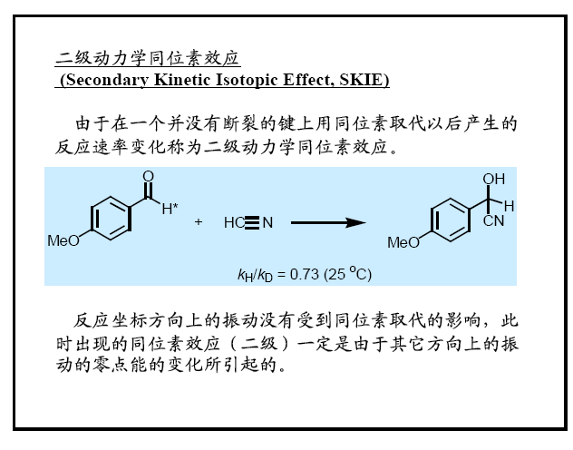

Slide 16
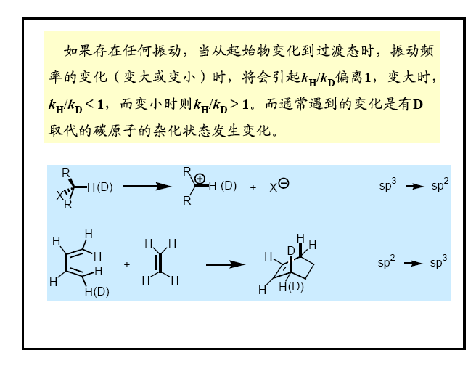

Slide 17
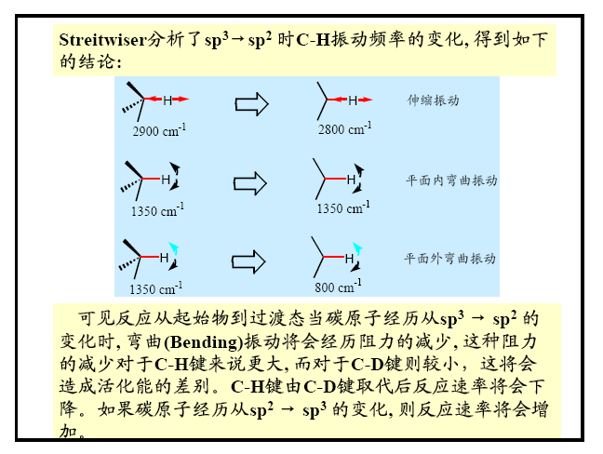

Slide 18
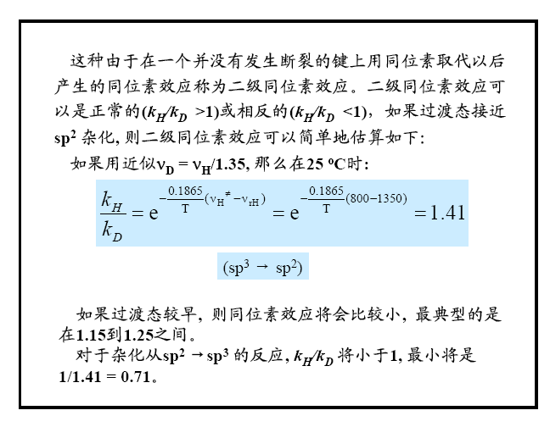

Slide 19
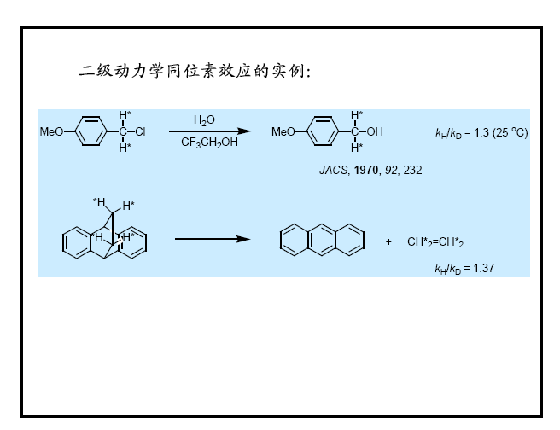
反应实例

Slide 20
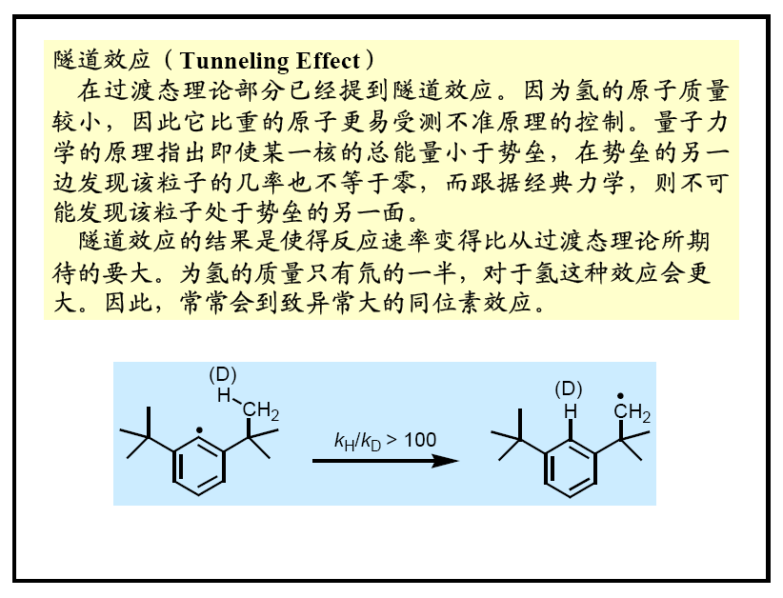

Slide 21
High-Precision Simultaneous Determination of Multiple Small Kinetic Isotope Effects at Natural Abundance
一种新测定方法的简介
Daniel A. Singleton

Slide 22
Disadvantage of traditional methods for the determination of KIEs
Absolute rate measurements are rarely sufficiently precise.
Competition reactions are usually adopted.
The synthesis of isotopically labeled materials is arduous.
Only one KIE can be determined every time.

Slide 23
A New Method Was Established by Singleton in 1995!
Idea:
As any reaction proceeds, the starting materials are fractionatively enriched in isotopically slower-reacting components. The proportion of a minor isotopic component in recovered material compared to the original starting material (R/R₀) is related to the fractional conversion of reactants (F) and the KIE.

Slide 24
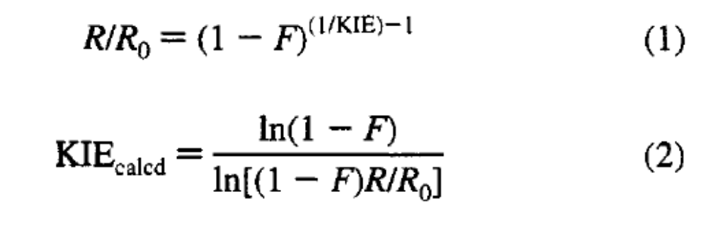
For example, a KIE of 1.05 results in ~25% enrichment of a slower-reacting isotopic component at 99% conversion.

Slide 25
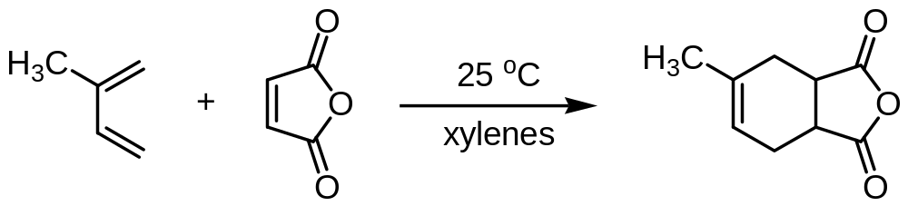
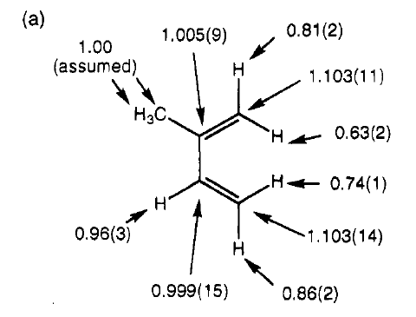
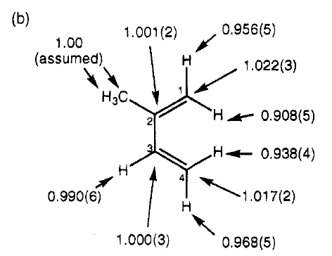
²H and ¹³C recovered at 98.9% conversion
²H and ¹³C KIEs

Slide 26
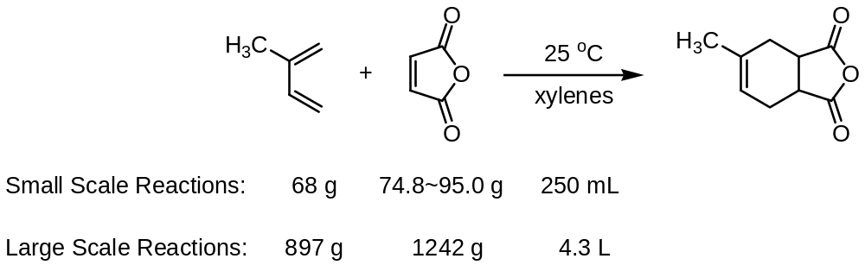
Major disadvantage of this new method for the determination of KIEs
The reaction must be sufficiently scalable to allow recovery of adequate starting materials.
The starting material must be isolable from a large amount of product.

Slide 27
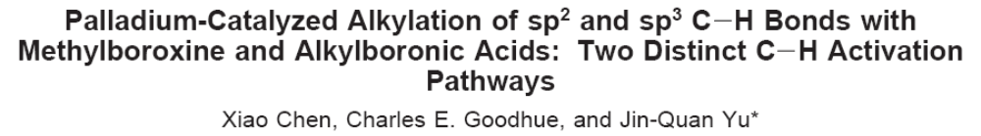
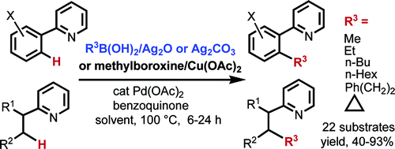
在反应机理研究中的应用
实例1：

Slide 28
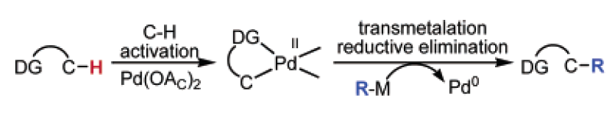
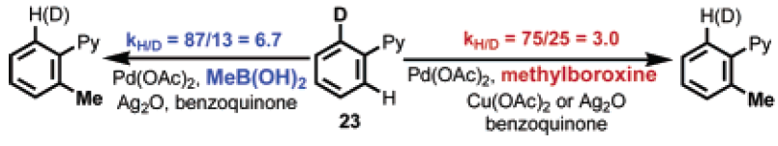

Slide 29
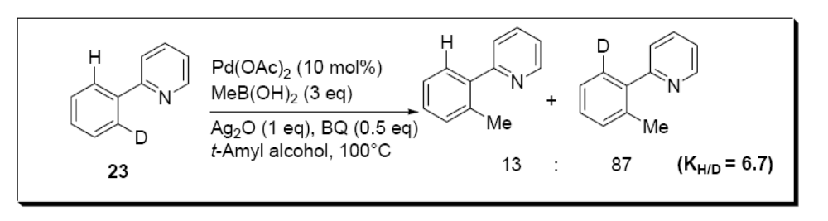
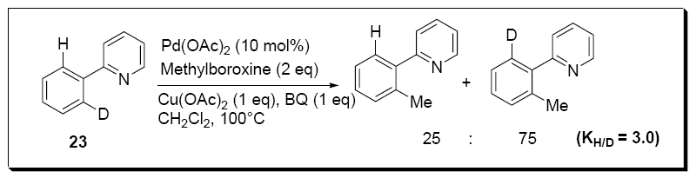
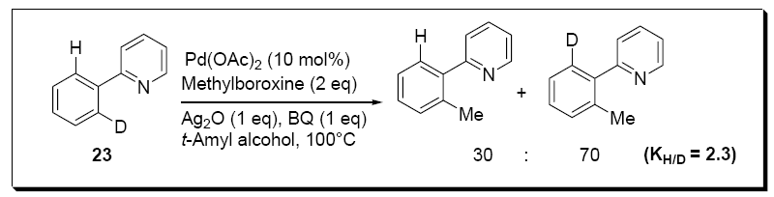

Slide 30
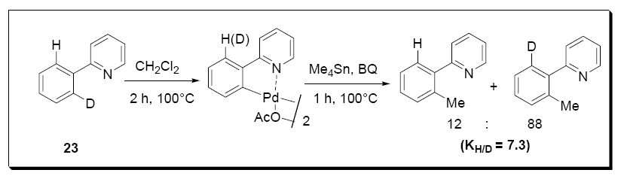
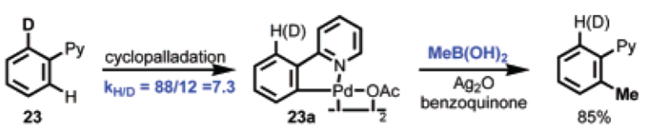

Slide 31
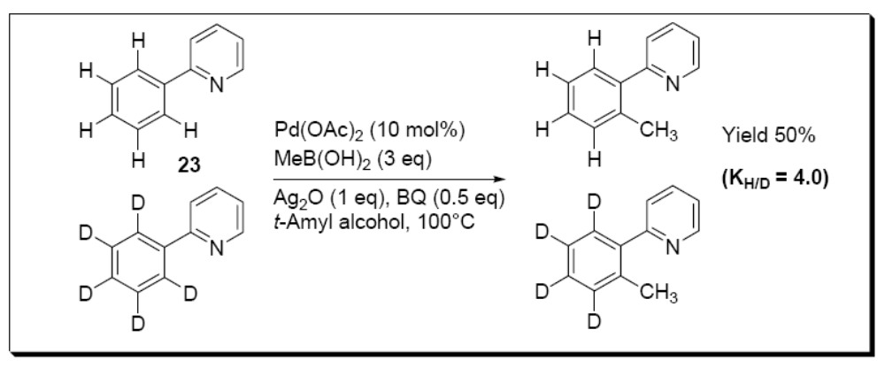
Intermolecular KIEs
C-H cleavage is the rate-determining step.

Slide 32
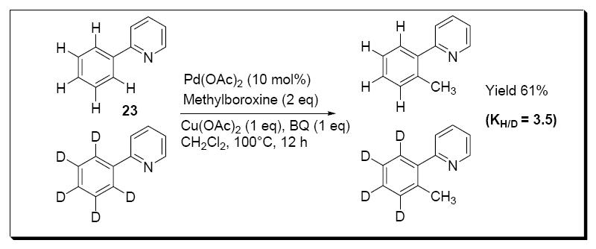
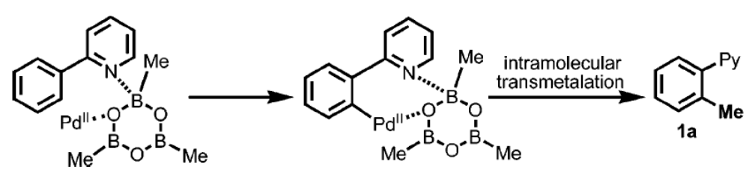

Slide 33
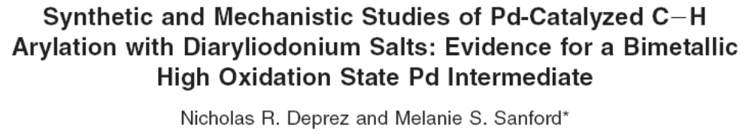
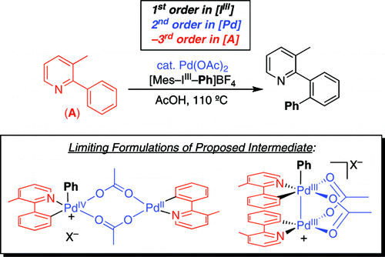
实例2：

Slide 34
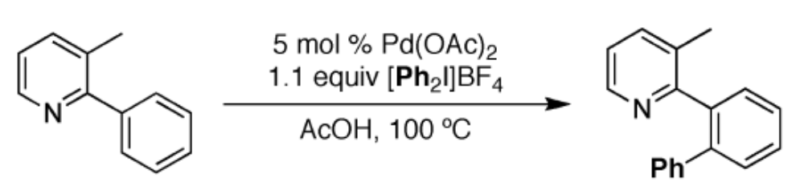
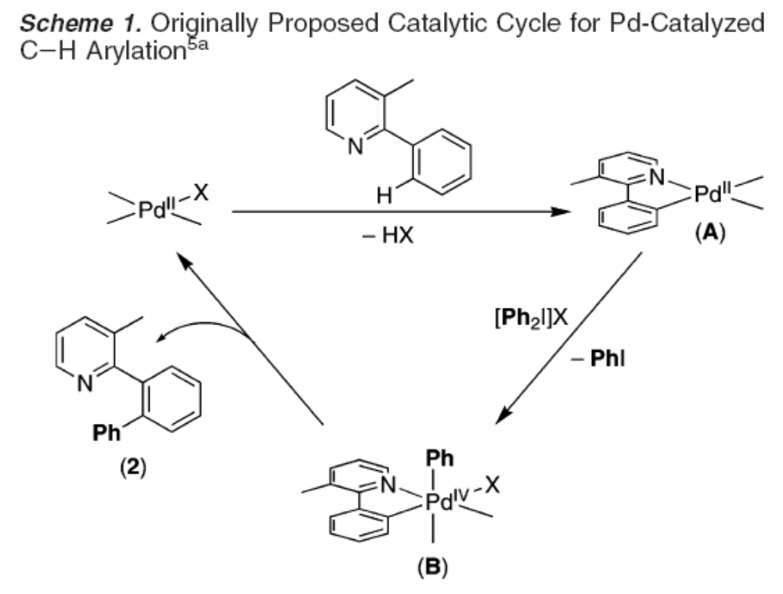

Slide 35
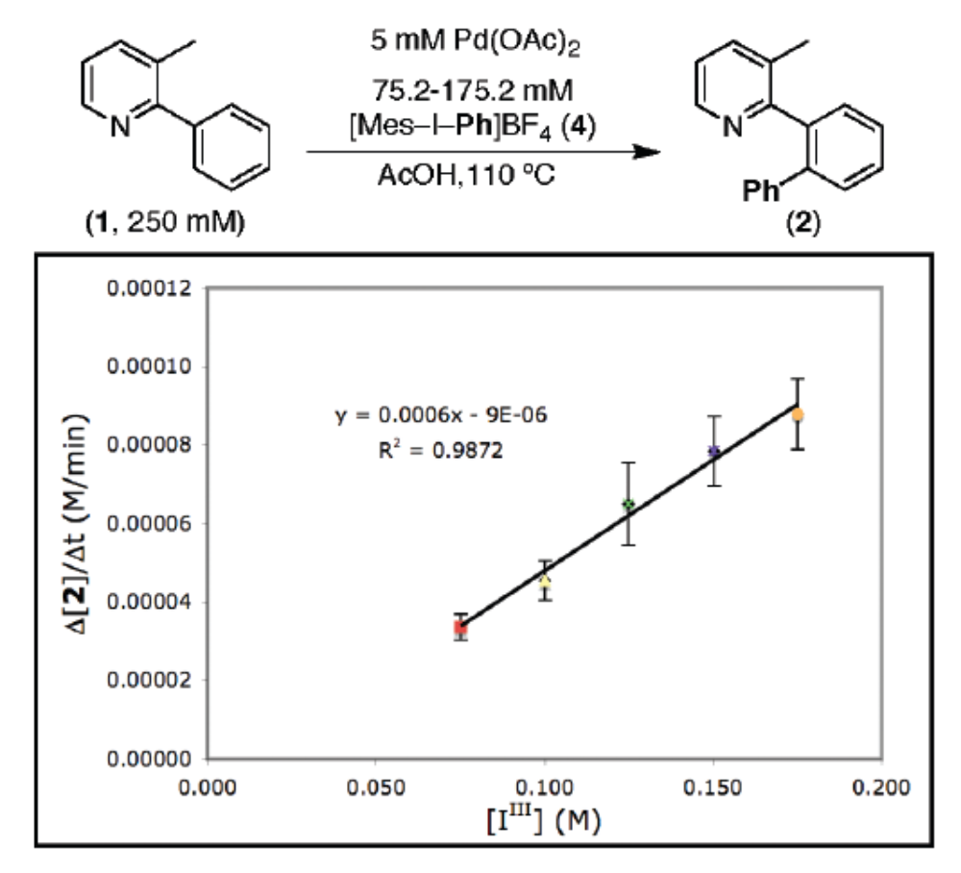

Slide 36
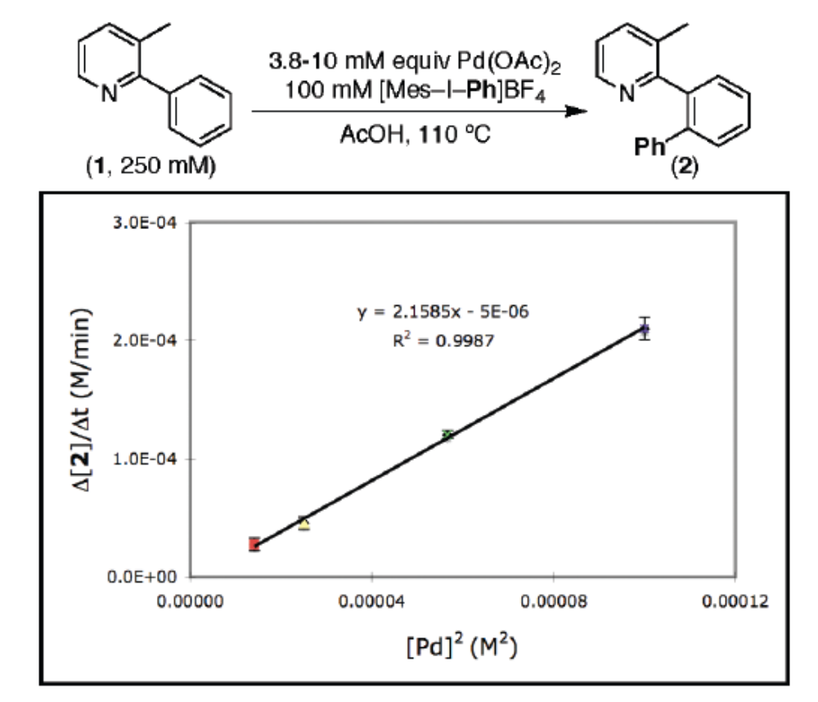

Slide 37
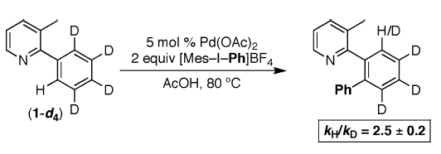
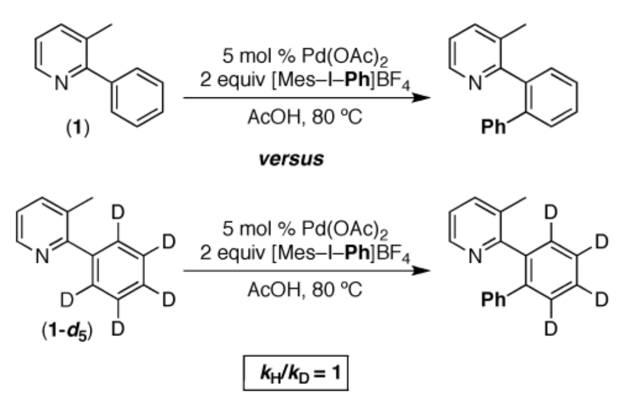
C-H cleavage is not the rate-determining step.

Slide 38
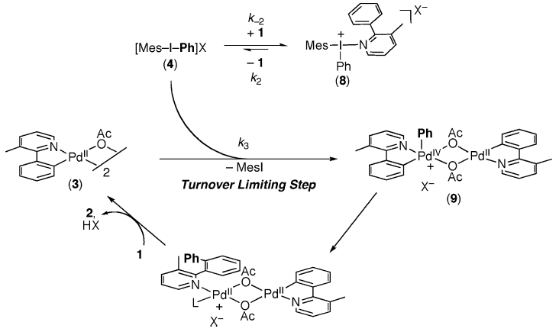
New mechanism

Slide 39
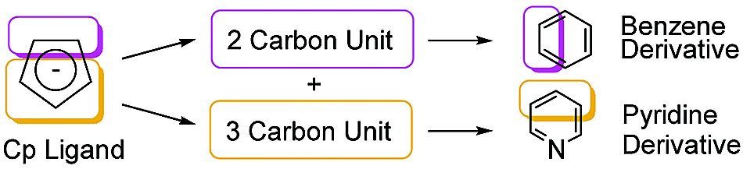
同位素标记实验及应用
实例1：

Slide 40
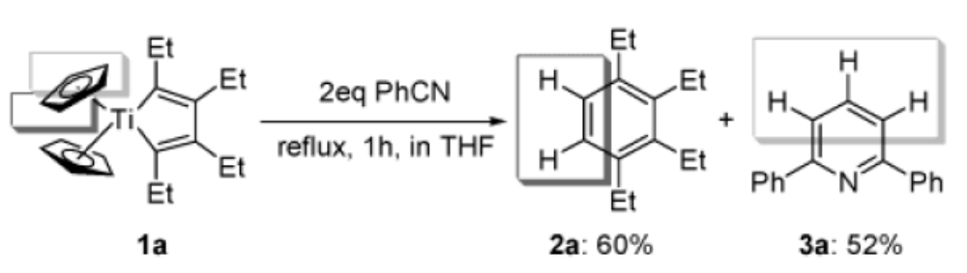
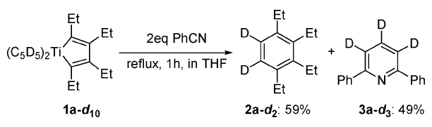
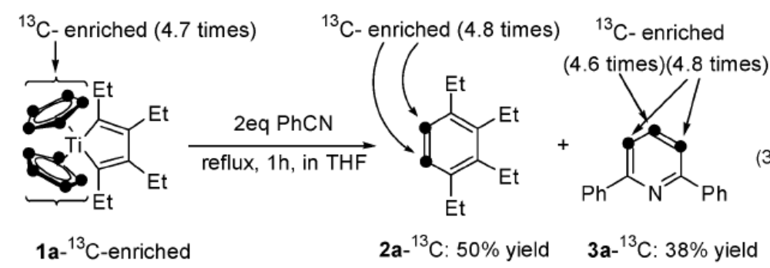

Slide 41
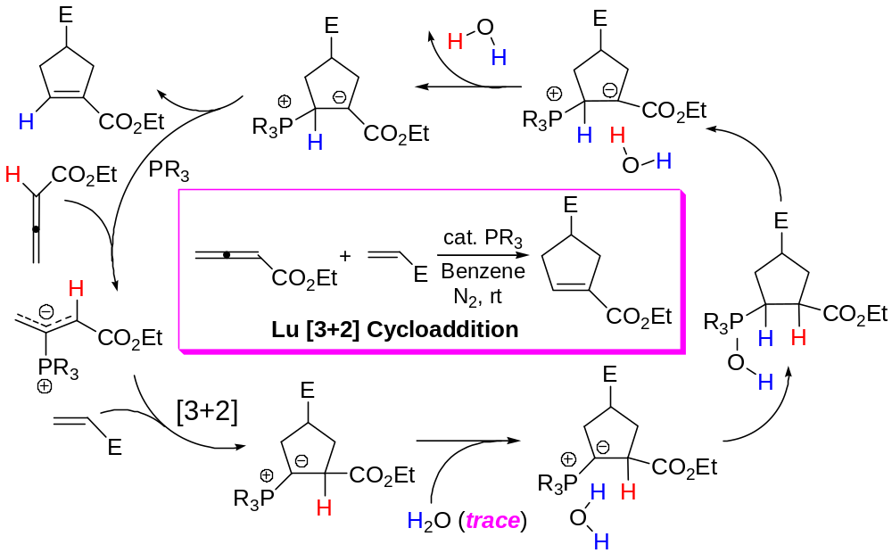
实例2：
Phosphine-catalyzed [3+2] cycloaddition reactions of allenoates and electron-deficient alkenes
Liang, Y.; Liu, S.; Xia, Y.; Li, Y.; Yu, Z.-X. Chem. Eur. J. 2008, 14, 4361;
Xia, Y.; Liang, Y.; Chen, Y.; Wang, M.; Jiao, L.; Huang, F.; Liu, S.; Li, Y.; Yu, Z.-X.
J. Am. Chem. Soc. 2007, 129, 3470.

Slide 42
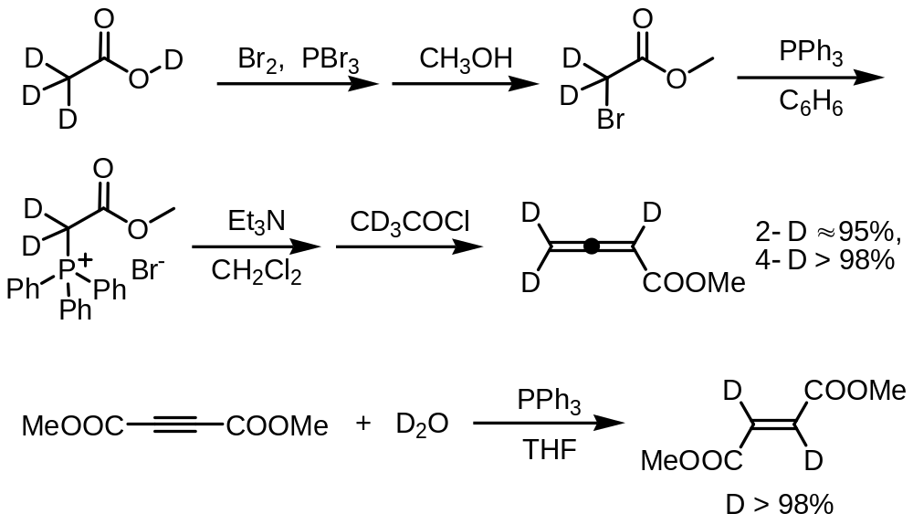

Slide 43



Slide 44

Control experiments

Slide 45

Overall potential energy surface

Slide 46



实例3：

Slide 47


