Slide 1
Chapter 5 Linear Programming
  Linear Programming, a. k. a. Linear Optimization, is referred to as the case when both the objective function and constraints are linear functions of the variables.
  As shown in Chapter 1, the feasible region of the linear programming problem is an enclosed convex polygon or polytope. The optimal solution is often located at one or more vertex points.
  The mathematical model of the linear programming problem is also comprised by the objective function, variables, and the constraints. The constraints usually consist of a series of equalities or inequalities, as well as a series of non-negative constraints for all the variables.

Slide 2
5.1 Mathematical Formulation of Linear Programming
  General Form:
  min (max) f(X) = c₁x₁ + c₂x₂ + ··· + c_{n}x_{n} = Σc_{j}x_{j}
  ( j = 1, 2, ··· , n)
  s.t. Σa_{ij} x_{j} = b_{i} (i = 1, 2, ··· , m)
  x_{j} ≥ 0 ( j = 1, 2, ··· , n)
  Vectorial Form:
  min (max) f(X) = C^{T}X
  s.t. AX =b
  x_{i} ≥ 0 (i = 1, 2, ··· , n)

Slide 3
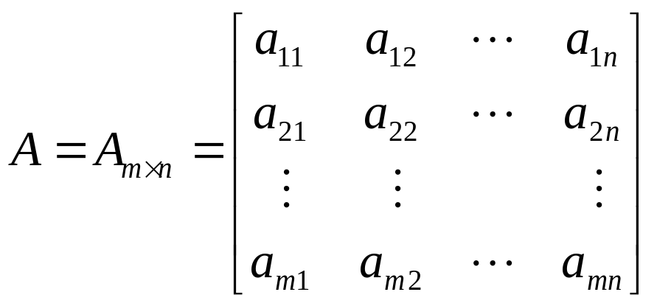
5.1 Mathematical Formulation of Linear Programming (II)
  where: X = [x₁ , x₂ , ··· , x_{n}]^{T} C = [c₁ , c₂ , ··· , c_{n}]^{T}
  b = [b₁ , b₂ , ··· , b_{m}]^{T}
  A is the coefficient matrix; AX = b are the constraint equations; x_{i} ≥ 0 are the nonnegativity constraints.

Slide 4
5.1 Mathematical Formulation of Linear Programming (III)
  In general, it should have m < n since the constraint equations can have multiple solutions only when m < n sustains. The goal of the linear optimization is to find the optimal one from these multiple solutions to make the objective function achieve the optimal value.
  In the standard math form of the linear programming problem, all the constraints ought to be equalities except the non-negative constraints for the variables.
  If in the practical problems, there exists other inequalities, then for each of them, a non-negative variable should be employed into these inequalities to make them equalities. This non-negative variables are called the slack variables.

Slide 5
5.1 Mathematical Formulation of Linear Programming (IV)
  e.g. (exempli gratia):
  max f(X) = 60x₁ + 120x₂
  s.t. 9x₁ + 4x₂ ≤ 360 3x₁ + 10x₂ ≤ 300
  4x₁ + 5x₂ ≤ 200 x₁ , x₂ ≥ 0
  Introducing 3 new slack variables x₃, x₄, x₅, then the problem becomes:
  max f(X) = 60x₁ + 120x₂
  s.t. 9x₁ + 4x₂ + x₃ = 360 3x₁ + 10x₂ + x₄ = 300
  4x₁ + 5x₂ + x₅ = 200 x₁ , x₂ , x₃ , x₄, x₅ ≥ 0

Slide 6
5.2 Solution for the L. P. Problem
  The solutions for the linear programming problems can be classified as three categories:
  1. Basic solution: only satisfies the constraint equations.
  2. Basic feasible solution: satisfies both the constraint equations and the non-negative constraints for variables.
  3. Optimal solution: the basic feasible solution which makes the objective function achieve the optimal value.

Slide 7
5.2.1 Basic Solution of L. P. Problems
  The constraint of the linear programming problems actually is a linear equation set consisting of n variables and m equations (n>m). Since the number of variables is more than the number of equations, there are multiple solutions for this equation set.
  If setting n-m variables to zeros, then the constraint becomes an equation set with m variables and m equations. This equation set can be solved to get the values of these m variables. These m values and the n-m ZERO values comprise a solution of this equation set, which is referred to as the Basic Solution of the linear programming problem.
  In this solution, the n-m variables which have ZERO values are called Non-basic Variables, and the other m variables are called Basic Variables. Therefore, a basic solution is composed by n-m non-basic variables and m basic variables.

Slide 8
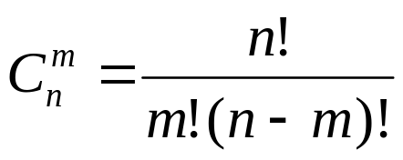
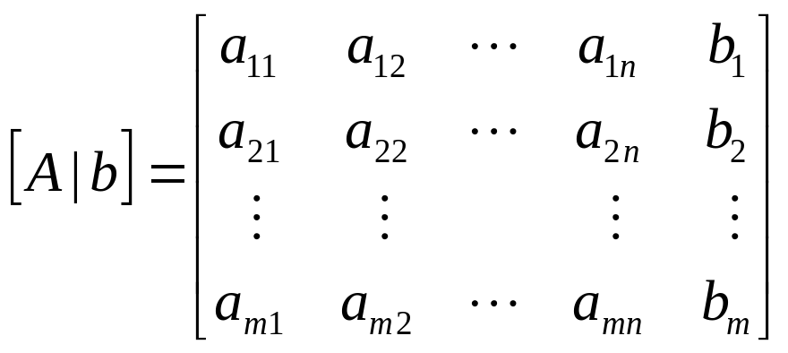
5.2.1 Basic Solution (II)
  The n-m non-basic variables can be chosen randomly and set as zero, then solve the other m basic variables to form a basic solution. Thus the number of basic solutions can be determined as:
  The augmented matrix can be obtained by combining the coefficient matrix A and the constant vector b:

Slide 9
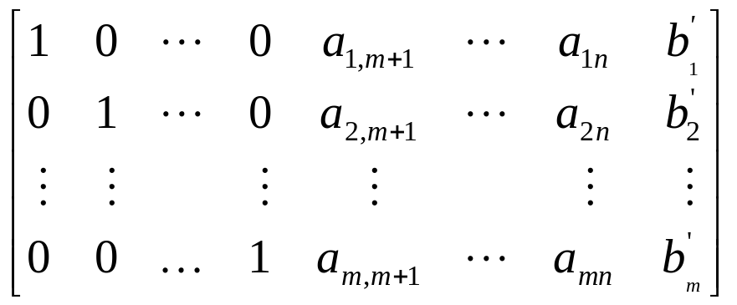
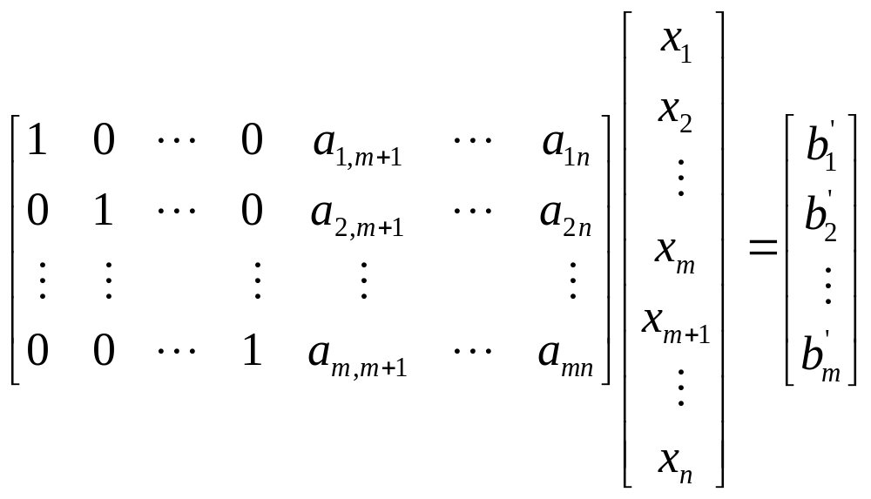
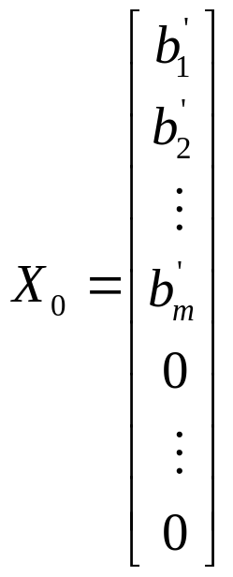
5.2.1 Basic Solution: Conversion
  Make transformations to the augmented matrix such that it becomes:
(5-5)
  Let the n-m variables (from x_{m+1} to x_{n}) be non-basic variables, i.e., set their values to be zero, then the equation turns to be:
⇒
Basic Solution
(5-6)

Slide 10
5.2.1 Conversion of BS (II)
  These transformations of the augmented matrix can be made via the Gaussian Elimination, of which the basic procedures are described as follows:
  1. Choose the principal element a_{lk} which needs to be changed to be “1”, where subscripts l and k denoting the row and the column on which the principal element is, respectively;
  2. Divide all the elements on the principal row by a_{lk} such that the principal element a_{lk}=1;
  3. Make all the elements on the principal column zero except the principal element.

Slide 11
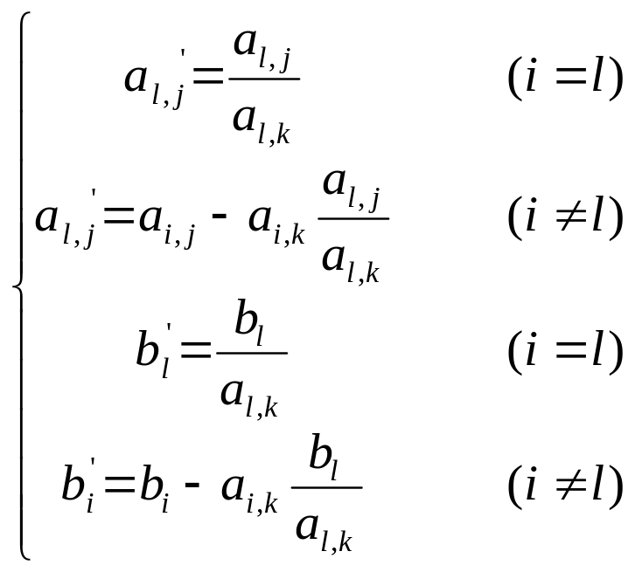
5.2.1 Conversion of BS (III)
  The formula for Gaussian Elimination:
  (i = 1, 2, ··· , m)
  ( j = 1, 2, ··· , n)
  Hence, a basic solution can be obtained by making m Gaussian eliminations to the augmented matrix. The principal element can be chosen from any column.

Slide 12
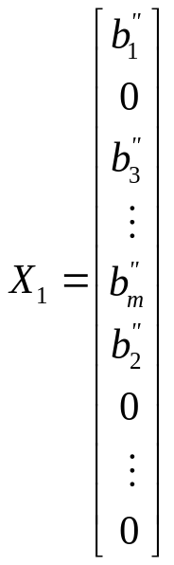
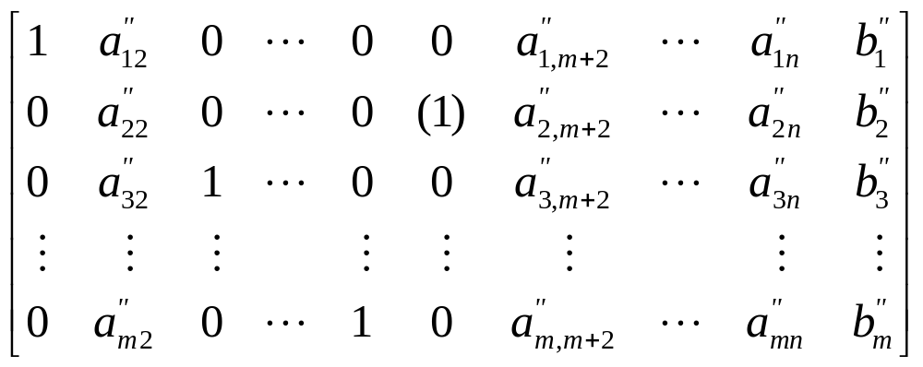
5.2.1 Conversion of BS (IV)
  Once a basic solution is acquired, another basic solution can be obtained via transformations on the augmented matrix. For example, in Eq.(5-5), choose a_{2m+1} as the new principal element and make some transformations, we can get:
Basic Solution
⇒
  The difference between X₁ and X₀ is that, x₂ has changed from a basic variable to a non-basic variable, while the non-basic variable x_{m+1} becomes a basic variable.

Slide 13
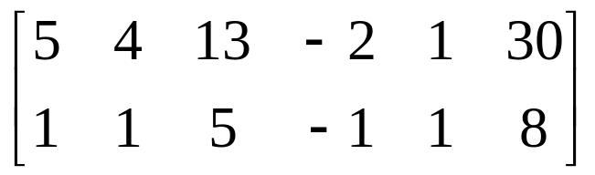
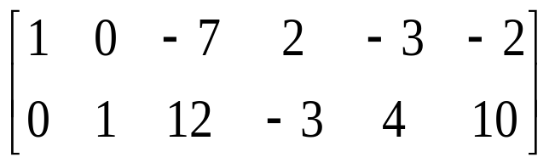
5.2.1 Example
  Ex: Solve the L.P. problem min f(X) = x₁ + x₂
  s.t. 5x₁ + 4x₂ + 13x₃ - 2x₄ + x₅ = 30
  x₁ + x₂ + 5x₃ - x₄ + x₅ = 8 x₁, x₂, ···, x₅ ≥ 0
  Solution: Construct the augmented matrix
Choose a₁₁ and a₂₂ as principal elements
⇒
The basic solution: X₀ = [-2, 10, 0, 0, 0, 0]^{T}, f(X₀) = 8
Basic variables: x₁ = -2, x₂ = 10;
Non-basic variables: x₃ = x₄ = x₅ = 0.

Slide 14
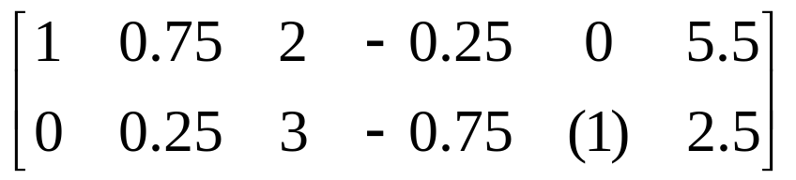
5.2.1 Example (Cont’d)
In the new augmented matrix, choose a₂₅ = 4 as the principal element, make transformations to get:
Therefore another basic solution can be acquired:
It can be seen that X₀ is a basic solution but NOT a basic feasible solution; X₁ is not only a basic solution but a basic feasible solution. Continue transforming can get more basic feasible solutions, including the optimal solution.

Slide 15
5.2.2 Basic Feasible Solution
  The basic feasible solution is a solution satisfying both constraint equations and non-negative constraints. The optimal solution lies in the basic feasible solutions.
  It can be proven that there are two cases for the acquirement of an initial basic feasible solution:
  1. If all the constraint equations are the inequalities with “≤” except the non-negative constraints, and the components in the constant vector are also positive numbers, then a basic feasible solution can be acquired by introducing the slack variables and using them as the basic variables.

Slide 16
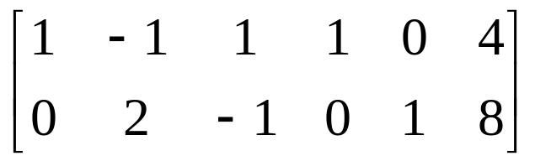
5.2.2 Basic Feasible Solution (II)
  e.g., for the following constraints:
  x₁ - x₂ + x₃ ≤ 4
  x₁ + 2x₂ - x₃ ≤ 8
  x₁ , x₂ , x₃ ≥ 0
  Introducing slack variables x₄ and x₅:
  x₁ - x₂ + x₃ + x₄ = 4
  x₁ + 2x₂ - x₃ + x₅ = 8
  x₁ , x₂ , … , x₅ ≥ 0
⇒
  The corresponding augmented matrix is:
  The solution is X₀ = [0, 0, 0, 4, 8]^{T} . Obviously it is a basic feasible solution where the basic variables are the slack variables are x₄ and x₅.

Slide 17
5.2.2 Basic Feasible Solution (III)
  2. If there exists equalities in the constraints, a variable similar to the slack variable can be introduced into each inequality constraint, called the artificial variable. Then an assistant LP program can be established and a basic feasible solution can be obtained by solving this problem.
  The objective function of the assistant LP program is the sum of all the artificial variables. The constraints include the equality constraints with the artificial variables and the non-negative constraints for all variables (including the artificial variables).
  During the solving process of the assistant LP problem, when the value of the objective function is zero, the solution is found, where the basic feasible solution is the part without the artificial variables.

Slide 18
5.2.2 Basic Feasible Solution (IV)
  e.g., for linear programming problem:
  min f(X)= x₁ + x₂ + x₃
  s.t. x₁ - x₂ + 2x₃ = 4
  x₁ + 2x₂ - x₃ = 8
  x₁ , x₂ , x₃ ≥ 0
  After introducing the artificial variables, the assistant LP problem is set as:
  min φ(X)= x₄ + x₅
  s.t. x₁ - x₂ + 2x₃ + x₄ = 4
  x₁ + 2x₂ - x₃ + x₅ = 8
  x₁ , x₂ , … , x₅ ≥ 0

Slide 19
5.2.3 Conversion of BFS
  Since basic feasible solutions are a part of basic solutions, the conversion of BFS can still be done using the same strategy, i. e., transformations via Gaussian Elimination.
  In order to obtain the optimal solution by the conversion, three problems need to be solved:
  (1) Optimal Condition: after conversion, the objective function value should not only decrease, but have the biggest reduction.
  (2) Nonnegativity Condition: the solution after the conversion is still a basic feasible solution, i.e., the values of the constants are greater or equal to zero.
  (3) Judgement of the optimal solution: need to judge if the solution is indeed an optimal solution.

Slide 20
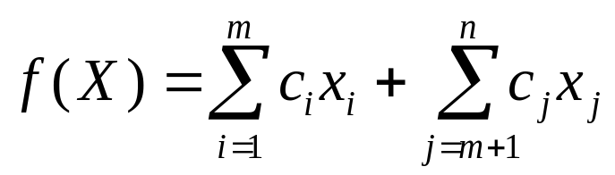
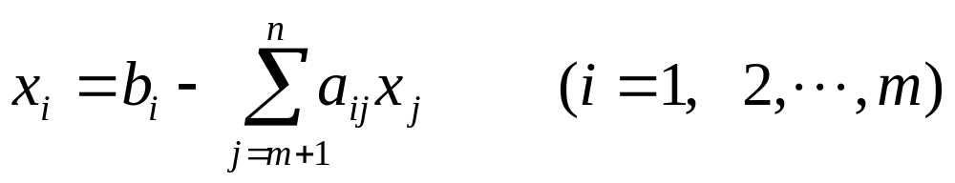
5.2.3 Conversion of BFS (II)
  1. Optimal Condition
  The objective function of the LP problem can be written as:
  where, x_{i} represents the basic variable and x_{j} denotes the non-basic variable.
  According to Eq.(5-6),each basic variable x_{i} can be presented by non-basic variables x_{j} as:

Slide 21
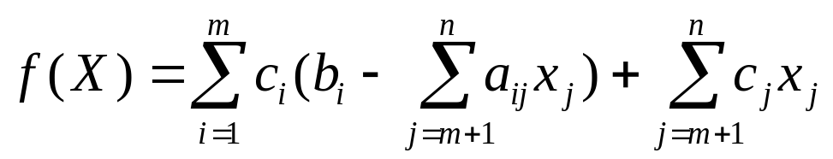
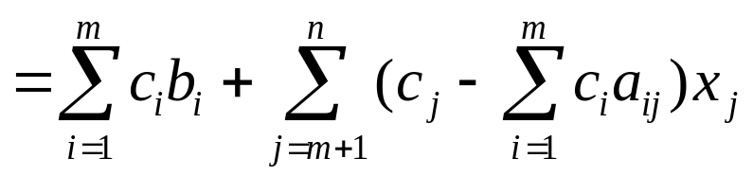
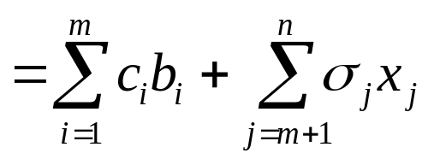
5.2.3 Conversion of BFS (III)
  Thus, the objective function can be expressed as:
  where, Σc_{i}b_{i} represents the objective function value before the conversion, and σ_{j} = c_{j} - Σc_{i}a_{ij} represents the Judgement Number of the column j.

Slide 22
5.2.3 Conversion of BFS (IV)
  During the conversion of the basic solution, the essence of the transformations via Gaussian Elimination is the switch between a basic variable and a non-basic variable.
  During the conversion of the basic feasible solution, the difference is that the non- basic variable (with the value of zero) is required to become a non-negative basic variable.
  Among the n-m non-basic variables x_{j}, there is only one needs to become a non-negative basic variable, the others remains to be 0. In order to make the objective function value decrease after the conversion, the judgment number corresponding to this variable should be negative, i.e., σ_{j} < 0.

Slide 23
5.2.3 Conversion of BFS (V)
  Judgment Number Criterion: convert the non-basic variable with the Smallest judgment number into a basic variable. That is, choose the column with the Smallest judgment number to be the principal column for next transformation. The smaller the judgment number is, the more the function value decreases.
  σ_{k} = min {σ_{j} | σ_{j} < 0, j = 1, 2, …, n}
  If all the judgment numbers are non-negative, i.e.:
  σ_{j} ≥ 0 ( j = 1, 2, …, n )
  Then the function value can’t decrease any more, which means the current solution is the optimal solution. Thus, the judgment number can be used to determine whether the current basic feasible solution is the optimal solution or not. If not, it can also be used to identify the principal column for next transformation.

Slide 24
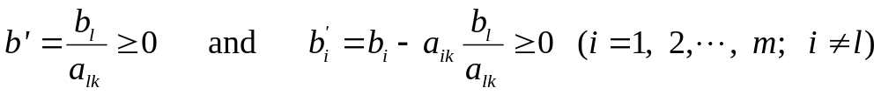
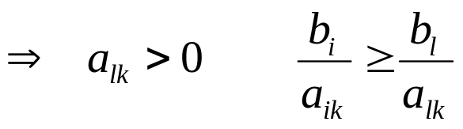
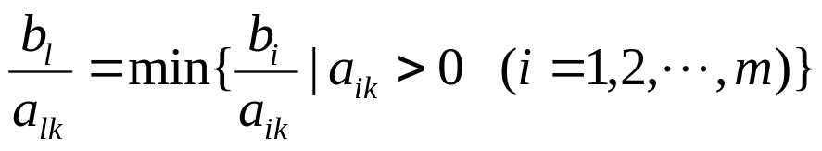
5.2.3 Conversion of BFS (VI)
  2. Non-negativity Condition
  After converting one basic feasible solution to another one, all the components in the constant vector b', after the conversion, must be non-negative, i.e.:
  Hence, after the principal column k has been identified by the judgment number criterion, one can choose the principal row l according to the following criterion, to ensure the solution after conversion is still a basic feasible solution.

Slide 25
5.3 The Simplex Method
  The Simplex Method is a LP algorithm based on the conversion of the basic feasible solution. In general the transformations are developed in a table called the simplex table.
  The simplex table is a transformation table based on the augmented matrix of the constraints. It contains all the information needed for solving the LP problem.
SIMPLEX TABLE |  | x₁ x₂ … x_{n} | x_{n+1} x_{n+2} … x_{n+m} | b_{i}
Basic Variable | Coefficient | c₁ c₂ … c_{n} | 0 0 … 0 | c₀
x_{n+1} x_{n+2} : x_{n+m} | 0 0 : 0 | a₁₁ a₁₂ … a_{1n} a₂₁ a₂₂ … a_{2n} : : : a_{m1} a_{m2} … a_{mn} | 1 0 … 0 0 1 … 0 0 0 0 0 0 … 1 | b_{n+1} b_{n+2} : b_{n+m}
Judgment number σ_{j} |  | σ ₁ σ ₂ … σ _{n} | 0 0 … 0 | f(X)

Slide 26
5.3 The Simplex Method (II)
  About the transformation in the simplex table:
  (1) Each simplex table corresponds to a basic feasible solution, which is comprised by m non-negative values of the basic variables and n-m zeros of the non-basic variables.
  (2) When the judgment numbers in the bottom line of the simplex table are all non-negative, the current solution is the optimal solution of the LP problem. When there exists negative numbers, further transformation is needed.

Slide 27
5.3 The Simplex Method (III)
  (3) The principal column k for next transformation is the column with the smallest judgment number; the principal row l is the row having the smallest quotient of b_{i} / a_{ik} , where a_{ik} is the positive coefficient in the principal column and b_{i} is the corresponding term in the constant vector.
  (4) The judgment number for the basic variable is always zero; The judgment number for the non-basic variable equals σ_{j} = c_{j} - Σc_{i}a_{ij}, where c_{j} is the coefficient on the top of the column and c_{i} is the coefficient on the left end. The number at the bottom right corner represents the function value f(X).

Slide 28
5.3 The Simplex Method (IV)
  (5) When there are equalities in the constraints, an artificial variable can be introduced into each equality, and an assistant LP problem can be constructed with the sum of the artificial variables as the objective function.
  (6) The assistant LP problem can be solved via the simplex table. When the number on the right bottom corner in the simplex table, i.e., the function value f(X), is equal to zero, the assistant problem is solved and a basic feasible solution of the original problem is found. Then the simplex table of the original problem can be established, and the optimal solution can be found by continuing the transformations on the simplex table.

Slide 29
5.3 Examples for Simplex Method
Ex 5-1: Solving the following linear programming problem using the simplex method.
min f(X) = -60x₁-120x₂
s.t. 9x₁ + 4x₂ ≤ 360
3x₁ + 10x₂ ≤ 300
4x₁ + 5x₂ ≤ 200
x₁ , x₂ ≥ 0

Slide 30
5.3 Solution for Example 5-1 (I)
Solution:
1. Introduce the slack variables x₃, x₄, x₅, and the problem becomes:
min f(X) = -60x₁-120x₂
s.t. 9x₁ + 4x₂ + x₃ = 360
3x₁ + 10x₂ + x₄ = 300
4x₁ + 5x₂ + x₅ = 200
x₁ , x₂ , x₃ , x₄ , x₅ ≥ 0

Slide 31
5.3 Solution for Example 5-1 (II)
2. Establish the initial simplex table:
Basic Variables | Coeffic-ients | x₁ x₂ x₃ x₄ x₅ | b_{i}
 |  | -60 -120 0 0 0 | 0
x₃ x₄ x₅ | 0 0 0 | 9 4 1 0 0 3 (10) 0 1 0 4 5 0 0 1 | 360 300 200
σ_{j} |  | -60 -120 0 0 0 | 0

Slide 32
5.3 Solution for Example 5-1 (III)
3. The initial basic feasible solution can be obtained:
X₀ = [0, 0, 360, 300, 200]^{T} , f(X₀) = 0
Since the judgments σ₁ and σ₂ are less than zero, X₀ is not the optimal solution.
min {σ₁ , σ₂ , σ₃ , σ₄ , σ₅} = σ₂ = -120
min {b_{i}/a_{i,2} | a_{i,2} > 0 (i=1, 2, 3)} = b₂/a_{2,2} = 300/10 =30
⇒ k = 2, l = 2
Thus choose a_{2,2} as the principal element for the next transformation.

Slide 33
5.3 Solution for Example 5-1 (IV)
4. Choose a_{2,2} and the new simplex table becomes:
Basic Variables | Coeffic-ients | x₁ x₂ x₃ x₄ x₅ | b_{i}
 |  | -60 -120 0 0 0 | 0
x₃ x₂ x₅ | 0 -120 0 | 7.8 0 1 -0.4 0 0.3 1 0 0.1 0 (2.5) 0 0 -0.5 1 | 240 30 50
σ_{j} |  | -24 0 0 12 0 | -3600
The corresponding basic feasible solution is:
X₁ = [0, 30, 240, 0, 50]^{T} , f(X₁) = -3600
Since σ₁ = -24 < 0, X₁ is not the optimal solution.

Slide 34
5.3 Solution for Example 5-1 (V)
5. min {b_{i}/a_{i,1} | a_{i,1} > 0 (i=1, 2, 3)} = b₃/a_{3,1} = 50/2.5 = 20
⇒ choose a_{3,1} = 2.5 as the principal element for next transformation and the new simplex table becomes:
Basic Variables | Coeffic-ients | x₁ x₂ x₃ x₄ x₅ | b_{i}
 |  | -60 -120 0 0 0 | 0
x₃ x₂ x₁ | 0 -120 -60 | 0 0 (1) 1.16 -3.12 0 1 0 0.16 -0.12 1 0 0 -0.2 0.4 | 84 24 20
σ_{j} |  | 0 0 0 7.2 9.6 | -4080

Slide 35
5.3 Solution for Example 5-1 (VI)
6. The corresponding basic feasible solution is:
X₂ = [20, 24, 84, 0, 0]^{T} , f(X₂) = -4080
Since all the judgment numbers are all non-negative, X₂ is the optimal solution.
After removing the slack variables, the optimal solution for the original problem is:
X* = [20, 24]^{T} , f(X*) = -4080

Slide 36
5.3 Another Example for Simplex
Ex 5-2: Solving the problem using the simplex method.
min f(X) = x₁+x₂
s.t. 2x₁ + x₂ + 2x₃ = 4
3x₁ + 3x₂ + x₃ = 3
x₁ , x₂ , x₃ ≥ 0

Slide 37
5.3 Solution for Example 5-2 (I)
Solution:
1. Introduce the artificial variables x₄ and x₅, establish the assistant problem as:
min φ(X) = x₄ + x₅
s.t. 2x₁ + x₂ + 2x₃ + x₄ = 4
3x₁ + 3x₂ + x₃ + x₅ = 3
x₁ , x₂ , x₃ , x₄ , x₅ ≥ 0

Slide 38
5.3 Solution for Example 5-2 (II)
2. Establish the simplex table for the assistant problem:
Basic Variables | Coeffic-ients | x₁ x₂ x₃ x₄ x₅ | b_{i}
 |  | 0 0 0 1 1 | 0
x₄ x₅ | 1 1 | 2 1 2 1 0 (3) 3 1 0 1 | 4 3
σ_{j} |  | -5 -4 -3 0 0 | 7
The corresponding basic feasible solution is:
X₀ = [0, 0, 0, 4, 3]^{T}
X₀ is not the optimal solution. Choose a_{2,1}=3 as the principal element for the next transformation.

Slide 39
5.3 Solution for Example 5-2 (III)
3. Choose a_{2,1} as the principal element for the next transformation, the new simplex table becomes:
Basic Variables | Coeffic-ients | x₁ x₂ x₃ x₄ x₅ | b_{i}
 |  | 0 0 0 1 1 | 0
x₄ x₁ | 1 0 | 0 -1 4/3 1 -2/3 (1) 1 1/3 0 1/3 | 2 1
σ_{j} |  | 0 1 -4/3 0 5/3 | 2
The corresponding basic feasible solution is:
X₁ = [1, 0, 0, 2, 0]^{T}
X₁ is not the optimal solution since σ₃ = -4/3 < 0.

Slide 40
5.3 Solution for Example 5-2 (IV)
4. min {σ_{k} | σ_{k} < 0} = σ₃ = -4/3
min {b_{i}/a_{i,1} | a_{i,1} > 0 (i=1, 2)} = b₁/a_{1,3} = 1.5
⇒ choose a_{1,3} = 4/3 as the principal element for next transformation and the new simplex table becomes:
Basic Variables | Coeffic-ients | x₁ x₂ x₃ x₄ x₅ | b_{i}
 |  | 0 0 0 1 1 | 0
x₃ x₁ | 0 0 | 0 -3/4 1 3/4 -1/2 1 5/4 0 -3/4 1/2 | 3/2 1/2
σ_{j} |  | 0 0 0 1 1 | 0

Slide 41
5.3 Solution for Example 5-2 (V)
5. The corresponding basic feasible solution is:
X₂ = [1/2, 0, 3/2, 0, 0]^{T} , φ(X₂) = x₄ + x₅ = 0
Now all the artificial variables and the objective function are all zeros, so X₂ with the artificial variables removed is an initial basic feasible solution for the original LP problem.
That is, the initial basic feasible solution for the original problem is:
X₀ = [1/2, 0, 3/2]^{T}

Slide 42
5.3 Solution for Example 5-2 (VI)
6. Now solve the original LP problem:
The simplex table corresponding to X₀ is:
Basic Variables | Coefficients | x₁ x₂ x₃ | b_{i}
 |  | 1 1 0 | 0
x₃ x₁ | 0 1 | 0 -3/4 1 1 5/4 0 | 3/2 1/2
σ_{j} |  | 0 -1/4 0 | 1/2
Since σ₂ = -1/4 < 0, X₀ is not the optimal solution.
It is easy to choose a_{2,2} as the element for next transf.

Slide 43
5.3 Solution for Example 5-2 (VII)
3. The new simplex table is:
Basic Variables | Coefficients | x₁ x₂ x₃ | b_{i}
 |  | 1 1 0 | 0
x₃ x₂ | 0 1 | 3/5 0 1 4/5 1 0 | 9/5 2/5
σ_{j} |  | 1/5 0 0 | 2/5
The corresponding solution is:
X₁ = [0, 0.4, 1.8]^{T} f(X₁) = 0.4
X* = X₁ is the optimal solution for the original problem since all the judgment numbers are non-negative now.

