Slide 1
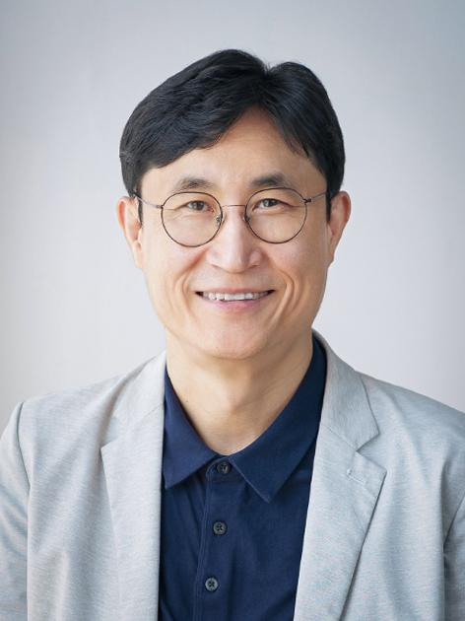
소 속 : 성균관대학교 소프트웨어학과
연구실 : 성균관대학교 N센터 86409호
E-mail : yjko@skku.edu
HP : https://nlp.skku.edu
성명 : 고영중

Slide 2
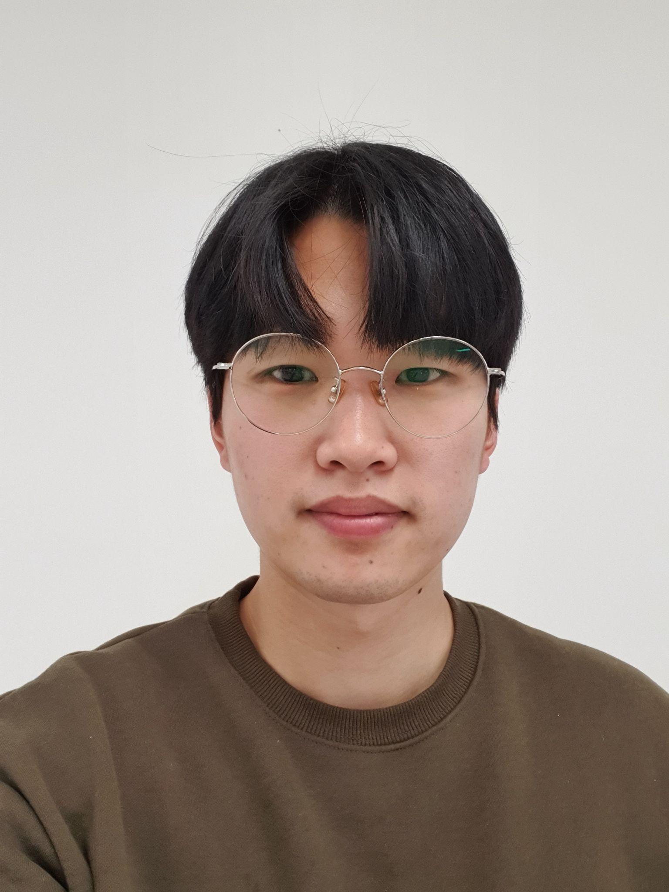
Course : 박사과정
Team : Information Retrieval
E-mail : bonggeun.choi818@gmail.com
HP : https://bg-choi.github.io
성명 : 최봉근

Slide 3
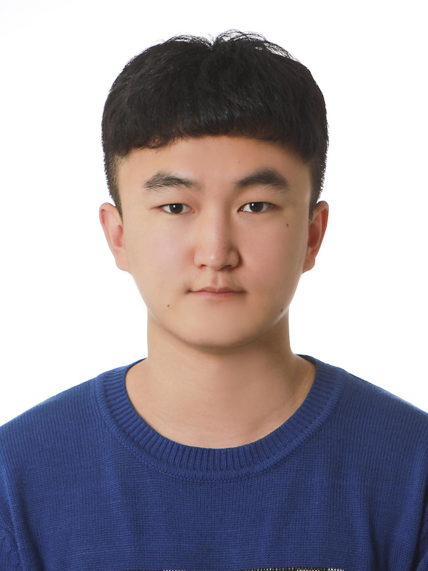
Course: 박사과정
Team : Controllable Text Generation
E-mail : kdysunleo98@gmail.com
HP : https://github.com/kdysunleo
성명 : 김두영

Slide 4
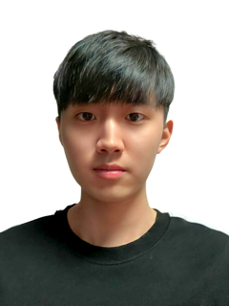
Course : 박사과정
Team : Information Retrieval
E-mail : keunhakim98@gmail.com
HP : https://github.com/KIMKEUNHA
성명 : 김근하

Slide 5
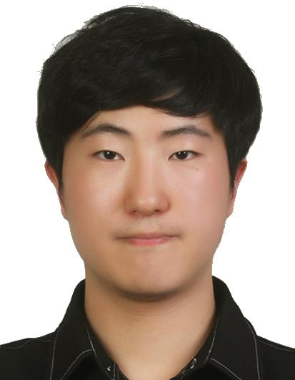
Course: 박사과정
Team : Dialogue System
E-mail : yoonjinjang98@gmail.com
HP : https://github.com/yali98
성명 : 장윤진

Slide 6
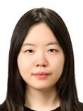
Course : 박사과정
Team : Information Retrieval
E-mail : ymheo1123@gmail.com
HP : https://github.com/user13571
성명 : 허유민

Slide 7
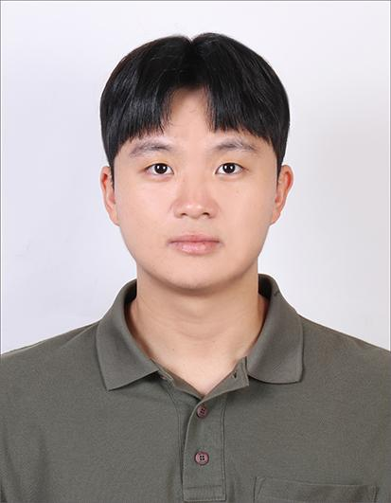
Course : 석박사통합과정
Team : Information Retrieval
E-mail : alswns078@gmail.com
HP : https://github.com/alswns078
성명 : 최민준

Slide 8
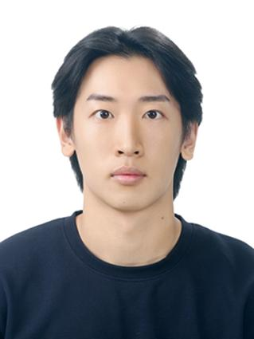
Course : 석박사통합과정
Team : Dialogue System
E-mail : ljh010110@g.skku.edu
HP : https://github.com/ljh010110-skku-edu
성명 : 이준희

Slide 9
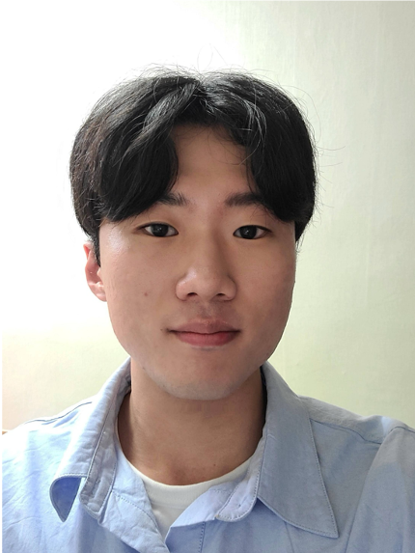
Course : 석박사통합과정
Team : Information Retrieval
E-mail : hjunho2357@gmail.com
HP : https://github.com/opkwisdom
성명 : 한준호

Slide 10
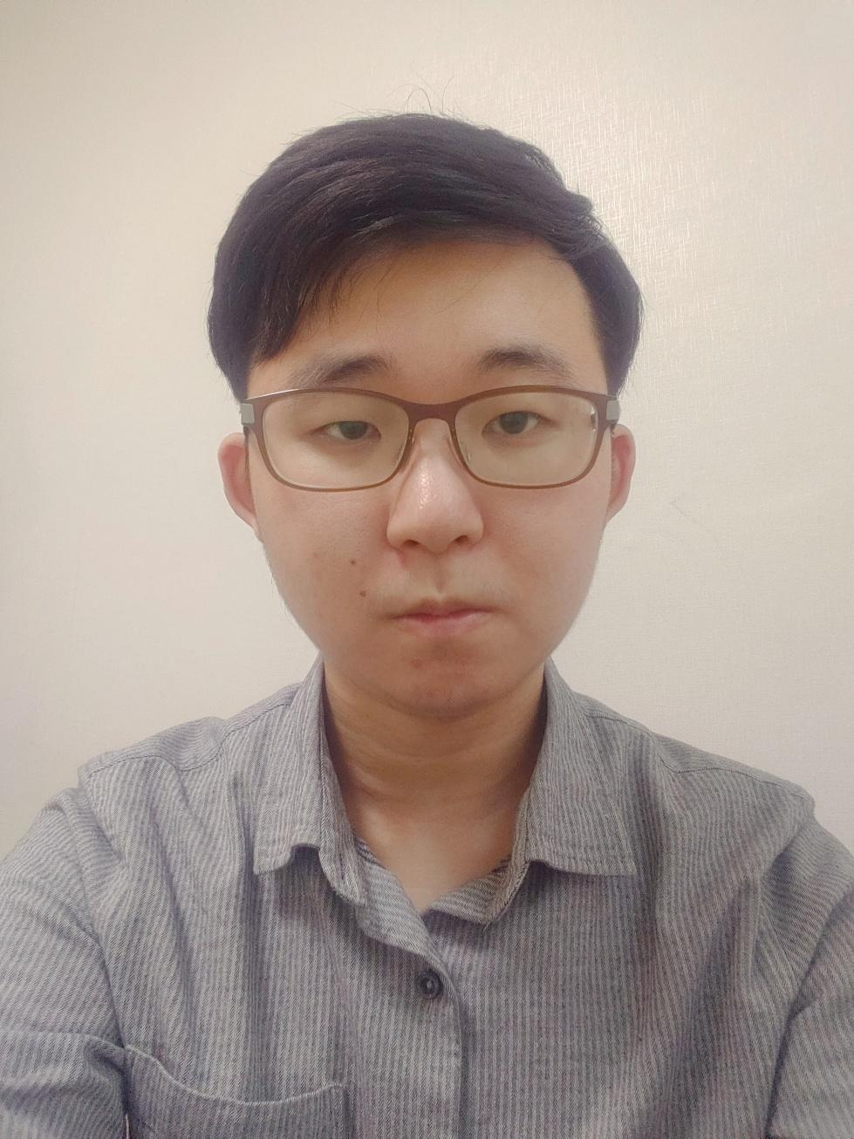
Course : 석박사통합과정
Team : Controllable Text Generation
E-mail : kimtaeklim2002@gmail.com
HP : https://github.com/r01ex
성명 : 김택림

Slide 11
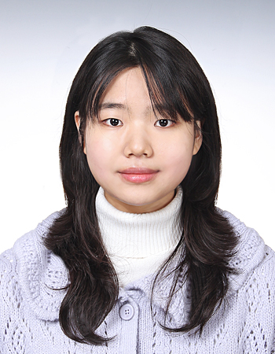
Course : 석박사통합과정
Team : Controllable Text Generation
E-mail : yewon0742@gmail.com
HP : https://github.com/aeongaewon
성명 : 이예원

Slide 12
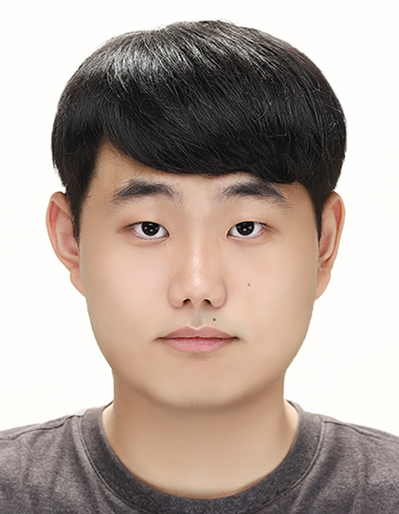
Course : 석박사통합과정
Team : Information Retrieval
E-mail : jsms48252@gmail.com
HP : https://github.com/jsms4825
성명 : 이준서

Slide 13
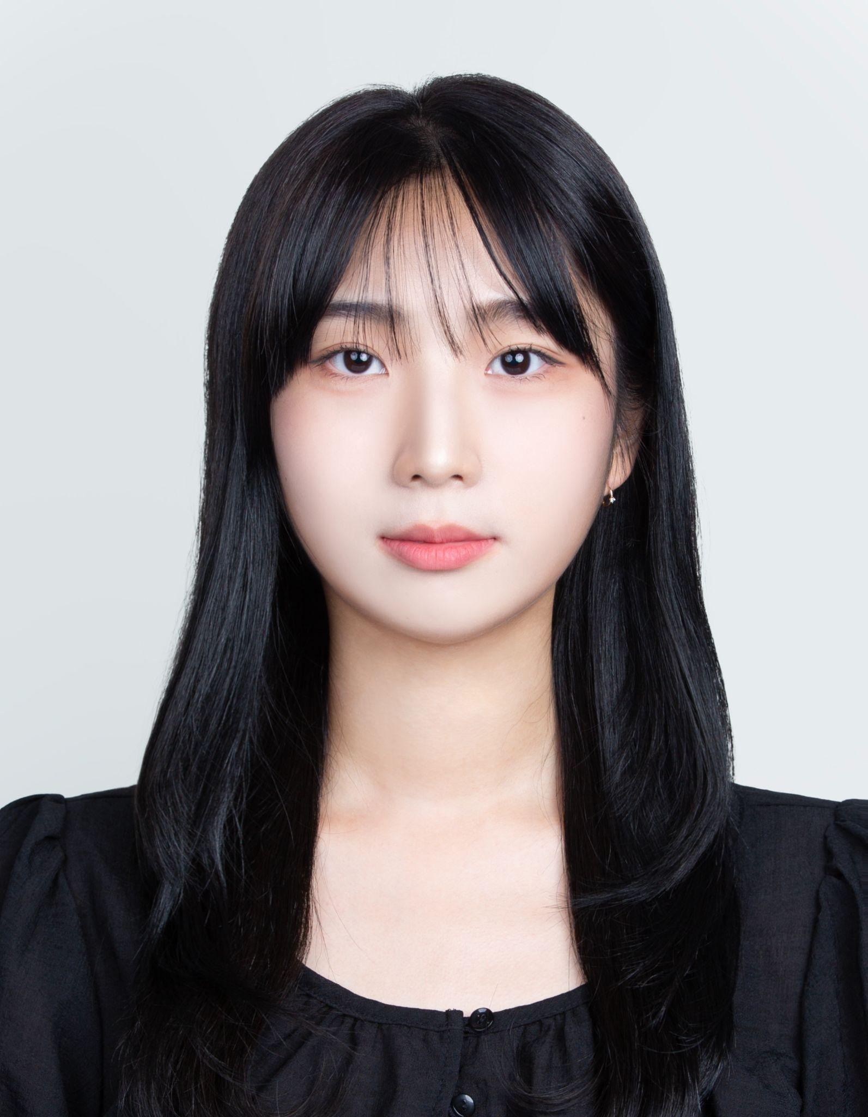
Course : 석박사통합과정
Team : Controllable Text Generation
E-mail : jeongwu510@gmail.com
HP : https://github.com/hiwjddn
성명 : 김정우

Slide 14
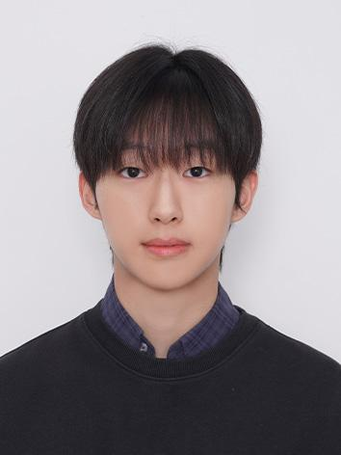
Course : 석박사통합과정
Team : Dialogue System
E-mail : junwookim618@gmail.com
HP : https://github.com/Wnsdnl
성명 : 김준우

Slide 15
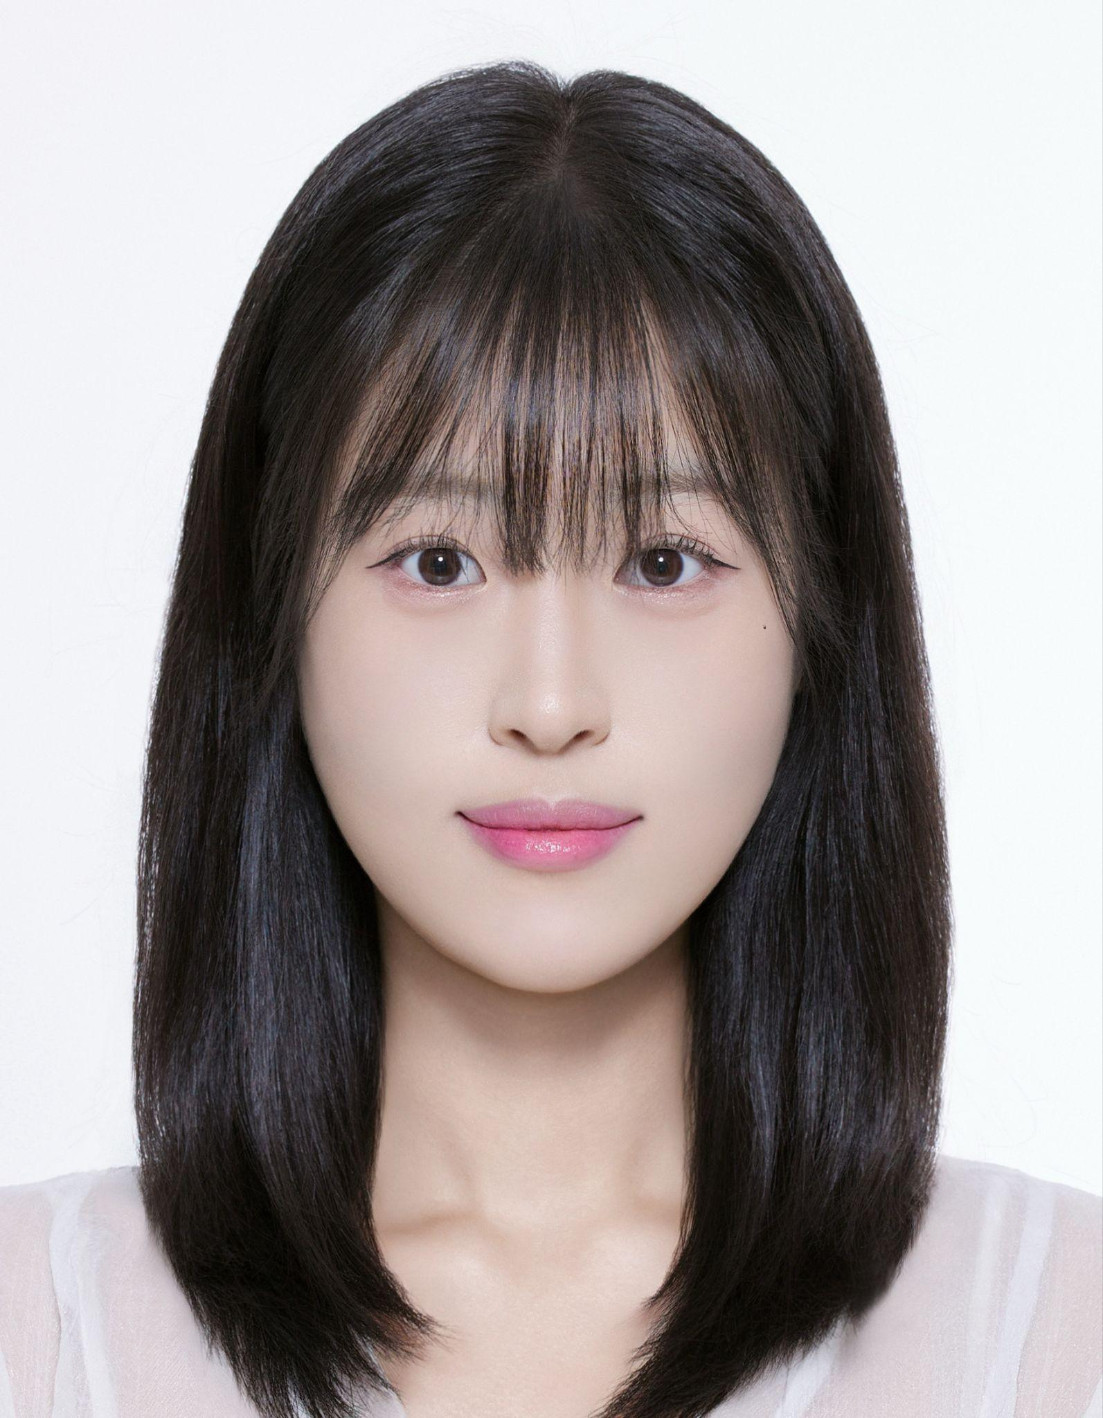
Course : 석박사통합과정
Team : Information Retrieval
E-mail : eqsubin@gmail.com
HP : https://github.com/kangsoobin
성명 : 강수빈

Slide 16
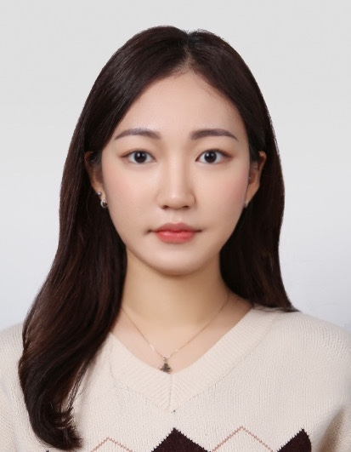
Course : 석사과정
Team : Dialogue System
E-mail : wjreh12@gmail.com
HP : https://github.com/uomiz
성명 : 허지원

Slide 17
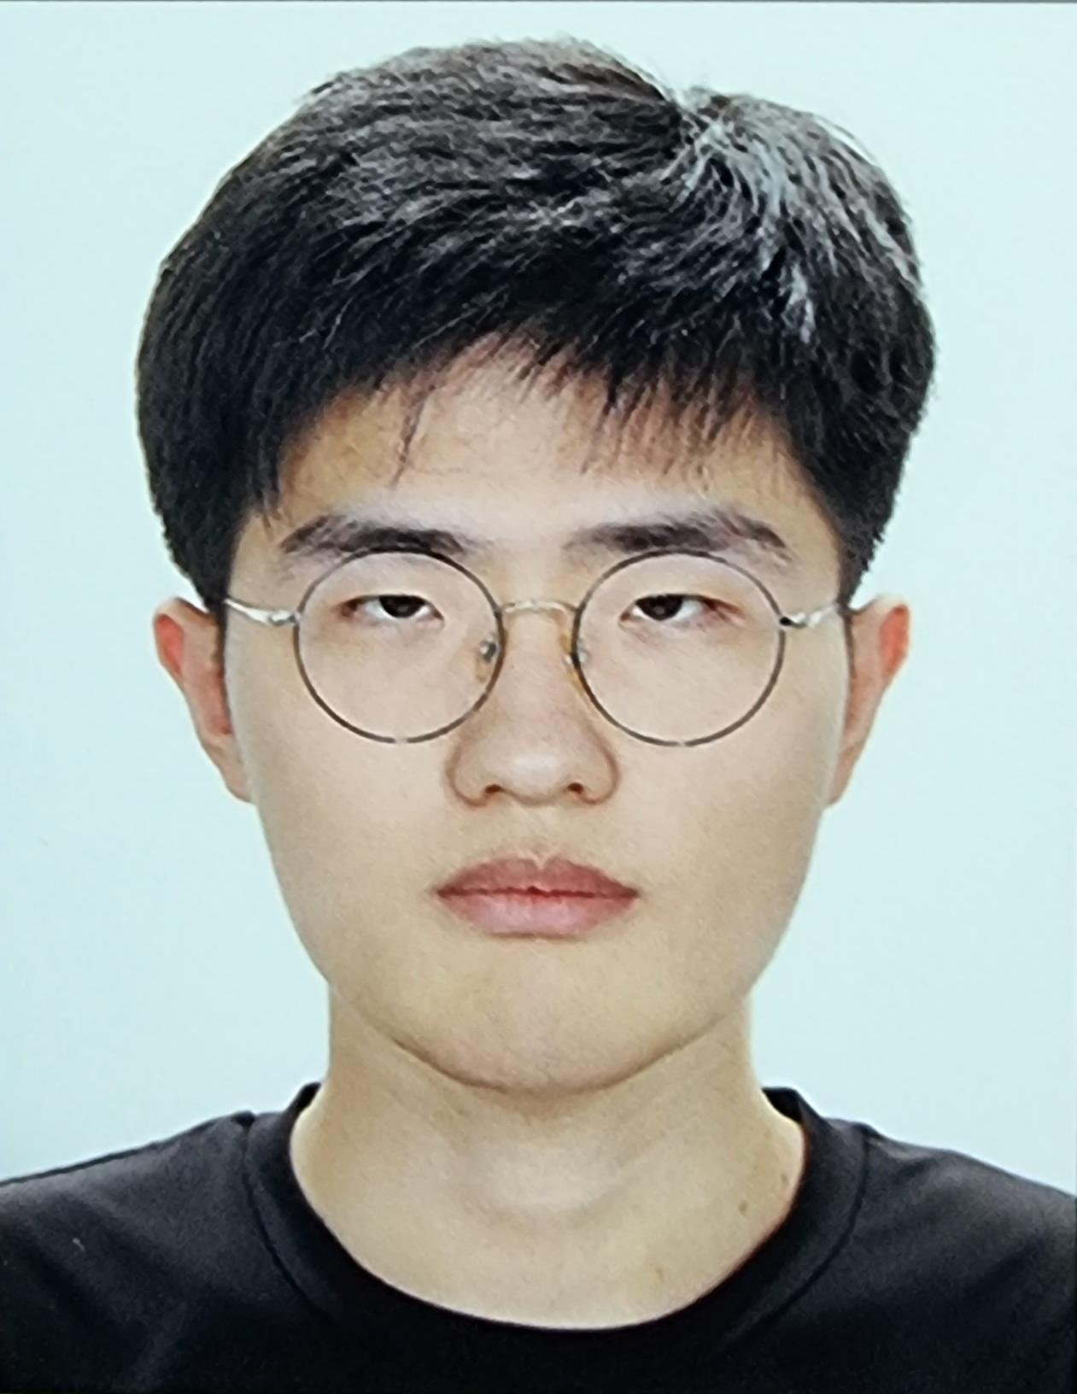
Course : 학부과정
Team : Natural Language Processing
E-mail : lingajs7515@gmail.com
HP : https://github.com/hecarimday
성명 : 박진석

Slide 18
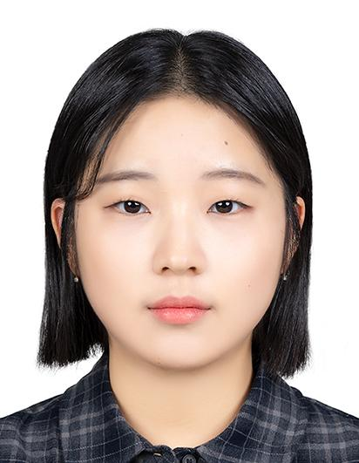
Course : 학부과정
Team : Natural Language Processing
E-mail : sy951020@gmail.com
HP : https://github.com/sksy930
성명 : 이서영

Slide 19
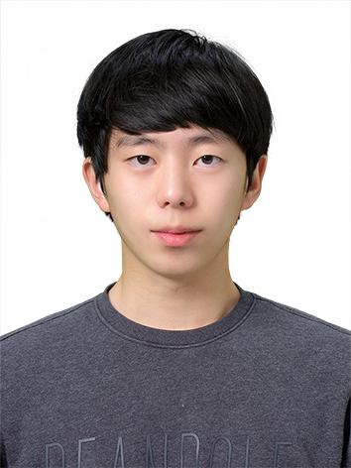
Course : 학부과정
Team : Natural Language Processing
E-mail : james0107james@gmail.com
HP : https://github.com/Lee-seunghyeon2
성명 : 이승현

